Slide 1
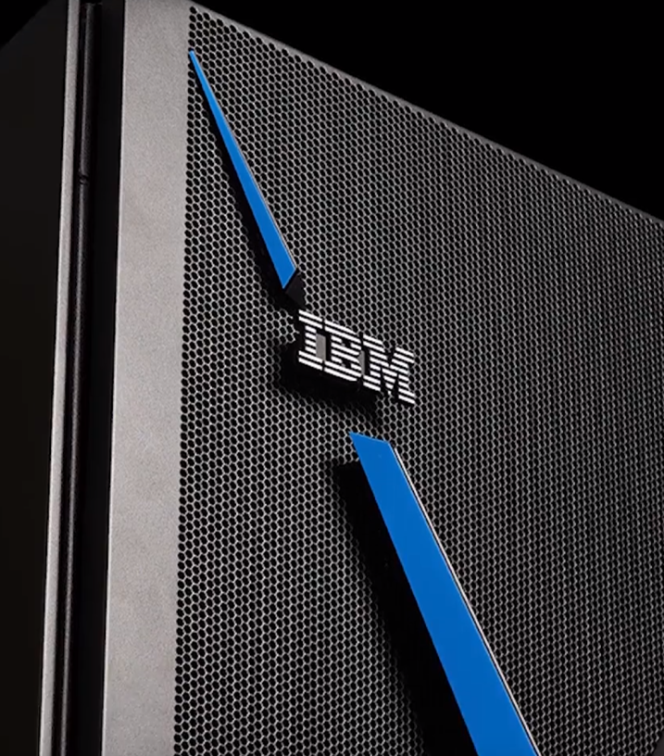
IBM Power Virtual Server
Client presentation
—
Andrew Jones
Principal Solution Architect
IBM Technology Sales Enablement andrewj@us.ibm.com
Notes:
Welcome to the overview of IBM Power Virtual Server (PowerVS).
PowerVS is an IBM Cloud-hosted infrastructure that provides a secure and scalable server virtualization environment that is built upon the IBM Power Systems platform. PowerVS servers are in IBM data centers and distinct from the IBM Cloud servers with separate networks and Solid-State Hard Drive (SSD) direct-attached storage. Clients choose IBM Power Systems for security, scalability, reliability, and the performance required for mission-critical workloads.

Slide 2

Agenda
Update at final
IBM Power high performance systems
Why IBM Power Virtual Server?
Client references
Resources
Notes:
This presentation reviews key characteristics of the IBM Power Systems family, discusses why Power clients are looking at cloud options, dives into how IBM Power Virtual Server (PowerVS) meets the most critical Power workload needs in the cloud, and looks at IBM’s clients who have made the move with great success. Links to resources for more information are also provided.

Slide 3
IBM Power
Notes:
This section introduces IBM Power.

Slide 4
IBM Power Systems
Engineered for agility
Respond faster
Modernize your applications
to business demands, protect your data from core to cloud, and streamline insights and automation.
and infrastructure with frictionless hybrid cloud experience.
Notes:
The world is amid a digital transformation. As businesses adapt to capitalize on digitalization, digital ‘trust’ is a currency that drives opportunity. Power Systems’ clients typically have higher-risk environments where outages are costly, so there is a need for extremely low-risk infrastructure. Power Systems are enterprise-class machines associated with high trust and performance while x86 systems are designed to accommodate multiple markets and design points, like laptops, PCs, and servers. Power Systems are designed for high-performance, enterprise workloads such as data analytics, artificial intelligence (AI), and cloud-native apps and microservices — in other words, workloads that are driving innovation and digital transformation.
For the IBM Power Systems, integrity has many facets, including the ongoing commitment to excellence in system security, design, and development practices. IBM Power Systems are designed to prevent unauthorized applications, subsystems, and users from bypassing system security or disabling key system processes and resources. One of a firm's most valuable resources is its data. This includes client lists, accounting data, employee information, and much more. Such critical data must be securely managed and controlled, and simultaneously made available to authorized users. IBM Power Systems maximizes a client’s availability and reliability with built-in advanced recovery and infrastructure redundancy.
References:
Top IBM Power Systems myths: x86 is the industry standard and Power is becoming obsolete. https://www.ibm.com/blog/top-ibm-power-systems-myths-x86-is-the-industry-standard/

Slide 5
IBM Power for scalability and performance for the most demanding workloads
Reliable – 99.9999%
ITIC survey of 1,900
C-level executives across 37 vertical markets gives
IBM Power a 99.9999% availability rating.¹
Secure – 3.3 minutes
Survey says that
IBM Power experiences 3.3 minutes or less
of unplanned outage due to security issues.²
Sustainable – 20%
Mondi sees a 20% increase in end-user application performance for SAP S/4HANA, boosting operational efficiency to meet their climate objectives.³
AI ready – 3.5X faster
IBM tests show that
for large language
AI models, IBM Power S1022 servers process up to 42% more batch queries per second compared to x86 servers during
peak load.⁴
Notes:
IBM Power is designed and built for scalability and performance for the most demanding, enterprise workloads.
In its 2023 Global Server Hardware, Server OS Reliability Report 1, Information Technology Intelligence Consulting (ITIC) found C-level executives reported IBM Power provided them 6 nines of reliability. The only systems with less down time was IBM Linux One and IBM Z.
In their 2022 report, ITIC found IBM Power systems experienced 3.3 minutes or less of unplanned outages due to security issues and only 2% of respondents reported a successful hack over the last 2 months.
The leading packaging manufacture, Mondi Group, saw a 20% increase in end-user application performance for their SAP S/4HANA systems and 100% uptime ensuring 24 by 7 availability and enabling them to boost operational efficiency.
And in IBM tests, IBM Power provides significant performance improvements over x86 systems; processing as much as 42% more batch queries per second for large language AI models.
References:
¹ “ITIC 2023 Global Server Hardware, Server OS Reliability Report”, August/September 2023. https://www.ibm.com/account/reg/us-en/signup?formid=urx-39584
² “ITIC 2022 Global Server Hardware, Server OS Reliability Report”, August/September 2022. https://www.ibm.com/account/reg/us-en/signup?formid=urx-50805
³ “Mondi Group sprints toward sustainability success”, 2021. https://www.ibm.com/case-studies/mondi-group-systems-hardware-sap-s4-hana
⁴ “Top 5 reasons to run AI workloads on IBM Power”, 2023. https://www.ibm.com/downloads/cas/VAJDRW18

Slide 6
IBM Power System
AIX
IBM i
Linux
AIX on Power drives innovation with hybrid-cloud and open-source capabilities that help enterprises build
and deploy modern applications within
a secure and resilient environment.
IBM i is a platform
for innovators, by innovators. Continuous availability, the latest security features
and easy integration with IoT, AI, and IBM Watson provide clients with the insights that are integral to their organization.
Linux on Power is an industry-standard open operating system with faster processing speed, bandwidth, and inherent security.
Notes:
The IBM Power Systems family of servers is unique in that it allows clients to run the workloads and operating systems of their choice, namely AIX, IBM i, and Linux (Red Hat Enterprise Linux and SUSE Linux Enterprise Server). Regardless of the operating system, they all benefit from the underlying performance, security, scalability, reliability, and availability that Power servers provide.
Clients can choose to run workloads on different operating systems concurrently, each within logical partitions (virtual machines) on the same physical server. This allows clients to choose the operating system that is best for a given workload. This is important if an application is operating system dependent. For example, traditional AIX and IBM i users can continue running workloads on those operating systems, whereas new Linux-based partitions can be created to experiment with and run workloads that might only be supported on Linux (such as running a Red Hat OpenShift cluster or some open-source software).
Terminology:
IoT: Internet of Things

Slide 7
Why IBM Power Virtual Server?
Notes:
This section discuss the value proposition, advantages, use cases, and highlights of IBM Power Virtual Server.

Slide 8


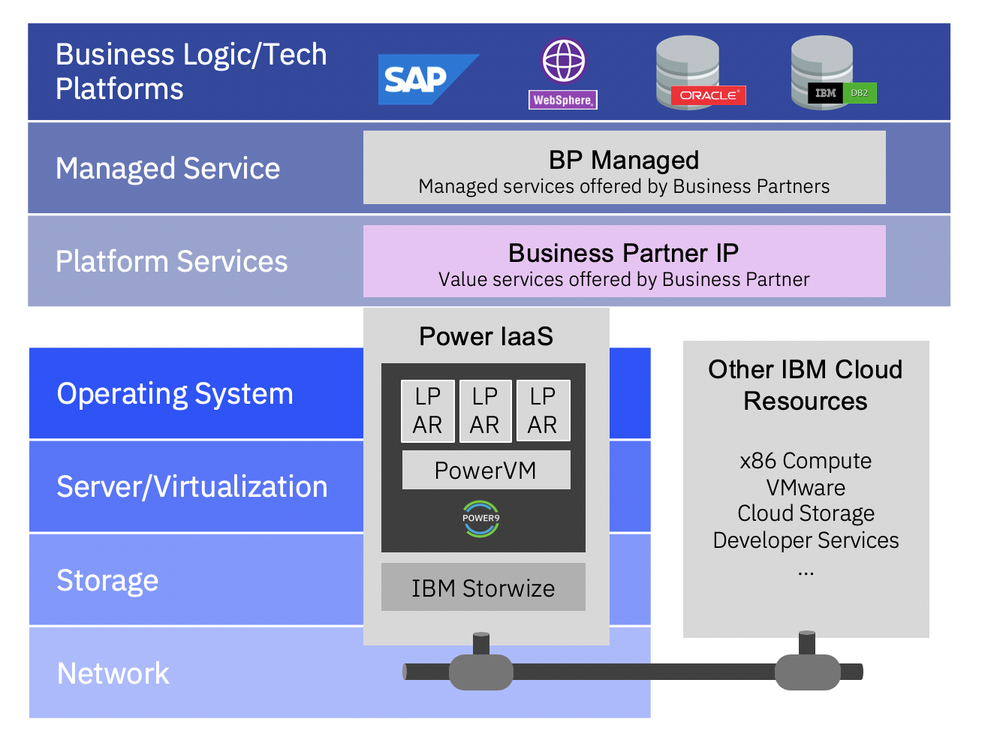




Accelerated time to value
Mitigating operational risk
Modernization without replatforming
Full enterprise stack with consistent architecture as
on-premises
Superior resiliency, performance,
and security
Supported by Oracle Certified by SAP
Enabled by IBM i ISVs
Comprehensive compliance
Flexible and cost-effective consumption
21 worldwide data centers
Notes:
IBM Power Virtual Server (PowerVS) is IBM Power in the IBM Cloud Infrastructure-as-a-Service (IaaS) offering. With the PowerVS service in IBM Cloud, clients can quickly create and deploy virtual servers running AIX, IBM i, or Linux with cloud consumption-based pricing plans. These servers are virtual machines, also referred to as logical partitions (LPARS) that are running on IBM Power Systems servers and the PowerVM hypervisor. After a client provisions a Power Virtual Server instance, the client will get access to infrastructure and physical computing resources without the need to manage or operate them.
PowerVS servers are in IBM data centers, distinct from IBM Cloud servers, with separate networks with direct-attached storage. The environment is in its own ‘pod’, with the internal networks that are fenced and offer connectivity options to meet client requirements. The IBM Cloud infrastructure design enables PowerVS servers to maintain key enterprise software certification and support, and provides comprehensive compliance, as the PowerVS architecture is identical to the certified Power on-premises infrastructure. As a result, system administrators who run on-premises environments today can use the same tools and workflows with PowerVS.
IBM manages up to operating system deployment while clients or their partners self-manage the operating system and applications. By deploying these virtual machines on the same hardware that clients run on-premises, clients are taking advantage of the same superior secure, scalable, resilient features, performance, and capabilities that IBM Power Systems servers are known to provide. Oracle supports workloads running on PowerVS. PowerVS is certified by SAP and enabled by IBM i ISVs. Also, being collocated and connected with IBM Cloud in 21 worldwide data centers (more data centers coming), clients get that fast, self-service provisioning, flexible management both on-premises and off-premises. And access to a stack of enterprise IBM Cloud services, all with the pay-as-you-go billing. This lets clients easily scale up and out, without needing to refactor their code.
Clients can use these cloud-based servers for for many scenarios. For example, clients can build separate and secure sandbox environments for users to develop and test their workloads. Clients can test out new versions of the operating system or get experience with newer hardware that might not be available within their own data center. Another common use case is the implementation of a disaster recovery strategy without needing to build out a secondary data center.
Terminology:
BP: Business Partner
IP: Intellectual Property
ISV: Independent Software Vendors
LPAR: Logical Partition

Slide 9
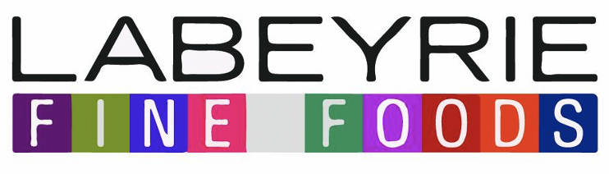


The best overall value virtual machine for Oracle,
SAP, and IBM i workloads
Oracle/JD Edwards
SAP
IBM i
The largest banks, pharma retailers, utility companies, industrial companies and US Federal
run-on Power
Superior performance, resiliency, flexibility,
and security
Power delivers up to 50% savings over AWS for Oracle licenses per core
Power Virtual Server is the only fully certified stack providing full Oracle on Power support
Power Virtual Server accelerates time to revenue, decreases client risk, and enables modernization
  Accelerate time to revenue: Power Virtual Server enables seamless migration to cloud with frictionless deployment
  De-risk: Resilient infrastructure maximizes availability and reduces downtime
  Modernization: Power Virtual Server accelerates SAP modernization, helping businesses improve their competitiveness and reduce costs with most granular certified SAP instances
212% ROI for SAP on IBM Cloud over 3 years
IBM i provides continuous availability, enhanced security, simplified management, and integration with new technologies
  Only runs on Power and risky to replatform to x86
  Near-zero downtime ensures that mission-critical applications remain up and running
  Enhanced options for achieving greater levels of security with IBM i 7.5
  Flexible licensing and support result in reduced TCO and increase flexibility with OpEx consumption
58% less expensive than competition
Notes:
Clients choose IBM Power Virtual Server (PowerVS), as it delivers the best overall value virtual machine for Oracle, SAP, and IBM i workloads in cloud.
Oracle:
Oracle is an important workload on Power Systems on-premises. PowerVS delivers the same value to Oracle workload as on-premises. It provides superior performance, resiliency, flexibility, and security for Oracle workloads. PowerVS Shared Processor Pools (SPPs) help reduce Oracle software licensing costs by optimizing and limiting processor core usage. PowerVS can deliver up to 50% total Oracle license per core savings over AWS. PowerVS is also the only fully certified stack providing full Oracle on Power support in the cloud.
Labeyrie Fine Foods Group benefited from PowerVS and was able to migrate existing on-premises workloads as part of their Oracle Enterprise Resource Management (ERP) modernization project by using an identical technology stack, both on-premises and in the cloud. Labeyrie takes advantage of the contributions of cloud computing in terms of operational and financial performance, by benefiting from hourly billable cloud resources for specific needs.
SAP:
PowerVS accelerates time to revenue, decreases client risk, and enables modernization. It is the only SAP-certified Power offering on a public cloud for SAP HANA, SAP S/4HANA, and SAP NetWeaver. It offers flexible SAP HANA and S/4HANA compute options, so clients can accelerate cloud deployment and achieve rapid migration and simple management from on-premises to cloud with consistent architecture. Reduced TCO (total cost of ownership) with PowerVS is another great advantage due to granular scaling from 128 GB to 22.5 TB. The SAP benchmark is the SAP Application Performance Standard (SAPS) metric. PowerVS has the highest number of SAPS, almost 1 million, which is a world record SAPS performance benchmark for IaaS environment.
To empower every customer to complete key journeys online and on mobile devices, Ecogas, moved to a next-generation, in-memory SAP S4/HANA platform on PowerVS instances. Ecogas realized a 35% boost in compute performance and reduced operational costs by 20%.
IBM i:
IBM i is an important workload for Power Systems. It only runs on Power, and it is risky to replatform to x86. Clients who run mission-critical applications on IBM i, are looking for new ways to consume resources and have shown growing interest in cloud solutions. PowerVS delivers the same look and feel, and value to clients as on-premises Power Systems.
As part of a data center consolidation project, Ricoh Company, Ltd., a digital information management company, uses PowerVS and IBM i to consolidate their European data centers. Richo realized a 40% savings in annual data center operating costs and a 4-hour reduction in their customer’s daily data backup time.
Terminology:
AWS: Amazon Web Services
OpEx: Operational Expense
ROI: Return on Investment
TCO: Total Cost of Ownership
US: United States
References:
“Labeyrie Fine Foods picks IBM Power Systems Virtual Server”, February 4, 2021. https://www.ibm.com/blog/labeyrie-fine-foods-picks-ibm-power-systems-virtual-server/
“Delivering digital services to millions of energy customers during the pandemic and beyond”, August 2022. https://www.ibm.com/case-studies/ecogas-power10
“Collaborating to deliver new hybrid cloud solutions”, October 2023. https://www.ibm.com/case-studies/ricoh-usa-inc
IBM PowerVS Oracle/AIX appendix, May 2023. https://ibm.seismic.com/Link/Content/DCWXP69pVGCRF8qBJcdc3HfHmBq3
IBM PowerVS SAP appendix, June 2023. https://ibm.seismic.com/Link/Content/DC2hCWfqmX8pcG7G4WDhDVmPc6BP

Slide 10






Cloud advantages with PowerVS
Grow at your own pace
Optimize consumption
Run mission-critical workloads
Migrate to hybrid cloud
Modernize workloads
Access AI
Notes:
IBM Power Virtual Server (PowerVS) allows clients to grow at their own pace by using affordable pay-as-you-go billing to manage operational costs and reduce capital expenditures, all with no upfront costs.
With cloud style elasticity, clients can easily grow and shrink compute capacity based on actual infrastructure demand. With PowerVS, there is no need to over provision to plan for future growth or peak usage periods. Clients can also save on 3rd-party software licensing costs and use existing IBM i licenses.
PowerVS provides an ideal environment to run mission-critical workloads that drive business. This includes SAP, Oracle, and any IBM i applications.
Leverage the global deployment of IBM PowerVS to migrate existing workloads to build hybrid cloud deployments using existing Power skills and resources. And enhance application availability and extend resiliency in the event of disasters.
Connect to over 200 modern cloud services to transform business models like web, DevOps, and IBM Db2 workloads.
And improve decision making and build cognitive applications by connecting existing PowerVS applications to IBM Watson.
Terminology:
DevOps: Development and Operations

Slide 11
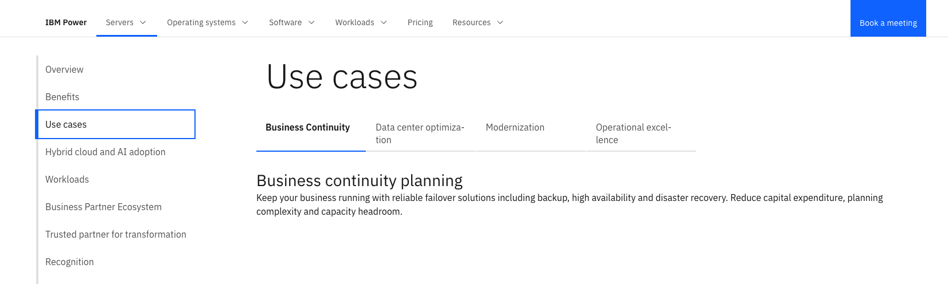






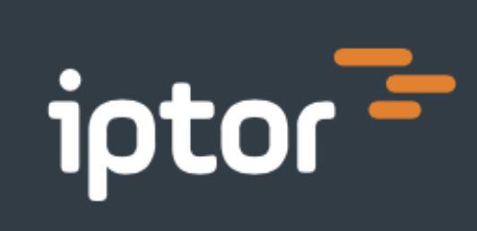
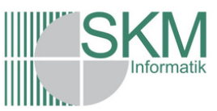
IBM Power Virtual Server
Popular Use Cases
Data center optimization
Business expansion and
worldwide growth
Frictionless migration; architecture aligned with certified stack
Grow quickly, accelerate time
to value and geographic expansion
Maintain ISV certifications
and support
Multisite implementation
with production, HA, DR,
and Dev/test environments
Business Continuity
Reliable failover solutions
Backup, HA, and DR
Reduce CapEx
Flexible DR capacity
Reduce capacity planning complexity and capacity headroom
Modernization
Modernize process and evaluate cloud feasibility
Increase business agility
Modernize - connected with 200+ IBM Cloud services
Cloud integrated API that easily integrates to existing tooling
Shift from buying max capacity
to provision on-demand
Start with Dev/Test environment
Operational excellence
Operational Excellence and
Cost Optimization
Ease of technology upgrade
Pay-as-you-go billing; CapEx
to OpEx
Align specialized skilled resources with key business objectives
Improve service and response time
Notes:
Clients that use IBM Power Systems on-premises can now quickly extend their Power workloads to the cloud. Clients that like Power because of the scalability, reliability, and performance characteristics can now expand their hybrid cloud journey with IBM Power Virtual Server (PowerVS) for a consistent experience.
Common use cases include:
Data center optimization
PowerVS offers clients the capability to grow quickly, on demand. As a highly available cloud system, PowerVS accelerates time to value for unpredictable workloads or when a client wants to support geographic expansion in less time than it takes to get a new data center up and running. With Power VS, clients can rehost workloads with an architecture that is aligned with their on-premises certified stack and maintain ISV certifications and support. Iptor Sweden AB, a leader in enterprise resource planning, was able to reduce their IT infrastructure by up to 80% and cut down the time that is spent on managing it. According to Christopher Catterfeld, Chief Marketing and Product Officer and Managing Partner, “IBM Power Systems Virtual Server offers the advantage of the same architecture that clients have grown to love and trust, now both on and off-premises.”
Business Continuity Planning
As clients look for disaster recovery (DR) solutions and don't want to build out the second data center of their own, PowerVS enables clients to have a cloud configuration available for failover from a reliable vendor, in a cost-effective way. Mainline Information Systems, an IBM Business Partner, bolstered National Van Lines business continuity strategy with replication and disaster recovery solutions that use IBM PowerVS and eliminated on-premises infrastructure.
Modernization
Clients realize that cloud models come with new and different development and test skills and methods that can benefit the enterprise’s application development environment for the future. Clients can look to PowerVS to modernize without having to replatform applications and migrate to the more advantageous application models, as well as to shift from buying max capacity to provisioning cycles and services, on-demand. SKM Informatik GmbH, an IT system house in Germany, migrated a complex system from Microsoft Azure to PowerVS resulting in the ability to deploy and scale workloads globally, get back time for core tasks, get more from software with less servers, and leverage open source to drive innovation.
Operational excellence
With ‘pay-as-you-go’ billing and flexible scaling, clients can scale-out and scale up PowerVS resources without extra capital investment, moving from a capital expenditure (CapEx) to an operating expense (OpEx) model, while improving service and response times to end-users. FNZ Ltd., a global financial services company, was able to improve their operations in testing new software by spinning up new virtual servers in as little as 10 minutes and complete testing 15 times more quickly.
Terminology:
CapEx: Capital Expenditure
Dev: Development
DR: Disaster Recovery
HA: High Availability
ISV: Independent Software vendor
OpEx: Operational Expenditure
References:
“National Van Lines Bolters Business Continuity with IBM PowerVS Hybrid Cloud Environment”. https://mainline.com/case-studies/national-van-lines-ibm-power/
“Fueling innovation with hybrid cloud and application modernization”, November 2022. https://www.ibm.com/downloads/cas/29RYARBY
“A series of successes”, 2021. https://www.ibm.com/case-studies/fnz-uk
“Solving supply chain challenges whenever, wherever”, September 2021. https://www.ibm.com/case-studies/iptor-sweden

Slide 12
IBM Power Virtual Server
Highlights
21
Data centers across
the globe and growing
Client deployed Production, HA/DR, and Dev/Test use cases
Key Workloads
Certified SAP IaaS
SAP NetWeaver and S4/HANA
Oracle Supported
IBM i workloads
Red Hat OpenShift
IBM Cloud Paks
OS: AIX, IBM i, and Linux
Comprehensive Compliance
GDPR
SOC 1 and 2
PCI DSS Certification
ISO 27K
HIPAA-ready
Why It Matters
Frictionless expansion and migration between on-premises and Power Virtual Serve: identical architecture with enterprise Power Systems on-premises from microprocessors, firmware, PowerVM, PowerVC, and dual VIOS to SAN storages
Same workloads supported on-premises are supported in Power Virtual Server: Oracle, SAP, IBM i, RedHat OpenShift, and more
Secure Infrastructure as a Service; resilient platform for mission-critical workloads; flexibility to scale on-demand; cloud consumption model to pay for use; reduce CapEx; specialized skills not required; Cloud Native development on Power
650+
Notes:
As of July 2024, Power Virtual Server (PowerVS) is available in 21IBM data centers around the world. With over 650 clients and counting, PowerVS fully supports production and other nonproduction workload environments such as high availability/disaster recovery (HA/DR), and development (Dev)/Test use cases. Key workloads for IBM clients running on PowerVS include SAP HANA, traditional SAP workloads, Oracle, custom AIX and IBM i applications, Red Hat OpenShift, and IBM Cloud Paks. Nominations are now being accepted for EPIC (the healthcare software and services company) workloads for the Training Program.
Enterprise users might find moving Power workloads out of a “known” on-premises environment to an “unknown” virtual environment to be counterintuitive for security reasons. But PowerVS combines all the security capabilities of physical Power Systems servers with robust IBM Cloud security capabilities, including Identity and Access Management (IAM). Also, PowerVS includes comprehensive governance compliance, including General Data Protection Regulation (GDPR), multiple Service Organization Control (SOC) designations, Payment Card Industry Data Security Standard (PCI DSS) Certification, and International Organization for Standardization (ISO) 27K.
Why PowerVS Matters?
It provides frictionless expansion and migration between on-premises and PowerVS due to the identical architecture with enterprise Power Systems on-premises.
Same workloads supported on-premises are supported in PowerVS such as Oracle, SAP, IBM i, and RedHat OpenShift.
PowerVS delivers value to the client for its security, resiliency, flexibility, reduced capital expenditures, cloud native development on Power, etc.
Terminology:
CapEx: capital expenditure
GDPR: General Data Protection Regulation
HIPAA: Health Insurance Portability and Accountability Act
IaaS: Infrastructure as a Service
ISO: International Organization for Standardization
PCI: Payment Card Industry
SAN: Storage Area Network
SOC: System and Organizational Controls
VIOS: Virtual I/O Server
References:
IBM PowerVS Epic apêndix, February 8, 2023. https://ibm.seismic.com/Link/Content/DCCbDCDpV6VmJGqMbHVCC9BqRpqB

Slide 13
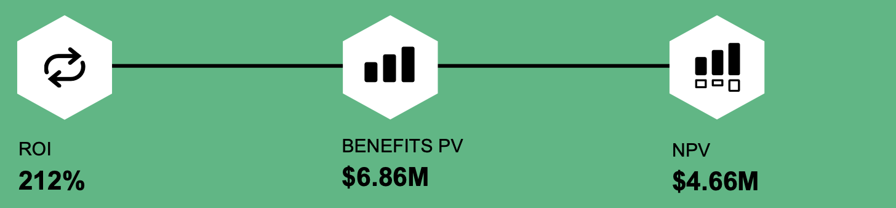
Forrester Total Economic Impact study
212% ROI for SAP on IBM Cloud over 3 years
Forrester interviewed representatives from organizations that use IBM Cloud for SAP
 | Manufacturing |  | Food and beverage |  | Financial services |  | Insurance
ROLE | IT director |  | IT infrastructure director |  | Enterprise architect |  | Global strategy director
LOCATION | Europe HQ, global |  | North America HQ, global |  | North America |  | North America HQ, global
EMPLOYEES | 11,000 |  | 31,000 |  | 7,500 |  | 40,000
SAP WORKLOADS | 200 |  | 200+ |  | 400 |  | 100+
Benefits PV breakdown:
$2.6M Reduced operational risks from improved availability
$2.3M Increased operational efficiency
$1.3M Reduced data center costs
$0.8M Reduced compliance and security risks
“We need to grow [and] need [a solution that will] not have any bottleneck or constraint or surprise. This is why we put in place [IBM Cloud for SAP].”
— IT Director, Fortune 500 Manufacturing enterprise
Read the Report
Watch the Webinar
Translations coming soon: German, French, Spanish, Portuguese, Japanese, Italian
Notes:
IBM commissioned Forrester Consulting to conduct a Total Economic Impact (TEI) study and examine the potential return on investment (ROI) enterprises may realize by deploying Cloud for SAP. To better understand the benefits, costs, and risks associated with this investment, Forrester interviewed four representatives with experience using IBM Cloud for SAP. For the purposes of this study, Forrester aggregated the interviewees experiences and combined the results into a single composite organization that is a global organization with 30,000 employees across a multitude of locations and maintains more than 100 SAP workloads.
After the investment in Cloud for SAP, the interviewees noted improved availability and reduced efforts needed to manage workloads, leverage data for analysis and reporting, and perform security- and compliance-related tasks. Key results from the investment include data center cost savings as well as a reduction of operational, security, and compliance risks. The representative interviews and financial analysis found that a composite organization experiences benefits of $6.86 million over three years versus costs of $2.20 million, adding up to a net present value (NPV) of $4.66 million and an ROI of 212%. Three-year, risk-adjusted present value (PV) quantified benefits for the composite organization include:
Reduced downtime and other disruptions by 135,000 hours. The resilience and high availability features of IBM Cloud for SAP improves productivity by reducing the number of downtime incidents or amount of resolution time and other disruptions. This benefit is worth more than $2.6 million to the composite organization over three years.
Improved productivity of SAP system personnel by up to eight FTEs per year. Efforts needed to manage SAP workloads and related data sets, analyses, and reporting are reduced by up to eight FTEs per year. The value of this benefit totals $2.3 million over three years.
Avoided infrastructure and other data center costs worth $1.3 million. Moving away from on-premises hardware reduces the need to replace end-of-life hardware and other data center costs.
Increased efficiency on compliance and security tasks by 50%. By using IBM Cloud, deployments and continuous security and compliance monitoring reduces internal efforts that are related to security and compliance tasks, leading to a three-year benefit worth $754,000.
Terminology:
FTE: full-time equivalent
References:
Forrester: The Total Economic Impact of IBM Cloud for SAP. https://www.ibm.com/downloads/cas/4RLB8QVG
The Total Economic Impact of IBM Cloud for SAP Webinar. https://ibm.seismic.com/Link/Content/DCpWjd2JBmTdp8mPQW2hmW2VpDqd

Slide 14
IBM Power Virtual Server in Hybrid Cloud TCO Advantage
For Power applications moving to cloud, Power Virtual Server yields about 47% savings over Azure and AWS (x86) Public Clouds.
On-premises Power legacy to Power Virtual Server yields on average 35% savings.
Infrastructure savings
Enhanced business outcomes
Workforce productivity and acceleration
44%
Decreased hardware costs by up to 44%
50%
Reduced licensing costs by up to 50%
10x
Increased release frequency by up to 10 times, signifying more features and patches reaching clients quicker
2x — 10x
Accelerated workload processing speed 2 — 10 times
33% — 90%
Infrastructure administration labor reallocated
66%
Accelerated development cycles by up to 66%
Sources: Application modernizationon IBM Power IBM IT Economics Consulting & Research CPO Spotlight
Notes:
This self-explanatory slide shows the total cost of ownership (TCO) advantage of IBM Power Virtual Server (PowerVS) in Hybrid Cloud.
As the workloads can be processed much faster on PowerVS, companies see infrastructure savings, enhanced business outcomes, and workforce productivity and acceleration. For Power applications moving to cloud, PowerVS yields about 47% savings over Azure and AWS (x86) Public Clouds. For new (“greenfield”) applications, where no migration is involved, PowerVS yields on average 35% savings to on-premises Power legacy systems. It is important to note that other than data center savings, labors, and enhanced business outcomes, clients can save up to 50% licensing costs, which is significant.
References:
“IBM IT Economics Consulting & Research CPO Spotlight”. https://ibm.seismic.com/Link/Content/DC3RMH7h46mfHG72H2DPJG494hJd
“Application modernization on IBM Power”, July 2022. https://ibm.seismic.com/Link/Content/DCdqHMJMVMMBWGcWbPX7Xd7P936B

Slide 15
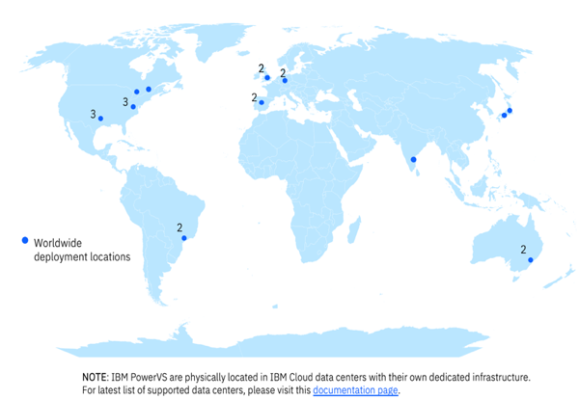
PowerVS availability
21 data centers in 9 countries across 10 regions
Americas (4 regions)
Dallas (3)
Washington DC (3)
Toronto
Montreal
Sao Paulo (2)
EMEA (3 regions)
Frankfurt (2)
London (2)
Madrid (2)
APAC (3 regions)
Sydney (2)
Osaka
Tokyo
Chennai
IBM PowerVS are physically located in IBM Cloud data centers with their own dedicated infrastructure. For the latest list of supported data centers, please visit this documentation page.
Notes:
This slide shows that IBM Power Virtual Server (PowerVS) is available in 21 data centers across 9 countries around the world, and that number is growing. This is a huge differentiator for IBM, as it leads all other vendors of Power on Cloud in its number and breadth of Power cloud locations.
References:
“Creating a Power Virtual Server workspace”, 2024. https://cloud.ibm.com/docs/power-iaas?topic=power-iaas-creating-power-virtual-server

Slide 16
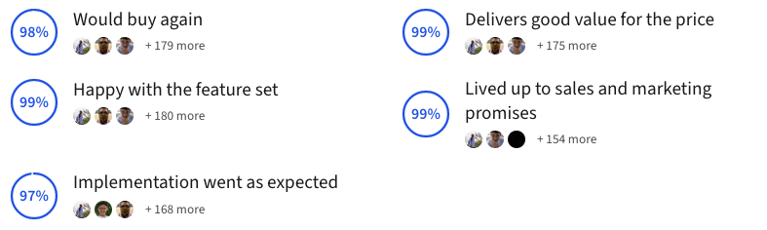
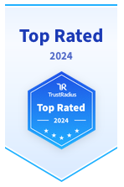
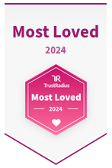
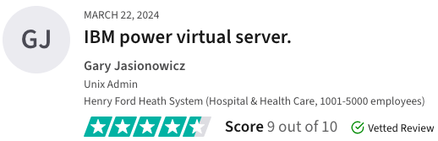
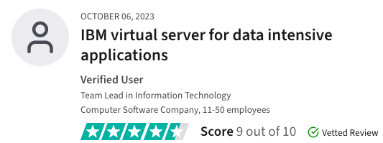
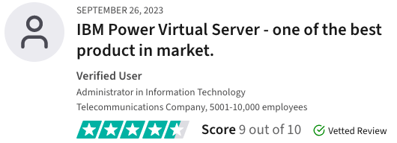
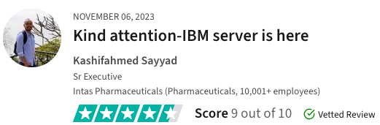
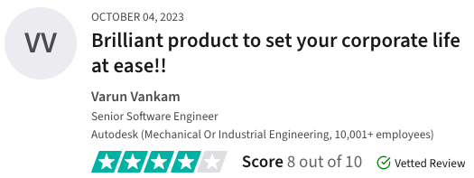
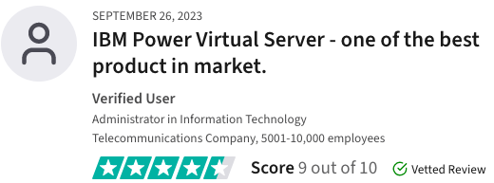
What clients are saying
Recognized by TrustRadius as a leader in Infrastructure-as-a-Service (IaaS)
  Based entirely on client feedback
  Compared to other competing offerings,
  such as Microsoft Azure and Amazon AWS
Notes:
Here are a few more things clients are saying about IBM PowerVS.
At the bottom of this slide are actual client quotes about the Power Virtual Server (PowerVS) as captured by TrustRadius. TrustRadius is a reliable review site for business technology, serving both buyers and vendors. Since 2016, the TrustRadius Top Rated Awards have become the industry standard for unbiased recognition of business-to-business technology products.
In 2024, PowerVS has been recognized by TrustRadius as a “top rated” and the “most Loved” in Infrastructure-as-a-Service (IaaS). In 2023, IBM Power Virtual Server received awards for “Best Feature Set”, “Best Relationship”, and “Best Value for Price”. These awards are based entirely on client feedback, as shown on the slide, and are not influenced by analyst opinion. The awards were in a category that compared PowerVS to other competing offerings, such as Microsoft Azure and Amazon Web Services (AWS).
References:
IBM Power Virtual Server, 2024. https://www.trustradius.com/products/ibm-power-system-virtual-server/reviews

Slide 17
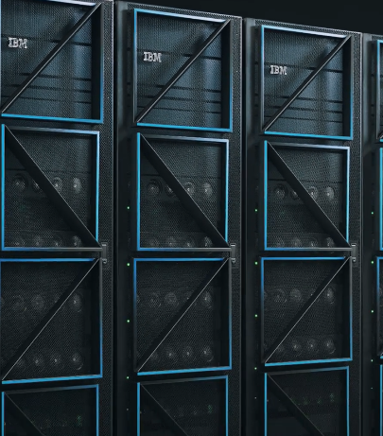
Resources
IBM.com:
PowerVS product page
YouTube Videos
IBM Power Systems Community
IBM Power Systems Virtual Server Redbooks
Power TCO Calculator
Video: What is a Power Virtual Server?
Video: Power Systems Virtual Server
PowerVS Documentation
Notes:
Visit IBM’s website where there are links that detail IBM Power Virtual Server’s key features, value, testimonials, and offerings.
Terminology:
TCO: Total Cost of Ownership
References:
“PowerVS product page”. https://www.ibm.com/products/power-virtual-server
“YouTube Videos (Start PowerVS at a low price)”. https://www.youtube.com/watch?v=NsADM37hREE&t=71s
“IBM Power Systems Community”. https://community.ibm.com/community/user/power/home
“IBM Power Systems Virtual Server Redbooks”. https://www.redbooks.ibm.com/search?query=power%20systems%20virtual%20server
“Video: What is a Power Virtual Server?”. https://mediacenter.ibm.com/id/1_720yfdmk
“Video: Power Systems Virtual Server”. https://mediacenter.ibm.com/id/1_5jr9ths4
“PowerVS Documentation”. https://cloud.ibm.com/docs/power-iaas
”Power TCO Calculator”. https://www.ibm.com/account/reg/us-en/signup?formid=urx-52579

