Slide 1

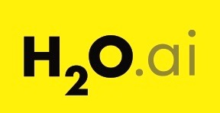


H2O Driverless AI on
IBM Power Systems
“AI to do AI”
Kelly Schlamb (kschlamb@ca.ibm.com)
Luis Armenta (luis.armenta@us.ibm.com)
Rafael Coss (Rafael.Coss@h2o.ai)
Notes:
Machine learning is difficult and good data science talent is hard to come by. Even so, data science teams today are still expected to generate insights and value from their data at ever increasing speeds. If their business isn’t improving their existing products or innovating towards new products, they can be sure that their competition is.
But what if machine learning could be made simple? What if the best practices, tips and techniques of the world’s top data scientists could be applied automatically to machine learning projects such that even novice data scientists could quickly build trusted and accurate models?
That’s exactly what H2O Driverless AI (Driverless AI) brings to the table. Driverless AI is an artificial intelligence (AI) platform for automatic machine learning. It automates some of the most difficult and time-consuming machine learning tasks such as feature engineering, model validation, model tuning, model selection and model deployment. It aims to achieve the highest predictive accuracy, comparable to expert data scientists, but in much shorter time… all thanks to end-to-end automation. Driverless AI also offers automatic visualizations and machine learning interpretability (MLI).
Driverless AI runs on commodity hardware but it was also specifically designed to take advantage of graphical processing units (GPUs), including multi-GPU servers such as the IBM Power Systems AC922 server, the best server for Enterprise AI… period.
Credits: This deck contains new content as well as content pulled together from existing IBM and H2O.ai enablement decks, originally built by many people across both companies.

Slide 2

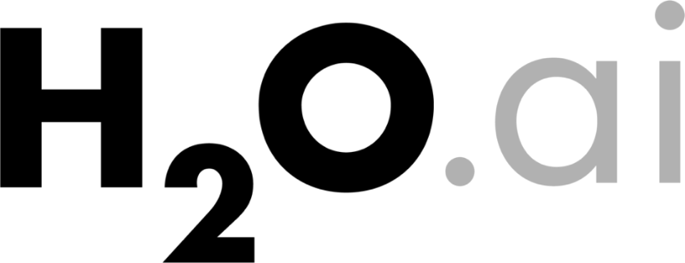
Introducing H2O.ai and
H2O Driverless AI
Notes:
This section introduces the H2O Driverless AI offering and the benefits it brings to organizations as part of their AI journey.

Slide 3
AI is Transforming the IT Industry
300%
200%
9/10
Increase in AI spend year over year
Increase in jobs requiring AI skills
CIOs planning to use machine learning
"AI is the fastest growing workload on the planet”
“Demand for AI Talent
on the Rise”
“Businesses are preparing for
the widespread adoption of
machine learning”
Notes:
Everyone agrees… artificial intelligence (AI) is transforming the IT industry today.
There are 3 big forces driving this AI transformation:
Increase in AI spending and the significance of AI everywhere. Forrester has publically said that AI is the fastest growing workload on the planet (https://www.forrester.com/report/AI+Deep+Learning+Workloads+Demand+A+New+Approach+To+Infrastructure/-/E-RES142531).
The number of jobs and demand for data scientists or analytics people with the right skills are on the rise, according to every study on Data Scientists; here we have cited the Indeed online job posting site (https://www.hiringlab.org/2018/03/01/demand-ai-talent-rise/). Some other related statistics:
Estimated shortage of 250,000 data scientists in the US by 2024: https://www.mckinsey.com/business-functions/mckinsey-analytics/our-insights/the-age-of-analytics-competing-in-a-data-driven-world
Data scientist roles have grown 650% since 2012: https://economicgraph.linkedin.com/research/LinkedIns-2017-US-Emerging-Jobs-Report
Data scientist job postings rose 75% from January 2015 to January 2018: https://www.bloomberg.com/news/articles/2018-05-18/-sexiest-job-ignites-talent-wars-as-demand-for-data-geeks-soars
Data scientists and advanced analysts are projected to see demand rise by 28% by 2020: https://www-01.ibm.com/common/ssi/cgi-bin/ssialias?htmlfid=IML14576USEN
And finally, from Gartner to ServiceNow surveys, 9 out of 10 CIOs plan on using machine learning (ML) in the enterprise. Why? Because business leaders are demanding it. They want greater insights into their business and future possibilities, and AI and ML deliver those results. The ServiceNow quote comes from an analysis of survey results here: https://www.servicenow.com/content/dam/servicenow-assets/public/en-us/doc-type/resource-center/white-paper/wp-cio-global-pov.pdf.

Slide 4

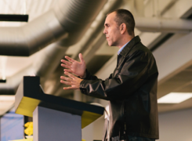
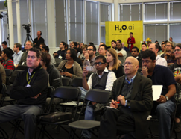

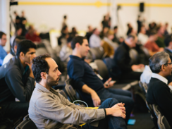

H2O.ai Company Overview
Company | Founded in Silicon Valley in 2012 Series C Investors: Wells Fargo, NVIDIA, Nexus Ventures, Paxion Ventures
Products | H2O Open Source Machine Learning (14,000 organizations) H2O Driverless AI – Automatic Machine Learning
Leadership | Market Leader recognized by Gartner, Forrester, InfoWorld, Constellation Research
Team | 130+ AI experts (Kaggle Grandmasters, Distributed Computing and Visualization experts)
Global | Mountain View, London, Prague, Chennai
Notes:
What is H2O.ai?
H2O.ai was founded in 2011 and incorporated in 2012. They closed a Series C round of financing in November 2017. Customer investment led the round including Wells Fargo and strategic partner NVIDIA.
H2O.ai is the creator and inventor of H2O open source. Nearly 14,000 organizations, businesses, governments and universities use H2O as their platform. H2O.ai brought H2O Driverless AI to market in late 2017. It is the premier product for automatic machine learning, and this presentation covers what it is, its value and who is using it.
In the February 2018 Gartner Magic Quadrant for Data Science and Machine Learning Platforms (https://www.gartner.com/doc/3860063/magic-quadrant-data-science-machinelearning), H2O.ai was recognized as being a “Leader”, with the most complete vision relative to other participants.
The H2O.ai team includes over 100 people, with some of the world’s best AI experts. This also includes Kaggle Grandmasters. Kaggle is an online tournament for data scientists, who compete for fame and money by delivering the best data science results for a particular problem. Companies offer a challenge, along with some prize money, and data scientists spend time building and fine-tuning their models to get the best results they can. When they win a number of competitions, they can claim a Grandmaster title/status, similar to that of a Chess Grandmaster. There are only just over 100 Grandmasters on the planet today and H2O.ai employs a number of them (in addition to many Kaggle Masters as well). H2O.ai’s talent also extends out to distributed computing experts and visualization experts.
H2O.ai is a global company. They are headquartered in Mountain View, California, USA and also have offices in Prague (AI Center of Excellence), London, and Chennai.

Slide 5

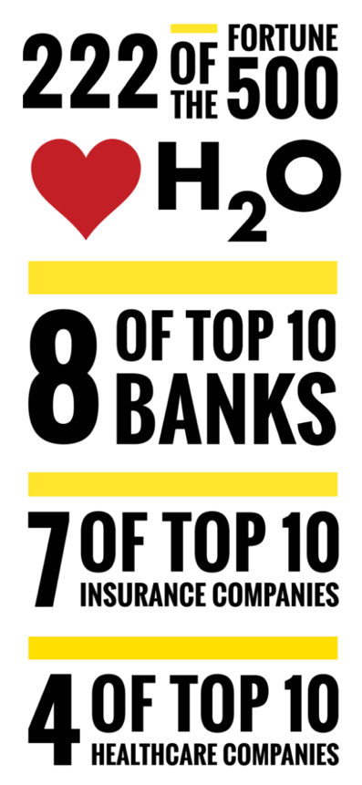











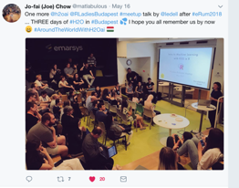









Growing Worldwide Open Source Community
H2O World
NYC, London, SF
14,000 Companies using H2O
155,000
data scientists
130K Meet-up Members
Notes:
H2O.ai is a recognized leader in AI, with its open source commitment being a major factor in this.
Left hand side: H2O open source is used by over 14,000 companies, and some of the leading statistics are represented in the graphic.
Right hand side with select customer logos: H2O.ai has many paying customers for both H2O Enterprise Support and Driverless AI. Customers within every industry are benefiting from the use of machine learning and H2O.ai’s products
The demand for Driverless AI is strong. As of Dec 15, 2018 there have been over 6,000 trial requests (which includes a 21 day free license). Customers that are using Driverless AI are generating over 5 million models a month, and of course these numbers continue to increase over time.

Slide 6
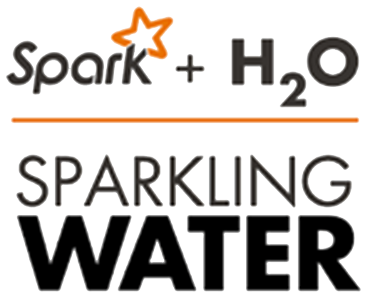

H2O.ai Product Suite
-3
Automatic feature engineering, machine learning and interpretability
In-memory, distributed machine learning algorithms with H2O Flow GUI
H2O AI open source engine integration with Spark
GPU-accelerated
machine learning package
Built for domain users, analysts and data scientists – GUI based interface for end-to-end data science
Fully automated machine learning from ingest to deployment
Licensed on a per seat basis
(annual subscription)
Open Source
100% open source – Apache V2 licensed
Built for data scientists – interface using R, Python on H2O Flow (interactive notebook interface)
Enterprise Support subscriptions
Notes:
Driverless AI is the focus of this presentation, but to better understand their entire portfolio and in what situations they’re used, let’s take a look at some of the other products that H2O.ai offers. And just to be clear, the IBM and H2O.ai partnership is specific to Driverless AI and sellers are compensated for the sale of it only – and not for the other things shown here. But again, the point is to help you understand where it fits within their whole portfolio.
From H2O.ai’s marketing material:
H2O is a fully open source, distributed in-memory machine learning platform with linear scalability. H2O supports the most widely used statistical and machine learning algorithms including gradient boosted machines, generalized linear models, deep learning and more. H2O also has an industry leading automatic machine learning functionality that automatically runs through all the algorithms and their hyperparameters to produce a leaderboard of the best models. The H2O platform is used by over 14,000 organizations globally and is extremely popular in both the R & Python communities. The current version of H2O is version 3 and so it can be referred to as H2O 3 or H2O core (see here for more details on H2O: http://docs.h2o.ai/h2o/latest-stable/h2o-docs/welcome.html).
Sparkling Water allows users to combine the fast, scalable machine learning algorithms of H2O with the capabilities of Spark. Spark is an elegant and powerful general-purpose, open-source, in-memory platform with tremendous momentum. H2O is an in-memory platform for machine learning that is reshaping how people apply math and predictive analytics to their business problems. Integrating these two open-source environments provides a seamless experience for users who want to make a query using Spark SQL, feed the results into H2O to build a model and make predictions, and then use the results again in Spark.
H2O4GPU is an open source, GPU-accelerated machine learning package with APIs in Python and R that allows anyone to take advantage of GPUs to build advanced machine learning models. A variety of popular algorithms are available including Gradient Boosting Machines (GBMs), Generalized Linear Models (GLMs), and K-Means Clustering.
H2O Driverless AI embeds the techniques of expert data scientists in an easy to use application that helps scale your data science efforts. Driverless AI empowers data scientists to work on projects faster using automation and state-of-the-art computing power from GPUs to accomplish tasks in minutes that used to take months. With Driverless AI, everyone including expert and junior data scientists, domain scientists, and data engineers can develop trusted machine learning models. This next-generation automatic machine learning platform delivers unique and advanced functionality for data visualization, feature engineering, model interpretability and low-latency deployment.
H2O.ai also provides Enterprise Support for these offerings, which includes expert 24×7 email and phone support, access to H2O data scientists and algorithm experts, and a dedicated Customer Success Manager.
And just a reminder that when talking about H2O Driverless AI, it is incorrect to refer to it as simply “H2O”. As you’ve just seen, they have a completely different offering with that name and so you should use the name “H2O Driverless AI” or simply “Driverless AI”.

Slide 7
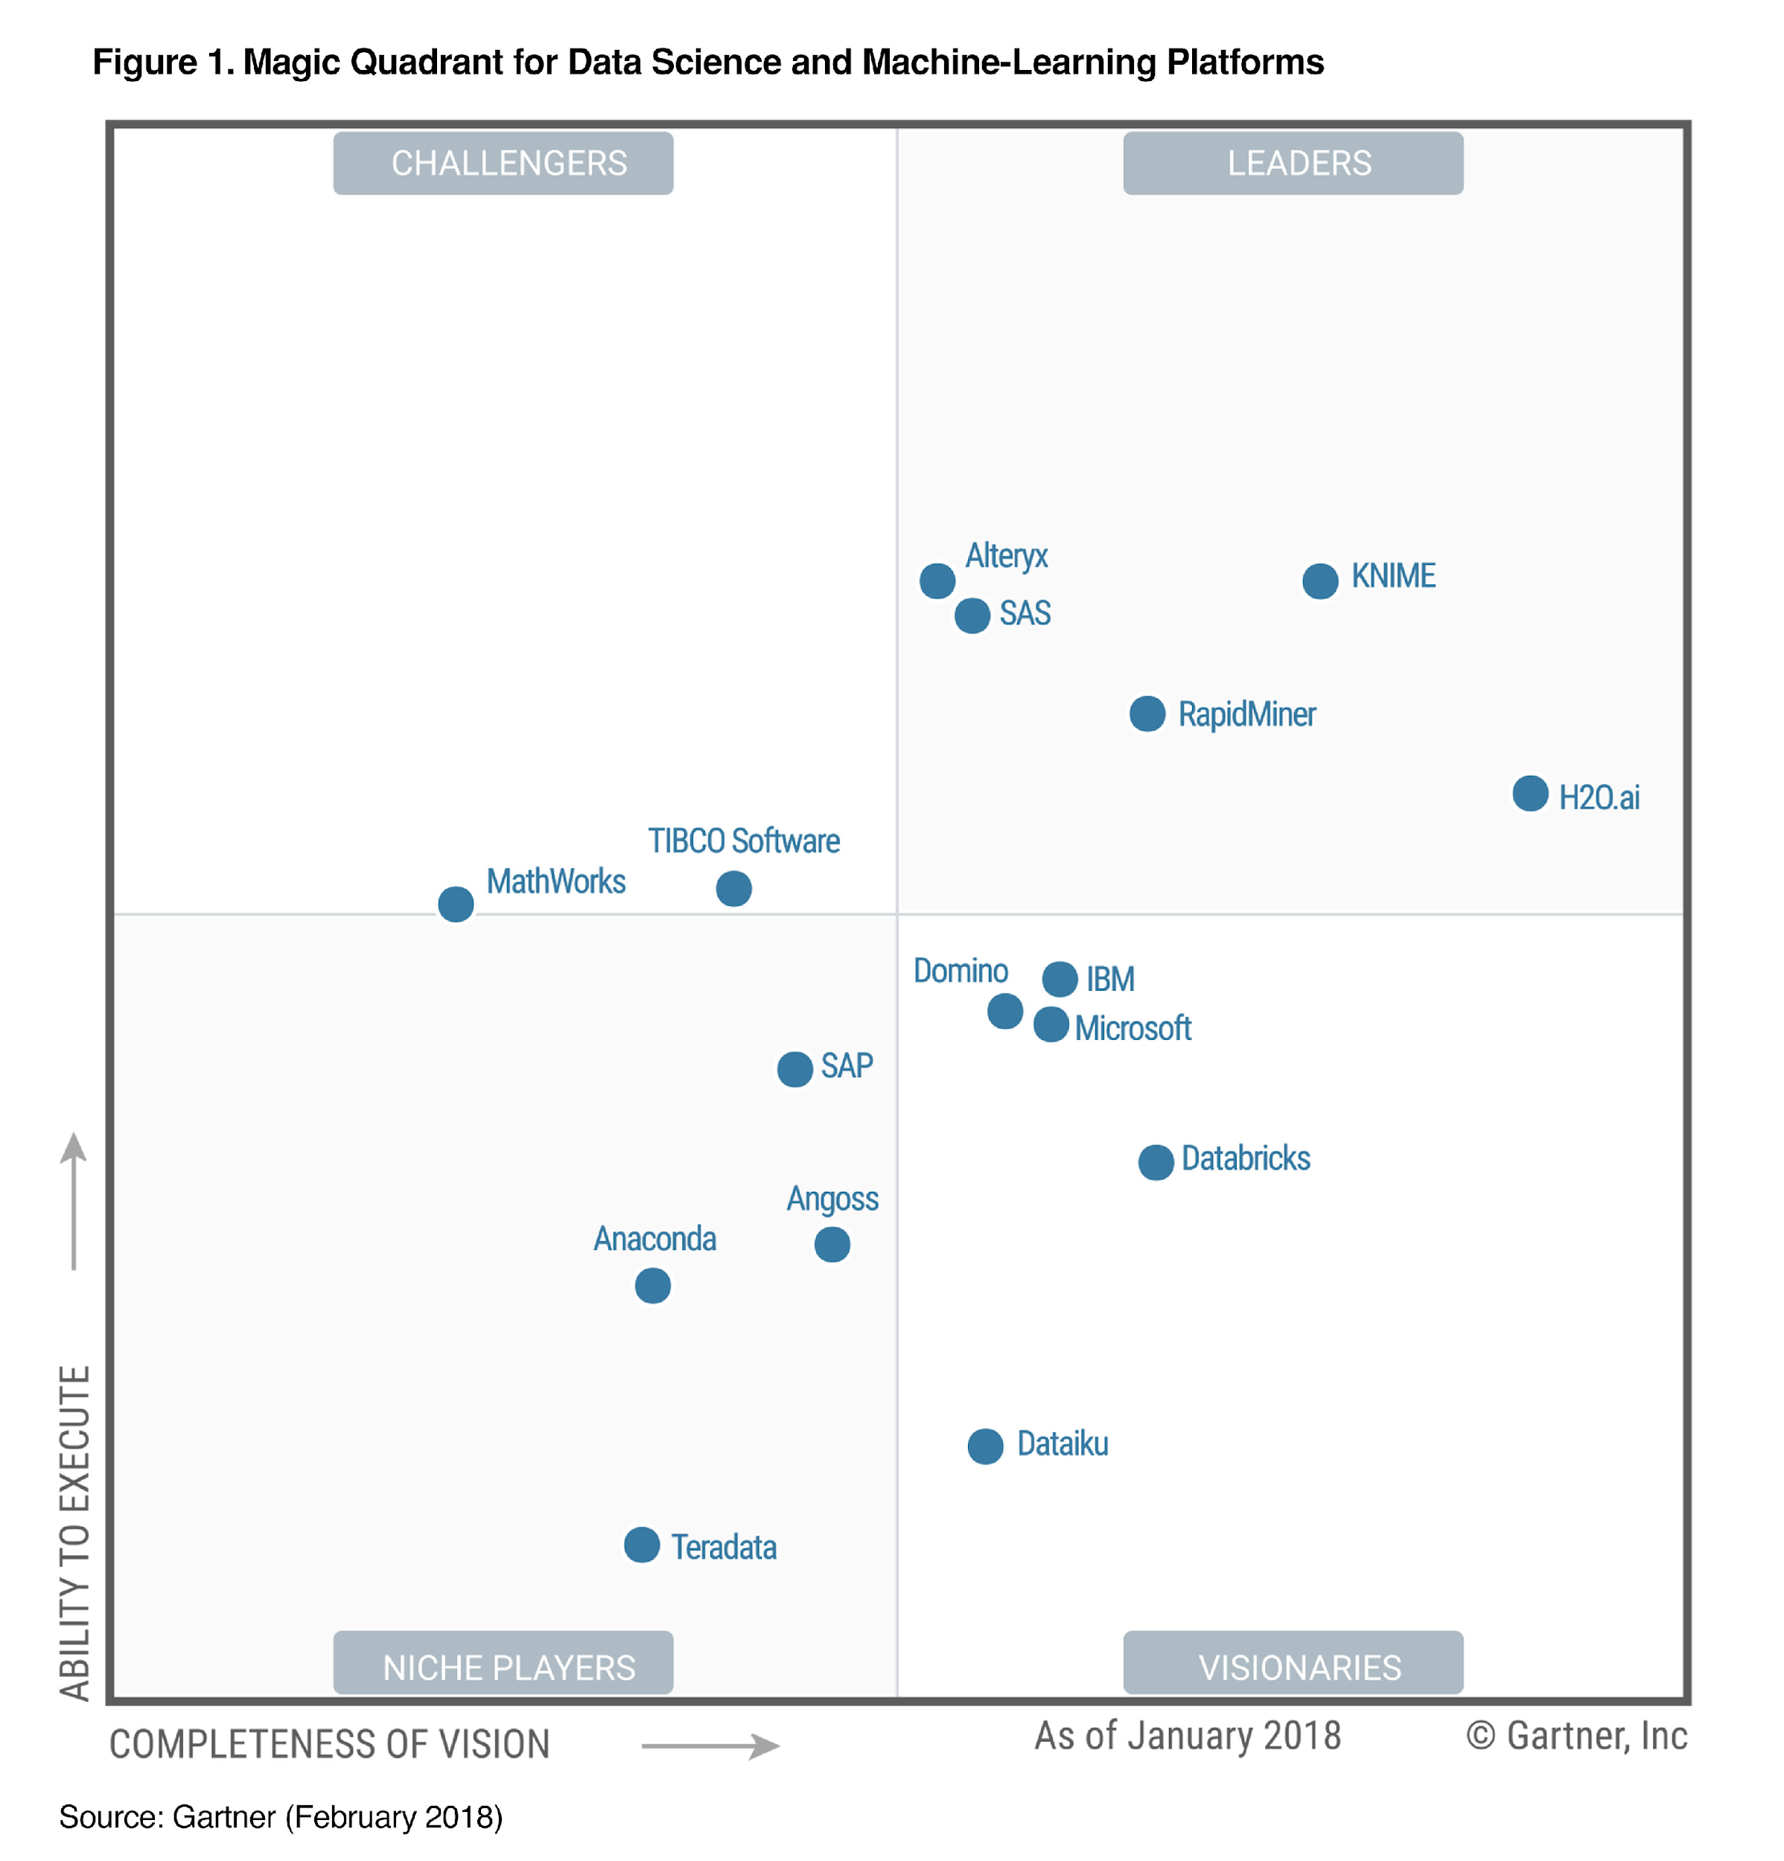
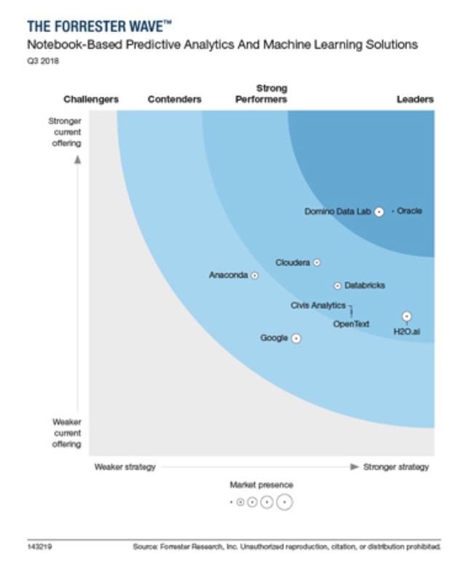
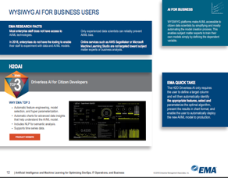
H2O.ai is a Recognized Leader in AI and ML
2018 Gartner Magic Quadrant for Data Science and
Machine Learning Platforms
Forrester Wave: Notebook-Based Predictive Analytics And Machine Learning Solutions, Q3 2018
Top 3 Artificial Intelligence (AI) and Machine Learning (ML) Software Solution
“Technology leadership … with a distinguished vision”
“H2O.ai’s future is automated machine learning”
“its bright future is in Driverless AI”
“its vision of creating an AI and ML tool that ultimately aims to allow almost everyone within the business to create their own predictive models”
“the quasi-industry standard”
Notes:
Industry analysts agree on H2O.ai as a leader in artificial intelligence (AI) and machine learning (ML). Here are several reports highlighting this leadership, including the 2018 Gartner Magic Quadrant (MQ) and the 2018 Forrester Wave for the spaces in which H2O.ai competes, as well as an Enterprise Management Associates report naming H2O.ai as a top 3 AI vendor.
Gartner Magic Quadrant for Data Science and Machine Learning Platforms (February 2018)
Gartner recently named H2O.ai as the “Leader” in their Data Science and Machine Learning Platform Magic Quadrant (https://www.gartner.com/doc/3860063/magic-quadrant-data-science-machinelearning).
Gartner recognized H2O’s technology differentiators, such as GPU integration, ecosystem development and automation, among other key differentiators. It should be noted, though, that their positioning is based on their entire portfolio – H2O, H2O Flow, H2O Sparkling Water and so on. Driverless AI was mentioned, though, in the context of demonstrating the company’s vision.
Another interesting fact to note is that many of the other participants in the magic quadrant use H2O open source “under the hood”. In other words, H2O is the underlying machine learning platform for solutions from Tibco, Rapid Miner, Knime, and Domino Data. Even companies like Datarobot use H2O algorithms.
Let’s take a moment to talk about IBM’s placement here, which is in the “Visionaries” category. While it is an accomplishment in itself to be a part of this group, IBM was previously included in the “Leaders” category in 2017. However, only a part of IBM’s portfolio was included in the 2018 assessment. For example, Data Science Experience (now known as Watson Studio and Watson Studio Local) was excluded, but it was included in 2017. And at the time, Gartner noted that “DSX is likely to be one of the most attractive platforms in the future – modern, open, flexible, and suitable for a range of users, from expert data scientists to business users.” IBM does feel strongly that they deserve to be placed in the “Leader” space and more details on this, including IBM’s internal response, can be found here: https://ibm.ent.box.com/s/2259an361xlp4hqkxmcuekqihku5lbs8.
Forrester Wave for Notebook-Based Predictive Analytics and Machine Learning Solutions (Q3 2018)
This Forrester Wave discusses how H2O.ai is a strong performer in the machine learning solution market and that Driverless AI is its bright future.
The report can be found here: https://www.forrester.com/report/The+Forrester+Wave+NotebookBased+Predictive+Analytics+And+Machine+Learning+Solutions+Q3+2018/-/E-RES143219.
Enterprise Management Associates (EMA) – Top 3 Report and Decision Guide for Artificial Intelligence and Machine Learning for Optimizing DevOps, IT Operations and Business (Q4 2018)
In this report, EMA highlighted the following capabilities as reasons for Driverless AI being in their Top 3: automatic feature engineering, model selection and hyperparameterization; automatic charts for advanced data insights that help understand the AI/ML model; inclusion of natural language processing (NLP) for semantic analysis; time series data support.
The report can be found here: https://www.h2o.ai/wp-content/uploads/2018/10/EMA-H20-Top3-AI-2018-DecisionGuide-chapter-9B.pdf.

Slide 8
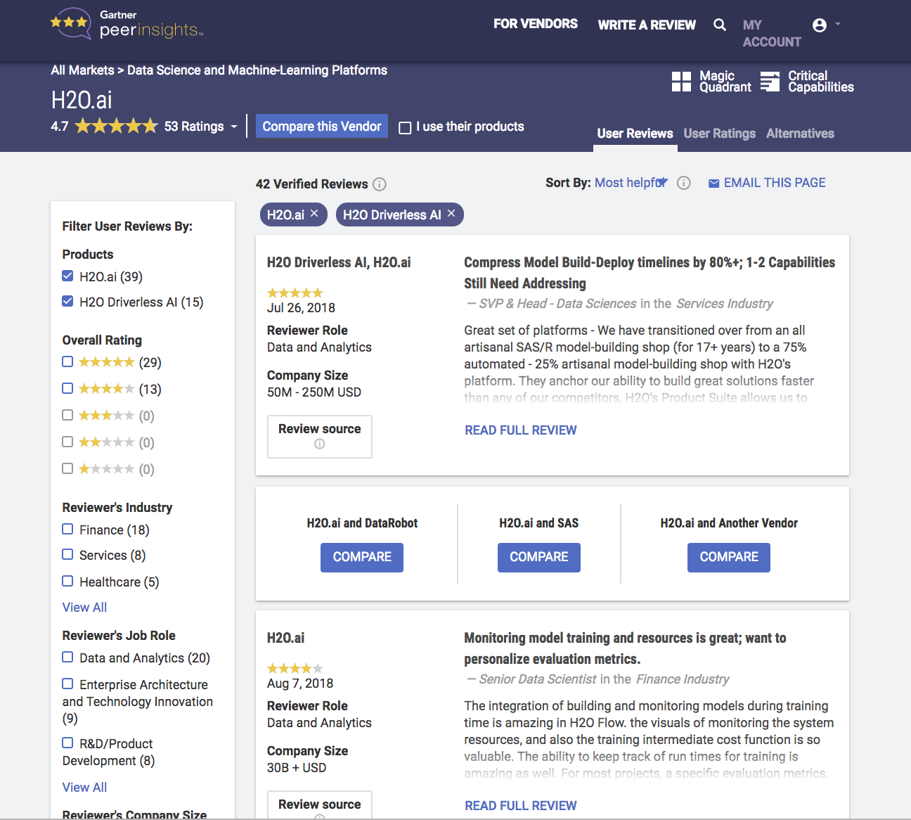

Highly Regarded by Customers
“H2O Driverless AI feature engineering is better than anything I've seen out there right now. And the scoring pipeline generation is probably one of the bigger pluses for me. These features alone have provided us with a true competitive edge in agile manufacturing. It's a massive time saver.”
Dr. Robert Coop
AI and ML Manager
Stanley Black & Decker
Notes:
Gartner Peer Insights is a platform for ratings and reviews of enterprise technology solutions by end-user professionals for end-user professionals. People can provide anonymous feedback and ratings for technology vendors and their products. As you can see, H2O.ai’s ratings are top notch here.

Slide 9
The Challenges of Enterprise AI Adoption
Weeks to Months
~100
Data Science
“Grandmasters” in the World
Time for a data scientist
to build a model
Black box models
Lack of AI Talent
Time to Insights Slow
Lack of Trust in AI
”US alone faces a shortage of 190,000 people with analytical expertise.”
Notes:
There are 3 key obstacles or challenges that companies face around Enterprise AI adoption. Let’s call them the 3 T’s: Talent, Time, Trust.
Talent: There is a shortage of data scientists in the market, and people with strong analytical skills.
Time: The time it takes for a data scientist to train their models and get results can take months in some cases. One aspect of this is the manual effort in going through the machine learning workflow (which includes data quality checking, feature engineering, hyperparameter tuning, building multiple models and ranking them, interpreting the model and documentation). Another aspect is the amount of processing time it takes to build models. Ultimately, value comes from fast time to insights – which means being able to build, train and deploy models quickly. Another aspect of where time comes into play, impacting overall time to value, is the complexity and time involved in getting the data science environment setup. Installing and configuring machine learning and deep learning frameworks can be complex and very time-consuming.
Trust: It’s great to see an outcome, but it’s important to be able to explain that outcome (especially in regulated industries). If there is no transparency or interpretability, then it’s difficult to trust the results being produced by “black box” models. In fact, lack of trust in models can be a major reason why machine learning models are not deployed.
To understand the reference to “Grandmasters”, please see the speaker notes on the following slide.
McKinsey & Company Report: https://www.mckinsey.com/business-functions/digital-mckinsey/our-insights/big-data-the-next-frontier-for-innovation

Slide 10
Why H2O Driverless AI Delivers AI for the Enterprise
Months down to Hours
Top
Trust
Automated
GPU-accelerated ML
with IBM AC922
Data Science Experts
In AI
“Expert Data Scientist in a Box”
Time to Insight
Explainability & Transparency
Notes:
H2O Driverless AI is ideal for driving Enterprise AI adoption because it tackles those challenges that were discussed on the previous slide (the 3 T’s – Talent, Time and Trust):
Talent: H2O.ai currently employs a number of the top data scientists is the world (Kaggle Grandmasters and Masters – see below for more details). They have created the recipes that have been infused into Driverless AI, essentially providing an “expert data scientist in a box”. Driverless AI is ideal for all levels of users. Novice data scientists can use it to supplement their skills and quickly develop trusted machine learning models. And it also provides additional “horse power” to existing, more experienced data science teams.
Time: With Driverless AI, especially on servers with GPUs (such as IBM Power Systems AC922 – built for Enterprise AI), businesses are getting significant savings in the time it takes to train their algorithms and analyze (inference) the outcomes. Driverless AI saves time by automating the machine learning workflow, while providing industry-leading model accuracy. Tasks such as training, feature engineering, model optimization and tuning are all done automatically. This means that data scientists can train models faster, resulting in faster time to insight. Additionally, the installation of Driverless AI is very straightforward, avoiding the complex and time-consuming task of installing and configuring machine learning frameworks – especially if needing to also include additional components, like Notebooks and other tooling.
Trust: Driverless AI incorporates Machine Learning Interpretability (MLI), which was invented by H2O.ai. It provides reason codes and simple, plain English to tell why a model delivered the results it did. Regulators and enterprises looking for compliance will immediately gain value from MLI. In addition to MLI, Driverless AI has Auto Visualization and Auto Documentation, giving the data scientist or analyst a visualization of their data sets, and automatically generated documentation on the model and its output.
Driverless AI also includes many security features that enterprises demand.
There are many types of machine learning algorithms and types of problems that can be solved, but H2O Driverless AI focuses on Supervised Learning projects – specifically Regression and Classification (Binary, Multinomial) problems. It uses tabular structured data (comma separated values (CSV) files with rows and columns) as input. Data can be numeric, text, categorical and date/time. It also handles time-series data very well. Natural Language Processing (NLP) is also now possible with Driverless AI.
For those not familiar with Kaggle (https://www.kaggle.com/), it is a community of data scientists in which people find and publish data sets, explore and build models, work with other data scientists and machine learning engineers, and enter competitions to solve data science challenges. It is considered the largest and most diverse data science community in the world, spanning 194 countries with users ranging from those with very little experience to many of the world’s best known researchers and data scientists.
In June 2017, Kaggle announced that it passed 1,000,000 registered users (called Kagglers). Performance tiers are used to track somebody’s growth as a data scientist on Kaggle. Along the way, people earn medals for achievements and compete for data science glory. The highest level that one can achieve is “Grandmaster”, in which somebody has consistently demonstrated outstanding performance in one or more categories of expertise on Kaggle. In the category of competitions, there are 1,074 Masters and only 130 Grandmasters (as of December 2018). They are the best of the best… and H2O.ai has a number of top Grandmasters and Masters in their team.

Slide 11
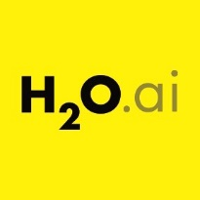
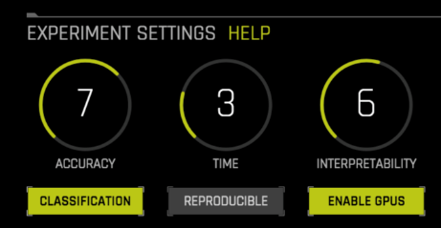
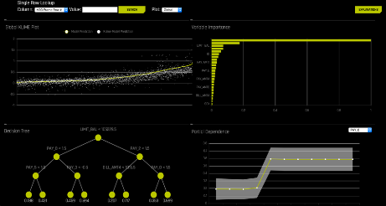
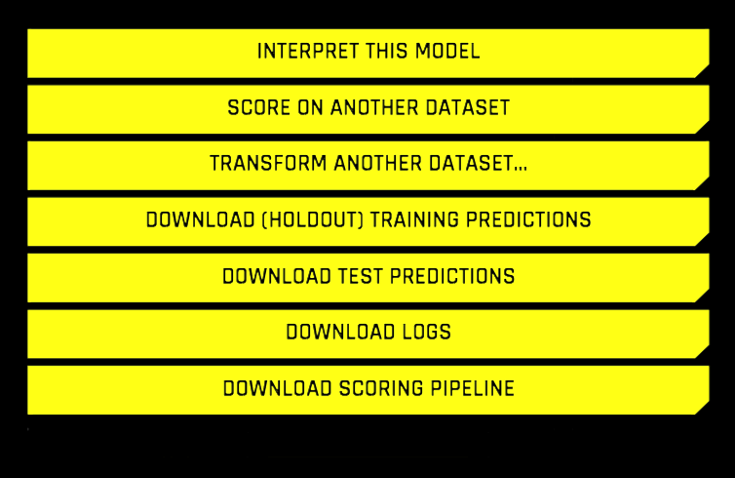
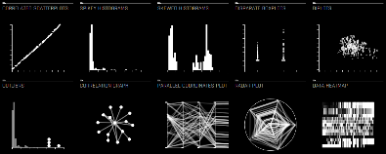

H2O Driverless AI – Simple, Fast, Accurate, Interpretable
Automatic Data Visualization
Automatic generation of visualizations and graphs to explore your data before the model-building process
Most relevant graphs shown for the given data set
Identify outliers and
missing values
Fast and
Accurate Results
“Data Scientist in a Box”
Simple interface
Automatic feature engineering to increase accuracy
Automatic recipes for solving wide variety of use-cases
Automatic tuning to
find and tune the right ensemble of models
Industry Leading Interpretability
Trusted results with explainability and transparency
Interpretability for debugging, not just for regulators
Get reason codes and model interpretability in plain English
K-Lime, LOCO, partial dependence and more
Easy Deployment for Low Latency Models
Production-ready, stand-alone scoring pipelines that are easy for IT to deploy and manage
Python and Java
Streamlined scoring code to deploy on any device: on the edge, mobile, …
Very fast (milliseconds) to satisfy today’s real-time apps
Notes:
H2O Driverless AI is an artificial intelligence (AI) platform for automatic machine learning. It’s power comes from its unique ability to automate many of the difficult and time-consuming tasks that make up data science and machine learning workflows. The built-in intelligence and automation are based on techniques and best practices from some of the most experienced and accomplished data scientists in the world. Feature engineering, model validation, model tuning and model selection are some of the tasks which have been automated. It aims to achieve the highest predictive accuracy, comparable to expert data scientists, but in much shorter time thanks to this end-to-end automation. The result is a platform that is so simple (yet powerful) to use that a novice can get results on par with an expert. This has been seen by people putting Driverless AI to the test in Kaggle data science competitions, coming up with expert-level results with very little time and effort. Driverless AI also provides automatic visualizations and machine learning interpretability (MLI).
It’s also very easy to get data into the system. Driverless AI can import datasets from the local file system but it can also import data from common data and storage systems such as Hadoop, Amazon S3, Google BigQuery and Snowflake, among others.
Automatic Data Visualization: For imported datasets, Driverless AI can generate visualizations and create data plots (charts/graphs) that are most relevant to the data from a statistical perspective. These visualizations help the data scientist understand data and feature relationships and help to validate that the data is in good shape before starting the model building process (what is referred to as an “experiment” in Driverless AI).
Fast and Accurate Results: Just how good is automatic machine learning? H2O.ai put Driverless AI to the test by letting it compete in Kaggle and they found that it ranked in the top 1-5 percentile “out-of-the-box” for most competitions. That means that Driverless AI can be better than anywhere from 95% to 99% of all data scientists for certain models, without any human intervention. That is an amazing feat. In fact, on the BNP Paribas competition, Driverless AI ranked in the top 10 within just a few hours of running, whereas all of the Grandmasters who ranked above it needed weeks of effort to get their results.
Industry Leading Interpretability: Driverless AI not only builds highly accurate models and ensembles (combinations of models), but it also runs through a whole slew of different techniques to interpret the results and provide reason codes for every single prediction. Especially in regulated industries, model transparency and explanation are just as important as predictive performance. Techniques used include: LIME, Surrogate Models, Shapley, LOCO, Partial Dependence and more. Driverless AI utilizes LIME (Local Interpretable Model-Agnostic Explanations)-based algorithms such as K-LIME and LIME-SUP to build an interpretable model that can explain the predictions of complex models that are generated during training. The output of LIME is a list of explanations, reflecting the contribution of each feature to the predictions of the model being interpreted. H2O.ai’s scientists recently published a book on interpretability called “An Introduction to Machine Learning Interpretability” which can be found here: https://www.oreilly.com/library/view/an-introduction-to/9781492033158/. Driverless AI is the most advanced explainable AI solution in the market and it continues to incorporate the latest research from academia.
Easy Deployment for Low Latency Models: In a typical enterprise machine learning workflow, the deployment of models is often a painful and laborious process. There are many things that can go wrong… due to human errors, bad data science practices, different tools/infrastructure, incompatible code, lack of testing, versioning, communication and so on. Driverless AI’s Automatic Pipelines is the solution to ease those pain points. It generates a production-ready, standalone scoring pipeline (for Python and Java) that is optimized for low latency scoring and can be deployed on the edge or in any scoring environment. It’s also easy to update when a new model version is available. The pipeline includes all of the feature transformations that were used to build the model. For example, your original source dataset might have 10 columns and Driverless AI’s automatic feature engineering technology might consider 1000 new features but end up using 200 of them in the building the model. When it comes time to score data in the future, only those original 10 columns are provided, but the pipeline also includes all of the feature transformations used to transform those original 10 columns (features) and build the model.

Slide 12
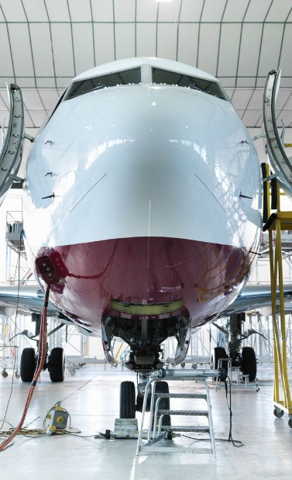

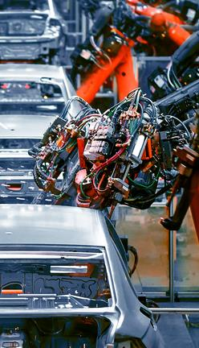



H2O Driverless AI
Customer Use Cases
Notes:
This section provides some examples of how some large, well-known companies across different industries are benefiting from their use of H2O Driverless AI.

Slide 13



H2O Driverless AI Delivers Value in Every Industry
Financial Services
Healthcare
Marketing
Manufacturing
Near perfect scores
+6%
Accuracy
2.5x performance
25%
time savings
Matched 10 years of machine learning expertise
Increased customer satisfaction
Outperforms alternative digital marketing
Accurately predicting supplies & materials for future orders
“Driverless AI is giving amazing results in terms of feature and model performance “
“Driverless AI powers our data science team to operate at scale. We have the opportunity to impact care at large.”
“Driverless AI helped us gain an edge for our clients. AI to do AI, truly is improving our system on a daily basis.”
“H2O Driverless AI feature engineering is better than anything I've seen out there right now.”
Venkatesh Ramanathan
Sr. Data Scientist, PayPal
Bharath Sudarshan
Dir. of Data Science, ArmadaHealth
Martin Stein
Chief Product Officer, G5
Robert Coop
Sr. Data Scientist, SB&D
Notes:
H2O’s Driverless AI is being implemented across many different business domains: finance, healthcare, marketing and manufacturing to name a few. Here are some of the results of key customers using Driverless AI.

Slide 14

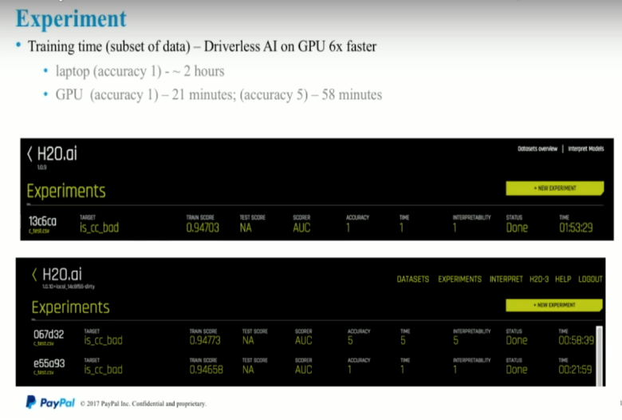
Financial Fraud Detection
  Driverless AI matched
  10 years of expert
  feature engineering
  Increased accuracy
  from 0.89 to 0.947 (6%)
  in detecting fraudulent activity
  6X speed up when
  running on an IBM Power GPU-based server
“Driverless AI is giving amazing results in terms of feature and model performance “
Venkatesh Ramanathan
Senior Data Scientist, PayPal
Notes:
PayPal is a global company operating a worldwide online payments system. As with many financial companies, fraud prevention is a significant area of investment for them. For over 10 years they’ve been successfully using machine learning in their fraud prevention efforts. With their use of H2O Driverless AI, the top 5 features extracted by H2O Driverless AI bested 10 years’ worth of expert engineered features. At the same time, H2O Driverless AI increased model accuracy from .89 to .947 (a 6% increase). Additionally, running on an IBM Power GPU-based server allowed the team to train the model 6x faster when compared to a CPU-only environment.
PayPal has identified other areas in their business in which they believe H2O Driverless AI will improve their current results.
For more information see the published customer case study, which is found here: https://www.h2o.ai/wp-content/uploads/2018/06/H20-Customer-Case-Study-PayPal-5302018-FINAL-NEW-2-1.pdf.
SUMMARY
Situation:
Need to detect buyer and seller collusion
Need to account for volume and value threshold variances
Solution with Driverless AI:
Created a network structure to identify collusion
Apply automatic feature representation to graph data
Merge extracted data with expert engineered features
Driverless AI to engineers additional features
Iteration builds fraud models that learn
Results:
Driverless AI matched 10 years of expert feature engineering
Increased accuracy from 0.89 to 0.947 means huge reduction in loss due to very large volume of transactions
6X speed up when using H2O GPU drivers

Slide 15



Improving Profitability of
Core Financial Services
Improved years of expert
feature engineering
Increased accuracy of existing credit risk scoring in less time
2x propensity to buy for new bank products
Accelerated by IBM Power Systems AC922
“We were also able to double the propensity for our banking customers to accept an offer of credit products, such as credit cards… We plan to use
the platform for more use cases in the future.”
Ruben Diaz
Data Scientist,
Visión Banco
Notes:
Visión Banco, based in Asunción, Paraguay, provides financial services to small and micro-sized companies in Paraguay. It offers credit card services, remittances, utility and tax collection services, pension plan contribution plans and payment transfer services.
Their data science team has been using machine learning for years to build credit risk scoring algorithms and recently they have extended their use of machine learning to better help identify customers to target for new banking products. They initially started building models with open source R and then moved to using R with open source H2O to improve accuracy and model development time.
Most recently they have moved to Driverless AI which has provided them with another boost to accuracy and reduction in model building and development time. The result has been an improvement in credit risk scoring accuracy as well as an increase in the propensity of their customers to buy new credit products.
Ruben Diaz, data scientist at Visión Banco explained the benefits of their H2O Driverless AI and IBM Power Systems solution: “We started using H2O Driverless AI for critical use cases: propensity to buy, default prediction and credit risk scoring. By using Driverless AI on IBM Power Systems, we have been able to significantly improve the accuracy, in less time, of our credit risk scoring model. These new models are now in production doing credit scoring in real-time. We were also able to double the propensity for our banking customers to accept an offer of credit products, such as credit cards, which is a great result. We plan to use the platform for more use cases in the future.”
For more information on this use case, see the following press release: https://www.h2o.ai/company/news/h2o-ai-ibm-vision-banco-machine-learning/.
SUMMARY
Situation:
Minimize risk in providing credit
Better target customers for new banking products
Solution with Driverless AI:
H2O Driverless AI on the IBM Power Systems AC922 server
Speeds up model building and improves accuracy of credit risk scoring
Rapid prototyping and building a set of expert machine learning models to better target customers to buy new products
Results:
Improved the accuracy of their credit risk scoring, with real-time scoring capabilities
Quickly developed a new model that doubled propensity to buy

Slide 16
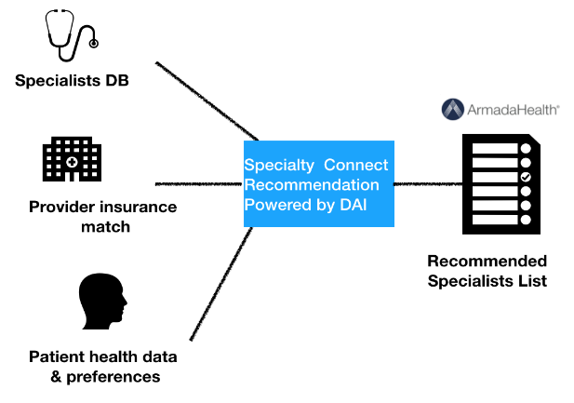

Connecting Patients to
Specialists for Better Healthcare
Companies have seen “skyrocketing” net promoter scores and “near perfect” customer satisfaction rates
Customer loyalty and premium retention rates have increased
Reduces costs, while patients receive care faster
“Driverless AI powers our data science team to operate efficiently and experiment at scale. With this latest innovation, we have the opportunity to impact care at large.”
Bharath Sudarshan
Director of Data Science and Innovation
Armada Health
Notes:
ArmadaHealth is a health data science and services company, offering solutions to improve the healthcare experience for individuals, businesses and employees. Their proprietary solutions combine big data and expert clinical insights to match consumers with the most appropriate physicians for their condition. The result is improved health outcomes, reduced healthcare expenses and exceptional patient satisfaction. H2O Driverless AI is a core component of their machine learning initiatives.
SUMMARY
Situation:
Connect patients to specialists to receive the right care faster with insurance provider, specialist and patient all to consider
Eliminate the frustration and costs of random searches by patients
Solution with Driverless AI:
Specialty Care Connect is the first health technology program connecting members to the right physician by combining customized physician database with evaluation criteria from clinical experts
Use of machine learning to find the right recommendation and to help the patient through their entire journey without hiring a large scale data science team
Rapid prototyping and building a set of expert data science models that offer recommendations to users
Results:
Efficient and more rapid recommendations to connect patients to specialists
Patients receive the right care quickly
Eliminates cost in the provider networks

Slide 17
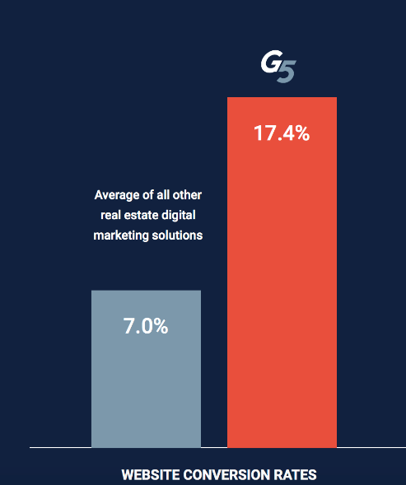
Marketing Optimization for the Real Estate Market
Outperforms other real estate digital marketing solutions by 2.5X
A G5 client saved $500K annual digital spend while increasing web traffic 3X
10X faster model creation
“Driverless AI helped us gain
an edge with our Intelligent
Marketing Cloud for our clients.
AI to do AI, truly is improving our system on a daily basis.”
Martin Stein
Chief Product Officer
Notes:
G5 is a leading innovator in marketing optimization for the real estate industry. G5 has partnered with H2O.ai to launch G5’s next generation Intelligent Marketing Cloud, using H2O Driverless AI. Driverless AI has been used to optimize the Intelligent Marketing Cloud to provide a solution that can prioritize inbound leads to simultaneously drive conversions, and cut digital marketing spend.
For more information on this use case, see the following press release: https://www.h2o.ai/company/g5-and-h2o-ai-partner-to-deliver-ai-optimization-for-real-estate-marketing/.
SUMMARY
Situation:
Needed to monitor marketing channels, customer journeys, and provide a competitive advantage to their clients vs. alternative digital marketing solutions (“do better than Google”)
Speed, innovation, and insights need to be at the core of G5’s business
Solution with Driverless AI:
Using Driverless AI, the team was able to get speed to customer insights and innovate more quickly to offer a superior solution to their clients to match customers to available real estate
Models optimized to understand the customer journey, provides intelligent lead scoring, and provides true economic value for their clients (reduces vacancy rates)
Models continue to learn regularly, delivering innovation to clients
Results:
Time compression for intelligent lead scoring from 1 week to 20 minutes
Accuracy has increased to 95%
Provides more intelligent marketing leads to their clients
A client saved $500K in digital marketing spend for the year while tripling their website traffic
Clients match consumers to real estate needs faster to reduce vacancies

Slide 18
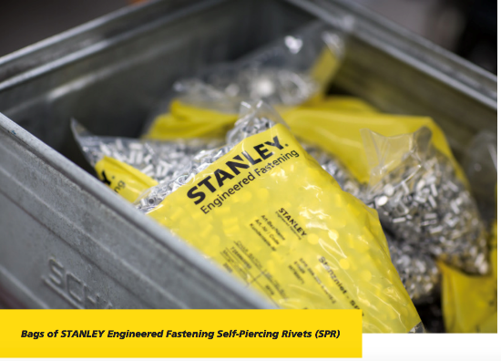
Improve Manufacturing
Sales and Forecasting
Time savings of 25%
with 1 data scientist
Saved 1 month of time in model tuning and training for industrial product line
Accurately predicted supplies and materials
for a future client order increasing forecast accuracy
“H2O Driverless AI feature engineering is better than anything
I've seen out there right now. And the scoring pipeline generation is probably one of the bigger pluses for me. It's a massive time saver.”
Robert Coop
Sr. Data Scientist
Stanley Black & Decker
Notes:
Stanley Black & Decker, Inc. is a Fortune 500 American manufacturer of industrial tools and household hardware, as well as a provider of security products and healthcare solutions.
Using H2O Driverless AI, they are developing AI-enabled manufacturing processes which have the potential to drastically reduce the amount of time required for product development. Since deploying H2O Driverless AI, Stanley Black & Decker has begun evaluating additional AI projects across the company where Driverless AI can help deliver greater insights and cost savings to the business.
For more information on this use case, see the following press release: https://www.h2o.ai/company/news/h2o-ai-empowers-stanley-black-decker-to-develop-innovative-manufacturing-processes/.
SUMMARY
Situation:
Improve the sales and forecasting of parts and products across the supply chain and to retail outlets
Address the complexity of selling in 100 countries with manufacturing across 11 countries
Solution with Driverless AI:
Using Driverless AI, they are now able predict a 6 month product sales forecast in emerging markets
Driverless AI is used by the data scientists to make them more efficient and save valuable time with automated feature engineering
Results:
Supply chain is more efficient, by using 10 different models to predict the build of one product from various manufacturing plants

Slide 19

IBM & H2O Driverless AI
Simplifying and Accelerating
Enterprise AI Initiatives
Notes:
Now that you understand the benefits of H2O Driverless and have an idea of how customers are using it to improve their Enterprise AI initiatives, let’s take a brief look at how IBM Power Systems can be used to accelerate those initiatives and bring faster time to insight. Additionally, you’ll see how Driverless AI complements the existing PowerAI offerings.

Slide 20


H2O Driverless AI Benefits from the
Power Systems Advantage
2.6x
9.5x
30x
More RAM
Max I/O bandwidth
Faster on GPUs
Big Data Scale
High Speed Data Transfer
GPU Accelerated ML
Integrated Systems Approach
Notes:
H2O Driverless AI and IBM POWER9 GPU-based Systems are bringing together best of breed AI innovation. To handle the increasingly complex workloads of AI you need an integrated system of software and hardware that is fully optimized for each other. H2O Driverless AI on IBM POWER9 delivers precisely that.
IBM POWER9 supports nearly 2.6x more RAM and 9.5x more I/O bandwidth than comparable systems. And in particular, the IBM Power Systems AC922 server was built to be the best server for Enterprise artificial intelligence (AI). In addition to supporting up to 6 NVIDIA V100 GPUs on a single server, there are other unique characteristics that help accelerate machine learning and deep learning workloads like no other server can. For example, the AC922 uses PCIe gen 4 and also introduces second generation NVLink technology between the CPU and GPU; this is 5.6x faster than PCIe Gen 3 architectures to which x86 remains committed in their current offerings (2018). Other GPU offerings in the marketplace only accelerate communications between GPUs but the NVLink technology in the AC922 accelerates GPU communications as well as GPU to CPU communications which is critical for AI workloads.
And IBM didn’t just focus on the NVLink communications for the CPU ←→ GPU pipeline … the AC922 was designed as a balanced system; specifically for the AI era with industry leading memory bandwidth, PCIe Gen 4 busses (for the best network connectivity), and high performance storage adapters.
Driverless AI is built on top of datatable (for data ingest and feature engineering) and H2O4GPU (for machine learning). datatable is a Python package for manipulating 2-dimensional tabular data structures, similar in spirit to the Python pandas library. However, datatable has an emphasis on speed and big data support. H2O4GPU is H2O.ai’s open source, GPU-accelerated machine learning package with APIs in Python and R that allows anyone to take advantage of GPUs to build advanced machine learning models. Both of these things take advantage of the additional RAM, I/O and GPU capacity available on IBM Power Systems, speeding up the overall machine learning workflow.
With the power of GPU-accelerated machine learning, H2O.ai was able to deliver nearly 30x speedup on model building in their own internal testing.
Details on the H2O.ai and IBM partnership (including H2O.ai talking about the specific H2O Driverless AI and IBM Power results detailed on the slide) can be found here: https://www.h2o.ai/blog/h2o-world-ibm-partnership/. Also see IBM’s blog on this partnership here: https://www.ibm.com/blogs/systems/ibm-and-h2o-ai-machine-learning-ibm-power-systems/.

Slide 21
H2O Driverless AI on IBM Power Systems
A Winning Combination
2x
1.5x
5x
Faster Feature
Engineering
Data Ingest
Time Series
Big Data Scale
High Speed Data Transfer
GPU Accelerated ML
Integrated Systems Approach
Notes:
Further to what was discussed on the previous slide, this slide shows some additional speed improvements related to the pairing of H2O Driverless AI with IBM Power Systems.
In H2O.ai’s internal testing they found that data ingest speed was nearly 2x with the IBM POWER9-based server with GPUs compared to an Intel CPU-only server. Additionally, feature engineering was 50% faster. As pointed out on the last slide, with the power of GPU-accelerated machine learning they saw a nearly 30x speedup on model building. Overall, they were able to accelerate Driverless AI by up to 10x for IID data and up to 5x for time series data.
In this context here, IID (Independent and Identically Distributed) data refers to data where the individual rows (or observations) are essentially independent of each other, unlike time series data where there is a relationship between rows in the dataset as they are collected over time. For example, whether a customer applying for a new mortgage is likely to default on that mortgage at some point in the future would use IID data such as age, income, current net worth and so on to make the prediction. For time series data, think of a utilities company; for example, a utility company tracks resource utilization over the course of a day, weeks and years where trends of usage over time periods are a factor in the prediction process.
Details on the H2O.ai and IBM partnership (including H2O.ai talking about the specific H2O Driverless AI and IBM Power results) can be found here: https://www.h2o.ai/blog/h2o-world-ibm-partnership/. Also see IBM’s blog on this partnership here: https://www.ibm.com/blogs/systems/ibm-and-h2o-ai-machine-learning-ibm-power-systems/.

Slide 22



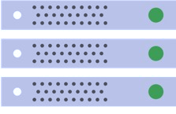
AI for
Data Scientists and
non-Data Scientists
PowerAI Vision
Auto-DL for Images & Video
H2O Driverless AI
Auto-ML for Text & Numeric Data, NLP
Label
Train
Deploy
Import
Experiment
Deploy
PowerAI: Open Source ML Frameworks
Deep Learning Impact (DLI) Module
Data & Model Management, ETL, Visualize, Advise
PowerAI
Large Model Support (LMS)
Distributed Deep Learning (up to 4 nodes)
Distributed Deep Learning (DDL – 1000s of nodes)
Auto Hyper-parameter Tuning
PowerAI
Enterprise
IBM Spectrum Conductor with Spark
Cluster Virtualization,
Dynamic Resource Orchestration,
Multiple Frameworks, Distributed Execution Engine
  Accelerated Infrastructure
  Accelerated Servers
  Storage
Notes:
H2O Driverless AI is a complementary piece to the IBM Portfolio of PowerAI-related offerings.
Note that the intention of the chart is not to show that H2O Driverless AI sits on top of a PowerAI-enabled stack. Instead, it is shown as being a new member of IBM’s family of AI offerings on Power – and that it’s similar to PowerAI Vision in that they both offer automatic data science capabilities (one is deep learning for computer vision and the other is machine learning for tabular data). They both include a very simple interface and workflow approach, with many of the typical machine learning or deep learning tasks handled automatically by the software, allowing even novice users to be immediately productive and to be able to build and deploy accurate models fast.
And just as a brief refresher on PowerAI (see the PowerAI module in the course for more details), with PowerAI, IBM is taking the most popular open source machine learning and deep learning frameworks like TensorFlow/Keras, PyTorch and Caffe, among others, and have built a supported distribution out of it.
Think of it like RedHat and how it packages Linux. You don’t go to linux.org to get Linux, you go to RedHat or SUSE or Ubuntu. It’s in the same way that IBM has packaged these machine learning and deep learning frameworks. Instead of going to all these various websites and building this software stack yourself, IBM has done it for you. IBM curates it, tests it and constantly updates it based on new releases. But then on top of that, IBM has added several tools to make it easier to use this open source software, and of course IBM gives you much higher performance for training AI models.
PowerAI Enterprise includes enterprise support and additional capabilities above what is included in the base offering:
Integrated & Supported Platform
Validated & Co-optimized Software & Hardware
Enterprise L1-L3 Support
Integration with Data Stores, Cloud, Cluster Management
Integration with key ML Platforms (Watson Studio Local (formerly Data Science Experience Local), Anaconda, H2O)
Integration with key Inference Platforms
Higher Productivity for Data Scientists
Performance: Scalability (reduction in training times)
Capability: Large Models (larger more complex models for higher accuracy)
Ease of Use: Auto-hyper-parameter tuning
Enable Non-Data Scientists to use AI
Rapid Prototyping & Labeling for SMEs
Auto-ML (with PowerAI Vision)

Slide 23
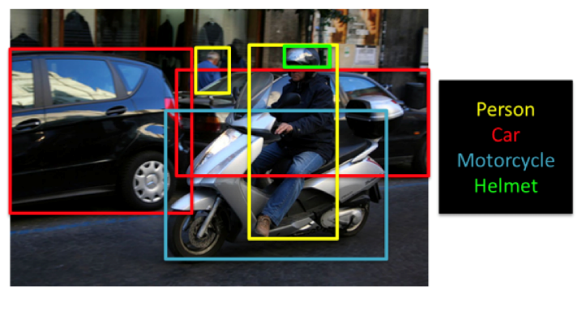

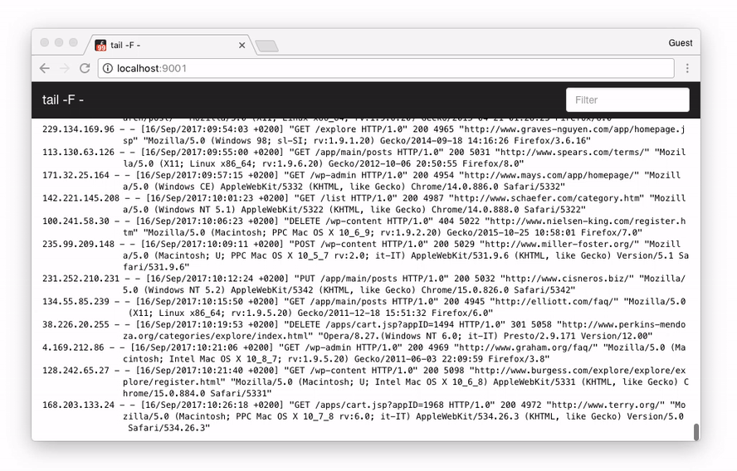
H2O Driverless AI Complements IBM PowerAI Vision
IBM PowerAI delivers
Deep Learning for Images
H2O Driverless AI is
Automatic Machine Learning
Transactional
Sensors
Log
NLP
Notes:
H2O Driverless AI and IBM PowerAI are perfectly complementary to each other. PowerAI Vision delivers deep learning for image and video recognition problems. Driverless AI delivers automatic machine learning for all other kinds of enterprise data: transactional, log and sensor. Driverless AI also supports Natural Language Processing (NLP) where you can do things like sentiment analysis of text data (extracted from Tweets, for example). Both H2O Driverless AI and IBM PowerAI Vision allow even novice users to be immediately productive.
IBM PowerAI Vision is designed for business users with little to no expertise in deep learning. Business users often have access to volumes of images and videos that they are trying to gain insights from, but they struggle with three key aspects: labelling data, training models, and deploying models for inference.
Data labeling is one of the most laborious tasks in a typical supervised learning deep learning project. PowerAI Vision provides a labeling tool which allows a business user (no need for a data scientist), to label images and videos. In addition to manual labeling, PowerAI Vision allows clients to build a model based on a small subset of the data and then use auto-labelling to accelerate the rate of creating additional labeled datasets for more in-depth training.
Once labelled, image classification and/or object detection models can be created with just the click of a button. And once a model is created, it’s yet another single click to deploy the model and test it out with new image datasets. Or you can deploy the model on an FPGA device or other edge device for rapid and scalable inferencing.
With H2O Driverless AI, it’s just as easy. A user that is working on a regression or classification problem (their skill can range from a novice to an expert data scientist) can easily import a dataset, one-click to see visualizations of that data, and then start the model building process with one more click. Much of the time-consuming work associated with building a model (for example: feature engineering, model tuning, model selection and so on) is handled automatically by Driverless AI – hence the term automatic machine learning.
There are expert settings that can be manipulated if needed, but there are three simple-to-understand knobs that the user can choose to adjust – Accuracy, Time and Interpretability. And these are set to intelligent defaults, which means that the user doesn’t even have to change them if they don’t want to. The only other thing the user has to do is pick the column in the dataset that they’re trying to predict (they know the result/prediction of the existing labeled data – but this is what needs to be predicted based on future input where you don’t have labeled outcomes). Another click of a button to start the model building process (what H2O.ai calls an “experiment”) and that’s it. And once the model is built, scoring pipelines are automatically built that are easy to deploy.

Slide 24

Integration of H2O Driverless AI with PowerAI Enterprise
Deploy and manage instances of H2O Driverless AI with PowerAI Enterprise
(through IBM Spectrum Conductor)
What’s available today (as of Nov. 2018)
Multiple instances of Driverless AI deployed across the
cluster (up to one instance per host)
Automatic failover: if Driverless AI goes down,
it is restarted on another host
Easy start/stop of Driverless AI through the web interface
User permissions management
Shared file system for data and logs
Roadmap
Running Driverless AI across multiple machines
Running multiple instances on a single host
Integration of Driverless AI authentication with
PowerAI Enterprise authentication
Log retrieval from IBM Spectrum Conductor web interface
…
IBM
Spectrum
Conductor
Notes:
Included as part of IBM PowerAI Enterprise is IBM Spectrum Conductor, which allows for the deployment of modern computing frameworks and services for a multitenant enterprise environment. And with Spectrum Conductor, H2O Driverless AI can now be easily deployed into the cluster.
This includes the ability to have H2O Driverless AI scale across compute nodes with multiple instances, where each instance is allocated to one host. Availability is also a key capability, where an instance of Driverless AI can failover to another host if it goes down (if resources are available). You can also easily start and stop H2O Driverless AI and maintain instances for each user (or groups of users) through role-based access control (RBAC) and consumer association, along with all other workloads – all in one shared compute cluster.
The story doesn’t end there, though. There are more things coming in the future around the tight integration of Spectrum Conductor and Driverless AI. One such improvement is around multi-instance deployments. You will be able to run multiple Driverless AI instances on the same host, where each instance is allocated a GPU or a subset of GPUs from the host. This is tentatively planned for Q1 2019. Some of the other features and enhancements planned are shown here on the slide.

Slide 25
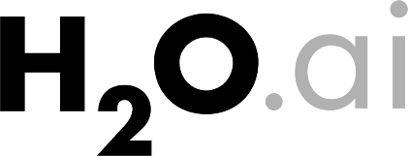

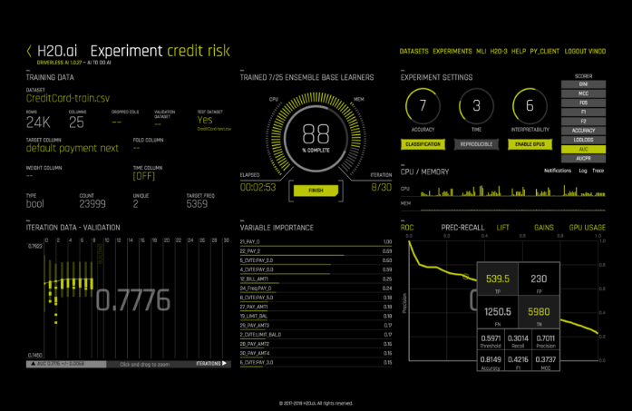
The H2O Driverless AI Experience
Notes:
This section takes a closer look at the machine learning workflow and H2O Driverless AI’s place within it. It also includes an overview of the steps involved in using Driverless AI.

Slide 26

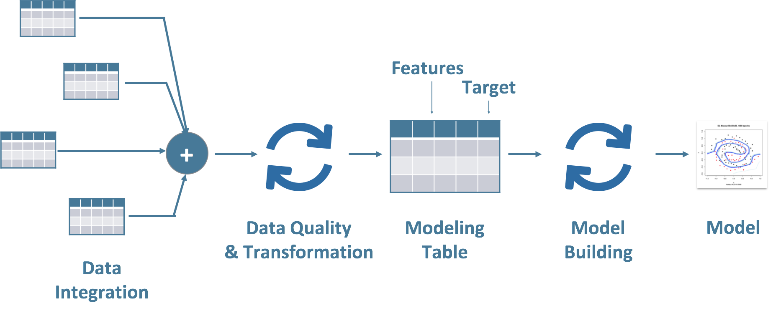
Driverless AI: Automates Data Science and Machine Learning Workflows
Driverless AI
Notes:
<PRIOR TO CLICKING TO INITIATE ANIMATION>
Let’s take a look at the typical enterprise machine learning workflow.
Data is sitting in different silos, databases or other sources and there is a lot of ETL work needed to join these disparate data sources together to be brought in as a dataset for machine learning and analysis. At this point, there is also a fair amount of data transformation work that needs to be done including data cleaning, “wrangling” and one-hot encoding, among others, to get it to a machine-learning ready state.
Data scientists will typically then spend a lot of time performing feature engineering. In machine learning, a feature is an individual measurable property or characteristic of something being observed/recorded. Feature engineering is the process of applying statistical and other techniques to optimize raw features (the data columns coming in), synthesize new features by combining raw features, find interaction terms, apply dimensionality reduction and other methods to transform the data into a new dataset that is highly optimized to take advantage of the machine learning algorithms.
For example, one of the input columns (features) might be a date, in which case we might want to generate new columns (features) based on this date. Let’s say that the problem being solved is to predict the insurability of a driver and the date represents their birthday. It is probably useful to generate an age column from it, as a person’s age often factors into insurability. Perhaps the date feature represents when a particular retail store purchase was made, then it might be useful to extract the day of the week (Sunday – Saturday) from it, as the day of the week is likely going to be a factor in predicting future sales (more sales at a shopping mall likely take place on a Saturday versus a Wednesday). This process of feature engineering is iterative and can be very time consuming and laborious. This is also something that needs a lot of expertise to be effective.
After that step, data scientists will build a lot of models to try to evaluate their performance and find the best model or ensemble for the problem (an ensemble is the combination of results from multiple models to improve the overall performance).
Once that is done, they’ll have to work with their development and operations teams to try and deploy these models into production.
Finally, data scientists will need to document the entire process including specific steps and then help explain the results of the model to the business users.
<CLICK>
With H2O Driverless AI, the pieces of the workflow in the grey box have been automated. Please note that Driverless does not perform any ETL. You still need to use your existing enterprise ETL tools to bring data together. But once the data is in a single file, Driverless AI can perform a lot of exploratory analysis using Automatic Visualization which can review the shape of the data and look for skews, spikes, missing values and so on. It also does basic transformations such as one-hot encoding, among others.
It then runs through series of automatic feature engineering recipes, depending on the type of problem, and applies expert-level techniques like weight of evidence, target encoding, dimensionality reduction, exponential smoothing, interaction effecting and clustered target encoding among others. Don’t worry if these terms don’t make a lot of sense to you – again, the beauty of Driverless AI is that it’s all being done for you automatically under the covers.
Driverless AI also iteratively (and in parallel) builds hundreds to thousands of models to evaluate the features, plus tune hyperparameters, to find the best combination of features and models for the final outcome. Once the best feature pipeline and model/ensemble is selected, it generates an automatic pipeline that is ready to deploy in production environments… fully optimized for low latency.
Finally, Driverless AI also runs through a whole gamut to interpretability techniques to explain every prediction and provide reason codes to the user.

Slide 27





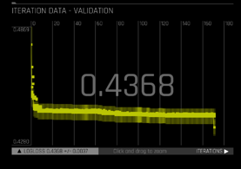



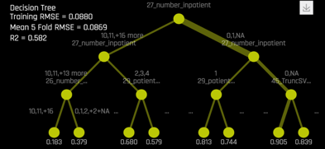



H2O Driverless AI: How it Works
1
Drag and drop data
2
Automatic Visualization
3
Automatic Machine Learning
4
Automatic Scoring Pipelines
Use best practice model
recipes and the power of high performance computing to Iterate across thousands of possible models including advanced feature engineering and parameter tuning
Deploy ultra-low latency Python or Java Automatic Scoring Pipelines that include feature transformations and models.
Ingest data from cloud, big data and desktop systems
Understand the data
shape, outliers, missing values, etc.
HDFS
Local
Automatic Machine Learning
Model Recipes:
IID data
Time-series
More on the way
Survival of the Fittest
Model
Documentation
Modelling
Amazon S3
Deploy Low-latency
Scoring to Production
X
Y
Automatic
Scoring Pipeline
Snowflake
Advanced Feature
Engineering
Machine learning
Interpretability
Google BigQuery
Dataset
+
Algorithm
+
Model
Tuning
Azure Blog Storage
Powered by GPU Acceleration
Notes:
At a very high level, here’s how Driverless AI works:
Ingest data from any data source: Hadoop, Snowflake, S3 object storage, Google BigQuery – Driverless AI is agnostic about the data source.
Use Automatic Visualization and its various plots, graphics and charts to look at the data, and understand the data shape, outliers, missing values and so on. This is where a data scientist can quickly spot things such as bias in the data.
Based on the problem type, Driverless AI will use recipes to do advanced feature engineering (automatically), while the model continues to iterate across thousands of choices, does parameter tuning, and looks for the best fit of the model.
Finally, another amazing feature of Driverless AI is that it can build an automatic scoring pipeline, which means it can generate Python and Java code to deploy low latency scoring of that model into production. Imagine taking that scored model and propagating it across every edge device – on smart phones, or in cars, to continuously generate value.
Through this process, Machine Learning Interpretability gives the data scientist the reason codes and insight into what model was generated and which features were used to build the model. Automatic documentation gives one an in-depth explanation of the entire feature engineering process. This satisfies that desire to have trust in AI with explainability.
This entire process is done through a graphical user interface, making it easy for even a novice data scientist to be productive immediately.
Of course, acceleration to achieve faster time to insight is important, and an IBM Power System server with GPUs (such as the AC922) will give the highest level of acceleration to gain results and insights faster.
The slide makes reference to IID (Independent and Identically Distributed) data. This refers to data where the individual rows (or observations) are essentially independent of each other, unlike time series data where there is a relationship between rows in the dataset as they are collected over time. For example, whether a customer applying for a new mortgage is likely to default on that mortgage at some point in the future would use IID data such as age, income, current net worth and so on to make the prediction. For time series data, think of a utilities company; for example, a utility company tracks resource utilization over the course of a day, weeks and years where trends of usage over time periods are a factor in the prediction process.

Slide 28
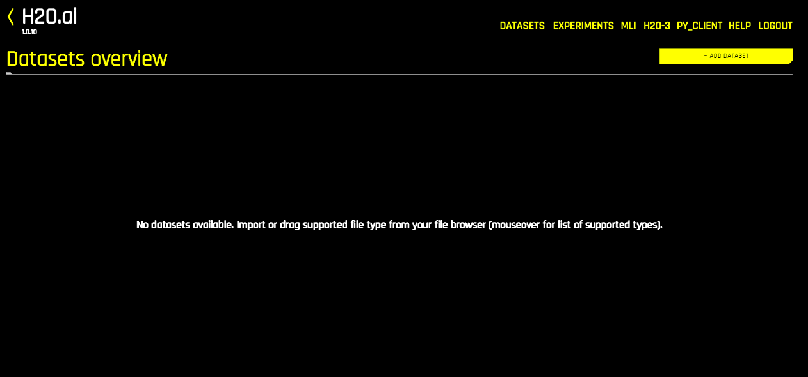
The Driverless AI Experience
Import Data
Review Auto-Visualizations
Start Experiment
Review Winning Model
Review Model Interpretations
Deploy Model
Notes:
In H2O Driverless AI, the workflow for building a model is referred to as an “experiment”. Over the next few slides we’ll walk through the process of setting up and starting an experiment.
Once you have logged into Driverless AI (by going to the URL for your server and logging in with your user ID and password credentials) you are brought to the Datasets Overview page.
From here, you can import a dataset – which is required before you can start making predictions on it. Datasets must be in delimited text format, but Driverless AI will automatically detect the separator character (one of , | ; t). Driverless AI supports the following dataset file formats: csv, tsv, txt, dat, tgz, gz, bz2, zip, xz, xls, xlsx, nff, feather, bin, arff and parquet.
You can add datasets by dragging and dropping files from your local machine directly onto this page or you can click the “Add Dataset (or Drag and Drop)” button to upload or add a dataset. You can search the server’s local file system or upload a file, and depending on how the environment was setup there may be other options such as importing from Amazon S3 object storage or importing from a Hadoop File System, among others.
Once you have imported a dataset, you can click on it and you will be presented with 3 options: Details, Visualize, Predict.
If you click on Details you will be presented with summary information about the dataset, including details about each of the columns in the dataset. This includes the name, type, count, mean, minimum, maximum, standard deviation, frequency and the number of unique values, among others This gives you your first glance at the characteristics of the data in your dataset. If you hover over the top of a column you can see the values from the first 20 rows for that column.
You can also click on the “Dataset Rows” button to see all of the rows in the dataset.
The other two options (Visualize and Predict) are covered in subsequent slides.
A commonly used dataset is the credit card default payments data set (which is shown in some of these screenshots) and can be found here: https://archive.ics.uci.edu/ml/datasets/default+of+credit+card+clients.

Slide 29
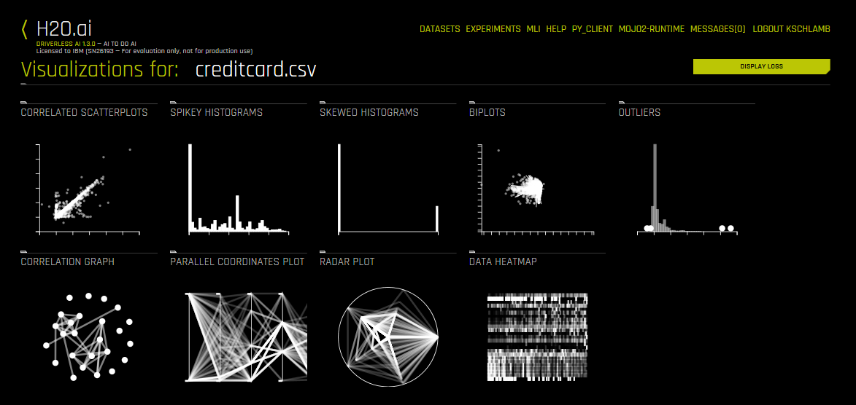
The Driverless AI Experience
Import Data
Review Auto-Visualizations
Start Experiment
Review Winning Model
Review Model Interpretations
Deploy Model
Notes:
Again, after you have imported a dataset, you can click on it and you will be presented with 3 options: Details, Visualize, Predict.
If you click on Visualize, Driverless AI’s AutoViz capability will automatically create data plots/graphs for the selected dataset. The graphs that you’re presented with can vary based on the nature of the data in your dataset. This is helpful for data scientists and data engineers who want to better understand the composition of the datasets and see trends and possible issues, such as large numbers of missing values, bias or significant outliers that could impact modelling results.
Automatic visualization types include:
Clumpy Scatterplots
Correlated Scatterplots
Unusual Scatterplots
Spikey Histograms
Skewed Histograms
Varying Boxplots
Heteroscedastic Boxplots
Biplots
Outliers
Correlation Graph
Parallel Coordinates Plot
Radar Plot
Data Heatmap
Missing Values Heatmap

Slide 30
The Driverless AI Experience
2. Review Auto-Visualizations
Notes:
This is the screenshot from the previous size enlarged for the audience to see better.

Slide 31
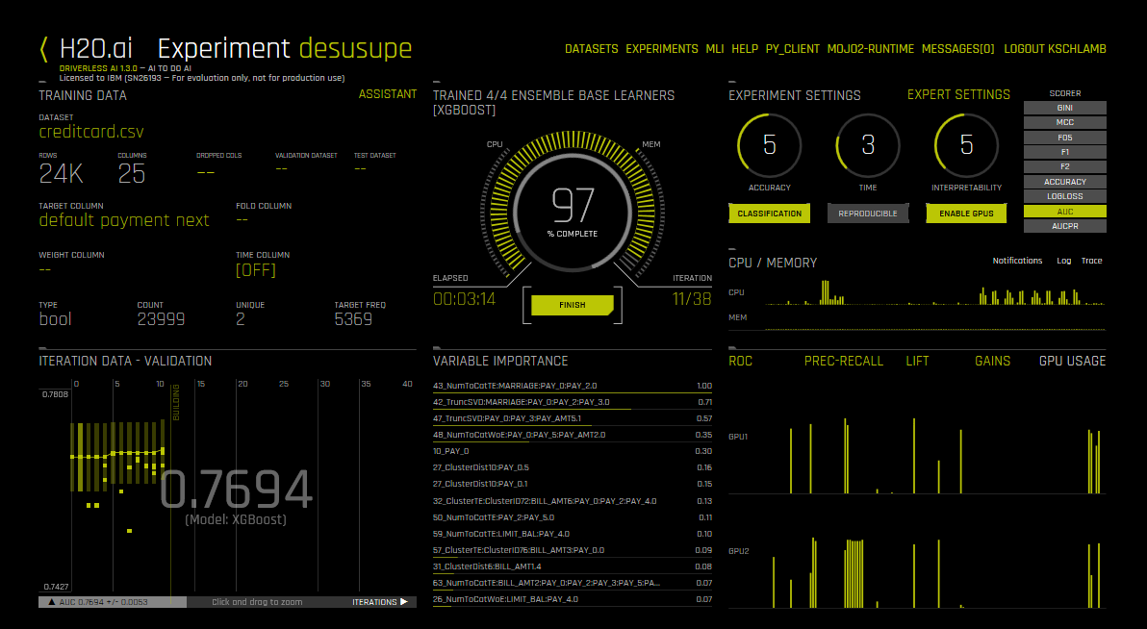
The Driverless AI Experience
Import Data
Review Auto-Visualizations
Start Experiment
Review Winning Model
Review Model Interpretations
Deploy Model
Quickly start an experiment and benefit from built-in automation:
Feature Engineering
Model Tuning
Model Selection
Notes:
In H2O Driverless AI, the workflow for building a model is referred to as an “experiment”. Now that you’ve imported a dataset and looked at the visualizations that Driverless AI built for it, it’s time to start an experiment.
You can do this by either clicking on the “Experiments” option in the menu and then clicking the “+ New Experiment” button – or you can click on an imported dataset and choose the “Predict” option.
At a minimum, the user only has to provide the initial dataset and choose a target column before clicking the “Launch Experiment” button to start building their model. However, Driverless AI provides a variety of experiment settings and expert settings that can be specified or adjusted when building your models (we’ll look at some of the more basic experiment settings over the next couple of slides).
Once the experiment has been launched, Driverless AI automates the process of feature engineering, model validation, model tuning and model selection.
Each experiment is given a name (by default it’s a randomly generated string that follows a consonant, vowel, consonant, vowel, etc. pattern). However, you can change the name at anytime during or after the experiment.
As the experiment runs, a running status displays in the upper middle portion of the screen. First, Driverless AI figures out the backend and determines whether GPUs are running. Then it starts parameter tuning, followed by feature engineering. Finally, Driverless AI builds the scoring pipeline.
In addition to the status, the screen also displays details about the dataset, the iteration data, the variable importance list (more on this later) and CPU/memory information.

Slide 32
The Driverless AI Experience
3. Start Experiment
Quickly Start Experiment
Model Tuning
Feature Engineering
Model Selection
Notes:
This is the screenshot from the previous size enlarged for the audience to see better, along with some of the key capabilities highlighted.

Slide 33
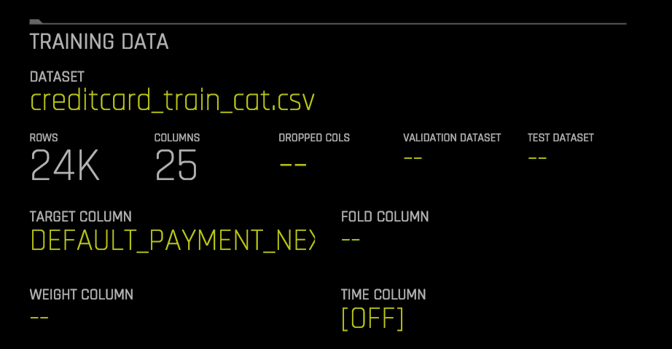
It’s Easy to Start an Experiment
Columns to exclude from experiment
Dataset being used to train the models
Data used for parameter tuning
These are the only required settings – all others are optional depending on the scenario
What column are we trying
to predict?
Data used to calculate metrics for the final model;
not used
during training
Should certain rows of data have a
higher weight?
Is this a time-series forecasting exercise?
Notes:
Here are some of the experiment settings that can be specified before starting an experiment. At a minimum, the dataset and the target column are all that need to be provided.
Target column: This is the column in the input dataset (the training dataset) that you want to predict.
Dataset (Training): This is the dataset that you initially specified that you want to base the predictions on – the training dataset. It is used for training purposes. However, if no separate validation dataset is provided then this dataset will be used for validation as well. But if a validation dataset is provided then this training dataset is not used for parameter tuning – only for training.
Validation dataset (optional): This is used for tuning the parameters (models and features). If provided, the entire training dataset will be used for training, and validation of the modeling pipeline is performed with only this validation dataset. However, if a validation dataset is not provided then the training data is used.
Test dataset (optional): This is used for the final stage scoring and is the dataset for which model metrics will be computed against. Test set predictions will be available at the end of the experiment. This dataset is never used during training of the modeling pipeline.
Dropped columns (optional): Columns that you do not want to be used as predictors in the experiment. Note that Driverless AI will automatically drop ID columns and columns that contain a significant number of unique values.
Time column (optional): Used for time-series data, if applicable; this is the column that provides the time order of the observations.
Weight column (optional): This is a column in the dataset that indicates the observation weight (that is, the sample or row weight), if applicable. Rows with higher weights have higher importance. If nothing is specified then each row will have an observation weight of 1 – equal weighting.
Fold column (optional): This is a column used to create stratification folds during cross-validation, if applicable. This can help to build better models when the data is grouped naturally. If left empty, the data is assumed to be IID (Identically and Independently Distributed). For example, when viewing data for a pneumonia dataset, person_id would be a good fold column because the data may include multiple diagnostic snapshots per person, and we want to ensure that the same person’s characteristics show up only in either the training or validation frames, but not in both to avoid data leakage. If nothing is specified then the folds will be determined by Driverless AI.
There are various other settings and things that can be adjusted that are not shown here, such as the model scorer to use in the experiment. See the H2O Driverless AI documentation for details on all of the possible settings available: http://docs.h2o.ai/driverless-ai/latest-stable/docs/userguide/running-experiment.html.

Slide 34
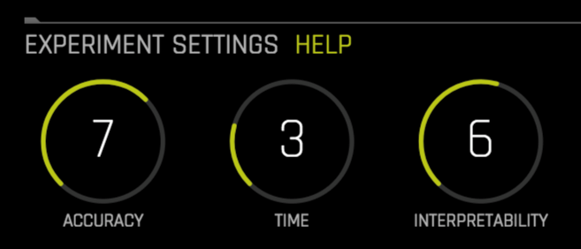
Experiment
Settings
Accuracy
Time
Interpretability
Relative accuracy – higher values should lead to higher confidence in model performance (accuracy)
Impacts things such as level of data sampling, how many models are used in the final ensemble, parameter tuning level, among others
Relative time for completing the experiment
Higher settings mean:
  More iterations are performed to find the best set of features
  Longer “early stopping” threshold
Relative interpretability – higher values favor more interpretable models
The higher the interpretability setting, the lower the complexity of the engineered features and of the
final model(s).
Notes:
Prior to starting an experiment, in the middle of the experiment screen are three knobs that the user can choose to adjust: Accuracy, Time and Interpretability. Each can be set to a value between 1 and 10 (inclusively).
However, Driverless AI will automatically suggest default intelligent settings for your experiment to get you started quickly. It will also show you an experiment preview based on those settings. As you change each knob value, the experiment preview pane will automatically update to show you how this change impacts things for your specific experiment.
The settings are fairly self-explanatory. For Accuracy, as it increases, more work is done by Driverless AI and more things will be considered or performed as part of the feature engineering, training and selection process. Time is the relative time for completing the experiment (that is, higher settings take longer) and specifying a higher value will instruct Driverless AI that it has more time to do more work to try to find the best model. Interpretability impacts the complexity of the models that Driverless AI builds. If there is a strong need or requirement to have a model that is clearly explainable then a higher value should be used. A lower value means that Driverless AI is allowed to be more creative – perhaps coming up with engineered features that might not make any sense to somebody looking at them (and would never have even been considered by an expert data scientist, perhaps), but do provide more accurate models.
Note that setting all 3 knobs to the highest setting (10) does not provide the most complex and accurate models. Higher values for Accuracy and Time mean a relative increase in accuracy, but a high value for Interpretability means less complexity, and potentially less accuracy (since you want the resulting model to be easier to understand and explain). Therefore, the settings that provide the highest accuracy would typically be 10, 10 and 1 – but of course, this will have the least interpretability.

Slide 35
Auto Feature Generation
Kaggle Grandmaster Out of the Box
Feature Transformations
Examples of Generated Features
Automatic Text Handling
Frequency Encoding
Cross Validation
Target Encoding
Truncated Singular
Value Decompression
Clustering and more
Examples of
Original Features
Notes:
As previously discussed, one of the things that H2O Driverless AI does is automated feature engineering. The logic behind this is based on the tricks and techniques of the data science experts and Kaggle Grandmasters that work at H2O.ai. And again, the benefit here is that Driverless AI is going to apply this “magic” automatically under the covers when you’re performing your prediction experiments.
Shown here is an example of what you’ll see when an experiment completes, showing the relative importance of the features (both the raw, original features and the generated, engineered features) in the resulting model. The names of the engineered features are frequently quite cryptic, but include the original feature names and the transformations done on them.
Some examples of the types of feature transformations that might be done are shown on the right side of the slide.

Slide 36
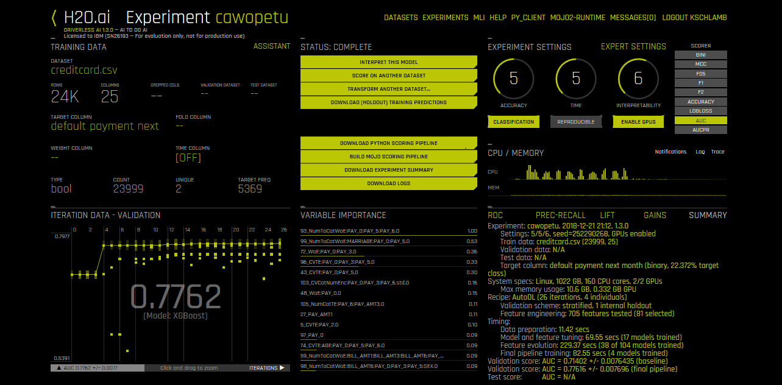
The Driverless AI Experience
Import Data
Review Auto-Visualizations
Start Experiment
Review Winning Model
Review Model Interpretations
Deploy Model
Notes:
Once an experiment has finished running, various pieces of information will be provided on the screen. For instance, the final model score is shown (you will see a point in time model score while the experiment is running… it changes over time as the experiment’s tuning and validation progresses).
You will also be presented with an Experiment Summary, which includes a description of the final model. This is the model that is used to score new datasets and create the scoring pipeline. The final model may be an ensemble of models depending on the accuracy setting. The Experiment Summary also includes information about the final model’s performance.
In the upper middle portion of the screen will be a series of yellow buttons, which represent next steps for you to take. They include:
Interpret this Model: Brings you to the Machine Learning Interpretability (MLI) page which opens with a summary of the interpretation.
Score on Another Dataset: After you generate a model, you can use that model to make predictions on another dataset.
Transform Another Dataset: Applies the same transformations and feature engineering that was done to improve the original training dataset to a new dataset.
Download Validation Predictions: If a validation dataset was provided then this can be used to download the predictions made against it.
Download Test Predictions: If a test dataset was provided then this can be used to download the predictions made against it.
Download Python Scoring Pipeline: Provides a standalone Python scoring pipeline.
Build MOJO Scoring Pipeline: Provides a standalone Model Object, Optimized (Java) scoring pipeline.
Download Experiment Summary: Provides a ZIP file containing various assets, including an experiment summary document.
Download Logs: Downloads various log files associated with the experiment.

Slide 37
The Driverless AI Experience
4. Review Winning Model
Notes:
This is the screenshot from the previous size enlarged for the audience to see better.

Slide 38
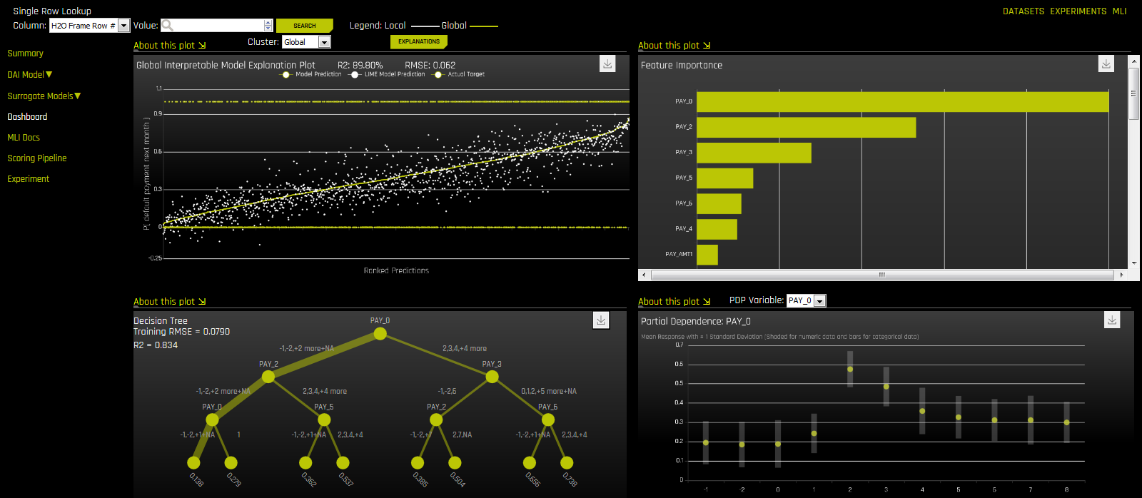
The Driverless AI Experience
Import Data
Review Auto-Visualizations
Start Experiment
Review Winning Model
Review Model Interpretations
Deploy Model
Notes:
Interpretability is a key feature of H2O Driverless AI that helps explain how a model works (so it might be easier for you to think of it as model explainability rather than interpretability). This is important because delivering trusted and transparent results increases the adoption of AI and also allows a company to comply with government regulations.
After an experiment finishes and Driverless AI has built a model (often a complex model that isn’t easily explainable), you can click on the “Interpret this Model” button to bring you to the Machine Learning Interpretability (MLI) page (it may take a few minutes at first for it to build up the various surrogate models and charts).
At first, you’ll be shown a summary with some basic facts about the model, as well as variable importance for both the original features and the derived/generated features.
You can then choose various options from the menu that lets you look at charts for the different surrogate models that have been built. There is also a Dashboard option (shown on this slide) that shows multiple charts at the same time on the screen: K-LIME, Variable Importance, Decision Tree and Partial Dependence. Each chart helps to explore the modeling techniques and results more closely.
These techniques are crucial for those who must explain their models to regulators or customers. What exactly these things are and how they’re used are beyond the scope of this presentation, so please refer to the H2O Driverless AI documentation if you want to learn more on this important topic: http://docs.h2o.ai/driverless-ai/latest-stable/docs/userguide/interpreting.html.
In addition to interpreting its own models, Driverless AI can interpret external models too. This is done by loading in a dataset that includes the predictions made by the external model.
H2O.ai’s data scientists recently published a book on interpretability called “An Introduction to Machine Learning Interpretability” which can be found here: https://www.oreilly.com/library/view/an-introduction-to/9781492033158/. Also, a great video dedicated to Driverless AI interpretability can be found here: https://www.youtube.com/watch?v=5jSU3CUReXY. It’s highly recommended that you go through these assets.

Slide 39
The Driverless AI Experience
5. Review Model Interpretations
Notes:
This is the screenshot from the previous size enlarged for the audience to see better.

Slide 40
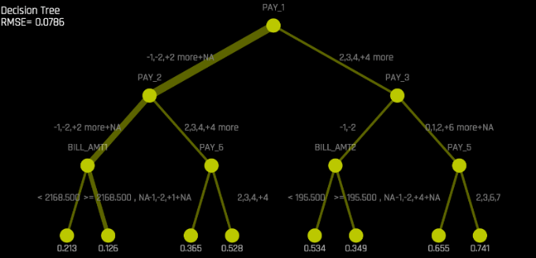
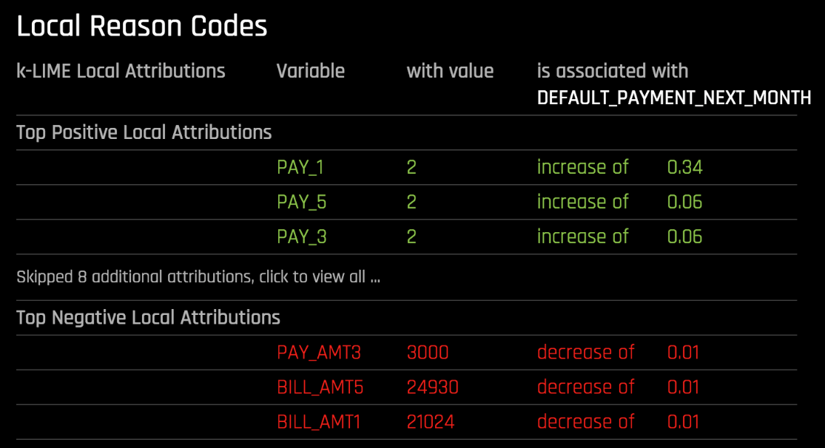
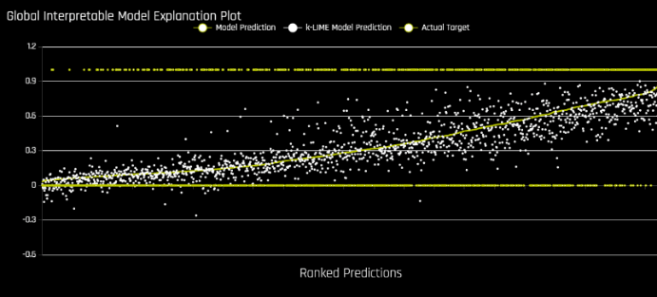
Different ways to help you interpret and understand the model
Surrogate Decision Tree
Reason Codes
K-Lime Linear Models
Why will someone Default?
A Pay Amount of $3,000 decreases their likelihood to default
The fact that they haven’t paid in 2 months increases their
likelihood to default
Notes:
The previous slide talked about the Machine Learning Interpretability (MLI) feature of H2O Driverless AI. This is a closer look at some of the pieces of information that Driverless AI generates to help explain the results for a model.
Because the model that Driverless AI builds is often very complex – having potentially built many new generated features as part of the feature engineering process – Driverless AI uses surrogate models to help explain the behavior of the complex model. Basically, surrogate models are simple models of complex models. They are not exact, but they are very close approximations. The main benefit is being able to tell us about a very complex system in the space of the original inputs (the original features or data columns provided).
One thing that Driverless AI generates is a Surrogate Decision Tree, which is an approximate flow chart of the complex model’s behavior (where the inputs involved are only the original features, and none of the generated features). Features (sometimes referred to as variables) that are higher up in the tree have more importance in the decision-making process. Again, inputs to the tree are the original inputs from the dataset and the Surrogate Decision Tree tries to model the predictions of the complex model that Driverless AI previously built for you. An example tree is shown here on the top-left part of this slide.
Another surrogate model built for interpretability is a K-LIME model. K-LIME is based on LIME (Local Interpretable Model-Agnostic Explanations) which builds an interpretable model that can explain the predictions of complex models that are generated during training. K-LIME is probably most useful to advanced users. An example of a K-LIME model chart is shown on the bottom-left part of this slide.
When viewing the K-LIME chart (either directly through the menu or as part of the dashboard), clicking on the “Explanations” button will show Global Reason Codes, with English language explanations of the impact of the most important variables (features).
Additionally, you can click on the data point (the dot) associated with a particular record and then see the explanations (the Local Reason Codes) associated with that particular record. This reason code panel is shown on the right portion of this slide. Also, after having clicked on a particular record in the K-LIME chart you will also see it reflected in the other charts as well (such as in the Surrogate Decision Tree where you’ll see the “path” taken for that particular record through the decision tree).
Most of the Driverless-AI-generated graphics are downloadable as static images which you can use in your own documents and presentations.
Please see the H2O Driverless AI documentation if you want to read more about interpretability: http://docs.h2o.ai/driverless-ai/latest-stable/docs/userguide/interpreting.html.
H2O.ai’s scientists recently published a book on interpretability called “An Introduction to Machine Learning Interpretability” which can be found here: https://www.oreilly.com/library/view/an-introduction-to/9781492033158/. Also, a great video dedicated to Driverless AI interpretability can be found here: https://www.youtube.com/watch?v=5jSU3CUReXY. It’s highly recommended that you go through these assets.

Slide 41
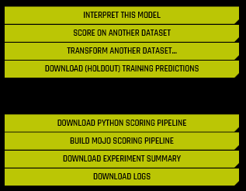
The Driverless AI Experience
Import Data
Review Auto-Visualizations
Start Experiment
Review Winning Model
Review Model Interpretations
Deploy Model
Notes:
H2O Driverless AI automatically generates Python scoring pipelines as well as new ultra-low latency MOJO (Model Object, Optimized) automatic scoring pipelines. The new automatic scoring pipeline is a unique technology that deploys all feature engineering and the machine learning model in a highly optimized, low latency production ready Java code that can be deployed anywhere. This technology is critical for enterprises running models that need ultra-fast scoring for real-time applications running on a range of devices.
The Python scoring pipeline is slower but easier to use than the MOJO scoring pipeline. It’s recommended to use the MOJO Scoring Pipeline for a pure Java solution. This solution is flexible and is faster than the Python Scoring Pipeline, but it requires a bit more coding.
The Python package contains an exported model and Python 3.6 source code examples for productionizing models built using H2O Driverless AI. The files in this package allow you to transform and score on new data.

Slide 42


H2O Driverless AI Delivers Automatic ML for the Enterprise
Performs the function of an expert data scientist
Create models quickly with GPUs and Machine Learning automation
Delivers insights and interpretability
Created and supported by world renowned AI experts from H2O.ai
Award-winning software
21 day free trial for Driverless AI
Notes:
H2O Driverless AI is ideal for driving Enterprise AI adoption because it solves the AI Talent, Time and Trust challenges:
Talent: Driverless AI was built by the top Kaggle Grandmasters at H2O.ai and provides the functionality of an expert data scientist in software. It’s ideal for a novice data scientist to supplement his/her skills, or to add additional ”horse power” to an existing data science team.
Time: Driverless AI, especially on GPU systems such as the IBM Power AC922 server, is decreasing the amount of time it takes to train models, with features such as automatic feature engineering. With Driverless AI, Data Scientists can quickly train models and gain insights faster – by automating the tedious process of building a high quality machine learning model.
Trust: Driverless AI incorporates Machine Learning Interpretability (MLI), invented by H2O.ai. It provides a set of detailed reports and dashboards to easily understand model results. Regulators and enterprises looking for compliance will immediately gain value from MLI. Additionally, Driverless AI has Auto-Visualization and Auto-Documentation, giving the data scientist or analyst a visualization of their data sets, and automatically generated documentation on the model and its output.
Driverless AI won the InfoWorld technology of the year award in 2018. Other awards won by H2O.ai can be found here: https://www.h2o.ai/company/awards/.
And don’t forget, you can download Driverless AI for a 21 day free trial from the H2O.ai website (https://www.h2o.ai/).

Slide 43

Sales Resources
Notes:
Now that you’ve learned about the benefits and features of H2O Driverless AI and the value that IBM Power Systems brings to the table, let’s close things out with some final sales-related topics, including sizing, ordering instructions and where to get more information and help.

Slide 44

Benefits of the IBM & H2O.ai Partnership
H2O.ai is the Open Leader in AI
(open source community and AI market leader)
H2O.ai will back up IBM
H2O.ai will provide both pre & post sales technical support globally
H2O.ai will drive demand via marketing campaigns, meetups, webinar, events
H2O.ai will sell jointly. Their reps are compensated to sell with IBM
H2O.ai will provide all customer support
IBM sales & channel can retire quota by selling H2O Driverless AI
Short sales cycle (~100 days)
H2O.ai is on IBM Systems ordering system, AAS as an IBM PID (just like PowerAI Vision)
High net revenue
Joint sales enablement material
Many use cases in each industry
with evidence of value (ROI)
Easy to demo, easy to talk about
*** IBM Internal and Business Partner Use Only ***
Notes:
H2O.ai is the Open Leader in AI as evidenced by the community statistics and the Gartner Magic Quadrant positioning shown earlier in this presentation.
The bulleted points on this slide should be self-explanatory as to how H2O.ai will help you as a seller to succeed.
H2O.ai’s website includes information on industries, use cases and customer stories. See the following page for Driverless AI-specific information: https://www.h2o.ai/products/h2o-driverless-ai/#use-cases.

Slide 45
Driverless AI Capacity Planning for IBM Power Systems
 | Minimum Configuration | Growth Configuration | Maximum Configuration
POWER9 server • Type-Model | IBM Power AC922 • 8335-GTH • Air-cooled | IBM Power AC922 • 8335-GTH • Air-cooled | IBM Power AC922 • 8335-GTX • Water-cooled
Processors, cores | Two 16-cores | Two 20-cores | Two 22-cores
Memory | 128 GB | Up to 2 TB | Up to 2 TB
Storage | 1 3.8 TB SSD + 1 3.8 TB SSD for redundancy | Same as Minimum, plus add up to two NVMe cards | Same as Minimum, plus add up to two NVMe cards
Network adapter | One 10 GbE | Two or more 10 GbE | Two or more 10 GbE
GPUs: NVIDIA Tesla V100 GPU Accelerators with NVLink | 2 | 4 | 6 (requires water cooling)
Number of simultaneous users | 2 | 4 | 6
Single server configurations
are supported
IBM AC922 server is recommended
3 configuration sizes
Sizing depends on:
    Type and number of simultaneous users
    Type of data experiments
    Degree of exclusivity of GPUs
    Time-to-completion needs
Maximum configuration requires water-cooled server model and water cooling capabilities in data center
More details available in the Driverless AI on IBM Power Systems Capacity Planning Guide: https://developer.ibm.com/linuxonpower/driverless-ai-on-power/
*** IBM Internal and Business Partner Use Only ***
Notes:
Among the many IBM POWER9 processor-based servers that support GPUs, the IBM Power System AC922 server is considered to be the best matched server for Driverless AI. Shown here are three configuration sizes: Minimum, Growth, and Maximum. In general, the number of simultaneous users determines the hardware configuration required for running Driverless AI on IBM Power servers. The Power AC922 processor and memory features are not upgradable in the field; thus it is essential to choose the correct configuration when making your initial system order.
The minimum single-server configuration is essentially the smallest Power AC922 configuration that you can order. This minimum configuration can support approximately two simultaneous users. However, the actual number of users will vary based on the type of user (single user or super user), degree of exclusivity to GPUs, the type of data experiment (that is, basic, real-time or compute-intensive workloads) being run and time-to-completion needs. This minimum configuration offers one 16-core CPU and one GPU for processing power to each of the two users. One 3.8 TB solid-state drive (SSD) drive is recommended in addition to a second 3.8 TB SSD drive for data redundancy.
The growth single-server configuration uses the same Power AC922 server type and air-cooled model as the minimum configuration. This growth configuration provides a configuration that is needed to meet future growth needs within the air-cooled server type. The growth configuration offers more processor cores and GPUs along with more memory, storage, and network adapters. The Power AC922 server has a total of four PCIe card slots across storage and network. You can add up to two NVMe cards for additional performance based on the dataset size and data ingestion requirements. The recommended disk space is 10x the dataset size. Two network adapters are recommended. However, as an alternative, if only one network adapter is needed, a third NVMe card could be added. The growth configuration can support approximately four simultaneous users. However, the actual number of users will vary based on the type of user, the type of data experiments being run, and the actual configuration features chosen. The growth configuration offers each of the users one GPU for processing power.
The maximum single-server configuration uses the same Power AC922 server type, but requires the water-cooled server model because of the number of GPUs and the heat energy they produce when running. If your data center has water cooling capabilities, you can consider this configuration to maximize your AI capabilities within a single-server configuration. The maximum configuration offers the most processor cores and GPUs along with more memory, storage and network adapters. The Power AC922 server has a total of four PCIe card slots across storage and network. You can add up to two NVMe cards for additional performance based on the dataset size and data ingestion requirements. The recommended disk space is 10x the data set size. Two network adapters are recommended. However, as an alternative, if only one network adapter is needed, a third NVMe card could be added. The maximum configuration can support approximately six simultaneous users. However, the actual number of users will vary based on the type of user, the type of data experiments being run, and the actual configuration features chosen. This maximum configuration offers each of the users one GPU for processing power.
All of these details can be found in the publically available Driverless AI on IBM Power Systems - POWER9 server capacity planning guide (https://developer.ibm.com/linuxonpower/driverless-ai-on-power/).

Slide 46
How IBM Reps get paid for selling H2O Driverless AI
Summary
  H2O Driverless AI PID:
    RFA 73918
    Availability: 7/27
    Offering in AAS, worldwide
    PID: 5639-AIH
  This H2O Driverless AI PID is Power Revenue and sellers
  (both Direct & BP) will get paid for selling this AAS PID
Pricing
  List Price set at $130K per user license
  Max delegated discount set at 20% off List Price
  Deeper than delegated discount will need management approval
  Max discount cannot go below the per license royalty for each customer license.
Royalty to H2O
  Royalty per user license to H2O
    $40K per license for the first year (from 3Q18 – 2Q19)
    $50K for second year (from 3Q19 – 2Q20)
IBM Reps Sales Compensation
  Rep Revenue recognition for selling H2O DAI is based on NET REVENUE
  Net Revenue = H2O DAI PID Selling Price – Royalty to H2O
  There is NO sales registration Needed
  H2O DAI can be sold separately without Power hardware
  IBM Reps also get credit for selling the Power Hardware in addition
  to the H2O DAI AAS PID (If hardware is sold with the H2O DAI PID)
IBM Rep Sales Credit Example for selling per user license of the H2O DAI PID ( 5639-AIH)
PID : 5639-AIH List Price | $130,000
Max Delegated Discount (20%) | - $26,000
Selling Price | $104,000
Royalty to H2O | - $40,000
Net Revenue (Rep Credit) | $64,000
*** IBM Internal and Business Partner Use Only ***
Notes:
This slide describes how sellers are compensated for selling H2O Driverless AI. It should be self-explanatory.

Slide 47
Who to contact for help
IBM Contacts
Sales Leaders:
WW: Rick Newman (rbnewman@us.ibm.com)
NA: Shannon Elwell (slelwell@us.ibm.com)
NA (Tech): James Nash (jjnash@us.ibm.com)
Europe: David Chancellor-Maddison (DAVIDCH@uk.ibm.com)
APAC: Sinisa Nikolic (sinisa@sg.ibm.com)
Japan: Lewski Mamada (RMAMADA@jp.ibm.com)
LA: Marcos Quezada (maq@ar.ibm.com)
Offering Management:
Luis Armenta Garza
(luis.armenta@us.ibm.com)
H2O.ai Alliance Manager:
Les Png (lpng@us.ibm.com)
Enablement:
Kelly Schlamb (kschlamb@ca.ibm.com)
Chris Eaton (ceaton@ca.ibm.com)
*** IBM Internal and Business Partner Use Only ***
Notes:
Please reach out to any of the contacts listed for assistance with H2O Driverless AI opportunities.

Slide 48



Additional sources of information
H2O DAI in SmartSeller: http://ibm.biz/SS-H2O-DAI
H2O DAI Demo Video: https://www.youtube.com/watch?v=5jSU3CUReXY
H2O DAI Walkthrough on Power: http://ibm.biz/H2O-DAI-Power-Video
H2O DAI Documentation: http://ibm.biz/H2O-DAI-Docs
Driverless AI Slack Community (Internal)
https://h2odriverlessai.slack.com
Note: Internal, but some people
from H2O.ai are members
Slack Community (Public)
Community: http://tinyurl.com/h2o-slack
Guide: http://tinyurl.com/hac-community-guide
Ask questions, discuss use cases, feedback, …
*** IBM Internal and Business Partner Use Only ***
Notes:
To get more information on H2O Driverless AI, check out the resources shown here.
The Slack channel (which is public and available to everybody) is a great place to go for help. Ask questions of the experts or provide feedback. However, as this is a public community, please don’t use this to discuss sales-related activities.
Once you’ve signed up, make sure you give the community guide a read so that you understand how to engage the folks that are there to help. For instance, emojis act like tags and their use is strongly encouraged. There are emojis to represent product names and emojis for questions, feedback, install and getting started.

Slide 49
BACKUP SLIDES
Notes:
In this section are slides with additional reference information that might be of interest to the reader or might be useful for a client presentation.

Slide 50


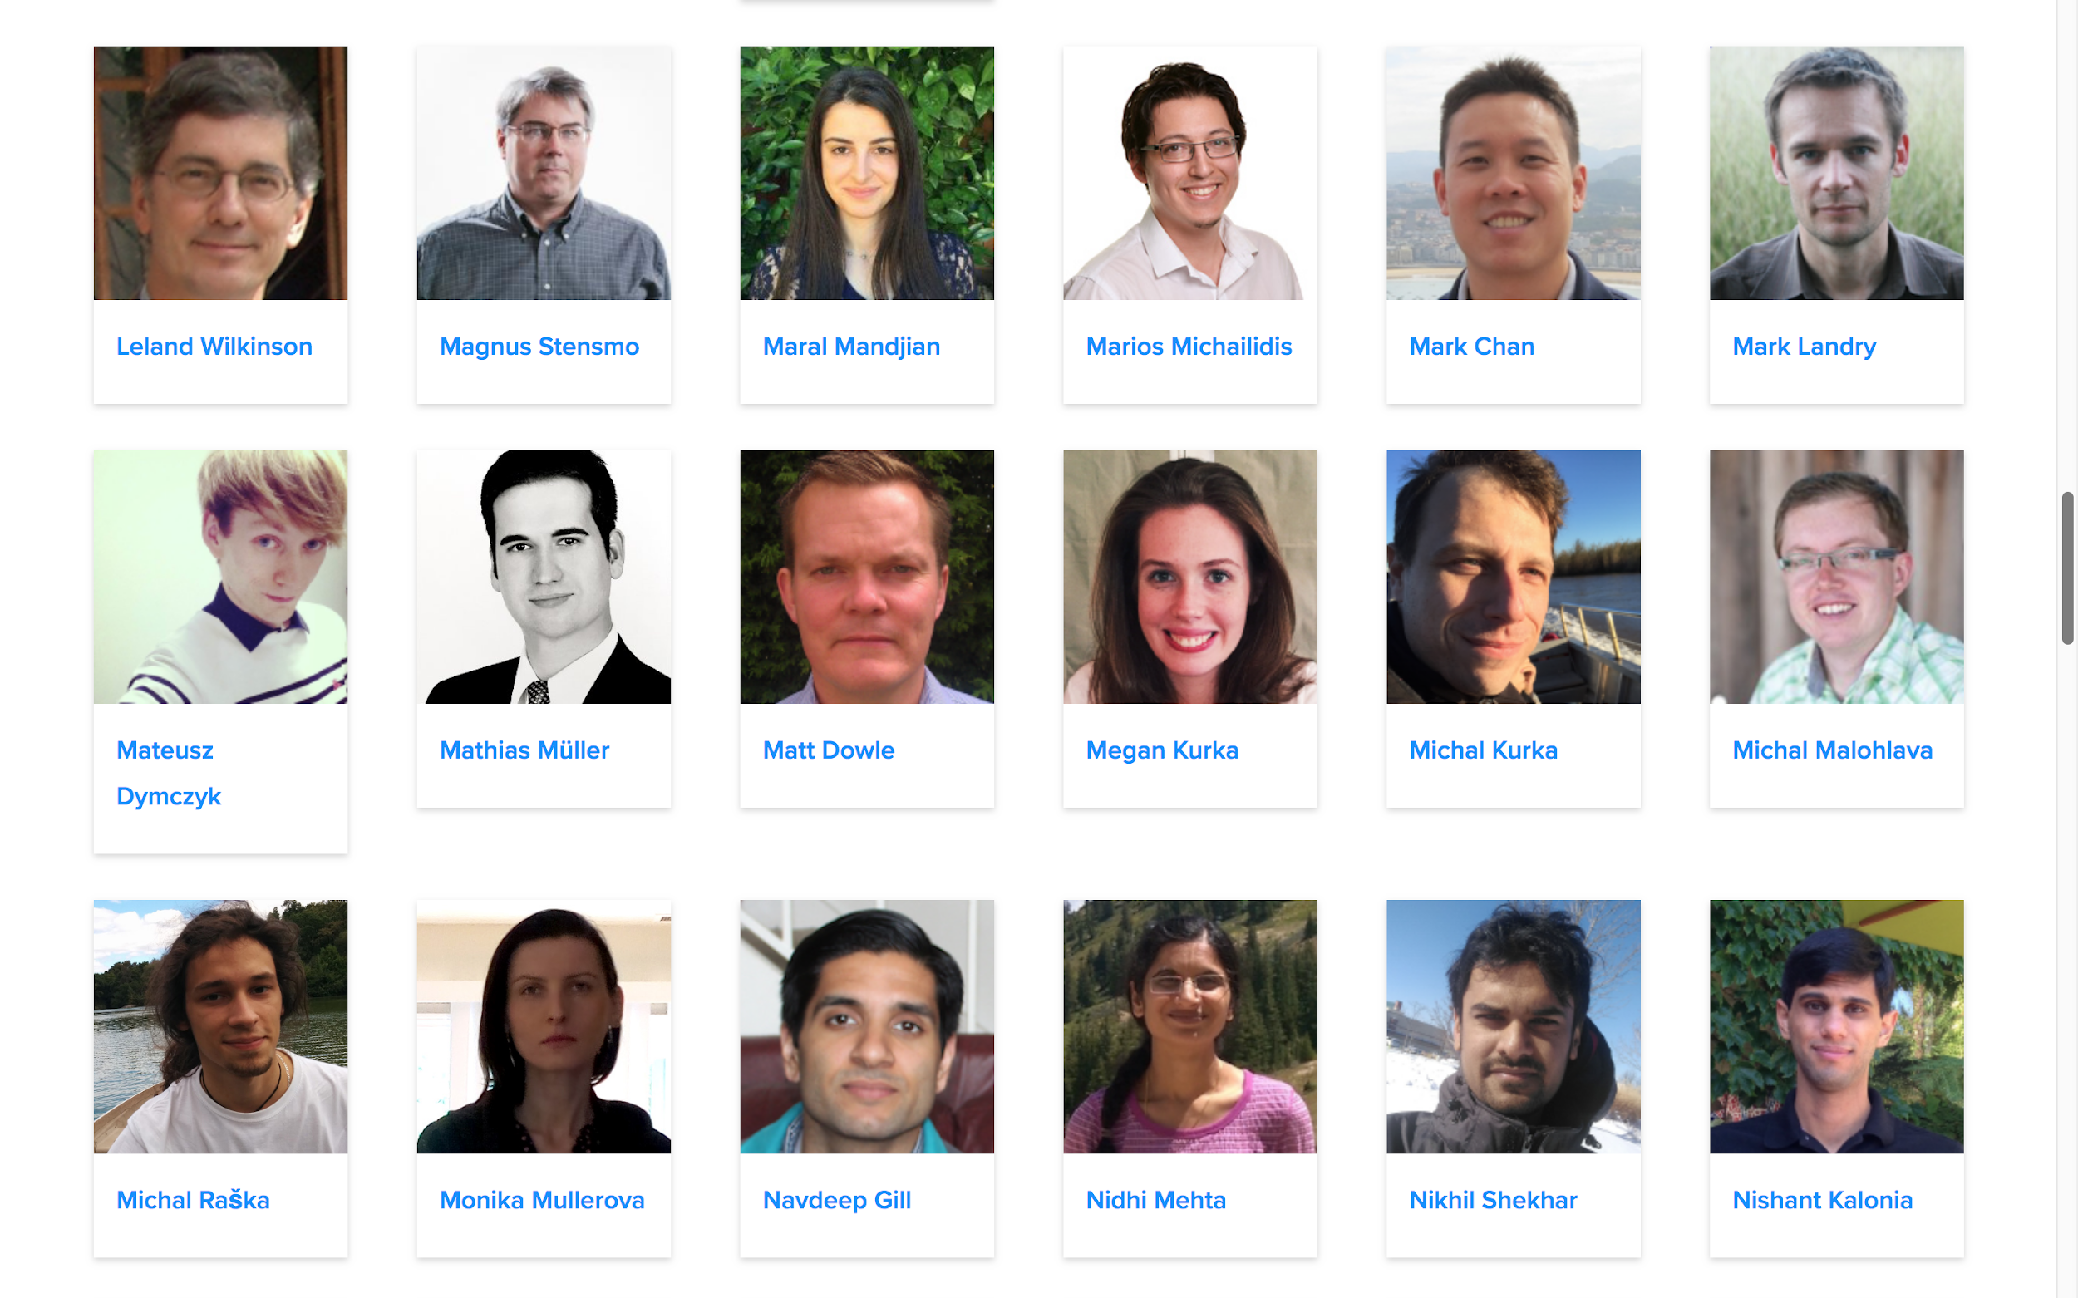

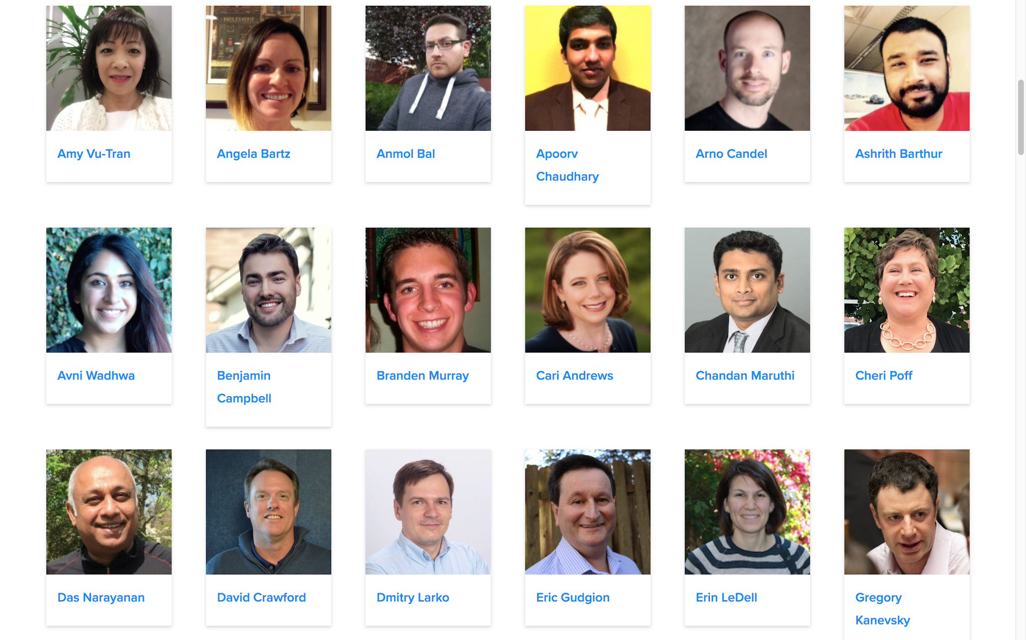
Grandmasters (their highest ranking)
Worlds largest data science community (over 2 million members)
Best known for AI competitions
1st
4th
13th
Code and analysis sharing
AI and ML education
25th
33rd
48th
Public datasets
http://www.kaggle.com
Notes:
Kaggle (https://www.kaggle.com/) is an online community of data scientists in which people find and publish data sets, explore and build models, work with other data scientists and machine learning engineers, and enter competitions to solve data science challenges. It is considered the largest and most diverse data science community in the world, spanning 194 countries with users ranging from those with very little experience to many of the world’s best known researchers and data scientists.
Kaggle was founded in April 2010 and was acquired by Google in March 2017. Kaggle announced that it passed the 1 million registered users mark in June 2017 and then 2 million registered users in August 2018. Kaggle members are referred to as Kagglers.
With respect to the competitions, various companies and organizations offer up data science challenges, typically with some amount of prize money involved, and data scientists spend time building and fine-tuning their models to get the best results they can. Kaggle competitions regularly attract over a thousand teams and individuals.
The types of competitions vary across different industries and problem domains. For example, some recent examples of competitions include:
NFL Punting Analysis ($80,000 prize money) – Analyze NFL (US’s National Football League) game data and suggest rules to improve player safety during punt plays.
Microsoft Malware Prediction ($25,000 prize money) – Can you predict if a machine will soon be hit with malware?
Humpback Whale Identification ($25,000 prize money) – Can you identify a whale by its tail?
Human Protein Atlas Image Classification ($37,000 prize money) – Classify subcellular protein patterns in human cells.
Performance tiers are used to track somebody’s growth as a data scientist on Kaggle. Along the way, people earn medals for achievements and compete for data science glory. The highest level that one can achieve is “Grandmaster”, similar in concept to that of a Chess Grandmaster. This title is awarded when somebody has consistently demonstrated outstanding performance in one or more categories of expertise on Kaggle. These Grandmasters are the best of the best in the world of data science.
As of December 2018, there are 1,074 Masters and only 130 Grandmasters in the category of competitions (these are the numbers shown on the bottom of the slide). There are other categories in which people can earn these titles as well, but the competitions category has the most by far.
While Kaggle is best known for its competitions, it does offer other benefits to the data science community. For example, it has thousands of public datasets that people can share, download and use. Kaggle also includes Kernels, a cloud-based workbench for data science and machine learning where data scientists can share code and analysis in Python and R.
Additionally, Kaggle offers education material on artificial intelligence and machine learning and has a job board where employers can post jobs.
<CLICK>
H2O.ai has a number of Kaggle Grandmasters and Masters on their team. Shown here are some of the Grandmasters, along with the highest ranking that they have achieved. It is their collective experience, skills and best practices that are behind the automatic machine learning that is inside of H2O Driverless AI.

Slide 51
Client Roadmap to Getting Started with H2O Driverless AI
Get the 21 day free trial for Driverless AI
  Don’t have the hardware… try the Qwiklab cloud training environment
Follow the Tutorial video
Learn how Driverless AI delivers Trust & Explainable AI
Learn more about NLP and Time-Series in Driverless AI
Watch Replays from H2O World London 2018
Watch “Democratizing Intelligence” by Sri Ambati, CEO &Founder
Learn how PayPal is solving fraud with Driverless AI
Notes:
If a client wishes to learn more about H2O Driverless AI then there are various resources available to them. Shown here are links to videos and webinar replays that will give them a better understanding of some of Driverless AI’s features.
H2O.ai offers a 21 day free trial license. This can be installed onto on-premises servers or public cloud servers. There is also a Qwiklab option. It’s described as an Introduction to Driverless AI, but it’s essentially just providing the environment for people to try Driverless AI out. It is suggested that they watch the Tutorial video and try to follow along in this (or their own) environment.
Links:
Driverless AI: https://www.h2o.ai/try-driverless-ai/
Qwiklab cloud training: https://h2oai.qwiklabs.com/focuses/4?locale=en&parent=catalog
Tutorial: https://www.youtube.com/watch?v=5jSU3CUReXY
Trust & Explainable AI: https://www.youtube.com/watch?v=axIqeaUhow0
NLP: https://www.brighttalk.com/webcast/16463/337294
Time-Series: https://www.brighttalk.com/webcast/16463/330616
Replays (October 2018): http://h2oworld.h2o.ai/h2o-world-london/
Watch “Democratizing Intelligence”: https://www.youtube.com/watch?v=ZrlJQqNaSMI
Learn how PayPal: https://www.youtube.com/watch?v=r9S3xchrzlY

Slide 52
H2O Driverless AI Ordering Process
Direct or BP Seller
Initial purchase or
Repurchase after 12 months
  Overview:
  Order in AAS (PID 5639-AIH)
    Select # Licenses (#FC 0001 and/or 0002 used)
    Require 1 license per user
  IBM SW Manufacturing sends order info to H2O.ai
    Customer and quantity information send to H2O.ai
    Customer is mailed H2O.ai contact information and EULA
  Customer contacts H2O.ai to obtain SW key and support entitlement
    Obtains software key (start date = IBM reported ship date)
    Support entitlement
  Seller Compensation
    BP Compensation paid via typical product discount
    Direct sellers compensated on net (discout price minus royalty)
    H2O.ai seller compensated by H2O.ai.... No impact to IBM driven compensation
  License term is 12 months
    Purchase new license prior to expiration
    Follow same process for new license
PID
5639-AIH
Single
(#FC 0002)
AAS Order
5x Bundle
(#FC 0001)
IBM Manf. Fulfills Order
IBM Manf. marks order complete
IBM delivers instructions to customer on how to contact H2O.ai
IBM sends H2O.ai information on the deal
IBM invoice and revenue recognition
Customer engages H2O.ai
H2O.ai provides license key to customer and entitles support.
Customer downloads Driverless AI from H2O.ai
*** IBM Internal and Business Partner Use Only ***
Notes:
This flowchart describes the process for ordering H2O Driverless AI. It should be self-explanatory.

