Slide 1

SAP HANA on POWER
An Introduction
Liwen Yeow (yeow@ca.ibm.com)
Analytics on Cognitive Systems –
SAP HANA on POWER Technical Sales and Enablement
Notes:
This is an introductory course to set the ground work on Why SAP HANA on POWER is the best solution for customers. This course will by no means delve in detail on any technical topics but it will give the reader the “big story” on how SAP HANA came into being and the evolution of their core business product, S/4HANA. IBM and SAP have had a very long relationship, as you will hear about in the following slides.
IBM has many touch-points with SAP from Analytics with Db2, Cloud and Cognitive with IBM Cloud and Watson, in Systems with the POWER and Storage offerings, in GBS with SAP Consultancy Services and GTS with hosting services, and more.

Slide 2
In 1972, five entrepreneurs in Germany had a vision for the business potential of technology. Starting with one customer and a handful of employees, SAP set out on a path that would not only transform the world of information technology, but also forever alter the way companies do business. Now 46 years and approximately 378,000 customers stronger, more than ever, SAP is fueled by the pioneering spirit that inspired its founders to continually transform the IT industry
Notes:
SAP was started by 5 former IBM employees who had a vision of transforming how business applications can be used. Up until this point, business transactions were mostly done in batch on the mainframe (for example, transactions were recorded on punch cards and were submitted for processing only at night or at specific intervals). Their idea was to build an interactive “real time” application where orders could be submitted and inventory updated immediately. This was revolutionary at that time.
Of the 5 founders of SAP, only Hasso Plattner is still semi-active in the management of the company and is currently the chairman of the supervisory board.

Slide 3
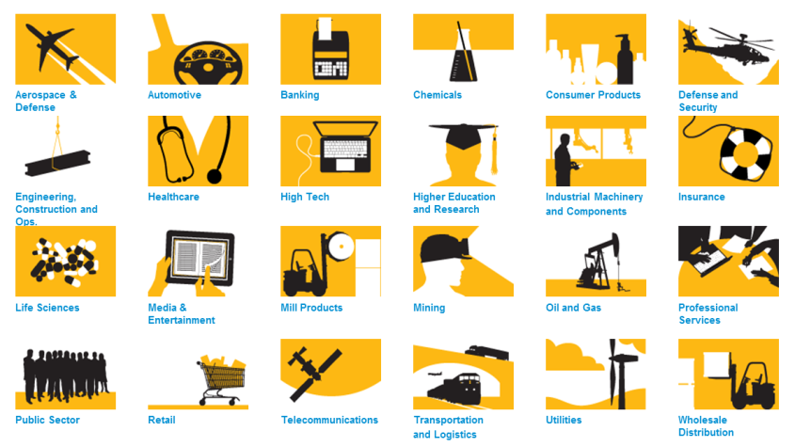
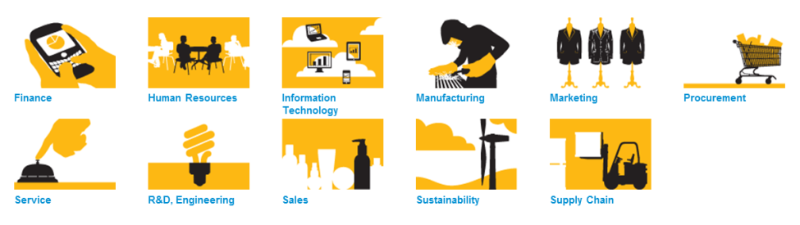
SAP Business Solution Portfolio
25 Industry Solutions
Support business processes horizontally within an enterprise
11 LoB Solutions
Support business processes vertically within an organization
Notes:
SAP, over the years, and with the help of many companies in their respective industries, had developed specific industry solutions. SAP has built solutions for 25 specific industries, such as Aerospace, Utilities, Automobiles, Healthcare, Retail, Oli & Gas, etc. These solutions have incorporated the Best Practices of each individual industry and help speed the implementation with the clients.
Within the Line of Business (LoB), SAP has further implemented solutions that addresses each of the LOB needs. These LOB solutions are in Finance, HR, IT, Manufacturing, Marketing, Procurement, Services, R&D/Engineering, Sales, Sustainability and Supply Chain.
With this broad scope of industry and expertise, SAP has most client’s needs covered in whichever industry they are in and business processes they would like to implement.

Slide 4

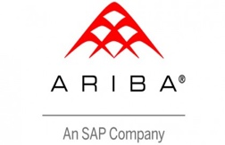


SAP acquisition in 2011 for Billion $3.4
SAP SaaS offering for Human Capital Management) (exclusively, not on-premise)
SAP acquisition in 2012 for Billion $ 4,5
Combination of cloud-based and on premise applications
Established global B2B customer network (Ariba Network)
Hybris was founded in 1997, headquartered in Zug, Switzerland
SAP acquisition in 2013
Products for Commerce
  B2B, B2C
Products for Marketing
  Real-Time Customer Insights
  Unique Customer Experiences
Concur was founded in 1993, headquartered in Bellevue, WA, United States of America
SAP acquisition in 2014 for $8.3 billion
Concur Travel & Expense, cloud-based travel and expense management
Notes:
As of July 2018, SAP has acquired 68 companies. The key business application acquisitions are the ones listed on this slide – Successfactors, Ariba, Hybris and Concur. These key products are all Cloud base products, which is the direction SAP and many other companies are going. Other product acquisitions, such as Sybase, BusinessObjects, CallidusCloud, are to strengthened SAP’s technology base or to augment the existing business products.
Successfactors is a SaaS HCM and talent management offering
Hybris is an enterprise Omnichannel and product content management software that is positioned as relating to CRM and Marketing tools and a microservice platform.
Ariba is the strategic SAP product for Cloud-based Procurement and Supplier Collaboration, and is the most comprehensive solution for buyers and suppliers digital collaboration.
Concur is a SaaS product which provides travel and expense management services to businesses (which IBM uses).

Slide 5
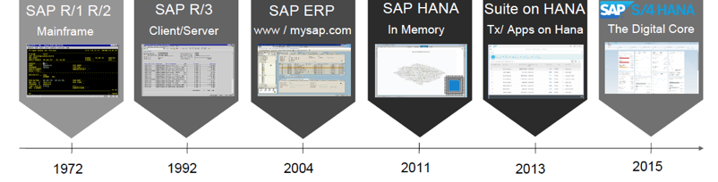
Evolution of SAP S/4HANA
SAP started out with R/1 and R/2 as a real-time system offering on the mainframe. Initially it was a 1-tier system, which then became 2-tier with R/2
By this time, distributed Unix and Windows systems were available and SAP ported their ERP application to these platforms as R/3
Multiple components were merged into SAP ERP such as BW, SEM and ITS. The business logic and technical (Basis) layer were separated for ease of implementation
SAP introduces its own
in-memory database. HANA will enable applications to run both transactional and analytical workloads on a single copy of the data
SAP ports its Business Suite applications to run on HANA
SAP introduces S/4HANA, an ERP replacement, that will form the Digital Core of SAP’s modernization of the enterprise business processes
Notes:
In the early 1970s, SAP R/1 was born. This was a 1-tier architecture where the Presentation, Application and Database are installed in one system/server. The first module that was developed was a financial accounting system. Toward the end of the 70’s, SAP re-evaluated their 1-tier structure, and R/1 made way for SAP R/2 – a 2-tier structure where Presentation was on one server and Application and Database on the second.
In the early 90’s, SAP introduced R/3 with its client-server concept, uniform graphical interface, dedicated use of relational databases from various vendors, including IBM, Microsoft, Informix, Software AG and Oracle. R/3 was a 3-tier structure with the Presentation layer on the desktop, one or more Application Servers on another server tier and the Database on the 3rd server tier. This concept enabled their “ERP” application to scale out horizontally, by adding more application servers, with increased workload. SAP R/3 consisted of various applications on top of SAP Basis, SAP's set of middleware programs and tools. All applications were built on top of the SAP Web Application Server. Extension sets were used to deliver new features and keep the core as stable as possible. The Web Application Server contained all the capabilities of SAP Basis.
A complete architecture change took place with the introduction of mySAP ERP in 2004. R/3 Enterprise was replaced with the introduction of ERP Central Component (SAP ECC). The SAP Business Warehouse, SAP Strategic Enterprise Management and Internet Transaction Server were also merged into SAP ECC, allowing users to run them under one instance. The SAP Web Application Server was wrapped into SAP NetWeaver, which was introduced in 2003. Architectural changes were also made to support an enterprise service architecture to transition customers to a Service-Oriented Architecture (SOA). The latest version, SAP ERP 6.0, was released in 2006.
In 2011, SAP introduced their own database called HANA. The HANA database was built as an in-memory database that would serve as a core transformation piece for SAP applications to move to a “Simplified” model. Initially, HANA was used by SAP Business Warehouse to improve reporting performance and remove the need to aggregate data.
In 2013, SAP expanded the number of applications, including transactional applications, to run on top of HANA. SAP Business Suite on HANA (SoH) was introduced to help customers running on legacy 3rd party databases to migrate over to HANA.
2015 saw the introduction of S/4HANA, a new ERP product which was rewritten to take full advantage of the ability of HANA to do both transactional and reporting workload on the same database.
The simplification of data structures within the application eliminated many thousands of tables that were necessary in the older ECC application. Transactional data that was once aggregated in overnight batch jobs for reporting was no longer required as the in-memory technology of HANA was able to provide reporting directly from the transactional tables. In addition, data was no longer required to be ETLed (Extracted, Load and Transformed) to the SAP BW application for further analysis (to do trend analysis).
Other capabilities that came along with S/4 were the ability to access other data sources (Hadoop, IoT, graph data) and the ability to run text search and predictive analytics. S/4HANA now opened up a whole new world for companies to modernize and digitized their businesses with what SAP calls the Digital Core.

Slide 6
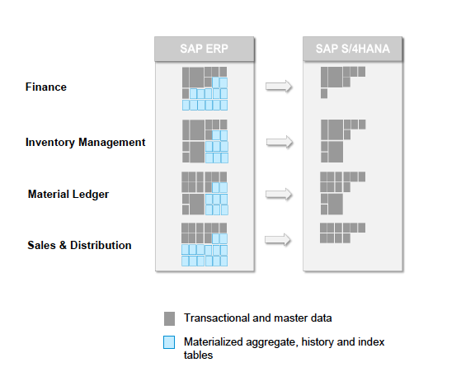
Differences between ERP and S/4
Notes:
In the previous slide, we mentioned that S/4 brought about the “Simplification” of the application and business process. To illustrate how this simplification works, we show in the left box the number of tables within the database that is required to support the Finance, Inventory management, Material Ledger and S&D modules within the ERP application. The dark boxes represent the transactional and master data tables (where the transactional data could be a product being purchased at a store, and the master data tables contain a specific part and the characteristics representing a certain colour or size). The blue boxes represent data that has been derived from the transactional tables (dark boxes) that have been aggregated in different forms to help in the performance of different reports. Some of these blue boxes are also indexes that also assist in the reports or transactions.
In S/4HANA, none of the aggregate or index tables are needed as data in stored in columnar format in the HANA database and is stored in-memory for optimal query/report performance. The benefits of using HANA in such an application like S/4 are
Data is immediately available for query/reports from the transactional tables.
There is no need to setup aggregation jobs (batch jobs) at night, thereby simplifying the business processes
The data footprint is much smaller as data is no longer repeated from the transactional tables

Slide 7




Where did SAP HANA come from?
SAP HANA is the brainchild of SAP Chairman Hasso Plattner and developed by, then CTO of SAP, Vishal Sikka. HANA is the result of a combination of several technologies of:
MaxDB live-cache memory engine
P*TIME in-memory OLTP engine
SAP’s own TREX text search engine
+ + =
Notes:
SAP HANA was born out of the combination of several technologies, some owned by SAP, and others acquired by SAP. The original concept of HANA was conceived by Hasso Plattner at the Hasso Plattner Institute with the prototype in-memory database called SanssouciDB. This was taken over by the then CTO of SAP, Vishal Sikka, to make this into a product. Two in-memory technologies were used: live-cache memory engine from SAP’s own MaxDB database and another, the OLTP in-memory engine, P*TIME, from a Korean company acquisition. The text search capability in HANA was from an long-time existing SAP technology known as TREX engine.
Before HANA, SAP had several of it’s own “legacy” databases that were used by SAP applications. MaxDB, formerly called SAPDB, was a database acquisition from ADABAS. SAP ASE, formerly known as Sybase ASE, came with the Sybase acquisition. Live-cache is a feature of MaxDB that was mainly used in the APO application.

Slide 8
AnyDB
Prior to SAP HANA, SAP applications all ran on top of 3rd party vendor databases such as Oracle, IBM Db2, Microsoft SQL Server and SAP MaxDB, collectively known as AnyDB.
These databases are still supported today but it is SAP’s stated intention that by 2025, all 3rd party databases, will no longer be supported.
All new SAP application development is now built on top of SAP HANA database
Notes:
SAP has had a long relationship with 3rd party database vendors since the introduction of R/3. The supported databases for most of the SAP applications such as ECC, BW, SRM, SCM, Solution Manager, Portal, etc. have been Oracle, SQL Server, MaxDB and Db2 (on all platforms, z/OS, Linux Unix and Windows, and IBM i), and lately, SAP ASE. SAP also used to support Informix but that was discontinued when IBM acquired Informix.
With the introduction of SAP HANA, SAP has publicly stated that by 2025, all SAP applications would have been rearchitected to run on top of HANA and all 3rd party databases (Oracle, SQL Server, MaxDB and Db2) will at least be supported until that time. SAP refers to these databases as as AnyDB.

Slide 9
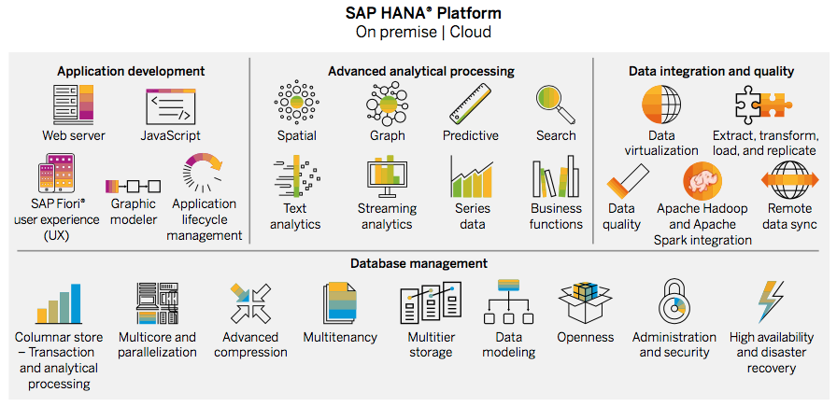
What is SAP HANA?
SAP HANA is an in-memory data platform that is deployable as an on-premises service, or in the cloud. It is a revolutionary platform that’s best suited for performing real-time analytics, and developing and deploying real-time applications. At the core of this real-time data platform is the SAP HANA database.
  Core of every strategic initiative at SAP
  In Memory, columnar, massively parallel database processing
  Converges online transaction processing (OLTP) and online analytical processing (OLAP) operations on a single data copy in one in-memory, column-based data store
For full details access the SAP Paper “Rethink the Possible with the SAP HANA Platform”
Notes:
HANA was originally an acronym for– High-performance ANalytical Appliance. When first introduced, HANA could only be purchased as a preconfigured appliance. SAP has partnered with hardware vendors to deliver HANA on various Intel platforms. Over the past 2 years, SAP has introduced a new concept, whereby customers can use their certified hardware of servers with existing enterprise storage. This is know as TDI – Tailored Datacenter Integration.
The software part of HANA consists of several pieces. The SAP In-Memory Database (IMDB, or previously known as In-Memory Computing Engine, ICE, IMCE) provides a columnar oriented in-memory database architecture for storing data efficiently with high compression ratios in memory. Specialized engines handle other functions, such as the Predictive engine, Graph Engine and Text Search Engine.. Built into the HANA engine are tools for modeling and managing data for application development. It can also perform advanced analytical processing and comes with tools to integrate external data sources.
The HANA database is considered revolutionary, compared to the existing AnyDB databases. Customers are now able to run real-time analytics on the same database where data is stored from the transactional application workloads. The HANA platform is the basis of all new SAP application development and forms the strategic direction for SAP going into the future.

Slide 10
Why SAP HANA?
SAP ERP generally runs a Transactional workload
SAP BW is an Operational Data Warehouse with Analytical workload
Running both workloads well for S/4 requires HTAP - Hybrid Transactional and Analytical Processing, capability in
the database….
and it runs even better on a flexible high performance server
= OLTP +
= OLAP
-------
= HTAP
=> HANA on POWER
Notes:
SAP ERP is one of the many SAP applications that is classified as an Online Transactional Processing (OLTP) application. An OLTP workload has the characteristics of small amounts of data being accessed (read) and written to tables in the database with each transaction, but having many hundreds or thousands of transactions going against the database each second.
SAP BW (Business Warehouse), on the other hand, is classified as having an Online Analytical Processing (OLAP) workload. The workloads in this case are fewer but there can be millions of rows in tables being access per transaction.
Today, SAP OLTP applications are generally separated from the OLAP applications and data is either transferred from the OLTP applications to the OLAP applications or aggregated within the OLTP application for reporting at given intervals (nightly or in batches). Wouldn’t it be nice and simpler to be able to run reports or analysis on the transactional data?
As HANA evolved over the past 7 years, it became a Hybrid Transactional and Analytic Processing (HTAP) database. This means that HANA, today, can be used for both Analytical (SAP BW) and Transactional (SAP ECC) workloads. SAP has rearchitected SAP ERP into S/4HANA to be able to do this and give customers the ability to run their business in “real time”.
For customers to gain the full benefit of this capability and have the flexibility of utilizing their server investment, running HANA on IBM POWER provides the best TCO over Intel servers.

Slide 11
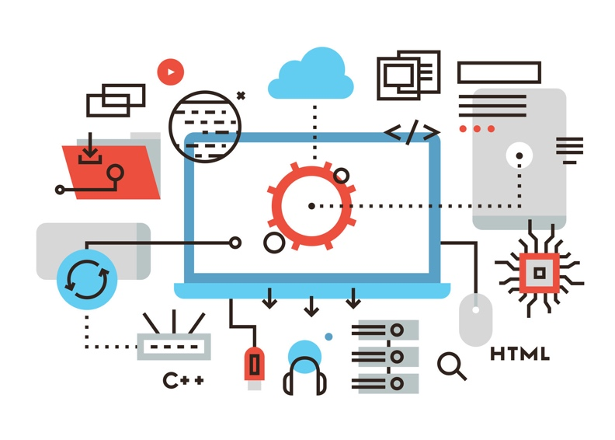
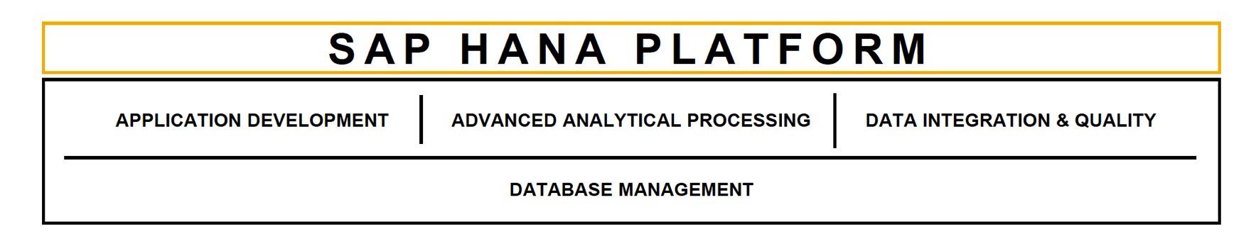
Overview of SAP HANA
SAP HANA is not just a database
It is a Platform
Notes:
SAP promotes HANA as not just a database but as a platform for development, analytics and integration platform, that sits on the HANA in-memory database.
The database is a fully ACID (Atomicity, Consistency, Isolation, Durability is a set of properties of database transactions intended to guarantee validity even in the event of errors, power failures, etc.) compliant database that can be accessible by SQL, JDBC ODBC, JSON and Odata. It uses the standard security model of authorization and privileges to the database objects and table data.
Application developers can write code in all the latest modern languages, like Java Script, Java, Node JS, C++ (and more) and frameworks like Git, GitHub.
HANA is heavily promoted as an Advanced Analytical Processing platform that has support and integration of R, predictive analytics, graph, and streaming.
Finally, federation is a big part of the value proposition of the HANA Platform. SAP positions the HANA Platform to integrate IoT (Internet of Things), Spark and Hadoop and customized adapters for any 3rd party applications and data sources

Slide 12
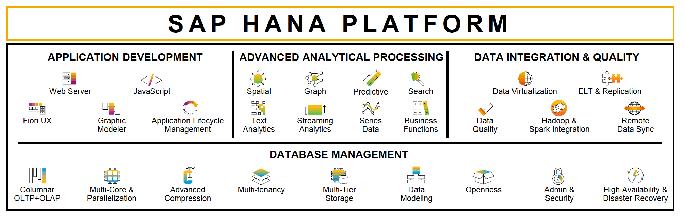
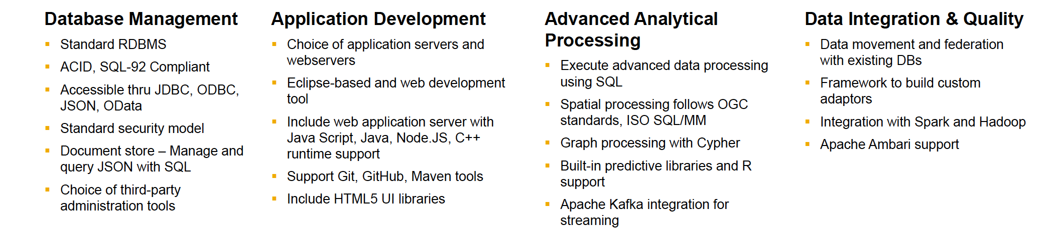
HANA Usage
Notes:
Besides being a in-memory columnar database, SAP HANA is a platform for developing applications, running advanced analytical processing and integrating many different remote data sources.
Application Development - SAP HANA Platform includes application services to build web-based applications and supports open development standards, such as SQL, HTML5, Java Script, JDBC, ODBC, JSON and OData. The web server supports server side JavaScript and OData. The Fiori UX libraries allow developers to build beautiful HTML5 user interfaces that are not only accessible from any device, but are dynamically adapted to the device on which they are accessed. The Application Lifecycle Management tool helps to perform version control, bundle, transport and install applications.
Advanced Analytical Processing – The ability to process multiple data types – structured, unstructured, text, spatial and series data – in one system enables you to build next generation applications. Advanced processing capabilities such as predictive (60+ algorithms), data quality, and graph provide deeper insights. SAP HANA Platform’s built in business function libraries help to push down more logic inside the database accelerating application performance and reducing data movements.
Data Integration - Organizations generate and store data in multiple systems. To deliver a complete picture of an enterprise, SAP HANA platform includes integration services to handle various integration strategies from a variety of data sources. SAP HANA Platform also includes an adapter framework to build custom adapters to either move data from an additional source or federate queries to any source. The built-in streaming processor can capture and analyze live data streams on the fly and route incoming data to the appropriate storage or dashboards. Remote Data Sync synchronizes data between SAP HANA and thousands of remote databases (SQL Anywhere, UltraLite). SAP HANA Platform provides several integrations to Hadoop. Data in Hadoop can be accessed through Spark and HIVE (a Hadoop ecosystem query language similar to SQL). Additionally, with native virtual User Defined Functions (vUDF), SAP HANA Platform can directly access Hadoop data and functions as if they were local tables.

Slide 13

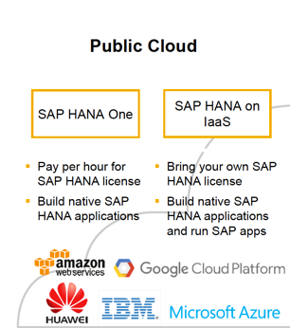
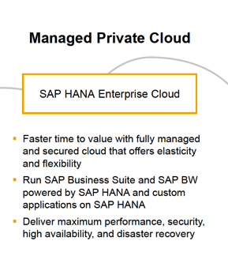
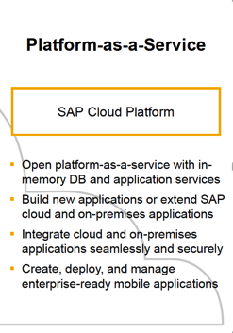
HANA in the Cloud
Roll your own applications
PoCs
ISV
IaaS Platform
Managed by SAP
PaaS Platform
Customers and Partners
Build extensions and solutions
Notes:
HANA is available in the Public Cloud on Amazon, Google Cloud Platform, Huawei, IBM Public Cloud and Microsoft Azure. Customers can either pay per hour for HANA licenses or Bring Your Own License (BYOL).
SAP HANA One is available on AWS. SAP HANA One includes roughly 30 GB of usable RAM per instance, making the cloud platform suitable for companies that want to conduct proof-of-concept projects, build and deploy HANA applications for production use or get started with in-memory applications. SAP also recommends SAP HANA One as a way for independent software vendors (ISVs) to build and deliver SAP HANA applications.
SAP HANA on IaaS can either be used to build custom applications or SAP applications.
SAP offers SAP HANA Enterprise Cloud (HEC) as a Managed Private Cloud that is fully managed by SAP. The SAP HANA Enterprise Cloud is a private cloud hosting service. SAP considers this as their IaaS offering. The cloud service hosts SAP Business Suite software, which includes SAP HANA custom and out-of-the box applications and SAP NetWeaver Business Warehouse software on a single instance of the SAP HANA in-memory database platform. The primary characteristic of HEC is that it is a complete managed service by which SAP provides the infrastructure as well as the deployment and management of the applications.
A third way to access HANA in the Cloud is as a Platform as a Service (PaaS) as SAP Cloud Platform. SAP Cloud platform is a PaaS offered by SAP for customers and partners to develop and deliver cloud applications, extensions, and solutions. SAP Cloud Platform is the PaaS layer of the HANA Enterprise Cloud solution. This enables customers and partners to extend functionality of their applications hosted in the HANA Enterprise Cloud and also build new applications. In this case, applications built on SAP Cloud Platform (SCP) are essentially running on SAP Hana Enterprise Cloud. Think of SCP as similar to the extensions customers build into their Netweaver and HEC is the base Netweaver product (for example, ECC).

Slide 14
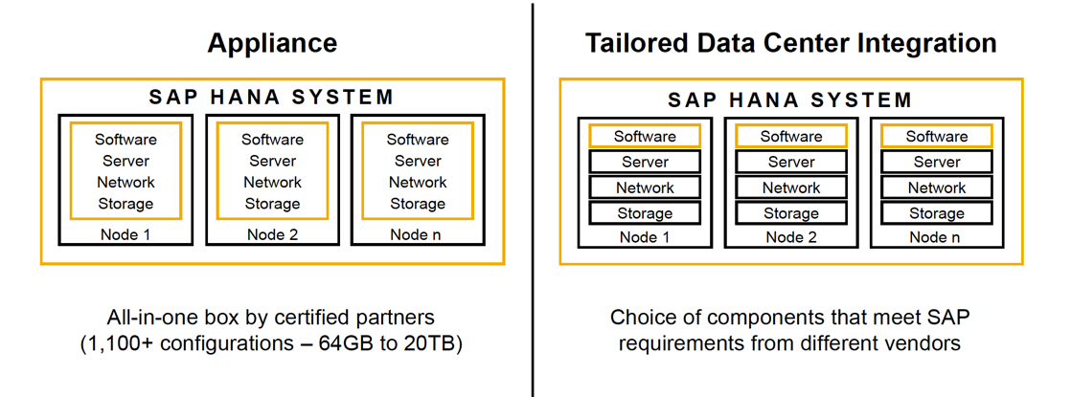
HANA on Premises
Two deployment options
to choose from
Notes:
HANA on Premises is available as an Appliance or as a Tailored Data Center Integration (TDI) from a multitude of hardware vendors. The appliance vendors have over 1,000+ configurations to choose from, starting from the smallest appliance that start at 64GB RAM to over 20TB in a scale-out configuration on Intel Haswelll, Broadwell and Skylake CPUs. POWER TDI solutions can scale-out to 160TB (for BW at 16 nodes) and 64TB (for S/4 at 4 nodes)
SAP HANA TDI has gone through several updates since its introduction. Today, SAP supports TDI phase 5, which decouples the close ratio between CPU cores and RAM, sizing the servers based on the calculated SAPS for each applications. Here is a brief overview of the HANA TDI phased approach towards a modern, highly performant and efficient in-memory database platform:
Phase 1 & 2 SAP delivered cost-optimized storage and networking for SAP HANA by allowing customers to leverage their existing enterprise storage and data center networking infrastructure for HANA.
Phase 3, SAP introduced low cost, entry level HANA servers based on the Intel Xeon E5 processor, which is widely used in commodity hardware – thus significantly lowering the entry barrier for customers embarking on their HANA journey.
Phase 4, SAP further strengthened the power of its rich and ever-growing partners ecosystem by adding support for HANA on the IBM POWER8 processor.
Phase 5, brings two new important developments for customers:
Customer workload-driven HANA system sizing to allow customers to fine-tune their system configurations for their specific workloads and purchase systems with the optimal number of cores and memory.
Extended Intel Xeon E7 CPU support for Broadwell and Skylake-based servers: Partners will now be able to build HANA systems using a wide range of CPUs that differ in frequency, processing power, and most importantly cost

Slide 15

HANA Vendor Support
Two deployment options to choose from
Appliance Tailored Data Center Integration
Processors Operating Systems
Storage Providers
SAP Certified HANA Appliances
SAP Certified Storage providers
Notes:
This slide shows the many vendors that supply infrastructure in support of HANA. On the left are hardware appliance vendors. IBM does not supply a POWER appliance. (We used to when we had the xSeries servers, which were eventually sold to Lenovo)
On the right are infrastructure vendors for TDI with processors from IBM and Intel and supported operating systems. To date, IBM POWER7, POWER8 AND POWER9 servers are certified for HANA. With TDI, customers can use any one of the certified enterprise storage from the vendors listed. To see the full list of appliance configurations and storage, a hotlink is provided at the bottom of each column.
Appliances - https://www.sap.com/dmc/exp/2014-09-02-hana-hardware/enEN/index.html
TDI Storage - https://www.sap.com/dmc/exp/2014-09-02-hana-hardware/enEN/enterprise-storage.html

Slide 16
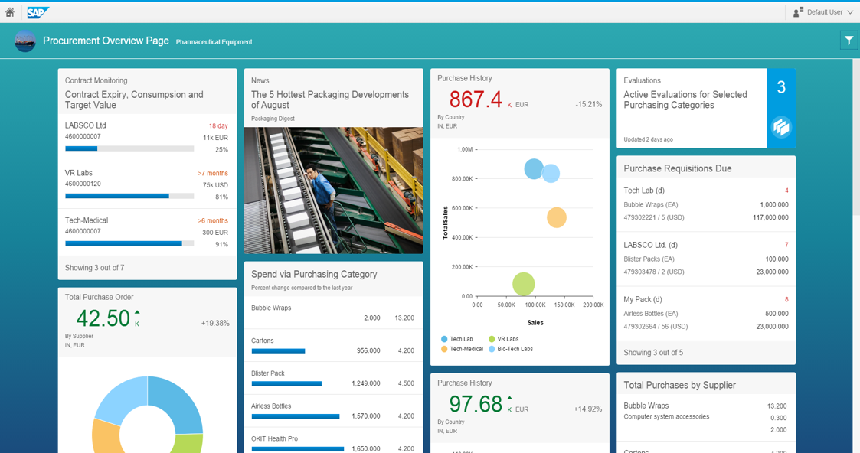
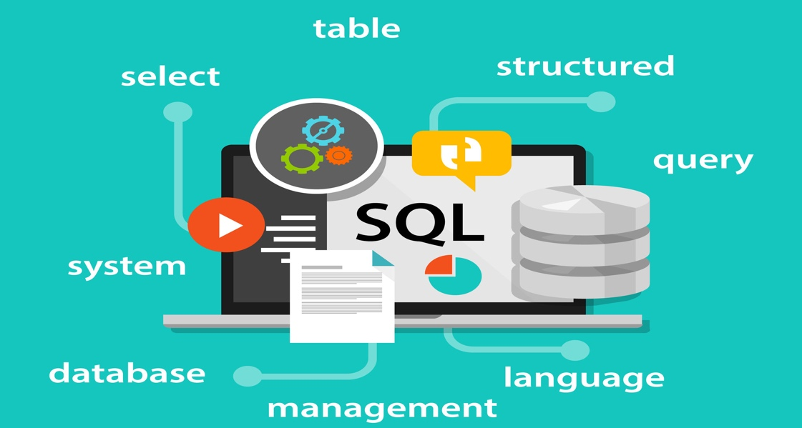



What is the difference between HANA and S/4?
S/4 is the application (like Finance)
SAP HANA is the database
(data repository)
S/4
SAP HANA®
OS
Server Hardware
Storage Hardware
Notes:
You may be slightly confused at this point as to the difference between HANA and S/4HANA. Looking at the diagram on the left, we have illustrated the hardware and software stack that a typical customer would have installed. Starting at the bottom in grey boxes are the infrastructure pieces that IBM could provide. For example, you would have POWER-based server running SUSE or Red Hat Linux as the operating system and data is stored on an enterprise storage, such as the IBM FlashSystem or DS8000.
SAP HANA is the Database Management System (DBMS) that organizes, stores, and accesses the SAP application data in columnar format. However, it’s important to note that SAP HANA can be used as a database with and without SAP applications. One can imagine writing your own applications and using HANA as the database. The HANA database must run on it’s own server (or servers if it is on a scale-out environment) or partition (LPAR), with the S/4 (or BW/4 or C/4) applications running on a separate partition (LPAR) or server.
S/4HANA is closely tied to HANA as the ERP application that sits on top of HANA. S/4 MUST use SAP HANA as the database. There are no other databases available for S/4 as in previous SAP ERP versions (ERP 6.0 or R/3). S/4 exploits all the features of HANA for best performance. Other recent announced applications that run specifically on HANA are BW/4HANA and C/4HANA.

Slide 17
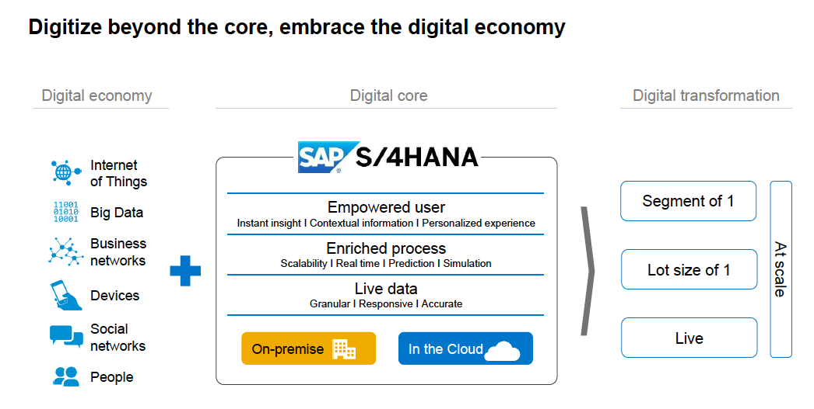
S/4HANA – Digital Core
Only 1% of business’s data is analyzed today
Transform companies to give customers a digital experience
Real-time insights
Visibility into mission critical processes, suppliers, workforce, Big Data and IoT
Built on Innovative in-memory database
  New architecture and data models
  Renewed applications
  New UI technology
  Cloud & on-premise deployment models
  Natively integrated
Notes:
The digital economy is real and it is here to stay. Businesses that aim to survive and thrive in the digital economy will need to become a technology business that provides a digital experience to their customers, partners, stakeholders, and employees. In order for these organizations to become digital businesses they must reimagine their business based on real-time insights.
Companies can overcome complexity and drive business innovation with a digital core. A digital core empowers companies with real-time visibility into all mission critical business processes and processes around customers, suppliers, workforce, Big Data and the Internet of Things. This integrated system enables business leaders to predict, simulate, plan and even anticipate future business outcomes in the digital economy.
SAP offers a digital core to customers and partners: SAP S/4HANA. SAP S/4HANA is the next generation business suite that enables companies to reinvent business models and drive new revenues and profits. The new suite is able to easily connect to people, devices, and business networks in real-time to deliver new value in the digital economy.
When SAP looked into what’s happening within customers’ businesses and talked with analysts, they found that businesses need a digital core to understand all the digital information that is moving in and out of the company because less than 1% of the data that exists in businesses today is analyzed and turned into business benefits. Data that should be creating business insights and opportunities is disorganized, it has become distracting clutter.

Slide 18
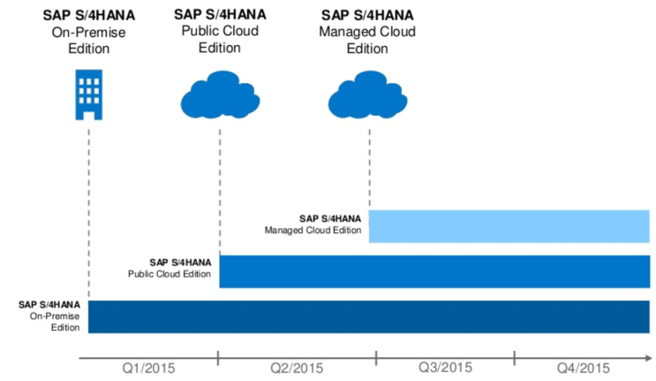
The S/4 Product Family
S/4HANA Public Cloud – Simplified, HANA-based end-to-end solutions for lines of businesses (LOB) operated in the SAP public cloud with full SaaS qualities
S/4HANA Private Managed Cloud
  A full ERP-only version, partly simplified, fully HANA-based
  30% Fiori-based UI (rest classical SAP GUI)
  It is operated and managed in the new Innovation-HEC along SaaS operation practices
S/4HANA on-Premise – Full on-premises ERP version (equal to Suite on HANA) with Simplification Exchange Innovation add-ons for finance
Notes:
The S/4 product family – new products that will be delivered within 2015, starting Q1 – consist of the following three products (deployment options):
S/4HANA Public Cloud – simplified, HANA-based end-to-end solutions for Lines of Business (LOB) operated in the SAP public cloud with full SaaS qualities (like, end-to-end ERP processes for the Professional Services industries; end-to-end Marketing Campaign Management; Operational Procurement, and so on).
S/4HANA Private Managed Cloud – a full ERP-only version, partly simplified, fully HANA-based, ~30% Fiori-based UI (70% classical SAP GUI), operated and managed in the new Innovation-HEC (HANA Enterprise Cloud) along SaaS operation practices
S/4HANA on-Premise – full on-Premise ERP version (equal to Suite on HANA) with Simplification Exchange Innovation add-ons for finance (sFIN Q1) and logistics (sLOG Q4)

Slide 19

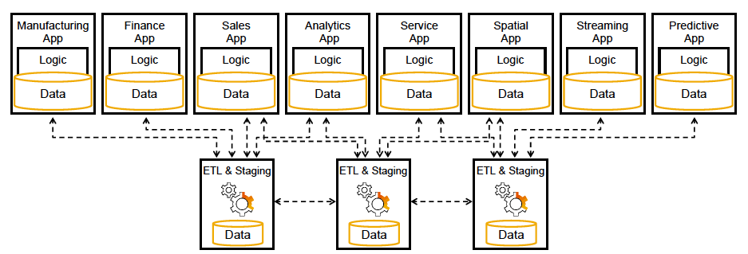
Complexity
Each SAP application maintains its own
Database
Application stack
Technology stack
Customization
Data is transferred from one application to another or from external sources
Notes:
The SAP ecosystem of applications has always been a very complicated and labour intensive undertaking. Each application required deep understanding of the application logic and the technology stack beneath it. SAP had designed each piece as a separate layer that could be modified, upgraded, or changed with minimal dependence on each other. While this made the development of the application solution easier for the SAP developers, it added more work on the customer’s side to keep track of the version, Support Package level, and Enhancement Package level in each SAP application, which is likely to be different.
Moving data (often referred to as ETL – extract transform and load) from an ERP application to a BW (Business Warehouse) application, for example, to be able to run reports or spot trends is essential. However, data sources could come from a multitude of SAP and non-SAP applications. Each application may have a slightly different meta data definition of the same data (example: lastname at 25 characters, and may be defined as last_name with 30 characters in another application). These inconsistencies need to be resolved prior to landing the data in SAP Business Warehouse (BW). Companies hire many BW specialist just to maintain their systems. Because of the many SAP application landscapes (a landscape may consist of a Production, QA, and Development systems) and each having its own separate database, teams of SAP Basis and DBAs are required to maintain the systems.
One can now see how complex this endeavor can be to run a large SAP application ecosystem.

Slide 20

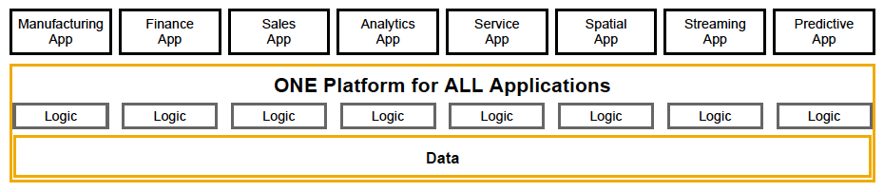
With S/4HANA, Simplify by
Consolidating onto one platform
One database
Smaller data footprint
Simplified data model with significantly fewer tables
Transacting, reporting and running analytics in one SAP application
Notes:
The key message from SAP with S/4HANA is “Simplify”. What they mean with that message is that customers can now consolidate all their SAP applications onto one HANA Platform on one database (in production. Customers will still need to have a different HANA Platform for QA, Dev and Test).
So instead of having individual stacks for each application as you had seen in the previous slide, all this logic and structure gets consolidated into one simple platform. Here, you will have the individual SAP applications (whichever the customer has implemented) sitting on top of the respective logic layer, but all accessing the same data within a single HANA database. Discrepancies, as mentioned, in the field descriptions are no longer an issue..
This simplification reduces the effort to maintain many complex SAP systems and centralizes the data for all applications into one location, thereby facilitating the ability to run reports in real-time against data that comes from any/all applications. Another main benefit of consolidating all the applications into one database is the simplified data model which will result in a much smaller data footprint.

Slide 21






Rapid adoption of SAP HANA on POWER Systems
Acceleration: 0 to >1300 clients in 36 months
50+ CSP/MSP using IBM POWER for SAP HANA Clouds
4 out of the top 10 Fortune 500 Global
60% faster from procurement to go-live (e.g. 2.5 months instead of 6)
17 out of the top 135 European Companies
2018 SAP Pinnacle awards Winner
IBM POWER Systems - Global Partner of Year – Infrastructure
Seidor - running on POWER, Cloud Partner of the Year
Notes:
We will now discuss why POWER Systems is such a good fit for HANA.
HANA on POWER was introduced a little over 3 years ago and despite such a late start, IBM has acquired over 1,300 clients. HANA on POWER is also used by 4 out of the top 10 Fortune 500 Global customers and 17 out of the top 135 European Companies. While many started their journey with HANA on x86, when there was no POWER Systems available, many have seen the benefits, which we will discuss in the next few slides.
Not only have customers implemented HANA on POWER, but Cloud Service Providers (CSP) and Managed Service Providers (MSP) also see the great flexibility POWER servers brings to them hosting clients. These CSP/MSP customers are not only looking for a higher utilization out of the servers they have installed to improve their profit margins but they are looking for a smaller server footprint in their data. With POWER, customers are also seeing a speedier go-live implementation from the time the servers are procured to the time they are able to roll out the applications.
center
Over the years, IBM had won numerous SAP Pinnacle awards. In 2018, it is not surprising that IBM POWER Systems won the SAP Pinnacle award again, this time it is for Global Partner of the Year for Infrastructure. Seidor, a user of POWER servers, won the SAP Pinnacle award for Cloud Partner of the Year.

Slide 22


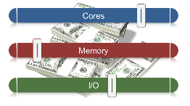
What makes IBM POWER Systems the best platform for clients’ mission critical SAP HANA deployments?
Flexibility
Superior virtualization and management features to afford flexibility and maximum utilization
Resiliency
Unsurpassed RAS characteristics to support mission critical SAP applications
Performance
Highest throughput per core and core/memory bandwidth to deliver faster business results, up to 2x Intel-based alternatives
Competitive Cost
TCA competitive to x86 and
TCO better than x86
Notes:
When proposing POWER for HANA projects, there are basically 4 key areas in which we would claim as our primary value proposition or differentiator to Intel x86 offerings – Flexibility, Resiliency, Performance and Competitive Cost.
Flexibility – POWER Systems capability of virtualizing the server to run multiple production and non-production HANA LPARS in a fixed or dynamic environment facilitates in the highest utilization of the server. Customers have the flexibility to resize LPARS dynamically, or add/remove LPARS as the workloads or project requirements change means that their investment is safeguarded.
Resiliency - Enterprise applications need 24x7 availability. POWER Systems provides reliable infrastructure for enterprise with the best in class Reliability, Availability and Serviceability (RAS) and Security features. Customers can rest assure that they can run their mission critical SAP applications on this platform and feel secure.
Performance – It’s no coincidence that POWER servers hold the top spot in the SAP Standard Application Benchmarks for BW-EML (Business Warehouse-Enhanced Mixed Load) workload with the highest throughput per core and core-memory bandwidth. This translates into faster business results that are 2x better than Intel-based servers.
Competitive Cost – POWER Systems are priced very competitively against Intel x86 systems when looking at the long term Operating Expense (OPEX). With the flexibility of POWER as discussed previously, the initial cost of acquiring multiple servers to support the SAP landscape is an advantage for POWER Systems.

Slide 23
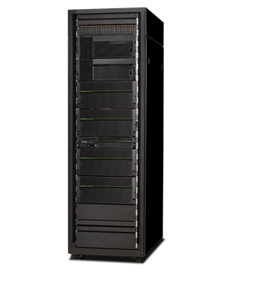

The POWER Portfolio has the flexibility to Scale-Up and Scale-Out
SAP HANA Scale-Up
Minimal data center footprint
One server, one operating system to
update, patch, upgrade
One host to operate, manage, and
provide power supply
SAP HANA Scale-Out
Provides more HW flexibility and requires less initial investment
Need more space and power in data center
Operational and management costs will be much higher
Requires more upfront knowledge about data, applications, and hardware
Notes:
Let’s talk about the flexibility of POWER Servers. IBM has servers that will accommodate the largest S/4 system in a single box of up to 24TB, while Intel Servers can only go up to 20TB. As more customers migrate their current legacy ERP systems over to S/4, there will be a growing demand for such large servers. The benefit to customers, and a recommended approach by SAP is to scale-up first as it’s beneficial because there is only one server and one operating system to manage with hardware and software maintenance.
However, if the customer prefers to scale-out, or has an environment that is larger than 24TB for S/4 or 16TB for BW, we have the ability to scale-out with up to 4 nodes in the cluster for S/4 (at 24TB/node), and 16 nodes (at 16TB/node) for SAP BW. Smaller servers e.g. S822 or S824 could also be used to scale-out if the customer is planning on a smaller investment of hardware.
A scale-out environment obviously requires more rack/floor space, power, cabling and in the longer term, more operational and management cost. In many cases, additional complexities, such as knowledge of how application’s data is accessed is critical in deciding the data partitioning strategy, making this approach more expensive.

Slide 24

Tailored Datacenter Integration (TDI) with IBM POWER
Provide more flexibility, easier to manage & scale, lower TCO, Utilize existing investment
Higher Density Virtualized Memory Configurations (Scale-Up)
Smaller Datacenter Footprint (Reduce Sprawl/Complexity)
Lower OPEX Over Time (Easier to Manage)
Superior Reliability and Availability (Lower Risk)
HANA TCO Evolution
OPEX Over Time with Scale Out Appliance
Notes:
We’ve mentioned some aspects of what Tailored Datacenter Integration (TDI) brings to a Hana implementation vs a HANA appliance implementation. POWER servers for TDI bring flexibility, ease of management and lower TCO to SAP HANA customers. For existing POWER customers, they may be able to use their current POWER investment, assuming they have existing extra capacity.
The ratio of cores to RAM is much lower with POWER servers (minimum of 4 cores/128GB RAM and a max of 192 cores/16TB(OLAP) or 176 cores/24TB(OLTP)) compared to Intel at 20 cores/128GB. With POWER Virtualization (LPAR), more production HANA instances can be hosted on the same server utilizing the available memory (RAM) installed.
The ability to virtualize the server for more production instances equates to less individual servers required. With Intel servers, virtualization for more than one SAP production instance in a single server is not supported.
This virtualization again leads to a simpler management of the infrastructure, hence, lowering OPEX over time.
POWER servers are also highly reliable with many RAS (Reliability, Availability and Serviceability) features available to help reduce the risk of any component failure to provide 24x7 availability

Slide 25
Resiliency
IBM POWER Systems delivers
Reliability required by mission critical environments
Highly resilient and secure system with
99.999% uptime
PowerVM has full resource isolation
Designed with built in memory failure prevention
Dynamic component de-allocation, on the fly
repair and fault isolation
Zero documented security risk for the past 3 years
Enterprise Resource Pools for workload relocation and balancing beyond server boundaries
Notes:
Running Mission Critical applications, like SAP ERP, requires a rock-solid operating infrastructure that can provide 24x7 availability. Next to IBM System z servers, IBM POWER Servers are rated by customers as the most reliable and secure infrastructure amongst distributed platforms. PowerVM the virtualization capability that comes with POWER Servers, provides full and complete resource isolation (one application in a given partition will not impact the resource utilization of the other partitions running on the same server). This is also true for data in memory and keeps the partitions completely secure.
POWER Servers feature Chipkill memory. Chipkill is IBM's trademark of advanced error checking and correcting (ECC) computer memory technology that protects computer memory systems from any single memory chip failure as well as multi-bit errors from any portion of a single memory chip.
Other components in the server are architected to dynamically de-allocate the resources or isolate and repair the fault on the fly. All these features help in keeping a POWER server running with redundant components.
In terms of Security risks that we hear so often in the news, no POWER Systems have had any reported exposures in the past 3 years.
Another advantage of POWER is Enterprise Resource Pools. A POWER enterprise pool is a group of systems that can share Mobile Capacity on Demand (CoD) processor resources and memory resources. It provides flexibility when you manage large workloads in a pool of systems and helps to rebalance the resources to respond to business needs. This feature is useful for providing continuous application availability during maintenance. Not only can workloads be moved easily to alternate systems but the processor activations and memory activations can be moved too. Disaster recovery planning is also more manageable with the ability to move activations where and when they are needed.

Slide 26
Systems Architecture
SMT enables higher throughput and reduces core count. Particularly suited to support HANA features such as the HANA indexing server, which is know to
spawn many hundred threads. SMT technologies have been built to handle
this type of behaviour
Large memory footprints enable larger single node HANA in-memory database systems and provide more flexibility to consolidate workloads
POWER systems feature superior CPU and Memory bandwidth to handle
HANA in-memory data operations faster
Higher CPU clock speeds and overall processing capabilities leading to HANA record benchmarks
4x
threads per core vs. Intel
24TB*
larger memory space vs. Intel
1.8x
system bandwidth vs. Intel
2x
core performance vs. Intel
* Scale-up for S/4 and SoH. For BW/4HANA or BWoH, the max is 16TB
Notes:
When compared to Intel servers, POWER has many features that imbue it with performance characteristics that is ideally suited for SAP HANA. Being an in-memory database, almost all of its active data must reside in memory (RAM) and transferred to the CPU for processing. In order to process the query quickly, HANA parallelizes the processing within the CPU. This requires the server, and specifically, the processor architecture to incorporate such features to support the expected fast performance.
With POWER SMT technology, we have 4X more threads than Intel’s x86 (8 vs 2) which benefits HANA’s massive requirement for parallelism. Higher concurrent workloads will benefit the most from availability of more threads.
The E880 enterprise servers support a maximum of 32TB, of physical RAM, of which POWER is certified by SAP up to 24TB per S/4 instance and 16TB per SAP BW instance (POWER E980, when certified by SAP, will support up to 64TB of physical RAM). This is the largest amount of RAM available for a single server compared to Intel x86 servers at 20TB.
POWER systems out performs Intel servers1.8x in the bandwidth for transferring data between between RAM and CPU. Intel Skylake has a memory bandwidth of 128GB/sec compared to POWER, at 230GB/sec. This is especially critical in an in-memory database like HANA.
In core performance, POWER achieves at least 2x the performance of Intel x86. This better performance can be seen in the SAP HANA benchmarks.

Slide 27


POWER faster memory bandwidth is ideal for in-memory applications like SAP HANA
1.8x
memory bandwidth vs Intel
(up to 32TB of memory E880C and 64TB of memory on E980)
POWER9
POWER8
POWER7+
Memory
large, fast workspace to maximize business insight
Skylake SP
Broadwell E7
Min / Max
0
100
200
300
400
Memory Bandwidth GB/s
Source: IBM CPO
Notes:
HANA, as discussed, is an in-memory database. This means that data in memory must be moved in and out of the CPU efficiently to see the performance gains over legacy databases. Bottlenecks at this point will have a significant performance impact.
The larger the bandwidth, the better it is for performance. With POWER, this bandwidth is at 230 GB/s compared to 128 GB/s (min) on Intel Skylake processors. This gives POWER up to 1.8x the memory bandwidth compared to Intel Skylake SP. Customers can expected to see extraordinary performance in a highly data intensive workload, such as SAP BW

Slide 28



Enterprise Level Virtualization
Consolidate multiple HANA workloads onto fewer systems, increasing server utilization.
Live Partition Mobility (LPM) avoids service impact due to systems maintenance
HANA benefits from Enterprise Resource Pool (EP) and Cores on Demand (COD) by accessing capacity and resources in unexpected situations.
PowerVC improve administrator productivity and simplifies the management of HANA VMs and LPARs on POWER Systems servers.
Notes:
Server virtualization is common these days on most major platforms. We have VmWare vSphere, Linux OS with KVM and Xen, and IBM POWER with PowerVM. While on the surface everyone claims to be able to virtualize their servers to run multiple partitions, they are not all equal. The biggest drawback to virtualization is putting another layer of software abstraction between the OS and the underlying hardware resources. The obvious impact to this is a direct hit to the performance of the application running in a virtual machine. Other issue could be resources that are shared (example: CPU, RAM could be compromised from a security aspect).
With PowerVM, each virtual machine, or LPAR (Logical Partition), is completely isolated and does not have any performance impact. PowerVM brings enterprise level virtualization that enables customers to consolidate multiple HANA server workloads onto fewer POWER servers and help increase server utilization. Most servers running HANA workloads on Intel x86 servers have utilization rates of less than 25%. Customers can also combine HANA and non-HANA workloads on the same server to ensure maximum utilization and ease transitioning to HANA.
Maintenance on systems running HANA has an impact on service levels. Live Partition Mobility (LPM) avoids service impact due to systems maintenance and long loading times by enabling the live migration of partitions between servers. LPM could also be used when customers need to upgrade or change POWER servers (moving from POWER8 to POWER9)
Enterprise workloads require freedom from resource constraints: HANA benefits from Enterprise Resource Pools (EP) and Cores On Demand (COD) by accessing capacity and resources in unexpected situations.
IBM PowerVC is an advanced virtualization and cloud management offering. Built on OpenStack, it provides simplified virtualization management and cloud deployments for IBM AIX®, IBM i and Linux virtual machines (VMs) running on IBM POWER Systems™. The product is one option to build private cloud on the IBM POWER Systems.

Slide 29

Better Total Cost of Ownership
As business grows, the HANA database size increases, and larger server memory is required
In the SAP 2-socket server certification,
POWER9 systems can support 33% larger HANA databases than x86 servers (4TB vs. 3TB)
AND
With less than half the cores
Which results in
Lower purchase and maintenance cost for smaller servers
Lower power consumption
Lower complexity
Don’t get trapped by hardware restrictions
Notes:
With SAP HANA being an in-memory database, the more memory (RAM) a server has, the larger the database it can support. Customers businesses are constantly growing and the application data that is being held in the databases are also expected to grow. A server sized for today’s workload will inevitably be obsolete if it is no longer able to accommodate the data growth. POWER servers are designed to address this issue with its large memory (RAM) capacity and grow with the customer’s needs.
All hardware vendors must go through a rigorous SAP certification testing to qualify their servers and storage to run HANA. In the SAP certification of IBM’s latest POWER9 servers in the 2-socket server category, the POWER9 scale-out servers, 922 and 924 (including L922, S922, S924, H922 and H924), were the initial severs to be fully certified for HANA. We are expecting that the scale-up enterprise servers, E950 and E980, will follow suit soon after in Q3 2018.
The POWER9 924 server was SAP certified to support up to 4TB RAM with 24 cores. Compare this to the largest x86 server which is SAP certified for 3TB and requiring 56 cores. This certification, not only allows customers to support larger HANA databases on the POWER9 server, but will require less than half the number of cores.
The lower RAM to core ratio directly translate to savings in server infrastructure cost with smaller HANA servers for each HANA instance in the SAP application landscape ( for production, quality assurance, development, test, training, …). With fewer and smaller servers, this again, will lower the power/cooling consumption and complexity in the maintenance of the sprawl of servers in the data center.

Slide 30

Total Cost of Ownership (TCO) is much more than Total Cost of Acquisition (TCA)!
Components | Environments |  |  |  |  | Time
 | Prod | Dev | Test | QA | DR
Hardware | $ | $ | $ | $ | $ | Planning
Software | $ | $ | $ | $ | $ | Upgrades
People | $ | $ | $ | $ | $ | Migration
Network | $ | $ | $ | $ | $ | Growth
Storage | $ | $ | $ | $ | $ | Parallel Costs
Facilities | $ | $ | $ | $ | $ | Net Present Value
QoS – Availability, Reliability, Security and Scalability
TCA
TCO
TCO study by: CTO Systems DACH & SOLAR Team &
Notes:
When looking at the cost between POWER and Intel, most customers assume that running Intel x86 servers are always cheaper than POWER. However, today, POWER has competitive “H family” offerings for the POWER Servers running Linux (E950 that includes the OS and PowerVM). Besides the cost of hardware and software, consider the virtualization, performance and RAS capabilities that POWER Servers bring over Intel x86 servers. These extra capabilities translate directly into admin resources, networking equipment, storage and facilities (floor space, power, cooling) savings. You not only need to look at the initial acquisition cost but the overall cost over a 3 or 5 year period.

Slide 31

Opportunities
Greenfield
New SAP customers, brand new S/4, BW/4, C/4 implementation, home grown HANA analytical application, ISV HANA application
Migration from AnyDB
Customers who run existing SAP applications on AnyDB and migrating to HANA (example: Business Suite on HANA or BW on HANA)
Migration from x86
Existing customers who are already running SAP applications on HANA on x86 appliances
Upgrade to S/4, BW/4, C/4
Existing SAP customers who are on SAP ”legacy” applications on HANA (example: SoH, BW), and are implementing the new ”/4” applications
Notes:
There are 4 areas of opportunities where POWER servers can be introduced into SAP environments.
The first is probably the easiest: the customer is either a new SAP customer who has not yet implemented any SAP applications or are on “legacy” SAP applications but are building a new S/4, BW/4 or C/4 implementation that is independent of the “legacy” systems. The new application implementation is on HANA as the database. These are the “Greenfield” implementations. These customers may also be implementing 3rd party HANA-based applications developed by ISVs. You must get in early while the customer is still considering the HANA infrastructure to deploy. For customers who have already POWER servers installed, the job should be much easier. Intel x86 server only customers may require more convincing and likely a Proof of Concept (PoC) bakeoff
The second category are customers who are already running on AnyDB databases (Db2, Oracle or SQL Server), with their legacy SAP Netweaver-based applications (ERP, Business Suite, SVM, CRM, BPC, etc.) on either x86 or POWER servers. These customers are only switching databases from AnyDB to HANA and upgrading the “legacy” SAP applications to HANA compatible versions. Make sure you partner with an SAP AE, GBS/Deloitte/Accenture consultants who will help sell the customer on the new HANA-based applications (Business Suite on HANA, BW on HANA, BPC on HANA) and support your proposal to run it on POWER Servers. In most cases, this will require a PoC where the customer will compare the benefits and compatibility of their “legacy” applications between AnyDB and the HANA database.
The third category are customers who are already running S/4 (or BW/4 or C/4) on HANA but on Intel x86 servers. Here, the customer has already bought into the HANA advantage and your mission is to convince them that POWER is the better enterprise SAP database server over x86.
The fourth and final category are customers on “legacy” SAP applications that are already on HANA (Suite on HANA, BW on HANA), who are now ready to upgrade to S/4, BW/4 or C/4 applications. These customers may be on either x86 servers or POWER7 servers. If they are on x86 servers, convincing them to switch to POWER is similar to the third category. If the customer is already on POWER7, they would need to upgrade their server to POWER8 or POWER9 if the application runs on HANA 2.0

Slide 32

Greenfield
Customer Benefits
Easy and faster deployment
Fewer headcount to run environment
Secure and stable application environment that meets or exceeds Service Level Agreement
Lower TCO
Notes:
Greenfield customers may already be familiar with SAP applications but are doing a reimplementation on S/4, BW/4 or C/4. These customers are implementing a brand new SAP HANA application that does not have a dependency on any previous SAP installation or are new to SAP applications. Here are the business benefits:
Easy and faster deployment - Implementing these new applications on HANA on Power will give them the flexibility to deploy on a smaller partition and grow the capacity as the workload and database increases. During the development phase, project managers can easily add LPARS for Dev/TEST/QA in the landscape without having to procure additional servers, speeding up the project for a faster deployment.
Fewer headcount to run environment – with fewer servers and environments to maintain, the savings on administrators will go directly to lowering the Operating Expense (OPEX) costs for the project.
Secure and stable application environment that meets or exceeds SLAs – with 99.999% availability and the RAS features of Power servers, LOB can expect 24x7 availability to run the business and keep their data secure.
Lower TCO – by fully utilizing the capacity of the servers to consolidate applications across their landscapes, the businesses are able to cut Capital Expenses (CAPEX) and Operating Expenses (OPEX) costs.

Slide 33
Migration from AnyDB
AnyDB
Customer Benefits
Quicker and simpler migrations
Secure and stable application environment that meets or exceed Service Level Agreement (SLA)
Consolidation of environments
Fewer h/c to run environment
Real-time reporting capabilities
Reusing existing IT resources
Notes:
These customers are migrating from existing SAP “legacy” applications on AnyDB to HANA on Power, for example, ERP on Db2 to Business Suite on HANA. These customers are not yet ready to make the full leap onto the S/4, BW/4 or C/4 SAP applications and would like to remain on the “legacy” SAP applications, at least for now. These customers could either be on x86 or POWER server infrastructure. These customers will see benefits in these areas:
Quicker and simpler migrations - migrating from AnyDB to HANA can be made simpler by placing all the systems in the landscape on fewer Power servers compared to x86 servers. This helps the migration project proceed quickly with the ability to flexibly allocate partitions as required within a server. PowerVM allows existing SAP instances on POWER to co-exist on the same server during the migration to HANA.
Secure and stable application environment that meets or exceeds SLAs – with 99.999% availability and the RAS features of Power servers, LOB can expect 24x7 availability to run the business and keep their data secure.
Consolidation of environments – host multiple HANA production applications on the same server or a combination of production and non-production HANA applications. Customers with existing legacy SAP applications can also co-exist with newer HANA SAP applications on the same server with the flexibility of PowerVM.
Fewer headcount to run environment – with fewer servers and environments to maintain, the savings on administrators will go directly to lowering the Operating Expense (OPEX) costs for the project.
Real-time reporting capabilities – by migrating to SAP applications on HANA on POWER Servers, customers will be able to run their real-time reporting capabilities faster.
Reusing existing IT resources – Customers who have invested in POWER systems for their legacy SAP applications can reuse the same POWER servers to host the migrated or new HANA SAP applications.

Slide 34

Migration from x86
Customer Benefits
Simpler environment to maintain
Secure and stable application environment that meets or exceed Service Level Agreement (SLA)
Lower TCO
Accommodate more data
Faster processing and reporting
Notes:
The target customer here is currently on SAP applications on HANA on x86 servers. Migration from x86 to Power on HANA enabled SAP applications:
Simpler environment to maintain – customers benefit from the ability to run more production applications on the same server, something that cannot be done on x86. This reduces the number of servers required for the migration project and reduces Capital Expense (CAPEX) cost too.
Secure and stable application environment that meets or exceeds SLAs – with 99.999% availability and the RAS features of Power servers, LOB can expect 24x7 availability to run the business and keep their data secure.
Lower TCO – by fully utilizing the capacity of the servers to consolidate applications across their landscapes, the businesses are able to cut Capital Expenses (CAPEX) and Operating Expenses (OPEX) costs.
Accommodate more data – As businesses grow, so will the amount of data in the database. With POWER servers, customers can have access to servers with 24TB RAM compared to 20TB on x86. This means that customers do not have to scale-out their environment, which adds complexity and higher cost to the business.
Faster processing and reporting – compared to x86, Power servers have better performance and throughput which leads to faster processing of data and quicker generation of reports.

Slide 35
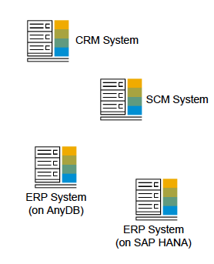
Upgrade to S/4HANA
SAP Business Suite
SAP S/4HANA
On Premises
Customer Benefits
Simpler environment to maintain
Fewer headcount
Faster processing and reporting
Secure and stable application environment that meets or exceeds Service Level Agreement
Reusing existing IT resources
Notes:
Customers who are on legacy SAP applications on AnyDB or HANA and are upgrading to S/4 will see benefit in these areas:
Simpler environment to maintain – customers benefit from the ability to run more production applications on the same server, something that cannot be done on x86. This reduces the number of servers required for the migration project and reduces Capital Expense (CAPEX) cost too.
Fewer headcount to run environment – with fewer servers and environments to maintain, the savings on administrators will go directly to lowering the Operating Expense (OPEX) costs for the project.
Faster processing and reporting – compared to x86, Power servers have better performance and throughput which leads to faster processing of data and quicker generation of reports.
Secure and stable application environment that meets or exceeds SLAs – with 99.999% availability and the RAS features of Power servers, LOB can expect 24x7 availability to run the business and keep their data secure.
Reusing existing IT resources – Customers who have invested in POWER systems for their legacy SAP applications can reuse the same POWER servers to host the migrated or new HANA SAP applications.

Slide 36
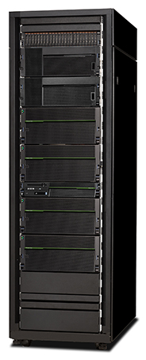
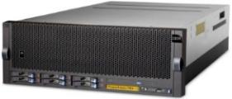



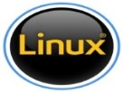
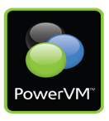







POWER8 Systems Server Family
ALL systems are certified for use with SAP Business Suite
ALL systems are supporting SAP HANA
Power Systems E850
POWER Systems S824
4-socket, 4U
Up to 48 cores
4 TB memory*
11 PCIe Gen 3
AIX, Linux
PowerVM
Power Systems E870/E880
2-socket, 4U
Up to 24 cores
2 TB memory
11 PCIe Gen 3
AIX, IBM i, Linux
PowerVM
POWER Systems S822
POWER Systems S814
4-sockets per Drawer
Up to 64 / 192 cores
Max. of 8 / 32 TB memory
AIX 7.1 TL03+SP, 6.1 TL09+SP
i5OS 7.2 TR1, 7.1 TR9
RHEL 7, 6.6
SLES 12, 11SP3
AIX, Linux
PowerVM
POWER Systems S822L
2-socket, 2U
Up to 20 cores
9 PCIe Gen 3
AIX & Linux
PowerVM
1-socket, 4U
Up to 8 cores
512 GB memory
7 PCIe Gen 3
AIX, IBM i, Linux
PowerVM
POWER Systems S812L
2-socket, 2U
Up to 24 cores
1 TB memory
9 PCI Gen3
Linux only
PowerVM or PowerKVM
1-socket, 2U
Up to 12 cores POWER 8
512 GB memory
6 PCI Gen3
Linux only
PowerVM or PowerKVM
Notes:
Customers running HANA on POWER have a wide range of POWER systems to select from. This slide shows the POWER8 family of servers with the smallest on a single socket up to the largest enterprise server with 8 sockets. All these servers are certified by SAP to run HANA.
The “L” models are preinstalled Linux-only models while the rest could be installed with AIX or IBM i. PowerVM, the virtualization capability, is included in all the servers. HANA Scale-out can be done on the S824 model for S/4 or BW. Scale-Up can be done with the E850 and E870/E880 Enterprise servers.

Slide 37

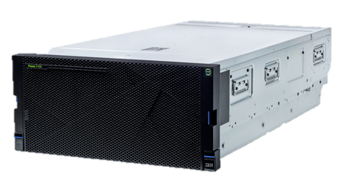
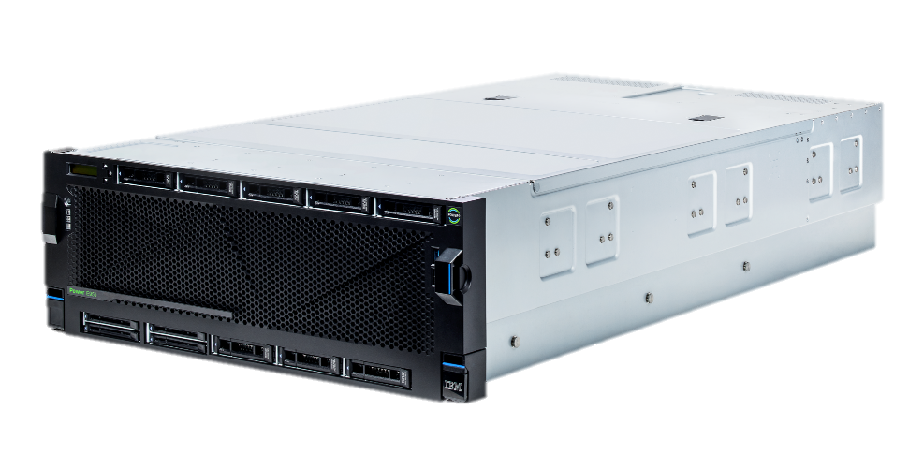
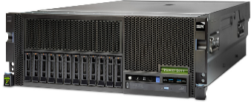

Next Generation HANA on POWER
IBM POWER9 Family
Optimized for SAP HANA in-memory database workloads
H922
1,2-socket, 2U
4, 8, and 10 cores per socket
4TB memory
H924
2-socket, 4U
8, 10, and 12 cores per socket
4TB memory
E950
2,4-socket, 4U
8, 10, 11, and 12 cores per socket
16TB memory
E980
5U CEC + 2U Control Unit
Max of 192 SMT8 processor cores
8, 10, 11, and 12 cores per socket
64TB memory
Ideal for Scale-Out configurations
Ideal for Scale-Up configurations
Notes:
The next generation of POWER Systems servers with POWER9 technology is built with innovations that can help deliver security and reliability for the data-intensive workloads of today's enterprises. POWER9 technology is designed from the ground up for data-intensive workloads like databases and analytics.
This new server generation has twice the memory footprint of IBM POWER8 servers, making it an ideal platform for in-memory and data-centric applications. Changes in the memory subsystem and the use of industry standard memory DIMMs take POWER9 technology to the next level by superseding a number of existing price/performance offerings. Designed to run commercial, cognitive, and database workloads POWER9 technology provides a highly competitive server platform, client references indicate POWER servers help provide a robust and secure backbone of their IT infrastructure. More companies are using POWER technology in their IT infrastructure down from the shop level to large data center deployments.
The introduction of the H922 and H924 servers marks the first time IBM has announced a dedicated Power server specifically optimized for SAP HANA. These servers are specifically configured to run SAP HANA. (Note that aside from fully running Linux, these servers can have up to a maximum of 25% of their cores dedicated to running AIX or IBM i workloads). These servers are the only 2-socket servers available for SAP HANA with 4TB of memory. SAP HANA is an in-memory database and therefore the more memory available to SAP the better…and nothing beats the H922 and H924 for memory per socket. Both these servers have been certified by SAP for HANA.
Customers looking for scale-up options on POWER Servers have a choice of E950 or E980. These servers are currently being certified by SAP and are expected to complete certification testing in October, 2018. These servers, like the H922 and H924 are ideal for hosting multiple production SAP application instances in a virtualized environment with PowerVM. In addition, to mitigate seasonal peaks in the the business cycle workload and/or growth, Capacity on Demand (CoD) and Enterprise Pools are available to prevent disruption to the business.

Slide 38
Notice and disclaimers
Information in these presentations (including information relating to products that have not yet been announced by IBM) has been reviewed for accuracy as of the date of initial publication and could include unintentional technical or typographical errors. IBM shall have no responsibility to update this information. This document is distributed “as is” without any warranty, either express or implied. In no event shall IBM be liable for any damage arising from the use of this information, including but not limited to, loss of data, business interruption, loss of profit or loss of opportunity. IBM products and services are warranted according to the terms and conditions of the agreements under which they are provided.
IBM products are manufactured from new parts or new and used parts. In some cases, a product may not be new and may have been previously installed. Regardless, our warranty terms apply.”
Any statements regarding IBM's future direction, intent or product plans are subject to change or withdrawal without notice.
The provision of the information contained herein is not intended to, and does not, grant any right or license under any IBM patents, copyrights, trademarks or other intellectual property right.
IBM, the IBM logo, ibm.com, AIX, BigInsights, Bluemix, CICS, Easy Tier, FlashCopy, FlashSystem, GDPS, GPFS, Guardium, HyperSwap, IBM Cloud Managed Services, IBM Elastic Storage, IBM FlashCore, IBM FlashSystem, IBM MobileFirst, IBM Power Systems, IBM PureSystems, IBM Spectrum, IBM Spectrum Accelerate, IBM Spectrum Archive, IBM Spectrum Control, IBM Spectrum Protect, IBM Spectrum Scale, IBM Spectrum Storage, IBM Spectrum Virtualize, IBM Watson, IBM Z, IBM z Systems, IBM z13, IMS, InfoSphere, Linear Tape File System, OMEGAMON, OpenPower, Parallel Sysplex, Power, POWER, POWER4, POWER7, POWER8, Power Series, Power Systems, Power Systems Software, PowerHA, PowerLinux, PowerVM, PureApplica- tion, RACF, Real-time Compression, Redbooks, RMF, SPSS, Storwize, Symphony, SystemMirror, System Storage, Tivoli, WebSphere, XIV, z Systems, z/OS, z/VM, z/VSE, zEnterprise and zSecure are trademarks of International Business Machines Corporation, registered in many jurisdictions worldwide. Other product and service names might be trademarks of IBM or other companies. A current list of IBM trademarks is available on the Web at "Copyright and trademark information" at: www.ibm.com/legal/copytrade.shtml.
Linux is a registered trademark of Linus Torvalds in the United States, other countries, or both. Java and all Java-based trademarks and logos are trademarks or registered trademarks of Oracle and/or its affiliates.

