Slide 1



POWER9 Scale Out Servers
MTM 9009-42A (S924)
MTM 9009-41A (S914)
MTM 9009-22A (S922)
MTM 9008-22L (L922)
MTM 9223-42H (H924)
MTM 9223-22H (H922)
Technical Details
Ron Arroyo
Distinguished Engineer – Systems Development
arroyor@us.ibm.com
Notes:
In this presentation we will be going through some of the technical details of the POWER9 Scale out Servers. We have a family of scale out servers as you can see on this page. There are some nice groupings for these; we will be going through them individually but a lot of them are very similar so we will be grouping them together and going through two or three at a time. The groupings all have a similar design point and architecture.

Slide 2
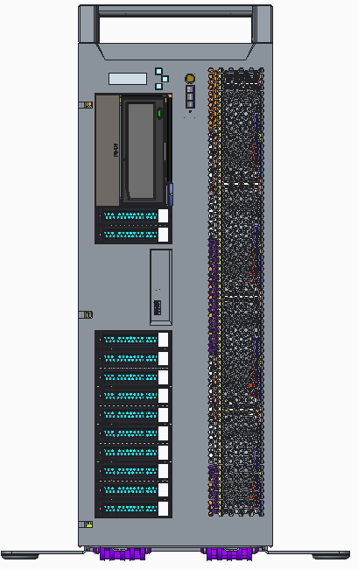
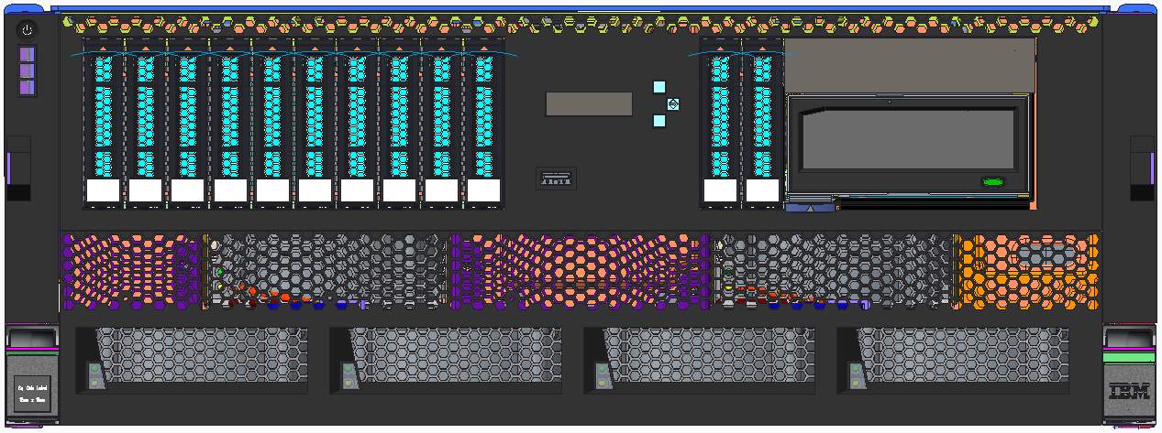
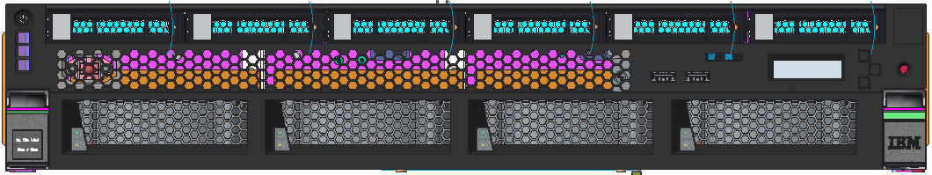
POWER9 Scale-out Servers - the most reliable and resilient entry level cloud-enabled servers
S924/H924 2-socket 4U server, is designed to meet highest performance and security with a memory footprint of up to 4TB, an industry leader in the 2 socket market
S914 1-socket 4U server is the price attractive entry offering into the POWER9 family of servers. Industry leading integrated security and reliability as well cloud enabled out of the box with integrated PowerVM technology
S922/H922 2-socket 2U server is designed to meet highest performance and security in a dense form factor with a memory footprint of up to 4TB, an industry leader in the 2 socket market
L922 2-socket 2U server is designed to meet highest performance and security for Linux workloads in a dense form factor with a memory footprint of up to 4TB, an industry leader in the 2 socket market
Notes:
This is the entry level set of POWER9 servers. These are the 2 socket servers and we have several form factors, similar to what we did with POWER8, with both 2U and 4U servers in 1 and 2 socket configurations.
I’ve listed out 4 groups here to consolidate. The first row is the S924 and the H924. The H version is for SAP HANA and is the same architecture and design as the S model. This is the flagship server for the family in a 4U package and has the highest performance of the family of servers and will have up to 4TB of memory available.
The next row (S914) is the following to the S814. It is a 1 socket 4U (or Tower model). The purpose of this model is to provide a very attractive server for AIX and IBM i from an entry price point perspective.
The bottom two groupings (S922/H922 and the L922) – again the H version is the same as the S version with only a few minor aspects that we will discuss later in this deck. These two bottom rows are the high density version with 2U and 2 socket systems. They have half the height at 2U but have the same number of sockets and the same amount of memory available compared to the 4U systems (at 4TB). The L922 is architecturally the same as the S922/H922 but is for Linux only.
Note that the only model that is available in a tower version is the S914. All the other servers are rack mount only options.

Slide 3
S924 / H924 Scale Out Server
4U server - 19” Rack enclosure
POWER9 Scale-Out SMT8 processor (12-core, 10-core, 8-core)
Up to 4TB Memory Capacity
  Industry Standard DDR4 RDIMMs @ up to 2666 Mhz operation
11 PCIe Gen3/Gen4 slots
  Five PCIe Gen4 slots (4 CAPI enabled)
  Six PCIe Gen3 slots (1 reserved for Ethernet adapter)
4 High Speed 25Gb/s ports for future OpenCAPI Acceleration
12 or 18 SFF (2.5”) SAS bay options
Two internal storage controller slots
  Single or Split backplane or Dual RAID Write Cache support
  2 Internal NVMe Flash boot adapters (two M.2 devices per card)
Internal RDX Media bay (DVD external)
I/O Expansion Drawer support
Supports AIX, IBM i and Linux (H924 limits AIX and IBM i to 25% core activations)
Notes:
Starting with the S924 and H924:
The server is 4U with the scale-out SMT8 cores available in 12-core, 10-core and 8-core but we will discuss the core options more in an upcoming slide. The server has a maximum memory capacity of 4TB and now we are using industry standard DDR4 RDIMMS running at speeds up to 2666 Mhz depending on your configuration (more details on the memory again in an upcoming slide).
Like POWER8, these servers still have 11 PCIe slots but the difference is the new PCIe Gen4. The server has a combination of PCIe Gen3 and Gen4 slots and we will walk through the details of the slot options on an upcoming slide. POWER9 has introduced OpenCAPI acceleration and we have 4 high speed 25Gb/s ports that will be utilized later this year and into next year as OpenCAPI offerings become available.
From a storage perspective we have very similar configurations to what we had on POWER8. These servers will have both a 12 bay configuration as well as an 18 bay configuration using small form factor (SFF) fast bays with faster interfaces for those bays. We will cover the storage controllers more in future slides but suffice it to say for this slide that there will be similar configurations to POWER8 with the addition of 2 internal NVMe Flash boot adapters if you are just looking to load your boot images or VOS images for local storage and all the rest of your storage is out on a SAN. Another thing from a media standpoint is that for the 4U servers there will be an RDX media bay option but note that there will be no DVD. If you want to attach a DVD, you would do so with an external DVD drive connected through USB. Of course I/O expansion drawers are also supported.
From an operating system perspective, the S924 supports AIX, IBM i and Linux (specific Linux distributions are detailed at the end of this deck). Note that for the H925 which is targeted at SAP HANA (which runs only on Linux) we support Linux but we also will allow clients to run 25% of their cores with AIX or IBM i for other workloads related to that SAP HANA implementation. This is pretty much the only difference from a hardware standpoint between the S924 and the H924.

Slide 4
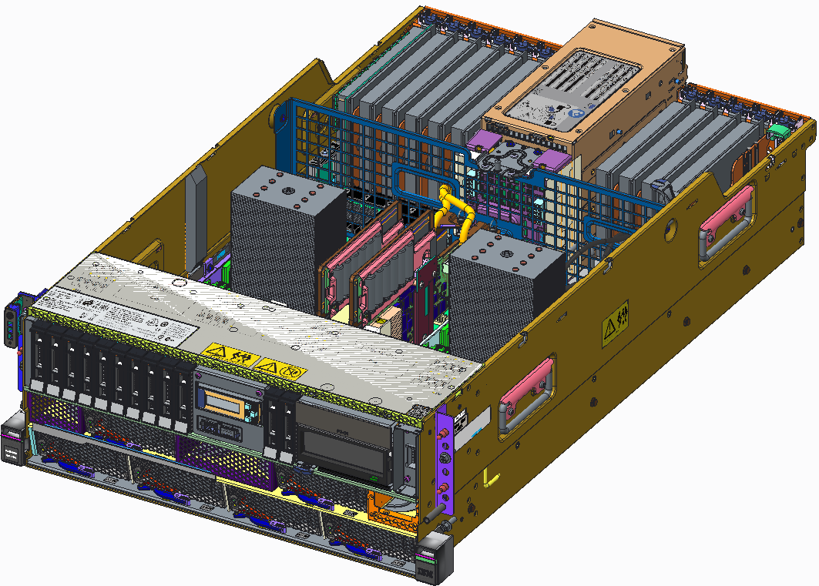
S924 / H924 Scale Out Server
2 Internal Storage slots
5 PCIe Gen4 slots
6 PCIe Gen3 slots
2 Processor
modules
16 DDR4 RDIMM’s per processor
32 DDR4 RDIMM’s total
12 SFF bays & 1 RDX bay, or 18 SFF bays
6 Blowers
LCD Display
USB 3.0
Notes:
Here is a diagram that shows you the high level specifics of the S924/H924 configuration. Along the back is the 11 PCIe slots and in the middle of the slots are the power supplies (very similar to the S8924). You will see the processors (the gray towers which are the heat sinks) and the internal storage controller slots are sitting in between the two processor modules. This is different from POWER8 and gives us better air flow.
Memory is down on the planar which are hard to see in this diagram but they are on each side of the processors (another diagram later in the deck will provide a better view of the memory slots).
On the front side you can see on the server itself we are showing the 12 bay option with the RDX bay on the right side. In the lower left of the slide you can see what the 18 bay option looks like (no RDX bay replaced by 6 more SSF bays).
From the air flow perspective we have moved to 6 blowers which sit in the front side at the bottom front as shown above.

Slide 5
S924 / H924 Processor Highlights
SCM Design – Single Chip Module
Three processor offerings available (SMT8 cores)
  12-core processor (maximum throughput)
  10-core processor
  8-core processor (maximum core performance)
Single processor config supported for 8 and 10-core processor offerings
Processor frequencies dynamic by default: Set to Max Performance Mode
Increased processor to processor fabric interconnect
  Two 16Gb/s X-Bus fabric connect between CPUs
Feature Code | Processor SMT8 Cores | Typical Frequency Range | IBM i P Group
EP1G | 12 cores | 3.4 to 3.9 Ghz (max) | P20
EP1F | 10 cores | 3.5 to 3.9 GHz (max) | P20
EP1E | 8 cores | 3.8 to 4.0 GHz (max) | P20
Notes:
Let’s take a deeper look at the processor design. POWER9 is a single chip module which is a little different than POWER8 where the entry plans were dual chip modules (where we had 2 six core dies in one socket). In POWER9 there are no dual chip modules, there are only single chip modules. As previously mentioned we will have 3 offerings with an 8-core and 10-core and a 12-core processor.
Some guidance here (similar to POWER8), if you are looking for maximum throughput then use the 12-core processor. However, if one of your priorities is the fastest execution of a single thread or core, then go down to the lower core counts with the 8-core having the fastest speed available. The 8-core will running typically between 3.8 and 4.0 GHz while the 12-core will be running between 3.4 and 3.9GHz. And shown above the IBM i P Group will be P20 for all three offerings.
You can buy the 8-core or 10-core offering then you have the option to populate just one socket. However, if you purchase the 12-core configuration then you have to populate both sockets. There is no single socket 12-core offering.
Power frequencies will be dynamic by default. This is different than we have done in the past where we have fixed the frequency. In the next slide we will discuss the various performance and power modes. But for the S924 and H924 the default setting will be maximum performance mode (described more on the next chart).
Note the new interconnect fabric between the two sockets are running at significantly higher speeds at 16GB/s for maximum scalability from 1 socket to 2 sockets and more tolerant of any memory affinity issues.

Slide 6
POWER9 Power Management Modes
Frequency
Static Power Save Mode
Static Nominal Mode
  Idle Power Saver (IPS) can be on or off
Dynamic Performance Mode
  Workloads run at highest frequency possible
  Max Workload/Max Cores runs >= nominal in all environments
  CPU managed to Nominal power draw
  Idle Power Saver (IPS) can be on or off
Maximum Performance Mode
  Workloads run at highest frequency possible
  Max Workload/Max Cores runs >= turbo in favorable environments
  CPU managed to Turbo power draw level – Higher acoustics
  Idle Power Saver (IPS) can be on or off
Ultra
Light
Workloads or
many Idle Cores
Light/Medium
Workloads or
a few Idle Cores
Turbo
High
Ambient
Range
Nom
Socket Idle
OR
System Idle
(if IPS on)
System Idle
(if IPS on)
System Idle
(If IPS on)
P.S.
Static
Nominal
Dynamic Performance
Maximum Performance
0 Ghz
Notes:
Let’s walk through the power management modes (which will be the same for all systems). In the past we have had static power save mode which runs the systems at even lower than nominal mode. This allows a client to set the systems at the lowest possible power mode for times when they are not using the system (weekends, holidays, etc.).
Static nominal mode which is how we ran things in the past on prior systems where systems run at the nominal frequency and remains static regardless of the workload, data center temperature and we just run at the same frequency.
For POWER9 there is a new capability that allows the system to run at an optimum frequency. We have micro processors that are measuring temperature, monitoring power and also monitoring the workload and so we will be able to adjust the processor to move the frequency based on what the workload is doing. Most customers are running at a nominal environment and are rarely running the processor at 100% utilization. If they are sitting at the 30 to 50% utilization then we have the ability to adjust the frequency to optimize it and go as high as we can.
Maximum performance mode will run the processors at the highest possible frequency range. This will draw more power but you will get a higher set of frequencies that we can dynamically adjust within.
Most systems will default to maximum performance mode.

Slide 7

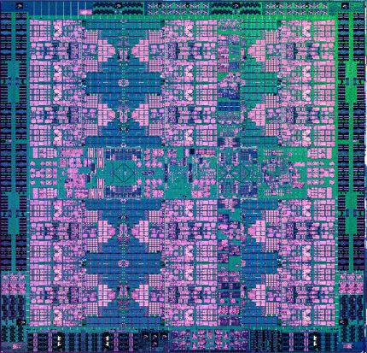
S924 / H924 Memory
Low latency direct attach memory architecture
Up to 170 GB/s peak memory bandwidth per socket
Industry standard DDR4 memory RDIMMs
16 DIMM slots per socket, 32 DIMM slots total
Maximum memory capacity 4TB
Minimum config is 2x 8GB DIMM’s per processor socket
Supported DIMM sizes and frequencies shown in table below
DIMM plug rules per socket
  DIMM’s installed: 2, 4, 6, 8, 12, 16
  DIMM’s in the same Quad as shown must be the same size
POWER9
Quad
Quad
Quad
Quad
Feature Code | DIMM Size | 2-8 DIMMs per socket | 10-16 DIMMs per socket
EM60 | 8GB DIMM | 2666 MHz | 2133 MHz
EM62 | 16GB DIMM | 2666 MHz | 2133 MHz
EM63 | 32GB DIMM | 2400 MHz | 2133 MHz
EM64 | 64GB DIMM | 2400 MHz | 2133 MHz
EM65 | 128GB DIMM | 2400 MHz | 2133 MHz
Notes:
For the memory, we are using the direct attach memory architecture (no buffer chips like we have had in previous scale out systems). They will run at up to 170GB/s peak memory bandwidth per socket. And as mentioned earlier we will be using industry standard DDR4 RDIMMS with 16 DIMMs per socket and 32 DIMS total in the server.
This gives us a max memory configuration of 4TB. The minimum memory is 2 8GB DIMMs per socket. If you only have 1 socket populated then the minimum is 2 DIMMs for a total of 16GB of memory minimum or if you have both sockets populated then you will need 4 DIMMS for a total of 32GB of memory minimum.
The DIMM sizes are listed in the table above and you can see the frequency of the DIMMs listed. If someone needs the maximum frequency due to a specific workload then they can run up to 8 DIMMs at 2666 MHz (one DIMM per channel). If they need more than one DIMM per channel then they need to run at 2133 MHz. If you want to go with larger DIMM size and have only 1 DIMM per channel then you can run at 2400 MHz.
Note that the feature codes for the H924 and H922 are different than the S924 and S922. For the HANA models they are: 8 GB (EM6G), 16 GB (#EM6J), 32 GB (#EM6K), 64 GB (#EM6L), or 128 GB (#EM6M).
From a plug rule perspective you must have 2 DIMMs installed at a time up until you get to 8 DIMMs per socket. So you can go with 2, 4, 6, 8 DIMMS which are the allowable configurations. Above 8 then you have to install them in quads so you then can have 12 or 16 DIMMs after that (per socket). The only other configuration to keep in mind is that when you install 2 DIMMS in a quad, if you want to then add 2 more DIMMS into the same quad, the DIMMs have to be the same. Every quad must have the same DIMM sizes within the quad.

Slide 8
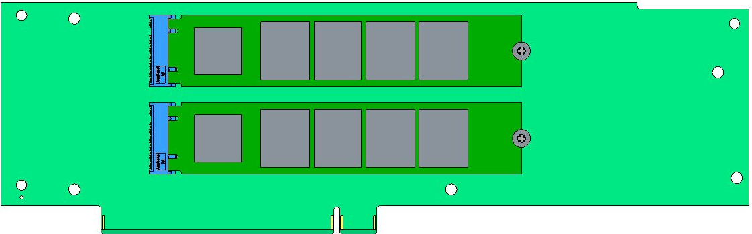
S924 / H924 Internal Storage Options
Internal Storage Options
FC | Description
EC59 | NVMe Card with two M.2 connectors
EJ1C | Single RAID 0,10,5,6 12 SFF bays (Gen3-Carrier), 1 RDX bay
EJ1E | Split Backplane RAID 0,10,5,6 6+6 SFF bays (Gen3-Carrier), 1 RDX bay
EJ1M | Dual Write Cache RAID 0,10,5,6,5T2,6T2 12 SFF bays (Gen3-Carrier), 1 RDX bay
EJ1D | Dual Write Cache RAID 0,10,5,6,5T2,6T2 18 SFF bays (Gen3-Carrier)
EU00 | RDX Docking Station
Supported Media Overview
NVMe M.2 Flash devices
400GB 1.5 DWPD (ES14)
SFF HDDs
600GB, 1200GB, 1800GB - 10K RPM
300GB, 600GB – 15K RPM
SFF SSDs
387GB, 775GB, 1551GB – 10 DWPD
931GB, 1860GB, 3720GB – 1 DWPD
RDX Disk Cartridge
1TB Disk Cartridge (EU01)
2TB Disk Cartridge (EU2T)
M.2 NVMe Device
Internal NVMe
Card
12 SFF bays,
1 RDX bay
PCIe Gen3 x8
18 SFF bays
Notes:
Now let’s talk about storage on the next 2 slides. For those familiar with POWER8 a lot of this will be the same.
Let’s start on the upper left and focus on the internal storage configuration options. Most is the same with the addition now in POWER9 of the new NVMe card option. If you are familiar with NVMe flash its basically a flash modules that is connected directly via PCIe (as shown in the bottom right). We are basically routing the PCIe directly up into the flash modules. These are M.2 form factor flash modules and you can see we have two connectors (these are separate FRUs) which are x4 PCIe lanes. We have 8 lanes coming into the card so we take 4 for each module. This is one option to install into the internal controller slots.
The remainder of the slots are similar to what we had with POWER8. In fact most are exactly the same 6GB fast controller technology from POWER8. You have a few options. You can populate the 12 SSF bays on one domain (often called JBOD even though there is some non-write cache options). EJ1E allows you to take the 12 bay backplane and split it into 2 domains for redundancy which also supports RDX.
Then we have two RAID configurations: the dual full write cache for both the 12 bay backplane (EJ1M) and the 18 bay backplane (EJ1D).
And for the 12bay backplane you can order the RDX docking station (EU00) – not available with the 18 by backplane. You can see the front panel configuration in the bottom left of this slide.
In the top right you can see the high level overview of the configurations that are supported in terms of SSDs and drive sizes.

Slide 9
S924 / H924 External Storage Options
FC / MTM | Description
ESLL | 19” Disk Expansion Drawer 12 LFF Gen2-Carrier Bays (Slider12)
ESLS | 19” Disk Expansion Drawer 24 SFF Gen2-Carrier Bays (Slider24)
5887 | 19” Disk Expansion Drawer 24 SFF Gen2-Carrier Bays (EXP24S) Migrate
EUA5 | USB DVD w/ Cable
7226-1U3 | 19” Media Drawer with 2 bays
Notes:
We will support external storage as well with a 19 inch 12 bay large form factor (LFF) expansion drawer as well as the 24 bay small form factor version of that as well. And we will also support the migration of the older EXP24S expansion drawers but only from a migration standpoint.

Slide 10
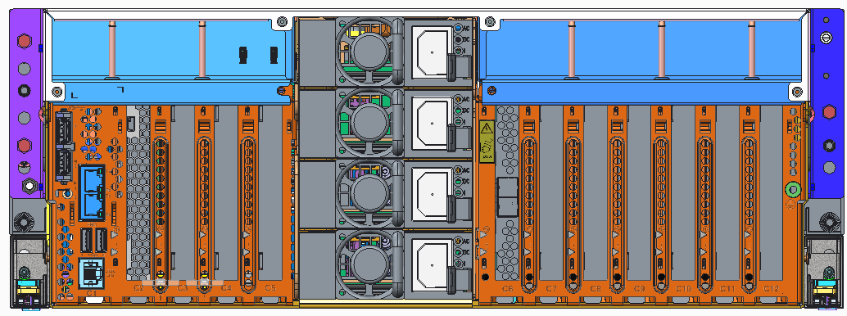
S924 / H924 PCIe Slots
Internal PCIe Slot Summary
USB 3.0 Ports
Power
Supply
Slot | Attributes | Note
C1 | Service Processor Card
C2 | PCIe Gen4 x8 (x16 Conn) | 2nd POWER9 socket
C3 | PCIe Gen4 x16 (EJ08 slot)
C4 | PCIe Gen4 x16 (EJ08 slot)
C5 | PCIe Gen3 x8 | 1st POWER9 socket
C6 | PCIe Gen3 x8 (x16 Conn)
C7 | PCIe Gen3 x8
C8 | PCIe Gen4 x8 (x16 Conn)
C9 | PCIe Gen4 x16 (EJ08 slot)
C10 | PCIe Gen3 x8
C11 | PCIe Gen3 x8
C12 | PCIe Gen3 x8 (x16 Conn)
Power
Supply
HMC Ports
Power
Supply
USB 2.0
Ports
Power
Supply
Serial Port
External PCIe Expansion Summary
Num of CPUs | Max num of I/O Exp Drawers (EMX0) | Max num of I/O Fanout Modules (EMXF) | Total PCIe Slots
1 | 1 | 1 | 13
2 | 2 | 3 | 26
EJ08 – I/O Expansion Adapter
PCIe Slots are Concurrently Maintainable
Full Height, Half Length PCIe form factor
Notes:
Finally let’s take a look at the PCIe slots in the S924 and H924.
In the upper right you can see the back of the server which has the slots numbered from left to right. C1 is the server processor card while C2 to C12 are the PCI slots. The table on the left shows you the capabilities of each slot showing if it is a Gen4 or Gen3 slot and the type of connectors (x8 or x16). Also shown in green are the I/O expansion adaptor slots (C3, C4 and C9) if you want to add adapter cards that connect to the expansion drawers.
Note that all slots are concurrently maintainable and they are all full height, half length PCIe form factors as well.
From an I/O expansion stand point, if you have only 1 socket populated then you will have 1 I/O Expansion drawer and up to one fanout module in that drawer. So with only one socket populated you can have 8 PCIe slots (as shown in the table using C5 to C12) plus the 5 with one expansion drawer. If however you have 2 sockets populated then you can have 2 expansion drawers with 3 fanout modules thus giving you the 11 PCIe slots plus an additional 15 in the expansion for a total of 26 slots.

Slide 11
S914 Scale Out Server
4U server - 19” Rack enclosure or Tower
POWER9 Scale-Out SMT8 processor (8-core, 6-core, 4-core)
Up to 1TB Memory Capacity
  Industry Standard DDR4 RDIMMs @ up to 2666 Mhz operation
8 PCIe Gen3/Gen4 slots
  Two PCIe Gen4 slots (2 CAPI enabled)
  Six PCIe Gen3 slots (1 reserved for Ethernet adapter)
2 High Speed 25Gb/s ports for future OpenCAPI Acceleration
12 or 18 SFF (2.5”) SAS bay options
Two internal storage controller slots
  Single or Split backplane or Dual RAID Write Cache support
  2 Internal NVMe Flash boot adapters (two M.2 devices per card)
Internal RDX Media Bay (DVD External)
I/O Expansion Drawer support for 8-core and 6-core feature only
110 VAC support
Supports AIX, IBM i and Linux
Notes:
For the S914 this is a 1 socket version of the 4U model we just went through. Therefore the I/O and storage are the same but the processor offerings do change. The first thing you notice is there is an 8-core, 6-core and 4-core.
Given you only have one socket populated and with some other limitations we will go through, the maximum memory available to put on this system is 1TB. Same memory DIMMs as with the S924 which we already covered.
The PCIe slots are the same as the S924 with only 1 socket populated so there are 8 available PCIe slots.
Everything else is essentially the same from a feature standpoint for this server.

Slide 12
S914 Scale Out Server
2 Internal Storage slots
2 PCIe Gen4 slots
6 PCIe Gen3 slots
1 Processor
module
16 DDR4 RDIMM’s
12 SFF bays & 1 RDX bay, or 18 SFF bays
4 Blowers
LCD Display
USB 3.0
Notes:
You can see that the overview here is very similar to the S924 but the right side of the server is not populated. There are no PCIe slots on the far right side, no DIMM slots on the right side of the server and therefore some cost efficiencies with this configuration.
As you can see on the upper left there is a tower model as well as a rack model. And since there is only 1 socket populated there are only 4 blowers in the front instead of the 6 used in the 924.

Slide 13
S914 Processor Highlights
SCM Design – Single Chip Module
Three processor offerings available (SMT8 cores)
  8-core processor (maximum throughput)
  6-core processor
  4-core processor (minimum entry price)
Processor frequencies dynamic by default: Set to Dynamic Performance Mode
Feature Code | Processor SMT8 Cores | Typical Frequency Range | IBM i P Group
EP12 | 8 cores | 2.8 to 3.8 GHz (max) | P10
EP11 | 6 cores | 2.3 to 3.8 GHz (max) | P10
EP10 | 4 cores | 2.3 to 3.8 GHz (max) | P05
Notes:
From a processor standpoint, as mentioned this is one of the key differences between the S914 and the S924 is the number of cores in the processor. The S914 comes in 8-core, 6-core and 4-core processors.
Just like the S924 however, the more cores in the processor the more throughput you are going to be able to achieve. One of the primary purposes of the S914 is to provide a lower entry price point offering and therefore the 4-core processor will get you to that lower entry price point.
You can also see the IBM i software tier price groups (with the 4-core being at the lowest tier).
And unlike the other servers in the family, the S914 is shipped by default with the Dynamic Performance Mode set. One of the reasons for this is that in the Tower configuration it is assumed that this server may not be in a machine room and setting to maximum performance mode may have undesirable acoustics for an office setting. All of the performance modes are still available so they can be changed if the administrator needs to.

Slide 14
S914 Memory Subsystem
Low latency direct attach memory architecture
Up to 170 GB/s peak memory bandwidth per socket
Industry Standard DDR4 RDIMMs
16 DIMM slots total
Maximum memory capacity 1TB (4-Core feature limited to 64GB)
Minimum config is 2x 8GB DIMM’s
Supported DIMM sizes and frequencies shown in table below
DIMM plug rules per socket
  DIMM’s installed: 2, 4, 6, 8, 12, 16
  DIMM’s in the same Quad as shown must be the same size
Quad
POWER9
Quad
Quad
Quad
Feature Code | DIMM Size | 2-8 DIMMs per socket | 10-16 DIMMs per socket
EM60 | 8GB DIMM | 2666 MHz | 2133 MHz
EM62 | 16GB DIMM | 2666 MHz | 2133 MHz
EM63 | 32GB DIMM | 2400 MHz | 2133 MHz
EM64 | 64GB DIMM | 2400 MHz | 2133 MHz
Notes:
The memory is the same architecture as the S924. The only difference is that we do not support the 128GB DIMMs on this system so with only 1 socket and 64GB DIMMs as the maximum size, the maximum total memory is 1TB.
Everything else is the same as what was discussed in the S924 slide previously.

Slide 15
S914 Internal Storage Options
Internal Storage Options
FC | Description
EC59 | NVMe Card with two M.2 connectors
EJ1C | Single RAID 0,10,5,6 12 SFF bays (Gen3-Carrier), 1 RDX bay
EJ1E | Split Backplane RAID 0,10,5,6 6+6 SFF bays (Gen3-Carrier), 1 RDX bay
EJ1M | Dual Write Cache RAID 0,10,5,6,5T2,6T2 12 SFF bays (Gen3-Carrier), 1 RDX bay
EJ1D | Dual Write Cache RAID 0,10,5,6,5T2,6T2 18 SFF bays (Gen3-Carrier)
EU00 | RDX Docking Station
Supported Media Overview
NVMe M.2 Flash devices
400GB 1.5 DWPD (ES14)
SFF HDDs
600GB, 1200GB, 1800GB - 10K RPM
300GB, 600GB – 15K RPM
SFF SSDs
387GB, 775GB, 1551GB – 10 DWPD
931GB, 1860GB, 3720GB – 1 DWPD
RDX Disk Cartridge
1TB Disk Cartridge (EU01)
2TB Disk Cartridge (EU2T)
M.2 NVMe Device
Internal NVMe
Card
12 SFF bays,
1 RDX bay
PCIe Gen3 x8
18 SFF bays
Notes:
This slide is exactly the same as the S924 with the new NVMe cards supported as well as the 12 bay and 18 bay configurations.
From an offering perspective however, the 4-core configuration is limited to no I/O expansion and no external storage expansion.

Slide 16
S914 External Storage Options
FC / MTM | Description
ESLL | 19” Disk Expansion Drawer 12 LFF Gen2-Carrier Bays (Slider12) | Not available with 4-core Feature
ESLS | 19” Disk Expansion Drawer 24 SFF Gen2-Carrier Bays (Slider24) | Not available with 4-core Feature
5887 | 19” Disk Expansion Drawer 24 SFF Gen2-Carrier Bays (EXP24S) Migrate | Not available with 4-core Feature
EUA5 | USB DVD w/ Cable
7226-1U3 | 19” Media Drawer with 2 bays
Notes:
As mentioned on the previous slide, for the 4-core configuration this expansion information is not available. However on the 6 and 8-core configuration the expansion drawers supported are the same as those supported with the S924.

Slide 17
S914 PCIe Slots
Internal PCIe Slot Summary
USB 3.0 Ports
Power
Supply
Slot | Attributes | Note
C1 | Service Processor Card
C5 | PCIe Gen3 x8 | 1st POWER9 socket
C6 | PCIe Gen3 x8 (x16 Conn)
C7 | PCIe Gen3 x8
C8 | PCIe Gen4 x8 (x16 Conn)
C9 | PCIe Gen4 x16 (EJ08 slot)
C10 | PCIe Gen3 x8
C11 | PCIe Gen3 x8
C12 | PCIe Gen3 x8 (x16 Conn)
Power
Supply
HMC Ports
Power
Supply
USB 2.0
Ports
Power
Supply
Serial Port
External PCIe Expansion Summary
EJ08 – I/O Expansion Adapter
Num of CPUs | Max num of I/O Exp Drawers (EMX0) | Max num of I/O Fanout Modules (EMXF) | Total PCIe Slots
1 | 1 | 1 | 13
PCIe Slots are Concurrently Maintainable
Full Height, Half Length PCIe form factor
(not available with 4-core feature)
Notes:
PCIe slots are the same as with the S924 when only one socket is populated. That is, we populate slots C1 (the service processor card) and C5 to C12 are the same as with the S924.
Also note that the PCIe expansion is the same as the S924 with one socket populated which gives you the additional 5 slots for a total of 13 available slots.
Again, all of the slots are concurrently maintainable and they fit the full height, half length PCIe form factor.

Slide 18
S922 / H922 / L922 Scale Out Server
2U server - 19” Rack enclosure
POWER9 Scale-Out SMT8 processor (12-core, 10-core, 8-core, 4-core offerings)
Up to 4TB Memory Capacity
  Industry Standard DDR4 RDIMMs @ up to 2666 Mhz operation
9 PCIe Gen3/Gen4 slots
  Five PCIe Gen4 slots (4 CAPI enabled)
  Four PCIe Gen3 slots (1 reserved for Ethernet adapter)
4 High Speed 25Gb/s ports for future OpenCAPI Acceleration
8 SFF (2.5”) SAS bay option
2 internal storage controller slots
  Single or Split backplane support
  2 Internal NVMe Flash boot adapters (two M.2 devices per card)
I/O Expansion Drawer support
S922 / H922 supports AIX, IBM i and Linux
  H922 limits AIX and IBM i to 25% core activations
  IBM i partitions require VIOS
L922 supports Linux only (First GA is PowerVM only, future support for bare metal and KVM)
Notes:
Now let’s look that the 2U models. The design is very similar for all 3 2U offerings so let’s look first at the overall summary of the S922, H922 (same as S922 but specific to SAP HANA) and L922 (same but specific to Linux).
All are 2U 19 inch servers with 12-core, 10-core, 8-core and 4-core offerings with 4TB of memory. Unlike POWER8 there is no reduction in memory capacity between the 4U and 2U offerings here so we can put the full 4TB of memory in these 2U configurations.
In the 2U servers we have 9 PCIe slots available (unlike the 11 available in the 4U configuration and we will discuss the configuration in an upcoming slide. As well there will be 4 ports for OpenCAPI acceleration.
Only one storage bay option is available for the 2U servers with 8 small form factor SAS bays. There will be both single and split backplane support as well as the 2 internal NVMe flash boot adapters (as with the 924). There will not be any support for the dual RAID write cache capability that was available in POWER8 (it is only available in the 4U configuration). The I/O expansion drawers are supported and the configurations will be shown in a future slide.
From an OS perspective, the S922 and H922 both support AIX, IBM i and Linux but note that the H922 will be limited to supported AIX and IBM i for up to 25% of the cores only. The L922 supports Linux only and will only support PowerVM as the hypervisor. There will be support in the future for bare metal or KVM as a hypervisor.

Slide 19
S922 / H922 / L922 Scale Out Server
2 Internal Storage Controller slots
5 PCIe Gen4 slots
4 PCIe Gen3 slots
2 Processor
modules
16 DDR4 RDIMM’s per processor
32 DDR4 RDIMM’s total
6 Front SFF bays
2 Internal SFF bays
4 Blowers
LCD Display
USB 3.0
Notes:
The high level diagram above looks very similar to the 924 configuration but of course the heat sinks are only 2U tall not 4U tall. The rest is mostly the same with 8 DIMMs on each side of the processor. And the low profile form factor PCIe slots at the back.
There will be 6 storage bays at the front with 2 others that are sitting behind the front 6 but have a few more steps to get to those (although still simple to get to). 6 are front accessible and the other 2 are in cyan blue shown above.
Instead of the 6 blowers with the S924 there are only 4 blowers in the S922.

Slide 20
S922 / H922 Processor Offering
SCM Design – Single Chip Module
Three processor offerings available (SMT8 cores)
  10-core processor (maximum throughput)
  8-core processor (maximum core performance)
  4-core processor (minimum entry price)
Single processor configs supported
EP16 4-Core feature limited to single socket config only
Processor frequencies dynamic by default, set to Maximum Performance Mode
** P10 group limits IBM i partitions to a max of 4 cores
Feature Code | Processor SMT8 Cores | Typical Frequency Range | IBM i P Group
EP19 | 10 cores | 2.9 to 3.8 GHz (max) | P10 **
EP18 | 8 cores | 3.4 to 3.9 GHz (max) | P10 **
EP16 | 4 cores | 2.8 to 3.8 GHz (max) | Not Supported
Notes:
For the processor offering in the S922 and H922 it is the same single chip module with the option of a 10-core for maximum throughput workloads, an 8-core processor for workloads that need the highest single core or single thread performance. And for the lowest cost model there is 4-core processor offering.
You have the option to populate one or two sockets for the 10-core and 8-core offering but if you choose the 4-core processor then the only option is to populate a single socket (there is no 2 socket 4-core offering available with the S922 or H922). And much like the S914, the 4-core offering does not support external I/O or external disk expansion.
Similar to the other slides, you can see the IBM i processor group tier for software pricing purposes.

Slide 21
L922 Processor Offering
SCM Design – Single Chip Module
Three processor offerings available (SMT8 cores)
  12-core processor (maximum throughput)
  10-core processor
  8-core processor (maximum core performance)
Single processor config supported for 8 and 10-core processor offerings
Processor frequencies dynamic by default, set to Maximum Performance Mode
Feature Code | Processor SMT8 Cores | Typical Frequency Range
ELPX | 12 cores | 2.7 to 3.8 GHz (max)
EPPW | 10 cores | 2.9 to 3.8 GHz (max)
ELPV | 8 cores | 3.4 to 3.9 GHz (max)
Notes:
For the L922 the 4-core option is removed and there is a 12-core option added for maximum throughput but note that the 12-core configuration is only available with both sockets populated.

Slide 22
S922 / H922 / L922 Memory
Low latency direct attach memory architecture
Up to 170 GB/s peak memory bandwidth per socket
Industry standard DDR4 memory RDIMMs
16 DIMM slots per socket, 32 DIMM slots total
Maximum memory capacity 4TB
Minimum config is 2x 8GB DIMM’s per processor socket
Supported DIMM sizes and frequencies shown in table below
DIMM plug rules per socket
  DIMM’s installed: 2, 4, 6, 8, 12, 16
  DIMM’s in the same Quad as shown must be the same size
POWER9
Quad
Quad
Quad
Quad
Feature Code | DIMM Size | 2-8 DIMMs per socket | 10-16 DIMMs per socket
EM60 | 8GB DIMM | 2666 MHz | 2133 MHz
EM62 | 16GB DIMM | 2666 MHz | 2133 MHz
EM63 | 32GB DIMM | 2400 MHz | 2133 MHz
EM64 | 64GB DIMM | 2400 MHz | 2133 MHz
EM65 | 128GB DIMM | 2400 MHz | 2133 MHz
Notes:
From a memory standpoint all three offerings are the same and in fact they are the same as the 4U offerings in all cases.

Slide 23
S922 / H922 / L922 Storage Options
Internal Storage Options
FC | Description
EC59 | NVMe Card with two M.2 Connectors
EJ1F | Single RAID 0,10,5,6 8 SFF Bays (Gen3 Carrier)
EJ1H | Split Backplane RAID 0,10,5,6 4+4 SFF Bays (Gen3 Carrier)
M.2 NVMe Device
Supported Media Overview
NVMe M.2 Flash devices
400GB 1.5 DWPD (ES14)
SFF HDDs
600GB, 1200GB, 1800GB - 10K RPM
300GB, 600GB – 15K RPM
SFF SSDs
387GB, 775GB, 1551GB – 10 DWPD
931GB, 1860GB, 3720GB – 1 DWPD
Internal NVMe
Card
PCIe Gen3 x8
External Storage Options
S922 / H922 FC | L922 FC | Description
ESLL | ELLL | 19” Disk Expansion Drawer 12 LFF Gen2-Carrier Bays (Slider12)
ESLS | ELLS | 19” Disk Expansion Drawer 24 SFF Gen2-Carrier Bays (Slider24)
5887 | EL1S | 19” Disk Expansion Drawer 24 SFF Gen2-Carrier Bays (EXP24S) migrate
EUA5 |  | USB-DVD with Cable
7226-1U3 |  | 19” Media Drawer with 2 bays
Notes:
This is a bit different than the 4U. We will of course still have the ability to support NVMe cards. This is a very inexpensive way to store your boot image or your VIOS server, then this will be the lowest price option for that. If you want that configuration you can order just the NVMe cards and no DASD backplane or storage controller cards that need to be ordered. This would be a very attractive pricing for clients that just need local storage for boot devices.
For clients that need spinning devices or SSDs we do offer the storage controller cards with the single domain for the 8 drives or split into 2 domains for people that want split backplane for redundancy. No dual RAID high performance write cache options.
For external storage options we will support the new disk expansion drawers (12 and 24 bay). Note that the feature codes are different for the S922/H922 and the L922 so they have been listed here for your convenience.

Slide 24
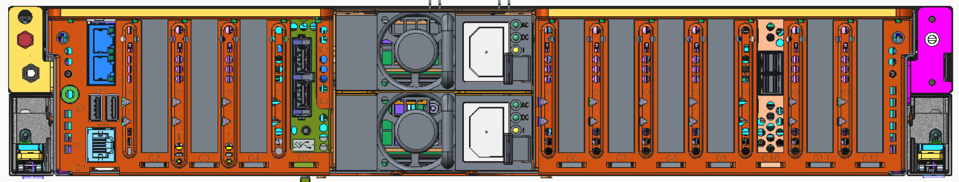
S922 / H922 / L922 PCIe Slots
Internal PCIe Slot Summary
HMC
Ports
USB 3.0
Ports
Slot | Attributes | Note
C1 | FSP Service Processor Card
C2 | PCIe Gen4 x8 (x16 Conn) | with 2nd POWER9 module populated
C3 | PCIe Gen4 x16
C4 | PCIe Gen4 x16 (EJ05 slot, note 1)
C6 | PCIe Gen3 x8 (x16 Conn) | with 1st POWER9 module populated
C7 | PCIe Gen3 x8
C8 | PCIe Gen4 x8 (x16 Conn)
C9 | PCIe Gen4 x16 (EJ05 slot, note 2)
C11 | PCIe Gen3 x8
C12 | PCIe Gen3 x8 (x16 Conn)
USB 2.0
Ports
Serial
C1
C2
C3
C4
C6
C7
C8
C9
C11
C12
External PCIe Expansion Features S922/H922
Num of CPUs | Max num of I/O Exp Drawers (EMX0) | Max num of I/O Fanout Modules (EMXF) | Max PCIe Slots
1 | 1 | 1 | 11
2 | 2 | 2 | 19
EJ05 – I/O Expansion Adapter
External PCIe Expansion Features L922
PCIe Slots are Concurrently Maintainable
Low Profile PCIe form factor
Num of CPUs | Max num of I/O Exp Drawers (ELMX) | Max num of I/O Fanout Modules (ELMF) | Total PCIe Slots
1 | 1 | 1 | 11
2 | 2 | 2 | 19
Note 1 – If EJ05 is installed, Rear USB ports not available
Note 2 – If EJ05 is installed, External SAS port not available
Notes:
From a PCIe slot standpoint, this is the slots we will be supporting from the 2U. Very similar to the 4U. These slots are concurrently maintainable and for the 2U these will be low profile form factor just like the POWER8.
From an I/O expansion stand point it’s very similar to the 4U. For 1 socket populated you will now be able to get up to 11 PCIe slots and when both sockets are populated you can get 2 expansion drawers with 2 fanout expansion models delivering up to 19 PCIe slots.
Note that for the L922 the number of slots are the same but the feature codes are different.

Slide 25
Software Stack Support
Firmware level FW910
HMC code level V9R1.910
VIOS 2.2.4, 2.2.5, 2.2.6
AIX 7.2 TL2
AIX 7.2 TL0, TL1 (P8 Compatibility Mode)
AIX 7.1 TL4, TL5 (P8 Compatibility Mode)
AIX 6.1 TL9 (P7 Compatibility Mode)
IBM i 7.3 TR4
IBM i 7.2 TR8
Ubuntu 16.04.4 LTS (P8 Compatibility Mode)
RedHat RHEL 7.4 LE (P8 Compatibility Mode)
SuSE SLES 11 SP4 (P8 Compatibility Mode)
SuSE SLES 12 SP3
Notes:
This slide is self explanatory showing the operating systems and firmware levels that are supported on all of the POWER9 servers (of course as noted in the server configuration slides, some of the servers only support Linux and the H servers have limited cores that can run AIX and IBM i but the versions are listed above).

Slide 26
Thank you
Ron Arroyo
Distinguished Engineer – POWER Systems Development
—
arroyor@us.ibm.com

Slide 27
Backup Materials

Slide 28
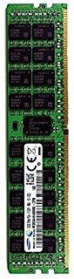
S924 / H924 System Topology
Ports T5, T6
OpenCAPI
Ports T7, T8
OpenCAPI
25 Gb/s
25 Gb/s
P9
X Bus 4B
P9
16 DDR4 RDIMMs
2133-2666 MHz
16 DDR4 RDIMMs
2133-2666 MHz
X Bus 4B
CAPI 2.0
C9
PCIe Gen4 x16
x1
USB 3.0
PCIe Gen4 x16
C4
CAPI 2.0
CAPI 2.0
C8
PCIe Gen4 x8 (x16 Conn)
x8
Gen3
Switch
x8
Storage
Controller
Slot
PCIe Gen4 x16
C3
CAPI 2.0
C5
PCIe Gen3 x8
PCIe Gen4 x8 (x16 Conn)
C2
C6
PCIe Gen3 x8 (x16 Conn)
C7
PCIe Gen3 x8
x8
Gen3
Switch
x8
Storage
Controller
Slot
C10
PCIe Gen3 x8
Eth
C11
PCIe Gen3 x8
C??
Indicates PCIe Slot Number
C12
PCIe Gen3 x8 (x16 Conn)

Slide 29
S914 System Topology
Ports T5, T6
OpenCAPI
25 Gb/s
P9
16 DDR4 RDIMMs
2133-2666 MHz
CAPI 2.0
C9
PCIe Gen4 x16
x1
USB 3.0
CAPI 2.0
C8
PCIe Gen4 x8 (x16 Conn)
x8
Gen3
Switch
x8
Storage
Controller
Slot
C5
PCIe Gen3 x8
C6
PCIe Gen3 x8 (x16 Conn)
C7
PCIe Gen3 x8
x8
Gen3
Switch
x8
Storage
Controller
Slot
C10
PCIe Gen3 x8
C??
Indicates PCIe Slot Number
Eth
C11
PCIe Gen3 x8
C12
PCIe Gen3 x8 (x16 Conn)

Slide 30
S922 / H922 / L922 System Topology
Ports T5, T6
OpenCAPI
Ports T7, T8
OpenCAPI
25 Gb/s
25 Gb/s
P9
X Bus 4B
P9
16 DDR4 RDIMMs
2133-2666 MHz
16 DDR4 RDIMMs
2133-2666 MHz
X Bus 4B
CAPI 2.0
C9
PCIe Gen4 x16
x1
USB 3.0
PCIe Gen4 x16
C4
CAPI 2.0
CAPI 2.0
C8
PCIe Gen4 x8 (x16 Conn)
x8
Gen3
Switch
x8
Storage
Controller
Slot
PCIe Gen4 x16
C3
CAPI 2.0
PCIe Gen4 x8 (x16 Conn)
C2
C6
PCIe Gen3 x8 (x16 Conn)
C7
PCIe Gen3 x8
x8
Gen3
Switch
x8
Storage
Controller
Slot
Eth
C11
PCIe Gen3 x8
C??
Indicates PCIe Slot Number
C12
PCIe Gen3 x8 (x16 Conn)

