Slide 1
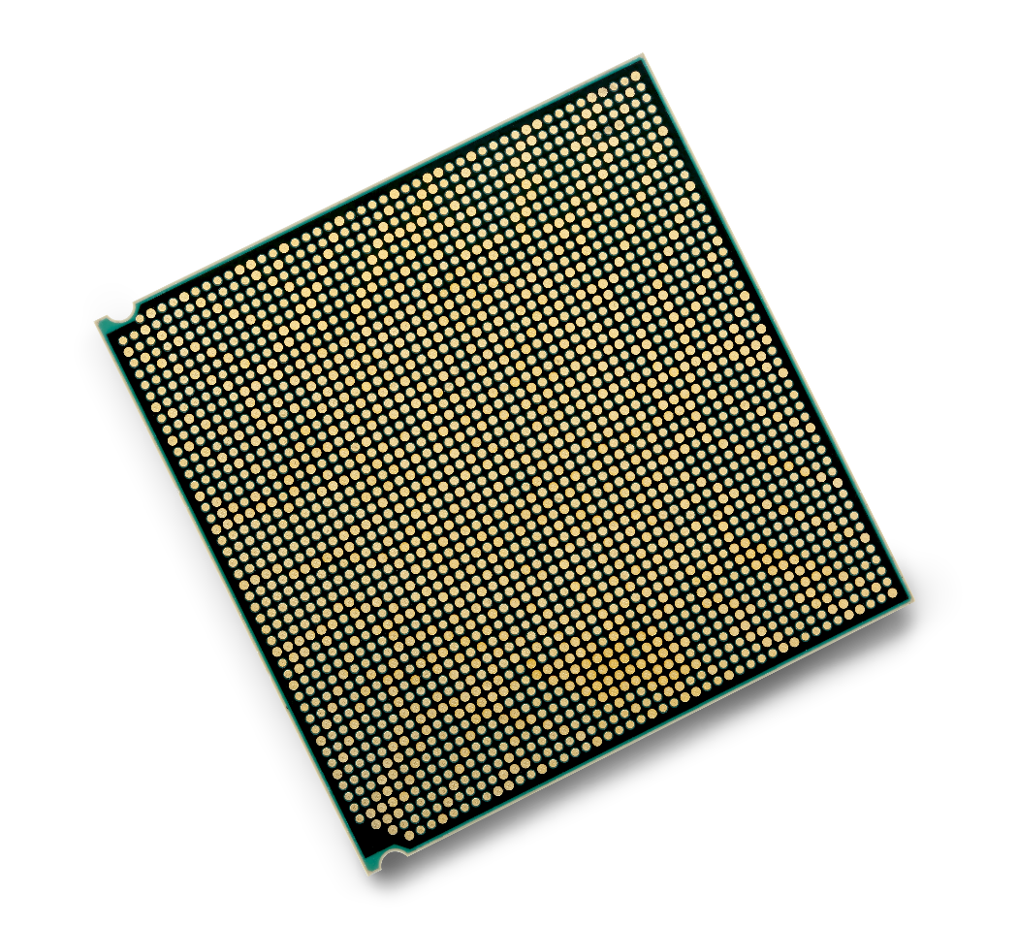
IBM POWER9: Enterprise servers Accelerate your enterprise with a future-forward server infrastructure — Chris Eaton (ceaton@ca.ibm.com) Ross Perry (ross.perry@ibm.com)
Notes:
In this presentation we will cover the POWER9 Enterprise servers which include both the new E950 and E980 along with their SAP optimized “twins” the H950 and H980. Note that in these slides we will focus on the E9xx servers but the same features and functions are also planned at some point in the future for the H9xx models. The H950/H980 have not been announced and so SAP HANA clients should look at the E950 and E980 as their platform of choice for SAP HANA workloads.
For these specific servers, you will often be talking to existing Power Enterprise server accounts about the new POWER9 capabilities and as such we have included performance comparisons with POWER7 as well as POWER8 servers in addition to comparisons vs. x86 systems.
In the first half of the deck, we will focus on the problems that IT organizations face and how the POWER9 Enterprise servers solves those problems for our clients in a unique way.

Slide 2
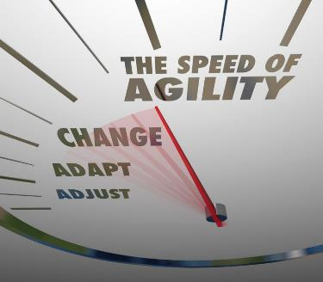
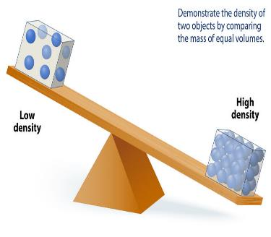
IT Industry Imperatives
Increase Agility
IT needs to deliver agility to LOBs while maintaining security, integrity, and availability.
Increase Availability
Downtime is money. In 2018, 33% of enterprises say hourly downtime cost them $1M to $5M+.
Eliminate Data Breaches
Likelihood of a company being breached in next 24 months = 28%, costing $3.6M per breach
Increase Server Utilization
Delivering cloud-like agility can improve server utilization and reduce software and hardware costs.
Notes:
Let’s first talk about IT and the challenges faced by every IT organization today. The IT organization has always been focused on making sure systems were secure and highly available to their lines of business (LOB). However, over the years, lines of business, who are primarily focused on new ways to acquire clients and/or generate more revenue from existing clients have begun to set off on their own because they have found IT to be to rigid and inflexible. It’s not that IT doesn’t want to be more flexible, but they often struggle trying to balance security, reliability, and availability with the agile needs of the LOBs. In many cases, LOBs have gone off and built their own applications on various infrastructures and then just pushed on to IT to support or they end up with a serious data breach or scalability issue that they can’t solve which again requires IT to rescue the situation.
To get through this organization challenge, IT organizations must become more agile while at the same time maintaining their availability and security posture. And at the same time, IT must reduce costs by consolidation. Cloud deployment has been a great way to achieve this for IT but there are many cases where public cloud solutions are not sufficient (either the data must remain on premises for security or regulatory reasons or the data is generated on premises and the latency to move it to public clouds is too great). Thus clients MUST implement private cloud solutions in order to deliver the capabilities that cloud based IT provides while keeping the controls in place to keep the data secure.
Increase Agility:
Agility is the key to success for any line of business. Being able to adapt, adjust, and change direction as needed in real time is critical in today’s hyper personalized environments. The same is true for IT… they must be able to adapt and adjust to the changing needs of their clients in the various lines of business. However, they must also maintain the security, reliability, and availability of the systems they support; hence the need for pre-built private clouds. There are just too many moving parts for an organization to cobble together; various open source frameworks that need to be integrated together for clients to ensure the integrity and security of the full solution. It’s imperative to partner with a full private cloud solution (like IBM Cloud Private) in order for IT to be able to focus on what’s important to their organization rather than focusing on how to integrate and test various pieces of the full solution stack.
Increase Availability:
You have probably heard the term “time is money”. In the case of downtime for a business, the time their infrastructure or systems are down literally costs them money. From hundreds of thousands of dollars per hour to over $5M/hour, the cost of downtime can be significant and it is a top concern for many CIO’s and IT personnel.
ITIC’s 2018 Hourly cost of Downtime Survey found that 98% of 800 respondents say that, on average, a single hour of downtime per year costs their company over $100,000. Additionally, 81% indicated that the average hourly cost of an outage exceeds $300,000. And 33% of respondents say hourly downtime costs their firms from $1 million to over $5 million (USD). These statistics exclude any civil or criminal penalties that may ensue in the wake of the outage. These figures also do not take into account any additional monies a company might spend on “goodwill” gestures to customers or business partners whose business transactions may have suffered because of the outage.
Cost of downtime:
As soon as your service degrades or crashes, you start losing money. If you make money from ads that’s lost ad revenue. If you run an e-commerce store, it’s the number of lost sales times the average sale amount. If you’re a ride-hailing service, it’s the number of failed hails times the expected average fare. However the larger cost is actually lost employee productivity. We have all faced this one. How many times have you been unable to get some of your work done because one system or another was offline? In an HIS Markit study, it was found that the cost of downtime to North American enterprises in 2016 was $700 billion. Of that, 78% was actually due to lost productivity and only 17% was due to revenue loss. So if your client doesn’t think their systems have a huge revenue impact, make sure they also understand the productivity loss that comes with downtime. (Note that for those focused on numbers 78%+17% only adds up to 95%...what happened to the other 5%? Well in the study they found that 5% of that $700 billion was spent on fixing the downtime problems.)
Sources:
ITIC’s 2018 Hourly cost of Downtime Survey: https://www-01.ibm.com/common/ssi/cgi-bin/ssialias?htmlfid=23015323USEN
2016 IHS Markit study on business losses due to downtime: https://technology.ihs.com/572369/businesses-losing-700-billion-a-year-to-it-downtime-says-ihs
Eliminate Data Breaches:
No matter the size of the company, security remains a top concern for CIO’s and IT executives. Recent threats like Spectre and Meltdown have highlighted just how painful a data breach can be for any organization.
The likelihood of experiencing a data breach in the next two years is 28%. While the cost of a data breach can vary depending on the size of the organization and the amount of data exposed, the costs can be significant, with an average of $3.6M.
As we will discuss in more detail later, POWER9 provides end-to-end security from the processor to the OS, and everything between to keep your business protected while data is at rest and in motion.
The Ponemon Institute research found in 2017 that:
$3.62 million is the average total cost of data breach
$141 is the average cost per lost or stolen records
It takes companies an average of 191 days to find out about a data breach, extending the window of opportunity during which attackers covertly reside in the breached systems and harvest more data!
It takes an average of 66 days to contain a data breach
The faster a data breach can be identified and contained, the lower it will cost.
Note that with GDPR puts even higher costs on clients as they can face fines of up to 4 % of their worldwide annual turnover or €20 Million, whichever is higher per data breach.
* Source: 2017 Ponemon Cost of Data Breach Study: Global Overview -- http://www.ibm.com/security/data-breach/
Increase Server Utilization:
Finally, IT continues to struggle with server sprawl (to many underutilized servers in a data center). The cost of the data center itself and the power and cooling requirements can quickly outpace the cost of the hardware and software contained within the data center. This is why clients continue to look for ways to reduce server and storage footprint and to increase the density of the applications that run on any given server.
Cloud deployments bring the ability to consolidate multiple workloads on a single system, but with that comes the headaches of managing the workloads to ensure they do not collide with each other. Power systems have long been the leader in virtualization technology and have among the highest application density of any platform. Increased performance and scalability allow clients to put more work on fewer cores and higher amounts of memory allow data intensive workloads to complete more quickly (thus making CPU cycles available for other workloads).
We will discuss further in this deck the advances in performance compared to x86 and compare to prior generations of Power systems; but suffice it to say, POWER9 Enterprise Servers take workload consolidation to a whole new level.

Slide 3
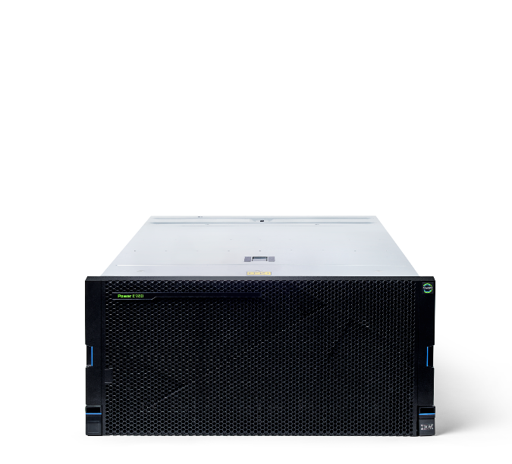
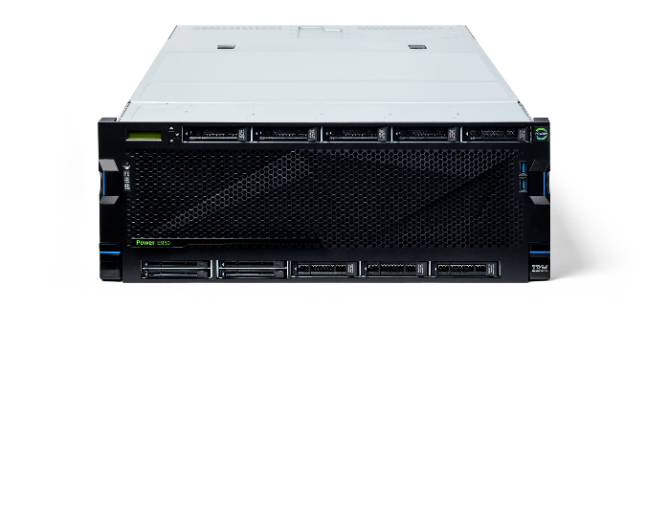
IBM Power System E980
Gain the extraordinary scalability, security, performance and availability for your data centers with cloud deployments for your most demanding AIX®, IBM i and Linux applications. The flexibility of this large enterprise server helps develop a large cloud infrastructure with proven reliability.
Meet the IBM Power Systems enterprise servers for accelerating your cloud infrastructure
IBM Power System E950
Benefit from blazing performance, extreme agility and industry leading reliability in a compact 4-socket system. It is an ideal platform for growing medium-size businesses and as a departmental server or data center building block for large enterprises.
Notes:
To address these IT challenges, IBM has recently announced the next evolution in Power Enterprise Systems…the E950 and E980.
The E950: Designed for private cloud and cognitive workloads, the E950 offers a unique blend of enterprise-class capabilities in a 4-socket 4U form factor. Optimized for private cloud deployments, the IBM® Power System E950 midrange server offers a unique blend of enterprise-class capabilities in a reliable, secure, space-efficient 4-socket 4U form factor that delivers exceptional performance for medium and large enterprises at an affordable price. The Power E950 is ideal for cloud deployments with built-in virtualization and flexible capacity. It allows you to deliver faster business results by increasing throughput and reducing response times with POWER9 processors and increased memory and I/O bandwidth.
The E980: The flexibility of the IBM® Power System E980 high-end enterprise server can help you build out a large cloud infrastructure with proven reliability, tighter security, rapid scalability, and simplified maintenance and management. With up to 192 POWER9 cores, up to 64 TB memory, and the fastest POWER9 processors in the Power Systems portfolio, the Power E980 delivers extraordinary performance and availability for data centers with demanding AIX, IBM I, and Linux applications.
In the following slides we will cover in detail how the E950 and E980 address the IT imperatives from the previous slide (private cloud agility, increased availability, secure by design, and increased server virtualization density).

Slide 4
Industry experts react to IBM’s latest enterprise systems announcement
“You’ve convinced me. I’ll be telling my clients they should upgrade to these new Power servers.” – Dan Bowers, Gartner
“The reliability of Power is just unmatched and the cost savings to migrate – very compelling story.” – Pat Moorhead, Moor Insights
“Great announcement. This sounds like an excellent and unmatched product.” – Fuad Abozovic, Fudzilla
Notes:
It’s not just IBM that is singing the praises of the new POWER9 Enterprise servers. Following their announcement, several industry experts noted that these Power systems are “unmatched” and that clients should “upgrade” to these new servers.
You can read the quotes yourself but they all agree that POWER9 Enterprise servers are something their clients should consider as a basis for their private cloud infrastructure.

Slide 5
80% of Fortune 100 leverage IBM Power Systems
Notes:
Many vendors will put a chart like this in front of clients. And in most cases we wouldn’t bother with something like this. However, you will run into clients that think that anything but Intel is dead. Far from it! In fact if you look at the Fortune 100 businesses, 80% of them trust IBM Power Systems for some of their most data intensive and business critical applications. These are of course some of the most recognized companies in the world and they trust IBM Power Systems to help run and manage their businesses.
The Fortune 100 is an annual list of the 100 largest U.S. public and privately held companies, published by Fortune magazine. The ranking is compiled using gross revenue figures. The Fortune 100 list is more exclusive than both the Fortune 500 (which accounts for 2/3rds of the US GDP) and Fortune 1000 lists.
Don’t be afraid of clients that think x86 is the only solution they need….teach them that their peers continue to put their trust in Power Systems.
Based on Fortune 500 2018 List - http://fortune.com/fortune500/list/

Slide 6
Industry leaders trust Power Systems
10 / 10
Top Banking
Companies
8 / 10
Top Healthcare
Companies
9 / 10
Top Insurance Companies
8 / 10
Top
Retailers
Notes:
Not only do a vast majority of the Fortune 100 trust Power Systems, but if you look at the top industries, their leadership also trust IBM Power Systems to run and manage their businesses. From banking to retail, you can find Power Systems making a difference globally.
Why do these industries trust Power?
The IBM Power Systems product team continues to fuel innovation and extend Power’s leadership in performance, scalability, and security, while maintaining our longstanding position as the most reliable servers in the industry and protecting our clients investments as they evolve their infrastructure.
These are just a few of the reasons customers continue to trust their mission-critical workloads to IBM Power Systems.
Based on Fortune 500 2018 List - http://fortune.com/fortune500/list/

Slide 7
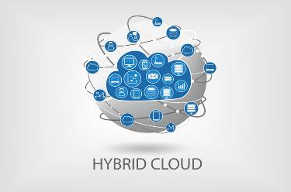
Cloud Infrastructure – Trusted!
Simplified multicloud
With IBM POWER9, you can dynamically scale compute and memory on demand and build a cloud designed for the most data intensive workloads.
Proven reliability
Today’s always-on world requires resilient, mission-critical servers that deliver continuous operations. IBM servers ranked the most reliable for the 10th straight year.
Built-in security from end-to-end
IBM Power Systems have security built in at all layers in the stack – processor, systems, firmware, OS and Hypervisor. Your data is protected in motion and at rest.
Scalable, affordable performance
IBM POWER9 drives the world’s fastest supercomputers and is ready to accelerate your enterprise. Gains are significant moving from x86 or older Power servers.
Notes:
The latest release in the POWER9 line is the enterprise scale up servers known as the E950 and E980 (along with their “twins” which are SAP HANA optimized, the H950 and H980). These servers are designed for clients that are looking to consolidate workloads into a smaller virtualized footprint or clients looking for the ultimate in single server scalability. Clients looking to build a private cloud and run more workloads than can fit on an x86-based system are perfect candidates for these servers.
We will deliver into the specific areas later in this deck, but clients should know that the four key value propositions of the enterprise line are:
Simplified multicloud – Building your cloud on a Power platform reduces complexity, controls costs, and drives agility. With IBM Power based cloud solutions, you can cloud-enable any workload without migration and build a cloud that handles the most data intensive workloads. You have the ability to create your cloud strategy - Private, Hybrid or Multi-Cloud. Instantly cloud enable any workload with IBM POWER9 based Power Systems and build a cloud designed for the most data intensive workloads. With the reliability and scalability of the Enterprise server line, the E950 and E980 include some of the world’s best virtualization technology that allow for rapid cloud deployments and extensive workload consolidation to help clients deliver more agility to their lines of business.
Proven reliability - Today’s always-on world requires resilient, mission-critical servers that deliver continuous operations. IBM Power Systems provides the industry leading uptime. In fact, IBM Power Systems ranks #1 in every major reliability category by ITIC and is an industry leader of Mid Range and High End Servers.
Built-in end-to-end security - Security is binary, either you have it, or you don’t. If your company is ever under attack, every level of your IT architecture needs to be secure, from the chip of the smallest server to your hybrid cloud. With security built in, starting at the chip level, IBM POWER9 helps keep your company out of the headlines. IBM also ships the entire line of Power Systems with patches for both Spectre and Meltdown preinstalled, and set up to protect clients right out of the box.
Scalable, affordable performance - You need servers that stay ahead of workload challenges, new data sources, and compute demands. IBM POWER9 drives the world’s largest super computers and is ready to accelerate your enterprise.

Slide 8
Simplified Multicloud
“Pay As You Grow” IT for Mission Critical Workloads
Dynamically scale compute and memory on demand based on business needs
Designed for Agility
Effortlessly move workloads across generations of Power Systems without disruption
Seamless Multicloud Compatibility
Open integration with leading multicloud managers and easily import/export VMs between Power based private and public clouds
Notes:
Let’s look at each of those four infrastructure pillars in more detail and talk about what Power Systems Enterprise Servers delivers in each of these four areas.
The first is “Simplified Multicloud”; what does that mean? First of all it’s not about public OR private cloud; it’s all about public AND private cloud for our clients. There is a need within any large enterprise to be able to leverage both cloud deployment models, and in many instances, to leverage both within a single application or line of business. This hybrid approach means that clients need the flexibility and simplicity to be able to choose the platform and location that makes the most sense for any given workload. Cloud should not be thought of as a place but rather as a method of delivering services in an agile and always available manner.
There are two critical capabilities that the underlying infrastructure must be able to provide in order to deliver a true cloud experience, which are scalability and agility. With IBM POWER9 based Power Systems, you can dynamically scale compute and memory on demand and build a cloud designed for the most data intensive workloads. With “Pay As You Grow” IT, you can dynamically scale compute and memory on demand based on business needs. You can allocate more resources to a given instance as needed and when the resources are no longer needed you can just as easily remove them.
IBM Power systems has long been the leader in virtualization and was building private clouds long before anyone called them a cloud. The ability to deploy multiple production workloads and multiple OS instances (IBM i, AIX, or Linux) within a single server, with workload isolation, is unmatched in the industry. This allows clients to greatly reduce their data center footprint by consolidating more workload onto fewer physical systems. In fact, you can deploy up to 8 SAP HANA production instances per server with POWER9.
The second critical cloud capability is designing for agility. By this we mean that the infrastructure must be able to spin up and shut down instances at any time; quite simply, be able to add or remove resources seamlessly. But just as important, the system must be able to move instances between systems for capacity and/or availability reasons without disruption. POWER9 has built-in PowerVM hypervisors in all systems which provides for this dynamic sharing of resources across up to 1000 VMs with uninterrupted movement of instances across and within systems, all with policy-based automation and self-service tooling.
Now for hybrid cloud deployments, IBM Power Systems provides open integration with leading multicloud managers. This allows clients to rapidly build and deploy cloud-native apps for scalability and optimal performance in multicloud environments and easily import/export VMs between Power-based private and public clouds as well as migrate VMs from older power systems.

Slide 9
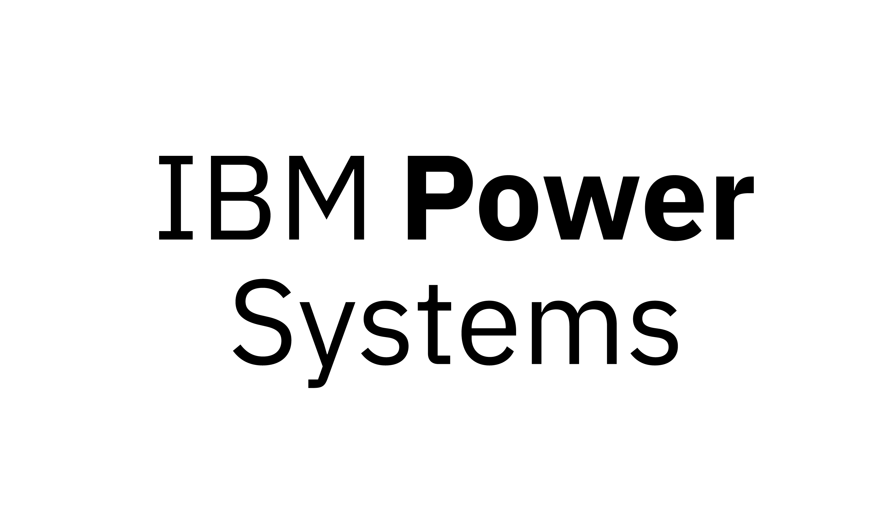
Enterprise Cloud Ready: IBM Cloud Private
Secure, enterprise-grade services and operations
Large and growing ecosystem of application runtimes, software, data and other value-added services
Supports Power, IBM Z, x86 heterogeneous clusters
PRIVATE
Faster insights for cognitive applications
Better performance at lower cost
Seamless modernization for AIX and IBM i apps
Easiest heterogeneous cloud to install and operate
on
Enterprise grade. Open by design. Accelerated by Power.
Notes:
The key take away to remember with respect to cloud is that “Cloud” is not a place – rather it’s a capability and a way of developing applications and deploying infrastructure in a more agile fashion. By leveraging IBM Cloud Private (ICP) on top of Power Systems, clients can have a full stack solution with a rich application catalog running on top of a powerful infrastructure which is optimized for the workloads they are running. Whether you're focused on deep or machine learning, application and infrastructure, Hadoop, Spark, noSQL and SQL databases, or the modernization of data centric applications, Power Systems brings a stronger solution for clients to be able to get more out of their infrastructure investments.
Specifically, POWER9 Enterprise systems are the perfect infrastructure for ICP given the larger capacity they bring to the table; allowing clients to consolidate even more workloads onto a single private cloud platform. For more in-depth details on IBM Cloud Private on Power, review the material in the Smartseller collection here: https://smartseller.mybluemix.net/#/collection/ae7f5d20-c7a8-42f5-9e58-2d9963f27e06?CallSource=ss
For clients with mission critical and performance sensitive applications, the IBM POWER9 Enterprise servers allow them to leverage the best infrastructure for deploying these types of data workloads on. Quite simply, IBM Power Systems gives you secure and scalable private cloud platform for creation and management of cloud-native applications.

Slide 10
Modernization to Private Cloud with IBM Cloud Private and Power Systems
Simplifies Cloud Application Deployment
Over 50% faster to deploy applications versus traditional infrastructure ¹
And is 27% less expensive than the public cloud to run a typical workload mix ²
With 88% more containers per core supported on Power versus x86 ³
Notes:
What does this mean from an offering perspective? The combined value of IBM Cloud Private (for platform as a service - PaaS) + POWER9 Enterprise systems is a “full stack” private cloud solution. This combination is complimentary and will thoroughly modernize the way our clients operate both their application and infrastructure environments from the bottom to the top of their stack.
Ask your client “What if you could change the way you deploy technology – if you could eliminate the bottlenecks that you currently have in your infrastructure today?” IBM Cloud Private with Enterprise Power Systems was built to address these very issues – it changes the game and eliminates the roadblocks.
IBM has taken on the issues that plague most data centers and has created a private cloud solution that’s turbo boosted with Power servers to greatly simplify cloud application deployment. This gives you the composable services from the ICP catalog to improve speed to market for application developers with over 50% faster application deployment versus traditional infrastructure, and is 27% less expensive than the public cloud to run for a typical workload mix because it all runs atop one of the highest performing compute platforms for modern workloads. This combination delivers 88% more containers per core supported on Power versus x86.
The bottom line: IBM Power infrastructure offers a modern “full stack” platform and a set of infrastructure services with predictable costs, capacity, and performance rivaling and exceeding that of the public cloud. All with the security and control of on-premises infrastructure.
Source: IDC, “TCO Analysis Comparing Private and Public Cloud Solutions for Running Enterprise Workloads Using the 5Cs Framework”, August 2017
Source: IDC, “Nutanix Delivering Strong Value as a Cost-Effective, Efficient, Scalable Platform for Enterprise Applications”, August 2017
Results are based on IBM internal testing of single system and OS image running the Acme Air work load (https://github.com/acmeair) on a private network with a dedicated JMETER driver machine and dedicated MongoDB server machine with one MongoDB instance per 8 WAS containers. Each WAS container was bound to a full core to run with 20 users and a 25ms think time between transactions. Tests are valid as of November 29th, 2016; individual results will vary depending on individual workloads, configurations and conditions. 120 containers on IBM Power System S822LC for Big Data; 20 cores / 160 threads, POWER8; 2.92GHz, kernel 4.4.0-12-generic, compared to 76 containers on 2-socket x86 server with 24 cores / 48 threads; Intel E5-2650 v4; 2.2 GHz. Both configurations ran with CPU frequency governor of performance, and hardware prefetch disabled and running Ubuntu 16.04 with 512 GB memory, included 1TB SATA 7.2K rpm HDD, 10 Gb 4-port, 1 x 16gbps FCA. SW stack was Websphere Application Server V9.0 Liberty profile;Java options: -Xmx512m -Xms512m -Xgcthreads8 -Xnocompactgc -Xnoclassgc -Xconcurrentlevel0 –Xdisableexplicitgc; Open source Docker Version: 1.12.0 / API : 1.24 / Go : 1.6.3; Docker storage driver: overlay2 and aufs had similar results

Slide 11
Proven Reliable
Industry Leading Reliability
IBM Power Systems ranked the most reliable for the 10th straight year¹
Investment Protection
Committed 10+ year roadmap for both IBM i and AIX
Industry Leadership in Enterprise Servers
IBM Power Systems was #1 in combined 8 socket large system, standard rack optimized and tower servers during 2017 with an aggregate revenue share of 34.4% ²
Notes:
For clients that have mission critical applications and/or those that want to deploy a private on-premises cloud, there is a need for hyper availability. Today’s always-on world requires resilient, mission-critical servers that deliver continuous operations. IBM Power Systems has been ranked as the most reliable for 10 straight years and is an industry leader for enterprise servers availability. In fact, an ITIC study (more details on the next slide) also showed that IBM Power delivered the highest uptime of 99.9996% (2.0 minutes/server/annum unplanned downtime) of any non-mainframe Linux platforms in their survey.
Another aspect of reliability is the longevity of the solution and the investment protection provided by IBM. IBM has already committed to a 10+ years roadmap for both IBM i and AIX in addition to the Linux operating systems that are available on the E980 and E950. To protect your investment further, you can deploy these new generation of servers without recompiling existing applications from prior generations. Thus you can just deploy and go which allows you to effortlessly move workloads across generations of Power Systems without disruption.
In addition, IBM Power Systems was once again ranked by IDC as the industry leader in enterprise servers, achieving the #1 ranking in combined 16+ socket large system, standard rack optimized and tower servers during 2017 with an aggregate revenue share of 82.1%. As well, IBM Power Systems was #1 in combined 8 socket large system, standard rack optimized and tower servers during 2017 with an aggregate revenue share of 34.4%.
When availability and reliability matter, clients trust IBM Power Systems Enterprise Servers!
Sources:
1 - ITIC 2018 Global Server Hardware, Server OS Reliability Survey Mid-Year Update
2 - IDC's 1Q18 Quarterly Server Tracker Data

Slide 12
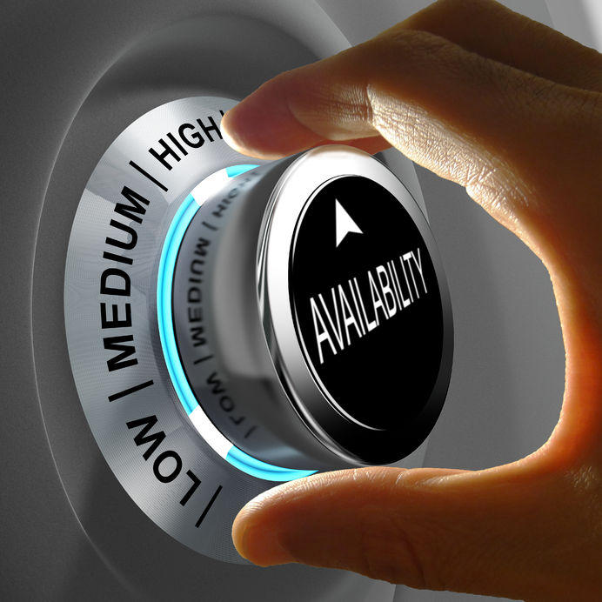
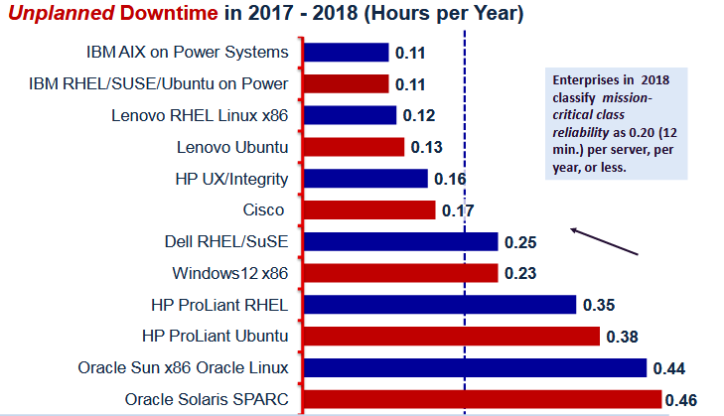
Ranked Number 1 in every major reliability category by ITIC
“IBM POWER8-based processor systems and the latest POWER9 servers provide several key feature/function advantages that advance reliability and enable customers to lower Total Cost of Ownership (TCO) and achieve near-immediate ROI.”
Notes:
We have already touched on reliability but let’s dig a bit deeper to look at what Information Technology Intelligence Consulting (ITIC) found in terms of the reliability and availability characteristics of Power Systems vs. client experiences running on other vendors hardware. In December of 2017 ITIC completed a study called the “ITIC 2017 – 2018 Global Server Hardware, Server OS Reliability Report”. This Report compares the reliability of 14 major server platforms, 18 server operating system distributions and 11 server hardware virtualization layers. It also provides an in-depth look at the internal issues that have the potential to positively or negatively influence the inherent reliability of servers and operating systems.
The report looks at several different aspects of reliability and availability. In the chart above, the report compares x86 vendors vs. UNIX/RISC based systems and shows that both IBM AIX on IBM Power Systems as well as several Linux distributions running on Power Systems had the lowest unplanned downtime of any vendor/OS combination they looked at; only 0.11 hours of unplanned downtime per year. That is in stark contrast to solutions offered by Dell, HP and Oracle whose unplanned downtime ranged from 0.25 to 0.46 hours per year per server. Enterprise clients in the survey consider 0.2 hours to be the cut-off for acceptable mission critical reliability.
For mission critical applications (data intensive workloads tend to be the most critical in any enterprise), having the reliability of Power Systems behind you means more productivity and less stress for those managing the infrastructure. The more work you run on your own private cloud, the more you are relying on the reliability and availability of those systems to deliver value to your business.
The full report can be found here: https://cloud.kapostcontent.net/pub/3dee045e-4b09-48e3-9077-8b126a9f2093/itic-2017-2018-global-server-hardware-server-os-reliability-report.pdf?kui=E2mHO3mgyvTuSgumkzvevA

Slide 13
Delivered with Security
End-to-End Security
Security built-in at all layers:
processor, firmware, OS, hypervisor
Secured Cloud
PowerVM is the only hypervisor amongst its major competitors with no reported vulnerabilities
Security In Motion
Protect data in motion with secured Live Partition Mobility (LPM)
Notes:
As was previously mentioned, the likelihood of a company being breached in the next 24 months is 28% and the cost of the average data breach is $3.6M. That’s why all IBM Power Systems are delivered with security by default. IBM believes security should be designed in and not as an add on. IBM Power Systems has security built in at all layers, from the processor to the firmware, to the operating system and the hypervisor in order to deliver end-to-end security. IBM owns this full stack and rigorously tests and delivers this end-to-end security.
For delivering your private cloud, you can rely on the track record that so many Power clients have come to trust. For example, PowerVM is the only hypervisor amongst its major competitors with no reported security vulnerabilities. And IBM reinforces security of cloud environments by only executing verified images across all layers, from processor to the OS.
But it’s not just about securing the infrastructure. Security in motion is also a critical component of maintaining that trust. Power Systems protects data in motion with secured Live Partition Mobility (LPM) as well as accelerated encryption built into the chip (120GB/S in POWER9 vs 60GB/S in POWER8) which helps protect data at rest and in motion.

Slide 14
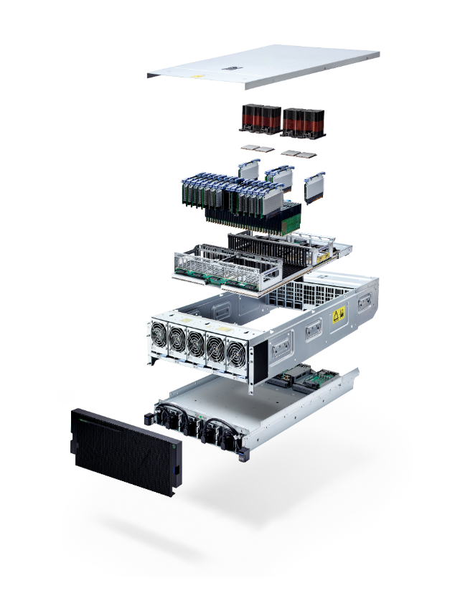
Scales Performance Affordably
POWER9 vs x86 Xeon SP
2x performance per core
1.8x memory bandwidth per socket
POWER9 vs. POWER8
2x – 4x memory capacity
40-50% more performance
Lower TCO
Save 50% in 3-5 years moving from POWER7 to POWER9
Notes:
Today, more than ever, you need servers that stay ahead of workload challenges, new data sources, and compute demands. IBM POWER9 processors not only drive the world’s fastest supercomputers, they are ready to accelerate your enterprise.
With 2x performance per core vs. x86 Xeon SP, IBM POWER9 allows you to do more with less which in turn saves you money on your software licenses. POWER9 also delivers 2.6x RAM per socket and 1.8x memory bandwidth per socket compared to x86 Xeon SP systems.
If you are already a Power customer running POWER8 servers you can upgrade and enjoy the 2x - 4x memory capacity, 2x I/O bandwidth increase and 40 - 50% more performance over existing POWER8 systems. Again this allows you to either consolidate more workload onto the same number of systems or reduce your software licensing costs by reducing the number of cores you are paying for software on.
And for those customers running POWER7 servers you can lower your total cost of ownership by 50% over 3-5 years by moving from POWER7 to POWER9 today.

Slide 15
Performance – E850 vs. E950
Sockets
2 or 4 sockets
2 or 4 sockets
More flexible core options and 4x more memory for data intensive workloads
Core Counts
3 options
4 options
Max Memory
4TB
16TB
Memory Bandwidth
768 GB/sec
920 GB/sec
Move data significantly faster through the system
IO Bandwidth
315 GB/sec
620 GB/sec
PCIe Gen 4 Sockets
10 PCIe Gen 4 slots
NVMe Bays
4 NVMe Bays
Notes:
This set of slides is a more detailed comparisons between POWER9, POWER8 and POWER7 Enterprise servers. If, for example, you are presenting to a client that is currently running an E880C, we suggest you remove the other comparison slides here and just focus on the specific comparison that is relevant to your client. But for completeness, we include the following comparisons in these 4 slides:
E950 vs. E850
E950 vs. E760
E980 vs. E880C
E980 vs. E780
This slide compares the E950 (right side) vs. the E850 (left side). As you can see both come in 2 and 4 socket configurations. However, the E850 came in 32 core, 40 core or 48 core options whereas the E950 comes in 4 options (32, 40, 44, and 48 cores). This allows clients greater flexibility in choosing the system size that is right for them. It should also be noted that the POWER8 processor was a dual chip module (DCM) while the E980 is a single chip module (SCM) which is delivers more efficient processor communications.
The E950 supports 4x more memory (16TB vs. 4TB) and increase the memory bandwidth by 20%. In addition, the I/O bandwidth has been increased by 2x and the E950 supports PCIe Gen4 which is 2x faster than PCIe Gen3 of the E850. On the storage side, the E950 provides faster and more compact storage with 4 NVMe bays and improves the serviceability cost of the storage with concurrently maintainable storage controllers.
Finally the E950 includes more reliable power and cooling with enhanced DC-DC regulator redundancy and concurrently maintainable fans.

Slide 16
Performance – E760 vs. E950
Sockets
1 or 4 sockets
2 or 4 sockets
Faster and more powerful cores to deliver faster insights
Core Counts
12, 24, 36, 48
32, 40, 44, 48
Max Memory
2TB
16TB
Memory Bandwidth
307 GB/sec
920 GB/sec
Move data significantly faster through the system
IO Bandwidth
74 GB/sec
620 GB/sec
PCIe Gen 4 Sockets
10 PCIe Gen 4 slots
NVMe Bays
4 NVMe Bays
Notes:
This set of slides is a more detailed comparisons between POWER9, POWER8 and POWER7 Enterprise servers. If, for example, you are presenting to a client that is currently running an E880C, we suggest you remove the other comparison slides here and just focus on the specific comparison that is relevant to your client. But for completeness, we include the following comparisons in these 4 slides:
E950 vs. E850
E950 vs. E760
E980 vs. E880C
E980 vs. E780
This slide compares the E950 (right side) vs. the E760 (left side). As you can see both come in systems up to 4 socket configurations (and the E760 also supports a 1 socket configuration). However, the E760 came in 12, 24, 36 and 48 core options whereas the E950 comes in 32, 40, 44, and 48 cores options so clients will get a minimum number of cores that was higher than they had with the E760. It should also be noted that the POWER9 processor delivers more efficient processor communications and has significantly faster cores.
The E950 supports 8x more memory (16TB vs. 2TB) and increase the memory bandwidth by 3 times. As well the I/O bandwidth has been increased by 8X and the E950 supports 10 PCIe Gen4 slots which are significantly faster than the 6 PCIe Gen2 slots available on the E760. On the storage side, the E950 provides faster and more compact storage with 4 NVMe bays and improves the serviceability cost of the storage with concurrently maintainable storage controllers.
Finally the E950 includes more reliable power and cooling with enhanced DC-DC regulator redundancy and concurrently maintainable fans.

Slide 17
Performance – E880C vs. E980
Sockets
4, 8, 12, 16
4, 8, 12, 16
Core Counts
Up to 192
Up to 192
2x more memory
Max Memory
32TB
64TB
IO Bandwidth
315 GB/sec
630 GB/sec
Move data significantly faster through the system
CEC Drawer Fabric
25.6 GB/sec
103 GB/sec
PCIe Gen 4 Sockets
8 PCIe Gen 4 slots / drawer
NVMe Bays
4 per drawer
Notes:
This set of slides is a more detailed comparisons between POWER9, POWER8 and POWER7 Enterprise servers. If, for example, you are presenting to a client that is currently running an E880C, we suggest you remove the other comparison slides here and just focus on the specific comparison that is relevant to your client. But for completeness, we include the following comparisons in these 4 slides:
E950 vs. E850
E950 vs. E760
E980 vs. E880C
E980 vs. E780
This slide compares the E980 (right side) vs. the E880C (left side). As you can see both come in 4, 8, 12, and 16 socket configurations and both support up to 192 cores. It should also be noted that the POWER8 processor was a dual chip module (DCM) while the E980 is a single chip module (SCM) which delivers more efficient processor communications.
The E980 supports 2x more memory (64TB vs. 32TB) allowing for greater consolidation of memory intensive workloads (like SAP HANA for example). The memory bandwidth between the two is the same (920 GB/sec/drawer) but the I/O bandwidth has been increased by 2X and the E980 supports PCIe Gen4 which is 2x faster than PCIe Gen3 of the E880C. The CEC drawer fabric also delivers 4x higher internode bandwidth via 25 GB/s SMP links and a flatter SMP topology which reduces latency and increases throughput. On the E980 side the fabric is 103 GB/sec while the 880C was 25.6 GB/sec.
On the storage side, the E980 provides faster and more compact storage with 4 NVMe bays which also allow clients to boot a system (locally) without the need for an external I/O drawer. and improves the serviceability cost of the storage with concurrently maintainable storage controllers.
Finally the E980 includes more reliability features with dynamic de-allocation of an SMP cable and ½ bandwidth more, SMP cable concurrent repair and distributed redundant clocks.

Slide 18
Performance – E780 vs. E980
Sockets
4, 8, 12, 16
4, 8, 12, 16
50% more cores with 16x more memory at more than 3x the bandwidth
Core Counts
Up to 128
Up to 192
4TB
64TB
Max Memory
Memory Bandwidth
272 GB/sec
920 GB/sec per drawer
IO Bandwidth
114 GB/sec
630 GB/sec
Move data significantly faster through the system
CEC Drawer Fabric
13 GB/sec
103 GB/sec
PCIe Gen 4 Sockets
8 PCIe Gen 4 slots / drawer
NVMe Bays
4 per drawer
Notes:
This set of slides is a more detailed comparisons between POWER9, POWER8 and POWER7 Enterprise servers. If, for example, you are presenting to a client that is currently running an E880C, we suggest you remove the other comparison slides here and just focus on the specific comparison that is relevant to your client. But for completeness, we include the following comparisons in these 4 slides:
E950 vs. E850
E950 vs. E760
E980 vs. E880C
E980 vs. E780
This slide compares the E980 (right side) vs. the E780 (left side). As you can see both come in 4, 8, 12, and 16 socket configurations and as mentioned the E980 supports up to 192 cores whereas the E780 only supported up to 128 cores (50% more cores with POWER9). It should also be noted that the POWER7+ processor was a dual chip module (DCM) while the E980 is a single chip module (SCM) which is delivers more efficient processor communications and helps to reduce software license costs for those software vendors that were treating the DCM as twice the price of an SCM configuration.
The E980 supports 16x more memory (64TB vs. 4TB) allowing for greater consolidation of memory intensive workloads (like SAP HANA for example). The memory bandwidth between the two systems is also dramatically improved (920 GB/sec/drawer for E980 vs. the 272GB/sec/drawer for E780). The I/O bandwidth has also increased by 4X and the E980 supports PCIe Gen4 which is significantly faster than PCIe Gen2 of the E780. The CEC drawer fabric also delivers 8x higher internode bandwidth via 25 GB/s SMP links and a flatter SMP topology which reduces latency and increases throughput. On the E980 side, the fabric is 103 GB/sec while the 780 was 13 GB/sec.
On the storage side, the E980 provides faster and more compact storage with 4 NVMe bays vs the 6 DASD bays of the E780. This also allow clients to boot a system (locally) significantly faster without the need for an external I/O drawer. and improves the serviceability cost of the storage with concurrently maintainable storage controllers.
Finally, the E980 includes more reliability features with dynamic de-allocation of an SMP cable and ½ bandwidth more, SMP cable concurrent repair and distributed redundant clocks.

Slide 19
INFRASTRUCTURE FOR ENTERPRISE PRIVATE CLOUDS
Notes:
Now let’s take a bit of a deeper look inside the E950 and E980 (note the internal features of the H950 and H980 are planned to be the same as the E9xx systems but have not yet been announced so there will be no details specified there).

Slide 20
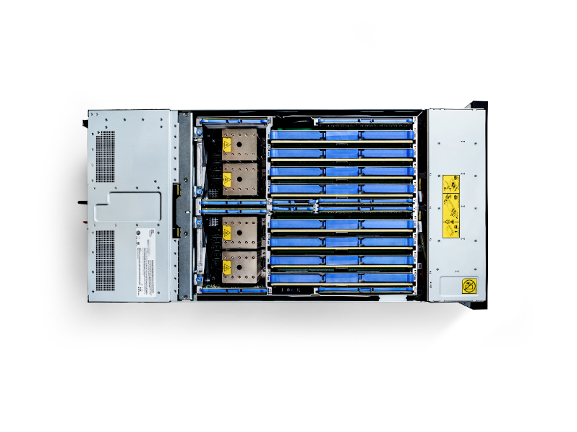
POWER9 E950
Improved economics of application delivery
4-socket 4U system
Up to 48 cores
Up to 16TB memory
Increased efficiency and lower operations costs
Increased bandwidth
Consolidation for many applications onto one system
Enhanced resiliency and serviceability
Hot plug, redundant power supplies and cooling all standard
Concurrent I/O maint.
Blind swap PCIe and disks
Rapid adjustment to changing demands
Built-in PowerVM
Capacity on Demand
Cloud management console
Notes:
What are the key design features of the E950 (and the future planned H950)?
Improved economics of application delivery
The IBM Power System E950 improves the economics of application delivery and IT services with the POWER9 architecture. This high-performance 4-socket system for medium and large enterprises delivers faster business results by increasing throughput and reducing response time with POWER9 processors and increased memory and I/O bandwidth.
Increased efficiency and lower operations costs
You can increase efficiency and reduce operations costs by consolidating older, underutilized servers. The Power E950 offers a compact, more cost-effective, space and energy efficient 4U form factor than POWER8, with a single system backplane and single cooling domain. It allows you to reduce maintenance, increase resource utilization and efficiency with up to 48 POWER9 cores and up to 16 TB DDR4 memory (4X vs POWER8).
Enhanced resiliency and serviceability
Hot plug, redundant power supplies and cooling are standard on the Power E950. The server offers an N+1 phase redundant voltage regulator subsystem for both processors and memory, and concurrent maintenance on I/O - blind-swap PCIe adapter slots and disks.
Rapid adjustment to changing demands
With the Power E950, you can rapidly adjust to the demands of a changing business climate. The server allows you to dynamically respond to workload changes with IBM PowerVM virtualization. You can seamlessly provision the processor or memory capacity permanently, or only as long as required, with capacity on demand for processors and memory.
The Power E950 is a redesigned 4-socket 4U system with increased bandwidth and efficiency compared to the E880C. Each Power E950 includes built-in PowerVM virtualization and provides a secure and scalable server virtualization environment for AIX and Linux (as well as IBM i but the E950 only supports AIX and Linux) applications built upon the advanced RAS features and leading performance of the Power Systems platform. PowerVC (based on OpenStack) cloud management is shipped as a priced option to support our clients cloud needs. Power E950 also includes Capacity on Demand and a three year license for Cloud Management Console (CMC). Similar to the Power E850C, the Power E950 will be in the small software tier. Finally, each Power E950 comes with three years of 24x7 service included which is a big advantage from a TCO perspective for customers currently on older Power systems.

Slide 21
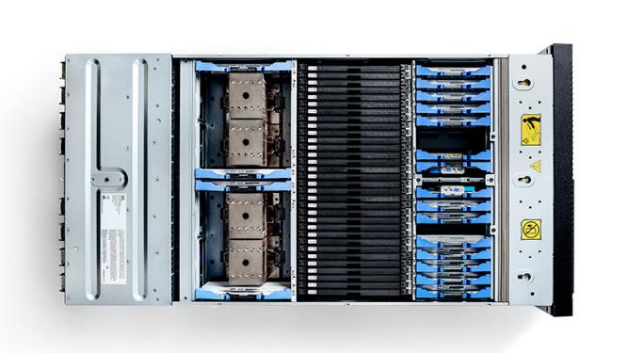
POWER9 E980
Massive throughput, performance and scalability
Modular high-end system up to 192 cores
Up to 64TB memory
1 to 4 nodes per system
Consolidation of underutilized servers
Increased bandwidth
Consolidation for many applications onto one system
Share resources in Power enterprise pools
Infrastructure resilience
Hot plug, redundant power supplies and cooling all standard
Concurrent I/O maint.
Blind swap PCIe and disks
Rapid service delivery and transition
Built-in PowerVM
Capacity on Demand
Non-disruptive upgrade from E870, E870C, E880, E880C
Notes:
What are the defining characteristics of the E980 (and the future planned H980)?
Massive throughput, performance and scalability
The IBM Power System E980 server offers a modular high-end system with up to 192 POWER9 cores, up to 64 TB memory and the fastest POWER9 processors in the Power Systems portfolio.
Consolidation of underutilized servers
The Power E980 allows you to enable large-scale consolidation of older, underutilized servers onto an ultra-efficient POWER9 high-end system with unprecedented levels of utilization and resource sharing to concurrently support AIX, IBM i and Linux applications.
Infrastructure resilience
The POWER9 high-end system is engineered to deliver the highest level of reliability, availability and serviceability. Features like hot plug, redundant power supplies and cooling are standard on the Power E980. As well as active memory mirroring which, when reading data from one location in memory, if an error is detected, the subsystem reads the data from the alternate location. A fault, even a solid uncorrectable error in the data, can be tolerated by using this feature. Note that IBM Power systems has long had concurrent maintenance for various parts of the hardware; allowing clients to add, remove or replace components while the system is still up and running. This includes power supplies, fans, disk drives, PCIe adapters, and I/O expansion drawers.
Rapid service delivery
The server delivers industry-leading virtualization, capacity on demand for processors and memory, and private cloud capacity to help provide seamless, non-disruptive growth and increased flexibility for multiple systems in an enterprise private cloud.
Smooth, non-disruptive transition
You can upgrade from Power Systems E870, E870C, E880 and E880C to maintain your investment in POWER8® and realize a smooth, non-disruptive transition by modernizing your infrastructure in less than 24 hours.
These features make the E980 the industry leader in per-core performance and massive throughput and bandwidth for the most demanding OLTP/database applications. With advanced virtualization capabilities including dynamic sharing of up to 192-cores, 64TB of memory across up to 1,000 partitions; Micro-Partitions and the ability to move live applications from one physical system to another without user interruption, the E980 is the best platform for workload consolidation.
All with the highest level of Power Systems Reliability, Availability and Serviceability that clients have come to put their trust in with IBM Power Systems. With comprehensive redundancy and system enablement for reduced unplanned downtime and elimination of planned application downtime.
And for existing clients we provide upgrades from POWER8 Power E870, E870C, E880, E880C systems to help clients preserve their investment in Power Systems & Software along with multi-system workload balancing & resource sharing with Power Enterprise Pools to enable clients to further optimize their TCO across multiple datacenter infrastructures.
The E980 is ideally suited for large enterprises looking to ceploy large-scale, secure private clouds in support of their mission-critical transactional and database applications. It is ideal for a consolidated and/or virtualized landscape of large-scale, in-memory database applications as well like SAP HANA.

Slide 22
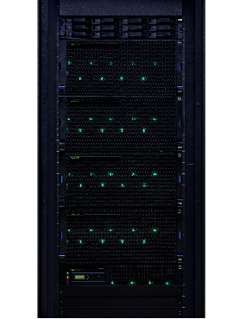
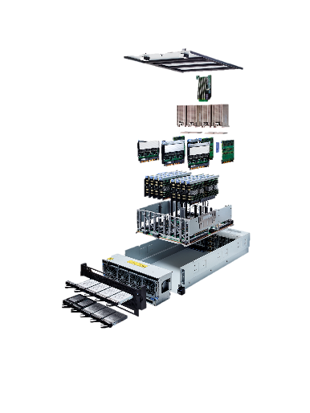
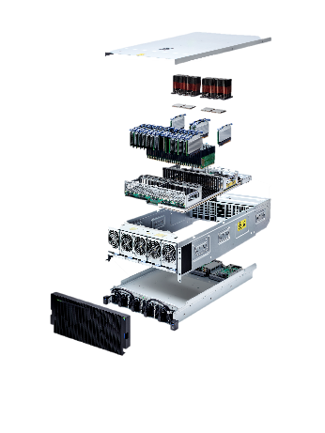
E950
4U, 2 or 4 sockets
Up to 48 processor cores
12, 11, 10 or 8 cores per socket
Up to 16TB total memory
4TB per processor
E980
Up to four 5U CEC drawers + 2U Control Unit
Up to 192 processor cores
12, 11, 10 or 8 cores per socket
Up to 64TB total memory
16TB per drawer
Where Mission Critical and Cloud come together
Notes:
If we look at the two systems side by side, here is the overall comparison of what’s inside:
The E950 comes in a 2 socket and 4 socket configurations in a 4U form factor for standard 19 inch rack enclosures. The E950 leverages the SMT8 processor in 12-core, 11-core, 10-core and 8-core offerings. Clients can leverage the 12-core processor for maximum throughput or the 8-core processor for maximum per core performance (or somewhere in between depending on the workloads they want to run on the system).
For private cloud deployments, the E950 server comes with up to 16TB of memory which supports up to 920 GB/s of total system memory bandwidth (230GB per processor) for memory demanding workloads like databases, data-intensive applications and in-memory analytics systems.
The E980 supports up to four 5U CEC drawers plus a 2U control unit all in the standard 19 inch rack enclosure. This allows up to 192 processor cores in total (like the E950 you can choose from 12-core (maximum throughput), 11-core, 10-core or 8-core (maximum per core performance) processors. The E980 servers are designed for continuous operations for business critical services and delvers more virtual machines (VMs) and more throughput per server than any other server on the market. The E980 supports 230 GB/s memory bandwidth and up to 4TB of memory per socket. The servers have 8 DIMM slots per socket, 32 DIMMs per drawer, 128 DIMMs max in the configuration and supports CDIMMS of 32, 64, 128, 256, and 512 GB DDR4 memory.

Slide 23
IBM Power Systems
Co-optimized software and hardware
Industry-leading accelerators and technologies
Open ecosystem
Cloud deployment options
Notes:
IBM Power Systems are built for the most demanding, data-intensive, computing on earth. IBM’s cloud-ready Enterprise servers help clients unleash insight from their data pipeline – from managing mission-critical data, to managing their operational data stores and data lakes, to delivering the best server for cognitive computing.

Slide 25
Backup

Slide 26
Key generational enhancements POWER7 to POWER9 (midrange)
Features | Power 760 | E850C | E950 | Impact (POWER7 to POWER9) | Impact (POWER8 to POWER9)
Processor | POWER7 | POWER8 (DCM) | POWER9 (SCM) | Faster and more powerful | More efficient processor communication
Sockets | 1 to 4 | 2 to 4 | 2 to 4
Cores | 12 or 24 or 36 or 48 | 32 or 40 or 48 | 32 or 40 or 44 or 48 | Higher minimum cores | More Processor Options
Maximum Memory | 2TB | 4 TB | 16 TB | 8X Maximum Memory | 4X Maximum Memory
DIMM Type/DIMM slots count | Up to 64 Industry Standard DIMMs | Up to 32 CDIMMs | Up to 128 Industry Standard DIMMs | Faster and More memory | More Memory Capacity and Flexibility
Memory Bandwidth | 307 GB/sec | 768 GB/sec | 920 GB/sec | 3X Memory Bandwidth | 20% more Memory Bandwidth
IO Expansion Slots | Yes | Yes | Yes
PCIe slots | 6x PCIe Gen2 | 11x PCIe Gen3 | 10x PCIe Gen4, 1x PCI Gen3 | More slots and Faster | PCIe Gen4
Acceleration Ports | No | Yes (CAPI 1.0) | Yes (CAPI 2.0 + OpenCAPI) | Future enablement for accelerators | Future enablement for accelerators
PCIe Hot Plug Support | Yes | Yes | Yes + Blindswap | Better Serviceability | Better Serviceability
IO bandwidth | 74 GB/sec | 315 GB/sec | 630 GB/sec | >8X IO bandwidth | 2X IO bandwidth
Ethernet ports | Max 40Gbs | Max 100 Gbs | Max 100 Gbs | Faster offerings
Internal Storage Bays | 6x 2.5” SAS bays | 12 (8x 2.5” SAS bays + 4x 1.8” SSD bays) | 12 (8x 2.5” SAS bays + 4x NVMe bays) | More SAS bays and more options | Faster and more compact storage
Internal Storage Controllers | Integrated | Integrated | Optional and Concurrent Maintainable | Improved cost and seviceability | Improved cost and seviceability
RAS |  |  | Enhanced DC-DC Reg Design Enhanced Fan Concurrent Maintainance P8 to P9 | More reliable and serviceable power | More reliable and serviceable power. More serviceable cooling

Slide 27
Key generational enhancements POWER7 to POWER9 (high-end)
Features | Power 780 | Power E880C | Power E980 | Impact (POWER7 to POWER9) | Impact (POWER8 to POWER9)
Processor | POWER7+ | POWER8 | POWER9 | Faster response time and increased system scalability | Faster response time and increased system scalability
Sockets | 4, 8, 12, 16 | 4, 8, 12, 16 | 4, 8, 12, 16
Cores | Up to 128 cores | Up to 192 cores | Up to 192 cores | Up to 50% more cores
Maximum Memory | 4TB | 32TB | 64TB | 16X increase in memory capacity significantly improves performance of large-scale in-memory DB applications | Enhance the performance of large-scale in-memory DB applications
Memory Bandwidth | 272 GB/sec / drawer | 920 GB/sec / drawer | 920 GB/sec / drawer | 238% increase in memory bandwidth provides improved application performance
I/O Drawer Expansion | Yes | Yes | Yes
PCIe slots | 6 PCIe GEN2 slots / drawer | 8 PCIe GEN3 slots / drawer | 8 PCIe GEN4 slots / drawer | Over 4X I/O bandwidth | 2X I/O bandwidth
IO bandwidth | 144 GB/sec | 315 GB/sec | 630 GB/sec
CEC Drawer fabric | 13.2 GB/s | 25.6GB/s | 103.12GB/s | Nearly 8X higher internode bandwidth via 25Gb/s SMP links which flatten SMP topology to reduce latency & increase throughput | 4X higher internode bandwidth via 25Gb/s SMP links flattens SMP topology to reduce latency & increase throughput
Acceleration Ports | No | Yes (CAPI 1.0) | Yes (CAPI 2.0 + OpenCAPI) | Future enablement for accelerators | Future enablement for accelerators
PCIe Hot Plug Support | Yes | Yes | Yes
Integrated I/O | Integrated Ethernet, DASD Controller, USB | USB adapters supported in PCIe adapter slots in a drawer | Integrated USB 3.0 ports | Flexibility for additional device attachment | Flexibility for additional device attachment
Internal Storage Bays | 6 DASD Bays / drawer | None - all bootable storage is external to the CEC drawers | 4 NVMe Bays / drawer | Faster bootable storage option | Enable clients to boot a system (locally) without the need for an external I/O drawer
RAS | Redundant Flexible Service Processors Redundant Clocks | Redundant Flexible Service Processors Redundant Clocks | Redundant Flexible Service Processors Guided FSP & SMP Cable installation Dynamic de-allocation of a SMP cable & 1/2 bandwidth mode SMP cable concurrent repair Distributed Redundant Clocks, no unique clock cabling required | Provide the highest level of single-system reliability available within the Power Systems portfolio, enhance business resilience & the availability of clients’ mission-critical applications to keep IT teams focused on deployment instead of system maintenance | Provide the highest level of single-system reliability available within the Power Systems portfolio, enhance business resilience & the availability of clients’ mission-critical applications to keep IT teams focused on deployment instead of system maintenance

