Slide 1
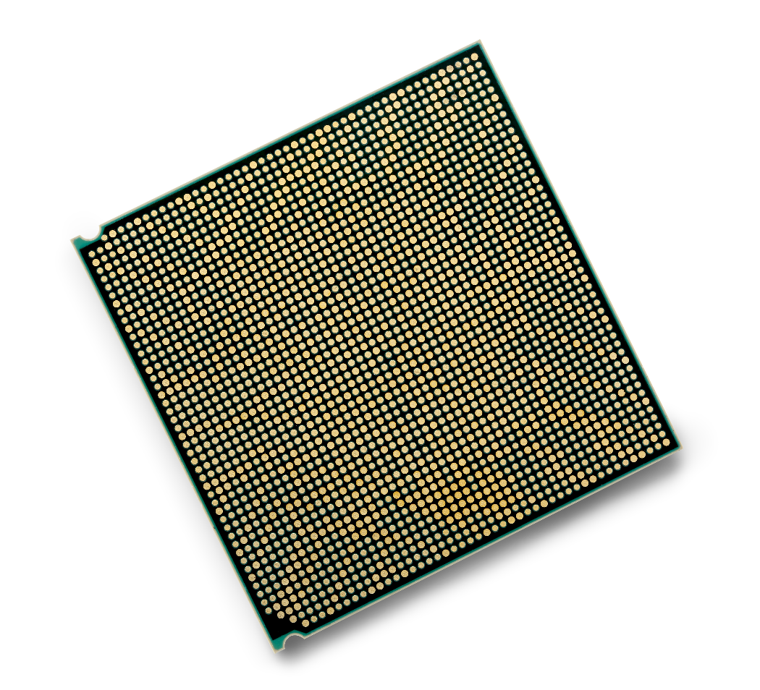

IBM POWER9:
Enterprise servers
Deeper Details for Sellers and Business Partners
—
Chris Eaton (ceaton@ca.ibm.com)
Ross Perry (ross.perry@ibm.com)
Adrian Robinson (adrianor@us.ibm.com)
George Gaylord (ggaylord@us.ibm.com)
Notes:
In this presentation we will cover the details of the POWER9 Enterprise servers which include both the new E950 and E980 along with their SAP optimized “twins” the H950 and H980. Note that in these slides we will focus on the E9xx servers but the same features and functions are also planned at some point in the future for the H9xx models. The H950/H980 have not been announced and so SAP HANA clients should look at the E950 and E980 as their platform of choice for SAP HANA workloads.
For these specific servers, you will often be talking to existing Power Enterprise server accounts about the new POWER9 capabilities and as such we have included performance comparisons with POWER7 as well as POWER8 servers in addition to comparisons vs. x86 systems.

Slide 2

Agenda – A look at what’s inside the box
E950 Details
  Processor and memory options
  I/O capabilities
  Software support levels
  Elastic capacity on demand
E980 Details
  Processor and memory options
  I/O capabilities
  Software support levels
  Elastic capacity on demand
Upgrade strategy and cost savings
Notes:
This deck is broken down into three parts:
The details on the E950 (and by extension the H950)
The details on the E980 (and the H980)
Strategies for getting clients to upgrade to POWER9 (cost savings and other programs available to help clients make the move).
The first two sections will cover the processor and memory options as well as the I/O capabilities of each server. We will also look at the operating system support levels and the benefits of clients leveraging capacity on demand with each of those two servers.
Where appropriate, this deck will call out what was made available in 3Q of 2018 and what was delivered in Q4 of 2018 (specifically around the E980 larger number of nodes supported).

Slide 3
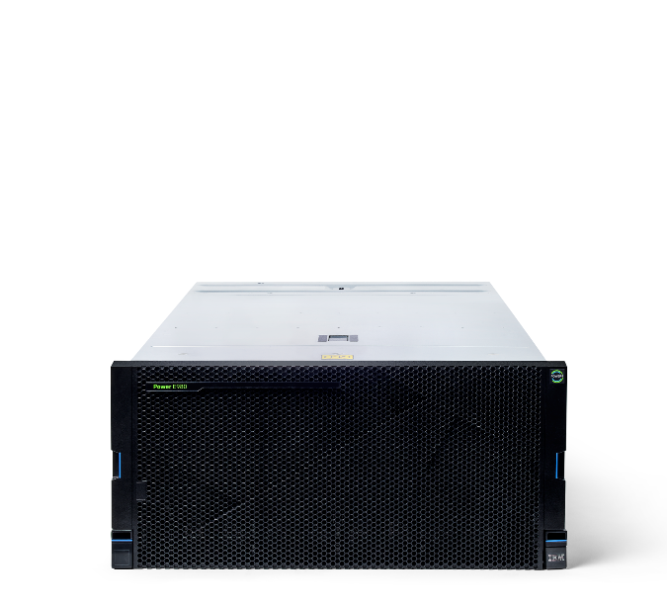
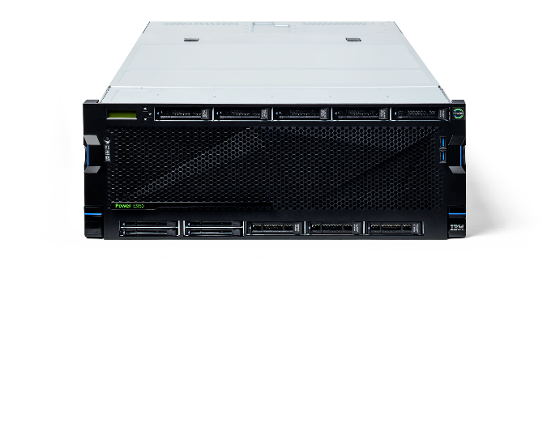
IBM Power System E980
Gain the extraordinary scalability, security, performance and availability for your data centers with cloud deployments for your most demanding AIX®, IBM i and Linux applications. The flexibility of this large enterprise server helps develop a large cloud infrastructure with proven reliability.
Meet the IBM Power Systems enterprise servers for accelerating your cloud infrastructure
IBM Power System E950
Benefit from blazing performance, extreme
agility and industry leading reliability in a compact 4-socket system. It is an ideal platform
for growing medium-size businesses and as
a departmental server or data center
building block for large enterprises.
Notes:
To address these IT challenges, IBM has recently announced the next evolution in Power Enterprise Systems…the E950 and E980.
The E950: Designed for private cloud and cognitive workloads, the E950 offers a unique blend of enterprise-class capabilities in a 4-socket 4U form factor. Optimized for private cloud deployments, the IBM® Power System E950 midrange server offers a unique blend of enterprise-class capabilities in a reliable, secure, space-efficient 4-socket 4U form factor that delivers exceptional performance for medium and large enterprises at an affordable price. The Power E950 is ideal for cloud deployments with built-in virtualization and flexible capacity for AIX and Linux workloads. It allows you to deliver faster business results by increasing throughput and reducing response times with POWER9 processors and increased memory and I/O bandwidth.
The E980: The flexibility of the IBM® Power System E980 high-end enterprise server can help you deploy large cloud infrastructures with proven reliability, tighter security, rapid scalability, and simplified maintenance and management. With up to 192 POWER9 cores, up to 64 TB memory, and the fastest POWER9 processors in the Power Systems portfolio, the Power E980 delivers extraordinary performance and availability for data centers with demanding AIX, IBM i, and Linux workloads.

Slide 4
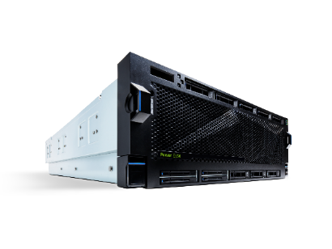
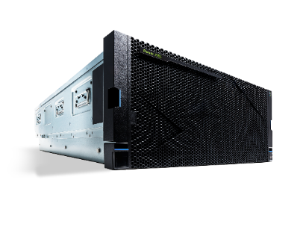
POWER9 for Enterprise Systems one page overview
Feature | E950 | E980 1-4 nodes
MTM | 9040-MR9 | 9080-M9S
System Packaging | 4U | 5U system node & 2U system controller unit
Processor Socket | 2 to 4 sockets | 4 sockets per node
# of cores | 32, 40, 44, or 48 cores | Up to 192 cores
Memory DIMM Slots – Max | 128 DDR4 Industry Standard DIMMs | Up to 128 DDR4 CDIMMs (32 per node)
Memory – Max | 16TB | 64TB
Built-in Virtualization | Yes | Yes
PCIe Gen4 Slots | 10 Slots | 8 Slots per node, up to 32 slots total
Operating System | AIX, Linux | AIX, IBM i, Linux
Notes:
This slide illustrates a short side-by-side comparison of our two enterprise servers.
The E950 is a 4U server that supports up to four POWER9 processors. Aside from the processor, the biggest change from POWER8 is the memory. The E950 supports up to 16TB of memory which is 4x the capacity of the E850C. This significant improvement makes it a very compelling platform for SAP HANA in-memory database workloads. IBM has also shifted from its historical custom memory CDIMMs to industry standard DIMMs to make the E950 an even more affordable option. Like other POWER9 servers, the E950 also received an I/O upgrade with new PCIe Gen4 slots that double the bandwidth of previous systems. The operating systems supported on the E950 are AIX and Linux (the details of which are explained later in this deck). The E950 was made available August 17, 2018.
The E980 is a modular, multi-node system (note that we will use the term node, CEC, and drawer as synonyms throughout this presentation). The system scales from 1 to 4 nodes with the 1 and 2 node options delivered in September of 2018 while the 3 and 4 node options were delivered in November, 2018. In addition to the significant performance and scalability for IBM’s most powerful enterprise server, clients also benefit from enhancements to the memory and I/O subsystem as well. Details of each of these servers follow in the next set of slides.

Slide 5
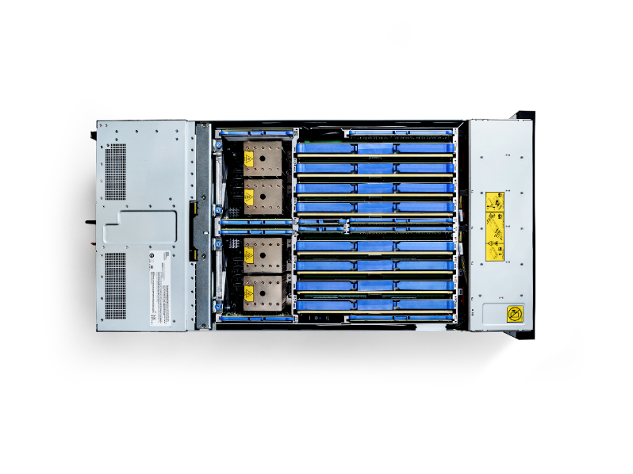




POWER9 E950
Notes:
What are the key design features of the E950 (and H950)?
Improved economics of application delivery
The IBM Power System E950 improves the economics of application delivery and IT services with the POWER9 architecture. This high-performance 4-socket system for medium and large enterprises delivers faster business results by increasing throughput and reducing response time with POWER9 processors and increased memory and I/O bandwidth.
Increased efficiency and lower operations costs
You can increase efficiency and reduce operations costs by consolidating older, underutilized servers. The Power E950 offers a compact, more cost-effective, space and energy efficient 4U form factor than POWER8, with a single system backplane and single cooling domain. It allows you to reduce maintenance, increase resource utilization and efficiency with up to 48 POWER9 cores and up to 16 TB DDR4 memory (4x vs POWER8).
Enhanced resiliency and serviceability
Hot plug, redundant power supplies and cooling are standard on the Power E950. The server offers an N+1 phase redundant voltage regulator subsystem for both processors and memory, and concurrent maintenance on I/O - blind-swap PCIe adapter slots and disks.
Rapid adjustment to changing demands
With the Power E950, you can rapidly adjust to the demands of a changing business climate. The server allows you to dynamically respond to workload changes with IBM PowerVM virtualization. You can seamlessly provision the processor or memory capacity permanently, or only as long as required, with capacity on demand for processors and memory.
The Power E950 is a redesigned 4-socket 4U system with increased bandwidth and efficiency compared to the POWER8 E880C. Each Power E950 includes built-in PowerVM virtualization and provides a secure and scalable server virtualization environment for AIX and Linux (as well as IBM i but the E950 only supports AIX and Linux) applications built upon the advanced RAS (Reliability, Availability, Serviceability) features and leading performance of the Power Systems platform. PowerVC (based on OpenStack) cloud management is shipped as a priced option to support our clients cloud needs. Power E950 also includes Capacity on Demand and a three year license for the Cloud Management Console (CMC). Similar to the Power E850C, the Power E950 will be in the small software tier. Finally, each Power E950 comes with three years of 24x7 service included which is a big advantage from a TCO perspective for customers currently on older Power systems.

Slide 6
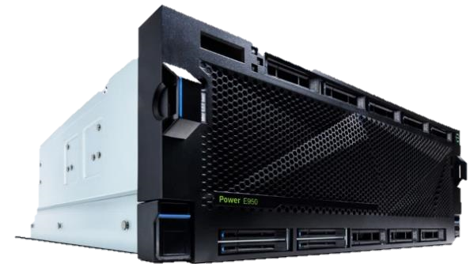
POWER9 4 Socket Server E950 Highlights
POWER9 Enterprise SMT8 processor (12-core, 11-core,10-core, 8-core offerings)
2 or 4 Processor Socket offerings (3 sockets in future GA)
Processor SCMs enables efficient 1-Hop processor fabric interconnect
Up to 16TB Total DDR4 DIMMs – up to 4TB per processor
    920 GB/s total system memory bandwidth, 230GB per Processor
    128 DIMM slots on 8 memory riser cards, 16 DIMM slots on each riser, 2 riser cards per processor
Capacity on Demand for Processor and Memory
10 PCIe Gen4 slots, 1 PCIe Gen3 - Blind swap, Full Height, Half Length
Four High Speed 25Gb/s acceleration ports to attach to future OpenCAPI accelerators
Internal Storage 8 SFF (2.5”) SAS bays + 4 NVMe Flash U.2 Bays
Controller adapters for Internal Storage plug into PCIe Slots
    Concurrently maintainable
    Single or Split backplane (Dual RAID write cache future support)
Enhanced DC-DC Regulator Redundancy
Full Fan Concurrent Maintenance
I/O Expansion and Storage drawers support
4U Server - 19” Rack Enclosure
Notes:
The Power E950 is a redesigned 4-socket 4U system with increased bandwidth and efficiency compared to the POWER8 E880C. With 4 options for core counts (12, 11, 10, and 8 core options) this server can be configured with 2 or 4 sockets populated. There is a plan to have a 3 socket option in the future. Note that unlike the dual chip modules of POWER8, the POWER9 processor is a single chip module (SCM) which provides for more efficient communication between processors and improves memory locality issues. SCM also reduces software costs for vendors that previously required twice the number of licenses for a dual chip module (DCM) processor.
The E950 supports up to 16TB of memory when all sockets are populated (4TB per socket) and supports up to 230GB/s memory bandwidth per processor. This server also includes superior reliability with chip kill (take a processor offline but keep the system running) and lane sparing technology (if a data lane is faulty take it offline but keep the system running) for higher availability. This is a big enhancement over the E850C and a key differentiator when comparing to the POWER9 scale-out servers.
In addition to the memory bandwidth enhancements, the I/O bandwidth has also been greatly improved with the availability of 10 PCIe Gen 4 slots which are 2x faster than Gen3. Along with the addition of 4 NVMe flash bays, the E950 is able to deliver higher performance for both in-memory databases as well as traditional I/O intensive applications like transactional and other analytic and data intensive workloads.

Slide 7
E950 Processor Highlights
Feature Code | Processor SMT8 Cores | Typical Frequency Range
EPWT EPWX | 12 cores 1way activation | 3.15 to 3.8Ghz (max) Min 12 cores activated
EPWY EPN3 | 11 cores 1way activation | 3.20 to 3.8Ghz (max) Min 11 cores activated
EPWS EPWW | 10 cores 1way activation | 3.40 to 3.8Ghz (max) Min 10 cores activated
EPWR EPWV | 8 cores 1way activation | 3.60 to 3.8Ghz (max) Min 8 cores activated
SCM Single Chip Design
Four processor offerings available (SMT8 cores)
  12-core processor (for maximum throughput)
  11-core processor
  10-core processor
  8-core processor (for maximum core performance)
Processor frequencies dynamic by default – set to maximum performance mode
Increased processor to processor fabric interconnect
  X-Bus fully connected fabric within CEC Drawer
  25Gbps link for future OpenCAPI accelerators
Minimum configuration is 2 CPUs installed
3 CPU configuration supported at future date
Min # of cores that must be activated is one socket’s worth
  See table in upper right corner
P9
P9
4B X Buses
16Gb/s
P9
P9
Notes:
Let’s take a deeper look at the E950’s processor design. As previously mentioned, POWER9 is a single chip module (SCM) which is different from the POWER8 dual chip modules (DCM) which had 2 dies in one socket. In POWER9 there are no dual chip modules, only single chip modules are available. As mentioned above, IBM has 4 offerings in the E950 with an 8-core, 10-core, 11-core, and a 12-core processor.
The same guidance applies to POWER9 as was given for POWER8 when it comes to choosing the core counts for the processor. If the client is looking for maximum throughput then they would use the 12-core processor. However, if their priority is the fastest execution of a single thread or core, then go down to the lower core counts with the 8-core having the fastest speed available. The 8-core will be running between 3.6 and 3.8 GHz while the 12-core will be running between 3.15 and 3.8GHz.
For the E950, you can populate either 2 or 4 sockets. There is a planned option in the future to support 3 socket configurations, but at this time the minimum number of sockets populated is 2 and the only other option is 4.
Power frequencies with the entire POWER9 line are dynamic. This is different than prior generations which had fixed frequencies. In the next slide we will discuss the various performance and power modes. For the E950 and E980, the default setting is maximum performance mode (described in more detail on the next chart).
Note the new POWER9 interconnect fabric between the sockets is running at significantly higher speeds. With POWER9, the interconnect fabric runs at 16GB/s for maximum scalability and it is also more tolerant of any memory affinity issues that may arise in some software applications.

Slide 8
POWER9 Power Management Modes
Static Power Save Mode
Static Nominal Mode
  Idle Power Saver (IPS) can be on or off
Dynamic Performance Mode
  Workloads run at highest frequency possible
  Max Workload/Max Cores runs >= nominal
  in all environments
  CPU managed to Nominal power draw
  Idle Power Saver (IPS) can be on or off
Maximum Performance Mode (default)
  Workloads run at highest frequency possible
  Max Workload/Max Cores runs >= turbo in favorable environments
  CPU managed to Turbo power draw level – Higher acoustics
  Idle Power Saver (IPS) can be on or off
Frequency
Ultra
Light
Workloads or
many Idle Cores
Light/Medium
Workloads or
a few Idle Cores
Turbo
High
Ambient
Range
Nom
Socket Idle
OR
System Idle
(if IPS on)
System Idle
(if IPS on)
System Idle
(If IPS on)
P.S.
Static
Nominal
Dynamic Performance
Maximum Performance
0 Ghz
Notes:
Let’s walk through the power management modes (which are the same for all POWER9 systems). Static power save mode, which runs the systems at even lower than nominal mode, allows clients to set their systems at the lowest possible power mode for times when they are not using the system (weekends, holidays, etc.).
Static nominal mode, runs at the nominal frequency and remains static regardless of the workload or data center temperature.
For POWER9, there is a new capability that allows the system to run at an optimum frequency. POWER9 servers have micro processors that are measuring temperature, monitoring power, and also monitoring the workload frequency based on what the workload is doing. Most customers are running at a nominal environment and are rarely running the processor at 100% utilization. If processor utilizations are sitting at 30 to 50%, then the server will adjust the frequency and optimize it and go as high as possible.
Maximum performance mode will run the processors at the highest possible frequency range. This will draw more power, but you will get a higher set of frequencies that can dynamically be adjusted within.
Most POWER9 servers, including both the E950 and E980, are shipped with the default set to maximum performance mode.

Slide 9
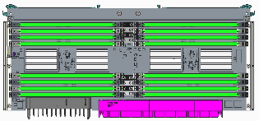
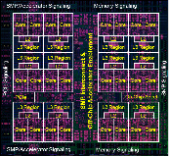
E950 Memory Subsystem Highlights
16 Terabytes
230 GB/sec
Maximum memory capacity on a Power E950
Maximum memory bandwidth
E950 Memory Riser Card 1
POWER9
E950 Memory Riser Card 2
4TB of memory maximum per socket
8 memory riser cards (2 per socket) with 16 DIMM slots per riser card
128 DIMMs slots total
8, 16, 32, 64, 128GB DDR4 DIMM sizes
Minimum configuration – 1 riser card per socket with 8 DIMMs installed
50% of installed memory must be activated or 128GB (whichever is greater)
Notes:
There are two memory architectures in the POWER9 line. There are direct memory interfaces with POWER9 chips in the two-socket (scale out) market and a buffered memory attachment for the mid-range (E950) and the high-end (E980) enterprise servers.
The E950 buffered memory architecture is different than what was available in the POWER8 line. POWER8 enterprise servers used custom DIMMs on an IBM card that had the buffered memory. With the POWER9 E950 server, IBM is leveraging riser cards. This is similar to what Intel is doing as well. The E950 has 2 riser cards per socket for a total of 8 riser cards in the 4 socket configuration.
The riser cards and industry standard DIMMs help optimize overall cost and allows for more granular memory packaging which provides better competitive positioning without losing the value of the buffered memory. The E950 supports up to 16TB of DDR4 memory. Note however that the use of riser cards and industry standard DIMMs means that you cannot bring your POWER8 server CDIMMS over into this server. That said, our experience is that in this offering space, most customers going to new technology will typically make a full purchase of a new system with new memory.
As you can see from the slide, the E950 supports 8GB, 16GB, 64GB, and 128GB DDR4 DIMMs; this means the maximum amount of memory depends on the size of the DIMMs you choose and the number of sockets populated. Given 2 riser cards per socket and 16 DIMM slots available on each riser card, you can easily calculate the DIMM sizes required for the total amount of memory a client needs. Note that the minimum configuration is 1 riser card per socket (and the maximum is 2 riser cards per socket) and the system must have a minimum of 8 DIMMs installed per riser card. This gives a minimum configuration of 128GB of memory (8GB DIMMS x 8 DIMMs installed x 1 riser card per socket x 2 socket minimum). If you are running with the minimum memory configuration then all 128GB of memory must be activated. If you have more than 128GB of memory installed then at least 50% of the memory must be activated (as long as that 50% is greater than 128GB).
There are of course plug rules for installing the memory which have been documented in the backup section of this presentation (it’s also available in the knowledge center for the E950).

Slide 10
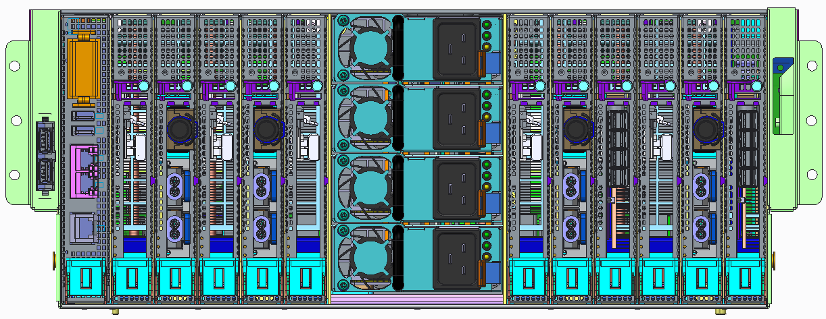
E950 PCIe Slots
Internal PCIe Slot Summary
E950 Rear view
Slot | Attributes | Note
C12 | PCIe Gen4 x8 (SAS adapter) | 1st POWER9 socket
C11 | PCIe Gen4 x16 (EJ08 slot)
C10 | PCIe Gen4 x16 (EJ08 slot)
C9 | PCIe Gen4 x8 (SAS adapter) | 2rd POWER9 socket
C8 | PCIe Gen4 x16 (EJ08 slot)
C7 | PCIe Gen4 x16 (EJ08 slot)
C6 | PCIe Gen3 x8 (rsrv for base Eth)
C5 | PCIe Gen4 x16 (EJ08 slot) | 3rd POWER9 socket
C4 | PCIe Gen4 x16 (EJ08 slot)
C3 | PCIe Gen4 x16 (EJ08 slot) | 4th POWER9 socket
C2 | PCIe Gen4 x16 (EJ08 slot)
C1 | Service Processor Card
USB 2.0
Ports
C1
FSP
C2
C3
C4
C5
C6
C7
C8
C9
C10
C11
C12
3Q 2018 - External PCIe Expansion Summary
Num of CPUs | Max Drawers (EMX0) | Max Fanout Modules (EMXF, 6 slots each) | Total PCIe Slots Internal and External
2 | 2 | 4 | 27
4 | 2 | 4 | 31
EJ08 – I/O Expansion Adapter
4Q 2018 - External PCIe Expansion Summary
Num of CPUs | Max Drawers (EMX0) | Max Fanout Modules (EMXF, 6 slots each) | Total PCIe Slots Internal and External
2 | 2 | 4 | 27
4 | 4 | 8 | 51
PCIe Slots are concurrently maintainable from rear via IO cassette
Full height, half length PCIe form factor
Notes:
From an I/O perspective, the E950 has a total of 12 PCIe slots with the first slot (C1) reserved for the service processor card. This leaves 11 slots available for clients to populate. Of those 11 slots, 10 are PCIe Gen4 while one Gen3 slot is reserved for the Base Ethernet card (C6).
As you can see from the above diagram, in a 2 socket configuration there are 6 PCIe Gen4 slots and the one Gen3 base ethernet card slot available. Adding the 2 additional sockets allows for another 4 PCIe Gen 4 x16 slots. All of the slots are concurrently maintainable and all are full height half length form factor slots.
The external PCIe expansion information is available on the lower left corner of the slide. As you can see, in 4Q2018, the E950 allows for an additional 2 drawers in the 4 socket configuration, for a total of 51 PCIe slots (internal plus external).
Use the following information while selecting slots for installing PCIe adapters in the E950 system:
C9 and C12 are general-purpose slots that are also designated as serial-attached SCSI (SAS) controller slots for controlling the internal disk bays.
All of the x16 PCIe slots are coherent accelerator processor interface (CAPI) enabled.
Four of the x16 PCIe slots support NVlink or OpenCAPI 25 Gbs cable cards. The OpenCAPI cable cards cannot be serviced with the system power turned on.
C1 is for the FSP2 service processor card. The FSP2 slot cannot be serviced with the system power turned on.
C6 is designated for the Base Ethernet card.
The feature code (FC) column listed in table 3 on this Knowledge Center lists all of the supported adapters for the E950: https://www.ibm.com/support/knowledgecenter/en/POWER9/p9eab/p9eab_950_slot_details.htm

Slide 11
Operating Systems and Firmware Stack Support
Operating System Support
  AIX 7.2 TL1, TL2
  AIX 7.1 TL5
  AIX 6.1 TL9
  VIOS 2.2.6.23
  SLES 11 SP4 BE - for SAP HANA (p8compat mode)
  SLES 12 SP3 LE (limited p9 mode)
  SLES 15 LE (p9 mode)
  RHEL 7.5 LE for P8 (p8compat mode)
  Ubuntu 16.04.4 for P8 (p8compat mode)
Firmware Support
  FW920 / HMC920
  PowerVM
Notes:
As for the operating and firmware supported, the E950 supports AIX (6.1, 7.1 and 7.2) as well as Linux (SLES 11, 12, and 15, as well as RHEL 7.5 and Ubuntu 16.04.4). Also shown on this slide are the firmware and HMC versions supported. And of course PowerVM comes preinstalled on all POWER9 servers.
11

Slide 12

Part migration from
E850 or E850C to E950
E950 is a roll in / roll out replacement from E850 and E850C.
However, there are several components
class that can be moved.
  Power Supplies: Yes from E850C only
  P8 IO adapters: Yes for legacy adapters
  that E950 supports
  IBM SAS adapter: Yes for F/C EJ0K level
  in all PCIe slots; F/C EJ0J in all PCIe
  slots except C9 and C12
  SAS HDD/SSD: Yes for the models that
  E950 supports
  IO Drawer: Yes
  DASD Drawers: Yes
Notes:
As previously mentioned, the E950 is typically a roll in of a new fully configured system and a roll-out of the older E850 or E850C system. However, it is possible to move some of the components from the older POWER8 E850/E850C to the new E950 server.
The above slide lists the components that you can move to the E950. Remember, as previously mentioned, the E850 memory cannot be moved to the E950 servers.

Slide 13
Elastic Capacity on Demand
US$5per day
buys one core of POWER9 performance - a processor core and 16GB of memory - on an IBM Power E950 using Elastic Capacity on Demand.
Activate an additional 2 processors and 16GB of memory for additional temporary capacity at around $50 for a M-F business week.
ECOD Pricing (includes activation and system software):
E850C/E950 Processor core $3/day
8 GB Memory $1/day
Notes:
Capacity on demand (CoD) is available in the E950, but it is important to highlight the price. This is a tremendous opportunity for clients that are deploying private cloud environments and turn on processors, as well as memory, for one day at a time at a very low cost.
This ability to burst new workloads for short periods, and be able to react quickly to increased demand in a private cloud is extremely valuable to clients. The pricing in the United States is just $3US per core per day and $1US per 8 GB of memory per day. This means that for just $5US per day clients can utilize a processor core + 16 GB of memory on a Power E950 that has dark resources installed. This is ideal for an extra project which requires resources for a short period of time or for increased application testing or for a short spike in demand.
Clients can buy this through the IBM marketplace where they can prepay for a set of resources. They simply need to sign up at the IBM marketplace, get their keys, and allocate their credits to a given system to be able to utilize this capability…SIMPLE!

Slide 14
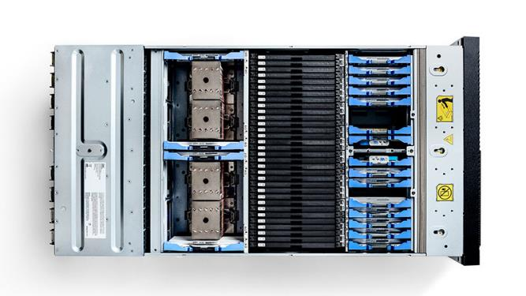

POWER9 E980
Notes:
What are the defining characteristics of the E980 (and H980)?
Massive throughput, performance, and scalability
The IBM Power System E980 server offers a modular high-end system with up to 192 POWER9 cores, up to 64 TB memory, and the fastest POWER9 processors in the IBM Power Systems portfolio.
Consolidation of underutilized servers
The Power E980 allows clients to enable large-scale consolidation of older, underutilized servers onto an ultra-efficient POWER9 high-end system with unprecedented levels of utilization and resource sharing. The E980 concurrently supports AIX, IBM i, and Linux applications.
Infrastructure resilience
This POWER9 high-end system is engineered to deliver the highest level of reliability, availability, and serviceability (RAS). Features like hot plug, redundant power supplies and cooling are standard on the Power E980; as well as active memory mirroring which, when reading data from one location in memory, if an error is detected, the subsystem reads the data from an alternate location. A fault, even a solid uncorrectable error in the data, can be tolerated by using this feature. Note that IBM Power Systems has long had concurrent maintenance for various parts of the hardware; allowing clients to add, remove, or replace components while the system is still up and running. This includes power supplies, fans, disk drives, PCIe adapters, and I/O expansion drawers.
Rapid service delivery
These servers deliver industry-leading virtualization, capacity on demand for processors and memory, and private cloud capacity to provide seamless, non-disruptive growth and increased flexibility for multiple systems in an enterprise private cloud.
Smooth, non-disruptive transition
Clients can upgrade from IBM POWER8 servers E870, E870C, E880, and E880C and maintain the investments they had previously made in POWER8 and realize a smooth, non-disruptive transition by modernizing your infrastructure in less than 24 hours!
These features make the E980 the industry leader in per-core performance, throughput, and bandwidth for the most demanding transactional and analytic database applications. With advanced virtualization capabilities, including dynamic sharing of up to 192-cores, 64TB of memory across up to 1,000 partitions, micro-partitioning, and the ability to move live applications from one physical system to another without user interruption, the E980 is the best platform for workload consolidation.
14

Slide 15
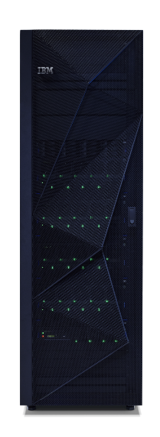

POWER9 High-end server: Power E980
  Maximize performance, scalability, and throughput
  (192 POWER9 cores, up to 64 TB custom memory, PCIe Gen4,
  25 Gb/s SMP fabric)
  Flexible, economically efficient infrastructure
  (Multi-OS: AIX, IBM i, Linux; Modular scalability, Integrated
  NVMe for boot, Capacity on Demand and Enterprise Pools)
  Improve infrastructure resilience
  Enable rapid service delivery
  (Cloud Management, built-in virtualization and Elastic Capacity on Demand)
  Deliver a smooth, non-disruptive transition to
  modernize your infrastructure
  1 to 4 nodes (5U) per system
  32, 40, 44 or 48 cores per node
  Up to 64 TB Memory
  8 cores, 256GB minimum active
  4 NVMe slots per node
  8 PCIe Gen4 adapter slots/node
  Up to 4 PCIe I/O drawers/node
Notes:
Let’s move on now to the flagship of the IBM Power Systems portfolio; the Power E980. This is IBM’s new modular high-end system that takes the place in our portfolio of both the E870 and the E880.
The E980 is the most scalable and most reliable system in the Power portfolio. And we aren’t just talking about the scalability of processors. This system also doubles the memory capacity from its POWER8 predecessor, now with up to 64TB. The E980 also has up to 16 PCIe I/O expansion drawers. This is truly an industry-leading platform in terms of packaging and performance all put together. The E980 is built for the largest enterprises and can scale up to 4 nodes but it can also be configured in a one node or a two node system for clients that really want the ultimate in reliability and the absolute scalability with a better form factor for their needs.
The E980 is ideal for a consolidated, large-scale virtualized application landscapes or large-scale, in-memory database applications like SAP HANA.

Slide 16
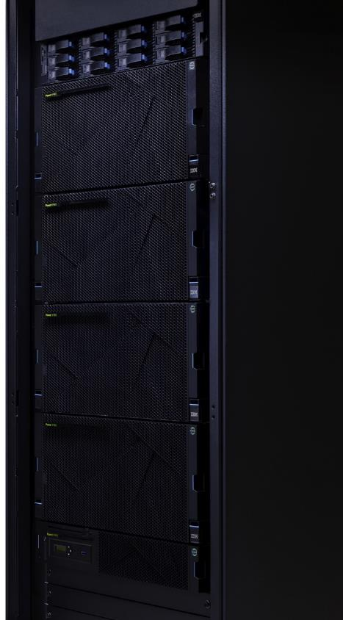
Power E980 enhancements over E880C
Scale-up POWER9 processors provides faster response time and increase system scalability.
Large-scale system throughput increase, enabled by not only the POWER9 processors, but also via a flatter system SMP topology that delivers a 4X increase in internode bandwidth.
2X memory capacity (up to 64TB per system) to enhance the performance of large-scale in-memory DB applications.
2X on chip crypto engines protect data at rest and in motion.
I/O infrastructure designed for PCIe Gen4 provides potential for up to 2X I/O bandwidth and concurrent maintenance on PCIe adapter slots, to improve throughput and help maintain service levels.
4 integrated NVMe drive slots per CEC enables clients to boot a system without the need for an external I/O drawer.
Notes:
Both the E980 and E880C come with up to 4 sockets and 198 cores but it should be noted that the POWER8 processor was a dual chip module (DCM) while the E980 is a single chip module (SCM) which is delivers more efficient processor communications. With a flatter SMP topology, the E980 delivers a 4x increase in internode bandwidth.
The E980 supports 2x more memory (64TB vs. 32TB) allowing for greater consolidation of memory intensive workloads (like SAP HANA for example). The memory bandwidth between the P8 and P9 is the same (920 GB/sec/drawer) but the I/O bandwidth has been increased by 2X and the E980 supports PCIe Gen4 which is 2x faster than the PCIe Gen3 of the E880c.
On the storage side, the E980 provides faster and more compact storage with 4 NVMe bays which also allow clients to boot a system (locally) without the need for an external I/O drawer. The E980 also improves the serviceability cost of the storage with concurrently maintainable storage controllers.

Slide 17
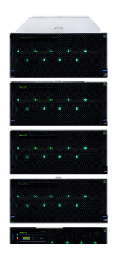
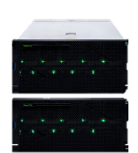
E980: The differences between 3Q and 4Q 2018 releases
3Q 2018 | Feature | 4Q 2018
Up to 2 5U CEC drawers | Number of drawers | Up to 4 5U CEC drawers
96 | Maximum # of cores | 192
32 TB | Maximum total memory | 64 TB
16 | PCIe Gen4 slots | 32
4 | I/O Expansion drawers | 16
No | Serial number preserving upgrade support from POWER8 | Yes
No | MES drawer adds supported | Yes
No | Earthquake certification | Yes
Notes:
It’s important to understand that the E980 is being delivered across two releases in 2018. The key difference on the technology side is that the first release, in 3Q 2018, will support up to 2 drawers (i.e. 2 nodes) which supports up to 96 total cores and 32TB of memory. It also supports 16 PCIe Gen4 slots (8 per drawer) and 4 I/O expansion drawers.
The 4Q 2018 release doubles the number of drawers to 4 which of course doubles the number of cores (to 192), doubles the memory (to 64TB) and doubles the number of PCIe Gen4 slots to 32. Note however, that it quadruples the number of I/O Expansion drawers available from 4 in the September 2018 release, to 16 in the November 2018 release.
On the non technical side, the 4Q2018 release also allows for the preservation of serial numbers when upgrading from POWER8 (for the benefit of client accounting methods and support). As well, MES drawer adds will be supported and as well as the delivery of earthquake certification for the E980.

Slide 18
E980 Processor Highlights
Four processor Offerings available (SMT8 cores)
  12-core, 11-core processor (maximum throughput)
  10-core processor
  8-core processor (maximum core performance)
Processor frequencies dynamic (default) for maximum performance
Capacity on Demand support – minimum cores active is 8
Increased processor to processor fabric interconnect
  16Gb/s X-Bus Fully connected fabric within CEC Drawer
  4x increase in external SMP fabric bus for Drawer to Drawer interconnect or Accelerator
Feature Code E980 | Processor SMT8 Cores | Minimum Active Cores per system | Typical Frequency Range | IBM i P Group
EFB3 | 12 cores | 8 | 3.55 to 3.9 GHz (max) | P30
EFB4 | 11 cores | 8 | 3.584 to 3.9 GHz (max) | P30
EFB2 | 10 cores | 8 | 3.7 to 3.9 GHz (max) | P30
EFB1 | 8 cores | 8 | 3.9 to 4.0 GHz (max) | P30
Notes:
As previously mentioned, POWER9 is a single chip module (SCM) which is different from the dual chip modules used in POWER8 where 2 dies were on a single socket. As shown on this slide, there are 4 offerings in the E980 (as in the E950) with an 8-core, 10-core, 11-core, and a 12-core processor.
With the same guidance we have had previously stated for the E950, maximum throughput is available with the 12-core or 11-core processor. Whereas the fastest execution of a single thread or core, is available with the use of 8-core processors. The 8-core will be running between 3.9 and 4.0 GHz while the 12-core will be running between 3.55 and 3.9GHz.
For the E980, regardless of the number of nodes/drawers in the system, you must have a minimum of 8 cores activated at all times.
As with the E950, frequencies with the full POWER9 line are dynamic and the default setting is maximum performance mode.
Note the new interconnect fabric between POWER9 sockets is running at significantly higher speeds. With POWER9, the interconnect fabric runs at 16GB/s for maximum scalability and it is also more tolerant of any memory affinity issues that may arise in some software applications.

Slide 19
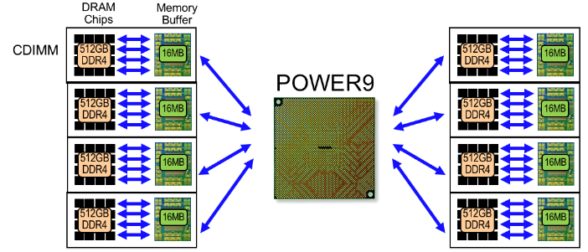
E980 Memory Subsystem
Up to 4TB buffered DDR4 memory/socket
64 Terabytes
Maximum memory capacity on a Power E980
230 GB/sec
Maximum memory bandwidth/socket
Support for larger in-memory database applications.
Deliver insights faster for competitive advantage.
16MB eDRAM L4 cache buffer per CDIMM
8 CDIMM slots/socket, 32 slots/drawer
128 CDIMM max config on 4-drawer system
Support for POWER8 DDR3/DDR4 CDIMM (carry-over on MES Model Upgrade)
Mixing DDR3 and DDR4 supported but drawers must be homogeneous
Feature Size | DIMM Size | Feature | Memory Speed | E980 Per-Node Maximum | E980 System Maximum
0 / 128 GB | 32 GB | #EF20 | 1,600 MHz | 1 TB | 4 TB
0 / 256 GB | 64 GB | #EF21 | 1,600 MHz | 2 TB | 8 TB
0 / 512 GB | 128 GB | #EF22 | 1,600 MHz | 4 TB | 16 TB
0 / 1,024 GB | 256 GB | #EF23 | 1,600 MHz | 8 TB | 32 TB
0 / 2,048 GB | 512 GB | #EF24 | 1,600 MHz | 16 TB | 64 TB
Notes:
For the memory subsystem, the E980 is similar to the POWER8 Enterprise servers, except there is 2x the memory on the E980 compared to the E880C. Each of the feature codes listed in the table on the lower left has four DIMMs per feature. For example, the 2TB feature (EF24) comes with four 512GB DIMMs.
This system delivers a very high capacity, high performance, memory subsystem to feed these very high-performance processors and IBM is delivering the unique 16 MB eDRAM forecast buffer on each CDIMM similar to POWER8.
It is important to note that clients can bring DDR3 or DDR4 DIMMs over, as part of an upgrade, from POWER8. Clients retain the capability not only to bring memory across, but they will also continue to have DRAM sparing in this configuration. Clients that have capacity on demand systems, with non-active memory installed will have that memory automatically activated by the system in the event some active memory fails for any reason. That’s a big difference between the E950 and the E980.

Slide 20
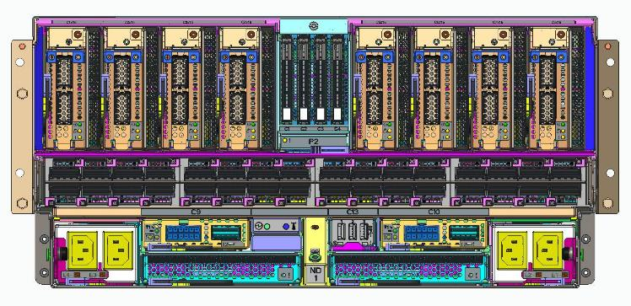
E980 PCIe Slots
C1
C2
C3
C4
C5
C6
C7
C8
Internal PCIe Slot Summary
Slots C1 to C8 are all PCIe Gen4 x16
All slots support I/O Expansion Adapter
PCIe Slots are Concurrently Maintainable
Half Height, Half Length PCIe form factor
HMC Ports
Serial Port
External PCIe Expansion Summary
3Q 2018
4Q 2018
Num of Drawers | Max num of I/O Exp Drawers (EMX0) | Total PCIe Slots
1 | 2 | 4+24
2 | 4 | 8+48
Num of Drawers | Max num of I/O Exp Drawers (EMX0) | Total PCIe Slots
1 | 4 | 48
2 | 8 | 96
3 | 12 | 144
4 | 16 | 192
Notes:
The PCIe slots on the E980 are very simple to remember, there are 8 ports per drawer and all ports are PCIe Gen4 x16 slots (half height, half length form factor). All of the slots support I/O expansion adapters and all slots are concurrently maintainable.
One thing to note is that in the first release (3Q18), the system supports up to 4 I/O expansion drawers (EMX0) for a total of 56 PCIe slots. The 4Q18 release increases the maximum number of I/O expansion drawers to 16 which supports up to 192 PCIe slots.

Slide 21
Operating Systems and Firmware Stack Support
Operating System Support
  AIX 7.2 TL1, TL2
  AIX 7.1 TL4, TL5
  AIX 6.1 TL9
  IBM i 7.3 TR5
  IBM i 7.2 TR9
  VIOS 2.2.6.31 (3Q2018) / VIOS 2.2.6.32 & 3.1.0 (4Q2018)
  SLES 11 SP4
  SLES 12 SP3
  SLES 15
  RedHat RHEL 7.5 LE (P8 Compatibility Mode)
  RedHat RHEL 7.6 LE (4Q)
  Ubuntu 16.04.4 (P8 Compatibility Mode)
Firmware Support
  Firmware level FW920.10 (3Q) / FW920.20 (4Q)
  HMC code level V9R1.920
Notes:
Much like the E950, the E980 supports AIX (6.1, 7.1 and 7.2) and Linux (SLES 11, 12, and 15, as well as RHEL 7.5 and 7.6 in Q42018 as well as Ubuntu 16.04.4). The big difference of course is that the E980 also supports IBM i (7.2 TR9 and 7.3 TR5). Also shown on this slide are the firmware and HMC versions supported, and of course, PowerVM comes preinstalled on all POWER9 servers.
21

Slide 22
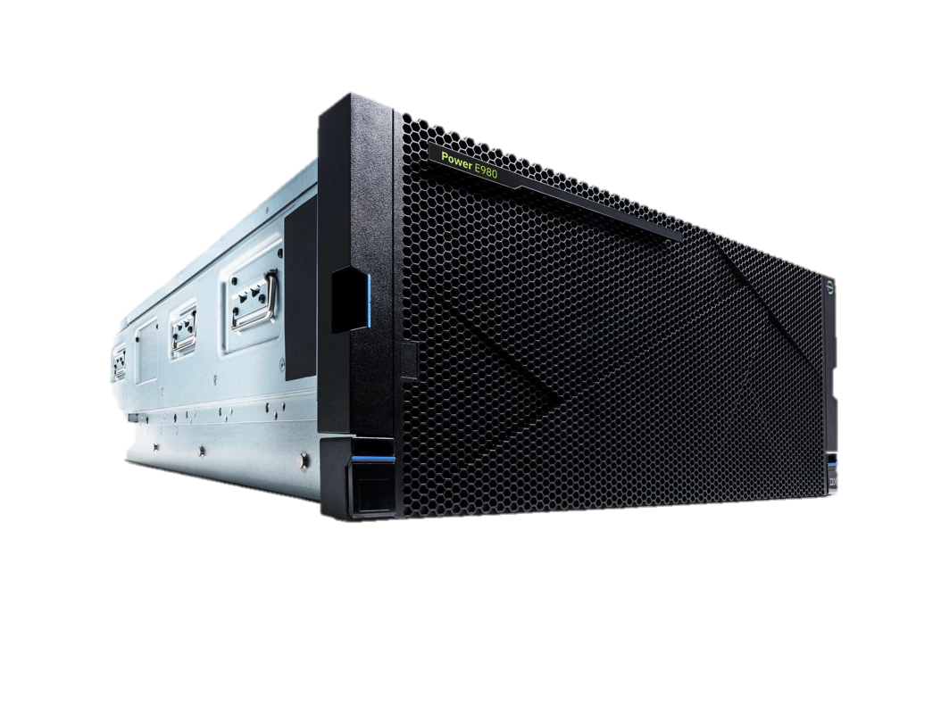
Elastic Capacity on Demand
US$15 per day
buys one core of POWER9 performance & 32GB of memory - on an IBM Power E980 using Elastic Capacity on Demand.
Activate a Power E980 processor and memory for additional temporary capacity at around $75 for a M-F business week.
Notes:
Elastic Capacity on Demand (CoD) is also available for the E980 as well, but it is important to highlight the price. This is a tremendous opportunity for clients that are deploying private cloud environments and turn on processors as well as memory for one day at a time at a very low cost. This ability to burst new workloads for short periods and be able to react quickly to increased demand in a private cloud is extremely valuable to clients. The pricing in the United States is just $11US per core per day and $1US per 8 GB of memory per day. This means that for just $15US per day clients can utilize a processor core + 16 GB of memory on a Power E980 that has dark resources installed. This is ideal for an extra project which requires resources for a short period of time or for increased application testing or for a short spike in demand.
Clients can buy this through the IBM marketplace where they could prepay for a set of resources. They simply need to sign up at the IBM marketplace, get their keys, and allocate their credits to a given system to be able to utilize this capability…SIMPLE!

Slide 23

Upgrades and
TCO Savings
Notes:
In this final section we will discuss the upgrade options from POWER7 and POWER8 systems, as well as the total cost of ownership (TCO) savings by moving to POWER9 E950 and E980.

Slide 24
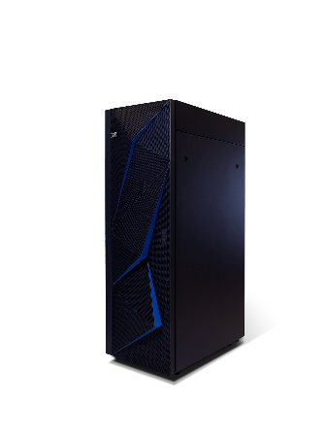
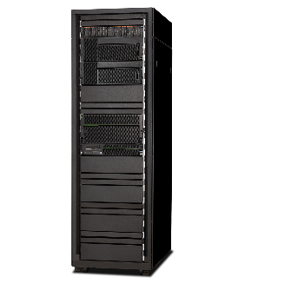
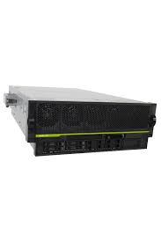

POWER8 to POWER9 transition guidance
96 cores @ 4.02GHz
96 cores
E880C
80 cores @ 4.19GHz
88 cores
64 cores @ 4.35GHz
E980
80 cores
64 cores
E870C
64 cores @ 4.02GHz
48 cores
48 cores @ 3.65GHz
44 cores
E850C
40 cores @ 3.95GHz
E950
40 cores
32 cores @ 4.22GHz
32 cores
Notes:
Here is a simplistic, high-level view of the potential transition paths from POWER8 to POWER9. Since IBM is only announcing two new enterprise servers, our clients with Power 770, Power E870 or Power E870C will most likely want to move to the Power E980. However, a transition to a Power E950 is also an option depending on their workloads.
The dark blue arrows represent what would be a typical upgrade while the light gray dotted arrows represent other options a client may consider when moving from POWER8 to POWER9.

Slide 25

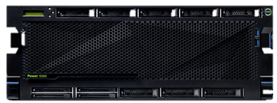
Migrate to POWER9 and save over 50% within 3 years
Power 770
64 cores
1 TB Memory
rPerf = 579
rPerf/core = 9.2
Move to POWER9
and SAVE
Power E950
24 active / 32 total cores
1 TB Memory
rPerf = 656
rPerf/core = 27.3
(9117-MMB)
(9040-MR9)
 | $US List
Hardware List | $ 0K
Software License List | $ 0K
HW Maint.(3yr 24x7) List | $230K
SW Maint. List (3yr 24x7 Large) | $190K
Total List Price | $420K
 | $US List
Hardware List | $182K
Software License List (transfer AIX) | $ 0K
HW Maint. List (3yr 24x7 included) | included
SW Maint. List (3yr 24x7 Small ) | $27K
Total List Price | $209K
¹AIX Enterprise Edition, PowerVM Enterprise Edition
**Configuration includes 2 x PCIe3 16Gb 2-port Fibre Adapters, 2 x PCIe3 4-port 10Gb FCOE Ethernet Adapters, 16 x 64GB DIMMs, SAN Boot
KEY BENEFITS
Consolidate from four nodes to one (reduce data center footprint, lower energy costs)
Nearly 3X performance per core
Over 12% additional capacity with 60% reduction in cores to save on future SW license/maintenance
Room to grow or handle unexpected spikes - 8 cores available for CUoD or Elastic COD
Deliver innovation for private cloud deployment
Enhanced security & RAS
Prices are preliminary, for illustration only, are subject to change without notice and will vary based upon client-specific configuration of cores, memory & I/O installed & purchased.
Notes:
Let’s look at the real benefits of moving from an older Power server to one with POWER9. On this slide we have an example of a Power 770 moving to a new Power E950. These configurations are just examples, but they demonstrate the advantages of moving. In this example, clients are able to move from a 4 node Power 770, to a single node Power E950. This drives cost saving opportunities on a number of levels. With the enhanced performance of the POWER9 processor clients will achieve nearly 3x performance per core, which allows for consolidation that reduces the data center footprint and lowers energy consumption/costs. The Power E950 configuration also has room to grow and scale based on clients business needs, and includes innovation for private cloud deployment, along with enhanced security and RAS capabilities. Clients can also save on software costs with fewer cores and the move from DCM to SCM cores.
Clients can get all of these enhanced capabilities and save over 50% versus maintaining the older Power 770 system. This estimated cost reduction does not factor in the additional cooling and power savings that may be realized based on consolidating to a single node system.

Slide 26


Migrate to POWER9 and save over 35% within 3 years
Power 780
96 cores @ 3.4GHz
1.5 TB Memory
rPerf = 886
rPerf/core = 9.2
Move to POWER9
and SAVE
Power E980
32 cores @ 4GHz
1.5 TB Memory
rPerf = 886
rPerf/core = 27.3
(9080-M95)
(9179-MHC)
 | $US List
Hardware List | $ 0K
Software License List | $ 0K
HW Maint.(3yr 24x7) List | $373K
SW Maint. List (3yr 24x7 Large) | $567K
Total List Price | $940K
 | $US List
Hardware List | $454K
Software License List (transfer AIX) | $ 0K
HW Maint. List (3yr 24x7 included) | $ 39K
SW Maint. List (3yr 24x7 Medium) | $110K
Total List Price | $603K
¹AIX Enterprise Edition, PowerVM Enterprise Edition
**Configuration includes 3 x PCIe3 16Gb 2-port Fibre Adapters, 3 x PCIe3 4-port 10Gb FCOE Ethernet Adapters, 12 x 128GB CDIMMs, SAN Boot
KEY BENEFITS
Consolidate to single node (reduce data center footprint, lower energy costs)
Nearly 3X performance per core
Save on SW licensing & maintenance by delivering equivalent performance with 1/3 of the cores and a lower tier
Provide innovation for private cloud deployment
Enhanced security & RAS
Prices are preliminary, for illustration only, are subject to change without notice and will vary based upon client-specific configuration of cores, memory & I/O installed & purchased.
Notes:
Similar to the prior example, this example shows a similar high-end Power 780 server moving to a new Power E980 server. The first benefit here is that clients are able to move from a multi-node Power 780 to a single node Power E980. This drives cost saving opportunities on a number of levels including reduced footprint, lower power and cooling costs, and simpler maintenance.
With the enhanced performance of the POWER9 processor, clients can realize a near 3x performance per core increase which allows for consolidation and can lower software costs for clients (in addition to the move from DCM to SCM chips which can also save on software costs). The Power E980 configuration also has room to grow and scale, based on business needs, and includes innovation for private cloud deployment along with enhanced security and RAS capabilities.
Clients get all of these advantages and save over 35% versus maintaining their older Power 780 system (this estimated cost reduction does not factor in the additional cooling and power savings that may be realized based on consolidating to a single node system).

Slide 27






POWER9 Enterprise: A Cloud-Everywhere Solution
Optimized for private, public, hybrid and multi-clouds
Built-in PowerVM, so every E950/E980 workload is virtualized with accelerated secure mobility
Cloud PowerVC Manager included in orders, for resource optimization and private cloud portal
Cloud Management Console (CMC) entitlement for consolidated monitoring over multiple locations
Consistent enterprise-wide multi-cloud management with VMware vRealize Suite integration
Create new Power cloud-native solutions with IBM Cloud Private suite of DevOps tools and app store
Dynamic resource management across multiple Power cloud servers with Enterprise Pools
Additional POWER9 Cloud benefits
  Simplified transfer of VMs between private and public clouds enables hybrid use cases
  Cloud-ready Power software images facilitate rapid workload provisioning
  Broader availability of term licenses and SaaS pricing for Power software and tools
Notes:
Although this presentation focused primarily on the hardware characteristics of the E950 and E980, what clients really care about is infrastructure to drive their application workloads. What clients are truly looking for is a platform optimized for private, public, hybrid, and multicloud environments. As discussed in the client presentation, there is no platform better positioned for private cloud. On this slide we discuss some key capabilities that make the POWER9 platform the best cloud infrastructure for clients that need private cloud in addition to their public cloud solutions.
Industry leading virtualization with cloud management capabilities allow clients to deliver agile IT to their lines of business while keeping the systems secure and highly available.
In addition, IBM makes it simple to transfer VMs between private and public clouds. Our cloud-ready Power software images also facilitate rapid workload provisioning.

Slide 28





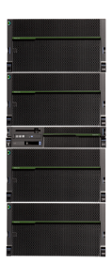
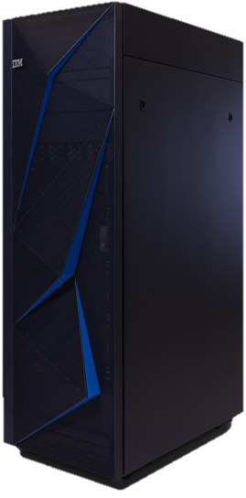
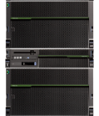


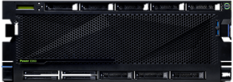

Power Enterprise Pools and Elastic Capacity can help enable a seamless transition to POWER9
Elastic, on premises cloud consumption model with IBM Marketplace for POWER8 and POWER9
Elastic Capacity from
IBM Marketplace/ESS
Power Enterprise Pool
Automation of Mobility with
Master HMC
Power E850C
Managing
HMC
Managing
HMC
POWER9 E950
Power E870C
POWER9
Power E880C
Notes:
28
28
28
IBM Power Systems are designed to eliminate planned and unplanned downtime for the world’s most demanding workloads. IBM continues to enhance Power Enterprise Pools and Capacity on Demand to help clients move from one generation of product to the next, as well as gain access to the compute resources they need, on demand.
Elastic Capacity on Demand (CoD - formerly referred to as On/Off CoD) allows clients to temporarily activate and deactivate processor cores and memory units to help meet the demands of business peaks. After a client activates a number of processor cores or memory units for a specified number of days, those processor cores and memory units are available immediately. Clients can start and stop requests for Elastic CoD, and are billed for usage at the end of each quarter.
POWER9 also integrates seamlessly into a client’s Power Enterprise Pool. A Power Enterprise Pool is a group of systems that can share Mobile Capacity on Demand (CoD) processor resources and memory resources.
Clients can move Mobile CoD resource activations among the systems in a pool with Hardware Management Console (HMC) commands. These operations provide flexibility when clients manage large workloads in a pool of systems and helps them to rebalance the resources to respond to business needs. This feature is useful for providing continuous application availability during maintenance. Not only can workloads be easily moved to alternate systems, but processor and memory activations can be moved. Disaster recovery planning is also more manageable with the ability to move activations where and when they are needed.

Slide 29



IBM Power E950 and E980 financing and payment options
Replace upfront costs with affordable monthly payments
Lease | Lowest periodic payment, protection against technology obsolescence, and lower TCO
Payment plan | Low rate interest payment plan up to 60 months, or a 0% interest 12 month payment plan
Payment deferral | “Install now – pay later” is available for both payment plans and leases
Payment plan with 4 month deferral | Promotional offer until December 1, 2018: No payments for 4 months, then a low rate payment plan for 32 months.
Minimize up-front payments and better align project cost outlays with anticipated benefits
Accelerate a project’s cash flow break-even point with affordable financing
Preserve cash and existing lines of credit for other initiatives
IBM Global Financing offerings are provided through IBM Credit LLC in the United States and other IBM subsidiaries and divisions worldwide to qualified commercial and government clients. Rates and availability are based on a client’s credit rating, financing terms, offering type, equipment and product type and options, and may vary by country. Non-hardware items must be one-time, non-recurring charges and are financed by means of loans. Other restrictions may apply. Rates and offerings are subject to change, extension or withdrawal without notice and may not be available in all countries. IBM Global Financing pricing example for illustration purposes; represents good credit client. Other terms and offerings available. More information @ https://www.ibm.com/financing/power
Notes:
NOTE – These offers are ONLY available in North America & Europe
IBM Global Financing offer leases, loans, and payment plans for IBM Power Systems solutions that can include the server plus systems software and prepaid maintenance. IBM also offers financing packages for additional IBM and non-IBM components of a solution such as application software, services, including SaaS, and other hardware. IBM rates are competitive and for IBM products and solutions, are often offered with low interest – sometimes at 0% over a 12 month payment plan.
For a limited time only (installation before December 1, 2018), there is a promotion in NA and Europe only. IBM Global Financing offers credit qualified clients a 4 month payment deferral with 0% interest, followed by a 32 month payment plan with low rate financing (30 or 33 in countries with quarterly payments)
Visit ibm.com/financing/power for more information.

Slide 30

Power to Cloud Reward Program
  Power to Cloud Rewards Points are included with each Power E950 & E980 system
  New #SVPC feature code released representing 5K points
  Added to each Power E950 & E980 system configuration at no additional charge
    Power E950 : 1x #SVPC = 5K points awarded
    Power E980 : 2x #SVPC = 10K points awarded
  Points redeemable for Lab Services engagements beginning at 10K points
REWARDS
Notes:
The IBM Power to Cloud Rewards Program allows clients to earn rewards points on purchases of IBM Power Systems including the IBM Power E980 and E950 and helps them to plan, design, and implement clouds platforms on IBM Power Systems and accelerate the transformation of IT infrastructure to private and hybrid cloud.
IBM Power to Cloud Rewards points can be used for a range of services focused on helping the transition from traditional IT platforms to private and hybrid cloud platforms leveraging the proven expertise of IBM Systems Lab Services consultants.

Slide 31
Why POWER9 Enterprise Systems?
Business challenges | Business benefits
Cloud strategy | IBM Power Systems enable the most data intensive and mission critical workloads in private and hybrid cloud environments
Ongoing security threats | POWER9 has security built-in at all layers, from the processor to the OS, to deliver end-to-end security
Balancing need for performance/scale with tight budgets and/or limited resources | POWER9 delivers great price / performance advantages and can be managed with fewer resources than x86
Ensure servers stay up and running with minimal interruptions | IBM Power Systems ranked the most reliable for 10th straight year and delivered uptime of 99.9996%
Maximize performance and usage of SAP HANA | Up to 16TB (E950) and 64TB (E980) memory footprint gives a competitive advantage and exploits current SAP HANA licenses better than x86
Notes:
IBM understands the business challenges our clients deal with every day. POWER9 Enterprise Systems were designed to enable our clients to overcome those challenges.
IBM Power Systems enables the most data intensive and mission critical workloads in both private and hybrid cloud environments, to help our clients build and manage the best cloud strategy for their business.
POWER9 has security built-in at all layers, from the processor to the OS, IBM delivers end-to-end security to safeguard our clients against the increasing number of security threats in the market.
POWER9 delivers great price/ performance advantages and can be managed with fewer resources than x86 to help our customers manage both their capital and operational expenses.
IBM Power Systems ranked the most reliable for the 10th straight year and delivered uptime of 99.9996% to ensure our clients businesses stay up and running with minimal interruptions.
IBM POWER9 Enterprise servers provide up to 16TB (E950) and 64TB (E980) memory footprint which gives a competitive advantage and exploits current SAP HANA licenses better than x86.

Slide 32
Notes:
32

Slide 33
Backup
Notes:
33

Slide 34
Key generational enhancements POWER7 to POWER9 (midrange)
Features | Power 760 | E850C | E950 | Impact (POWER7 to POWER9) | Impact (POWER8 to POWER9)
Processor | POWER7 | POWER8 (DCM) | POWER9 (SCM) | Faster and more powerful | More efficient processor communication
Sockets | 1 to 4 | 2 to 4 | 2 to 4
Cores | 12 or 24 or 36 or 48 | 32 or 40 or 48 | 32 or 40 or 44 or 48 | Higher minimum cores | More Processor Options
Maximum Memory | 2TB | 4 TB | 16 TB | 8X Maximum Memory | 4X Maximum Memory
DIMM Type/DIMM slots count | Up to 64 Industry Standard DIMMs | Up to 32 CDIMMs | Up to 128 Industry Standard DIMMs | Faster and More memory | More Memory Capacity and Flexibility
Memory Bandwidth | 307 GB/sec | 768 GB/sec | 920 GB/sec | 3X Memory Bandwidth | 20% more Memory Bandwidth
IO Expansion Slots | Yes | Yes | Yes
PCIe slots | 6x PCIe Gen2 | 11x PCIe Gen3 | 10x PCIe Gen4, 1x PCI Gen3 | More slots and Faster | PCIe Gen4
Acceleration Ports | No | Yes (CAPI 1.0) | Yes (CAPI 2.0 + OpenCAPI) | Future enablement for accelerators | Future enablement for accelerators
PCIe Hot Plug Support | Yes | Yes | Yes + Blindswap | Better Serviceability | Better Serviceability
IO bandwidth | 74 GB/sec | 315 GB/sec | 630 GB/sec | >8X IO bandwidth | 2X IO bandwidth
Ethernet ports | Max 40Gbs | Max 100 Gbs | Max 100 Gbs | Faster offerings
Internal Storage Bays | 6x 2.5” SAS bays | 12 (8x 2.5” SAS bays + 4x 1.8” SSD bays) | 12 (8x 2.5” SAS bays + 4x NVMe bays) | More SAS bays and more options | Faster and more compact storage
Internal Storage Controllers | Integrated | Integrated | Optional and Concurrent Maintainable | Improved cost and seviceability | Improved cost and seviceability
RAS |  |  | Enhanced DC-DC Reg Design Enhanced Fan Concurrent Maintainance P8 to P9 | More reliable and serviceable power | More reliable and serviceable power. More serviceable cooling

Slide 35
Key generational enhancements POWER7 to POWER9 (high-end)
Features | Power 780 | Power E880C | Power E980 | Impact (POWER7 to POWER9) | Impact (POWER8 to POWER9)
Processor | POWER7+ | POWER8 | POWER9 | Faster response time and increased system scalability | Faster response time and increased system scalability
Sockets | 4, 8, 12, 16 | 4, 8, 12, 16 | 4, 8, 12, 16
Cores | Up to 128 cores | Up to 192 cores | Up to 192 cores | Up to 50% more cores
Maximum Memory | 4TB | 32TB | 64TB | 16X increase in memory capacity significantly improves performance of large-scale in-memory DB applications | Enhance the performance of large-scale in-memory DB applications
Memory Bandwidth | 272 GB/sec / drawer | 920 GB/sec / drawer | 920 GB/sec / drawer | 238% increase in memory bandwidth provides improved application performance
I/O Drawer Expansion | Yes | Yes | Yes
PCIe slots | 6 PCIe GEN2 slots / drawer | 8 PCIe GEN3 slots / drawer | 8 PCIe GEN4 slots / drawer | Over 4X I/O bandwidth | 2X I/O bandwidth
IO bandwidth | 144 GB/sec | 315 GB/sec | 630 GB/sec
CEC Drawer fabric | 13.2 GB/s | 25.6GB/s | 103.12GB/s | Nearly 8X higher internode bandwidth via 25Gb/s SMP links which flatten SMP topology to reduce latency & increase throughput | 4X higher internode bandwidth via 25Gb/s SMP links flattens SMP topology to reduce latency & increase throughput
Acceleration Ports | No | Yes (CAPI 1.0) | Yes (CAPI 2.0 + OpenCAPI) | Future enablement for accelerators | Future enablement for accelerators
PCIe Hot Plug Support | Yes | Yes | Yes
Integrated I/O | Integrated Ethernet, DASD Controller, USB | USB adapters supported in PCIe adapter slots in a drawer | Integrated USB 3.0 ports | Flexibility for additional device attachment | Flexibility for additional device attachment
Internal Storage Bays | 6 DASD Bays / drawer | None - all bootable storage is external to the CEC drawers | 4 NVMe Bays / drawer | Faster bootable storage option | Enable clients to boot a system (locally) without the need for an external I/O drawer
RAS | Redundant Flexible Service Processors Redundant Clocks | Redundant Flexible Service Processors Redundant Clocks | Redundant Flexible Service Processors Guided FSP & SMP Cable installation Dynamic de-allocation of a SMP cable & 1/2 bandwidth mode SMP cable concurrent repair Distributed Redundant Clocks, no unique clock cabling required | Provide the highest level of single-system reliability available within the Power Systems portfolio, enhance business resilience & the availability of clients’ mission-critical applications to keep IT teams focused on deployment instead of system maintenance | Provide the highest level of single-system reliability available within the Power Systems portfolio, enhance business resilience & the availability of clients’ mission-critical applications to keep IT teams focused on deployment instead of system maintenance

Slide 36
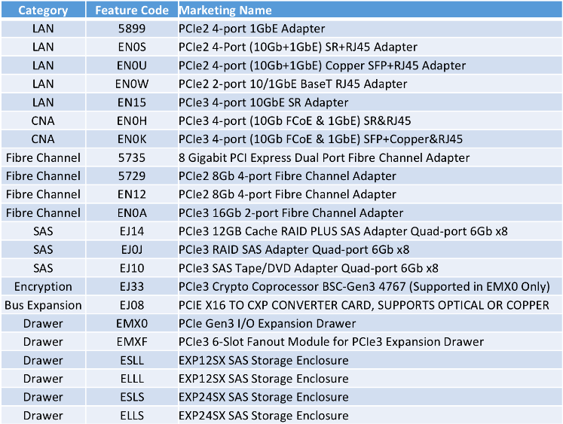
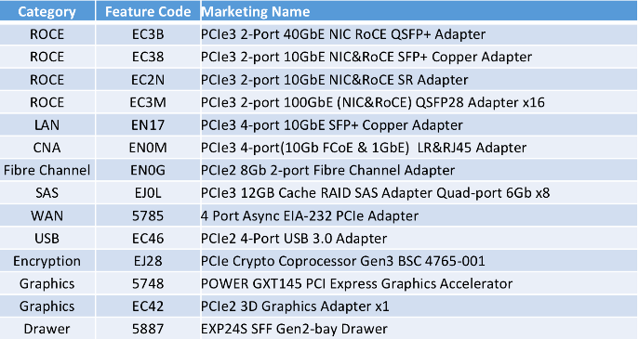
Power E950 planned I/O*
At GA 2H18
FW Update 1H19
IBM’s statements regarding its plans, directions, and intent are subject to change or withdrawal without notice at IBM’s sole discretion. The information mentioned regarding potential future products is not a commitment, promise, or legal obligation to deliver any material, code or functionality.
Notes:
This list on the left side of the chart are the POWER8 feature codes that are supported on the Power E950.
The one notable exception to POWER8 drawers that will not be initially supported is the home run drawer of the 5887 - EXP24S. This is not supported initially, but it will be supported along with these other cards that on the right hand side of the chart, with a plan to update the firmware in 1H19

Slide 37
E950 Memory Plug Rules Overview
Same DIMMs on each memory riser card.
Memory increment is 8 DIMMs
Start with minimum of 1 memory riser card per processor with minimum of 8 DIMMs installed in the white DIMM connectors. For consistency, install the ‘even’ riser card first for each processor.
Next increment of 8 DIMMs populated in order, CPU0, CPU1, CPU2, CPU3 conforming to rule of same type and size of DIMMs on each riser card. The processor order is preferred to have system configuration consistency and is not a requirement.
After all 1st (even) riser cards of the processors are filled up, add second memory riser card to CPU0 with 8 IS DIMMs. Second riser of each processor can have different IS DIMM capacity from that on first riser but it is recommended that the 2nd riser card has the same type and size DIMMs as the 1st riser card
Fill up 2nd riser card with the next 8 IS DIMMS conforming to rule of same type and size of DIMMs on each riser card
Repeat the above 2 steps with CPU1, then CPU2, then CPU3 until all 2nd riser cards are filled up.

Slide 38
Power E950 rPerf (AIX)
Preliminary projections for POWER9 rPerf - these projections are subject to change without notice until Announcement
Frequency (E950) | Processor | # Sockets | # Cores | rPerf (SMT8)
3.15 to 3.8 GHz (max) | 12 core | 4 | 48 | 1,146
3.20 to 3.8 GHz (max) | 11 core | 4 | 44 | 1,072
3.40 to 3.8 GHz (max) | 10 core | 4 | 40 | 1,034
3.60 to 3.8 GHz (max) | 8 core | 4 | 32 | 870
Up to 50% more performance when compared to POWER8 predecessor in default ship mode.
Frequency (E850C) | Processor | # Sockets | # Cores | rPerf (SMT4) | rPerf (SMT8)
3.65 GHz | 12 core | 4 | 48 | 757 | 810
3.95 GHz | 10 core | 4 | 40 | 675 | 722
4.22 GHz | 8 core | 4 | 32 | 575 | 615
For IBM & Business Partner Education Use Only – not meant for distribution & use with clients without prior approval and appropriate Non-Disclosure Agreement.
Notes:
From a performance perspective, these are the performance estimates that we've been working with subjective change.

Slide 39
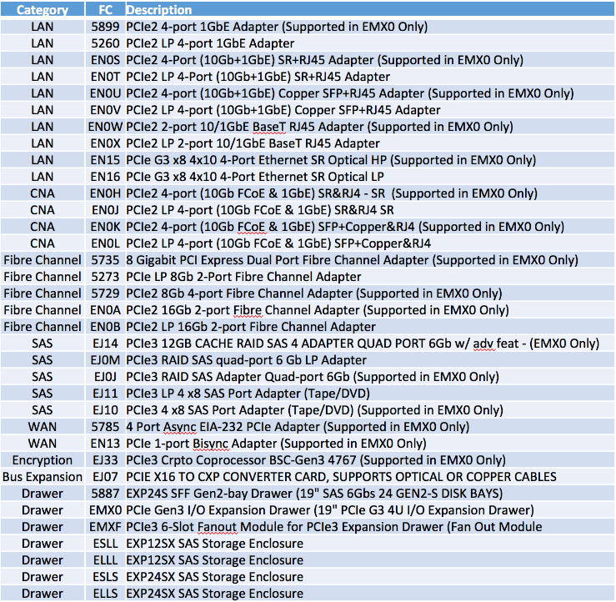
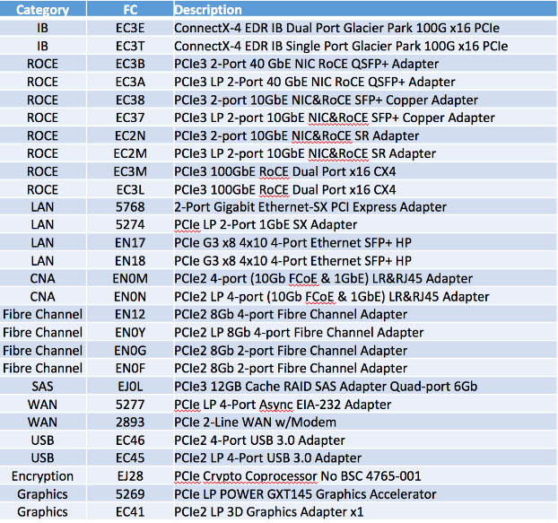
Power I/O planned* to be supported on Power E980
At GA 2H18
FW Update 1H19
  IBM’s statements regarding its plans, directions, and intent are subject to change or withdrawal without notice at IBM’s sole discretion. The information mentioned regarding potential future products is not a commitment, promise, or legal obligation to deliver any material, code or functionality.
Notes:
The left side of the chart is the range of options we have to bring existing cards over to a new system.
The right-hand side of the chart are some additional cards that we will continue to test and we expect to deliver support for but not until the first half of 2019 with a new firmware update.

Slide 40
E980 Memory
230 GB/s Memory Bandwidth and up to 4TB per socket
8 DIMM slots per socket, 32 DIMMs per drawer, same CDIMM technology as POWER8
32, 64, 128, 256, 512 GB DDR4 CDIMMs (16GB DDR4 CDIMM migrate support)
Support for migrating POWER8 DDR3 (16GB, 32GB, 64GB, 128GB) and DDR4 CDIMMs
Mixing DDR3 and DDR4 supported but drawers must be homogeneous
Capacity on Demand support (50% of installed memory must be activated)
Plug Rules (same as POWER8):
  Populate in Quad (group of 4)
  Minimum of 1 Quad per socket
Feature Code E980 | CDIMM Size
EF20 | 4 x DDR4 32GB
EF21 | 4 x DDR4 64GB
EF22 | 4 x DDR4 128GB
EF23 | 4 x DDR4 256GB
EF24 | 4 x DDR4 512GB
Migrate Only
Feature Code E980 | CDIMM Size
EM8J | 4 x DDR3 16GB
EM8K | 4 x DDR3 32GB
EM8L | 4 x DDR3 64GB
EM8M | 4 x DDR3 128GB
Migrate Only
Feature Code E980 | CDIMM Size
EM8U | 4 x DDR4 16GB
EM8V | 4 x DDR4 32GB
EM8W | 4 x DDR4 64GB
EM8X | 4 x DDR4 128GB
EM8Y | 4 x DDR4 256GB

Slide 41
E980 Internal Storage Option
4 NVMe bays per CEC Drawer
Read intensive Drives (2.2 drive writes per day)
Feature Code E980 | Storage Device
EC5J | NVMe 4K 800GB U.2 SSD IN 7MM CARRIER
E980 External Storage Options
FC / MTM | Description
ESLL | 19” Disk Expansion Drawer 12 LFF Gen2-Carrier Bays (Slider12)
ESLS | 19” Disk Expansion Drawer 24 SFF Gen2-Carrier Bays (Slider24)
5887 | 19” Disk Expansion Drawer 24 SFF Gen2-Carrier Bays (EXP24S) Migrate
EUA5 | USB DVD w/ Cable
7226-1U3 | 19” Media Drawer with 2 bays

