Slide 1
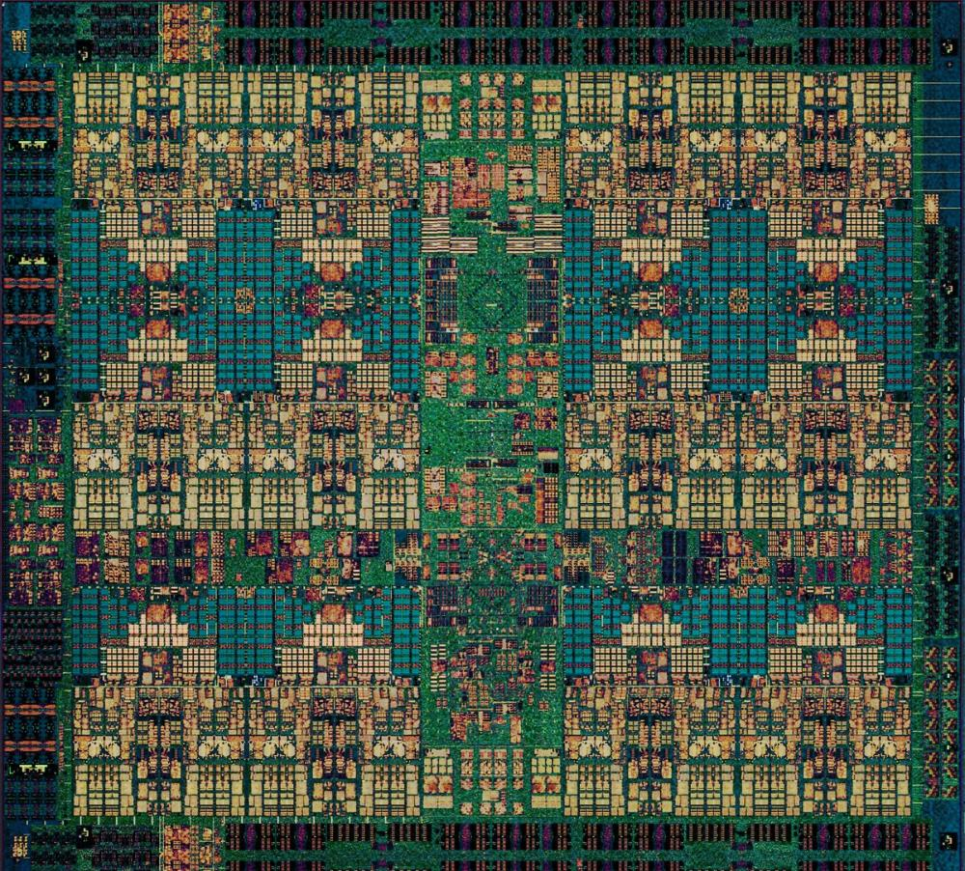

POWER9 Family
Understanding the Details
—
Chris Eaton (ceaton@ca.ibm.com)
James Allen (jdallen@us.ibm.com)
Notes:
This presentation gives you an overview of each server in the POWER9 family. Grouped by target workload, we will briefly discuss the servers, the number of sockets and cores available, the amount of memory in each server, and some other defining characteristics of each option. The speaker notes go into further details on each of the options.

Slide 2

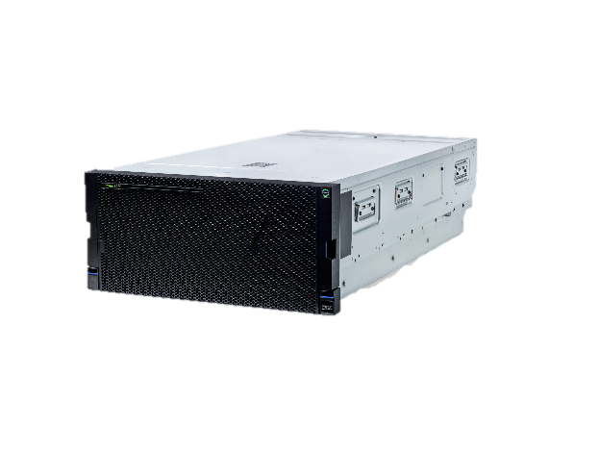
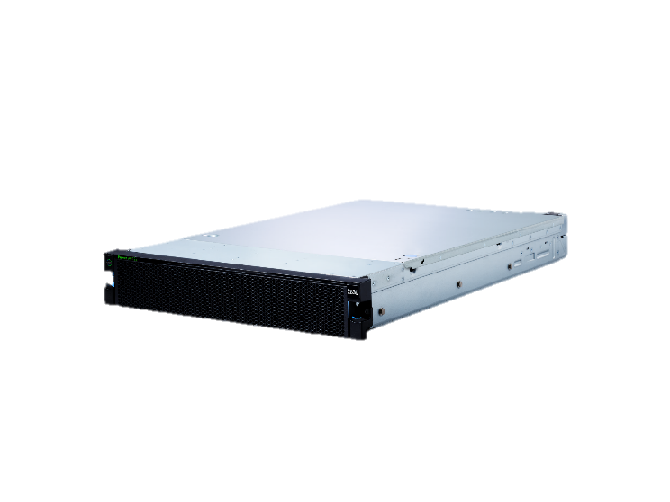
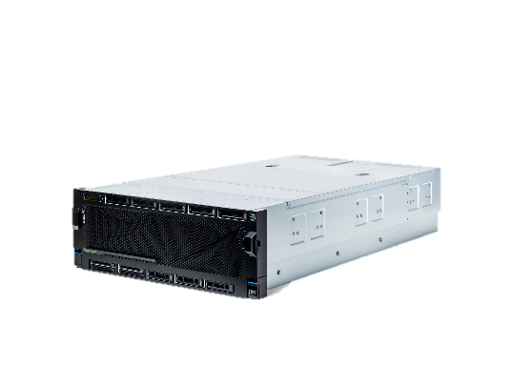
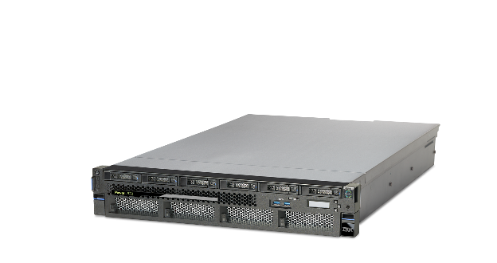
IBM POWER9 Family
When data-intensive workloads are the bottom line
Mission Critical Data Intensive Workloads for Private Clouds
Big Data Workloads
Enterprise AI Workloads
Entry
Midsize
Enterprise
S922/S914/S924
H922/H924/L922
E950
E980
LC922/LC921
AC922
Notes:
The POWER9 family of servers is designed to match the requirements of your most critical data-intensive workloads. From mission critical data workloads to Big Data systems to the next generation of AI workloads, POWER9 has you covered. If you are looking for a one size fits all solution, you should think twice about the ability to scale and meet the needs of the AI era. By leveraging servers that are optimized to your workload characteristics, you can not only gain a performance advantage on your competitors, but you can also gain a price-performance advantage and invest that savings into building next generation AI applications to disrupt your industry (before you get disrupted by someone else).
IBM POWER9 family server line can be thought of as 3 logical groupings of offerings:
For mission critical data intensive workloads and private clouds, these servers can be broken down further into entry level models (2 socket, 2U and 4U servers), midsized offering with the E950 and H950, and the high end enterprise class scale up server in the E980/H980.
Focused on big data workloads, the LC922/LC921 have 2 sockets and are available in a 2U and 1U form factor.
For Enterprise AI and high performance computing workloads we have the AC922
In the customer facing POWER9 Family presentation we focused on the various workloads and specifically focused on the Private Cloud capabilities of the family. In this presentation we will focus more on the servers themselves but suffice it to say that each member of the POWER9 family provides the capabilities to build private clouds especially with the inclusion of PowerVM preinstalled with each server as well as the capabilities of IBM Cloud Private for Power.
Each of these servers will be discussed in more detail in the following slides.

Slide 3
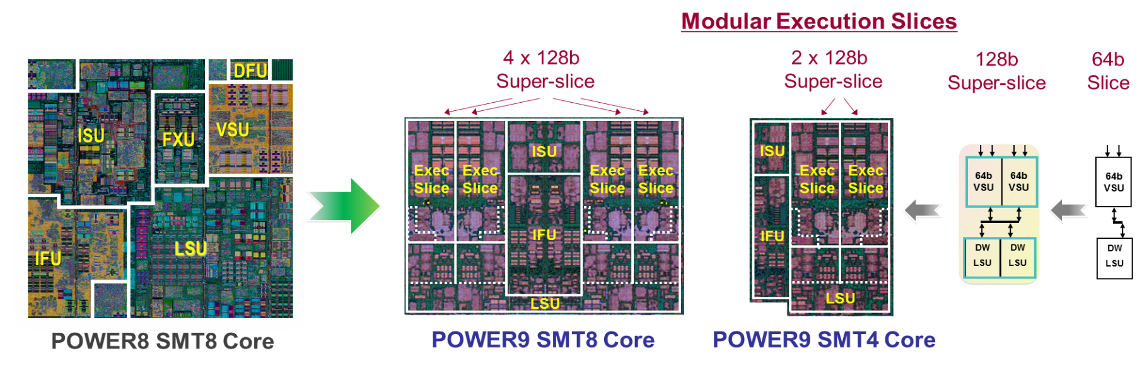
POWER9 Processor
The core consists primarily of the following units: instruction fetch unit (IFU),
instruction sequencing unit (ISU), load-store unit (LSU), and the execution slide (Exec Slice)
Notes:
Let’s first look at the POWER9 processor itself. The left side of this slide shows the various components that make up a POWER8 core. The POWER9 core was designed to create a chip which is symmetric in design. This enables a POWER9 processor that delivers both a large core, which contains 8 threads per core and alternatively, by slicing that large core in half which is enabled due to the symmetry, you get two cores each with 4 threads. The result is that the 12-core and 24-core versions of POWER9 each consist of the same number of slices (96 each) and the same amount of L1 cache.
If you look at the middle graphic and split the chip right down the middle, you can see that the right side (which is the next picture to the right labeled as “POWER9 SMT4 Core”) is symmetrical with the left side of the chip.
Execution Slice microarchitecture is POWER9's entirely new refactored core modular design. The same modules were used to build both the SMT4 and SMT8 cores.
A Slice is the basic 64-bit computing block incorporating a single Vector and Scalar Unit (VSU) coupled with Load/Store Unit (LSU). A VSU has a heterogeneous mix of computing capabilities including integer and floating point supporting scalar and vector operations. This setup allows for higher utilization of resources while providing efficient exchanges of data between the individual slices. Two slices coupled together make up a “Super-Slice”, which is a 128-bit POWER9 physical design building block. Two super-slices together along with an Instruction Fetch Unit (IFU) and an Instruction Sequencing Unit (ISU) form a single POWER9 SMT4 core. The SMT8 variant is effectively two SMT4 units.

Slide 4



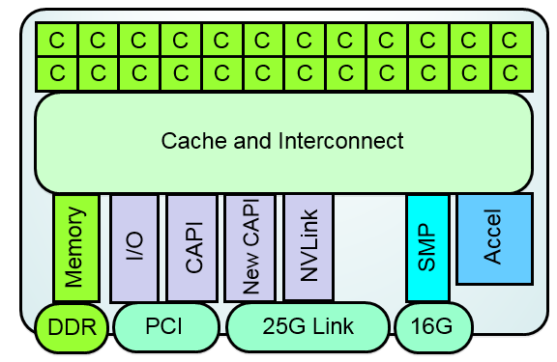
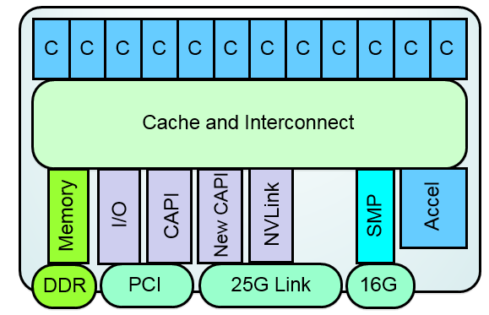
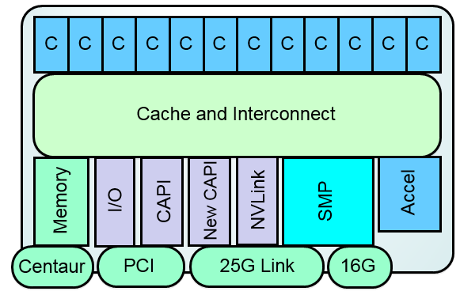
Targeted Implementations
Up to 24 Cores / Chip / Socket
max of 4 threads per core
Linux Ecosystem Optimized
Up to 12 Cores / Chip / Socket
max of 8 threads per core PowerVM Ecosystem Continuity
SMP scalability /
Memory subsystem
Scale-Out – 2 Socket Optimized
Robust 2 socket SMP system
Direct Memory Attach
Up to 8 DDR4 ports
Commodity packaging form factor
Scale-Up – Multi-Socket Optimized
Scalable System Topology / Capacity
Large multi-socket
Buffered Memory Attach
8 Buffered channels
Notes:
Since the IBM POWER9 processor has two different core structures, one with SMT8 and another with SMT4, what we achieve is two different processors core counts that align to the two different market needs.
The SMT4 aligns to the scale-out Linux ecosystem market where higher core counts enable the needed higher KVM granularity (more but smaller virtual environments) for these types of workloads. These processors will deliver up to 24 cores per socket with up to 8 memory busses for direct attach memory. This is important for competitive pricing while maintaining our focus on memory bandwidth in systems that need it. The higher core count processors are only available in 2 socket based systems.
The SMT8 cores have a maximum of 12 cores (½ of the 24 core count chips). The higher thread count enables stronger partitions (more threads available in a given partition allowing for greater concurrency), which is optimal for the PowerVM ecosystem. Higher thread counts enable partitions with more performance in the PowerVM ecosystem. Additionally, these SMT8 core processors have buffered memory interfaces for higher memory bandwidth. The SMT8 cores are enabled for both 2 socket and 4+ socket systems.
The first row in this slide is for the AC, S/H, L and LC systems while the bottom row represents the configurations for the Enterprise servers (E9xx/H9xx).

Slide 5

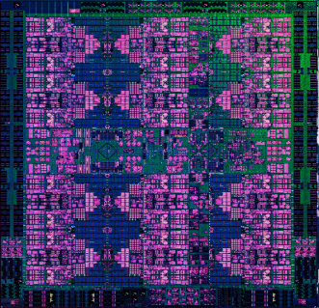

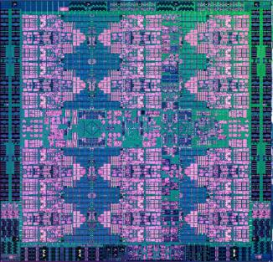
Two Memory Architectures
Scale Out (AC, S/H, L, LC)
Direct Attach Memory
Scale Up (E950, E980)
Buffered Memory
8 Direct DDR4 Ports
8 Buffered Channels
Up to 170 GB/s of bandwidth
Low latency access
Commodity packaging form factor
Adaptive 64B / 128B reads
Simplified design point
Up to 230 GB/s of bandwidth
Extreme capacity – up to 8TB / socket
Superior RAS with chip kill and lane sparing
Compatible with POWER8 system memory
Agnostic interface for alternate memory innovations
Notes:
There are two memory architectures for the POWER9 family of servers. For the scale-out server lines (AC, LC, S/H, and L) we are using the direct attach memory architecture (no buffer chips like we have had in previous scale out systems). This will typically reduce the cost of the memory as we can now use industry standard memory cards. They will run at up to 170GB/s peak memory bandwidth per socket and use industry standard DDR4 RDIMMS with 16 DIMMs per socket and 32 DIMMS total in the server. This gives a maximum memory configuration of 4TB. The minimum memory is two 16GB DIMMs per socket. If you only have one socket populated then the minimum is two 16GB DIMMs for a total of 32GB of memory or if you have both sockets populated then you will need a minimum of four 16GB DIMMS for a total of 64GB of memory at a minimum.
For the scale-up servers (E950/E980) we will continue to use the buffered memory as was the case in POWER8. This will provide both higher bandwidth (230GB/s vs. 170GB/s) as well as extreme capacity (up to 8TB of RAM per socket). For the high end enterprise scale-up servers being leveraged for private clouds, the additional memory capacity and bandwidth will allow for greater application density and therefore deliver more value than clients are able to get from other scale-up offerings on the market. The buffered memory configuration delivers superior reliability features like having the memory channel protected by strong cyclic redundancy check (CRC) with automatic retransmission (replay) of packet errors, dynamic lane sparing on memory channel which will repair faulty lanes concurrently during mainline operations, and chip kill which is advanced error checking and correcting which protects memory from any single memory chip failure.

Slide 6

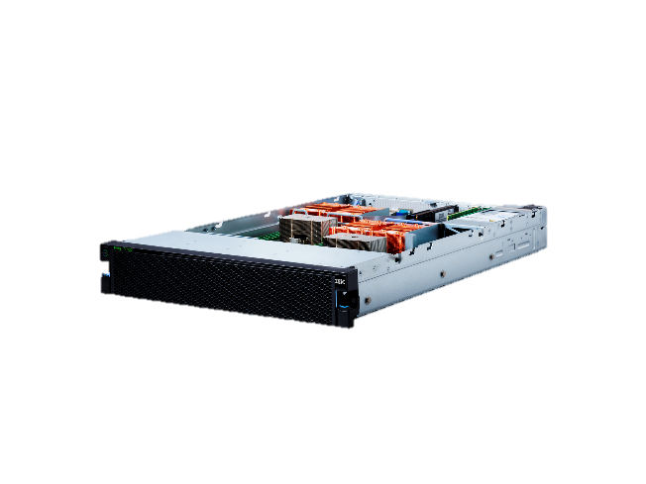
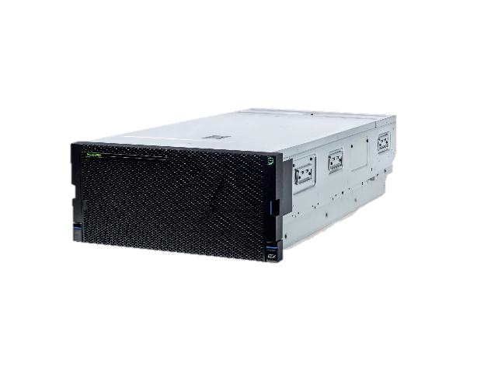
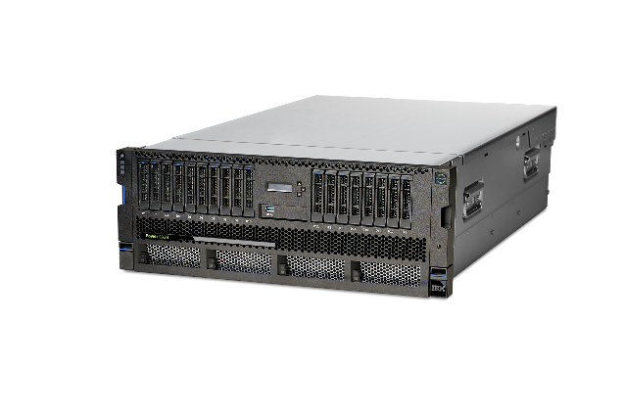
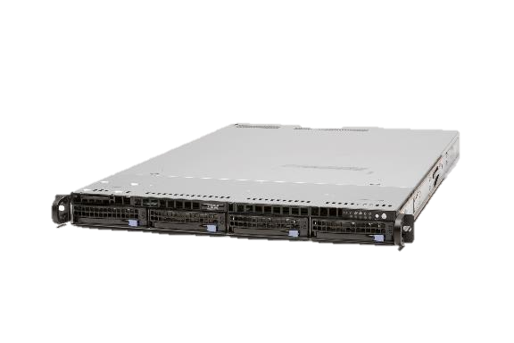
Systems designed to crush Big Data and
AI workloads
Deep Learning
Data Intensive Workloads
Big Data Workloads
Enterprise Private Clouds
Notes:
This brings us to the 4 workloads that the IBM POWER9 Systems lines are targeted at. The remainder of this presentation will walk through each of these lines in more detail. We use this transition slide between each set of servers so we will repeat these points on each of those slides but bold the section we are just about to move into.
Deep Learning: The Accelerated Computing (AC) line of servers is specifically designed for AI, Machine Learning and Deep Learning. With integrated NVIDIA GPUs and NVLink along with the highly optimized PowerAI software stack, the AC line of servers brings unparalleled performance to deep learning.
Data Intensive Workloads: The scale-out servers (S, L and H server lines) optimized for database and data intensive workloads. These servers deliver the most memory available today in a 2 socket 2U server and also come in 4U models as well. With specific servers even for SAP HANA, these systems are unbeatable when it comes to scale out workloads like MongoDB, EnterpriseDB, SAP HANA, Db2, and more.
Big Data Workloads: The LC line of servers are designed to crush Big Data workloads. These 1U and 2U systems pack in the performance and I/O capacity required for Hadoop and Spark workloads that x86 systems just can’t match.
Enterprise Private Clouds: For enterprise private clouds there is a special line of scale up line of servers (E950/E980) designed for maximum application density and performance. For workloads like SAP where you have multiple instance and landscapes in order to run your enterprise, running these on a single system not only provides economies of scale, but also delivers world leading performance and reliability for mission critical applications. And for SAP there is the H950 and H980 optimized for SAP HANA. Anywhere you need to consolidate multiple workloads to reduce cost and complexity, the enterprise private cloud servers is the place to look for unbeatable virtualization resulting in total cost savings over other offerings in the market.
6

Slide 7

The new AC922
Advanced IO interfaces:
  2nd Generation CPU - GPU NVLink: ~5.6X the CPU-GPU bandwidth compared to x86
  PCIe Gen4/CAPI 2.0: First to market with PCIe Gen 4 with 2x improvement over PCIe Gen 3 and next gen CAPI for coherent device attachment
Introducing Coherence: Treat system memory just like GPU memory enabling game changing simplification of programing and larger model sizes
GPU Direct: Peer to peer communication within a cluster for remote data access and transfer (RDMA)
The AC922 is designed to lead the market in AI, Machine Learning and Deep Learning as well as other High Performance Computing applications with acceleration for GPU optimized workloads.
Notes:
There are 3 key points with AC922 which make it the best server for Enterprise AI.
First, it’s designed from the ground up for AI workloads which starts with its acceleration superhighway. The AC922 introduces second generation NVLink between the CPU and GPU; this is 5.6x faster than PCIe Gen 3 architectures which x86 remains committed in their current offerings (2018).
Second, IBM didn’t just focus on the NVLink communications for the CPU ←→ GPU pipeline … the AC922 was designed as a balanced system; specifically for the AI era with industry leading memory bandwidth, PCIe Gen 4 busses (for the best network connectivity), and high performance storage adapters.
Finally, when designing this infrastructure, IBM took the world’s most prevalent open source machine learning (ML) and deep learning (DL) frameworks and optimized them around the AC922’s advanced infrastructure design with added enhancements such as Spectrum Conductor for Distributed Deep Learning (DDL) and large model support (LMS – more on that in a bit). This results in the best server and solution for Enterprise AI. Quite simply, AC922 lets you flatten the time to AI value curve by accelerating the journey to build, train, and infer deep neural networks
Note that the specifications of the AC922 GTH are as follows:
2 Socket, 2U packaging
Up to 40 POWER9 processor cores
Up to 4 NVIDIA Volta 2.0 GPUs
Up to 2TB of memory
4 PCIe Gen4 Slots
While the AC922 GTX model comes with:
2 Socket, 2U packaging
Up to 44 POWER9 processor cores
Up to 6 NVIDIA Volta 2.0 GPUs
Up to 2TB of memory
4 PCIe Gen4 Slots

Slide 8
Systems designed to crush Big Data and
AI workloads
Deep Learning
Data Intensive Workloads
Big Data Workloads
Enterprise Private Clouds
Notes:
Now let’s look at the second of our 4 workloads that the IBM POWER9 Systems lines are targeted at; Data Intensive workloads.
Deep Learning: The Accelerated Computing (AC) line of servers is specifically designed for AI, Machine Learning and Deep Learning. With integrated NVIDIA GPUs and NVLink along with the highly optimized PowerAI software stack, the AC line of servers brings unparalleled performance to deep learning.
Data Intensive Workloads: The scale-out servers (S, L and H server lines) optimized for database and data intensive workloads. These servers deliver the most memory available today in a 2 socket 2U server and also come in 4U models as well. With specific servers even for SAP HANA, these systems are unbeatable when it comes to scale out workloads like MongoDB, EnterpriseDB, SAP HANA, Db2, and more.
Big Data Workloads: The LC line of servers are designed to crush Big Data workloads. These 1U and 2U systems pack in the performance and I/O capacity required for Hadoop and Spark workloads that x86 systems just can’t match.
Enterprise Private Clouds: For enterprise private clouds there is a special line of scale up line of servers (E950/E980) designed for maximum application density and performance. For workloads like SAP where you have multiple instance and landscapes in order to run your enterprise, running these on a single system not only provides economies of scale, but also delivers world leading performance and reliability for mission critical applications. And for SAP there is the H950 and H980 optimized for SAP HANA. Anywhere you need to consolidate multiple workloads to reduce cost and complexity, the enterprise private cloud servers is the place to look for unbeatable virtualization resulting in total cost savings over other offerings in the market.
8

Slide 9
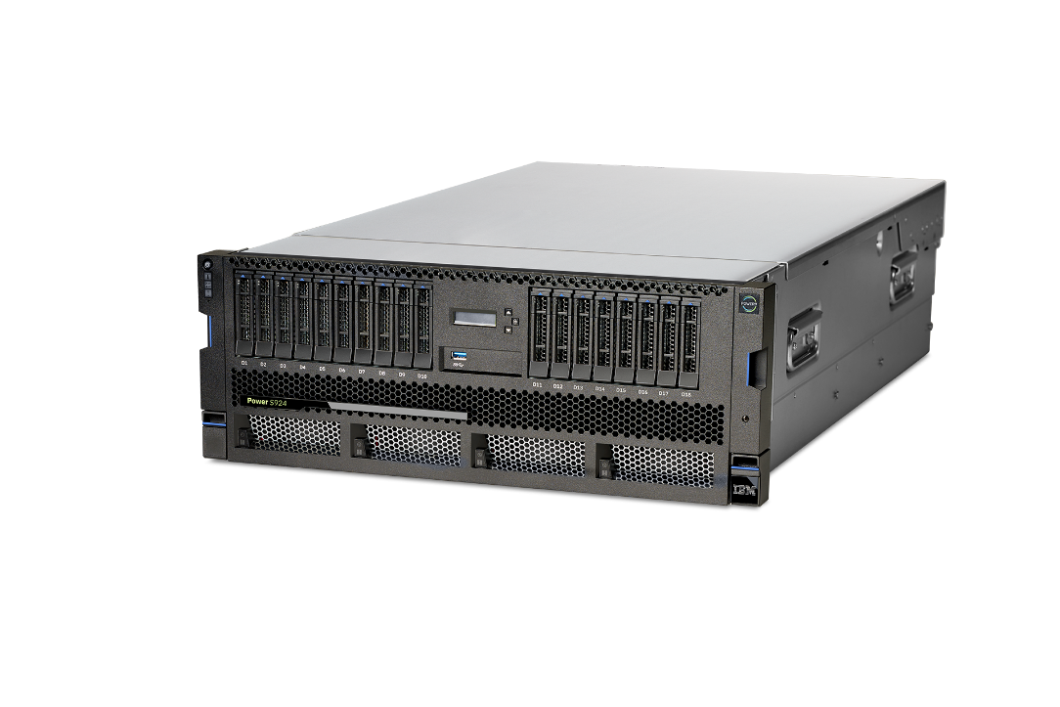
The new S924 / H924
2-socket, 4U
8, 10, or 12 cores per socket
32 IS RDIMM slots
4TB memory
4 CAPI 2.0 slots
Internal RDX Media
AIX, IBM i, Linux
PowerVM
In the Scale Out Server family, the S924 and H924 are designed to meet highest performance and security with a memory footprint of up to 4TB which is industry leading in the
2 socket market compared to x86 platforms
Notes:
Starting with the S924 and H924:
The S924/H924 are 4U, 2 socket servers with the scale-out SMT8 cores available in 12-core, 10-core and 8-core options. The servers have a maximum memory capacity of 4TB and now we are using industry standard DDR4 RDIMMS running at speeds up to 2666 MHz depending on your configuration.
Like POWER8, these servers still have 11 PCIe slots but these servers now come with new PCIe Gen4 slots which are 2x faster than PCIe Gen3. The servers have a combination of PCIe Gen3 and Gen4 slots available. POWER9 has also introduced OpenCAPI acceleration and we have 4 high speed 25Gb/s ports that will be utilized later this year and into next year as OpenCAPI offerings become available.
From a storage perspective, these servers have very similar configurations to what was available on POWER8. These servers have both a 12 bay configuration as well as an 18 bay configuration using small form factor (SFF) fast bays with faster interfaces for those bays. Another thing from a media standpoint is that the 4U servers have an RDX media bay option (Note that there will be no DVD. If you want to attach a DVD, you would do so with an external DVD drive connected through USB). Of course I/O expansion drawers are also supported.
From an operating system perspective, the S924 supports AIX, IBM i and Linux. Note that the H924 is targeted at SAP HANA (which requires Linux) but we allow clients to run up to 25% of their cores with AIX or IBM i for other workloads on the same box.

Slide 10
The new S914
1-socket, 4U Rack & Tower
4, 6, or 8 cores per socket
16 IS RDIMM slots
1TB memory
2 CAPI 2.0 Slots
Internal RDX Media
AIX, IBM i, Linux
PowerVM
The S914 is the price attractive entry offering into the POWER9 family of servers.
Industry leading integrated security and reliability as well cloud enabled out of
the box with integrated PowerVM technology
Notes:
The S914 is a 1 socket version of the 4U model we just went through. Therefore the I/O and storage are the same but the processor offerings do change. The first thing you notice is there are 8-core, 6-core and 4-core processor options.
Given you only have one socket populated, the maximum memory available to put on this system is 1TB. The PCIe slots are the same as the S924 with only 1 socket populated so there are 8 available PCIe slots.
Everything else is essentially the same as the S924 from a feature standpoint for this server. Note that it comes as a tower option (as shown above) or as a rack mounted server.

Slide 11
The new S922 / H922
1,2-socket, 2U
4, 8, or 10 cores per socket
32 IS RDIMM slots
4TB memory
4 CAPI 2.0 Slots
AIX, IBM i, & Linux
PowerVM
In the Scale Out Server family, the S922 is designed to meet highest performance
and security in a dense form factor with a memory footprint of up to 4TB
which is industry leading in the 2 socket market compared to x86 platforms
Notes:
Now let’s look that the 2U models. The design is very similar for all 2U offerings so let’s first look at the overall summary of the S922 and the H922 (which is the same as S922 but optimized for SAP HANA).
The S922 and H922 are 2U 19 inch servers with 10-core, 8-core and 4-core offerings with 4TB of memory. Unlike POWER8, there is no reduction in memory capacity between the 4U and 2U offerings here so you can put the full 4TB of memory in these 2U configurations.
The 2U servers also have 9 PCIe slots available (unlike the 11 available in the 4U configurations), with 4 ports for OpenCAPI acceleration.
Only one storage bay option is available for the 2U servers with 8 small form factor SAS bays. There are both single and split backplane support as well as the 2 internal NVMe flash boot adapters. There is no support for the dual RAID write cache capability that was available in POWER8 (it is only available in the 4U configuration). The I/O expansion drawers are supported as well.
From an OS perspective, the S922 and H922 both support AIX, IBM i and Linux but take note that the H922 is limited to support AIX and IBM i for up to 25% of the server’s cores.

Slide 12
The new L922
1,2-socket, 2U
8, 10 or 12 cores per socket
32 IS RDIMM slots
4TB memory
4 CAPI 2.0 Slots
Linux
PowerVM
In the Scale Out Server family, the L922 is designed to meet highest performance and
security for Linux workloads in a dense form factor with a memory footprint of up to 4TB
which is industry leading in the 2 socket market compared to x86
Notes:
The L922 has the same design as the S922 but is specifically designed for Linux workloads. For the L922, the 4-core option is removed and there is a 12-core option added for maximum throughput (note that the 12-core configuration is only available with both sockets populated for a total of 24 cores on the system).
The L922 only supports PowerVM as the hypervisor with planned support in the future for bare metal or KVM as a hypervisor.

Slide 13

Unleash POWER9 on SAP HANA with H922 and H924
  2-socket 4TB systems for SAP HANA
    Excellent competitor in 2-socket space
    Attractively priced systems for Linux-minded clients
      S922/S924 can also run SAP HANA for clients requiring more than 25% for AIX, IBM i cores
  Highly flexible systems with best in class virtualization
    Consolidate workloads to reduce data center footprint
    High utilization through mixed workloads with production
    SAP HANA, traditional, and non-production SAP running side-by-side
Notes:
The H922/H924 are the initial release of the 2-socket systems that are optimized to run SAP HANA.
Both of these models provide very competitive and attractively priced 4TB 2-socket system (compared to only 3TB on a similar x86 system)
IBM Power Systems continues with leadership in flexibility through virtualization with PowerVM. Clients can use virtualization to consolidate workloads onto a single system, reducing data center footprint. The ability to run mixed workloads leads to higher system utilization – run Production SAP HANA, traditional SAP on AIX or IBM i, non-production, and non-Linux applications all side by side on the same system.
These systems are for Linux-minded clients. These systems are packaged for the majority of the workload to run on Linux (SUSE, RHEL) with some AIX and IBM i (up to 25% of cores). For clients who need a higher percentage of AIX or IBM i, the S922/S924 systems can also run SAP HANA.
IBM intends to support SAP HANA on the IBM Power System H922 and H924 in production mode, with the following Linux operating systems, following near term certification of the environment:
Red Hat Enterprise Linux (RHEL) for SAP with Red Hat Enterprise Linux 7 for Power LE version 7.4
SUSE Linux Enterprise Server for SAP with SUSE Linux Enterprise Server 12 SP3

Slide 14
Systems designed to crush Big Data and
AI workloads
Deep Learning
Data Intensive Workloads
Big Data Workloads
Enterprise Private Clouds
Notes:
Now let’s look at the third of our 4 workloads that the IBM POWER9 Systems lines are targeted at; Big Data Workloads.
Deep Learning: The Accelerated Computing (AC) line of servers is specifically designed for AI, Machine Learning and Deep Learning. With integrated NVIDIA GPUs and NVLink along with the highly optimized PowerAI software stack, the AC line of servers brings unparalleled performance to deep learning.
Data Intensive Workloads: The scale-out servers (S, L and H server lines) optimized for database and data intensive workloads. These servers deliver the most memory available today in a 2 socket 2U server and also come in 4U models as well. With specific servers even for SAP HANA, these systems are unbeatable when it comes to scale out workloads like MongoDB, EnterpriseDB, SAP HANA, Db2, and more.
Big Data Workloads: The LC line of servers are designed to crush Big Data workloads. These 1U and 2U systems pack in the performance and I/O capacity required for Hadoop and Spark workloads that x86 systems just can’t match.
Enterprise Private Clouds: For enterprise private clouds there is a special line of scale up line of servers (E950/E980) designed for maximum application density and performance. For workloads like SAP where you have multiple instance and landscapes in order to run your enterprise, running these on a single system not only provides economies of scale, but also delivers world leading performance and reliability for mission critical applications. And for SAP there is the H950 and H980 optimized for SAP HANA. Anywhere you need to consolidate multiple workloads to reduce cost and complexity, the enterprise private cloud servers is the place to look for unbeatable virtualization resulting in total cost savings over other offerings in the market.
14

Slide 15
The new LC922
2 sockets, 2U
Up to 44 cores (2.6-2.91Ghz)
  16, 20, or 22 cores per socket
2TB Max Memory (16 DIMMs)
Max 120 TB storage (HDD)
Max 45.6TB (SSD) capacity
Ubuntu 18.04 LTS
RHEL 7.5 for POWER9
The LC922 is designed to crush Big Data workloads with enhancements to
the LC line’s open heritage while delivering superior performance in a cost optimized design.
Notes:
The LC922 system is designed for data – this is a 2U form factor system capable of up to 120TB HDD storage capacity; you can optionally add an additional 2 more drives in the rear just for the operating system – so the 120TB can be just for data. Bottom line, the L922 has massive storage capacity to meet your client’s most data intensive needs.
This system is also the industry’s first general compute system with PCIe Gen4 technology, delivering twice the data bandwidth as compared to PCIe Gen3 technology found in commodity x86 systems. This system is specifically designed to crush Big Data workloads but is also optimized to deliver superior performance at ~30% lower list price than an equivalent HP server.
It offers 2x the price performance for key workloads such as MongoDB, Spark, the IBM Data Science Experience (DSX), and more.
In summary, some of the benefits of the LC922 include:
LC922 delivers 2x price-performance over x86 alternatives for leading data rich applications (review claims in Smartseller for details)
Enables ~2x more active users on a single server with the LC922 improving infrastructure flexibility for data scientists.
IO leadership with the industry’s first general compute system containing PCIe 4.0 and CAPI 2.0.
Optimized design to deliver superior performance at a ~30% lower list price than an equivalent HP DL380 server.

Slide 16
The new LC921
2 socket, 1U
Up to 40 cores (2.13-2.2Ghz)
  16 or 20 cores per socket
2TB Max Memory (16 DIMMs)
Max 40 TB storage (HDD)
Max 15.2TB (SSD) capacity
Ubuntu 18.04 LTS
RHEL 7.5 for POWER9
The LC921 drives superior dense computing – it’s designed to be a balanced
system for throughput and density. Driving the most compute in the smallest rack space.
Notes:
The LC921 drives superior dense computing – it’s designed to be a balanced system for throughput and density. The LC921’s 1U packaging gives you up to 40 cores with 2TB of memory and up to 40TB of internal HDD storage. It’s also equipped with the industry leading PCIe Gen4 technology to meet dense computing deployment requirements.
Imagine the compute power you can drive with this system in a single rack – maximizing data center efficiency and reducing your infrastructure costs!

Slide 17
Systems designed to crush Big Data and
AI workloads
Deep Learning
Data Intensive Workloads
Big Data Workloads
Enterprise Private Clouds
Notes:
Now let’s look at the forth of our 4 workloads that the IBM POWER9 Systems lines are targeted at; Enterprise Scale Up Private Clouds.
Deep Learning: The Accelerated Computing (AC) line of servers is specifically designed for AI, Machine Learning and Deep Learning. With integrated NVIDIA GPUs and NVLink along with the highly optimized PowerAI software stack, the AC line of servers brings unparalleled performance to deep learning.
Data Intensive Workloads: The scale-out servers (S, L and H server lines) optimized for database and data intensive workloads. These servers deliver the most memory available today in a 2 socket 2U server and also come in 4U models as well. With specific servers even for SAP HANA, these systems are unbeatable when it comes to scale out workloads like MongoDB, EnterpriseDB, SAP HANA, Db2, and more.
Big Data Workloads: The LC line of servers are designed to crush Big Data workloads. These 1U and 2U systems pack in the performance and I/O capacity required for Hadoop and Spark workloads that x86 systems just can’t match.
Enterprise Private Clouds: For enterprise private clouds there is a special line of scale up line of servers (E950/E980) designed for maximum application density and performance. For workloads like SAP where you have multiple instance and landscapes in order to run your enterprise, running these on a single system not only provides economies of scale, but also delivers world leading performance and reliability for mission critical applications. And for SAP there is the H950 and H980 optimized for SAP HANA. Anywhere you need to consolidate multiple workloads to reduce cost and complexity, the enterprise private cloud servers is the place to look for unbeatable virtualization resulting in total cost savings over other offerings in the market.
17

Slide 18

The new E950
2 and 4-socket, 4U
SMT8
12, 11, 10 or 8 cores per socket
Up to 16TB Total DDR4 DIMMs – up to 4TB per processor
  128 DIMM slots on 8 memory riser cards, 16 DIMM slots on each riser, 2 riser cards per processor
Linux and AIX
In the Enterprise Server family, the E950 is designed with built-in virtualization so you can build a cloud that handles the most data intensive workloads for Private, Hybrid or Multi-Cloud environments.
IBM and Business Partner Internal Use Only – Until Announce
Notes:
The enterprise servers (E950 and E980) are designed for clients who need the highest levels of performance for building private cloud and/or consolidated environments.
The E950 comes in 2 socket and 4 socket configurations in a 4U form factor for standard 19 inch rack enclosures. The E950 leverages the SMT8 processor in 12-core, 11-core, 10-core and 8-core offerings. Clients can leverage the 12-core processor for maximum throughput or the 8-core processor for maximum per core performance (or somewhere in between depending on the workloads they want to run on the system).
For private cloud deployments, the server comes with up to 16TB of memory which has supports up to 920 GB/s of total system memory bandwidth (230GB per processor) for memory demanding workloads like databases, data-intensive applications, and in-memory analytics systems.
On the IO side the E950 delivers double the IO bandwidth of x86 systems with 10 PCIe GEN4 Slots (eight x16 and two x8 slots).

Slide 19
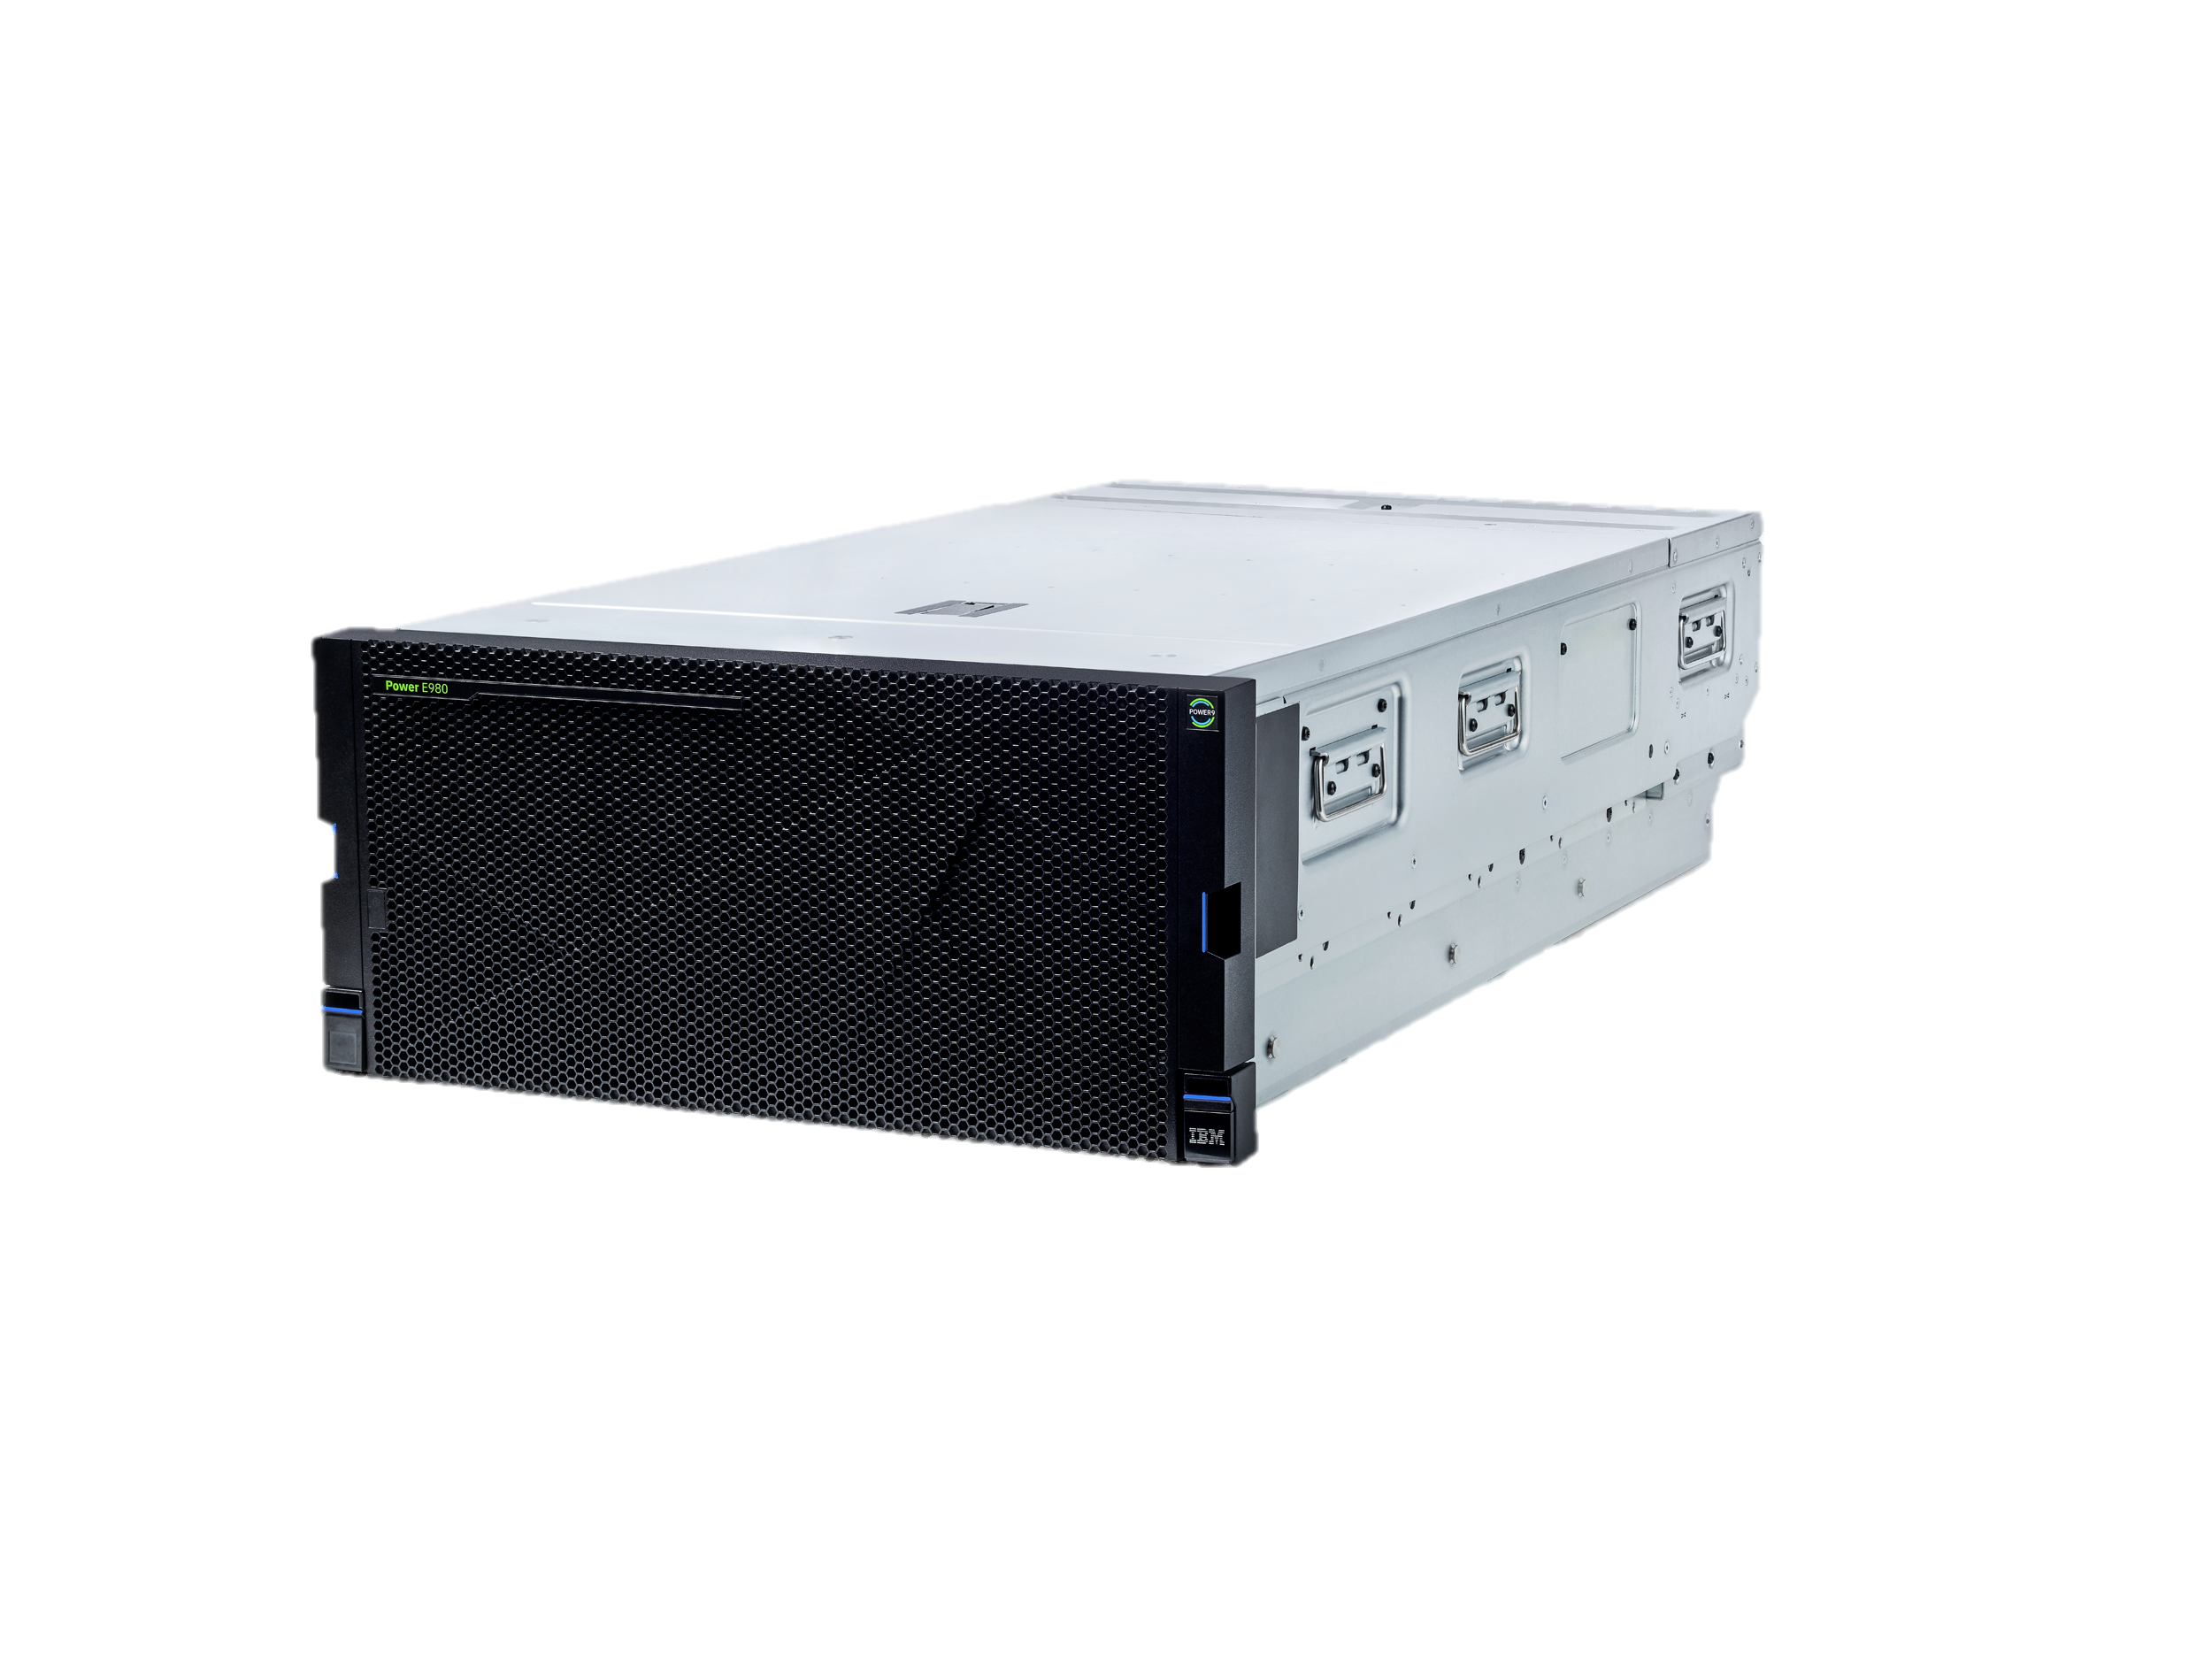
The new E980
Modular Scalable Design – Up to four 5U CEC drawers + 2U Control Unit
Max of 192 SMT8 processor cores
  12, 11, 10 or 8 cores per socket
Up to 64TB total memory (16TB per drawer)
Linux, AIX and IBM i
In the Enterprise Server family, the E980 ensures continuous operations for business critical services with the most reliable infrastructure with industry-leading uptime. Don’t sacrifice performance when your data needs to grow. With the E980, you get more VMs and more throughput per server that handles the most data intensive workloads.
IBM and Business Partner Internal Use Only – Until Announce
Notes:
The E980 supports up to four 5U CEC drawers (note CEC is a Central Electronic Complex - main CPUs, memory and I/O drawers), plus a 2U control unit all in the standard 19 inch rack enclosure. These servers deliver up to 192 processor cores in total (like the E950 you can choose from 12-core (maximum throughput), 11-core, 10-core or 8-core (maximum per core performance) processors). These servers are designed for continuous operations for business critical services and delvers more VMs and more throughput per server than anything else on the market.
These servers support 230 GB/s Memory Bandwidth and up to 4TB of memory per socket. With 8 DIMM slots per socket, 32 DIMMs per drawer, 128 DIMMs max in the configuration and supports CDIMMS of 32, 64, 128, 256, 512 GB DDR4
On the IO side the E980 supports up to 32 PCIe Gen4 slots (8 slots per drawer) and up to 4 IO expansion drawers (moving to up to 16 I/O Expansion Drawers in the 4th Quarter of 2018).

Slide 20
IBM POWER9 Family
When data-intensive workloads are the bottom line
Mission Critical Data Intensive Workloads for Private Clouds
Big Data Workloads
Enterprise AI Workloads
Entry
Midsize
Enterprise
S922/S914/S924
H922/H924/L922
E950
E980
LC922/LC921
AC922
Notes:
In summary, the POWER9 family of servers is designed to match the requirements of your most critical data-intensive workloads. From mission critical data workloads to Big Data systems to the next generation of AI workloads, POWER9 has you covered. If you are looking for a one size fits all solution, you should think twice about the ability to scale and meet the needs of the AI era. By leveraging servers that are optimized to your workload characteristics, you can not only gain a performance advantage on your competitors, but you can also gain a price-performance advantage and invest that savings into building next generation AI applications to disrupt your industry (before you get disrupted by someone else).
IBM POWER9 family server line can be thought of as 3 logical groupings of offerings:
For mission critical data intensive workloads and private clouds, these servers can be broken down further into entry level models (2 socket, 2U and 4U servers), midsized offering with the E950 and H950, and the high end enterprise class scale up server in the E980/H980.
Focused on big data workloads, the LC922/LC921 have 2 sockets and are available in a 2U and 1U form factor.
For Enterprise AI and high performance computing workloads we have the AC922

