Slide 1
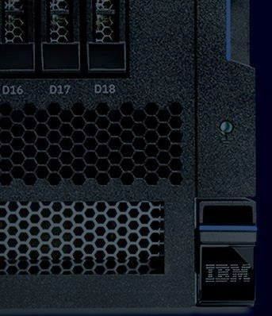

IBM Power Systems Scale Out Servers
Cloud-ready servers built for mission-critical applications
Simon Porstendorfer (Simon.Porstendorfer1@ibm.com)
James Allen (jdallen@us.ibm.com)
Chris Eaton (ceaton@ca.ibm.com)
Paul Zikopoulos (paulz@ca.ibm.com)
Notes:
This presentation covers the launch of the scale out servers (L922, S922, S914, S924, H922 and H924). These servers are designed for mission critical applications running on AIX, IBM i and Linux.
The focus of these servers is to deliver high resilience in a secure server which is built for scale out clusters and private clouds. Designed to run AIX, IBM i and Linux operating systems, IBM’s POWER9 servers are delivered secure with pre-loaded firmware and operating system security patches that mitigate known Meltdown and Spectre vulnerabilities in these operating system environments. Quite simply, out of the box, these systems mitigate these security threats to help protect your critical data and your business.
This server line also ships with PowerVM preloaded to help clients build private clouds with the industry leading virtualization density that Power Systems offers. Able to be deployed in a private cloud or as stand-alone services, the embedded PowerVM delivers superior virtualization density allowing clients to get more value out of their IT investments.
You can use this presentation for your own personal enablement or to present directly to clients. In this presentation, you will see certain facts repeated (in the speakers notes and sometimes the slides). This is by design to drive home a point and learning … but you are free to customize the deck’s storyline in any manner you wish.
There were a number of POWER9-based architectures rolled out throughout 2018. Starting with the lineup of 1 and 2-socket scale out configurations as well as a line of scale out servers for data intensive workloads. That followed with large-scale multi-sockets SMP servers including 4-socket midrange offering and a 4 to 16 socket modularized high-end offering; all delivering incredible opportunities for Linux, IBM i, and AIX.

Slide 2
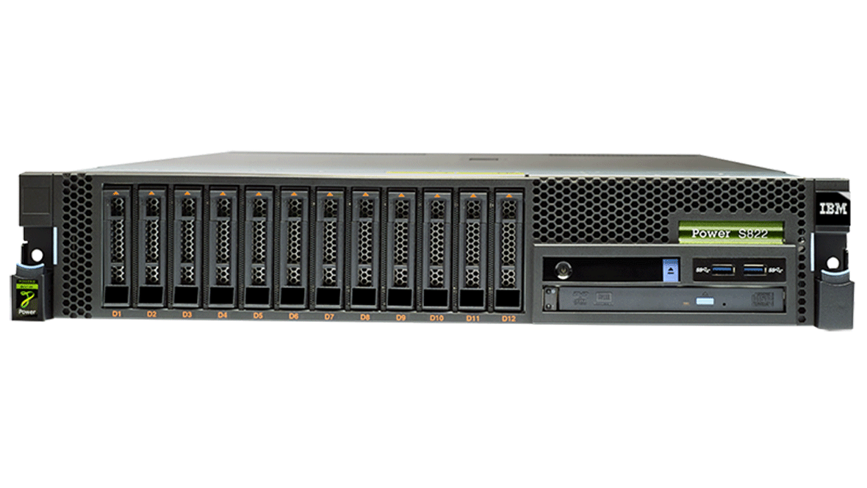
Power Systems Product Portfolio
POWER9 servers and solutions are built to crush today’s most advanced data applications …
from the mission critical applications you run today to the next generation of AI workloads
Mission Critical Workloads
Big Data Workloads
Enterprise AI Workloads
Entry
Mid
Enterprise
S922/S914/S924
H922/H924/L922
Q1 2018
E950
Q3 2018
E980
Q3 2018
LC922/LC921
Q2 2018
AC922
Q4 2017
Core Infrastructure
Next Gen AI Workloads
Notes:
IBM Power Systems delivers extreme performance across a broad spectrum of applications and workloads. From mission critical data intensive applications to the next generation of AI workloads, POWER9 has architected advantages over the competition.
The POWER9 server lineup can be categorized into 3 groups:
Mission Critical Workloads
These are data intensive applications that run our clients’ core business such as SAP HANA, Db2, Oracle, as well as open source databases (both noSQL and SQL flavors) such as MongoDB, Redis, MariaDB, among others. Applications in this space require impenetrable security to be baked into the system as well as the reliability clients have come to expect from Power Systems. Along with those table stakes, it’s the performance that really shines when it comes to POWER9. Delivering 2x more performance per core vs. x86, POWER9 is by far a better value for your clients enterprise IT needs.
Big Data Workloads
For crushing through large volumes of data there is nothing better than the LC line of servers was delivered with POWER9 in 2Q 2018. For Hadoop and Spark workloads running on Power Systems, these servers bring the compute density and the storage capacity to satisfy even the most demanding Big Data workloads
Enterprise AI Workloads
The next generation of competitive advantage for clients are from AI workloads. The AC922, delivered in Q4 of 2017, has been demonstrating the kind of deep learning performance and accuracy that can only be delivered with the combination of IBM POWER9, NVIDIA GPUs and the NVLink technology that ties the CPUs and the GPUs together, and specially engineered software (Distributed Deep learning, Large Memory Support, PowerAI Vision, among others) to be able to work on the most complex AI models.
As for the naming there are some changes from POWER8 and for those new to Power Systems, here is how to understand a server product name:
The first element is a letter that represents the type of server
L = Linux only server
H = SAP HANA optimized server
AC = Accelerated Computing server (focused on AI workloads)
S = Scale Out server (this is the base letter when one of the above is not used)
E = Enterprise scale up server
The first number is the POWER version (9 for POWER9 and 8 for POWER8, etc.)
The second number is the number of sockets in the server (1 socket or 2 sockets in the case of the scale out line)
The last number is the height of the server in U (2U, 4U and in the case of the enterprise server it is set to 0)

Slide 3



Private Cloud Ready
The ideal foundation for deploying a cloud strategy.
Secure by Design
Delivered secure for mission-critical data.
Designed for Mission Critical Applications
Performance and value for mission-critical applications like SAP HANA, Oracle, Db2,
as well as noSQL and SQL open source (MongoDB, MariaDB, and others) databases.
Future-forward infrastructure
Built-in PowerVM virtualization, IBM POWER9-based Power Systems are cloud-ready, enabling you to deploy the right cloud environment to meet your organization’s needs.
Notes:
Let’s dive deeper into the left side of the previous chart and spend the rest of this presentation talking about the mission critical workloads that the POWER9 scale out servers are targeted at.
Before getting into the details of the technology, let’s first understand what it is that these types of workloads require.
Private Cloud Ready
Private Cloud Ready means that these systems are designed and delivered with the best virtualization density in the industry. With PowerVM preloaded, clients can spin up private clouds behind their firewall and enjoy the same agility that public clouds offer while securing their data on premises. Remember! Cloud is a capability not a destination.
Secure by Design
Secure by design means we don’t bolt on security capabilities as an afterthought. With Power systems it’s a design point and a forethought. In fact, POWER9 systems are shipped by default with security patches already installed to ensure issues like Meltdown and Spectre don’t impact clients ability to remain secure right out of the gate.
Designed for Mission Critical Workloads - Performance and Reliability
For mission critical applications, the need for performance and reliability is paramount. Applications such as SAP HANA, Oracle, Db2, open source SQL and noSQL databases (MariaDB, MongoDB, and so on) are the engines that drive clients transactional and analytic workloads. They cannot be down for even a minute without impacting a company’s ability to run their business; what’s more, they must be able to handle the volume of users with the same performance day in and day out. That’s what it means to deliver mission critical applications and that’s what the POWER9 servers provide as the foundation for these types of applications.

Slide 4
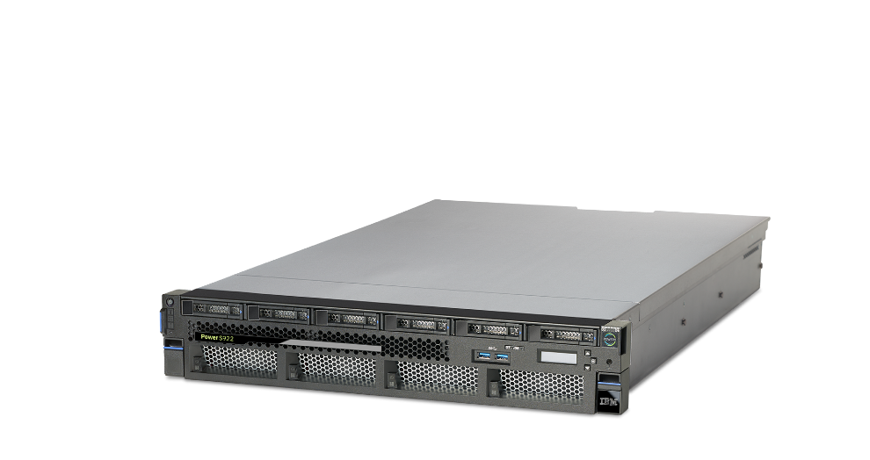
Private Cloud Ready
Built-in PowerVM
Superior virtualization density for higher utilization and more predictable response time.
Up to 4TB of Memory
Data intensive workloads love memory and POWER9 delivers up to 4TB per server – allowing applications to scale higher.
Infrastructure for IBM Cloud Private
IBM Cloud Private delivers a full cloud stack and POWER9 provides the high performance infrastructure to support the most demanding workloads.
Notes:
Let’s dive into each of these three aspects in more detail
The first one we mentioned is Private Cloud Ready. What does it take to be called “Private Cloud Ready?”
To answer that question, first think about what a private cloud requires. In order to build your own cloud on premises, you need a highly virtualized environment that can handle a lot of varying workloads without any one workload impacting the resources or capacity of another. With POWER9 servers, the systems all come with PowerVM built in.
POWER9 servers have the industry’s best virtualization engine when it comes to density. The ability to create more VMs on a given set of resources and have them all function at peak capacity is where PowerVM really shines. Add to that the ability for these servers to have up to 4TB of memory and now you have a system that not only has the processing capacity for a dense virtualized environment but you also have enough memory to handle even the most demanding workloads.
For example, both IBM Db2 BLU Acceleration and SAP HANA databases are very memory intensive (after all, they are in-memory columnar databases). By delivering more memory per socket than any other competitor, the POWER9 systems can meet the requirements of today’s data hungry workloads - all with the agility and growth capabilities that the scale out offerings from IBM provide.
Combining this with IBM Cloud Private (ICP) and you have a complete stack of cloud ready servers and applications at your fingertips.

Slide 5

Bucking the public cloud trend to improve performance and reduce costs
When delivering solutions to the healthcare industry, high reliability and fast, consistent performance are an absolute necessity. By migrating its platform from cloud-based services to private cloud, on-premise infrastructure based on IBM solutions, CipherHealth achieved huge gains in performance, improved reliability, and dramatically reduced costs.
50%+
reduction in monthly costs on infrastructure
88%
drop in time for data preparation (ETL) processes, allowing
for real time big
data processing
Eliminated
deviations in performance variability
“We see IBM Power Systems delivering 5x the capabilities of our previous cloud-hosted infrastructure
at half the price.”
Notes:
NOTE TO PRESENTER: THIS IS A POWER8 REFERENCE. THIS DECK WILL BE UPDATED WITH POWER9 REFERENCES AS THEY ROLL OUT INTO PRODUCTION – BUT THE REFERENCE STILL SPEAKS TO THE “POWER” of POWER.
Here is an example of a Power client that moved to private cloud to deliver increased performance at lower costs.
CipherHealth was able to reduce costs by 50% and at the same time improve their data preparation time (referred to as ETL: extract, transform, and load) performance by 88%. Why is this important? Because data loading in the cloud is very latency sensitive. As such, when data needs to move from on premises systems into the cloud or back again, the delay in performance due to the distance to the cloud provider can have a dramatic impact on performance. By moving their public cloud based systems on premises, CipherHealth was able to move their data closer to the systems and therefore see a large increase in performance.
At the same time they eliminated the variability that comes with public cloud based systems. Whenever you share infrastructure with another user (like in a shared server in the public cloud), you run the risk that other users will consume more than their share of the server’s capacity and thereby impact your performance.
All in all, CipherHealth was able to leverage Power Systems to deliver increased performance, better reliability to their end users and save money … a win-win-win.
For the full details, see this link to the reference case: http://ecc.ibm.com/case-study/us-en/ECCF-POC03328USEN.

Slide 6
Secure and available by design
Secure by Default
Pre-loaded with firmware and operating system security patches that mitigate known Meltdown and Spectre vulnerabilities.
Cloud Availability
Increase availability with integrated workload mobility, rapid capacity expansion and disaster recovery capabilities.
Always
ON!
Stay online 24/7 with RAS and high availability features.
Notes:
The second tenet is they must be secure and highly available by default … so that they can support mission critical applications. Of course high availability and reliability is baked into every IBM server. As noted from the ITIC 2017-2018 survey of over 750 enterprise organizations, IBM Power system topped the list for reliability and availability.
They found:
Among mainstream hardware platforms, IBM Power Systems have the least amount of unplanned downtime per server/per year.
88% of IBM Power Systems users running RedHat Enterprise Linux (RHEL), SuSE Linux Enterprise Servers (SLES) or Ubuntu Linux experience fewer than one unplanned outage per server, per year.
Only two percent of IBM servers recorded >4 hours of unplanned per server/per annum downtime; followed by six percent of HPE servers; eight percent of Dell servers and 10% of Oracle servers.
Meanwhile Reliability continues to decline for the fifth year in a row on the HP ProLiant and Oracle’s SPARC & x86 hardware and Solaris OS.
More details on this report can be found here: https://www-01.ibm.com/common/ssi/cgi-bin/ssialias?htmlfid=23015323USEN.
In addition to reliability, clients expect high security controls around their servers. While other vendors treat security as an add on, IBM ships its servers “secured by default”. This means they all Power servers in this line-up come preloaded with firmware and OS security patches already installed to address known issues with the Meltdown and Spectre vulnerabilities. In fact, we kept these security patches turned on in the system when running performance benchmarks because we feel that this most accurately reflects the environment you will run your workloads under. We don’t think you should trade off security for performance … which doesn’t seem to be an ethos shared by other vendor approaches

Slide 7


HR Group - Delivering instant sales and stock analytics with SAP HANA on IBM
Power Systems. By migrating SAP HANA to the IBM Power Systems platform,
HR Group accelerated key analytics processes, delivering near-instant insight into market trends at lower operational costs.
Near-instant
insight into market trends to respond
fast to shifting
retail demand
60% faster
Business processes with half the
processor cores
Optimizes
SAP system landscape to reduce cost and increase reliability
“Having all of our SAP applications on the single, highly reliable IBM Power Systems server platform helps us standardize systems management and increase productivity within the IT team. “
Notes:
NOTE TO PRESENTER: THIS IS A POWER8 REFERENCE. THIS DECK WILL BE UPDATED WITH POWER9 REFERENCES AS THEY ROLL OUT INTO PRODUCTION – BUT THE REFERENCE STILL SPEAKS TO THE “POWER” of POWER.
Trends in fashion change rapidly and it is crucial for retailers to respond fast to shifting market demands. As the industry faces shrinking profit margins, it becomes particularly important to be able to allocate the right products in the right sizes to the right stores at the right time; this helps to cut costs, reduce unsold and discounted stock, and maximize potential revenue.
Matthias Schäfer, Head of Application Development at HR Group, says, “We noticed that the business is getting faster and faster in terms of customer response, distribution, and to the whims of fashion. To sell our stock across all our branches at the best possible prices, we needed instant insights into customer behavior. Our regional sales managers can only effectively plan campaigns when they have access to up-to-the second sales figures. Using reliable facts enables them to adapt the product range in our branches to match customers’ tastes.”
Matthias goes on to say “SAP HANA on IBM Power Systems reduced complexity and increased energy efficiency in our data center. By combining SAP HANA with our point of sale (POS), we can instantly analyze sales information from 750 branches. On top of that, we use SAP POS Loss Prevention Analytics for Retail to monitor our transactions and flag up fraud and other suspicious activity as quickly as possible.”
After the initial implementation of SAP HANA on x86 servers, HR Group decided to move to SAP HANA on IBM Power Systems. With core SAP solutions already running on the IBM Power Systems platform, the move simplified its IT environment and streamlined operations and management processes.
For more details on this client success story refer to this link: https://www.ibm.com/case-studies/HR-Group.

Slide 8
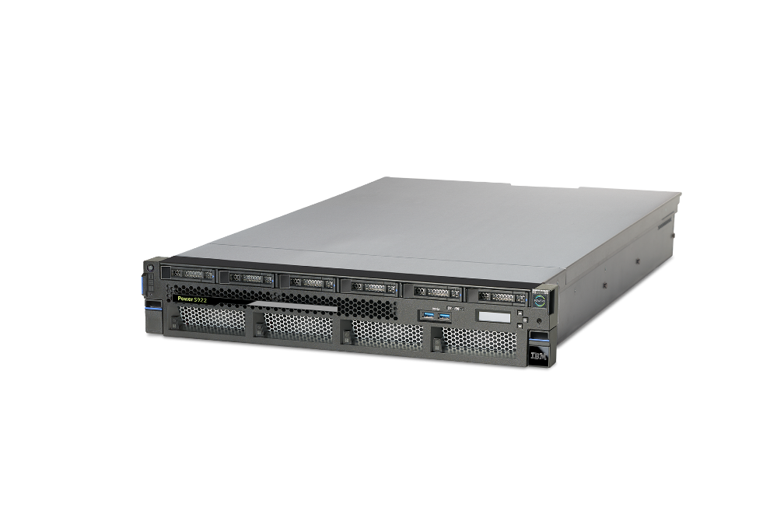
Mission Critical Applications
High Scalability
Take advantage of 4TB in-memory, 2 sockets and 12 cores/socket for database workloads (Db2, HANA, Oracle, MongoDB, and more).
High Availability
Increase availability with integrated workload mobility, rapid capacity expansion and disaster recovery capabilities.
Accelerated Interfaces
Smart acceleration enabled by CAPI technologies to improve data processing speeds.
Notes:
The final tenet is support for mission critical applications. Mission critical means it can never go down and it must be able to handle the highest demands of end users. A mission critical application must be able to scale on demand as you can never be sure you won’t experience a spike in user demand based on the success of an application.
With 4TB of memory in a 2 socket server, workloads like SAP HANA and Db2 (among others, such as MariaDB, MongoDB, +++) can be assured that there will be enough compute capacity and memory to meet the needs of these kinds of data hungry applications. And if the need for more capacity ever arises, scaling these servers out to clustered configurations gives near linear growth in building blocks that are large enough to handle these mission critical systems.
Finally, by leveraging the latest marketplace technologies such as PCI Gen4 and CAPI (Coherent Accelerator Process Interface), these servers are able to accelerate computing through very high speed data movement that is not available on x86 systems today.
All of this means you can count on the POWER9 server line for your most demanding workloads.

Slide 9


UOL Group - Opens the door to more holistic reporting and higher productivity. In the face of competitive pressures in the retail and hospitality industries, UOL Group uses
SAP ERP powered by SAP HANA running on state-of-the-art IBM Power Systems servers to facilitate analysis of data from its shopping malls, offices and hotels.
⇧30%
in performance:
drives rapid insight for decision-makers
65% cut
in energy consumption: helps the company pursue a greener approach to IT
50% savings
on space:
helps the company postpone enlargements to its data center
“We felt that IBM offered a combination of reliability, performance and value for money.”
Notes:
NOTE TO PRESENTER: THIS IS A POWER8 REFERENCE. THIS DECK WILL BE UPDATED WITH POWER9 REFERENCES AS THEY ROLL OUT INTO PRODUCTION – BUT THE REFERENCE STILL SPEAKS TO THE “POWER” of POWER.
UOL Group manages many operational functions – such as finance, procurement and materials management – using its core SAP ERP applications.
To accelerate analysis of its SAP data, UOL Group decided to migrate its entire SAP ERP landscape to the SAP HANA database. In order to support the SAP HANA database, UOL Group deployed three state-of-the-art IBM Power System servers, which are virtualized using IBM PowerVM and run the SUSE Linux Enterprise Server for SAP Applications operating system.
Foo Say Twang, Assistant General Manager, Group IT at UOL Group, explained: “SAP HANA solutions equip our employees across the globe with a reliable platform. We felt that IBM offered a combination of reliability, performance and value for money. The IBM team was helpful in addressing our queries and we have built a good relationship with them. We were satisfied with both the solution and implementation services from IBM and its partners.”
UOL Group is one of Singapore’s leading developers, with an extensive portfolio of development and investment properties, hotels and service suites. UOL Group, together with its hotel subsidiary Pan Pacific Hotels Group Limited (PPHG), owns two brands – namely Pan Pacific and PARKROYAL. PPHG now owns and/or manages over 30 hotels in Asia, Oceania and North America.
Details of the case study can be found here https://www.ibm.com/case-studies/UOL-Group.

Slide 10




Evolving from Compute Systems to Cognitive Systems
Dev Ecosystem
Industry Alignment
Not Just About Hardware Design
Partnerships
Open Frameworks
It’s about co-optimization
IBM Software
software
+
P8
P9
P10
hardware
Open Accelerator Interfaces
which just works for mission critical applications
Accelerator Roadmaps
Notes:
Typically, a presentation like this would start with a focus on the hardware optimization starting with the processor, the IO interfaces enabled by this processor, and what accelerators align to those interfaces to produce optimal performance. BUT REMEMBER this solution is not just about the hardware … which is why IBM refers to the POWER9 server line as Cognitive Infrastructure – it has a healthy dose of differentiated and innovative hardware and software in the offering.
<CLICK>
In this next section we are going to talk about the hardware that makes the POWER9 scale out servers optimized for mission critical applications that can be deployed in private clouds and have a need for the utmost security at higher performance than the competition. (If you want to start with software in this storyline, just flip the sections.)
As previously mentioned, IBM co-optimized software with hardware on the POWER9 server line… this is done by taking the world’s most demanding applications (Db2, SAP HANA, open source databases, and more) and optimizing them around the POWER9 advanced design. This co-optimization drastically flattens the time to success; not just in deploying secure servers but also in delivering industry leading performance for these mission critical applications.
With support for everything from the hardware to the software in this solution, not only does IBM’s Cognitive Infrastructure deliver differentiated hardware, but it also fits in with a software stack for mission critical and secure applications that’s equally rich and differentiated when run on IBM Power Systems.

Slide 11


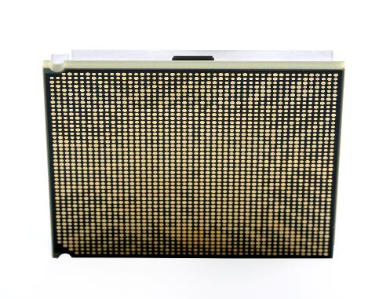
POWER9 processor
~1TB/s
BW into chip
7TB/s
on chip BW
The entire US Library Of Congress
can be processed on a POWER9
core chip in just over 1 second.
Notes:
Let’s first take a deeper look at the POWER9 processor itself which is used in the scale out server line as well as the enterprise and accelerated computing server lineup too. Innovation begins at the lowest levels of the processor and is built into every layer. This slide shows a remarkable example of the processor engineering that makes the POWER9 chip so advanced.
The first point is that the bandwidth (BW) into the chip is about 1TB per second while the bandwidth on the chip is 7TB per second. That sounds like a lot … but if you think of it in real world terms it really is astounding. At that level of bandwidth, you would be able to take the entire contents of the US Library of Congress (which today is about 10TB of printed material) and run it through the chip in just over 1 second … now that’s a speed reading exercise!
What this means for clients is that the most demanding and data intensive applications won’t be bottlenecked on the chip. In fact the issue is most likely that it will take more time to get the data from where it lives to the chip than it will take to process it.

Slide 12
Others
PCIe Gen3
POWER9 processor
1stchip with PCIe4
~1TB/s
BW into chip
POWER9
2x faster
PCIe Gen4
7TB/s
on chip BW
State of the Art I/O
and Acceleration
Attachment Signaling
  PCIe Gen 4 x 48 lanes
  192 GB/s duplex bandwidth
Notes:
The second key point is that the POWER9 processor is the first chip to be made available with PCIe Gen 4. Why is this important? As mentioned on the last slide, getting data into the chip is a bigger bottleneck than processing the data on the chip and that’s what makes the pipe to the chip a critical success factor in a high performance solution. Unlike x86 vendors that today (1Q19) only support PCIe Gen3, the PCIe Gen4 specification is 2x faster and provides up to 192GB/s duplex bandwidth across 48 lanes.
Clients with large data analysis challenges will benefit from both the high performance bandwidth on the chip as well as the PCIe Gen4 bandwidth to the chip.

Slide 13

More than one
transistor for every
person on the planet
POWER9 processor
1stchip with PCIe4
~1TB/s
BW into chip
4GHZ
PEAK FREQUENCY
7TB/s
on chip BW
8
BILLION TRANSISTORS
Notes:
How do IBM Power Systems keep getting faster and faster? By putting even more transistors on the chip. It’s hard to grasp how many transistors there are when you say 8 billion. Seems like a lot; but when you realize that there are only just over ~7.5 billion people on the planet you can quickly realize that having more than one transistor per human being on the planet packed into a small square chip is a massive feet of engineering.
The transistor form factor density that IBM has engineered in its POWER9 processing cores leads to even faster processing speeds and higher performance for those data intensive mission critical applications.

Slide 14
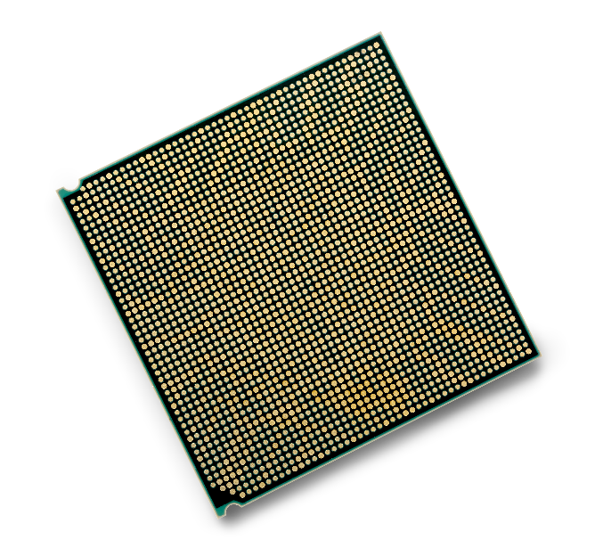
POWER9 processor
1stchip with PCIe4
~1TB/s
BW into chip
4GHZ
PEAK FREQUENCY
7TB/s
on chip BW
8
BILLION TRANSISTORS
>15
MILES OF WIRE
>24B
VIAS
17
LEVELS OF METAL
Innovation that makes a difference for mission
critical applications
Notes:
Here are a few other astonishing facts about IBM POWER9 processing cores. In this small processor there are over 15 miles of wire and 17 levels of metal. That seem shocking given the small dimensions of the processor itself. A VIA (vertical interconnect access) is an electrical connection between layers in a physical electronic circuit (going between layers). In the POWER9 processor there are more than 24 billion of these VIA connections. If every human on the planet held hands that would still only be just under 1/3rd of the number of connections that exist in this processor.
When you think about it, this level of engineering is quite incredible. But engineering just for the sake of engineering is not important. What is important is the innovation that leads to performance gains for clients that make a difference in their ability to compete in their markets. That’s what counts … and IBM Power Systems deliver in this area as well.

Slide 15

POWER9 vs.
x86 Xeon SP (Skylake)
POWER9 processor
2x¹
1stchip with PCIe4
performance
per core
~1TB/s
BW into chip
4GHZ
PEAK FREQUENCY
2.6x²
more RAM
per socket
7TB/s
on chip BW
1.8x³
memory bandwidth
per socket
8
BILLION TRANSISTORS
>15
MILES OF WIRE
>24B
VIAS
POWER9 with NVLink
vs. x86 Xeon
17
LEVELS OF METAL
9.5x⁴
CPU to accelerator bandwidth
Notes:
On the previous slide we talked about how it’s not just about engineering for engineering sakes ... it’s critical that the engineering leads to advantages for clients and that’s exactly what the POWER9 processor delivers. Performance benefits that help real clients’ mission critical applications to scale higher, perform better, and solve problems that lead to competitive advantages in their markets. This slide shows a few metrics that show the dominance of the IBM POWER9 processor over x86 (current as of 1Q19).
NOTE THAT THE ABOVE CLAIMS ARE FOR THE POWER9 PROCESSOR ARCHITECTURE AND ARE NOT SPECIFIC TO A GIVEN SERVER. IN FACT YOU WILL SEE IN THE PERFORMANCE SECTION THAT SOME OF THESE CLAIMS ARE DIFFERENT FOR THE SCALE OUT SERVER LINE AS SOME APPLY TO THE ENTERPRISE LINE. NOTE THAT THE POWER9 ARCHITECTURE IS THE SAME BUT THE AMOUNT OF MEMORY OR BANDWIDTH VARIES BY SERVER.
2x performance per core is based on IBM Internal measurements as of 2/28/18 on various system configuration and workload environments including (1) Enterprise Database (2.22x per core): 20c S922L (2x10-core/2.9 GHz/256 GB memory): 1,039,365 Ops/sec versus 2-socket Intel Xeon Skylake Gold 6148 (2x20-core/2.4 GHz/256 GB memory): 932,273 Ops/sec. (2) Db2 Warehouse (2.43x per core): 20c S922L (2x10-core/2.9 GHz/512 GB memory): 3242 QpH versus 2-socket Intel Xeon Skylake Platinum 8168 (2x24-core/2.7 GHz/512 GB memory): 3203 QpH. (3) DayTrader 7 (3.19x per core): 24c S924 (2x12-core/3.4 GHz/512 GB memory): 32221.4 tps versus 2-socket Intel Xeon Skylake Platinum 8180 (2x28-core/2.5 GHz/512 GB memory): 23497.4 tps.
2.6x memory capacity is based on 4TB per socket for POWER9 and 1.5TB per socket for x86 Scalable Platform Intel product brief: https://www.intel.com/content/dam/www/public/us/en/documents/product-briefs/xeon-scalable-platform-brief.pdf?asset=14606.
1.8x bandwidth is based on 230 GB/sec per socket for POWER9 and 128GB/sec per socket for x86 Scalable Platform Intel product brief: https://www.intel.com/content/dam/www/public/us/en/documents/product-briefs/xeon-scalable-platform-brief.pdf?asset=14606 .
9.5x is based on POWER9 and next-generation NVIDIA NVLink peak transfer rate is 150 GB/sec = 48 lanes x 3.2265625 GB/sec x 64 bit/66 bit encoding compared to x86 PCI Express 3.0 (x16) peak transfer rate is 15.75 GB/sec = 16 lanes X 1GB/sec/lane x 128 bit/130 bit encoding.

Slide 16

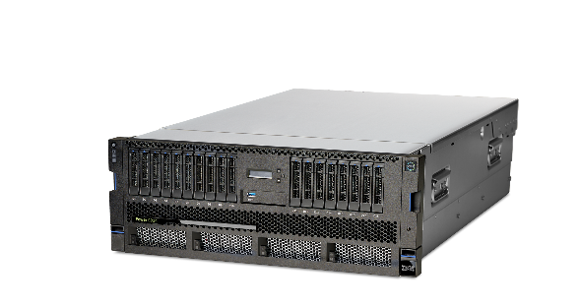
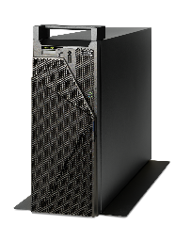
Industry leading 2-socket vs x86. Designed to meet highest performance and security needs, within a dense form factor, and a memory footprint up to 4TB.
S914
1-socket, 4U / Tower
4, 6 and 8 cores
per socket
1TB memory
AIX, IBM i, & Linux
PowerVM
L922
1,2-socket, 2U
8,10, and 12 cores per socket
4TB memory
Linux only
PowerVM
S922
1,2-socket, 2U
4, 8, and 10 cores per socket
4TB memory
AIX, IBM i, & Linux
PowerVM
S924
1,2-socket, 4U
8, 10, and 12 cores per socket
4TB memory
AIX, IBM i, & Linux
PowerVM
Notes:
The line of small enterprise servers starts with the S914. It’s a 4U that comes with 1-socket and has 4,6 or 8 cores per socket along with 1TB of memory. You can order an S914 as a Tower or rack mounted system. You might notice that this chart does not list processor frequencies … this is because the POWER9 servers ship with dynamic, adjustable frequencies.
By default, all of the offerings in this server line - except for the S914 - are set to run in “maximum performance” mode. The S914 is not as it is likely that this server (especially in the tower configuration) may not be running in a data center and therefore a client may not want the high fan speeds (and associated noise) to run out of the box as the default setting … of course, it’s an option.
The other servers in this lineup (L922, S922, and S924) all ship by default with the maximum performance setting for processor frequency. The L922 and S922 both come with 1 or 2 sockets in a 2U footprint and with the cores per socket as noted above. The L922 and S922 also comes with a maximum of 4TB of memory which is the largest amount of memory on the market (1Q19) for a 2 socket server compared to x86. Finally, the S924 is a 1 or 2 socket 4U server with up to 12 cores per socket and also comes with a maximum of 4TB memory.
Don’t forget, all of the servers in this line-up come with PowerVM pre-installed, which means clients can take advantage of the high virtualization density on these highly capable servers and build their own private clouds.
The H924 and H922 will be discussed in upcoming charts.

Slide 17
Evolving from Compute Systems to Cognitive Systems
Dev Ecosystem
Industry Alignment
Not Just About Hardware Design
Partnerships
Open Frameworks
It’s about co-optimization
IBM Software
software
+
P8
P9
P10
hardware
Open Accelerator Interfaces
which just works for mission critical applications
Accelerator Roadmaps
Notes:
In this next section we are going to talk about the software that is optimized for Power servers … namely the SAP HANA relational database and open source big data stacks and how the features of POWER9 accelerate solutions like this and drive the highest levels of performance for clients.
Note: This deck does not cover some of the non-performance related software components of the software and hardware stack. For example we will cover the performance advantages of POWER9 for SAP HANA but we do not cover all the other administrative and availability enhancements that POWER brings to a full SAP/POWER solution.
NOTE TO PRESENTER: For more SAP benefits you should look at the SAP HANA collections in SmartSeller, including the certification for SAP in SmartSeller. https://smartseller.mybluemix.net/#/category/r1mUxOt0-?CallSource=ss
The bottom line with co-optimization is that it’s not just the hardware (POWER9 systems) to help the small enterprise scale out servers achieve greater performance, and it’s not just the software (SAP, Db2, WebSphere, Hadoop, and so on) either … it’s the combination of the two working in harmony.

Slide 18


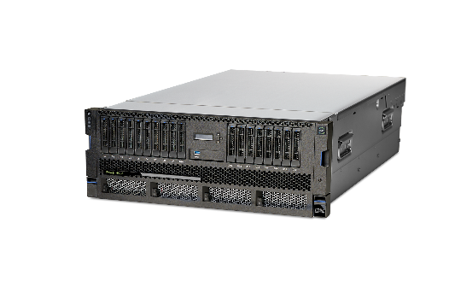
H922
1,2-socket, 2U
4, 8, and 10 cores per socket
4TB memory
Linux
Max. 25% of cores for AIX or IBM i
H924
2-socket, 4U
8, 10, and 12 cores per socket
4TB memory
Linux
Max. 25% of cores for AIX or IBM i
  Optimized for SAP HANA in-memory database workloads
    Up to 2-socket, 12 cores per socket with 4TB memory for SAP HANA workloads
  Highly flexible systems with
  best in class virtualization
    Consolidate workloads to
    reduce data center footprint
1.3x more memory capacity than x86 Xeon SP (Skylake) 2-socket platform
Only 2-socket Scale-out SAP HANA system (TDI5 or Appliance) with 4TB of memory
Notes:
The introduction of the H922 and H924 servers marks the first time IBM has announced a Power server specifically optimized for SAP HANA. These servers have the same configurations as the S922 and S924 shown on the previous slide, but are specifically configured to run SAP HANA. (Note that aside from fully running Linux, these servers can have up to a maximum of 25% of their cores dedicated to running AIX or IBM i workloads).
All of the benefits listed on the prior slide for the S922/S924 also apply to the H922/H924 with the added benefit that we can customize the price of the HANA optimized systems and simplify the ordering of the SAP HANA stack on these dedicated servers.
1.3X memory capacity is based on H922/H924/S924/S922 4TB per system for POWER9 and 3 TB per system (1.5TB per socket) for x86 Scalable Platform Intel product brief: https://www.intel.com/content/dam/www/public/us/en/documents/product-briefs/xeon-scalable-platform-brief.pdf?asset=14606
Appliance lists are here to backup the 4TB memory claim: https://www.sap.com/dmc/exp/2014-09-02-hana-hardware/enEN/appliances.html

Slide 19
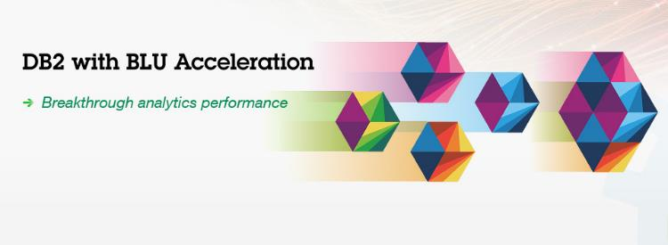
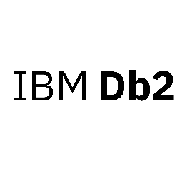
Mission Critical Databases
Guess what?
In memory databases…love memory!
With 4TB of memory in a 2U form factor, POWER9 runs in-memory databases better than anyone else
Just as important, databases love high bandwidth and large caches. POWER9 delivers 1.8x more bandwidth than x86
“I was asked to help one of our analysts who gave up on something he was executing across a billion records, because after 3 hours, the answer didn’t come back. We took that query (which involved a big join) & ran it on Db2 with BLU Acceleration and it finished in 10 seconds — 1080x faster.”
Randy Wilson
Lead Db2 DBA
Notes:
Another tightly integrated solution is IBM Db2 running on top of the POWER9 scale out server line. Specifically the Db2 BLU Acceleration feature is optimized for the large amount of memory and large caches available in POWER9. Db2 BLU Acceleration is an in-memory columnar database that is optimized for the cache sizes in POWER9 to deliver higher performance for analytic workloads compared to other in-memory database running on x86.
In fact, one client (BCBS Tennessee) found that running Db2 with BLU Acceleration on a query that took 3 hours on one system ran in just 10 seconds on Db2 on Power. The details of that reference can be found here: http://w3-public.dhe.ibm.com/ibmdl/pub/sales/ssi/ecm/po/en/pob03044usen/systems-hardware-power-systems-po-brochure-pob03044usen-20180125.pdf.

Slide 20


Leading Open Source Technologies
Available and Optimized for Linux on Power
Notes:
Modern and mature open source databases, such as MongoDB and EDB Postgres (based on PostgreSQL) are hardened for enterprise deployments and have innovative new capabilities beyond those of traditional enterprise databases. For example, healthcare organizations (like BCBS Florida) are using MongoDB to build new customer call-center applications that combine traditional patient billing data with new data formats, such as MRIs and lab test results. They are also using text data from specialist appointments to significantly reduce patient wait times and improve quality of care. Other organizations are using open source database management systems to combine GPS location data with real-time social media and video feeds with their own data to offer public transportation alternatives during peak travel times.
The good news is that you can take advantage of and modernize your data platform on Power Systems today because all of the major open source databases and technologies are available on IBM POWER. You can see examples of the most popular open source data technologies that are highly optimized for Linux on Power (this is little Endian Linux, so it’s the Linux your clients know from their x86 worlds) on this slide.
As a result, you will be able to take advantage of the performance and throughput advantages of the Power architectures which has been designed for data and delivers 2x better price/performance than comparable Intel x86 servers.
That translates into needing less servers and saving money on your initial acquisition costs along with ongoing operational support costs. You’ll also be able to run more database instances on each Power Systems server which means you’ll benefit from greater workload density and require 2x less servers which maximizes the utilization of your data center floor space.

Slide 21

Don’t rip & replace existing infrastructure to transform a business put data intensive workloads on the servers that were born to run them
Details on benchmarks in speaker notes.
68%
more operations
per dollar
40%
better performance
per system
112%
more operations
per dollar for
virtualized environments
62%
more operations per dollar for single image
84%
more virtual machines per dollar
74%
more throughput per dollar in a virtualized configuration for Cloud
on average
deliver
IBM Power Systems
80% more performance per dollar vs. x86-based servers
Notes:
Open source databases are only as good as the engine driving them. It’s critical to have a robust, high-performance infrastructure that’s optimized for data-intensive workloads. Next-generation developers require all this plus extreme flexibility and scalability, while IT seeks to lower costs per unit of compute, storage, and bandwidth. These servers integrate virtually seamlessly into data centers and clouds to scale mission critical workflows with maximum performance and minimum cost and server footprint. This integration frees up organizations to focus on solving critical business challenges and accelerating innovation. The exponential growth of data demands not only the fastest throughput but also smarter networks.
What do we mean when we say built for and optimized for POWER – this slide shows some good examples?
At this point in the conversation with your client you’ve now jointly agreed that open source and noSQL databases are dominating conversations in every company. The client understands that the most popular open source databases (SQL and noSQL) as well as other popular open source technologies (Hadoop, Spark, and so on) run on Linux (little Endian) on Power. And that the way IBM POWER servers are built and engineered, it gives them distinct advantages over data rich workloads … whether they are running on bare metal servers or virtualized. Now it’s time to show some of these databases running fast and some client examples as well.
The bottom line is that IBM Power Servers have been observed to deliver 80% more performance per dollar on average vs. x86-based servers. Don’t rip and replace your existing infrastructure to transform your business—just put your most data intensive workloads on the servers that were born to run them.
Just how big of a benefit is it?
At the bottom of this slide it notes that “IBM Power Systems deliver 80% more performance per dollar, on average, than x86-based servers … how can IBM make this (supported) claim? Let’s share some examples.
<CLICK>
MongoDB is a noSQL document store that’s ubiquitous when it comes to digital transformation initiatives. Ask around the organization who is leading a digital transformation, Chatbot, or mobile strategy, and you will surely find this technology. On application development teams, look for developers that talk about the MEAN (MongoDB, Express.js, Angular.js, Node.js) or MERN (MongoDB, Express.js, React.js, and Node.js) development stacks – the “M” says it all … these groups will all be drawn to this value proposition. There are multiple examples of the performance of MongoDB running on Power and the benefits it accrues to those projects in terms of agility and results. In one benchmark, MongoDB running on Power delivered 68% more operations for infrastructure dollar spent and 40% better performance than an x86 system.
Note: you will also come across a lot of developers that use the LAMP stack: Linux, Apache HTTP server, MySQL, and PHP). While the MERN and MEAN stacks are more ‘modern’ … LAMP dominated (and still does) many development houses. Power Systems support MySQL, so this is a great opportunity. In addition, it supports MariaDB (more on that in a bit).
<CLICK>
PostgreSQL is a powerful, open source object-relational database system. It has more than 15 years of active development and a proven architecture that has earned it a strong reputation for reliability, data integrity, and correctness. PostgreSQL prides itself on standards compliance. Its SQL implementation strongly conforms to the ANSI-SQL:2008 standard. It has full support for subqueries (including sub-selects in the FROM clause), read-committed and serializable transaction isolation levels. And while PostgreSQL has a fully relational system catalog which itself supports multiple schemas per database, its catalog is also accessible through the Information Schema as defined in the SQL standard. PostgreSQL has won praise from its users and industry recognition, including the Linux New Media Award for Best Database System and five time winner of the The Linux Journal Editors' Choice Award for best DBMS.
EnterpriseDB (EDB) Postgres offers not just support for PostgreSQL, but also extensibility features for availability and even Oracle compatibility. In a benchmark run on Power and x86 systems, a Power system was able to deliver 112% more operations per dollar for a virtualized (very critical to a discussions centered around private clouds) environment and 62% more operations per dollar for a single image. Do not lose site of the fact that EDB develops and integrates performance, security, and manageability enhancements into PostgreSQL to support enterprise-class workloads for its database, EDB Postgres Advanced Server.
EDB Postgres’ database compatibility for Oracle facilitates the migration of workloads from Oracle to EDB Postgres and supports the operation of many Oracle workloads running on EDB Postgres.
<CLICK>
MariaDB is a community-developed fork of the MySQL relational database management system intended to remain free under the GNU GPL (general public license). Development is led by some of the original developers of MySQL, who forked it due to concerns over its acquisition by Oracle Corporation.
MariaDB intends to maintain high compatibility with MySQL, ensuring a "drop-in" replacement capability with library binary equivalency and exact matching with MySQL APIs and commands. Contributors are required to share their copyright with the MariaDB Foundation. This is an important point to understand because MySQL was ubiquitous in the open source database landscape and is still heavily used today; for example, if you ask an IT shop if their developers use the LAMP stack, and they say “Yes”, they are using Linux, Apache (HTTP Server), MySQL, and PHP. MariaDB is a much desired substitute for MySQL and it runs faster on Power Systems.
There has been a lot of press with respect to Oracle’s acquisition of MySQL and how the model has changed (you have to pay for support to get access to certain features, and so on). Since MariaDB is pretty much drop and replace compatible with certain MySQL engines, it’s on the top list of many organizations that are concerned about Oracle’s interference in the open source market and the way they conduct their business.
In a MariaDB test on Power versus x86 infrastructure, Power supported 84% more virtual machines per dollar (again, very important details as it relates to the solution we are talking about) and 74% more throughput per dollar in a virtualized configuration for the cloud.

Slide 22


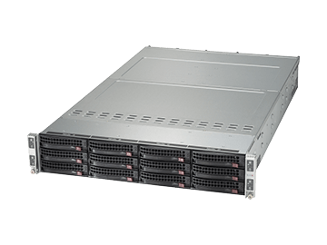



Transaction Processing
Intel Xeon Skylake
Platinum 8180
POWER9 S924
3 years with support
126.2 tps per $K
51.8 tps per $K
2.43x
better price
performance
total transactions per second
32,221 tps (24 cores)
(56 cores) 21,888 tps
3.4x
per core
performance
Details on benchmarks in speaker notes.
Notes:
What do we mean when we say built for and optimized for POWER – the next 3 slides illustrate great examples!
This benchmark ran Db2 11.1.2.2 and WebSphere Application Server 17.0.0.3 running the Daytrader 7 workload. The IBM solution delivered 2.43x better price performance and 3.4x better per core performance with a total solution cost that was 39% lower than the x86 solution.
<CLICK>
This is 2.43x better price performance …
<CLICK>
And 3.4x higher per core performance …
Notes:
This benchmark is based on IBM internal testing of the Daytrader 7 workload running Db2 Standard Edition V11.1.2.2 and WAS Liberty 17.0.0.3. Results were validated on 3/16/18 and the benchmark was run under laboratory conditions with speculative execution controls to mitigate user-to-kernel and user-to-user side-channel attacks on both systems. As always, individual results can vary based on workload size, use of storage subsystems, among other conditions.
Hardware specifics of this benchmark:
IBM Power S924 (2x12-core/2.9 GHz/1024 GB memory) 2 x 600GB SATA 7.2K rpm LFF HDD, 10 Gb two-port, 1 x 16gbps FCA, Db2 Standard Edition V11.1.2.2, WAS Liberty 17.0.0.3, RHEL 7.4 and PowerVM (60VMs).
Competitive stack; 2-socket Intel Xeon Skylake Platinum 8180 (2x28-core/2.5 GHz/768 GB memory), 2 x 300GB SATA 7.2K rpm LFF HDD, 1 Gb two-port, 1 x 16gbps FCA , Db2 Standard Edition V11.1.2.2, WAS Liberty 17.0.0.3, RHEL 7.4 and KVM (60 VMs) with KVM host on SuSE 12SP3.
Pricing is based on Power S924 http://www-03.ibm.com/systems/power/hardware/linux-lc.html, Db2: Pricing Link for SWG; and typical industry standard x86 pricing https://www.synnexcorp.com/us/govsolv/pricing/.
WAS and IBM Db2 Direct Standard Edition pricing based upon $US regional perpetual license costs where certain discounts can apply and includes 3 years of support.

Slide 23
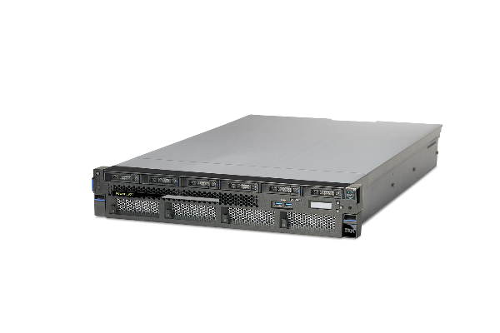
Data Warehousing
Intel Xeon SP
Platinum 8168
POWER9 L922
3 years with support
3.74 QphH per $K
1.53 QphH per $K
2.44x
better price
performance
total Queries per hour
3064 QphH (20 cores)
(48 cores) 2891 QphH
2.54x
per core
performance
Details on benchmarks in speaker notes.
Notes:
This next benchmark ran Db2 Warehouse executing a sample analytic workload of 30 distinct queries of varying complexity. The IBM solution delivered 2.44x better price performance and 2.54x better per core performance with a total solution cost that was 57% lower than the x86 solution.
<CLICK>
This is 2.44x better price performance …
<CLICK>
And 2.54x higher per core performance …
Notes:
This benchmark is based on IBM internal testing of Db2 Warehouse executing a sample analytic workload of 30 distinct queries of varying complexity (intermediate & complex). Results were validated on 3/14/18. The benchmark was run under laboratory conditions with speculative execution controls to mitigate user-to-kernel and user-to-user side-channel attacks on both systems. As always, individual results can vary based on workload size, use of storage subsystems, among other conditions.
Hardware specifics of this benchmark:
3 nodes of IBM Power L922 (2x10-core/2.9 GHz/512 GB memory) using 2 x 300GB SATA 7.2K rpm LFF HDD, 1GbE two-port, 10 GbE two-port, 1 x 16gbps FCA running Db2 Warehouse 2.5 and Spectrum Scale 4.2 with RHEL 7.4.
Competitive stack: 3 nodes of 2-socket Intel Xeon SP (Skylark) Platinum 8168 (2x24-core/2.4 GHz/512 GB memory) using 2 x 300GB SATA 7.2K rpm LFF HDD, 1Gb two-port, 10 GbE two-port, 1 x 16gbps FCA , running Db2 Warehouse 2.5 and Spectrum Scale 4.2 with, RHEL 7.4.
Pricing is based on Power L922 http://www-03.ibm.com/systems/power/hardware/linux-lc.html and typical industry standard x86 pricing https://www.synnexcorp.com/us/govsolv/pricing/.
Db2 Warehouse pricing based upon US$ regional perpetual license costs where certain discounts can apply.

Slide 24

IBM Cloud Private
Intel Xeon SP
Gold 6130
POWER9 L922
3 years with support
203.1 tps per $K
122.5 tps per $K
1.66x
better price
performance
total transactions per second
36,566 tps (16 cores)
(32 cores) 39,312 tps
1.86x
per core
performance
Details on benchmarks in speaker notes.
Notes:
This last benchmark ran a MongoDB transactional workload on IBM Cloud Private. The test included a VM image running the Acme Air workload with containers bound to a socket including a MongoDB microservice. It delivered 1.66x better price performance and 1.86x better per core performance … the IBM Power Systems solution cost was 43% lower than the x86 solution.
<CLICK>
This is 1.66x better price performance …
<CLICK>
And 1.86x better per core performance …
Notes:
This benchmark is based on IBM internal testing of a VM image running the Acme Air workload (https://github.com/acmeair) with containers bound to a socket including a MongoDB microservice. Results were validated on 3/17/18. The benchmark was run under laboratory conditions with speculative execution controls to mitigate user-to-kernel and user-to-user side-channel attacks on both systems. As always, individual results can vary based on workload size, use of storage subsystems, among other conditions.
Hardware specifics of this benchmark:
IBM Power L922 (2x8-core/3.4 GHz/256 GB memory) 2 x 600GB SATA 7.2K rpm LFF HDD, 10 Gb two-port, 1 x 16gbps FCA, EDB Postgres Advanced Server 10, RHEL 7.4 with PowerVM (2 partitions@8-cores each).
Competitive stack: 2-socket Intel Xeon Skylake Gold 6130 (2x20-core/2.1 GHz/256 GB memory), 2 x 600GB SATA 7.2K rpm LFF HDD, 1 Gb two-port, 1 x 16gbps FCA , RHEL 7.4, KVM (2 VMs@16-cores each).
Pricing is based on Power L922 http://www-03.ibm.com/systems/power/hardware/linux-lc.html, Typical industry standard x86 pricing https://www.synnexcorp.com/us/govsolv/pricing/.
IBM software pricing for ICP Cloud Native VPC Monthly Subscription.

Slide 25

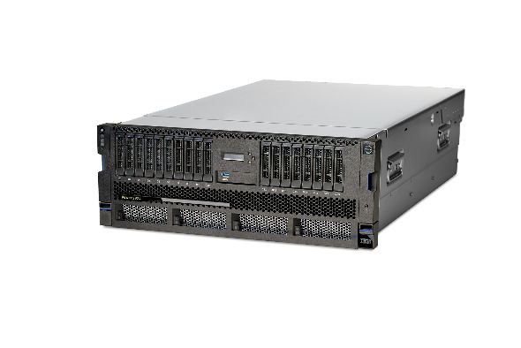
Client Advocacy
POWER9 Innovation
Excitement for POWER9
“POWER9 will help Mark III clients realize the true benefits of AI today by enabling a speedy, agile workflow for creating and iterating AI models that run at the speed of digital businesses today.”
– Andy Lin, Mark III
Industry leading NPS
The only processor specifically designed
for the AI era.
“POWER9 will propel the IBM i platform into the future. It will take software like our 3D configurator to another level by combining it with artificial intelligence and provide new insights.”
- Koen Decorte, CD Invest
“POWER9 is an absolute beast when it comes to moving data, a critical point for AI-processes.”
- Charles King, Pund-IT Inc.
“With the new POWER9 technology, I expect to achieve better performance, keep the same enterprise standards of availability and reduce maintenance costs.”
– Dmitry Mironov, Raiffeisenbank
Notes:
What do clients say about POWER9 (see the quotes on this slide)?
With an NPS score of 65 (among the highest at IBM), it is clear that customers are very happy with our products (Google has an NPS of 50, for reference).
Power Systems clients have decided to come back again and again for the reliability, security, and scalability of the platform. The performance is second to none … as is the value clients are getting for their mission critical applications as well as keeping their most important systems running day and night.
Add to that the AI capabilities of the POWER9 servers and clients now can not only run their mission critical transactional applications, but they can now combine that with AI workloads to gain a significant competitive advantage in their own markets. After all, those that don’t disrupt their industries are sure to fall behind competitors that do.

Slide 26

BACKUP
Notes:
These charts contain information that you may or may not wish to insert into your storyline.

Slide 27
Transition Map to POWER9 from Midrange & High-end Systems
Notes:
This slide shows some of the potential transition scenarios that can help optimize IT spend and opportunities for innovation as clients move to new POWER9-based infrastructure … from their existing POWER7 and POWER8 infrastructure investments. The basic proposition is that resources (money and time spent to maintain existing POWER7 systems) may be better utilized towards POWER8 system deployment and future POWER9 upgrades.
For example, current capacity reset offers provide credit for capacity migrating from POWER7 (or earlier generations) or by leveraging POWER7+ to POWER8 MES Model Upgrade options allow clients to reduce the acquisition price of a more scalable reliable, and affordable POWER 8 or POWER9 systems that can be less expensive to maintain versus existing POWER7 servers over the ensuing years.

Slide 28
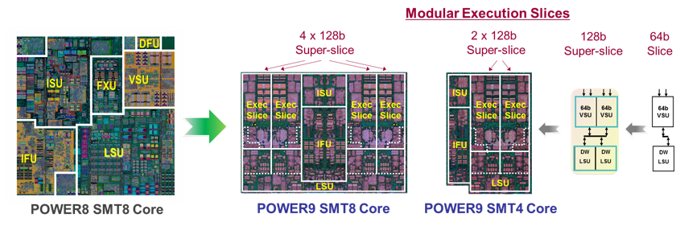
POWER9 Processor
redesigned core provides improved efficiency
and workload alignment with market needs
Notes:
The POWER9 redesigned core enables it to be optimized and aligned to market needs; this core comes with both SMT8 and SMT4 options (the SMT4 option is half of a full SMT8 core).
On the left of this slide, you can see the various components that make up a POWER8 core. In POWER9, the core was redesigned to create a chip which is symmetric in design … this enables IBM to put into the marketplace a processor which can deliver a large core (which contains 8 threads per core). By slicing that large core in half (which cane be done because of the symmetry), the POWER9 can also deliver two cores … each with 4 threads … in a smaller form factor.
To help you speak to this slide, it might be helpful to know the acronyms on it. A POWER9 processing core consists primarily of the following six units:
Instruction fetch unit (IFU)
Instruction sequencing unit (ISU)
Load-store unit (LSU)
Fixed-point unit (FXU)
Vector and scalar unit (VSU)
Decimal floating point unit (DFU)

Slide 29
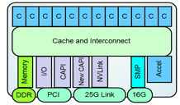
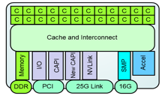
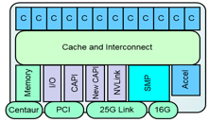
  POWER9 Processor Family
Core Count / Size
SMP scalability
Memory subsystem
SMT8 Core
12 SMT8 Cores / Chip
PowerVM Ecosystem Continuity
SMT4 Core
24 SMT4 Cores / Chip
Linux Ecosystem Optimized
Scale-Out – 2 Socket Optimized
Robust 2 socket SMP system
Direct Memory Attach
Up to 8 DDR4 ports
Up to 170 GB/s memory bandwidth
Commodity packaging form factor
Scale-Up – 4+-Socket Optimized
Scalable System Topology / Capacity
Large multi-socket
Buffered Memory Attach
8 Buffered channels
Up to 230 GB/s memory bandwidth
Notes:
POWER9 has two different core structures that align to the needs of the marketplace: SMT-4 Cores and SMT-8 cores.
The SMT-4 Core processor aligns to the scale-out Linux ecosystem market, where higher core counts enable higher KVM (Kernel-based Virtual Machine) granularity. The SMT 4 Core processors deliver up to 24 cores per socket with up to 8 memory busses for direct attached memory. This is important for competitive pricing while maintaining a focus on memory bandwidth (sometimes referred to as BW - this is a combination on the width of the bus (how many bits) and bus speed). The memory is highlighted on this slide because they are industry leading numbers; note that the higher core count processors are only available in 2 socket based systems.
The SMT-8 Core processor has a maximum of 12 cores per chip. The higher thread count enables stronger partitions and more performance, which is optimal for the PowerVM ecosystem. The SMT8 core processors also have buffered memory interfaces which allows for higher memory bandwidth. The SMT8 cores are enabled for both 2 socket and 4+ sockets.

Slide 30
Understanding Power Systems server naming
AXYZ
X – the first number in the server name represents the POWER version:
7 = POWER7
8 = POWER8
9 = POWER9
Y – the 2nd number in the name represents the number of sockets:
e.g. : S924 has 2 sockets while the L914 has one socket
A – the first letter in the offering name is set to the type of server:
  LC = Linux only server
  H = SAP HANA optimized server
  AC = Accelerated Computing server (focused on AI workloads)
  S = Scale Out server
  E = Enterprise scale up server
Z – the final number in the name refers to the height of the server in U
e.g.: the S924 is 4U high while the AC922 is 2U high
Notes:
As for the naming there are some changes from POWER8 and for those new to Power Systems, here is how to understand a server product name:
The first element is a letter that represents the type of server
LC = Linux only server
H = SAP HANA optimized server
AC = Accelerated Computing server (focused on AI workloads)
S = Scale Out server (this is the base letter when one of the above is not used)
E = Enterprise scale up server
The first number is the POWER version (9 for POWER9 and 8 for POWER8, etc.)
The second number is the number of sockets in the server (1 socket or 2 sockets in the case of the scale out line)
The last number is the height of the server in U (2U, 4U and in the case of the enterprise server it is set to 0)

