Slide 1

Introducing the
IBM Power Systems AC922
Cognitive Infrastructure for Enterprise AI
Dylan Boday, Ph.D. (dboday@us.ibm.com)
James Allen (jdallen@us.ibm.com)
Chris Eaton (ceaton@ca.ibm.com)
Paul Zikopoulos (paulz@ca.ibm.com)
Notes:
This presentation deck covers the launch of AC922 (codename “Newell”); it’s IBM’s Cognitive Infrastructure server (the follow on to the POWER8 S822LC infrastructure … codename “Minsky”) based on the new POWER9 processing core and other innovations. (The MTM 8335-GTG is the server that was made available in 4Q17 … the MTM 8335-GTH will debut in 2Q18 … both of these models are air-cooled).
The IBM “Minsky” (POWER8 S8222LC) system introduced the bus architecture to directly connect to the NVIDIA GPUs (referred to as the 25G bus) while the rest of the industry (Intel-based) communicates over a PCIe (Gen 3 at that) bus from the processor to the GPU - this creates a bottle neck. In “Newell” (POWER9 AC922) we bumped the speed of the NVLINK bus, increasing our advantage from POWER9. Also new in POWER9 is the introduction of PCIe Gen4 which is 2x faster than the Gen3 bus speed. You will see these stats repeated a number of times in this deck … because it is that important to understand!
The AC922 is a very highly anticipated product by the marketplace with a differentiated set of AI accelerating capabilities compared to what the competition has to offer. If you didn’t have time to read this presentation, and needed a slogan for the AC922, we’d simply tell you to scream out “Train more, build more, know more”.
You can use this deck for your own personal enablement or to present directly to clients. In this presentation you will see certain facts repeated (in the speakers notes and sometimes the slides). This is by design to drive home a point and learning … but you are free to customize the deck’s storyline in any manner you wish.
You are going to see a number of POWER9-based architectures roll out in 2018 (some of the roadmap is in the back of this deck). Of course we know that the AC922 came out in 4Q17 … it’s a robust direct memory attach architecture on a 2-socket LC SMP configurations. You’re going to learn how this whole architecture provides more performance and scale (via POWER9 processors), 2-4x memory capacity for in-memory databases, reduced latency and improved throughput with enhanced I/O support (PCIe Gen4 and integrated NVMe Flash which is bootable), and high bandwidth (25Gb/s – you will see this as 25G, 25GB, or 25GB/s throughout this presentation and in various nomenclature, so it’s good to know they are synonyms) link for GPU and OpenCAPI acceleration. In the initial release (4Q17) you could run RedHat Enterprise Linux (RHEL) on the AC922, but you will see (and should assume) Ubuntu support as well (debuts early 2018).
Throughout 2018 more POWER9-based servers will follow. In the 1H you will see expansion to the architecture lineup with 1 and 2-socket entry SOR configurations; further into the year buffered memory attach and large-scale multi-sockets SMPs offers make their way into the marketplace with a 4-socket midrange offering and a 4 to 16 socket modularized high-end offering; all delivering incredible opportunities for Linux, IBM i, and AIX.

Slide 2




THE AI ERA IS HERE.
We continue to experience exponential growth of data and data sources.
Computing has moved beyond a ‘post CPU only’ era, giving us vast computational power that was not accessible before.
CIOs are evolving from ‘chief information officer’ to ‘chief intelligence officer’ and the data science organization has continued to gain power and influence.
Notes:
This slide says it all – read it aloud to your client.

Slide 3

80%
of data scientists will have access
to deep learning capabilities in 2018
"AI initiatives require more than just data and
algorithms to be successful, they need a blend of skills,
infrastructure and business buy-in."
Notes:
Gartner predicts that 80% of data scientists will have access to deep learning (DL) capabilities this year (2018)!
Deep learning (DL) is a variation of machine learning (ML) and inherits all the benefits of ML. DL represents a major driver towards artificial intelligence (AI). As DL delivers superior data fusion capabilities over other machine learning (ML) approaches, Gartner predicts that by 2019, “Deep learning will be a critical driver for best-in-class performance for demand, fraud, and failure predictions, among other use cases.” (Performance in a DL world refers to the accuracy of the neural network … how it performs refers to how accurate its classifications are; when referring to performance in the traditional manner - as in speed - in the DL world, we often refer to it as training times).
Several breakthroughs in cognitive domains demonstrate the power of DL. For example, speech-to-text services are outperforming humans in similar tasks; PayPal is using DL as a best-in-class approach to block fraudulent payments and has cut its false-alarm rates in half! Amazon is also applying DL for best-in-class product recommendations.
<CLICK>
Today, most common use cases of ML through DL are in image, text, and audio processing — but increasingly also in predicting demand, determining deficiencies around service and product quality, detecting new types of fraud, streaming analytics on data in motion, and providing predictive or even prescriptive maintenance are big use case; however ML and AI initiatives require more than just data and algorithms to be successful … they need a blend of skills, infrastructure and business buy-in.
Source: https://www.gartner.com/newsroom/id/3804363

Slide 4





Right now, your infrastructure is putting up
ROADBLOCKS
Not equipped for cognitive data volumes
Blocks to acceleration
Not able to easily scale
Servers not specifically designed for AI workloads
Notes:
Your insights are up against a lack of enterprise readiness, blocked acceleration, servers not designed for modern workflows, and an inability to easily scale. Quite simply on the journey to AI are full of road blocks and traffic jams … all of which the AC922 was designed to bust through.
Is your company ready for AI? Most enterprises aren’t cognitive ready … their machines are not equipped to handle massive data volumes required for enterprise AI.
Accelerators enable AI … IBM has embraced it. It’s an after thought for x86 servers which blocks to acceleration; x86 is an architecture that bottlenecks performance and restricts data and memory management – ultimately limiting scale. Quite simply, x86-based servers are not designed for AI cognitive workloads … they were not designed for the data-intensive and highly parallel workloads that can lead to an advantage in the “AI wars”.
And of course all of these roadblocks means that today’s commodity systems won’t be able to easily scale AI and cognitive workloads.

Slide 5


AI DEMANDS A DIFFERENT TYPE OF SYSTEM
IBM Power Systems provides the cutting-edge advances in AI that data scientists demand,
and the critical reliability that IT needs.
IBM has reimagined infrastructure for the journey to AI
Notes:
The Artificial Intelligence (AI) destination is going to be a journey. Clients are faced with challenges when it comes to commodity hardware and open source software. In response, IBM has built the best systems in the marketplace to crush the data challenges of the AI era. These are enabled with advanced IO interfaces, new shared memory structures, and co-optimized hardware/software. Lastly, IBM offers support for the entire solution, from the hardware to the software … IBM can help clients on this journey and has positioned Power Systems as the partner for our clients journey to the AI era.
Data – of all shapes, formats and types – has quickly become a company’s most strategic asset; one that continues to grow exponentially in volume, variety and complexity. There is a clear recognition that data, if fully exploited, can help drive a competitive advantage.
of AI workload.
AC922 infrastructure gives data scientists the power to uncover insights significantly faster than x86 based solutions and this in turn reduces both training times for deep neural networks and the development pains around building them as well.
In fact, the latest POWER9 systems are designed to improve the performance of the world’s most popular open source deep learning (DL) frameworks (such as Google’s TensorFlow, Caffe, Chainer, among others) as well as accelerated modern databases such as Kinetica

Slide 6

Your journey begins with “What if?”
What if you had an
AI superhighway that gave you more accurate insights, faster?
Innovators,
Trailblazers,
Changemakers.
Notes:
Innovators. Trailblazers. Change makers. Your journey begins with “What if?”
What if you could access hidden data to leap ahead of the competition? What if you could break the barrier of experimentation and fully exploit Artificial Intelligence (AI) to unleash business insights? From the processor architecture and server hardware to software and services support, IBM has reimagined infrastructure for the AI era.
Indeed, if it’s Enterprise AI you seek – the search for the right infrastructure is OVER!
Say “Hello” to the POWER9 processor. Built from the ground-up for enterprise AI, POWER9 in the only processor with state-of-the-art I/O subsystem technology, including next generation NVIDIA NVLink 2.0, PCIe Gen4, and OpenCAPI. These interfaces give POWER9 a memory bandwidth superhighway that gives you more accurate insights, faster.

Slide 7



Evolving from Compute Systems to Cognitive Systems
Dev Ecosystem
Industry Alignment
Not Just About Hardware Design
Partnerships
Open Frameworks
It’s about co-optimization
IBM Software
software
+
P8
P9
P10
hardware
Open Accelerator Interfaces
which just works for ML, DL, and AI
Accelerator Roadmaps
Notes:
Typically, a presentation like this would start with a focus on the hardware optimization starting with the processor, the IO interfaces enabled by this processor, and what accelerators align to those interfaces to produce optimal performance. BUT REMEMBER this solution is not just about the hardware … which is why IBM refers to the AC922 as Cognitive Infrastructure – it has a healthy dose of differentiated and innovative hardware and software in the offering.
<CLICK>
In this next section we are going to talk about the hardware that makes the A922 Power server is optimized for AI, deep learning, machine learning, and cognitive workloads. (If you want to start with software in this storyline, just flip the sections.)
As previously mentioned, IBM co-optimized software with hardware on the AC922 … this is done by taking the world’s most popular open source deep learning frameworks and optimizing them around the AC922’s advanced design. This co-optimization drastically flattens to the time to success; not just in training the models for more accuracy, but getting them built, optimized, and put into production too.
For example there is a toolkit for computer vision (IBM PowerAI Vision) that allows for the collaboration of data scientists and non techies to work as s team … business experts can use a GUI toolset to label data for the neural network's training, the innovation automatically prepares the data (for example, a Caffe pipeline requires a specific resolution for computer vision neural networks and this toolset prepares that data for the pre-defined resolution level), and the data scientist builds the model. The AC922 is a complete AI and deep learning ecosystem! Other software enhancements include Spark Conductor for Distributed Deep Learning (DDL) and Large Model Support (LMS) - detailed later in this presentation.
With support for everything from the hardware to the software in this solution, not only does IBM’s AC922 Cognitive Infrastructure deliver differentiated hardware, but it also ships a software stack for deep learning and computer vision that’s equally rich and differentiated … and it’s only found on IBM Power Systems.
The bottom line with co-optimization is that it’s not just the hardware (POWER9 processor, NVIDIA GPU, and so on) to help the AC922 achieve greater performance, and it’s not just the software (DDL, LMS, and so on) either … it’s the combination of the two working in harmony.

Slide 8
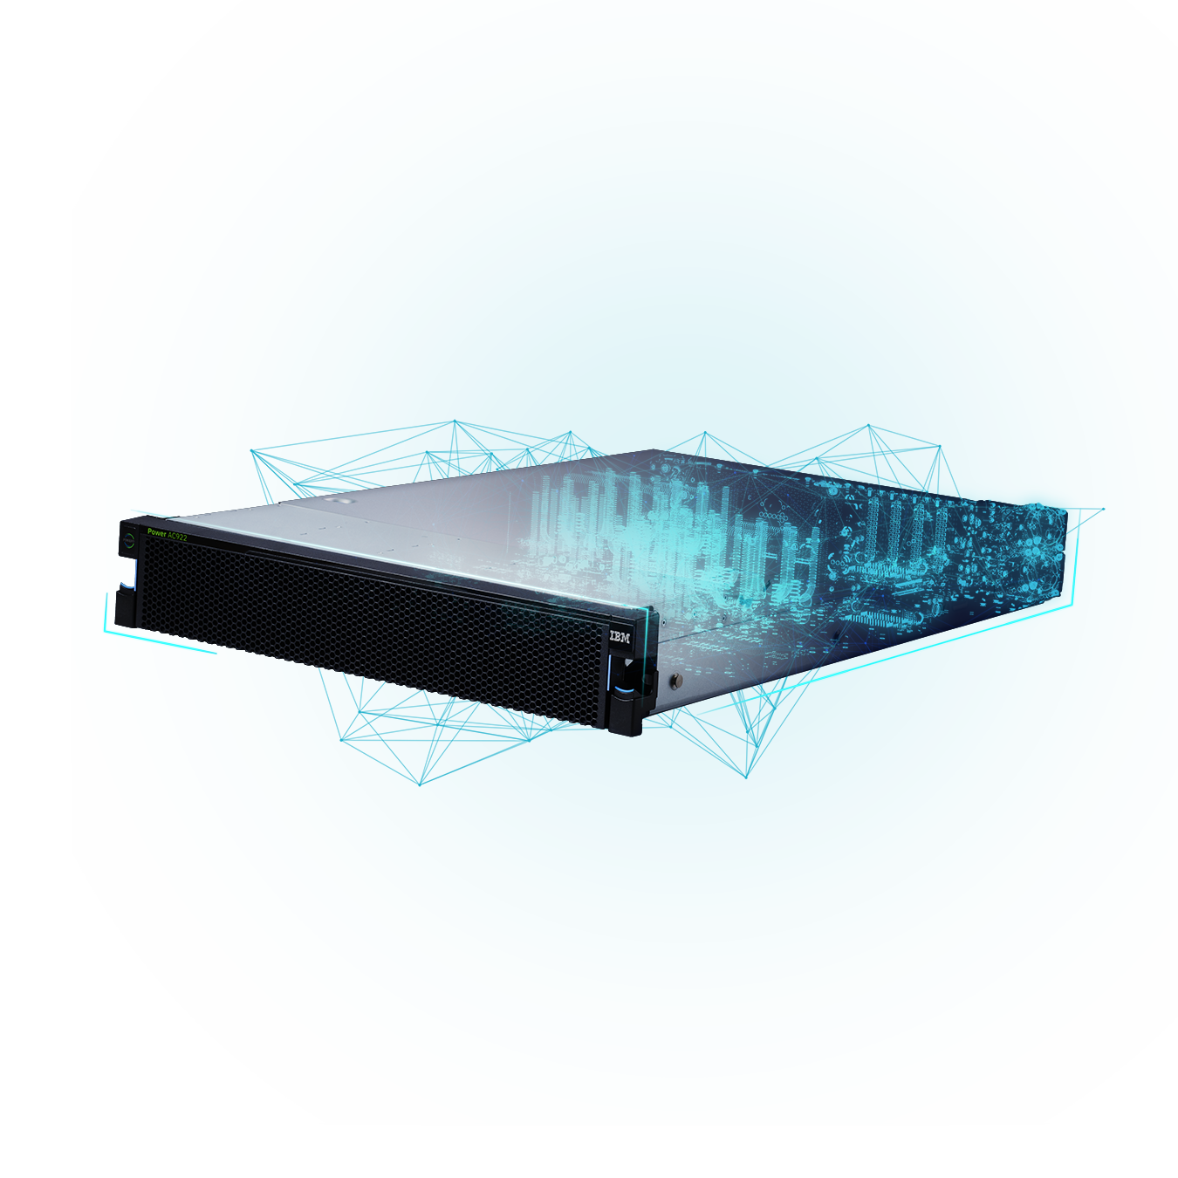
IBM Power Systems AC922
Best Infrastructure for Enterprise AI
Notes:
When IBM created AC922 infrastructure, the main thought was to position it as the best server for Enterprise AI.
This section covers all the details and facts you need to know to drive home the claim that the IBM Power Systems AC922 is the best server for Enterprise AI.
This slide is a great conversation starter to communicate the facts that you will learn in this section as to why AC922 infrastructure server is designed from the ground up to handle large complex data challenges facing the market today as they engage on cognitive and AI projects.
The rest of these speaker notes details about the AC922.
The AC922 (8335-GTG) is a 2U Linux-only server that’s designed for HPC(high performance computing) and AI (artificial intelligence) workloads. It is a 2 socket server with either 32 or 40 fully activated cores. Its architecture is intended for deep learning, AI, high performance analytics and HPC users. Although this box is targeted to a specific audience, it’s a good indicator of the technology to come in 2018 with the rest of the POWER9 lineup.
The AC922 is a 2-socket server that goes into a standard 19-inch rack. It requires that both sockets be populated with POWER9 SCM (single chip module) processors. There are two options for the processors: 16 core, 2.6ghz (3.09ghz turbo) and 20 core, 2.0ghz (2.87ghz turbo).
The AC922 provides for up to four NVIDIA air-cooled Tesla V100 attached with second generation NVLink to the processors (water-cooled options come in 2018). NVLink is a high-bandwidth, energy efficient interconnect between CPUs and GPUs, and between GPUs. It was initially introduced on the POWER8 S822LC and is enhanced in the POWER9 AC922. The IBM POWER is still the only server line that provides not only GPU to GPU acceleration, but also CPU to GPU acceleration.
There are 8 DDR4 memory DIMMs per socket and all DIMMs must be filled and activated. DIMM sizes are 16GB, 32GB or 64GB and cannot be mixed. This means the server will have either 256GB, 512GB or 1TB of memory. Having identical memory DIMM sizes and filling all the DIMMs ensures the best memory performance and bandwidth for the server.
There are 4 slots:
Slot 1—x4 slot with an x8 connector
Slot 2—x8 slot with an x8 connector, CAPI enabled
Slots 3, 4—x16 slots, CAPI enabled
Slot 2 should be reserved for the new EDR IB (InfiniBand) adapters – if you plan to use them. These new adapters are designed for very high performance and to accept an x8 bus from each processor—the only slot that they can be installed into is slot 2.
There are two x 2.5-inch internal SATA disk bays that can hold 1TB or 2TB hard disks or 960GB, 1.92TB, or 3.84TB SSDs. There are also two optional NVMe high performance storage adapters. If NVMe is chosen, then the 1.6TB NVMe flash adapter is the default, but it is possible to use an RPQ and order the 3.2TB adapter. An external DVD can be attached as needed.
There are a number of I/O adapters available—these are all low profile adapters. Currently adapter options include:
4 port 1Gb network
2 port 40/100GB network
2 port 10Gb network
4 port 10/1gb (2 x 10Gb and 2 x 1Gb—both SR and SFP+ options for 10Gb)
1 and 2 port EDR 100GB IB
2 port 16GB/s fiber channel adapter
1.6TB NVMe flash adapter or optional via RPQ 3.2TB flash adapter
The AC922 uses two hot swap 2200-watt power supplies in a redundant configuration. According to the announcement there is no power redundancy if GPUs are installed.
The server comes in an Open Power non-virtualized configuration which allows Linux to be used on bare metal with no virtualization. The supported operating system is Red Hat Enterprise Linux 7.4 for Power LE(IBM POWER9), or later. IBM provides Support line support for RHEL for 1year or 3 years with either 9-5 or 7/24 coverage. Hardware maintenance defaults to 9-5 NBD (next business day) for 3 years but can be uplifted to same day or 7/24. Service is CRU (customer replaceable unit) but can also be uplifted to IBM on-site repair.
Source: http://ibmsystemsmag.com/aix/trends/whatsnew/closer-look-ac922/

Slide 9

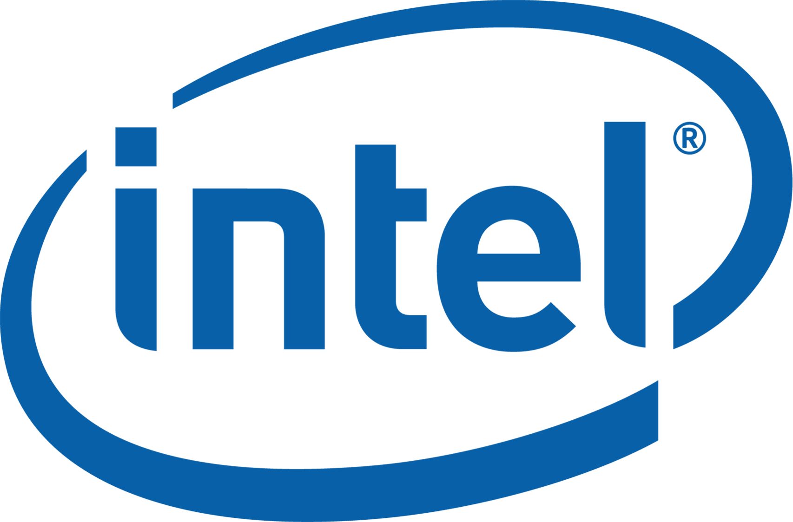
FORETHOUGHT
AFTERTHOUGHT
ACCELERATION
Notes:
Before delving into the details of AC922 infrastructure, let’s get one thing straight: accelerators empower AI … IBM has embraced it.
Acceleration to POWER9 is a forethought while for x86 it’s an afterthought (which seems to be blocking a open ecosystem for acceleration); x86 is an architecture that bottlenecks performance and restricts data and memory management – ultimately limiting scale.
Quite simply, x86-based servers are not designed for AI cognitive workloads … they were not designed for the data-intensive and highly parallel workloads that can lead to an advantage in the “AI wars”.

Slide 10


IBM POWER SYSTEMS
AC922
An Acceleration Superhighway
Unleash state of the art IO and accelerated computing potential in
the post “CPU-only” era
Designed for the AI Era
Architected for the modern analytics and AI workloads that fuel insights
Delivering Enterprise-Class AI
Flatten the time to AI value curve
by accelerating the journey to build,
train, and infer deep neural networks
Notes:
You might be wondering where the AC922 moniker comes from? Simple: This Accelerated Computing (AC) platform is loaded with POWER9 (9) on 2 socket systems (2) within a 2U standard rack footprint) … in short, the AC922.
There are 3 key points with AC922 which make it the best server for Enterprise AI.
First, it’s designed from the ground up for AI workloads, this starts with its acceleration superhighway. The AC922 introduces second generation NVLink between the CPU and GPU; this is 5.6x faster than PCIe Gen 3 architectures which x86 remains committed in their current offerings (2018).
Second, IBM didn’t just focus on the the NVLink communications for the CPU ←→ GPU pipeline … the AC922 was designed as a balanced system; specifically for the AI era with industry leading memory bandwidth, PCIe Gen 4 busses (for the best network connectivity), and high performance storage adapters.
Finally, when designing this infrastructure, IBM took the world’s most prevalent open source deep learning (DL) frameworks and optimized them around the AC922’s advanced infrastructure design with added enhancements such as Spark Conductor for Distributed Deep Learning (DDL) and large model support (LMS – more on that in a bit). This results in the best server and solution for Enterprise AI. Quite simply, AC922 lets you flatten the time to AI value curve by accelerating the journey to build, train, and infer deep neural networks
Additionally, this server design will find use in applications such as high performance computing (HPC) and accelerated databases … so don’t think (or let your customers think) this is a solution only for AI.

Slide 11
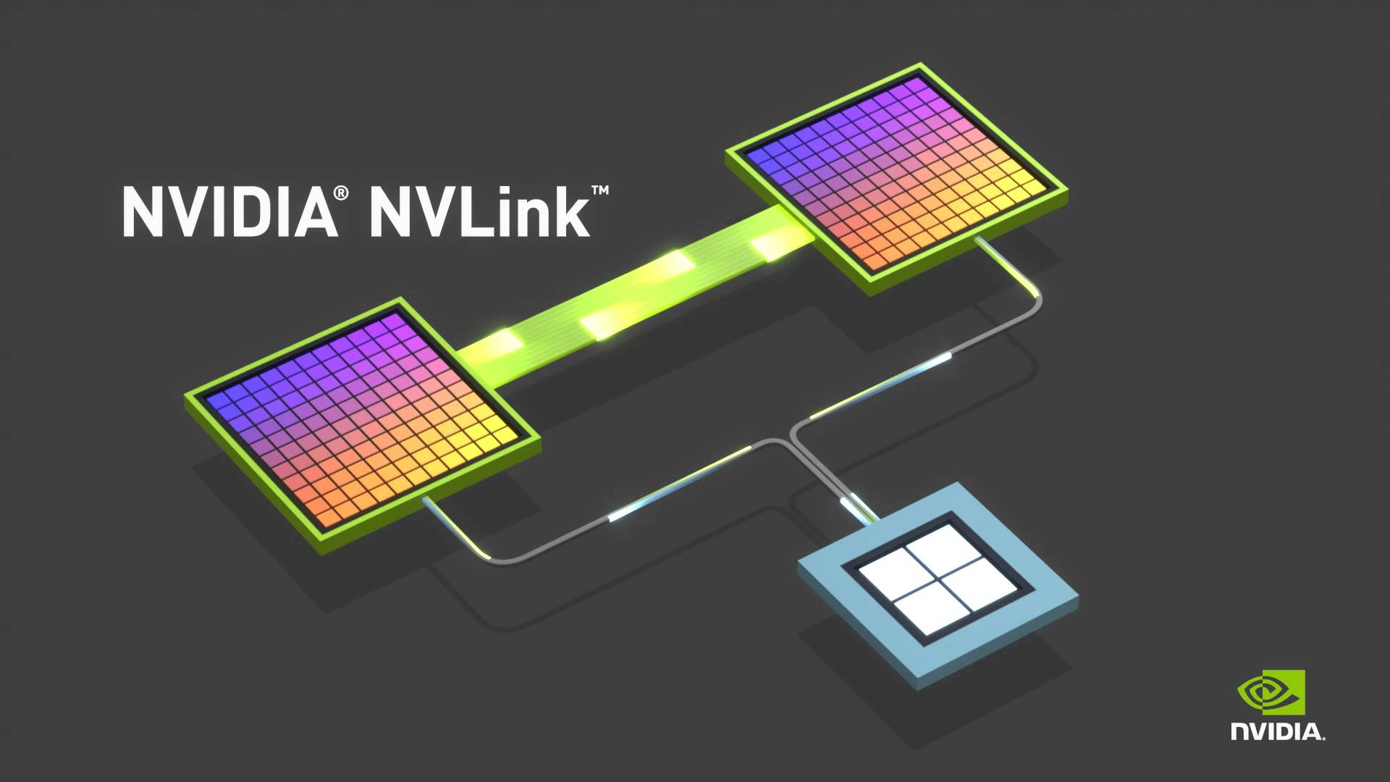



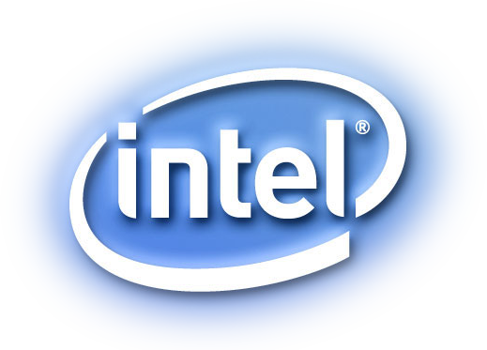

This speeds up
CPU ←→ GPU
GPU ←→ GPU
communications
AND
DOES NOT EQUAL
ONLY
This
speeds up
GPU ←→ GPU communications
GPU
Notes:
You are going to hear this a lot in this presentation, but we want to call it out right now, before we delved into details.
When talking about the benefits of NVIDIA NVLink technology, the things it can do for IBM POWER infrastructure are not the same as the things it can do on an x86 server.
When talking about exploiting GPUs for deep learning to accelerate training time … vendors often cite GPUs. And one of the technologies that creates a very fast pipe for GPU communications is NVDIA’s NVLink. HOWEVER! This technology on Intel is for GPU ←→ GPU communications whereas on POWER, NVLink is used to accelerate communications between GPU ←→ GPU and GPU←→ CPU … which gives it a number of performance training advantages which you will learn about in this presentation.

Slide 12
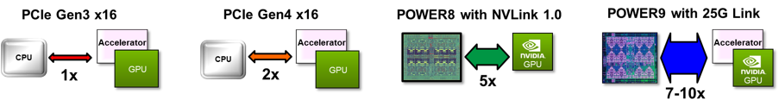
Seamless CPU and
Accelerator Interaction
coherent memory sharing
enhanced virtual address translation
Broader Application of
Heterogeneous Compute
designed for efficient programming models
accelerate complex AI & analytic apps
Others
PCIe Gen3
2x
PCIe Gen4
5x
POWER8
with NVLink 1.0
7-10x
POWER9 with 25G Link + NVLink 2.0
“vanilla”
extreme CPU and Accelerator bandwidth
Notes:
When IBM declares that POWER9 is the ideal processor for acceleration … one of the major proof points that we will point to are the various advanced I/O interfaces accelerations that are only available on the IBM Power architecture.
If you look at a “vanilla” system (whose bandwidth is gated by PCIe GEN 3) and normalize it to 1, then compare to the leading edge AC922 interfaces introduced into the POWER9 processor and the AC922 infrastructure, you get some of the speedup factors you see on this chart. For example, PCIe Gen 4 (operates at 16GB/s) has double the bandwidth compared to PCIe Gen 3 (which x86 processors remain committed to for 2018), so it’s 2x as fast.
Additionally Power is the only processor with NVIDIA NVLink 2.0 technology (it operates at 25 GB/s as opposed to NVLink 1.0 which operates at 20GB/s) between the processor (CPU) and the accelerator (GPU) delivering up to 10x the data throughput … all while providing a coherent interface.
As you can see, as you move away from the “Vanilla” Intel x86 architecture into one where innovation if fostered in a community (such as OpenPOWER), you realize more and more benefits (much like in the open source software world) such as increased performance, performance features, acceleration opportunities, and more.

Slide 13
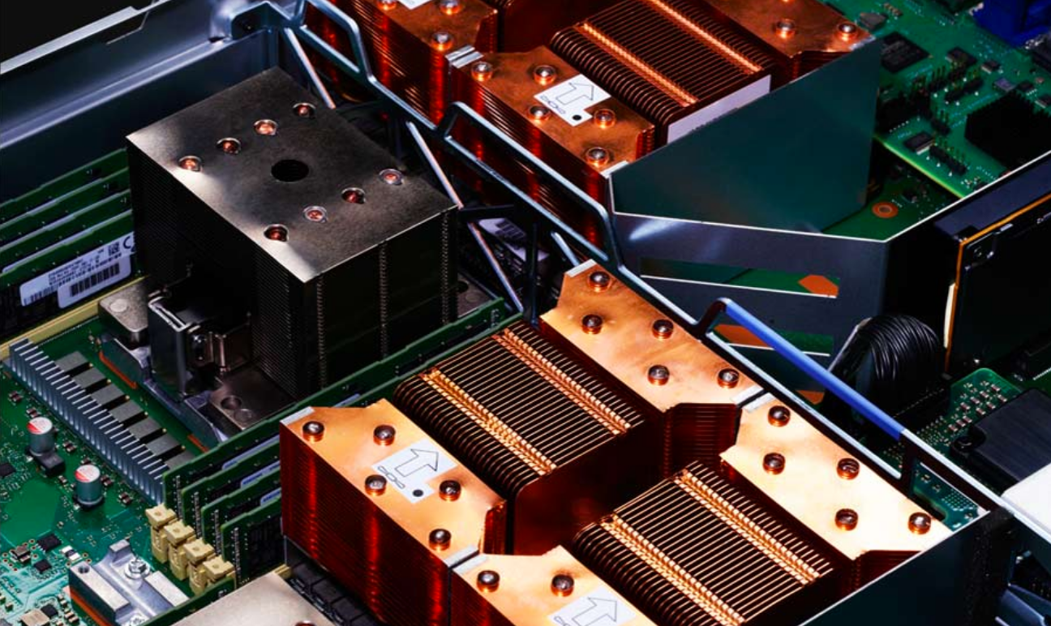
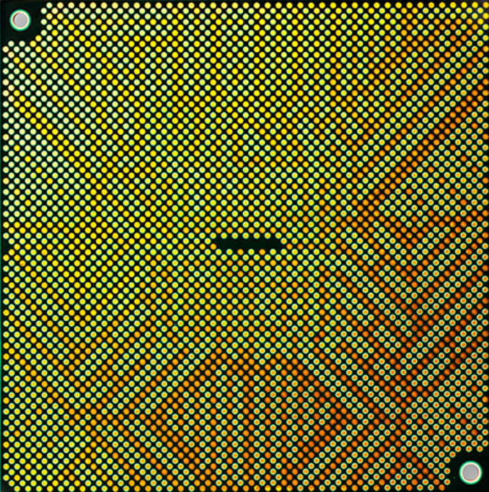
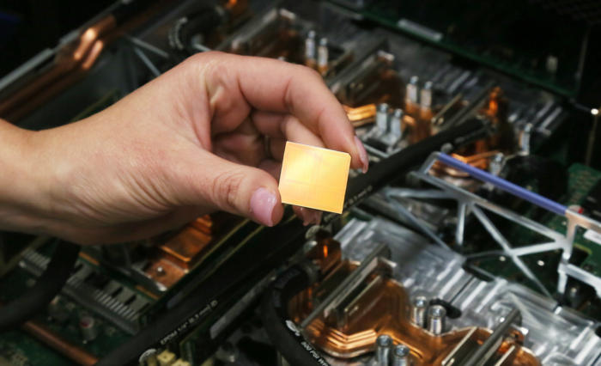
Acceleration
Super Highway
5.6x data throughput vs. PCIe Gen3
with NVIDIA NVLink optimization to the core
2x bandwidth
with PCIe Gen4 vs. PCIe Gen3
Access up to 2TB of system memory
delivered with coherence … only on POWER!
Superior data transfer to multiple devices
25G Links to OpenCAPI GPU devices
GPU ←→ CPU and GPU←→GPU speed-up
not just GPU ←→ GPU
Notes:
Memory enhancements, advances in graphic processing units (GPU), interconnects, and bandwidth all provide building blocks for a better performing AI architecture. In fact, the POWER9 release marks what will become an industry requirement: welcome to the “off-chip” era (where advanced accelerators like GPUs and FPGAs are engineered to drive modern workloads) and the sunset of the “totally on-chip” era where processing is integrated on a single chip.
POWER9 is the first commercial architecture loaded with NVIDIA’s next generation NVLink (AC922’s optimization isn’t GPU to GPU like other commercial platforms, it also included GPU to CPU where it’s needed the most), OpenCAPI, and PCI-Express 4.0. Think of these technologies as a giant hose to transfer data.
This slide shows a bit of a deep look into what we are talking about when we say “Cutting Edge” and built for Enterprise AI.
The figure at the bottom-right showcases Cognitive Systems AC922’s NVIDIA Next Generation NVLink technology that provided 5.6x data throughput when compared to PCIe Gen3. And since this server comes with PCIe Gen4, it should be noted that Gen4 delivers 2x the throughput when compared to PCIe Gen3’s bandwidth.
The top-right figure in this slide is the legendary IBM POWER processor at its latest version: POWER9. It delivers unmatched computer performance including a 4x bandwidth improvement over its predecessor (POWER8) with CAPI 2.0 high-bandwidth (25GB/s) link for GPU/OpenCAPI acceleration.
Finally, the server delivers simplified execution for Enterprise AI with large model support with up to 2 TB of coherent memory, GPU ←→ GPU and CPU ←→GPU communications.

Slide 14
4 GPUs @150GB/s
CPU ←→ GPU bandwidth
6 GPUs @100GB/s
CPU ←→ GPU bandwidth
Coherent access to system memory
PCIe Gen 4 and CAPI 2.0 to InfiniBand
Air and Water cooled options
Coherent access to system memory
PCIe Gen 4 and CAPI 2.0 to InfiniBand
Water cooled only
IB
IB
PCIe Gen 4
CAPI 2.0
PCIe Gen 4
CAPI 2.0
170GB/s
170GB/s
CPU
CPU
DDR4
DDR4
Coherent
access to
system memory
(2TB)
NVLink
100GB/s
NVLink
100GB/s
Coherent
access to
system memory
(2TB)
NVLink
150GB/s
NVLink
150GB/s
NVLink
100GB/s
NVLink
150GB/s
NVLink
100GB/s
NVLink
100GB/s
NVDIA V100
NVDIA V100
NVDIA V100
NVDIA V100
NVDIA V100
Notes:
IBM AC922 infrastructure comes in 2 different configurations. Both have coherent interfaces which enables the GPUs to directly communicate with the CPU memory structures with full coherency; both have PCIe Gen 4 and CAPI 2.0 to InfiniBand interconnects; finally, both have water cooled options (water cool options for both configurations won’t be available until 2Q’18 – the 8335-GTX).
As the slide shows, there is a 4-GPU AC922 configuration (which has a measured GPU ←→ CPU NVLink bandwidth at 150 GB/s across 2 NVLink connections to the CPU) and a 6-GPU AC922 configuration (available in 2Q18) with a measured GPU ←→ CPU NVLink bandwidth of 100GB/s with 3 NVLink supporting connections to the CPU.
Remember! Coherent access to system memory means that GPU memory is treated (can access) system memory which enables game changing simplification of application programing and support for larger model sizes.
If you were to compare the NVIDIA “Volta” GPU with NVLInk 2.0 used in the AC922 to the “Pascal” GPU with NVLink 1.0 used in the S822LC, you’ll find that a POWER9 core with NVLINK 2.0 (100 GB/s to 150 GB/s – depending on the configuration used from this slide) can deliver up to 87.5% increased bandwidth over its POWER8 predecessor. This performance bump is achieved in 2 ways. First, as previously mentioned, the bus speed of NVLink 1.0 to NVLink 2.0 goes from 20 GB/S to 25 GB/s respectively). Second, there’s a wider bus, increasing from 2 Bricks to 3 Bricks (1 Brick contains 8 lanes). The combination of bus speed and increased bus width allows for the 87.5% performance jump.
You’ll note that the 4 GPU configurations (the AC922 is also made available in a 2 GPU configuration, and even a 0 GPU configuration for that matter) provides more CPU-GPU bandwidth (150 GB/s) compared to the AC922 6 GPU configuration (100 GB/s); this is because the 300 GB/s pipe per socket is split 3 ways instead of 2 ways in the 6 GPU configuration (note the speeds depend on the cooling option as evident in this slide … up to 100 GB/sec air cooled or 150 GB/sec water cooled).
Also worth noting is that the L2 cache on the POWER9 core used in the AC922 is 512K and the L3 cache is 10 MB.

Slide 15
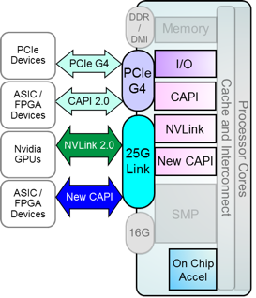
State of the Art I/O and Acceleration Attachment Signaling
  PCIe Gen 4 x 48 lanes – 192 GB/s duplex bandwidth
  25G Link x 48 lanes – 300 GB/s duplex bandwidth
Robust Accelerated Compute Options with OPEN standards
  On-Chip Acceleration – GZip x1, 842 Compression x2, AES/SHA x2
  CAPI 2.0 – 4x bandwidth of POWER8 using PCIe Gen 4
  OpenCAPI – High bandwidth, low latency and open interface
  using 25G Link
  NVLink 2.0 – Next generation GPU←→CPU bandwidth
  and integration
extreme processor / accelerator bandwidth and reduced latency
coherent memory and virtual addressing capability for all accelerators
openPOWER community enablement robust accelerated compute options
POWER9
Premier
Acceleration
Platform
Notes:
When we look at what really makes the POWER9 processor super charged … there is a lot of innovation around the IO interfaces (a repeating themes on the hardware components of the AC922 infrastructure); no question about it, IBM POWER9 is focused on device bandwidth acceleration while reducing latency … all with a coherent interface.
Quite simple, there are 2 busses available in the AC922 as you can see on this slide. The first is PCI Gen4: This bus supports PCIe Gen4 to PCI devices or ASICs/FPGAs via CAPI 2.0 protocol. The second bus is the 25G Bus: this bus supports NVLINK 2.0 to GPUs or Open CAPI 3.0 ASICs/FPGAs. (The capability is there for a CAPI device to plug into the GPU site, but currently there is no offering for this … stay tuned).
The two main new interfaces introduced in the POWER9 processor are PCI Gen 4 (operates at 16GB/s - an upgrade from PCI Gen 3 upon which Intel is still dedicated … at least throughout 2018 – which is 2x faster than PCI Gen 3) and 25G Link. PCIe Gen 4 has 48 lanes that can deliver a realized bandwidth rate of 192 GB per second; the 25G link is capable of 300 GB per second. If you look at the schematic on the left-hand side of this slide, you can see the 25G Link accelerates both the NVLink and CAPI. 25GB/s for NVLink is part of the 2.0 specification (NVLink 2.0), NVLink 1.0 (which was in the S822LC – “Minsky” – operates at 20 GB/s).
It’s worth commenting on OpenCAPI for moment. OpenCAPI was developed to fuel this heterogeneous computing revolution by unleashing the potential of these new technologies! New trends are emerging as accelerators become more commonplace and workloads are being re-written or developed from scratch with acceleration in mind.
OpenCAPI achieves this by providing very high bandwidth with coherency. The portion of the application running on the accelerator often requires fine-grained interaction with the portion of the application running on the CPU. The programming complexity and CPU overhead required to communicate with a traditional I/O-attached accelerator makes this impractical, but OpenCAPI places the accelerator natively into the application’s user space to bring about this fine-grained interaction. These trends led to the development of the OpenCAPI architecture. o facilitate broad adoption, OpenCAPI was architected to minimize the amount and complexity of circuitry required in an accelerator. In addition, OpenCAPI enables both advanced memory with a wide range of access semantics from load/store to user-mode data transfer models, and access to classic DRAM memory with extremely low latencies.
Today, OpenCAPI is becoming the open standard interface for high performance acceleration. There are a wide variety of OpenCAPI based products ranging from systems to components and additional hardware is being tested today in various laboratories.
Finally, POWER9 processors have an on-chip GZIP accelerator which speeds up compression and decompression work for various workloads.

Slide 16
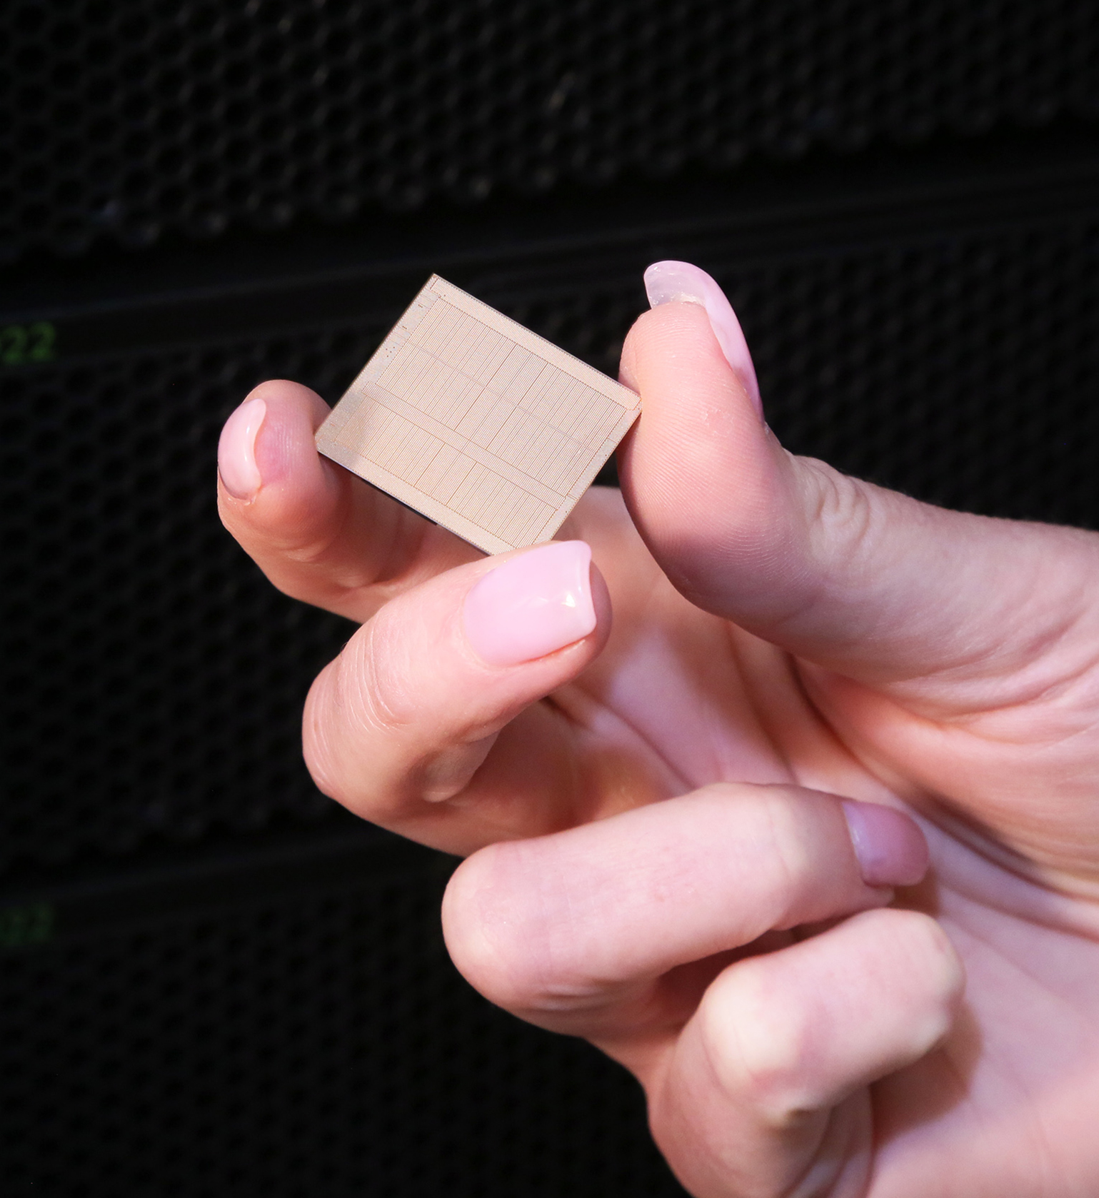

POWER9 is a chip which has a
new systems architecture that’s optimized for accelerators used
in machine learning.
IBM’s POWER9 is literally the Swiss Army knife of ML acceleration as it supports an astronomical amount of bandwidth … 10x of anything that’s out there today.
Notes:
How does the new IBM chip stack up? The TechCrunch article offered this breathless endorsement of the Power9's performance from analyst Patrick Moorhead of Moor Insights & Strategy: “Power9 is a chip which has anew systems architecture that is optimized for accelerators used in machine learning. Intel makes Xeon CPUs and Nervana accelerators and NVIDIA makes Tesla accelerators. IBM’s Power9 is literally the Swiss Army knife of ML acceleration as it supports an astronomical amount of IO and bandwidth, 10X of anything that’s out there today.”
Source: https://www.forbes.com/sites/bobevans1/2018/01/16/ibm-fueling-2018-cloud-growth-with-1900-cloud-patents-plus-blazingly-fast-ai-optimized-chip/#4c59f75184ac

Slide 17
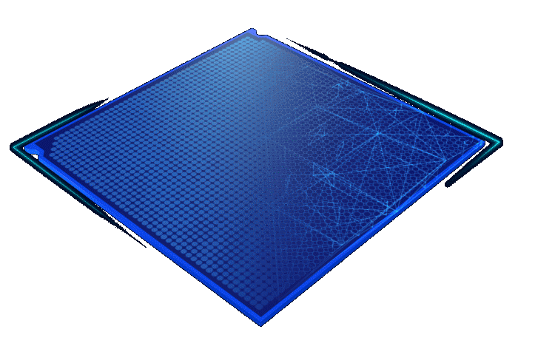
Say “Hello” to POWER9
9.5x
max I/O bandwidth
vs. x86
2x
faster core
performance
vs. x86
2.6x
more RAM supported
vs x86
1.8x
more memory bandwidth
vs x86
Notes:
Hello POWER9!
Built from the ground-up and optimized for enterprise Artificial Intelligence (AI) and Cognitive Computing, POWER9 in the only processor with state-of-the-art I/O subsystem technology, including next generation NVIDIA NVLink 2.0, PCIe Gen4, and OpenCAPI. These interfaces give POWER9 a memory bandwidth superhighway that give you more accurate insights, faster … and helps you reach your goals.
We spend the last couple of slides talking about how AC922 infrastructure is designed for the ‘off chip’ era … but it’s how the off chip technology interacts with the on chip technology that really sets this infrastructure apart … at the core of the AC922 is the IBM POWER9 processing core. On this slide you can see an umber of proof points that showcase this cores standalone capabilities alongside the acceleration capability.
Critical to POWER9 – which was four years in the making – is the interconnect subsystem which comprises of PCI-Express Gen-4, the latest generation of NVIDIA’s NVLink technology (now at Version 2, the POWER8 S822LC – codenamed “Minsky” - shipped with NVLink Version), and OpenCAPI architecture. This I/O subsystem can speed up the movement of data up to 9.5x the speed of PCIe 3.0-based x86 systems (which is the current technology point for Intel XEON chips as of 4Q17). The POWER9 chip also offers 2x the performance of those same x86 chips and 1.8x memory bandwidth. In addition, infrastructures like the AC922 (the POWER9 AI machine … which followed the POWER8 AI machine code-named “Minsky”) has the latest NVIDIA GPU accelerators: the Tesla V100 “Volta” chips (the S822LC had Tesla P100 “Pascal” chips). There are 2 CPUs and up to 4 NVIDIA GPUs supporting 16 total DIMMS within the 2U 19-inch rack mounted chassis.
Both the CPU and GPU come with a boost option to achieve maximum performance; the power and frequency of the CPU and GPU are dynamically managed to allow the system to stay within the power and thermal limits on the POWER9 core.
It’s worth a moment to truly understand the differentiated NVLink support in POWER9 compared to Intel systems because both vendors will talk about supporting it. The POWER9 processor is armed with NVLink interconnect technology that’s designed to accelerate the movement of data between the IBM POWER processor and NVIDIA GPUs in a manner that is unique to IBM (more on that in a bit).
Do not get confused because Intel will advertise the use of NVLink technology, and in Intel’s architecture NVLink is only used for GPU ← → GPU communications. BUT! NVLINK with POWER is used for both GPU ← → GPU and CPU ← → GPU communications! We are going to REPEAT this message many times in this deck (there is even a slide coming up on it … it’s critical you understand this point … but it’s up to you to mention it at this point in the presentation or not).
There are two POWER9 modules options (the server supports dynamic power and frequency control to enable maximum performance while remaining within the designed power and thermal constraints):
16 Core Processor Module – EP0K 190W – 250W (2.25GHZ - 3.12GHZ)
20 Core Processor Module – EP0M 190W – 250W (2.25GHZ - 2.80GHZ)
The feature codes of each of the processor choices from above is underlined. For example, the EPOK is the feature code for the 16 cores option.
There are 3 memory configuration offered at the AC922 GA in 4Q17 and two others coming in 2Q18. In the 4Q17 configuration, the memory available on the AC922 is 16GB (IS RDIMM DDR4 – EM61), 32GB (IS RDIMM DDR4 – EM63), and 64GB (IS RDIMM DDR4 – EM64). There are 8 RDIMMs per processor … 16 RDIMMs total per system with a 1 TB Max System Memory per system. The DDR4 DIMMS are industry standard. In 2Q18, an offering will debut at 8GB (IS RDIMM DDR4 – EM60) and 128GB (IS RDIMM DDR4 – EM65) memory options and the maximum memory will be extended to 2TB per system.
There are 5 different storage bays on this server. The storage features are packaged in a 2.5” carrier which allows for easy installation with 2 slots per server. There is no minimum quantity … for example, you can select no storage at all. The storage is driven by an integrated SATA RAID controller on a main planar and comes with RAID0, RAID1, and RAID10 options.
The storage options available include HDDs at 1TB (2.5” 7k RPM SATA – ELD0), 2TB (2.5” 7k RPM SATA – ES6A). SSD options include 960GB (2.5” SATA – ELU4), 1.92TB (2.5” SATA – ELU5), and 3.84TB (2.5” SATA – ELU6) options.

Slide 18


>
5-10x
FASTER
vs. previous
x86 system
75%
LESS NODES
for superior density
~29x
PER NODE PERFORMANCE
(>40TF)
~8x
MORE
STORAGE
(250PB@2.5TB/s)
16x
MORE
MEMORY
per node
“SUMMIT” on POWER
vs.“TITAN” on x86
Notes:
Leaders of organizations are grappling with how to embrace recent infrastructure innovations like acceleration, while simultaneously being challenged to incorporate analytics into their HPC workloads. On the horizon, even more demanding applications built with machine learning and deep learning are emerging to push system demands to all-new highs. With all of this change in the pipeline, the usual tick-tock of minor code tweaks to accompany nominal hardware performance improvements can’t continue as usual. For many HPC organizations, significant decisions need to be made. Realizing that these demands could only be addressed by an open ecosystem, IBM partnered with other industry leaders (Google, Mellanox, NVIDIA, among others) to form the OpenPOWER Foundation, dedicated to stewarding the Power CPU architecture into the next generation.
In 2017 (and through parts of 2018 until Summit becomes fully available) the fastest supercomputer in the world is (or was) China’s Sunway TaihuLight (Sunway); it’s capable of a whopping 93 PetaFLOPS operations per second. In 2018, the US plans to overtake this record with the help of IBM! This is Summit … the partnership between the Oak Ridge National Laboratory (ORNL) and IBM (among some other vendors … but the building block of this supercomputer is loosely the AC922). Summit will be capable of about 200 PetaFLOPs! Each node in this cluster has a specialized high performance server design by IBM (and its OpenPOWER partners). The nodes consist of 2 POWER9 processors and 6 NVIDIA Tesla V100 GPU Accelerators. In this cluster, the entire box is water cooled (though commercial units have the choice of either, the air cooled version for less demanding workloads).
Did you know that Summit has a sister? Her name is CORAL (more details on the next slide). In 2014, IBM’s disruptive approach for HPC innovation led to IBM being awarded 2 contract to build the next generation of supercomputers as part of the US Department of Energy’s Collaboration (C) of Oak Ridge (OR), Argonne (A), and Lawrence Livermore (L) program … and this is where the ‘CORAL’ moniker comes from. In partnership with NVIDIA and Mellanox (among others), IBM demonstrated that its “data-centric” approach to systems – an architecture designed to embed computer power everywhere data resides in the system, could lead to driving new insights at unprecedented speeds.
With these real-world and competitive performance results in mind, it’s no wonder why the US Department of Energy’s Oak Ridge National Library has teamed with IBM Cognitive Systems to deliver what is expected to be the most powerful computer (called Summit) in the world, scheduled for delivery in 2018 … and it’s built on IBM Cognitive Systems, using the technologies outlined in this presentation. For example, the CPU ←→ GPU interconnect will operate at speeds of 100GB-150GB/sec per link! Early benchmarking shows that Summit and Coral could be two of the world’s fastest supercomputers when they become fully operational in 2018.
Summit is the next leap in leadership-class computing systems for open science. Summit will deliver more than 5x the computational performance of Titan’s (its predecessor based on x86)18,688 nodes, using only ~4,600 nodes when it arrives in 2018 (they are basically rack-mounted server). Summit will be 5-10x more powerful than its predecessor and with just ¼ of the nodes compared to Titan, it’ll use substantially less power too.
Summit is built on a hybrid architecture, and each node will contain multiple IBM POWER9 CPUs and NVIDIA Volta GPUs all connected together with NVIDIA’s high-speed NVLink. Each node will have over ½ a terabyte of coherent memory (high bandwidth memory + DDR4) addressable by all CPUs and GPUs plus 800GB of non-volatile RAM that can be used as a burst buffer or as extended memory. To provide a high rate of I/O throughput, the nodes will be connected in a non-blocking fat-tree using a dual-rail Mellanox EDR InfiniBand interconnect … and of course all of this is underpinned by POWER9.
Upon completion, Summit will allow researchers in all fields of science unprecedented access to solving some of the world’s most pressing challenges in fields such as fuel efficiency, biology, drug development, light water nuclear reactors, astrophysics, superconductors and materials science, environmental science and climate change, and so much more.
Note: You can hear our IBM clients talking about Summit at https://www.olcf.ornl.gov/summit/
Learn even more: https://www.ibm.com/blogs/systems/reaching-the-summit-the-next-milestone-for-hpc/

Slide 19
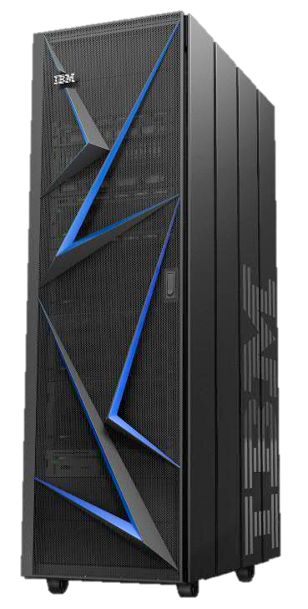
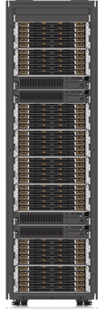






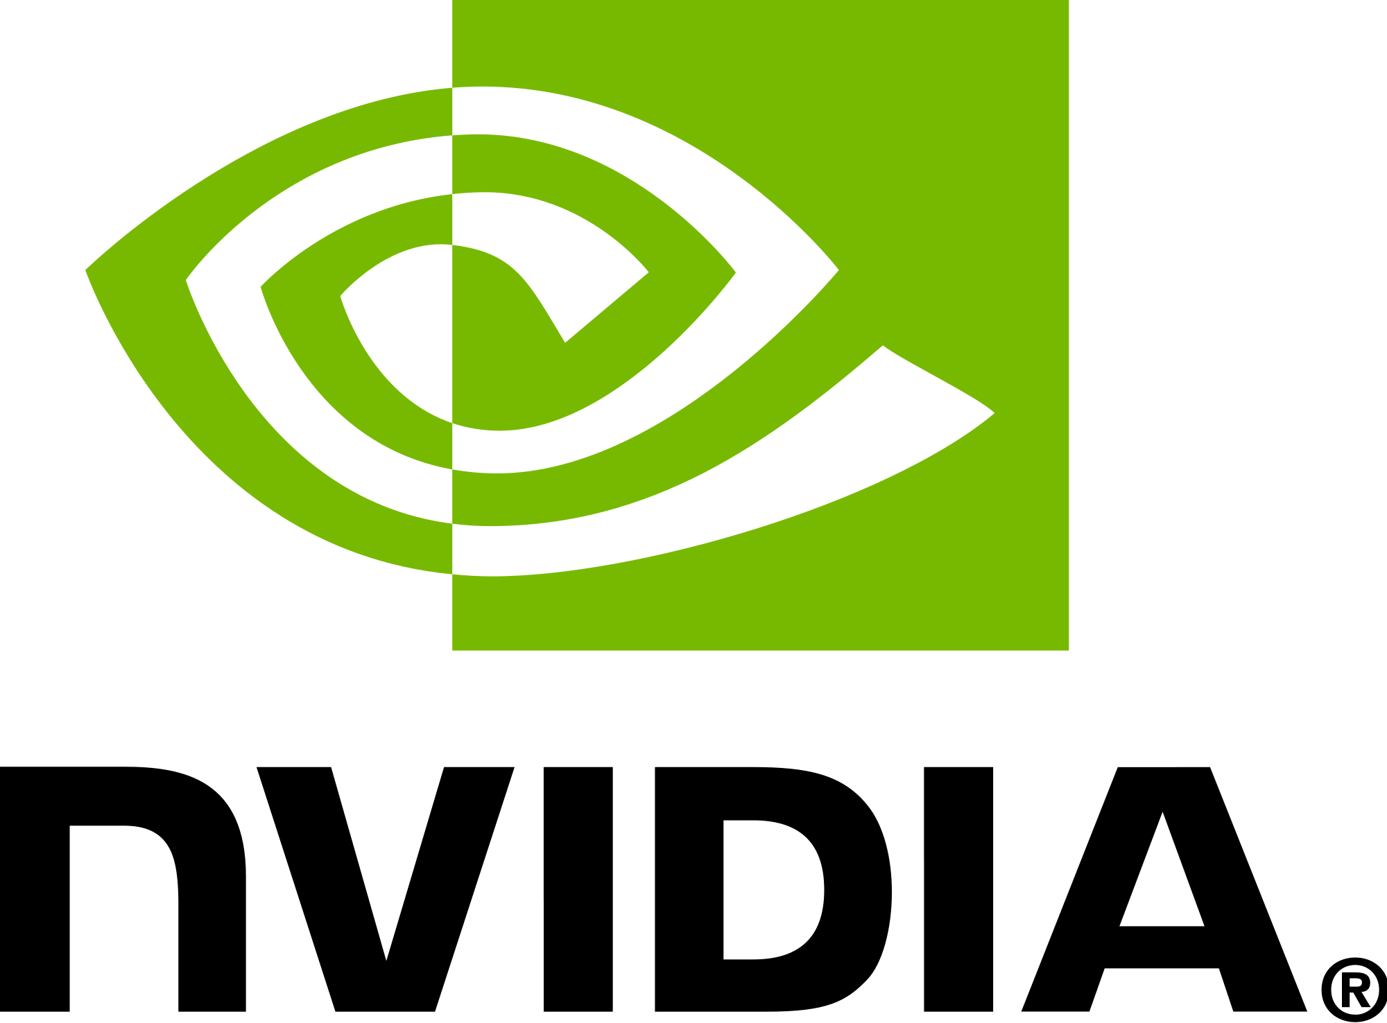

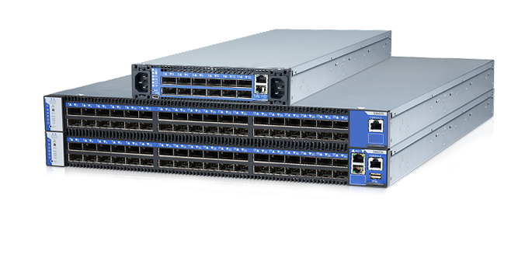
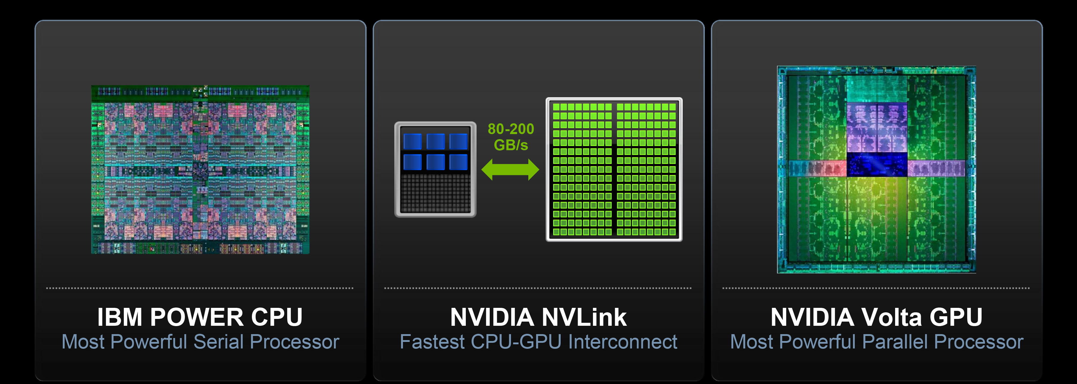
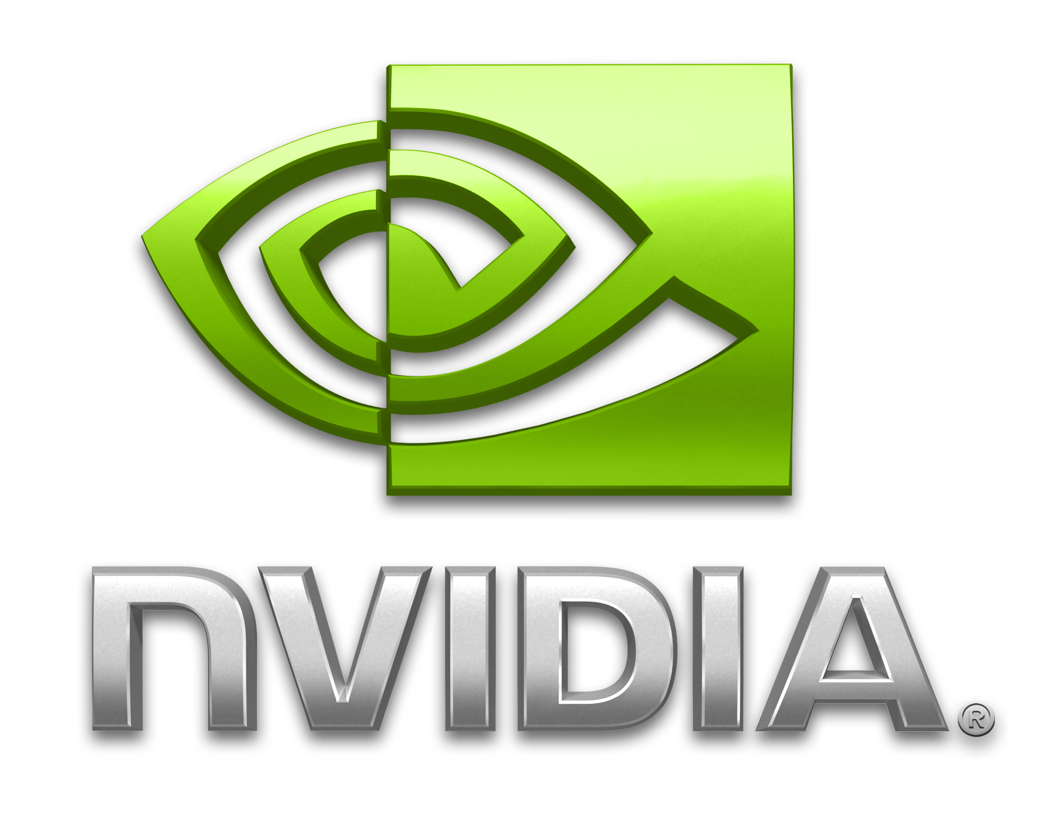

Compute Rack
18 Servers/rack
779 TF/s/rack
10.8 TB/rack
55 KW max
ESS Building Block
=
POWER9 2 Socket Server
Standard 2U 19” Rack Mount Chassis
2 P9 + 4/6 Volta GPU (@7 TF/s)
512 GB SMP Memory (32 GB DDR4 RDIMMs)
64/96GB GPU Memory (HBM stacks)
Scalable Active Network
IB4X EDR Switch
GSS-26
3 2U servers/rack
9 4U JBODs/rack
9 KW max/rack
22 cores
4 Threads/core, 0.65 DP TF/s
Volta 7 DP TF/s, 16GB @ 1.2TB/s
100-150
GB/s
Notes:
When talking about BM POWER-based AC922 infrastructure, you’d be remiss to at least not reference the CORAL and Summit projects detailed on the last (and this) slide. Coral is targeted to deliver 300+ petaflops of high performance computing and 3+ Exaflops of AI performance …. with 10x the flop advantage and 5-10x the performance advantage over its predecessor “Titan” (a cluster built on x86/NVIDIA) with ¼ the number of nodes.
This slide shows some of the technical details behind the joint IBM, CORAL, and US Department of Energy initiative. The key take-away from this slide is that all of the building blocks used to create what is expected to be the fastest computers in the world in 2018 are commercialized so everyone can take advantage of the innovation to accelerate their analytics and deep learning workloads on Linux. Quite simply, since CORAL was built by deploying a repeatable building block … IBM makes these building blocks publicly available so clients can build their own “mini CORAL” systems that can scale from a single node … to thousands of them. Quite simply, IBM has democratized the ability to build large scale AI higher performance computing systems.
<CLICK>
The main point to remember is that CORAL all starts with the IBM POWER9 processor and NVIDA’s Volta100 GPU. Remember NVIDIA NVLink technology that interconnects the GPU and CPU is unique to IBM … while other vendors will advertise NVLink technology in their marketing, the neglect to mention that’s only for GPU to GPU connections. You simply can't allow clients to not know that the IBM solution not only accelerates communications between GPU to GPU via NVLink, but also between CPU and GPU. Challenge your clients on this … I can’t tell you how many clients I’ve talked to that say NVLink isn’t unique, be polite, but be forceful and direct with the facts.
<CLICK>
All of the engineering and partnership between IBM and NVIDIA (among others) gets ‘boxed’ up in a POWER9 2-socket server that fits a Standard 2U 19” rack mount chassis (the world’s most used form factor). Each of these servers comes with 2 POWER9 CPUs and 4-6 NVIDIA Volta GPUs. Combining these foundation innovations on a motherboard, housed in a standard rack mount chassis, creates a repeatable building block that can be used for high performance computing and data-intensive workloads.
<CLICK>
In the CORAL use cases, these super cognitive servers were packaged within a rack that holds 18 servers.
<CLICK>
Mellanox is used as the high speed interconnect.
<CLICK>
The storage is ESS and serves as a storage building block for the cluster … as opposed to the compute building blocks (the POWER9 2 Socket Server). These storage servers have 9 4U-wide just a bunch of disks (JBOD) and draw a maximum of 9Kw per rack. All the storage pieces fit into 2 - 2U servers per rack.
And this is what makes a CORAL supercomputer.

Slide 20
Evolving from Compute Systems to Cognitive Systems
Dev Ecosystem
Industry Alignment
Not Just About Hardware Design
Partnerships
Open Frameworks
It’s about co-optimization
IBM Software
software
+
P8
P9
P10
hardware
Open Accelerator Interfaces
which just works for ML, DL, and AI
Accelerator Roadmaps
Notes:
<CLICK>
In this next section we are going to talk about the software that is optimized for Power servers … namely the PowerAI stack and how it takes advantage of the AC922 features. (Note that this deck does not cover some of the non-performance related software components of the PowerAI stack. For example, in this section we touch on a couple of software enhancements that accelerate AI such as Distributed Deep Learning (DLL) and Large Model Support (LMS); however, we do not cover PowerAI Vision (the toolset for labelling datasets for a Convolutional Neural Network – CNN), among other features like tools for hyper parameter optimization and deployment. See the Power AI Smarter course (https://drv-ctp6.canlab.ibm.com/smarter/#/systems/course/651) to add this information into your deck! (If you want to start with software in this storyline, just flip the sections.)
The bottom line with co-optimization is that it’s not just the hardware (POWER9 processor, NVIDIA GPU, and so on) to help the AC922 achieve greater performance, and it’s not just the software (DDL, LMS, and so on) either … it’s the combination of the two working in harmony.

Slide 21

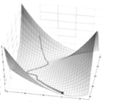


enterprise-ready
software distribution
built on open source
performance:
faster training times
for data scientists
tools for
ease of
development
Notes:
In 4Q16 IBM announced a significant revamp of PowerAI, seeking to address some of the bigger challenges facing developers and data scientists. The PowerAI value prop is simple: Flatten the time to training curve for the most prevalent open source deep learning frameworks with enterprise-class support and significantly cut down the training times required to build well performing deep learning neural networks through tools, infrastructure, and software innovations that simplify the development experience. The idea behind PowerAI is to embrace and extend the capabilities and creativity happening in open source communities (upon which IBM participates) and add in IBM unique capabilities that deliver on our value proposition.
The IBM approach manifests itself in a number of value differentiators for AI applications that the IBM Power brand brings to the table:
Enterprise Software distribution – Taking the best of the open source (across the entire stack) world while ensuring it is enterprise ready and supported. This support is a key differentiator.
Performance – This is enabled by taking the open source deep learning frameworks building optimizations around them such as advanced IO and scaling technology.
Productivity Tools – This is about providing data scientists with a rich set of visual tools that have intelligence built inside them to enhance the development experience and shorten the time to value.
Ensure you understand that while this presentation focused a lot on the performance of the new POWER9 processing architecture and the components of the AC922 infrastructure for AI, the AC922 is about accelerating performance of AI. This is why the PowerAI offering is more than just a story about making training times faster for deep neural networks. For example, the tools that ship with PowerAI allow business users (non-data scientists) and technical staff to work together to create labeled data sets. Details (and accompanying slides) on the entire PowerAI story are available on Smart Seller and within the Smarter PowerAI training (https://drv-ctp6.canlab.ibm.com/smarter/#/systems/course/651).

Slide 22
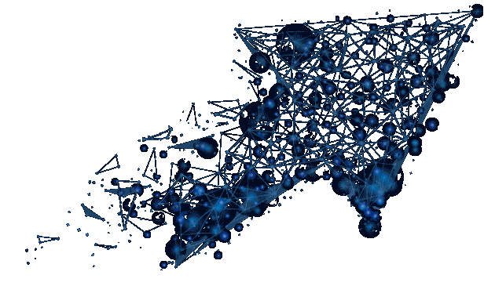
384 hours (16 days)
to train a model built on ImageNet-22K
using ResNet-101 on a server with 8 GPUs.
Distributed Deep Learning
trained this model in 7 hours
58x faster by scaling the workload across 64 servers and 256 GPUs. Now iterate!
POWER9 scales with 95% efficiency.
DDL makes
AI scale
Notes:
Deep learning has taken the world by storm in the last four years, powering hundreds of consumer web and mobile applications that we use every day. But the extremely long training times in most frameworks present a hurdle that’s curtailing the broader proliferation of deep learning. It currently may take days or even weeks to train large AI models with big data sets to get the right accuracy levels.
At the crux of this problem is a technical limitation. Today’s most popular open-source deep-learning frameworks do not seem to run as efficiently across multiple servers. So, while most data scientists are using servers with four or eight GPUs, they can’t scale well beyond a single node. For example, when we tried to train a model with the ImageNet-22K data set using a ResNet-101 neural network, it took us 16 days on a sing Power Systems server with four NVIDIA P100 GPU accelerators. 16 days – that’s a lot of time you could be spending elsewhere!
And since model training is an iterative task, where a data scientist tweaks hyper-parameters, models, and even the input data, and trains the AI models multiple times, these kinds of long training runs become a blockade to higher performing models.
So what does Distributed Deep Learning (DDL) do for you?
IBM invented turbo boost for deep learning: Distributed Deep Learning (DDL) is a PowerAI software library that hooks into popular open source machine learning frameworks like Google TensorFlow, Caffe, Torch, and Chainer. DDL enables these frameworks to scale (near linearly) to tens of IBM servers, leveraging hundreds of GPUs. With the DDL library, it took us just 7 hours to train the same model on 64 IBM Power Systems servers that have a total of 256 NVIDIA P100 GPU accelerators in them. 16 days down to 7 hours changes the workflow of data scientists. That’s a 58x speedup!
And it scales efficiently – Running across multiple nodes is only half the battle, doing it efficiently is the most important half. Fortunately, building upon a rich experience in HPC and analytics, IBM was able to scale deep learning frameworks across 256 GPUs with up to 95 percent efficiency! (Source: https://www.ibm.com/blogs/systems/scaling-tensorflow-and-caffe-to-256-gpus/).

Slide 23


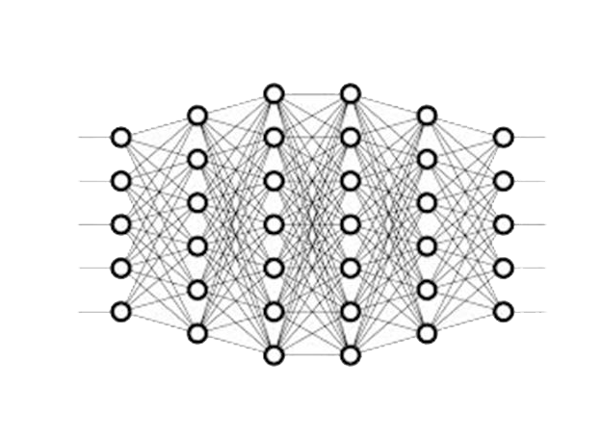


Limited memory on a GPU
is a problem for deep
neural network training
was
Traditional Model Support
(Competitors)
Large Model Support
(IBM Power)
Limited memory on GPU forces trade-off in model size / data resolution which leads to
less complex, shallower
neural nets that don’t perform
Use system memory and GPU
coherency with NVLink 2.0 to train deep neural nets with
higher resolution data and develop more accurate models for better inference capability
Notes:
IBM is dedicated to reduce the time it takes for deep learning systems to learn … improvements in this domain can help all kinds of roles in society; for example, a radiologist can get faster and more accurate reads of anomalies and masses on medical images.
One of the features in PowerAI that accelerates the building of deep neural networks is Large Model Support (LMS); another is Distributed Deep Learning (DLL) - more details on DLL can be found in the PowerAI enablement material on Smart Seller: https://drv-ctp6.canlab.ibm.com/smarter/#/systems/course/651.
Large Model Support directly addresses a big scaling challenge in deep learning: the size of memory available within GPUs. When data scientists develop a deep learning model, the structure of matrices in the neural net, and the data elements which train the model (in a batch), must sit within the memory on the GPU. As models grow in complexity and data sets increase in size, Data Scientists are forced to make tradeoffs to stay within the GPU’s constrained memory limits (in 1Q18, that’s around 16GB). So how do practitioners cope? They have to make the trade-offs you see on this slide (on the left are lower resolution images and on the right, are richer images which can provide better training and classification intuitions that the neural network) can learn from. With POWER9 infrastructure, practitioners can train their models with higher definition data and ultimately develop more accurate models that perform better than the models they can build when they are forced into less complex, shallower models.
POWER9 gives an even bigger boost to Large Model Support because it’s equipped with NVidia's NVLink 2.0. Specifically, with POWER9 and NVLink 2.0, the CPUs and the GPUs communicate with a coherent interface … this is unique in our industry right now; this feature basically enables near direct access of the system memory to the GPUs which enables the GPUs and data workflows to leverage the system’s memory for larger, more complex, higher resolution models. The end results? The AC922 enables faster training times with even more accuracy for deep neural networks than the POWER8 –based S822LC which still has a lead over Intel-based servers.
With Large Model Support, enabled by PowerAI's unique NVLink connection between CPU (memory) and GPU, the entire model and dataset can be quickly loaded in to system memory and cached down to the GPU for action. IBM’s testing has enabled increased model size (more layers, larger matrices), increased data element sizes (higher definition images), and larger batch sizes (for faster time to convergence). With Large Model Support, data scientists can load models which span nearly an entire terabyte of system memory across 4 GPUs. The final impact? Customers can now address bigger challenges and get much more work done within a cluster of PowerAI servers increasing organizational efficiency.
Here is a great example. Imagine if you were using a 480 x 480 resolution image to try and detect a faulty part. If that part was using the R(ed), G(reen), B(lue) color channel, each picture would feed into the neural networks 1st layer 691,200 inputs (480x480x3) for ever class of a faulty part the neural net was trying to detect. Now consider that higher resolution images could mean the ability to spot certain characteristics in the image that you couldn’t observe before (you do this all the time, watch HD TV and look at someone's face and you can see every wrinkle when compared to older resolution levels). Consider that a picture captured on a 6MB camera generates images with a 3,000 x 2,000 pixel resolution. In our example, that would increase the inputs by a whopping 26x: (3000 x 2000 x 3/ (480 * 480 / 3).
You can see this playing out on this slide. Competitors are bound to the traditional manner in which deep learning models (on the left) are supported. Notice there are two very pixelated blue-tone pictures of the Mona Lisa (on the left)… this is lower quality data. On the right hand side of this slide, is PowerAI’s Large Model Support. It should be obvious, the pictures are of higher quality and there are more of them. Which model do you think will be more accurate? Without PowerAI’s LMS, it’s obvious how companies have to settle for lower quality input data which means the model can’t be trained as well as it could be with the higher resolution data.

Slide 24





3.7x
train more
build more
know more
3.8x
2.3x
Notes:
It’s simple really … Enterprise AI requires new infrastructure that enable the cutting-edge AI innovation that data scientists desire, with the dependability IT requires. IBM Power Systems AC922 offers the fastest way to deploy accelerated databases and deep learning frameworks – with enterprise-class support.
You will hear IBM talk about systems like “Coral” and “Summit” – they’re expected to be the world’s most powerful super computers in 2018 (built on POWER9). But super computing deployment like ”Summit” represent only 10% of the technical and high performance computing (HPC) opportunities as commercial clients deploy deep techniques as a foundation for embedding AI into business processes. Well that’s exactly what the AC922 is all about … ring super computer scaling for deep learning to everyone.
This slide shows a summary of some of the every day deep learning projects clients are challenged with and how the AC922 can help them train their neural nets faster.
There are slides in this deck the delves into the details of each of these benchmarks … you can choose to use this slide as an introduction to those detailed slides … or remove the detailed slides that follow and just use these as statement slide.

Slide 25
Critical capabilities (regression, nearest neighbor, recommendation systems, +++) operate on more than just the GPU memory
Use Server and GPU memory to support higher resolution data by moving large amounts of data between the CPU and GPU
PowerAI automatically enables seamless use of Server and GPU memory
NVLink 2.0 and POWER9 significantly cuts training times and boosts performance (accuracy) of the model with higher resolution data
POWER9 delivers 3.8x reduction in
AI training with same NVIDIA GPU
train more | build more | know more
GoogLeNet – 1000 epochs
LOWER IS BETTER
[2622]
seconds
4xTesla
V100 GP
NVLink 2.0
3.8x faster
[9709]
seconds
4xTesla
V100 GPUs
PCIe3
Benchmark details in speaker notes.
Notes:
This slide shows an example of the benefits software features such as large model support (LMS – detailed on the last slide) can deliver practitioners building deep neural networks. The goal of this test? Use system memory and GPU memory to support more complex and higher resolution data. From a business perspective, IBM was showcasing how to maximize productivity training a CNN for medical/satellite image detection with Chainer on POWER9 with NVIDIA V100 GPUs. As you can see … the IBM AC922 infrastructure with POWER9 processing cores and NVLink 2.0 (which you now know enables enhanced Serer CPU ← → GPU communications) demonstrated a 3.8x reduction in training times vs. a tested x86 system (across 1000 epochs).
Specifically, in this test, IBM ran 1000 epochs (mini-batch size=5) of the Google’s GoogLeNet model (this neural network that was used to win the ImageNet 2014 computer vision competition) using the Enlarged ImageNet data set (its resolution was 240 x 240 and used the RGB color channel). This test move large amounts of data between the CPU and the GPU and in the end, the IBM POWER9 system reduced the training time for this model by 3.8x.
What could you do with that 3.7x faster training times? Perhaps you iterate on the model another ~4 times (or 4000 more epochs for greater performance of the model) or perhaps you deploy 5 models instead of a single one, each trained for 1000 epochs. You decide!
For this test, IBM used the a Power AC922 server that had 40 POWER9 cores (2 sockets x 20 core) running at 2.25GHz; the server comes with NVLink 2.0 supporting 4 Tesla V100 GPUs and 1024 GB memory. The competitive server had 2 Intel Xeon E5-2640 v4 chips for a total of 20 cores (2 sockets x 10 cores) running at 2.4 GHz and dispatching 40 threads; the servers uses PCIe 3 because Intel does not support NVLink 2.0 communications between CPUs and GPUs. The server had 1024 GB of RAM and the same 4 Tesla V100 GPUs.
Each server was running Ubuntu Linux 16.04 and used the Chainer framework (Chainverv3). The LMS/Out of Core with CUDA 9 / CuDNN7 patches can be download at: https://github.com/cupy/cupy/pull/694 and https://github.com/chainer/chainer/pull/3762.
More details… or things to know
ImageNet is an image database organized according to the WordNet hierarchy (currently only the nouns), in which each node of the hierarchy is depicted by hundreds and thousands of images. Currently it has an average of over 500 images per node. You can learn more about ImageNet at: http://www.image-net.org/. The GoogLeNet project was one of the winning teams in the 2014 ImageNet large-scale visual recognition challenge (ILSVRC), an annual competition to measure improvements in machine visual technology, based on ImageNet library.

Slide 26

Critical capabilities (regression, nearest neighbor, recommendation systems, +++) operate on more than just the GPU memory
Use Server and GPU memory to support higher resolution data by moving large amounts of data between the CPU and GPU
PowerAI automatically enables seamless use of Server and GPU memory
NVLink 2.0 and POWER9 significantly cuts training times and boosts performance (accuracy) of the model with higher resolution data
POWER9 delivers 3.7x reduction in
AI training with same NVIDIA GPU
train more | build more | know more
GoogLeNet – 1000 epochs
LOWER IS BETTER
[2940]
seconds
4xTesla
V100 GP
NVLink 2.0
3.7x faster
[11215]
seconds
4xTesla
V100 GPUs
PCIe3
Benchmark details in speaker notes.
Benchmark details in speaker notes.
Notes:
One of the more prevalent AI frameworks is Caffe. IBM conducted the same test from the previous slide (that used the Chainer framework) on Caffe to see the impact of Large Model Support (LMS) on this framework as well. Everything else was the same as the Chainer benchmark (in terms of server, workload, framework, and so on). Once again, POWER9 shows the value of NVLink 2.0 and the performance capability that it can deliver when the problem set becomes larger than the memory supported on the GPU cards. In this test, which again moves large amounts of data between the CPU and the GPU, we observed a reduction in model training times by 3.7x!
Specifically, this slide shows an example of the benefits software features such as large model support (LMS) – detailed on the last slide) can deliver practitioners building deep neural networks. The goal of this test? Use system memory and GPU memory to support more complex and higher resolution data. From a business perspective, IBM was showcasing how to maximize research productivity running training for medical/satellite images with Chainer on POWER9 with NVIDIA V100 GPUs. As you can see … the IBM AC922 server with POWER9 processing cores and NVLink 2.0 (which you now know enables enhanced Serer CPU ← → GPU communications) demonstrated a 3.8x reduction vs. a tested x86 systems (in runtime of 1000 iterations) to train medical/satellite images.
As previously noted, in this test we used the popular Caffe deep learning framework (as opposed to Chainer in the previous slide which yielded 3.7x accelerated training times), running on POWER9 (with NVLink 2.0) and PowerAI to demonstrate the performance benefit outline on the previous slide … namely when the the problem set becomes larger than the memory supported on the GPU cards. (The results you see on this slide are based on IBM internal measurements.) This is an important test because critical machine learning (ML) capabilities such as regression, nearest neighbor, recommendation systems, clustering, and so on operate on more than just the GPU memory. The great news is that IBM PowerAI’s Large Model Support (LMS) for deep learning automatically enables seamless use of Server memory and GPU memory for improved performance!
Specifically, in this test, IBM ran 1000 epochs (mini-batch size=5) of the Google’s GoogLeNet model (this neural network that was used to win the ImageNet 2014 computer vision competition) using the Enlarged ImageNet data set (its resolution was 240 x 240 and used the RGB color channel). This test move large amounts of data between the CPU and the GPU and in the end, the IBM POWER9 system reduced the training time for this model by 3.7x.
What could you do with that 3.8x faster training times? Perhaps you iterate on the model another ~4 times (or 4000 more epochs for greater performance of the model) or perhaps you deploy 5 models instead of a single one, each trained for 1000 epochs. You decide!
For this test, IBM used the a Power AC922 server that had 40 POWER9 cores (2 sockets x 20 core) running at 2.25GHz; the server comes with NVLink 2.0 supporting 4 Tesla V100 GPUs and 1024 GB memory. The competitive server had 2 Intel Xeon E5-2640 v4 chips for a total of 20 cores (2 sockets x 10 cores) running at 2.4 GHz and dispatching 40 threads; the servers uses PCIe 3 because Intel does not support NVLink 2.0 communications between CPUs and GPUs. The server had 1024 GB memory and the same 4 Tesla V100 GPUs. Each server was running Ubuntu Linux 16.04.
The IBM Caffe stack was use for the deep learning framework; the large model support code for IBM Caffe can be downloaded at https://github.ibm.com/TUNG/trlcaffe/tree/1.0-ibm-blc-bm-fix-hang+-p9collateral and is based on the "1.0-ibm-blc-bm-fix-hang+" branch (which servers as the base for PowerAI R4) and a PR#5972 from BVLC/Caffe (for supporting cudnn7).
More details… or things to know
ImageNet is an image database organized according to the WordNet hierarchy (currently only the nouns), in which each node of the hierarchy is depicted by hundreds and thousands of images. Currently it has an average of over 500 images per node. You can learn more about ImageNet at: http://www.image-net.org/. The GoogLeNet project was one of the winning teams in the 2014 ImageNet large-scale visual recognition challenge (ILSVRC), an annual competition to measure improvements in machine visual technology, based on ImageNet library.

Slide 27

Critical capabilities (regression, nearest neighbor, recommendation systems, +++) operate on more than just the GPU memory
Use Server and GPU memory to support higher resolution data by moving large amounts of data between the CPU and GPU
PowerAI automatically enables seamless use of Server and GPU memory
NVLINK 2.0 and POWER9 significantly cuts training times and boosts performance (accuracy) of the model with higher resolution data
POWER9 delivers 2.3x more images processed per second vs tested x86 systems
train more | build more | know more
GoogLeNet – 1000 epochs
HIGHER IS BETTER
[4763]
images /
second
4xTesla
V100 GP
NVLINK 2.0
2.3x faster
[2042]
images / second
4xTesla
V100 GPUs
PCIe3
Benchmark details in speaker notes.
Notes:
This slide shows how to maximize research productivity by training on more images in the same time with TensorFlow 1.4.0 running on a cluster of POWER9 AC922 servers with NVIDIA Tesla V100 GPUs connected via NVLink 2.0. The results show 2.3x more images processed per second vs tested x86 systems. PowerAI Distributed Deep Learning (DDL) library provides innovative distribution methods enabling AI frameworks to scale to multiple servers leveraging all attached GPUs. (Results are based IBM Internal Measurements running 1000 iterations of HPM Resnet50 on 1.2M images and validation on 50K images with Dataset from ILSVRC 2012 … which is ImageNET 2012.)
As previously noted, in this test we used the popular TensorFlow deep learning framework (as opposed to Chainer in the previous slide which yielded 3.7x accelerated training times), running on POWER9 (with NVLink 2.0) and PowerAI to demonstrate the performance benefit outline on the previous slide … namely when the the problem set becomes larger than the memory supported on the GPU cards. (The results you see on this slide are based on IBM internal measurements.) This is an important test because critical machine learning (ML) capabilities such as regression, nearest neighbor, recommendation systems, clustering, and so on operate on more than just the GPU memory. The great news is that IBM PowerAI’s Large Model Support (LMS) for deep learning automatically enables seamless use of Server memory and GPU memory for improved performance!
Specifically, in this test, IBM ran 1000 epochs (mini-batch size=5) of the Google’s GoogLeNet model (this neural network that was used to win the ImageNet 2014 computer vision competition) using the Enlarged ImageNet data set (its resolution was 2240 x 240 and used the RGB color channel). This test move large amounts of data between the CPU and the GPU and in the end, the IBM POWER9 system reduced the training time for this model by 3.7x.
What could you do with that 3.7x faster training times? Perhaps you iterate on the model another ~4 times (or 4000 more epochs for greater performance of the model) or perhaps you deploy 5 models instead of a single one, each trained for 1000 epochs. You decide!
For this test, IBM used the Power AC922 server that had 40 POWER9 cores (2 sockets x 20 core) running at 2.25GHz and dispatching XXX threads; the server comes with NVLink 2.0 supporting 4 Tesla V100 GPUs and 1024 GB memory. The competitive server had 2 Intel Xeon E5-2640 v4 chips for a total of 20 cores (2 sockets x 10 cores) running at 2.4 Ghz and dispatching 40 threads; the servers uses PCIe Gen 3 because Intel does not support NVLINK 2.0 communications between CPUs and GPUs. The server had 1024 GB of RAM and the same 4 Tesla V100 GPUs.
Each server was running Ubuntu Linux 16.04 and used the TensorFlow framework 1.4.0 with LMS/Out of Core with CUDA 9 / CuDNN7 patches that you can download at https://github.com/cupy/cupy/pull/694 and https://github.com/chainer/chainer/pull/3762.
More details… or things to know
ImageNet is an image database organized according to the WordNet hierarchy (currently only the nouns), in which each node of the hierarchy is depicted by hundreds and thousands of images. Currently it has an average of over 500 images per node. You can learn more about ImageNet at: http://www.image-net.org/. The GoogLeNet project was one of the winning teams in the 2014 ImageNet large-scale visual recognition challenge (ILSVRC), an annual competition to measure improvements in machine visual technology, based on ImageNet library.
Specifics
Hardware: 4 nodes of Power AC922; 40 cores (2 x 20c chips), POWER9 with NVLink 2.0; 2.25 GHz, 1024 GB memory, 4x Tesla V100 GPU ; Red Hat Enterprise Linux 7.4 for Power Little Endian (POWER9).
Competitive stack: 4 nodes of 2x Xeon E5 - 2640 v4; 20 cores (2 x 10c chips) / 40 threads; Intel Xeon E5 - 2640 v4; 2.4 GHz; 1024 GB memory, 4x Tesla V100 GPU, Ubuntu 16.04.
Software: Tensorflow 1.4.0 framework and HPM Resnet50 https://github.com/tensorflow /benc hma rks.gif (commit: f5d85aef) and with the following parameters: Batch – Size : 64 per GPU ; Iterations: 1100; Data: ImageNET; local – parameter - device: GPU; variable - update: replicated

Slide 28

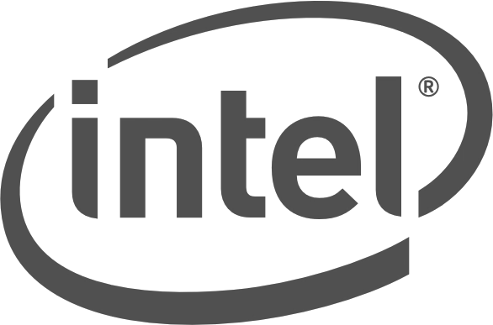

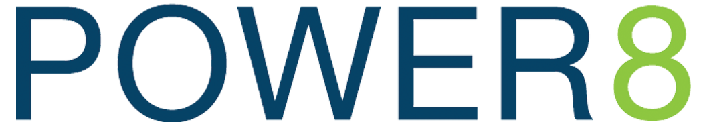

“Filter Tweets by Geographic Area” Marketing Test
80-600 concurrent users accessing 280M simulated tweets (queries/min)
Performance is so low,
it’s not on the chart
PCIe G4 bus versus PCIe G3
[3093]
[5737]
85%
faster
Benchmark details in speaker notes.
Notes:
Discussions about the AC922 will undoubtedly focus on deep learning … the path to AI; however this infrastructure delivers tremendous value for any application that was built to exploit the power of GPUs for application level performance.
IBM first debuted acceleration for the Kinetica database with the Power S822LC for HPC server … and it delivered ~2.7x better performance than GPU-enabled x86 systems running the same database and workload (because the POWER8 result was so far ahead of Intel, and POWER9 is even faster, we didn’t put the actual Intel results on this slide). The AC922 – based on POWER9 - delivers another factor of 1.8x performance for Kinetica over its POWER8-based predecessor … the S822LC! (Imagine what it will do against an Intel-based server.)
Specifically, IBM ran a popular set of queries (“Filter by geographic area”) used for Kinetica testing. These queries are run by 80 to 600 concurrent clients (with zero think time between the queries) that connect to a Kinetica database that houses a data set of 280 million simulated tweets.
The original hardware used for this benchmark was an IBM S822LC for HPC server with NVLink 1.0 which has 20 POWER8 cores (2 sockets with 10 core chips, running at 2.86 GHz, that are capable of dispatching 160 threads). This infrastructure also had 1024 GB of RAM, 2x 6Gb SSDs, 2-port 10 Gb Ethernet, 4x NVIDIA Tesla P100 GPUs and was used to set a performance baseline for the POWER9 baseline test.
This same benchmark was run on the new AC922 that comes with 32 POWER9 cores (2 sockets with 16 core chips, running at 2.25 GHz). This infrastructure had 1024 GB of RAM and 4x NVIDIA Volta V100 GPUs.
The result of this benchmark showcases the benefits of POWER9 over POWER8 … as seen on this slide … an ~2x performance boost or ~85% more throughput on an IBM Power AC922 server when compared to an IBM Power S822LC for HPC server.
The bottom line … POWER9 is the first and only processor with NVLink 2.0 between the CPU and GPU and as you can see, this impacts the performance of workloads such as Kinetica.
For more information on Power Systems performance on Kinetica and other workloads see https://developer.ibm.com/linuxonpower/perfcol/

Slide 29
XEON
E5-2640
V4
[12]
CUDA H2D Bandwidth Test on Ubuntu Linux v16.04
4xP100 GPUs
PCIe 3
2.8x
faster
[34.16]
4xP100 GPUs
2 NVLinks 1.0
3.8x
5.6x
faster
faster
1.34x
[45.9]
6xV100 GPUs
2 NVLinks 2.0
faster vs.
2x
[68]
faster vs.
4xV100 GPUs
3 NVLinks 2.0
Benchmark details in speaker notes.
Notes:
In this presentation we’ve talked about the benefits of NVLink. It’s VERY important that you ensure your client understands that when IBM measures NVLink performance, we are measuring the speed of data transfer between the CPU and GPU. Many clients don’t realize this because there are Intel-based AI hardware boxes that use NVLink; but that NVLink is for GPU to GPU communications (which Power supports as well)
The intent of this slide is to show the results of some tests IBM ran that measure the difference data bandwidth between the CPU and GPU across a number of different busses.
The predecessor to the AC922 was the IBM S822LC for HPC (initially codenamed “Minsky” … it’s based on POWER8 technology). This infrastructure leveraged NVLink 1.0 GPU ←→ CPU technology … and as you can see … it was ~2.8x faster running the CUDA H2D Bandwidth Test on Linux (Ubuntu 16.04) compared to the Intel server used for this test.
<CLICK>
So how does the new POWER9-based infrastructure compare running that same benchmark? As you’ve learned about in this presentation, there are a host of new innovations in POWER9, including the latest NVIDIA GPU and associated technology (for example, NVLink 2.0 – the latest specification of this NVIDIA technology … as of 1H18), IBM innovation (the POWER9 core and its new features), as well as the co-innovation between IBM and the partners that make up the OpenPOWER consortium. As of 1Q18, Intel servers are still using PCIe Gen 3 (POWER 9 server use PCIe Gen 4 for other communications) so it’s worth looking at the speedup of this test to get a feel for ability for the AC922 to impact your deep neural networks and convolutional neural networks training times. Quite simply, IBM didn’t sit on its leadership position with the SL822 for HPC … we furthered our lead with the AC922.
This AC922 was configured in a 6 x V100 GPU configuration and demonstrated a ~4x advantage over the PCIe 3 Intel-based server (remember, this configuration’s CPU←→GPU NVLink interconnect runs at 100GB/s and has two NVLink connection from the GPU to the CPU). This is offset due to the higher compute capability of this server’s configuration.
<CLICK>
And the AC922 configured with 4 x V100 GPUs with 3 NVLinks 2.0 connections between the CPU and the GPU achieves an incredible 5.6x better performance advantage!
<CLICK>
Also take note of the performance improvements of the AC922 over its predecessor, its S822LC for HPC server. The 6 Volta V100 GPU AC922 configuration is 1.34x faster than the S822LC predecessor (which had 4 Pascal P100 GPUs) while the AC922 4 x V100 configuration is 2x faster.
Details on the Results
These results are based on IBM internal measurements running the CUDA H2D Bandwidth Test on Linux (Ubuntu 16.04).
The IBM POWER9 infrastructure used for these tests was the AC922 which had 32 cores (2 x 16 POWER9 core chips running at 2.25 GHz), 1024 GB of RAM, and had 6 x Tesla V100 NVIDIA GPUs running NVLink 2.0 (which had 2 connections from the GPU to the CPU – denoted by the “2” in front of “NVLinks 2.0” label) for the 3.8x faster result, and 4 GPUs with 3 NVLink connections for the 5.6x better result (denoted by the “3” in front of “NVLinks 2.0” label).
The IBM S822LC for HPC server used for these test had 20 cores (2 x 10 POWER 8 core chips running at 2.86 GHz), 512 GB of RAM, and had 4 Tesla P100 GPUs running NVLink 2.0.
The comparison Intel server had 20 cores (2 x 19 Intel Xeon E5-2640 v4 chips running at 2.4 GHz with 40 threads), 1024 GB of RAM and had 4 NVIDIA Tesla V100 GPUs.

Slide 30
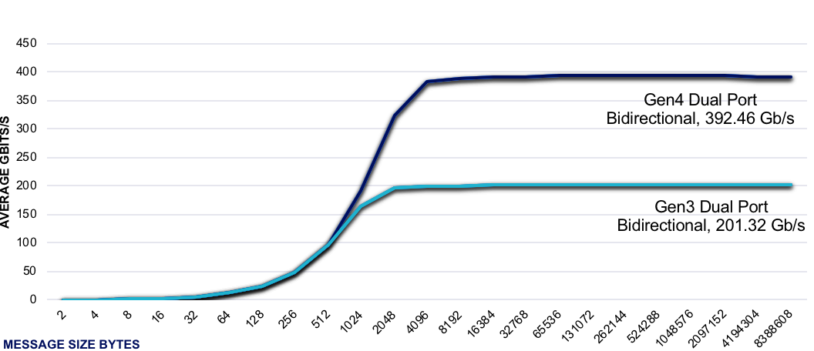
both use
PCIe G3
EDR InfiniBand 100GB/s Bandwidth
(Gen 3 vs Gen 4)
PCIe G4 bus versus PCIe G3
2x
PCIe G4
faster
Benchmark details in speaker notes.
Notes:
So far in this presentation you’ve heard (and seen) some details about the PCIe IO interface. The AC922 upgrades the PCIe bus from Gen3 (in the POWER8 offering and still used by Intel as of 1Q18) to Gen 4 for POWER9.
As you can see from this chart, a PCIe Gen 4 bus has ~2x the data movement advantage using InfiniBand over a PCIe Gen 3 bus. This is incredibly important when considering that InfiniBand is now PCIe Gen4 capable … yet another differentiator!
Another aspect to appreciate on this slide is when the true benefit of the PCI Gen 4 kicks in … as message sizes get bigger (the differentiation starts at about 512KB message size … look at the performance details in the bottom-left of this slide), the benefits accrued by PCIe Gen4 capable infrastructure are significant until they hit the saturation point of the Generation 4 PCI specification. What are those packets flowing through this bus? They could be large feature vectors of an input image that a convolutional neural network (CNN) is classifying, or perhaps a JSON-encoded client record in a MongoDB database, and more; in short, it’s your data!
As great analogy to think about here is your ability to remember a 4-digit code and a 16-digit credit card number … how much faster would you be if you could commit your 16-digit credit card number to memory versus having to go and look at the number 4 times (4 glances to look at the entire 16 digit code, remembering 4 digits each time). Not only could you remember credit card numbers off by heart, but you could easily remember conference passcodes, phone numbers, serial numbers, and so much more. This analogy serves useful for the benefits of PCIe Gen 4 versus PCIe Gen3.
Remember this … the AC922 is the best infrastructure for InfiniBand networking as it has the best network interconnect, with the best architecture, to support superior data transfer rates.

Slide 31
POWER9 delivers ~5x faster data movement CPU ←→ GPU when running CPMD simulations
POWER9 delivers 2.6x faster
CPMD simulation runs
with same NVIDIA GPU
HIGHER IS BETTER
LOWER IS BETTER
[351]
seconds
4VP100 GPUs
NVLink 2.0
2.6x
[~50GB/s]
train more | build more | know more
faster
NVLink 2.0
[673]
seconds
~5x
4xP100 GPUs
NVLink 1.0
faster
[~10GB/s]
PCIe G3
[917]
seconds
PCIe G3
4VP100 GPUs
NVLink 2.0
Benchmark details in speaker notes.
Notes:
CPMD (Car-Parrinello Molecular Dynamics) is a program for ab initio molecular dynamics (Ab initio molecular dynamics revolutionized the field of realistic computer simulation of complex molecular systems and processes, including chemical reactions, by unifying molecular dynamics and electronic structure theory.) It uses a density functional method to speed up quantum chemical computations.
The goal of this test was to reduce wait times and improve computational chemistry simulation execution times. In this test, IBM showcased that IBM Power System AC922 infrastructure delivered a 2.6x (917s / 351s = 2.61x) reduction in execution time against a tested x86 system using the same NVIDIA GPUs. The bottom line is that POWER9 with NVLink 2.0 unlocks the performance of a GPU-accelerated version of CPMD by enabling lightning fast CPU-GPU data transfer rates.
While the right-hand side of this slide showcase the performance result (where lower is better), the left hand side of this slide (where higher is better) showcases the data movement throughput metrics (which certainly contributed to performance in that the more data that moves through the ‘pipe’, the faster the transaction will presumably run) … which is incredibly important for today's cognitive driven workload era; after all, the craze around deep learning neural networks only came to be because of more labelled data and faster computers … but today those computers are ‘starving’ because the pipes between the system’s resources haven’t kept up (this is an areas where NVIDIA’s NVLink is helping … speeding up data transfer rates between the CPU and GPU on Power systems).
When looking at the data movement (CPU←→GPU) aspects that this benchmark showcased, IBM found that the effective data movement rate on the PCIe Gen3 bus was 10GB/s and using NVLink 2.0, it was 50GB/s … that means the AC922 moved data 5x faster in this test!
Where does the math the showcases 5x faster throughput between the CPU and GPU come from? The total data moved:
Data Movement: 634 GB H2D and 488GB D2H per rank and 3 ranks share each communication link
(634 + 488) * 3 = 3,366 GB (round to 3.3 TB)
PCIe: 3.3 TB / 10 GB/s = ~330s
Typical bandwidth assuming variation in data size and flow for CPMD is ~10 GB/s
NVLink 2.0: 3.3 TB / 50 GB/s = ~67s rounded to 70s
Typical bandwidth assuming variation in data size and flow for CPMD is ~50 GB/s
All the results you see on this slide are from running a hybrid version of CPMD (MPI + OPENMP + GPU + streams) with 256-Water Box runs using RANDOM initialization. The results on the right-hand side of this slide are reported in execution times … measured in seconds (so lower is better) and throughput rates are measured in GB/S (on the left, where higher is better).
IBM used two of its own servers for this test, one was based on POWER9 and the other POWER8. The IBM Power AC922 server had 40 POWER9 cores (2 socket x 20 core chips), running at 2.25GHz along with 4 x NVIDIA Tesla V100 GPUs and NVLink 2.0. The server had 1024 GB of RAM and used Pegas (RedHat) 1.0 with ESSL PRPQ; Spectrum MPI: PRPQ release, XLF: 15.16, and CUDA 9.1. The other IBM server was an IBM Power System S822LC for HPC; it had 20 POWER8 cores (2 sockets x 10 core chips) running at 2.86GHz and was capable of dispatching 160 threads. It came with 2 NVIDIA Tesla P100 GPUs with NVLink, had 256 GB of RAM, used 2 x 1TB SATA 7.2K rpm HDDs, 2-port 10 Gb Ethernet. Both results were run on Red Hat Enterprise Linux (RHEL) 7.4 with ESSL 5.3.2.0; PE2.2; XLF: 15.1, and CUDA 8.0.
The competitive Intel—based server had 2 Xeon E5-2640 v4 20 cores (2 sockets x 10 core chips) running at 2.4GHz and was capable of dispatching 40 threads. This server had 256 GB of RAM, 1 x 2TB SATA 7.2K rpm HDD, 2-port 10 Gb Ethernet and was running Ubuntu Linux 16.04 with OPENBLAS 0.2.18, OpenMPI: 1.10.2, GNU-5.4.0, and CUDA-8.0
More about CMPD
As previously noted, CPMD (Car-Parrinello Molecular Dynamics) is a program for ab initio molecular dynamics. It uses a density functional method to speed up quantum chemical computations. CPMD code is a parallelized plane wave / pseudopotential implementation of Density Functional Theory, particularly designed for ab-initio molecular dynamics. The CPMD consortium was established in 2001 in order to coordinate the development and distribution of the CPMD code. It is a virtual organization that comprises all the users and developers of the CPMD code around the world. CPMD is jointly copyrighted by IBM and the Max-Planck Institute in Stuttgart, Germany. It is mainly targeted at Car-Parrinello MD simulations, but also supports geometry optimizations, Born-Oppenheimer MD, path integral MD, response functions, QM/MM, excited states and calculation of some electronic properties. CPMD runs on almost any platform with a Fortran77 compiler supporting the Cray pointer extension. It is preconfigured to run on IBM AIX, Linux, SGI Irix, SUN Solaris, HP HP-UX and Tru64 UNIX,NEC Super-UX, and Hitachi HI-UX/MPP.

Slide 32



KEPRI
KEPRI, the research division of South Korea’s largest electric utility, is using data from drones and a deep learning neural network to recognize maintenance issues faster.
KEPRI chose PowerAI, leveraging the unique performance of NVIDIA NVLink-connected CPUs and NVIDIA Tesla P100 GPUs for faster deep learning training—delivering as much as a 30% performance advantage compared to conventional architecture.
Notes:
KEPRI
The largest electricity provider in South Korea tasked their research division, KEPRI, with finding a way to help keep electrical workers safe on the job. They found that AI technology not only kept them safe, but improved productivity as well. With the help of IBM, KEPRI gave their workers remote-controlled drones to gather photographs and videos of transmissions and tower lines. KEPRI realized that by training a deep learning neural network (DNN) to recognize maintenance issues, they could greatly reduce the time to diagnose problems. Because of the vast amount of visual data that will need to be analyzed and stored to feed the DNN, they needed an in-memory DBMS and a high-speed storage solution. KEPRI recognized that IBM’s PowerAI, the world’s leading distribution and support platform for open source machine and deep learning frameworks, was the best choice to help them train the DNN needed to identify the precise signs of a maintenance issue.

Slide 33



STONE RIDGE TECHNOLOGY
Stone Ridge Technology, maker of the ECHELON petroleum reservoir simulation software, completed an extremely challenging billion-cell reservoir simulation in just 92 minutes using IBM Power Systems—smashing the previous record of 20 hours.
The benchmark established by IBM and Stone Ridge Technology demonstrates that adopting a GPU-based approach could enable 10x or more simulations in a given time, giving greater statistical significance to results.
Notes:
STONE RIDGE TECHNOLOGY
Energy companies use reservoir modeling to predict the flow of oil, water and natural gas in the subsurface of the earth before they drill to figure out how to more efficiently extract the most oil. A billion-cell simulation is extremely challenging due to the level of detail it seeks to provide. Stone Ridge Technology, maker of the ECHELON petroleum reservoir simulation software, completed the billion-cell reservoir simulation in 92 minutes using IBM Power Systems.

Slide 34

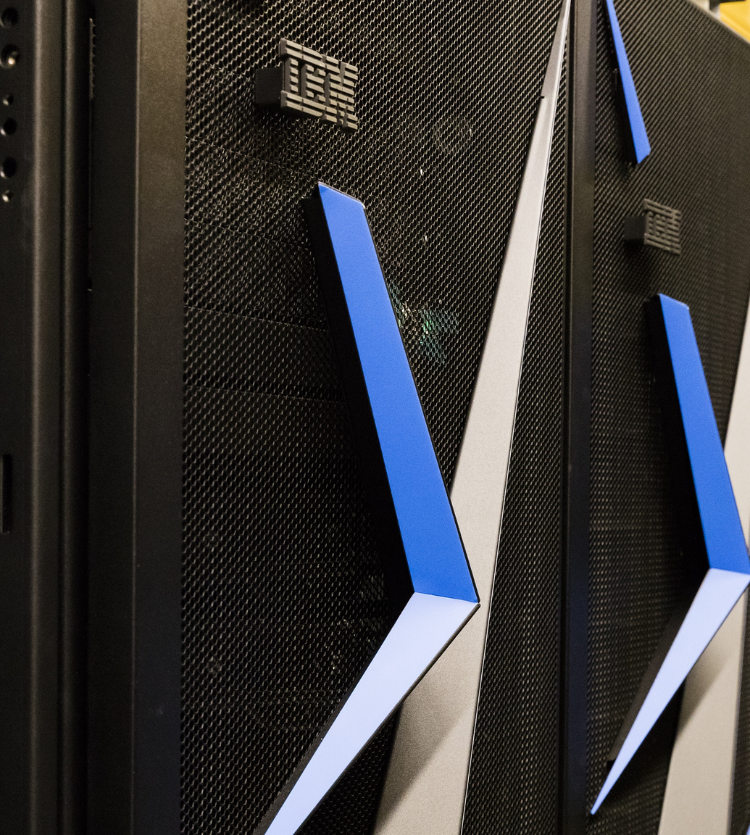




IBM unveils the
industry's most
advanced server
designed for AI.
POWER9 infrastructure
can improve the training times
of deep learning frameworks by nearly 4x over x86 servers.
supercomputers
and
tap into
POWER9
Power Systems deliver an AI insights superhighway across
a wide variety of industries, from healthcare to manufacturing
to banking.
IBM Power Systems AC922 servers with POWER9 were built to bring unprecedented speeds to deep learning and AI workloads.
Notes:
This chart summarizes and puts the key value propositions of the POWER9 and AC922 launch into perspective with our very bold (and accurate) statements. It’s a nice way to finish (or even start if you want to move the slide) a presentation on the IBM POWER9 story for deep learning and AI.
What IBM announced …
IBM introduced its next-generation IBM Power Systems infrastructure, incorporating its newly designed POWER9 processor built specifically for compute-intensive AI workloads. Four years in the making, the new systems are capable of improving the training times of deep learning frameworks by nearly 4x, allowing enterprises to build more accurate AI applications faster. The new POWER9-based AC922 systems are the first to embed leading edge technologies, including PCI-Express 4.0, next-generation NVIDIA NVLink 2.0 and OpenCAPI, which combined will accelerate data movement 9.5x faster than PCI-E 3.0 x86 systems.
POWER9 is at the heart of what is expected to soon be the most powerful data-intensive supercomputers in the world (expected in 2018), the U.S. Department of Energy’s “Summit” and “Sierra” supercomputers, and has been tapped by Google.
Why this matters …
The era of AI demands tremendous processing power and unprecedented speed. If we thought data was big before, the volume of data required to train a deep learning models is almost unfathomable. Today, companies are forced to string together dozens of boxes using a traditional hardware architecture just to start a proof of concept project, and they wind up spending weeks waiting for an outcome. The AC922 delivers exclusive innovations for data scientists to build applications faster, ranging from deep learning insights in scientific research to real-time fraud detection and credit risk analysis.
How IBM can help …
IBM is the only vendor that can provide enterprises with an infrastructure that incorporates cutting-edge hardware and software with the latest open-source innovations. With PowerAI, IBM has optimized and simplified the deployment of deep learning frameworks and libraries on the Power architecture, allowing data scientists to be up and running in minutes.

Slide 35
BACKUP
Notes:
These charts contain information that you may or may not insert into your storyline.

Slide 36
POWER9 Launch Roadmap
Q2 18
AC922
Water Cooled
“NEWELL”
LC922/LC921 “BOSTON”
Q3 18
Q1 18
E980 & H980
“FLEETWOOD”
E950 & H950
“ZEPPELIN”
Q4 17
S922
S914
S924
H922
H924
L922
AC922
Notes:
IBM started introducing the new POWER9 server line in 4Q17. As you now know, the POWER9 architecture is designed to be instrumental in accelerating complex analytic and cognitive applications that will help our clients deliver impact in their organizations and industry.
This slide shows the POWER9 offering roadmap and our plans to introduce POWER9 based architectures across our portfolio (the journey started in 4Q17 and continues in 2018). By now you know about the key system enhancements that POWER9 architecture will deliver:
More performance and scale via POWER9 processors
More Memory capacity for in-memory databases
Reduce latency and improve throughput with enhanced I/O support PCIe Gen4
Integrated NVMe Flash (bootable)
High-bandwidth (25Gb/s) links for GPU/OpenCAPI acceleration.
2017
In 4Q17 IBM introduced the first POWER9-based server designed for 1 and 2 socket SMP systems (the focus of the AC922 deck). This release allowed IBM to make the POWER9 technology available to our OpenPOWER partners and clients a 2-socket LC architecture for high performance computing (HPC) and high performance data analytics (machine learning, deep learning, BigData, and so on). These first systems are Linux-based and use high bandwidth direct-attach memory.
2018
So what happens in 2018? In 1H18 the plan is for IBM to introduce 1 and 2 socket entry systems designed for AIX and IBM i core business applications. (Think of these POWER—based servers as the follow-ons to the POWER8-based S822, S824, S814 servers); during this timeframe we will add an additional 2-socket LC offering too.
By mid-2018 IBM plans is to introduce more POWER9-based architecture … it’ll be focused on large-scale multi-socket (4 to 16 sockets) SMP systems and this will manifest itself through delivery of mid-range 4 socket 4U enterprise-class POWER9 servers (which will be the follow on to the POWER8-based E850C server). This new POWER9 infrastructure is aimed at large-scale requirements and utilizes buffered memory with industry standard DIMMs. These systems will support AIX and Linux-based applications.
2H18 will see IBM boisterously announce the flagship servers of the POWER9 portfolio … the high-end POWER9-based “stuff” if you will. This state of the server will scale from 4 to 16 sockets with an enhanced module design. This architecture will offer the highest level of scalability performance, robustness, and so on and is suited for clients with the most demanding Linux, IBM i, and AIX applications.
Upgrades and Multi-Generational Support: IBM intends to offer clients with POWER E870/E870C/E880/E880C systems a smoother migration path to POWER9-based systems as they become available.
There will be upgrade paths to the high-end POWER9 architecture from existing POWER8-based E870/E870C/E880/E880C systems. Upgrades to POWER9 will be similar to what you are used to with past generational upgrades with programs that allow you to preserve an existing POWER8 serial number. Having an upgrade to POWER9 from a recently purchased POWER8 systems (for example, 1-2 years) can allow a client to write-off the remaining value of their POWER8 system investment when they deploy POWER9. The client simply adds the POWER9 upgrade charge to the book value of the POWER8 system asset when they install the upgrade.
In addition, POWER9 high-end systems may interoperate in a Power Enterprise Pools with POWER8-based E870/E880/E870C/E880C systems. Power Enterprise Pools helps optimize availability, flexibility, and reduce overall system costs and can be a very effective tool for transitioning a client’s heterogeneous infrastructure to a new POWER generation. Power Enterprise Pools were designed to allow clients to share resources and support interoperability between discrete POWER technology generation (N-1 … which means three are no plans to enable POWER7 or POWER7+ systems to interoperate in a Power Enterprise Pool simultaneously with a POWER9 server. Clients that have remaining POWER7+ 770 or 780 systems in a Power Enterprise Pool that also has POWER8-based E8xxx servers are encouraged to migrate/upgrade or decommission these asset prior to deploying POWER9 serve within the same Power Enterprise Pool to ensure a smooth transition).
It’s also important to note that clients who have purchased POWER8 with Mobile Processor and Memory Activations can preserve their investments in these resources by not only sharing them (operationally) between POWER8 and POWER9 servers, but they can also convert or re-allocate these feature assets to another POWER9 system in the Power Enterprise Pool if they wish … at no additional charge … if they were initially purchased on the POWER8 system.

Slide 37

1U SYSTEM DETAILS
2U SYSTEM DETAILS
2 socket, 1U
Up to 40 cores (2.7-2.91Ghz)
2 TB Memory (16 DIMMs)
115 GB/sec max. mem. bandwidth
4x LFF/SFF (HDD/SSD)
Max 40 TB Storage (HDD)
30.72 TB (SSD) capacity
4 PCIe Gen4 slots, 3 CAPI
Support for 1 NVIDIA V100 GPU
2 sockets, 2U
Up to 40 cores ((2.7-2.91Ghz)
2 TB Memory (16 DIMMs)
115 GB/sec max mem. bandwidth
12x LFF/SFF (HDD/SSD)
Max 120 TB Storage (HDD)
92.16 TB (SSD) capacity
6 PCIe Gen4 slots, 3 CAPI
InfiniBand (IB) optional
Support for 2 NVIDIA V100 GPUs
LC922/921
GAs ~2Q18
Codename “Boston”
KEY SYSTEM HIGHLIGHTS
PCIe Gen 4 results in doubling I/O speed from Gen3
Higher IO throughput with more lanes of PCIe Gen4
4-way SMT processing throughput delivering more KVM granularity
CAPI 2.0 coherent accelerator attach
Do not communicate without NDA or until GA in 2Q18
Notes:
*** UNTIL IT BECOMES GENERALLY AVAILABLE IN 2Q18, THIS SLIDE IS NOT TO BE SHARED WITH CLIENTS OR COMMUNICATED EXTERNALLY. ***
IBM will Continue to deliver on the industry leading roadmap of leadership platforms with our 3rd generation Big Data & High Performance Analytics server throughout 2018.
If you get asked questions, use the above specs to generally describe the 2U and 1U systems that are planned to come out in 2Q18 … these servers will be used for the next iteration of IBM’s Hyperconverged Systems Power by Nutanix offering. (There will be additional enablement on this specific infrastructure too).
“Boston” (the LC922/921) will represent IBM 3rd generation of Big Data infrastructure in the marketplace; this infrastructure will see increased storage and memory capacity, add 2nd generation CAPI, add more bandwidth with PCIe Gen IO, and increase the POWER9 processing core count to 20 per socket (with SMT4). All in all, this infrastructure provides balanced compute with ample storage.

Slide 38
POWER’s
FUTURE
  More NVLink throughput
  Advancements in memory bandwidths
  New memory architectures
  Even more dense accelerated compute
POWER
AC922
POWER
S822LC for HPC
POWER
S822LC
Remains the only processor with NVLink (now 2nd Gen) and introduces PCIe Gen 4,
Coherence for near direct access to system memory (2TB)
Co-optimization with deep learning frameworks
Introduced the first processor with NVLink from CPU-GPU
2x memory bandwidth
Air and water cooled versions
Power Systems introduction of design and cost optimized Linux only servers
2X x86 memory bandwidth
Dedicated technical compute versions for GPU acceleration
2019-2020
+future
2017
2016
2015
Notes:
IBM introduced an Accelerated Power Infrastructure roadmap in 2014 and since that introduction, we have delivered an unmatched set of innovations into the marketplace that has had the effect of accelerating BigData and analytics workloads. You can see the epochs of these innovations on this slide.
It’s important too understand that these game-changing innovations aren’t just because IBM is investing in infrastructure for cognitive computing, but it’s also because of the OpenPOWER foundation that invites collaboration around high performance computing. Think of the innovations delivered to the marketplace through open source (Hadoop, Linux, XML, and many more), the same benefits hold true for infrastructure.
This slide shows some of the innovations IBM has delivered in the last couple of years. In 2015, IBM introduced the POWER S822LC server – this was the first Linux on Power server that was “designed and cost optimized” for deep learning workloads.
In 2016, the IBM Power server line took a significant step forward and changed the game for accelerated computing infrastructure with the introduction of the POWER S822LC for HPC server (codenamed “Minsky”) that was specifically designed for cognitive computing and deep learning workloads. This server was the industry’s first server with NVIDIA’s NVLink technology (generation 1 at the time) between the processor and the accelerator (it also came with both air and water cooled options).
IBM POWER’s current accelerated infrastructure roadmap extends beyond 2020 where IBM will continue to demonstrate continued differentiation through innovation with higher data fan with interfaces both with IO and memory which includes new memory architectures all in a more dense design.

Slide 39
Transition Map to POWER9 from Midrange & High-end Systems
Notes:
This slide shows some of the potential transition scenarios that can help optimize IT spend and opportunities for innovation as clients move to new Power-based infrastructure … from their existing POWER7 and POWER8 infrastructure investments. The basic proposition is that resources (money and time spent to maintain exiting POWER7 systems may be better utilized towards POWER8 system deployment and future POWER9 upgrades.
For example, current capacity reset offers provide credit for capacity migrating from POWER7 (or earlier generations) or by leveraging POWER7+ to POWER8 MES Model Upgrade options; this allows clients to reduce the acquisition price of a more scalable reliable, and affordable POWER 8 or POWER9 system that can be less expensive to maintain versus existing POWER7 servers over the ensuing years.

Slide 40
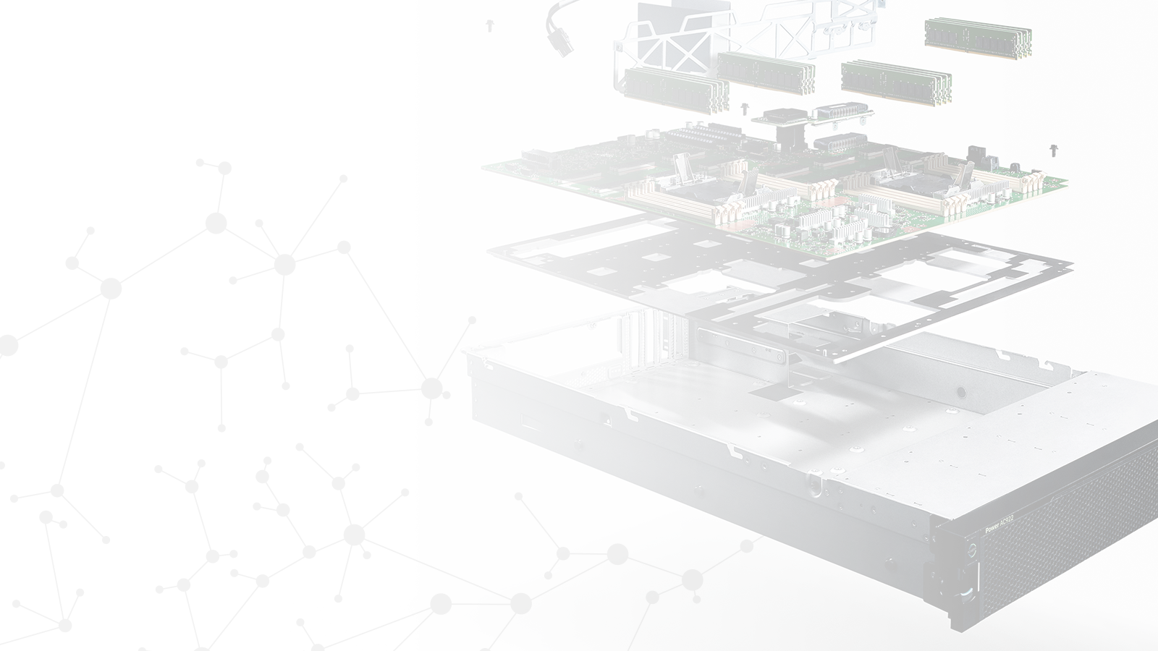
IBM POWER SYSTEMS
AC922
The best infrastructure for Enterprise AI
AC922 offers the fastest way to deploy accelerated databases and
deep learning frameworks – with enterprise class support.
3.7x+
Faster model training time with Chainer and Caffe
80%
Improved performance over the P8 leadership position with Kinetica extending heritage of performance leadership
5-10X
better HPC performance compared to prior DOE Supercomputer (Titan)
Notes:
This slides summarizes some of the key performance proof points detailed in this presentation.
You can move it into the deck as a summary chart to introduce some of the benchmarks (all the proof points on this slide are detailed specifically elsewhere in the deck), or remove the details and just use this slide.

Slide 41
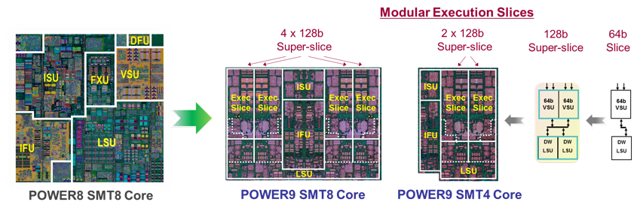
POWER9 Processor
redesigned core provides improved efficiency
and workload alignment with market needs
Notes:
The POWER9 redesigned core enables it to be optimized and aligned to market needs; this core comes with both SMT8 and SMT4 options (the SMT4 option is half of a full SMT8 core).
On the left of this slide, you can see the various components that make up a POWER8 core. In POWER9, the core was redesigned to create a chip which is symmetric in design … this enables IBM to put into the marketplace a processor which can deliver a large core (which contains 8 threads per core). By slicing that large core in half (which cane be done because of the symmetry), the POWER9 can also deliver two cores … each with 4 threads … in a smaller form factor.
To help you speak to this slide, it might be helpful to know the acronyms on it. A POWER9 processing core consists primarily of the following six units:
Instruction fetch unit (IFU)
Instruction sequencing unit (ISU)
Load-store unit (LSU)
Fixed-point unit (FXU)
Vector and scalar unit (VSU)
Decimal floating point unit (DFU)

Slide 42
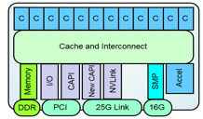
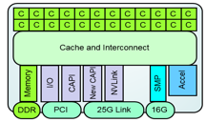
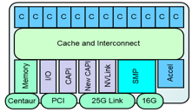
  POWER9 Processor Family
  Processors
Core Count / Size
SMP scalability
Memory subsystem
SMT8 Core
12 SMT8 Cores / Chip
PowerVM Ecosystem Continuity
SMT4 Core
24 SMT4 Cores / Chip
Linux Ecosystem Optimized
Scale-Out – 2 Socket Optimized
Robust 2 socket SMP system
Direct Memory Attach
Up to 8 DDR4 ports
Up to 170 GB/s memory bandwidth
Commodity packaging form factor
Scale-Up – 4+-Socket Optimized
Scalable System Topology / Capacity
Large multi-socket
Buffered Memory Attach
8 Buffered channels
Up to 230 GB/s memory bandwidth
Notes:
POWER9 has two different core structures that align to the needs of the marketplace: SMT-4 Cores and SMT-8 cores.
The SMT-4 Core processor aligns to the scale-out Linux ecosystem market, where higher core counts enable higher KVM (Kernel-based Virtual Machine) granularity. The SMT 4 Core processors deliver up to 24 cores per socket with up to 8 memory busses for direct attached memory. This is important for competitive pricing while maintaining a focus on memory bandwidth (sometimes referred to as BW - this is a combination on the width of the bus (how many bits) and bus speed. The memory is highlighted on slide slide because they are industry leading numbers, and note that the higher core count processors are only available in 2 socket based systems.
The SMT-8 Core processor has a maximum of 12 cores per chip. The higher thread count enables stronger partitions and more performance, which is optimal for the PowerVM ecosystem. The SMT8 Core processors also have buffered memory interfaces which allows for higher memory bandwidth. The SMT8 cores are enabled for both 2 socket and 4+ sockets.

Slide 43
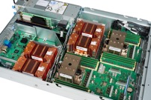
Power Systems Accelerated Compute (AC922)
Designed for Great Supercomputing & AI Leaders
Unprecedented performance and application gains with advanced IO interfaces integrated into the NEW P9 processor delivering capabilities not available on x86
Advanced IO interfaces:
  2nd Generation CPU - GPU NVLink: ~5.6X the CPU-GPU bandwidth compared to x86
  PCIe Gen4/CAPI 2.0: First to market with PCIe Gen 4 with 2x improvement over PCIe Gen 3 and next gen CAPI for coherent device attachment
Introducing Coherence: Treat system memory just like GPU memory enabling game changing simplification of programing and larger model sizes
Burst Buffer: Start/finish job data staging with high performance storage adapter resulting in significant improvement of computing efficiency
GPU Direct: Peer to peer communication within a cluster for remote data access and transfer (RDMA)
  Configuration System Details for 4Q GA
  MTM: 8335-GTG - Specific 4Q Feature Availability:
      1.6 TB NVMe high performance storage adapter
      2 SFF SATA: HDD (Max 4TB); SSD (Max 3.84TB)
      IO: EDR InfiniBand, Quad ENET (2x1/2x10 GB), Quad ENET (4x1 GB), 100 GB ENET
      RHEL 7.4 for P9
      Air cooled only version available (max 4 GPU’s)
      OpenBMC
    A rich configuration of AC922 will be available with a new MTM (8335-GTH) in 2Q’18 offering expanded OS (Ubuntu), full IO and a water cooled option (6 GPUs; 8335-GTX), 2 TB Memory.
        An upgrade from 8335-GTG to 8335-GTH is available as a no charge MES
        It is an optional upgrade for all 8335-GTG systems to get expanded OS and IO
        Optional upgrade is available through end of 4Q 2018
Notes:
The IBM Power AC922 server is the building block of what will likely be the world’s two fastest super computers in 2018 (Coral and Summit); with the AC922, IBM has made these building blocks available for everyone.
This slide summarizes all the points made in this presentation and with added details around migration. IT’s not really meant to be presented to a client, more for your reference.

Slide 44
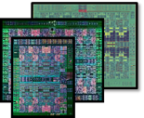
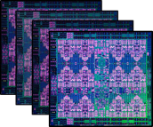


POWER 8 (1H14 - 28nm)
ENTERPRISE + BIG DATA OPTIMIZED
-up to 12 cores with SMT8
-CAPI acceleration
-High bandwidth GPU attach
POWER9
BUILT FOR ENTERPRISE AI
  only processor with NVLink and
  PCI Gen4 advanced IO interfaces
  premier platform for accelerated computing GPU and memory coherence
  processor family with scale-up
  and scale-out optimized silicon
POWER 7
(1H10 - 45nm)
ENTERPRISE
-8 Cores with SMT4
-eDRAM L3 Cache
POWER 7+
(2H12 - 32nm)
ENTERPRISE
-2.5x larger L3 cache
-on-die acceleration
-zero-power core idle state
Notes:
POWER9 builds on generations of innovation around the POWER architecture. POWER9 use 14nm technology and was built for the cognitive era. For example, POWER9 introduces the next generation of NVIDIA’s NVLink 2.0 technology, which debuted in POWER8, which accelerates CPU ←→ GPU data transfer speeds over what was already groundbreaking in POWER8.
Through two generations of the IBM Power processing core, Power remains the only processor in the industry to leverage NVLink between CPU ←→ GPU. As previously mentioned in this presentation (and well worth mentioning again), POWER9 also delivers PCIe Gen 4 and coherence, which are also industry firsts … and only available on POWER9.
All of this equates to the best platform for acceleration work in the marketplace – especially needed for AI, cognitive, deep learning, machine learning, as well as Big Data and analytics.
Over the course of 2017 (when the AC922 was delivered) and 2018 (there are many POWER-based infrastructure announcements), POWER9 will deliver (or has delivered in the case of the AC922) optimized silicon that targets the scale-up and the scale-out markets, with slight differences aligned to value add in each market. For example higher KVM (Kernel-based Virtual Machine) granularity and storage partitions for the PowerVM space is a great story for private cloud.

Slide 45

S822LC
POWER8
20 cores
4 - P100 GPUs
256GB RAM
Hardware List Price
$67,054
TCA Street Price
$53,654
TensorFlow
70
TCA Price/Performance
$766
AC922
POWER9
32 cores
4 – V100 GPUs
256GB RAM
Hardware List Price
$68,854
TCA Street Price
$55,083
TensorFlow
140
TCA Price/Performance
$393
C4130
x86 Broadwell
28 cores
4 – V100 GPUs
256GB RAM
Hardware List Price
$87,569
TCA Street Price
$70,055
TensorFlow
70
TCA Price/Performance
$1001
POWER / x86 Price Index
Hardware List Price Ratio
0.77 0.77
TCA Street Price Ratio
0.77 0.77
TCA Price Performance Ratio
0.77 0.39
vs. Broadwell
vs. Broadwell
Getting questions on GPU pricing compared to on-line pricing? IBM’s net price is competitive!
  Dell List price for a Tesla V100 GPU is $16,919 vs. $11,499 in AC922
Drive home AC922 GPU efficiency versus commodity x86 servers … CPU←→NVLink and LMS is a differentiator
P8 to P9 accelerated computing servers are a price point replace at 256GB memory capacities
HIGHLIGHTS
Notes:
This slide shows the AC922 pricing strategy; it doesn’t require much more explanation than what you see on it. It’s designed more for your educational purposes more so than it is to be presented to clients.

Slide 46

OpenBMC is a free open source management
software Linux distribution
IBM is the OpenBMC Community Leader
OpenBMC is gaining significant attention by large server vendors and hyper-scale datacenter users in the marketplace since being open sourced.
IBM brought OpenBMC into its design centers as a hallmark project
Significant focus on user interface, ease of use, and client feedback on needs
Preliminary external NPS score was 100
Every user polled was a promoter of OpenBMC
Open sourcing OpenBMC will lead to community code contributions which may be included in future IBM supported releases
Notes:
The IBM AC922 has a new Board Management Controller (BMC) interface called OpenBMC. Open BMC is a free open source management software Linux distribution of which IBM is a community leader … and gaining attention from users all over the marketplace. Quite simply, OpenBMC is the code stack used with the AC922 industry standard BMC service processor controller. Think of OpenBMC analogous to the way your car is likely inspected in the shop. It used to be the case where you would bring your car into the shop when you heard a sound, or on some maintenance window. Perhaps a mechanic would shine a light, diagnose, and investigate what was wrong with the car. Today, they simply plug a computer into the car’s port and it tells the mechanic what’s wrong (which begs the question why are they paid so much, but that’s a different conversation).
IPMI SoCs are known as baseboard management controllers (BMCs). The BMC is connected to most of the standard buses on the motherboard, so it can monitor temperature and fan sensors, storage devices and expansion cards, and even access the network (through its own virtual network interface that includes a separate MAC address). But BMCs almost invariably ship with a proprietary IPMI implementation which is limited in functionality to what the vendor chooses. Furthermore, IPMI is riddled with poor security and, thus, leaves servers vulnerable to all sorts of attacks. Once the BMC has been compromised, the attacker has direct access to essentially every part of the server.
One of the major reasons why the marketplace is enthused about OpenBMC is because of issues associated with the Intelligent Platform Management Interface (IPMI) – a set of system-management-and-monitoring APIs typically implemented on server motherboards via an embedded system-on-chip (SoC) that functions completely outside of the host system's BIOS and operating system. While IPMI is intended as a convenience for those who must manage dozens or hundreds of servers in a remote facility, IPMI has been called out for its potential as a serious hole in server security.
IBM pulled the OpenBMC project into a Design Thinking workshop and facilitated a group of external clients and contributors who helped enable the interface’s look and feel. When this was sent out for a broader set of reviews and followed up with the Net Promoter Score (NPS) questionnaire, it received a preliminary score of 100!
Learn more about OpenBMC at: https://lwn.net/Articles/683320/.

Slide 47


The Best Server for Enterprise AI
IBM Power Systems Accelerated Compute Series AC922
Delivering Enterprise-Class AI
Cutting-edge AI innovation CDOs desire with the dependability CIOs require
Simpler Deployment – Rapid AI deployment, with co-optimized software & hardware
Faster Insights – Exceptional performance
for resource-intensive deep learning training workloads that are the core of modern AI
Enterprise Support – Enterprise-class support for entire journey to AI
An Acceleration Superhighway
Unleash accelerated computing potential in the post CPU-only era
Fastest – ~5.6x data bandwidth to accelerators with NVLink CPU-GPU
Simplest – Coherence simplifies coding for data management
Most Efficient – Data-centric design for best utilization of acceleration
Designed for the Insight Economy
Architected for modern Analytics and AI that are fueling Insights
Exceptional Design – Next-gen I/O architecture years ahead of x86
Faster Data – 2-5.6x more I/O throughput, higher memory bandwidth and threads/core for today’s data-intensive workloads
At Massive Scale – Proven from small to exaFlop deployents, with near linear scale efficiency
Notes:
This is another summary slide that has a little more details that you can optionally put into your presentations.
Remember these key themes of the AC922 launch
The AC922 is an Acceleration Superhighway
Think of the AC922 as unconstrained data movement, which is 5.6x faster than that of the x86 PCIe Gen 3 bus. It also includes the NVIDIA NVLink technology 2.0 which enables a coherent interface that allows GPUs to have access to system memory … this simplifies the programing required to use accelerators and enables larger more complex deep learning models because they can access the large memory capacity of the AC922 system. Taking into consideration the AC922 server’s advanced IO and software innovations … the AC922 allows organizations to get the most out of their architectural investments and experience near-linear scaling of the GPUs with ~95% efficiency.
Designed for the Insight Economy
The AC922 isn’t just about GPUs. The AC922 “building block” is designed as a balanced system specifically for the insight economy. With industry leading memory bandwidth, accelerators, more compute, and more threads per core … it’s a proven architecture with deployments such as Summit and Coral (what is expected to be the two world’s fastest super computers debuting in 2018).
Delivering Enterprise-Class AI
Combining this exceptional design with the co-optimized PowerAI software (Distributed Deep Learning, Large Model Support, tooling, and more) you end up with infrastructure design Enterprise AI.
Again, the AC922 is more than just performance … it’s an architecture based the harmonization of hardware and software that come together to form a solution.
It’s also about simplicity … and cutting the time it takes to even get up and running with AI projects.

