Slide 1


PowerAI Deep Dive
Understanding the Details
—
Chris Eaton (ceaton@ca.ibm.com)
Scott Soutter (soutter@us.ibm.com)
Scott Campbell (campbesc@us.ibm.com)
Notes:
This session covers the details of PowerAI and PowerAI Enterprise. One confusing point to discuss right off the top is the naming. The portfolio is often referred to as PowerAI. However, there is an offering called PowerAI (currently at version 1.5.4 as of 4Q18). To prevent some confusion we will sometimes refer to this offering as PowerAI “Base” (even though that is not part of the real name). PowerAI “Base” is a free offering that provides the open source frameworks pretested and easily installable in one package. It also includes Large Model Support (LMS) and a restricted version of Distributed Deep Learning (DDL). The details of this will be covered later in this presentation. IBM also offers support for PowerAI “Base” for a fee. The second section of this presentation covers PowerAI Enterprise which includes “Base” in addition to several enterprise class features for extreme scalability, multi tenancy, workload management, and more. The majority of this presentation details the features in PowerAI Enterprise.

Slide 2
Agenda
PowerAI Portfolio (Base, Enterprise, Vision, and ISV tooling like H2O)
PowerAI “Base” - details of the offering, value, who to target it at, scale options
PowerAI Enterprise
  Understanding the enterprise portfolio pieces
  Deeper dive on LMS and DDL
  Deeper dive on hyperparameter optimization
  Deeper dive on inferencing
Packaging and offerings
Notes:
This presentation covers the overall PowerAI portfolio along with the features and benefits of the base offering and the extensive enterprise class capabilities of PowerAI Enterprise. The final section covers the various packaging options for the PowerAI portfolio.

Slide 3
PowerAI portfolio
What’s in the offering?
—
Notes:
Let’s first look at the offerings that make up the PowerAI portfolio.

Slide 4




PowerAI family
AI for
Data Scientists and
non-Data Scientists
PowerAI Vision
Auto-DL for Images & Video
H2O Driverless AI
Auto-ML for Text & Numeric Data, NLP
Label
Train
Deploy
Import
Experiment
Deploy
PowerAI: Open Source ML Frameworks
Deep Learning Impact (DLI) Module
Data & Model Management, ETL, Visualize, Advise
PowerAI
Large Model Support (LMS)
Distributed Deep Learning (up to 4 nodes)
Distributed Deep Learning (DDL – 1000s of nodes)
Auto Hyper-parameter Tuning
PowerAI
Enterprise
IBM Spectrum Conductor with Spark
Cluster Virtualization,
Dynamic Resource Orchestration,
Multiple Frameworks, Distributed Execution Engine
  Accelerated Infrastructure
  Accelerated Servers
  Storage
Notes:
With PowerAI, IBM is taking the most popular open source machine learning and deep learning frameworks like TensorFlow, PyTorch and Caffe, among others, and have built a supported distribution out of it.
Think of it like RedHat and how it packages Linux. You don’t go to linux.org to get Linux, you go to RedHat or SUSE or Ubuntu. It’s in the same way that IBM has packaged these machine learning and deep learning frameworks. Instead of going to all these various open source websites and building this software stack yourself, IBM has done it for you. IBM curates it, tests it and constantly updates it based on new releases. But then on top of that, IBM has added several tools to make it easier to use this open source software, and of course we give you much higher performance for training AI models.
PowerAI Enterprise includes enterprise support and additional capabilities above what is included in the base offering:
Integrated & Supported Platform
Validated & Co-optimized Software & Hardware
Enterprise L1-L3 Support
Integration with data stores, cloud, cluster management
Integration with key ML platforms (Watson Studio Local (formerly Data Science Experience Local), Anaconda, H2O)
Integration with key inference platforms
Higher Productivity for Data Scientists
Performance: scalability (reduction in training times)
Capability: large models (larger more complex models for higher accuracy)
Ease of Use: auto-hyper-parameter tuning
Enable Non-Data Scientists to use AI
Rapid prototyping & labeling for SMEs
Auto-ML (with PowerAI Vision)
Auto-DL (with H2O Driverless AI)

Slide 5


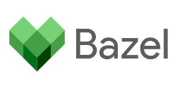

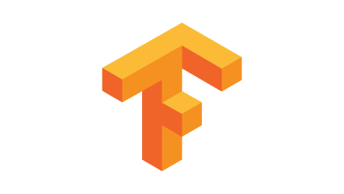


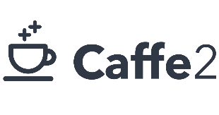

PowerAI 1.5.4 ("Base")
Curated, tested and pre-compiled binary software distribution that enables enterprises to quickly and easily deploy deep learning for their data science and analytics development
Including all of the following frameworks:
HDF5
OpenBLAS
BVLC Caffe
IBM Enhanced Caffe
Caffe2
TensorFlow
TensorFlow Probability
TensorBoard
TensorFlow-Keras
Notes:
The genesis of IBM PowerAI was to make it simple for data scientists to be more productive, more quickly, by greatly simplifying the tasks necessary to get up and running. PowerAI is an enterprise software distribution that combines popular open source deep learning frameworks, efficient AI development tools, and accelerated IBM Power Systems servers to take your deep learning projects to the next level.
For a fee, IBM offers formal support for PowerAI components as long as their versions are consistent with the release configuration (NOTE that PowerAI ‘Base” is a no charge offering but we do offer support for a fee). If you choose to use a different version of any of the components, no formal support will be available. However, in keeping with industry norms, specific questions can be posted on the PowerAI space on DeveloperWorks Answers: https://developer.ibm.com/answers/topics/powerai/. This forum is monitored by the IBM technical team and technical support is provided on a best effort basis.
There a several ways for you to get PowerAI 1.5.4.
Order it. PowerAI 1.5.4 is available as a no charge orderable part number from IBM.
Download it from here: http://ibm.biz/download-powerai
Get the Docker container from here: https://hub.docker.com/r/ibmcom/powerai/
As of PowerAI 1.5.4, the following frameworks are included in PowerAI base:
(Make sure to check the Knowledge Center for the latest versions as they change rapidly
https://www.ibm.com/support/knowledgecenter/SS5SF7_1.5.4/navigation/pai_software_pkgs.html):
DDL 1.2.0 - Distributed Deep Learning (with support for up to 4 nodes in PowerAI Base)
TensorFlow 1.12.0
Tensorflow Probability 0.5.0 - TensorFlow Probability is a library for probabilistic reasoning and statistical analysis.
TensorBoard 1.12.0 - a suite of visualization tools for TensorFlow
TensorFlow Keras – NOTE that Keras is supported as part of the TensorFlow core library and as such we can support Keras through TensorFlow
IBM enhanced Caffe 1.0.0
BVLC Caffe 1.0.0 - The Berkeley Vision and Learning Center (BVLC)
Caffe2 1.0rc1 – in technology preview
PyTorch 1.0rc1
Snap ML 1.0.0
Spectrum MPI 10.2
Bazel 0.15.0
OpenBLAS 0.3.3
HDF5 1.10.1
Protobuf 3.6.1
ONNX 1.3.0 – in technology preview

Slide 6



IBM adds value to curated, tested, and pre-compiled frameworks with PowerAI (“Base”)
Large Model Support
Use system memory with GPUs to support more complex models and higher resolution data.
Distributed Deep Learning
Simplifies the process of training deep learning models across a cluster for faster time to results.
Fully Supported by IBM
PowerAI software and the accelerated Power servers it runs on are supported by IBM technical support.
CPU
GPU
Notes:
There are three additional capabilities on top of the open source frameworks (and in addition to the performance advantage that Power brings to the table); Large Model Support (LMS), Distributed Deep Learning (DDL), and support by IBM.
Large Model Support
PowerAI addresses a fundamental limitation for deep learning; the size of memory available within GPUs. When training complex models or training with high definition images, the memory available on a GPU can be prohibitively restrictive. Instead of being forced into less complex, shallower deep learning models, customers can develop more accurate models with PowerAI Large Model Support.
With Large Model Support, enabled by PowerAI's unique NVLink connection between CPU (memory) and GPU, the entire model and dataset can be loaded in to system memory and cached down to the GPU for action. Customers can now address bigger challenges and get much more work done within a cluster of PowerAI servers increasing organizational efficiency. We will cover more details on LMS later in this deck.
Distributed Deep Learning
To accelerate the time dedicated to training a model, the PowerAI stack includes function for distributing a single training job across a cluster of servers. PowerAI’s Distributed Deep Learning brings intelligence about the structure and layout of the underlying hardware cluster (topology). The impact of this is significant! PowerAI with Distributed Deep Learning can scale jobs across large numbers of cluster resources with very little loss due to communications overhead. There will be more details later in the presentation. PowerAI 1.5.4 ("Base") allows for the use of DDL with up to a 4 node cluster. If a client wants to scale beyond 4 nodes, they must purchase PowerAI Enterprise.
Supported by IBM
Although PowerAI 1.5.4 ("Base") is available free to download and use, IBM also provides a “for fee” support offering for “Base” for those clients that want enterprise level support for the features and capabilities within the base offering.

Slide 7

PowerAI Enterprise
What’s needed for enterprise AI
—
Notes:
Now that we have discussed the capabilities of the base offering, let’s get into PowerAI Enterprise. Before getting into the technical details of PowerAI Enterprise, we will look at the motivation for the offering. In particular, what are the challenges that enterprise customers are facing as they move into the AI space and begin to develop and train ML and DL models.

Slide 8












What enterprise customers struggle with in AI
Faster Time
to Results & Accuracy
Faster Time
to Results & Accuracy
Increased Resource Utilization
Increased Resource Utilization
Simplified Management
Simplified Management
Enterprise Solution
Enterprise Solution
Notes:
There are a number of pain points that enterprise clients struggle with as they get deeper into their AI strategies. Those just testing the waters often struggle with just finding resources (data scientists for example) to help them get started. But for those that are already on an AI journey, they too have struggles that come with this new and evolving technology space.
The first is that they struggle with “not enough time”. Machine Learning and Deep Learning are very iterative processes. When you train a model you run through 1000s of iterations in order to tune the model. Then when you have a model, you refine it 100s more times by changing feature selections, hyperparameters, input data, and more. So that’s 1000s of iterations run 100s of times. Reducing the time for any single operation can result in hours, days or even weeks of saved processing time. That saved processing time can be turned back into tuning more models for even higher accuracy, or build more models. In data science, accuracy is the main goal of any model (the higher the accuracy, the higher the profits, or the more units sold, or the more lives saved, etc.).
Related to “not enough time” is that enterprise clients find they “can’t scale” their model training enough to get the work done in a reasonable amount of time. Or they can’t scale to train multiple models simultaneously on the same set of resources. This desire to increase resource utilization is a key objective for many enterprise clients that know exactly how to accomplish this for the point of sale systems or their data warehouses, but they struggle to do this with their machine learning and deep learning tasks. When you solve “not enough time” and “can’t scale” problems, the results are higher accuracy for data models and in the remainder of this presentation we will discuss exactly how PowerAI solves these two key issues to deliver better outcomes for clients.
The third item clients struggle with is the management of AI tasks. Everything from ingestion and preparation of data, to classifying data, feature engineering (the selection of what features matter to a training run and what features are just adding noise to the model), hyperparameter tuning (this will be described in more detail in an upcoming slide), and simplified deployment of models all contribute to clients struggling with management tasks. In the slides that follow, the simplified management available through PowerAI Enterprise, along with automated machine learning of H2O Driverless AI, and automated deep learning of PowerAI Vision will be discussed.
Finally, enterprise customers expect the highest levels of security, availability, scalability, reliability, and support from IBM. This is exactly what IBM provides with the PowerAI portfolio and in the last section in this presentation will discuss the features and capabilities that map to these enterprise requirements.
<CLICK>
Let’s begin with the first two categories as they are closely related – not enough time and can’t scale and how IBM PowerAI solves these challenges for clients.

Slide 9



Issues with AI today
Example
Whiteboard
Can’t
Not Enough
Scale
Time
RAM
RAM
RAM
No ability to use
CPUs
GPUs
GPUs
GPUs
Too Small
GPUs
Too slow for AI
Great for Matrix Math
Notes:
These next 3 slides provide you with a short whiteboard you can use with clients to discuss with them the limitations in scalability and time that they are likely experiencing today and how they can reap the benefits of PowerAI Enterprise to solve these challenges. Use screen show mode to see the whiteboard drawn out which corresponds to the speaker notes here over the next 3 slides.
<CLICK>
Start with “The Issues with AI today” …. If you are talking with the client more specifically about ML/DL you can replace AI with that.
<CLICK>
Scale is one issue clients are having with AI.
<CLICK>
The second issue is with the amount of Time you have to train machine learning (ML) and deep learning (DL) models
<CICK>
On the scale side, most clients can’t scale their ML workloads efficiently and so the accuracy of their models suffers.
<CLICK>
And with time the issue is that there is never enough and model training is an iterative process…the more you iterate the more precision you can gain but that takes time you may not have.
Let’s first focus on the Scalability side and talk about the issues facing data scientists today trying to build ML and DL models to predict buyer behavior.
<CLICK>
We have systems with lots of CPUs but the problem here is that CPUs are not well suited for machine learning. Why? ML & DL typically involves a lot of matrix mathematics. CPUs are great at serial processing (and to get parallelism I can run a lot of serial processes simultaneously or I can break a complex job down into many parts and run them in parallel). But multiplying two matrices using serial process is
<CLICK> too slow today.
<CLICK>
On the other hand, we have GPUs which are great at matrix math (the graphics processing unit is inherently parallel for these types of operations and are well suited for machine learning tasks)
<CLICK>
So we need systems that have a lot of powerful GPUs.
<CLICK>
(Draw a small pipe between the CPU and GPUs). But the problem is that I can’t run all my work on just GPUs. In a machine learning model, there is a lot of movement of data between the CPUs and the GPUs and the problem today with most systems is that the pipe between the GPUs and the CPUs is too small. Many companies have focused on large pipes between the GPUs but the problem them becomes the pipe between the GPU and CPU is too small to be effective.
<CLICK>
(Draw some memory cards). There is also a problem with the amount of memory available to the GPUs. For clients that have very complex models or are trying to process high definition video or images, there just isn’t enough memory on the GPUs to be able to build a precise model. Clients end up scaling back on the image quality and/or breaking the model up into smaller pieces to allow it to fit within the memory confines imposed on them by the GPUs. This leads to less accuracy in the models and therefore less accurate predictions of client behavior.
<CLICK>
Todays servers can come with terabytes of main memory but GPUs in those systems have no ability to use main memory directly.

Slide 10
Issues with AI today
Example
Whiteboard
Can’t
Not Enough
Scale
Time
RAM
RAM
RAM
Leverage Main Memory
No ability to use
CPUs
GPUs
GPUs
GPUs
Too Small
GPUs
NVLink 2.0
Too slow for AI
Great for Matrix Math
Notes:
How does PowerAI and IBM Power Systems solve this problem?
<CLICK>
(wipe out the small pipe and draw a really big one).
The first is with NVLink 2.0 in the IBM AC922 server. For example, the same high speed pipe that connects GPU to GPU also connects GPU to CPU and so you have the sufficient bandwidth to be able to process even the most complex models.
<CLICK>
(Now wipe out the red X between the memory and CPUs and put in a green checkmark).
And with our systems, we have coherent access to main memory from the GPUs. This means that models can be as complex as they need to be to solve the problem; there is no need to artificially reduce complexity just to make it fit into the memory available on the GPUs. And for clients working on image based models, there is no need to reduce the size of the images. Higher definition images stored in terabytes of main memory can be exploited to give higher accuracy in the models.
All of this means better predictions and therefore better outcomes.
10

Slide 11
Issues with AI today
Example
Whiteboard
Can’t
Not Enough
Scale
Time
Accuracy
Distributed Deep
Learning
RAM
RAM
RAM
Leverage Main Memory
CPUs
GPUs
GPUs
GPUs
GPUs
NVLink 2.0
Too slow for AI
Great for Matrix Math
Notes:
<CLICK>
Now draw a box around “the system” and repeat that box several times to show that you can build a cluster of systems.
<CLICK>
Leveraging Distributed Deep Learning (DDL) and/or Elastic Distributed Training (discussed later in this presentation) allows for models to be trained using a cluster of servers rather than just an individual system. By going across many systems, even the most demanding machine learning and deep learning algorithms can be exploited to build even more complex (and more precise) models.
<CLICK>
Put an X over Can’t and add in that PowerAI lets you scale up within a single systems (using more GPUs as needed that have high bandwidth access to the CPU as well as other GPUs) and scale out all of these benefits across multiple machines in a cluster using DDL. Now put an X over “Not Enough” as clients now have time to train multiple models across many systems simultaneously.
All of this means better predictions and therefore better outcomes. Which will result in higher levels of accuracy.

Slide 12

Deeper dive on
Large Model Support and Distributed Deep Learning
Notes:
Let’s dive deeper into both Large Model Support (LMS) and Distributed Deep Learning (DDL)

Slide 13
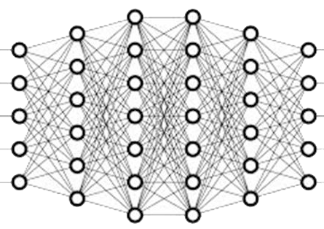
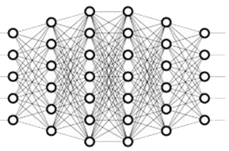

Train larger more complex models
Traditional Model Support
Large Model Support
Limited memory on GPU forces tradeoff in model size / data resolution
Use system memory and GPU to support more complex and higher resolution data
POWER NVLink
Data Pipe
System
Bottleneck
Here
DDR4
CPU
DDR4
POWER CPU
PCIe
NVLink
Graphics
Memory
GPU
Graphics
Memory
GPU
Notes:
PowerAI Addresses Memory Constraints within Deep Learning
Large Model Support
PowerAI Enterprise addresses a very big deep learning scaling challenge: the size of memory available within GPUs. When data scientists develop a deep learning workload, the structure of matrices in the neural model, and the data elements which train the model (in a batch), must sit within the memory on the GPUs. As models grow in complexity and data sets increase in size, data scientists are forced to make tradeoffs to stay within the constrained 32GB (or even 16GB on older GPU cards) memory limits. Instead of training on web-scale images, PowerAI users can train on high definition video. Instead of being forced in to less complex, shallower deep learning models, customers can develop more accurate models for better inference capability.
With Large Model Support, enabled by PowerAI's unique NVLink connection between CPU (memory) and GPU, the entire model and dataset can be loaded in to system memory and cached down to the GPU for action. IBM’s capabilities, with the co-optimized PowerAI software on the Power Systems servers, have enabled increased model size (more layers, larger matrices), increased data element sizes (higher definition images), and larger batch sizes (for faster time to convergence). With Large Model Support, data scientists can load models which span nearly an entire terabyte of system memory across the GPUs. The final impact? Customers can now address bigger challenges and get much more work done within a cluster of PowerAI servers increasing organizational efficiency.

Slide 14
Typical GPU connectivity
System Memory
System memory bus:
76.8 GB/s
CPU
PCIe: 32 GB/s
PCIe: 32 GB/s
GPU
GPU
NVLink on x86
Notes:
It all comes down to bus speeds – speed between the CPU and GPU and speeds between system memory and CPU.
If you talk to a client running on x86 about NVLink they will say “What’s the big deal, we have NVLink in our systems already”. But what they don’t understand is that what they have today on x86 is NOT the same thing we are providing with PowerAI and AC922.
NVLink on x86 improves the performance in communications from one GPU to another GPU. However, for enterprise clients who want to scale their AI workloads, there are bottleneck that come into play in two places:
Data needs to be transferred from system memory, through the CPU and onto the GPUs
The machine learning or deep learning algorithms running on the GPUs can only access GPU memory which is limited to 32GB (older GPUs are limited to 16GB).
The result is that on x86 systems, there is both a lot of wasted cycles while data is shuffled back and forth between system memory and the GPUs over a slow speed PCIe connection AND data scientists can only respond by simplifying their models (for example, use lower resolution images) because they can’t keep all of their complex models and high resolution images inside the limited GPU memory.
Note: This slide is for illustration purposes only and is not intended to represent an exact physical configuration/connectivity.

Slide 15
NVLink CPU to GPU connectivity only on POWER9
System Memory
System memory bus:
170 GB/s
CPU
NVLink 2.0: 150 GB/s
NVLink 2.0: 150 GB/s
GPU
GPU
NVLink 2.0
Notes:
PowerAI and POWER9 AC922 to the rescue! Integrated NVLink 2.0 on IBM Power Systems not only accelerates the communications between GPUs, we also accelerate the communications from GPU to CPU significantly (something the NVLink in the x86 systems can’t do). This means that data can more easily flow from system memory into GPUs and back again as needed.
PowerAI removes the restriction that frameworks like TensorFlow and Caffe need to be limited by the amount of memory available on the GPU. With PowerAI, these frameworks can run with large model support and thus allow the GPUs to leverage system memory at NVLink 2.0 speeds, allowing data scientists to build more complex (and therefore more accurate) models.
Note: This slide is for illustration purposes only and is not intended to represent an exact physical configuration/connectivity.

Slide 16
Effects of NVLink 2.0 on Large Model Support (LMS)
DGX1: PCIe connected GPU training one high res 3D MRI with large model support
AC922: NVLink 2.0 connected GPU training one high res 3D MRI with large model support
Notes:
Here is an example that illustrates the performance gains described in the previous slide. The above diagram comes from the NVIDIA Profiler which shows the training of one medical MRI image through a model.
The top graphic is running the model using PCIe connected GPUs <CLICK> and the red box represents the GPU utilization times) <CLICK> while the bottom graph shows NVLink 2.0 connected GPUs. <CLICK> You can see similar GPU processing in both red boxes but there are very large white gaps in the top graphic. In fact, it took the PCIe connected GPU 2.5x longer to process the image. The GPUs used in both cases are exactly the same model.
AC922 with NVLink 2.0 is 2.5x faster!
Why is there such a large difference? What is it that NVLink 2.0 and PowerAI LMS are providing here?
The gold bars here represent memory copy cycles from main memory to GPU and the white gaps on the GPU utilization line (which is the bottom row with the red box around it) are due to memory copy times, due to bus speeds. Note how much idle GPU white space there is on the DGX1 (the top graph) compared to the AC922 in the bottom graphic.
Make sure your clients are aware the NVLink between GPUs is not the same as NVLink 2.0 used in the AC922 and that system design is important. For clients in data science, IBM optimized infrastructure leads to higher productivity and improved model accuracy.

Slide 17
POWER9 with 4 GPUs is 2.1x faster than x86 with 8 GPUs
Notes:
One of the most prevalent AI frameworks is TensorFlow. In a test with a POWER9 AC922 server with 4 NVIDIA Tesla V100 GPUs compared to an NVIDIA DGX system with 8 NVIDIA Tesla V100 GPUs, the PowerAI system ran 2.1x faster with half the GPUs.
What can you do with 2.1x more time? Train your model through twice as many iterations for greater accuracy or train 2 models instead of just one in the same amount of time and with half of the computing resources!
Results are based IBM Internal Measurements running 1 Epoch training of 3DUnet CNN model (mini-batch size=1, patch_size= 192^3) on BRaTs dataset. (https://www.med.upenn.edu/sbia/brats2017/data.html)
Power AC922; 40 cores (2 x 20c chips), POWER9 with NVLink 2.0; 2.25 GHz, 1024 GB memory, 4xTesla V100 GPU ; Red Hat Enterprise Linux 7.4 for Power Little Endian (POWER9) with CUDA 9.2/ CUDNN 7.2.1;.
Competitive stack: 2x Xeon E5-2698 v4; 20 cores (2 x 10c chips) / 40 threads; 2.4 GHz; 1024 GB memory, 8xTesla V100 GPU, Ubuntu 16.04. with CUDA .9.0/ CUDNN 7.2.1 .
Software: IBM TFLMS - https://github.com/ibmsoe/caffe/tree/master-lms , 3DUnet Model - https://github.com/smatzek/3DUnetCNN/commit/e7d5fcee40a222f6897ea7d23816d4514d7aacb0,h

Slide 18
Choose your scale out distributed training model
Distribution Model | Benefit
Bring Your Own Framework & Native Distribution Engines | Frameworks included in the IBM PowerAI distribution (e.g. Tensorflow) and frameworks with their own native distribution engine (e.g. CaffeOnSpark, etc.)
Distributed Deep Learning (DDL) Very Large Scale-out Single Model | Single user, very large distribution for high-performance training
Elastic Distributed Training Resource Sharing & Multitenancy | Concurrent, dynamic and fault tolerant sharing of resources across many tenants and jobs
Notes:
You have heard of Distributed Deep Learning (DDL) as part of the PowerAI. However, there are multiple ways to distribute training tasks across a cluster of servers and each has their own unique advantages.
The first is that data scientists can build their own clustering tasks using capabilities of the native framework. For example, Distributed TensorFlow allows users to code clustered tasks across a cluster of servers. The benefits are that it is included with the open source TensorFlow package. However, it is more complicated for data scientists to build these types of distributed tasks and more rigid because the resource allocation is fixed when the task is created. Scaling shouldn’t be a task that consumes a data scientists time; this should be part of the infrastructure.
Distributed Deep Learning (DDL) is part of PowerAI “Base” and Enterprise (as mentioned in the portfolio slide). In the base edition, clients are able to cluster up to 4 nodes together while in PowerAI Enterprise, clients can cluster thousands of servers together to perform training tasks. This solution is ideal for very large scale out model training for single models at a time. The resource allocation is static in this method as well.
For multi-tenancy and dynamic resource sharing, Elastic Distributed Training delivers the most flexible solution. This feature allows clients to set up resource groups, prioritization and consumer groups to create a very flexible and scalable training platform for data scientists. We will cover this feature in more details later in this presentation in the manageability section.

Slide 19
Distributed Deep Learning (DDL)
Deep learning training takes days to weeks
Limited scaling to
multiple x86 servers
PowerAI with DDL enables scaling to 100s of GPUs
16 Days Down to 7 Hours
58x Faster
Near Ideal Scaling to 256 GPUs
16 Days
95%Scaling with 256 GPUS
7 Hours
ResNet-101, ImageNet-22K
ResNet-50, ImageNet-1K
Caffe with PowerAI DDL, Running on Minsky (S822LC) Power System
Notes:
One of today’s biggest pain points is how long it takes to train these AI models, when you are using a massive amount of data. Consider a visual recognition pipeline – like a medical MRI scan use case or cancerous morphology detection use case.
When looking at scalability, it’s important to understand how much work you get as you add nodes to a cluster. If going from 2 nodes to 4 nodes does not give you nearly double the work then you are spending money for diminishing returns. There are two ways to look at scalability. The first is, how much faster can I run a given workload as I scale the system. The graphic on the left shows that when going from 1 PowerAI server to a cluster of 64 systems, the workload ran 58x faster. Given how complex deep learning is, that is incredible scalability.
The second way to look at scalability is, as more resources are added, how much more work can get done in the same amount of time. The chart on the right shows that as a workload is scaled from 4 GPUs to 256 GPUs it scalse at 95% of linear scaling (i.e. linear would mean that with 64x the number of GPUs you get 64x more work done). You can see that the ideal or linear scalability line is almost right on top of the actual scalability we achieve with PowerAI DDL!

Slide 20

Deeper dive on hyperparameter optimization
Notes:
The next section is a deeper dive is on hyperparameter optimization. If you remember from the Understanding the Language of AI (https://ibm.box.com/s/prll68830raryqeoawg00ooaefg2ibfz) deck, a hyperparameter is a configuration parameter, when building a neural network, that describes how the learning will happen within the network. There are many hyperparameters to tune and data scientists spend a significant amount of time building models, changing hyperparameters and iterating over and over again tweaking these parameters and re-training models to find the optimal model.
Hyperparameters can have a large impact on the final accuracy of a data model and so getting these hyperparameters tuned correctly is a daunting task and can involve a significant amount of time for a data scientist. With PowerAI’s built in hyperparameter optimization, data scientists can save themselves considerable amounts of time and therefor build more accurate models.

Slide 21
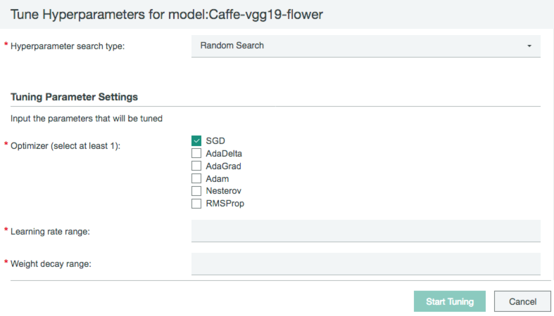
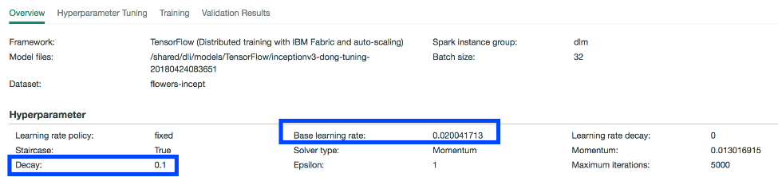
Hyperparameter search & optimization
Find the best hyperparameters using cognitive algorithms running in parallel, refining the values as the search progresses
Supported Algorithms
  Random Search
  Bayesian
  TPE
  Hyperband
  More to come…
Notes:
One of the first steps in developing a new AI model is to define the characterization of the training cycle. The variables which describe these elements of the model configuration are called hyperparameters.
For the same model, hyperparameters may be varied based on the training data set to achieve the optimal training result.
Hyperparameter optimization in PowerAI utilizes four major algorithms to automatically optimize hyperparameters, including: Random Search, Tree-structured Parzen Estimator Approach (TPE), Hyperband and Bayesian Optimization based on Gaussian Process, prior to the commencement of the training process.
PowerAI Enterprise automates this process by sampling from the training data set and instantiating multiple small training jobs across cluster resources (sometimes tens, sometimes thousands of jobs depending on the complexity of the model) and then selects the most promising combinations of hyperparameters to return to the data scientist. To ensure the best possible outcomes, the hyperparameter selection process uses the four aforementioned separate search algorithms to accurately select and then reflect the best combination of variables.
Afterwards, data scientists can kick off training with the optimal values of hyperparameter found in during this automated tuning.
Data scientists also have the option to select the hyperparameter search type (one out of four) along with a defined range of value for each hyperparameter to test out during the tuning phase. This gives expert data scientists the starting points to tell PowerAI to then explore from based on their own expertise.

Slide 22

Deeper dive on inferencing
Notes:
After a model is created, that model is used to predict an outcome based on new input data that was not seen during the training run. This prediction is referred to as an inference (we are inferring a result based on the model and the input).
Although model creation is a very complex and time consuming task, inferencing is another area where enterprise customers often struggle because a model may be built several times but the inferencing may be called several thousand times per minute and therefore the stress on the inferencing engine can be great.
This next section will discuss the inferencing options available as part of the PowerAI portfolio and how you can leverage the enterprise scalability IBM PowerAI offers.

Slide 23
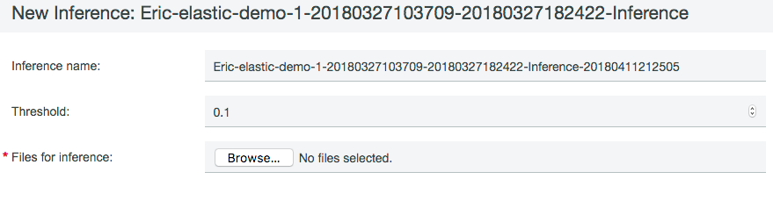
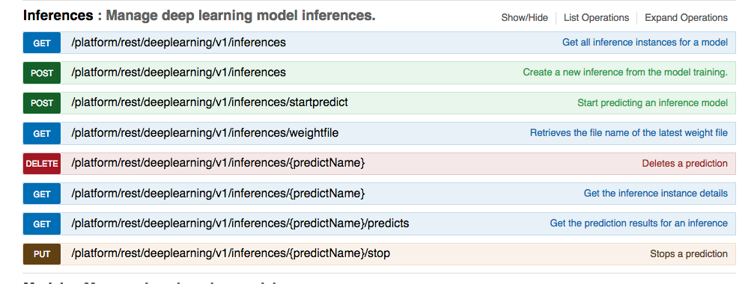
Inference using REST API
Single Inference is available via REST API in IBM PowerAI Enterprise
Notes:
When deploying models on the same server as used for training, PowerAI Enterprise (and also PowerAI Vision) provides a REST API interface to use for inferencing. This is an extremely popular method for web based applications that need to call a model to provide an inference. You simply make a REST API call with your input data and the PowerAI Enterprise inference engine will post back the reply with the results of the model prediction on that input data.

Slide 24



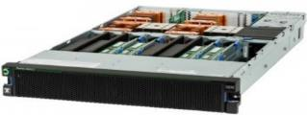

Choose your inference architecture for visual models
Cloud or Edge
Data Center: Train model & Compile to Edge
IBM PowerAI Inference Engine
model parser
Embedded FPGA
Trained model
Map to Different Platforms
NN structure
model analyzer
Embedded GPU
Estimate resources & performance
Backend specific optimization
CPU + GPU
Neural network processor
CPUs, GPUs
Notes:
Once a model is trained, you can begin to extract value from it. With PowerAI Vision (and soon with PowerAI Enterprise), IBM provides a choice of inference deployment options: inference as a service on the same cluster you were using for training, as well as deploying the inferencing on different architectures (Power or x86) with the PowerAI Inference Engine (PIE).
PIE gives the ability to train on a cluster of GPUs, and then deploy on an accelerator architecture which best matches your power, speed, and throughput requirements. This unique function automates the process of parsing a trained model, analyzing the requirements and estimated performance capabilities by architecture, and then writing the output to either an optimized GPU model, an embedded FPGA, or other types of existing or future inference architectures.
The outcome is a simplified deployment to harvest value from your trained neural model when, where, and how it best fits your organizational needs.

Slide 25






IBM PowerAI Enterprise
Faster Time
to Results & Accuracy
Increased Resource Utilization
Simplified Management
Enterprise Solution
Notes:
Now that we have covered the performance and scalability aspects of PowerAI, let’s turn our focus to the simplified management aspects of PowerAI Enterprise. As previously mentioned, clients on their AI journey constantly struggle with management tasks for data preparation, multi-tenancy and sharing resources during model training, model training monitoring, visualization, and more.
In this section we will discuss the PowerAI Enterprise capabilities that simplify these management tasks.

Slide 26
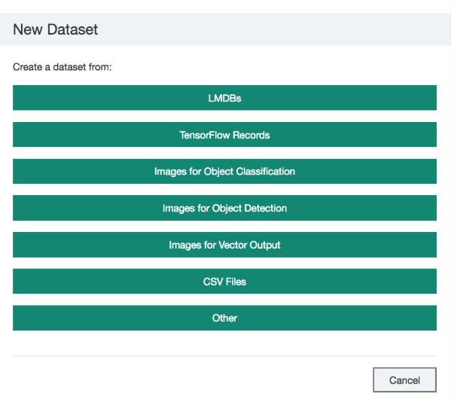
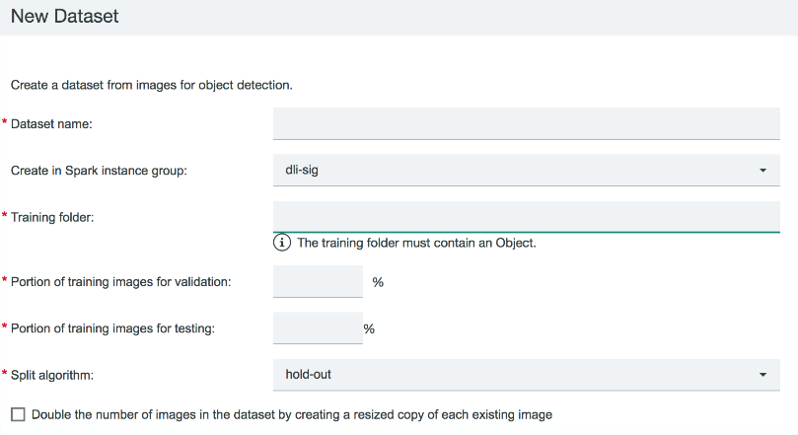
Data preparation for deep learning
Import from different formats
Transform, split and shuffle
Notes:
All machine learning and deep learning models train on large amounts of data. Fortunately (and unfortunately!), organizations are swimming in data sitting in structured and unstructured forms, and beyond the data they have under their control, organizations also have access to data for free or for a fee in a variety of sources.
Unfortunately (and this is a major impediment), very little of this data is in the place or the form which is necessary to train a new AI model. Many clients solve this problem using manual methods: SQL coding for relational database data and lots of Python scripting, often run inside of Spark clusters for speed of execution. Much of the code is “one-off” type code to transform very specific data sets while new data sets need their own code to parse and format.
For this first important step in the model development process, PowerAI Enterprise integrates a structured, template based approach to building and transforming data sets. It starts with common output formats (detailed on the left side of the slide), so that a user can select what type of data they need to use with the specific machine learning or deep learning framework they are going to run. This allows users to define the input format or structure of the raw data and some of the key characteristics for what will be needed in the transform step.
PowerAI Enterpriese provides the following dataset formats for preparation:
LMDB -> default data format for Caffe training
TensorFlow Records - default data format for TF training
Images for Object classification - converts raw image file into either LMDB or TensorflowRecord
Images for Object Detection - converts raw image into TensorflowRecord
Images for Vector Output - data type for transform learning. Transform learning enables training only at the last neural network layer. For example, a customer may have an Inceptionv3 file but they don’t want to re-train the whole file (convolution layers) and they only want to train the classification layer (last layer). They can upload the image data and we will transform it into Vector output which is the required format to train at the classification layer in a neural network.
CSV - this format is used by a large number of machine learning algorithms
Other – data scienists uploading their own data format that would be loaded by their model themselves, PowerAI Enterprise will not do any data transformation.
Once transformed, the dataset can be split into Train, Test and Validate output files for use in the building and testing of the model.

Slide 27
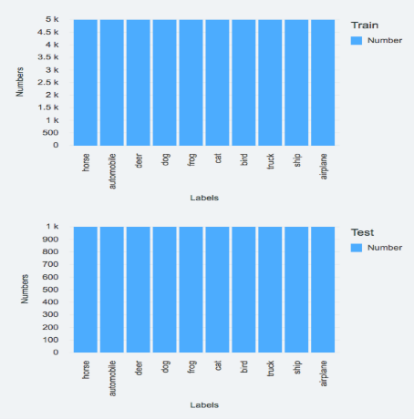
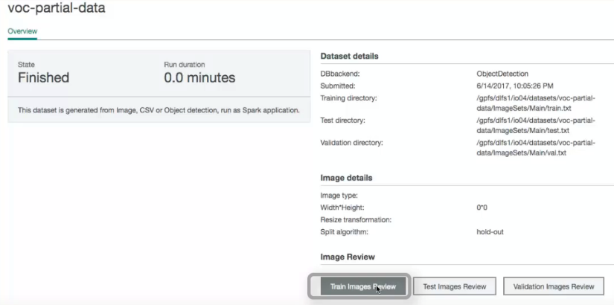
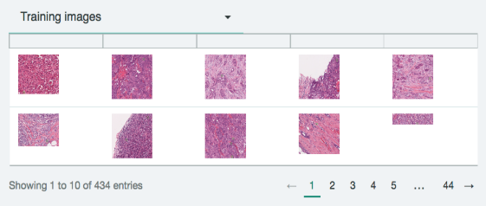
Data preparation for deep learning
Preview Results
Notes:
As part of the data preparation task, PowerAI Enterprise can give the data scientist a “check” on the validity of the training and testing data set as they are run through the transformation process. Clicking on Preview Results allows a data scientist to visualize the images and results of transformations.
Because these tools for preparing data in PowerAI have awareness of both the size and complexity of the data, as well as the scale of resources available, PowerAI Enterprise is able to intelligently manage the execution of training jobs: optimizing for either low cost (run across the fewest number of nodes/cores) or optimizing for the fastest execution of the transform job (run across more nodes/cores). This function, which is built upon machine intelligence, is core to the data preparation function in PowerAI Enterprise
Integrated in to the data preparation step is a quality check function which allows a data engineer or data scientist to check the clarity of signal in the data, running a simplified model and sample training run from within the data import tool. Although not as sophisticated as a fully developed model, this “gut-check” allows a data scientist to discover early on in the process whether there are obvious issues or deficiencies in the training data set before investing significant time in the model development phase.

Slide 28
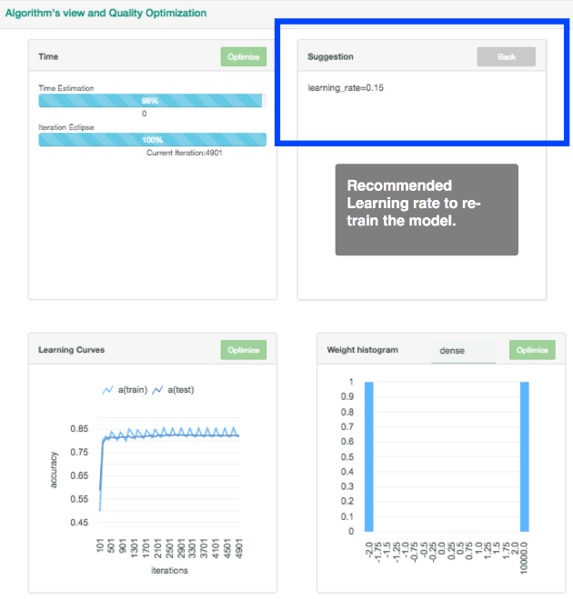
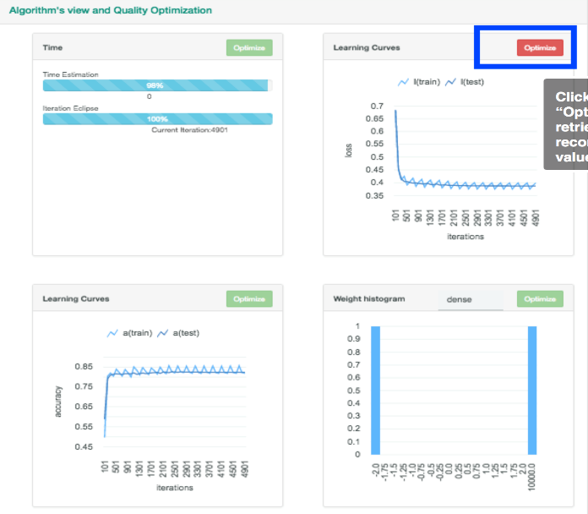

Deep Learning Impact Insight - Training visualization monitor, analyze, optimize
Notes:
One of the most challenging tasks for a data scientist is to find just the right hyperparameters to use when training a model. As previously mentioned, PowerAI Enterprise offers hyperparameter optimization which provides a great starting point for data scientists to be able to get up and running quickly with near optimal training runs. However, because those run off of a sample of the data, there are still opportunities for improvement. That’s where the Deep Learning Impact (DLI) component of PowerAI Enterprise comes into play. DLI provides training visualization, monitoring, and optimization capabilities.
While the model is training, the data scientist can visualize key metrics such as the loss rate, accuracy and other metrics important in the training runs. For example, if the data scientist is looking at the loss rate and is seeing that as epochs continue to execute, that there is no further gain in the accuracy and no further drop in loss rate, they can decide to terminate the model execution as they know further iterations will not create a more accurate model.
Another key capability is the ability to optimize hyperparameters based on the real training runs that are executed. For example, in the above slide you can see that clicking on the Optimize button brings up another dialog that tells the user that the learning_rate (an important hyperparameter) should be set to 0.15 and the model should be retrained with that new value. This can simplify the convergence towards an optimal set of hyperparameters based on the complete training runs across all the training data.

Slide 29
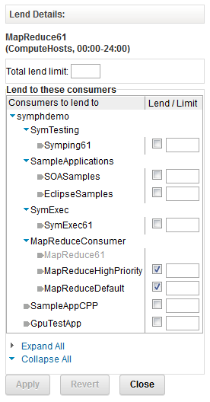
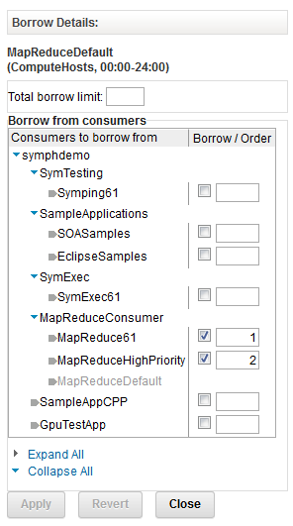
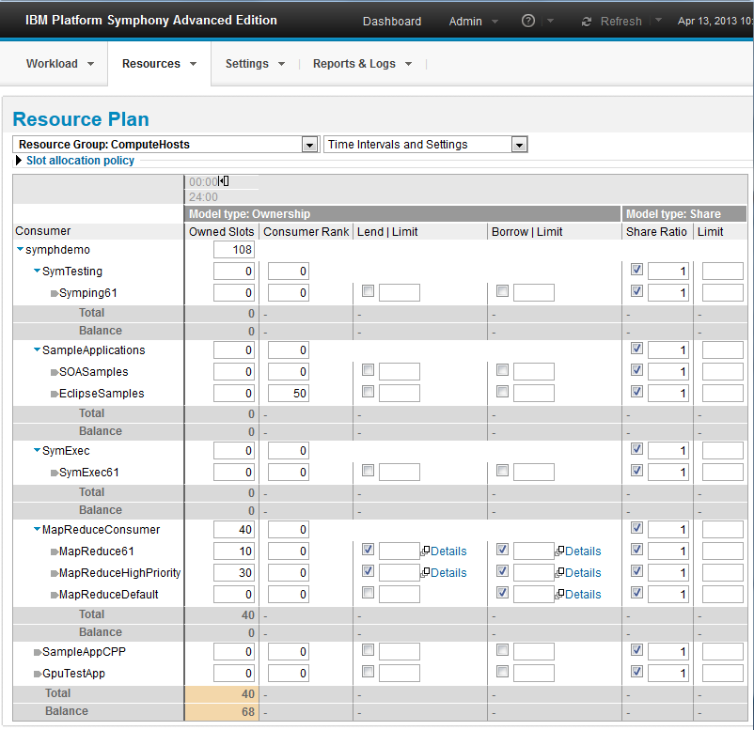
Dynamic, policy based resource plan
Sharing while preserving ownership
Change the plan ‘on the fly’ while workload is running
Allocations flex during runtime to reflect business priorities – Dynamic Allocation
Enables application level SLA management
Notes:
One of the most important features of PowerAI Enterprise is the dynamic, policy based resource plan capabilities. This is something almost all clients doing large training runs in a multi-tenant environment struggle with.
Here is the issue: when you begin a TensorFlow job for example, you specify how many nodes the job will run on and how many GPUs to use in the training run. Once the training run starts, there is no way (via TensorFlow or any other open source framework for that matter) to alter that allocation and if the job runs for hours or several days, everyone else is excluded from using those resources until that job finishes or until someone cancels that job. The results are frustrated data scientists who cannot get access to resources they need to do their job (and/or an excessive amounts of manual communication and coordination amongst a set of individuals that need to figure out who can have the servers resources and for how long).
PowerAI Enterprise solves this problem. First, PowerAI Enterprise allows clients to create resource plans to determine who will get what share of the various resources. This allows an administrator to divide the available resources in a fair way amongst all of the consumers that may come into the system. But even more important is that this resource plan is dynamic; if there is a critical job that comes onto the system that needs additional resources, the administrator can change plans on the fly to allocate more resources to that critical job. Most importantly, it allows for jobs to give up GPU resources when there is contention for such a resource in order to “play nicely” with other jobs that need that resource. And when the resources are not contended for, the jobs that are executing on the box can consume more GPUs if they are available and therefore finish their work more quickly.
All of this allows for data scientists to partake in the same SLA management capabilities that IBM has provided to other enterprise clients in other domains for decades.

Slide 30
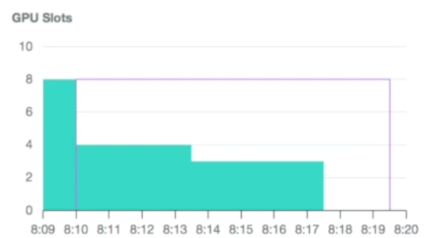
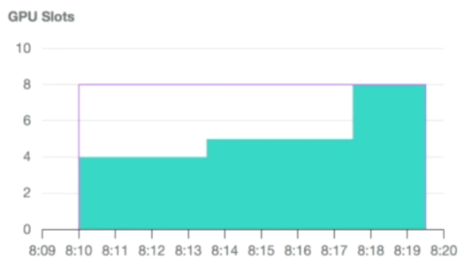
Elastic Distributed Training – Example
Job #1
Environment
  Two (2) POWER9 servers with four (4) GPUs
  Eight (8) GPUs total
  Policies
    Fairshare
    Preemption
    Priority
Timeline
  T0 - Job 1 starts, uses all available GPUs
  T1 - Job 2 starts, Job 1 gives up four GPUs
  T2 - Job 2 priority change, Job 1 gives up GPUs
  T3 - Job 1 finishes, Job 2 uses all GPUs
Job #2
T0
T1
T2
T3
Notes:
When a data scientist submits a training job they can specify the maximum number of GPUs that the job can use. While executing, PowerAI allocates as many GPUs as available to the job, up to the maximum number specified, or removes GPUs as other policies may dictate. Regardless of the number of GPUs allocated or removed from the job, the job will continue to execute until it completes (it will not fail due to starvation of GPU resources).
With Elastic Distributed Training (EDT), users can utilize quality of service policies to define how the system behaves during GPU allocation and job execution. IBM PowerAI Enterprise includes the following policies:
Fairshare – Sets the policy scheduler to share all available resources among all submitted jobs as equally as possible.
Preemption – Enables the running task to complete the current iteration and then assigns resource to another job (note that iteration is a subtask of a training run which may execute 1000s of iterations to complete).
Priority – Allows the higher priority job to use more resources than the other jobs.
In the example illustrated on this slide, Job 1 is submitted at 8:09 and runs on 8 GPUs since it is the only job executing. Job 2 is then submitted at 8:10. At this point the Fairshare policy ensures the GPUs are shared between all jobs, so Job 1 tasks are pre-empted and allowed to continue executing but with fewer GPUs. This allows 4 GPUs to be allocated to Job 2. Just past 8:13 the priority of Job 2 is increased. This means that Job 1 gets pre-empted again and will give up an additional GPU which is then allocated to Job 2. At this point, 3 GPUs are allocated to Job 1 and 5 are allocated to Job 2. Just past 8:17 Job 1 runs to completion freeing up 3 GPUs, which then get allocated to Job 2, which enjoys faster training time to throughout the rest of its execution as it is running on 8 GPUs.

Slide 31
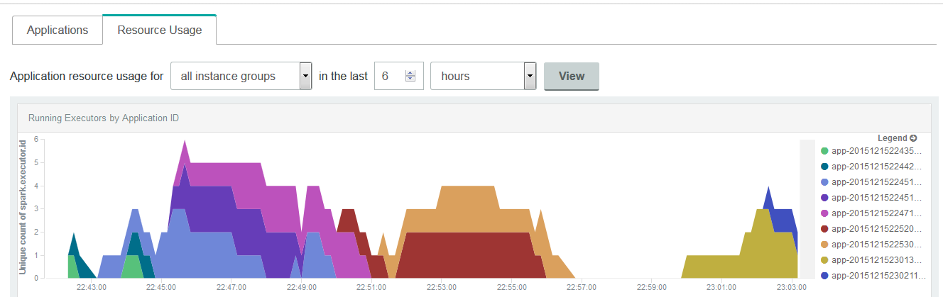
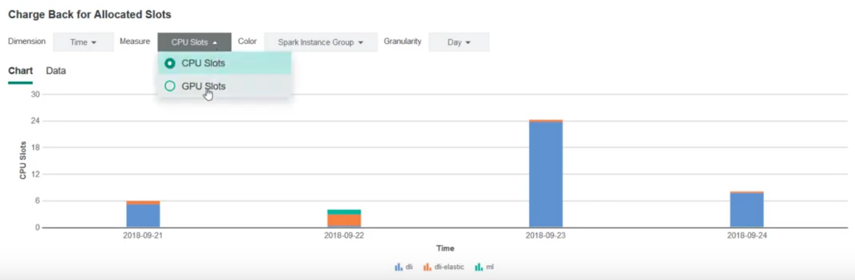
Monitor and chargeback accounting
PowerAI Enterprise includes detailed monitoring
PowerAI resource
chargeback reporting
Notes:
Another management feature that is part of PowerAI Enterprise (as part of the integration with Spectrum Conductor Deep Learning Impact) is the detailed resource monitoring as well as chargeback accounting reports based on various resources consumed by the various training models being executed.

Slide 32




IBM PowerAI Enterprise
Faster Time
to Results & Accuracy
Increased Resource Utilization
Simplified Management
Enterprise Solution
Notes:
Finally, it wouldn’t be an IBM product if it wasn’t focused on the needs of enterprise clients. Our customers expect security, availability, reliability, scalability, and more from us and they have relied on our solution integrity in this space for decades.

Slide 33
Production proven with enterprise security
Authentication
Impersonation
Production proven support for Kerberos, Siteminder, AD/LDAP and OS authentication
Allow different lines of
business to define production execution user
Authorization
Encryption
Fine grained access control
Role based control (RBAC)
Spark binary life cycle, notebook updates, deployments, resource
plan, reporting, monitoring,
log retrieval, and execution
SSL & daemon authentication
Storage encryption with IBM Spectrum Scale
Notes:
One of core technologies included in PowerAI Enterprise (Spectrum Conductor) has been implemented at large scale within many financial services companies (9 out of the top 10 investment banks as an example). These organizations drive very high standards for security, which PowerAI Enterprise now inherits. For example, most investment banks initiate quarterly penetration testing, both automated and manual. These tests focus on third party library vulnerabilities, man in the middle risks, clear text message passing, access controls, unauthorized access to data, and many other potential risks. As a result, IBM has spent a tremendous amount of time with each release, to ensure the security requirements from these demanding financial services customers can be met.
There are four critical areas of focus:
Authentication – This ensures the user logging into the system can be authenticated (ensuring they are who they say they are) and passes the correct credentials to the system in a secure manner. Kerberos authentication is the most common method, and is fully supported by PowerAI Enterprise. In addition, the authentication logic can be a plug-in, as is the case with Siteminder. Lastly, this authentication logic needs to tie back to an organizations user management system. In this context, PowerAI Enterprise supports both Active Directory (AD) and LDAP (Lightweight Directory Access Protocol) as the source for users and groups, who will have access to the PowerAI Enterprise system. This is a benefit as the client is not responsible for maintaining a separate and redundant authentication infrastructure just for PowerAI Enterprise.
Authorization – Once a user is authenticated, the next focus is to control the access points tied to authorization. PowerAI Enterprise supports full role based access control. This is a highly configurable system to manage access with fine grain control. The systems allows the cluster administrator to set up roles, associated attributes and privileges to each role, and assign users and/or groups to roles. Access control is managed within all aspects of the system, including the GUI, command line, and API integrations.
Impersonation – This is the ability to select operating system level users for execution of services (non-root), and then provide authorization to application users to access these services. This is critical when supporting a multi-tenant environment. Each application can have their own execution user, which is also tied to the authorization of data (for example, file system access control lists - ACLs). This ensures one line of business or application does not get unauthorized access to another applications data, when they are running on the same server. Without this capability, multi-tenancy would not be possible, as it would not be secure. On the user side, this allows a user or group of users to operate with elevated privileges within a specific instance or application inside the cluster, without giving them overall elevated authorization on the cluster as a whole. Essentially, allows sharing of resources while maintaining application run time isolation.
Encryption – All messaging between services and client connections, are encrypted via SSL/TLS. This eliminates clear text messaging and greatly reduces security risks. In addition, data at rest can also be encrypted, assuming the file system / storage devices supports encryption. IBM Spectrum Scale is an example where the data at rest can be encrypted, providing a complete solution from IBM.

Slide 34


Top reasons to choose PowerAI
Simplicity: Integrated
Platform that Just Works
Ease of Use,
Unique Capabilities
Faster Model Training Time
Open AI Platform w/ Ecosystem Partners
Power9
CPU
IBM SW
ISV SW
Solution SIs
PowerAI
GPU
Curate, test, and support fast moving Open Source
Provide enterprise distributions
Easy to deploy enterprise AI platform
Large data & model support with NVLink 2.0
Acceleration of analytics, ML and DL
AutoDL: PowerAI Vision AutoML: H2O
Elastic training: scale GPUs as required
Faster training times from single server
with scalability to 100s of servers
Leads to faster insights and better economics
Platform that Partners can build on
Software Partners: H2O, IBM, Anaconda
SIs, Solution Vendors
& Accelerator Partners
Notes:
Let’s summarize with the 4 areas that are the most common reasons why clients choose IBM PowerAI:
Simplicity – open-source is chaotic; IBM hardens & supports it which allows clients to get started much faster and with higher levels of reliability, providing a true enterprise AI platform.
Unique capabilities – from Large Model Support, to auto learning features like our PowerAI Vision, clients can leverage these unique capabilities to deliver faster training times and more accurate models. Clients with larger data science teams need strong multi-tenancy features and PowerAI’s elastic training is able to allocate GPUs dynamically, increasing & decreasing as required.
Faster AI model training – scaling from a single node to hundreds of servers means clients don’t have to worry about how successful they are (we are there for them as they grow). This results in faster insights and better economies of scale for our clients.
The Open Platform IBM enables software vendors and solution integrators to leverage their unique skills and combine them with our unique technologies to deliver even more robust solutions to our joint clients.

Slide 35
PowerAI
Offering packages
—
Notes:
Finally, let’s look at the PowerAI portfolio side by side to see when you would use the “Base” offering, PowerAI Enterprise, PowerAI Vision, H2O Driverless AI, and/or Watson Studio Local (formerly known as Data Science Experience Local or DSX Local) for your machine learning and deep learning tasks.

Slide 36
Comparing AI offerings on Power Systems
 |  | Deep Learning |  |  | ML and DL | Machine Learning
 |  | Power AI Base | Power AI Enterprise | AI Vision | Watson Studio Local | H2O Driverless AI
Offering | Description | Deep Learning | Deep Learning for the Enterprise | Deep Learning with Video tools | Notebook oriented development environment for ML and DL | Automated Machine learning
 | Pricing Model | Free download | Commercial | Commercial | Commercial | Commercial
 | Support | Available from IBM | IBM L 1-3 Included | IBM L1-3 Included | Available from IBM | H2O L 1-3
Applications | Text & Numeric | Yes | Yes | No | Yes | Yes
 | Images | Yes | Yes | Yes | Yes | No
 | Video | - | Optional add-on | Yes |  | No
 | Primary Persona | Data Scientist | Data Scientist | Line of Business | Data Scientist | Data Scientist
 | Second persona | IT | IT | IT | IT | Line of Business
 | User Skill Level | High | Medium to high | Low | Medium to high | Low to Medium
 | Strengths | Rapid deployment, high performance, scale | enterprise grade, High performance, rapid Deployment | Rapid deployment, simple GUI high performance | Notebook based development environment, strong collaboration, model management | Simplified deployment, intuitive user interface, automatic pipelines, "explainability" for models, end to end automation
Platform | Distributed DL (DDL) | 1-4 nodes | 1-thousands of nodes | Coming | Coming | -
 | Large Model Support | Yes | Yes | Coming | Coming | -
 | Server(s) | S822LC or AC922 | S822LC or AC922 | S822LC or AC922 | S822LC or AC922, LC922 | S822LC, AC922, LC921/922
IBM Products
 | Spectrum MPI (DDL) | Limited to 4 nodes | Included | ? |  | Optional add-on
 | Spectrum Conductor DLI | Optional add-on | Included | ? | Optional Add On | Optional add-on
 | IBM DSX Local | Optional add-on | Optional add-on | No |  | Optional add-on
Cloud | IBM Cloud Public | Yes | No | Trial only | Watson Studio | ?
 | IBM Cloud Private | Yes | Coming | Yes | Yes | Coming
Notes:
This chart is included for your reference to help compare the various offerings available as part of the PowerAI portfolio. We won’t go through each of the rows and columns in detail but they cover aspects of the offering (free vs. commercial), what applications are best for each offering, what type of clustering is available and what types of management products are available or included within the offering.

Slide 37
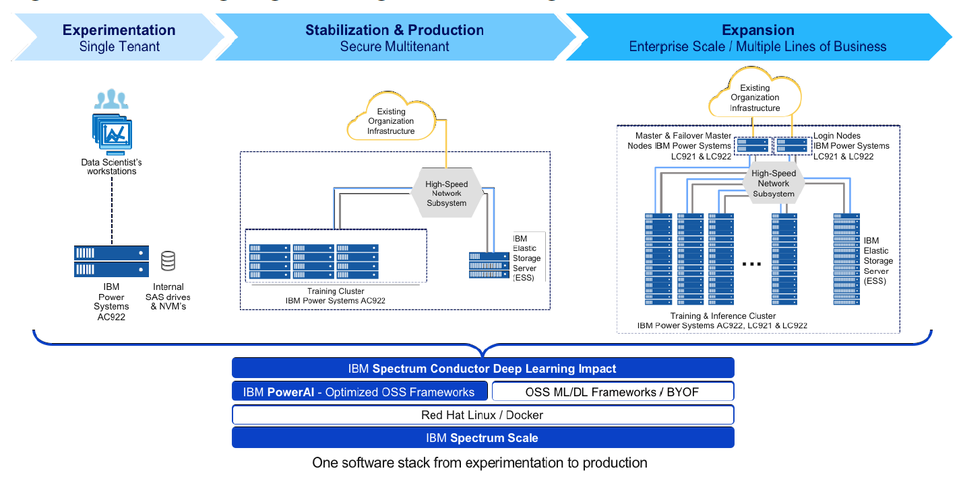
IBM Systems AI Infrastructure Reference Architecture
IBM PowerAI Enterprise software platform
IBM Power Systems servers
IBM Spectrum Scale on all-flash Elastic Storage Server
http://bit.ly/PowerAI_Ref_Arch
Notes:
Make sure you leverage the IBM Systems AI Infrastructure Reference Architecture. It includes everything from Proof of Concept (POC) and experimentation configurations to production configurations up to and including enterprise scale architecture. It includes the full configuration including the bill of materials needed to order each of the reference architectures.
You can find the reference architecture at http://bit.ly/PowerAI_Ref_Arch

Slide 38
PowerAI family
AI for
Data Scientists and
non-Data Scientists
PowerAI Vision
Auto-DL for Images & Video
H2O Driverless AI
Auto-ML for Text & Numeric Data, NLP
Label
Train
Deploy
Import
Experiment
Deploy
PowerAI: Open Source ML Frameworks
Deep Learning Impact (DLI) Module
Data & Model Management, ETL, Visualize, Advise
PowerAI
Large Model Support (LMS)
Distributed Deep Learning (up to 4 nodes)
Distributed Deep Learning (DDL – 1000s of nodes)
Auto Hyper-parameter Tuning
PowerAI
Enterprise
IBM Spectrum Conductor with Spark
Cluster Virtualization,
Dynamic Resource Orchestration,
Multiple Frameworks, Distributed Execution Engine
  Accelerated Infrastructure
  Accelerated Servers
  Storage
Notes:
In summary, with PowerAI, IBM is taking the most popular open source machine learning and deep learning frameworks like TensorFlow, PyTorch and Caffe, among others, and have built a supported distribution out of it along with enterprise level functions (management, availability, security, and more) which provide an enterprise class ML and DL platform.
Think of it like RedHat and how it packages Linux. You don’t go to linux.org to get Linux, you go to RedHat or SUSE or Ubuntu. It’s in the same way that IBM has packaged these machine learning and deep learning frameworks. Instead of going to all these various open source websites and building this software stack yourself, IBM has done it for you. IBM curates it, tests it and constantly updates it based on new releases. But then on top of that, IBM has added several tools to make it easier to use this open source software, and of course we give you much higher performance for training AI models.
PowerAI Enterprise includes enterprise support and additional capabilities above what is included in the base offering:
Integrated & Supported Platform
Validated & Co-optimized Software & Hardware
Enterprise L1-L3 Support
Integration with data stores, cloud, cluster management
Integration with key ML platforms (Watson Studio Local (formerly Data Science Experience Local), Anaconda, H2O)
Integration with key inference platforms
Higher Productivity for Data Scientists
Performance: scalability (reduction in training times)
Capability: large models (larger more complex models for higher accuracy)
Ease of Use: auto-hyper-parameter tuning
Enable Non-Data Scientists to use AI
Rapid prototyping & labeling for SMEs
Auto-ML (with PowerAI Vision)
Auto-DL (with H2O Driverless AI)

