Slide 1
PowerAI Snap ML Understanding the Details —
Chris Eaton (ceaton@ca.ibm.com)
Scott Soutter (soutter@us.ibm.com)
Notes:
This lesson focuses on Snap ML, which is technology available as part of the PowerAI offering. This short lesson will describe what many clients are doing in the machine learning space, the challenges they are facing with accelerating their machine learning, and how Snap ML solves those challenges. Some real world proof points will also be discussed, showing how clients save time and significantly reduce their machine learning training times (some as much as 20x to 40x).

Slide 2
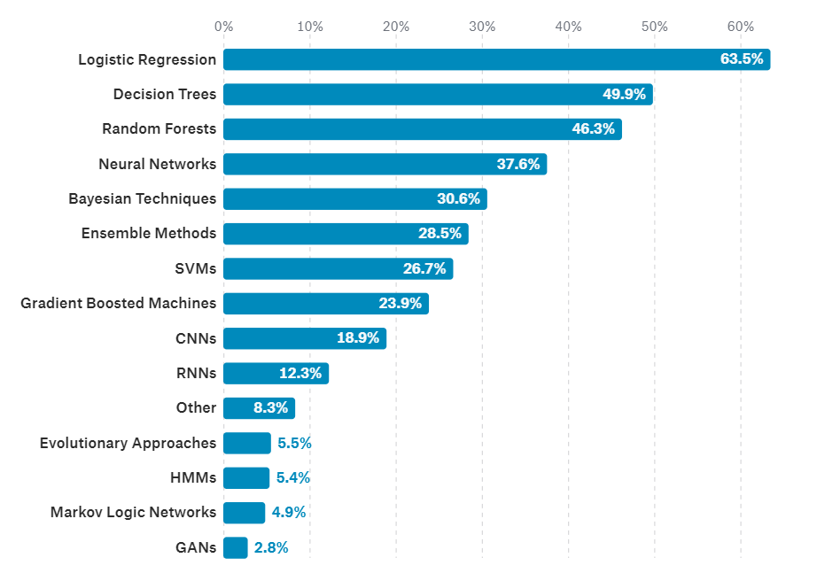
What data science methods are used at work?
Deep Learning is important and growing rapidly, but a Kaggle survey shows data scientists still rely primarily on machine learning algorithms
Notes:
If you read through the lesson on “The Language of AI” https://ibm.box.com/s/prll68830raryqeoawg00ooaefg2ibfz, you will know that there are differences between machine learning and deep learning. Although deep learning is getting a lot of attention in the AI space of late (and for good reason; it is growing exponentially in popularity and in capability), machine learning algorithms still make up a large portion of the AI space, and are used more often by data scientists in general.
A survey conducted by Kaggle (an online community of data scientists and machine learners) in 2017 found that machine learning algorithms are still among the most popular data science methods (https://www.kaggle.com/surveys/2017). In the above graph you can see that 63.5% of data scientists that responded to the survey use logistic regressions regularly while 49.9% and 46.3% of data scientists use decision trees and random forests respectively on a regular basis. The first appearance of a any deep learning algorithm is after the top 3 machine learning algorithms. The machine learning algorithms at the top of this survey are widely used but the problem has been (up until now) that they don’t leverage clusters of servers with GPU acceleration and rely heavily on single server processing and in many cases CPU only processing.
Logistic regression, for example, is used when the value you want to predict is binary (yes or no, 1 or 0, etc.). For example, a bank may want to predict if a loan application should be “accepted” or “denied”, or a retailer may want to know if a customized ad to a prospective client will “accept” the offer or “pass”. Limiting these critical predictive models to a single server or clusters of servers using only CPUs can dramatically impact a client’s ability to leverage insights to make better business decisions.

Slide 3
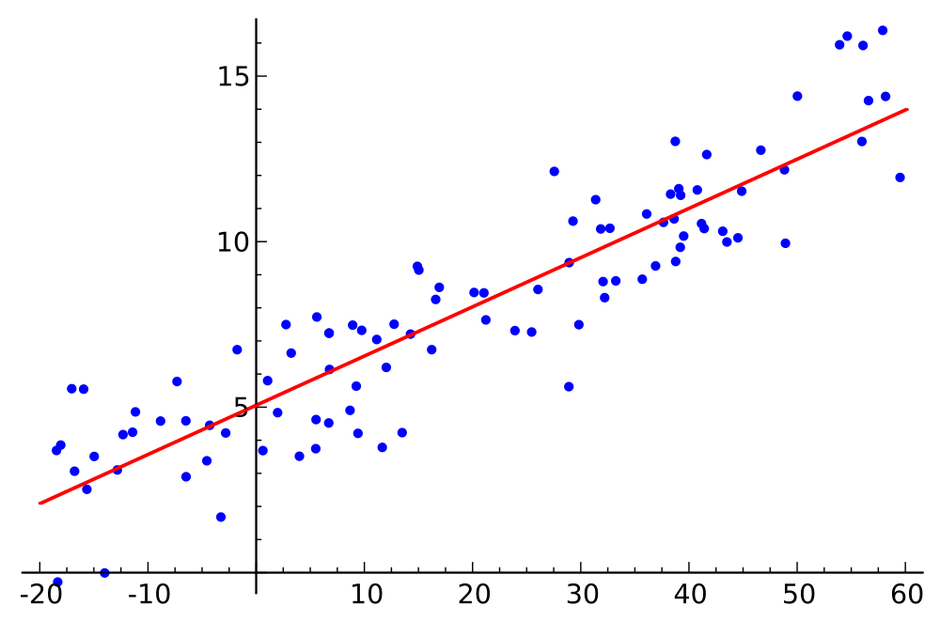
Enterprises rely on linear models for analytics
Regulated industries require explainable/interpretable predictions
Models are powered largely by text and structured data
Well understood tools; clients have deeper skill using Python, Spark, or R
Few of these linear models are cluster GPU accelerated, limiting both scale and speed…
Snap ML changes this to accelerate machine learning
Notes:
Why is it that so many enterprises rely on linear models and machine learning for analytics? There are a number of reasons but let’s focus on just a few here:
First, machine learning models (and linear models in particular) are much simpler to explain and/or interpret the predicted value. For example, in the data shown above, the predicted linear regression model is simply a formula that draws the red line above. If given a new x value the model will predict the y value by simply plugging the x value into the linear equation that is represented by the red line in the graph. It is very easy to explain how the prediction is derived. This is also true for several other machine learning algorithms. In many regulated industries, it is important (and in fact required) to be able to explain why a decision was made. For example, if someone applies for a loan from a financial institution and they are denied, many countries require the bank to be able to explain why the loan was denied. If the model is not easily interpreted, it would be a challenge (or impossible) for the bank to comply with that regulation to inform a client as to why they were denied. Linear models help enterprise clients explain the results of their model predictions.
Secondly, a large amount of data used by enterprise clients for machine learning is text based or structured data (relational tables for example). This is the area where machine learning and linear models do very well. Finding correlations between column values in a table and predicting the outcomes based on those values is the strength of machine learning in this space. Enterprises rely on their history of relational data to find insights that can then be applied to acquiring new clients and growing their existing clients.
Finally, building machine learning models with these algorithms is much simpler than building deep learning neural networks. Many clients have developers and data analysts that are already skilled in Python, Spark, or R languages that can more readily build and deploy these types of models.
The problem is that few of these linear models are cluster accelerated with GPUs and can only work on either a single GPU server, or in a clustered environment, are can only use CPUs (no GPU acceleration in a cluster configuration). This lack of scalability inhibits a data scientist’s speed at delivering and iterating over new models to improve their accuracy.
That is until now! Snap ML changes this space with the ability to leverage the benefits of PowerAI (particularly with distributed deep learning) to leverage clusters of GPU enabled servers to accelerate these models and improve training speeds and increase accuracy.

Slide 4
Snap ML Distributed GPU-Accelerated Machine Learning Library
Snap Machine Learning (ML) Library
APIs for Popular ML Frameworks
Logistic Regression
Linear Regression
Support Vector
Machines (SVM)
More Coming Soon
libGLM (C++ / CUDA Optimized Primitive Lib)
Distributed Hyper-Parameter Optimization
Distributed Training
Distributed Training GPU Acceleration Sparse Data Optimization
Notes:
IBM has developed an efficient, scalable machine learning library that enables very fast training of generalized linear models. Using this library, clients can remove training time as the bottleneck for machine learning workloads, paving the way to a range of new applications.
This library, called Snap Machine Learning (Snap ML), combines recent advances in machine learning systems and algorithms.
PowerAI delivers Snap ML capabilities, integrating native support for Spark based machine learning workloads in addition to logistic regression, linear regression and support vector machine algorithms.
The three main features that distinguish Snap ML are:
Distributed training: IBM has built the system as a data-parallel framework, enabling clients to scale out and train on massive datasets that exceed the memory capacity of a single machine, which is crucial for large-scale applications.
GPU acceleration: IBM has implemented specialized solvers designed to leverage the massively parallel architecture of GPUs while respecting the data locality in GPU memory to avoid large data transfer overheads. To make this approach scalable, IBM takes advantage of recent developments in heterogeneous learning in order to achieve GPU acceleration even if only a small fraction of the data can indeed be stored in the accelerator memory.
Sparse data structures: Many machine learning datasets are sparse. Therefore Snap ML employs new optimizations for the algorithms used in the system when applied to sparse data structures.
All of this results in significantly reduced training times and higher levels of accuracy.

Slide 5
46x faster than previous record set by Google Transparent to data scientists – plugs into existing machine learning codes Generalized linear models: linear regression, logistic regression, support vector machines FAST and EASY to cluster enable machine learning models for GPU and CPU
Snap ML: Training time goes from 1.1 hours to 90 seconds
Logistic Regression in TensorFlow(CPU-only) vs Snap ML (with GPUs)
46x Faster
89 x86 Servers
(CPU-only)
4 POWER9 Servers
With GPUs
Notes:
Here is a great proof point for the value of Snap ML. In this benchmark, IBM ran a logistic regression classifier on a data set with four billion training examples which had a million features with the goal of identifying who is going to click on any given advertising (as an example, a retailer looking at what is the next best offer or next best action for a given customer). The example in this slide was a benchmark for digital ad placement.
Google ran this benchmark on a cluster of 89 Intel servers and it took them over an hour to train this machine learning algorithm. With Snap ML, IBM was able to train the model across four AC922s with GPUs and complete the training in just 92 seconds. That’s a 46x speed-up versus the best previous benchmark result from Google.
Not only is it extremely powerful; it’s also extremely simple! Just plug in the Snap ML library calls in your Python, TensorFlow, sckit-Learn, or Spark jobs and PowerAI takes care of the rest.
*************************************NOTE***********************************************
NVIDIA has recently announced RAPIDS which also targets linear models for GPU acceleration so you may be asked about this technology. This technology is planned to be available on Power in 1Q2019 and some of this capability will be added to Snap ML. The main message here is that RAPIDS is complementary to Snap ML; RAPIDS is all about accelerating machine learning for GPU. We take it a step further with Snap ML and make stuff work at cluster scale.
*****************************************************************************************
If you want to see some of the details behind this benchmark, including a deeper description of the data set, watch this video; https://youtu.be/cMrf2ooTG8A
Benchmark details:
Dataset: Criteo Terabyte Click Logs (http://labs.criteo.com/2013/12/download-terabyte-click-logs/) 4 billion training examples, 1 million features. Model: Logistic Regression: TensorFlow vs Snap ML. Test LogLoss: 0.1293 (Google using TensorFlow), 0.1292 (IBM using Snap ML). Platform: 89 CPU-only machines in Google using TensorFlow versus 4 AC922 servers (each 2 Power9 CPUs + 4 V100 GPUs) with Snap ML

Slide 6
Snap ML is available now as a no-charge download from IBM Runs exclusively on the accelerated IBM Power AC922 or S822LC servers Can accelerate and scale existing models, with little or no modification
Simple to get started
Financial Services Usage Examples:
Predict credit default 23x faster than scikit-learn
Speed up model training for credit card fraud detection: 32x faster than TensorFlow, 12.5x faster than scikit-learn
Predict stock volatility from 10-k textual reports 35x faster than Apache Spark
Notes:
How do you get started with Snap ML? Easy! It is included in the PowerAI base installation as of 1.5.4 (note, if you are using 1.5.3 or earlier versions then you will need to separately install the Snap ML package; see the Knowledge Center for details).
The Snap ML library offers three different packages:
snap-ml-local: snap-ml-local is used for machine learning on a single machine.
snap-ml-mpi: snap-ml-mpi is used for distributed training of machine learning models across a cluster of machines.
snap-ml-spark: Similar to snap-ml-mpi, the snap-ml-spark package offers distributed training of models across a cluster of machines. This package is a technology preview in 1.5.4
Shown on this slide are 3 additional examples from Financial Services that have experienced huge benefits by leveraging Snap ML.
The first example is a Kaggle credit card default model which ran 23x faster than just regular scikit-larn by leveraging the capabilities of Snap ML.
Dataset: credit card defaults: https://www.kaggle.com/mlg-ulb/creditcardfraud/data 285,000 samples each with 31 features Model: Logistic Regression Runtime: TensorFlow: 27.38s, scikit-learn: 9.13s, Snap ML: 0.73s
The second example is using the same data set but instead of credit card defaults the model looks for credit card fraud. In this case the model trained 32x faster than TensorFlow and 12.5x faster than scikit-learn.
Dataset: credit card fraud: https://www.kaggle.com/mlg-ulb/creditcardfraud/data 285,000 examples, 31 features Model: Logistic Regression Runtime: TensorFlow: 27.38s, scikit-learn: 9.13s, Snap ML: 0.73s
The final example is a stock price predictor looking at text reports to determine stock movement. In this example Snap ML performed 35x faster than Spark MLlib.
Dataset: 10K Corpus (stock volatility measurements), 43,503 examples, 150,360 features Cluster: IBM Data Science Experience, 2 Spark Executors, Apache Spark v2.1.0 Evaluation: MSE measured on 10,876 unseen examples Runtime: Spark Mllib: 42.6s, Snap ML: 1.2s

