Slide 1
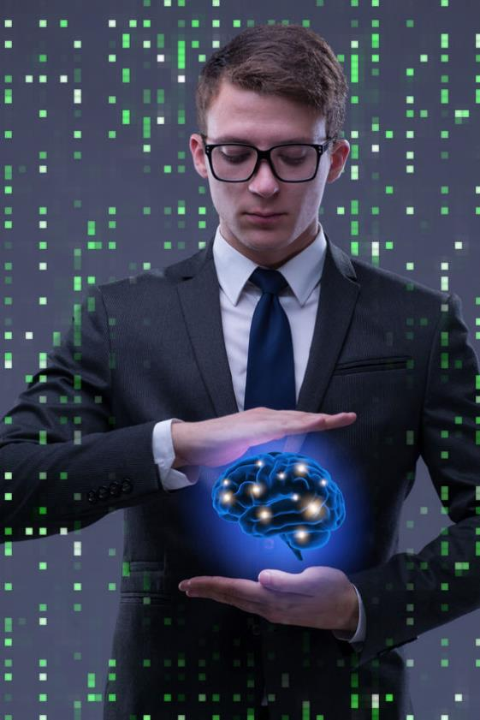
The Language of
Deep Learning
Andrew Laidlaw (andrew.laidlaw@uk.ibm.com)
Chris Eaton (ceaton@ca.ibm.com)
Notes:
This lesson will help you understand the language used in a discussion around deep learning. This is not a deep dive into deep learning technology but rather a “dictionary” of deep learning terms and jargon. Even if you are experienced in deep learning, machine learning and artificial intelligence, you may learn a new way to describe some of the terms you may use frequently with a novice user.
This session will not go into details on deep learning or machine learning but will give you an understanding of the terminology used when having an AI discussion with a client.

Slide 2
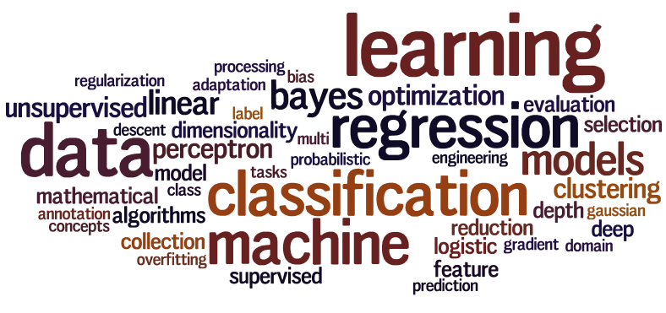
Session Objectives
Learn the vocabulary of deep learning
Ensure you know the terms used in the industry
Help you engage in conversations with data scientists
Not to teach you what Deep Learning is
Not an in depth technical study
Will not teach you any programming languages
Notes:
In this session we will discuss the vocabulary for deep learning and describe the terms you will commonly use in a discussion with a data scientist or a client. After going through this session (and reading the detailed speaker notes) you will understand the terms used in artificial intelligence (AI), machine learning (ML) and deep learning (DL); and you will also be able to have a more fluent conversation with a data scientist. We will also discuss the difference between machine learning and deep learning.
You will not become a deep learning expert, nor will you understand how to program or build deep learning models by reviewing this course. That will be part of other courses in AI, but this course will give you a good foundation to get started and allow you to understand what experts are talking about when they discuss AI, ML, and DL.

Slide 3
What is
Machine Learning and Deep Learning?

Slide 4
What is Machine Learning and Deep Learning used for?
Identifying patterns in data
Tools to help predict new values based on new data
Involves statistics – and lots of calculations
Notes:
You can go to Wikipedia to find the detailed definition of Machine Learning (https://en.wikipedia.org/wiki/Machine_learning) and Deep Learning (https://en.wikipedia.org/wiki/Deep_learning). Most definitions are quite complicated for a novice user and that’s because the true definition of these terms usually involves “how” the learning works and can get very complicated.
To simplify this, let’s discuss more about “what it is used for”. In general ML and DL algorithms are used to find patterns in data. That’s it in a nutshell. Finding patterns is only of minimal use in and of itself, but where pattern recognition really becomes valuable is using prior patterns to predict new values. For example, if you can find a pattern in home price data based on home sales in your area, you can build algorithms to predict current home prices. Or if you can find patterns in images, you can predict if an image is a picture of a dog or a cat. Or predict if a tumor is benign or malignant, based on the patterns of cell images you have seen in the past.
How this is all done under the covers and the details behind machine learning and deep learning won’t be discussed in detail in this presentation. We will only go as far as to introduce the concepts in order for you to understand the language of AI, ML and DL.

Slide 5
Data Types
Notes:
Before we get into the details behind the language of deep learning it’s important to have common vocabulary behind the data (where we are looking for the repeating patterns) that is used by the ML or DL programs. There are lots of types of data that can be used with ML and DL algorithms.

Slide 6
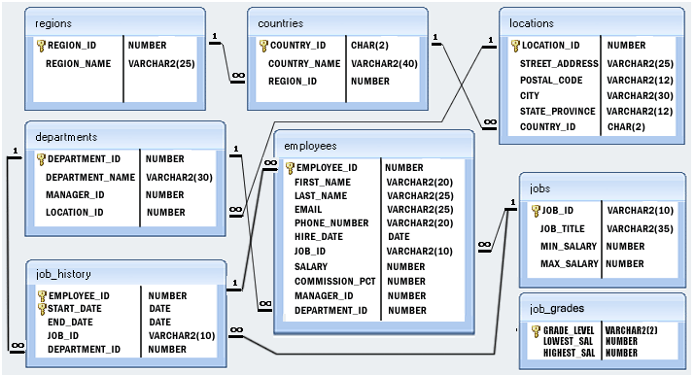
Structured Data
Data that has an enforced structure and values have defined data types
Relational databases contain mostly structured data
LIMIT_BAL | AGE | PAY_0 | BILL_AMT1 | BILL_AMT2 | BILL_AMT3 | PAY_AMT1 | PAY_AMT2 | PAY_AMT3
£20,000.00 | 24 | 2 | £3,913.00 | £3,102.00 | £689.00 | £0.00 | £689.00 | £0.00
£120,000.00 | 26 | -1 | £2,682.00 | £1,725.00 | £2,682.00 | £0.00 | £1,000.00 | £1,000.00
£90,000.00 | 34 | 0 | £29,239.00 | £14,027.00 | £13,559.00 | £1,518.00 | £1,500.00 | £1,000.00
£50,000.00 | 37 | 0 | £46,990.00 | £48,233.00 | £49,291.00 | £2,000.00 | £2,019.00 | £1,200.00
£50,000.00 | 57 | -1 | £8,617.00 | £5,670.00 | £35,835.00 | £2,000.00 | £36,681.00 | £10,000.00
£50,000.00 | 37 | 0 | £64,400.00 | £57,069.00 | £57,608.00 | £2,500.00 | £1,815.00 | £657.00
£500,000.00 | 29 | 0 | £367,965.00 | £412,023.00 | £445,007.00 | £55,000.00 | £40,000.00 | £38,000.00
£100,000.00 | 23 | 0 | £11,876.00 | £380.00 | £601.00 | £380.00 | £601.00 | £0.00
£140,000.00 | 28 | 0 | £11,285.00 | £14,096.00 | £12,108.00 | £3,329.00 | £0.00 | £432.00
£20,000.00 | 35 | -2 | £0.00 | £0.00 | £0.00 | £0.00 | £0.00 | £0.00
£200,000.00 | 34 | 0 | £11,073.00 | £9,787.00 | £5,535.00 | £2,306.00 | £12.00 | £50.00
£260,000.00 | 51 | -1 | £12,261.00 | £21,670.00 | £9,966.00 | £21,818.00 | £9,966.00 | £8,583.00
£630,000.00 | 41 | -1 | £12,137.00 | £6,500.00 | £6,500.00 | £1,000.00 | £6,500.00 | £6,500.00
£70,000.00 | 30 | 1 | £65,802.00 | £67,369.00 | £65,701.00 | £3,200.00 | £0.00 | £3,000.00
£250,000.00 | 29 | 0 | £70,887.00 | £67,060.00 | £63,561.00 | £3,000.00 | £3,000.00 | £3,000.00
£50,000.00 | 23 | 1 | £50,614.00 | £29,173.00 | £28,116.00 | £0.00 | £1,500.00 | £1,100.00
£20,000.00 | 24 | 0 | £15,376.00 | £18,010.00 | £17,428.00 | £3,200.00 | £0.00 | £1,500.00
£320,000.00 | 49 | 0 | £253,286.00 | £246,536.00 | £194,663.00 | £10,358.00 | £10,000.00 | £75,940.00
£360,000.00 | 49 | 1 | £0.00 | £0.00 | £0.00 | £0.00 | £0.00 | £0.00
£180,000.00 | 29 | 1 | £0.00 | £0.00 | £0.00 | £0.00 | £0.00 | £0.00
£130,000.00 | 39 | 0 | £38,358.00 | £27,688.00 | £24,489.00 | £3,000.00 | £1,537.00 | £1,000.00
£120,000.00 | 39 | -1 | £316.00 | £316.00 | £316.00 | £316.00 | £316.00 | £0.00
£70,000.00 | 26 | 2 | £41,087.00 | £42,445.00 | £45,020.00 | £2,007.00 | £3,582.00 | £0.00
£450,000.00 | 40 | -2 | £5,512.00 | £19,420.00 | £1,473.00 | £19,428.00 | £1,473.00 | £560.00
£90,000.00 | 23 | 0 | £4,744.00 | £7,070.00 | £0.00 | £5,757.00 | £0.00 | £5,398.00
£50,000.00 | 23 | 0 | £47,620.00 | £41,810.00 | £36,023.00 | £1,973.00 | £1,426.00 | £1,001.00
Notes:
The first category of data is “structured data”. By structured data we mean that the type of data itself has some kind of structure and the data is typically grouped into a form of structure. In the simplest case think of an Excel spreadsheet. In there, you have rows and columns. A column typically represents some attribute of your data using a well defined data type. For example, if you have a spreadsheet of accounts, one column might be the account number, another might be the account balance, another might represent a debit or a credit into that account, another might be a description of that transaction, etc. In DL and ML we call these attributes “features”.
For example, the bank balance column will contain a currency value, while the description column will likely contain a string of characters and a date column will contain only valid dates. These are known as “data types” and form the structure for a given column.
Each row in a structured dataset is well defined in that all the column values for a given row are all related. For example, one row might represent an order from a store (purchase of something) and contain the price, tax, description, date, time, etc of that purchase. The row is structured because there is a column for every value that is put into that row and each row has the same set of well defined columns.
Relational databases (like Db2, Oracle, SQL Server, etc) are the primary source of structured data within a company and often used as the source for ML and DL. In the case of structured data, we are usually trying to find patterns within the rows in order to predict a given column within the data. For example, if I have a table of home sales, some of the columns might be home type, location, number of bedrooms, number of bathrooms, room sizes, etc. (the features) and one of the columns will be sold price. In a machine learning algorithm, you might ingest all of that structured data and have the model learn how to predict the sold price column from the other data in that table. Then you can build an application to take in the various values that define the home (any of the columns) and predict the sold price column value.

Slide 7
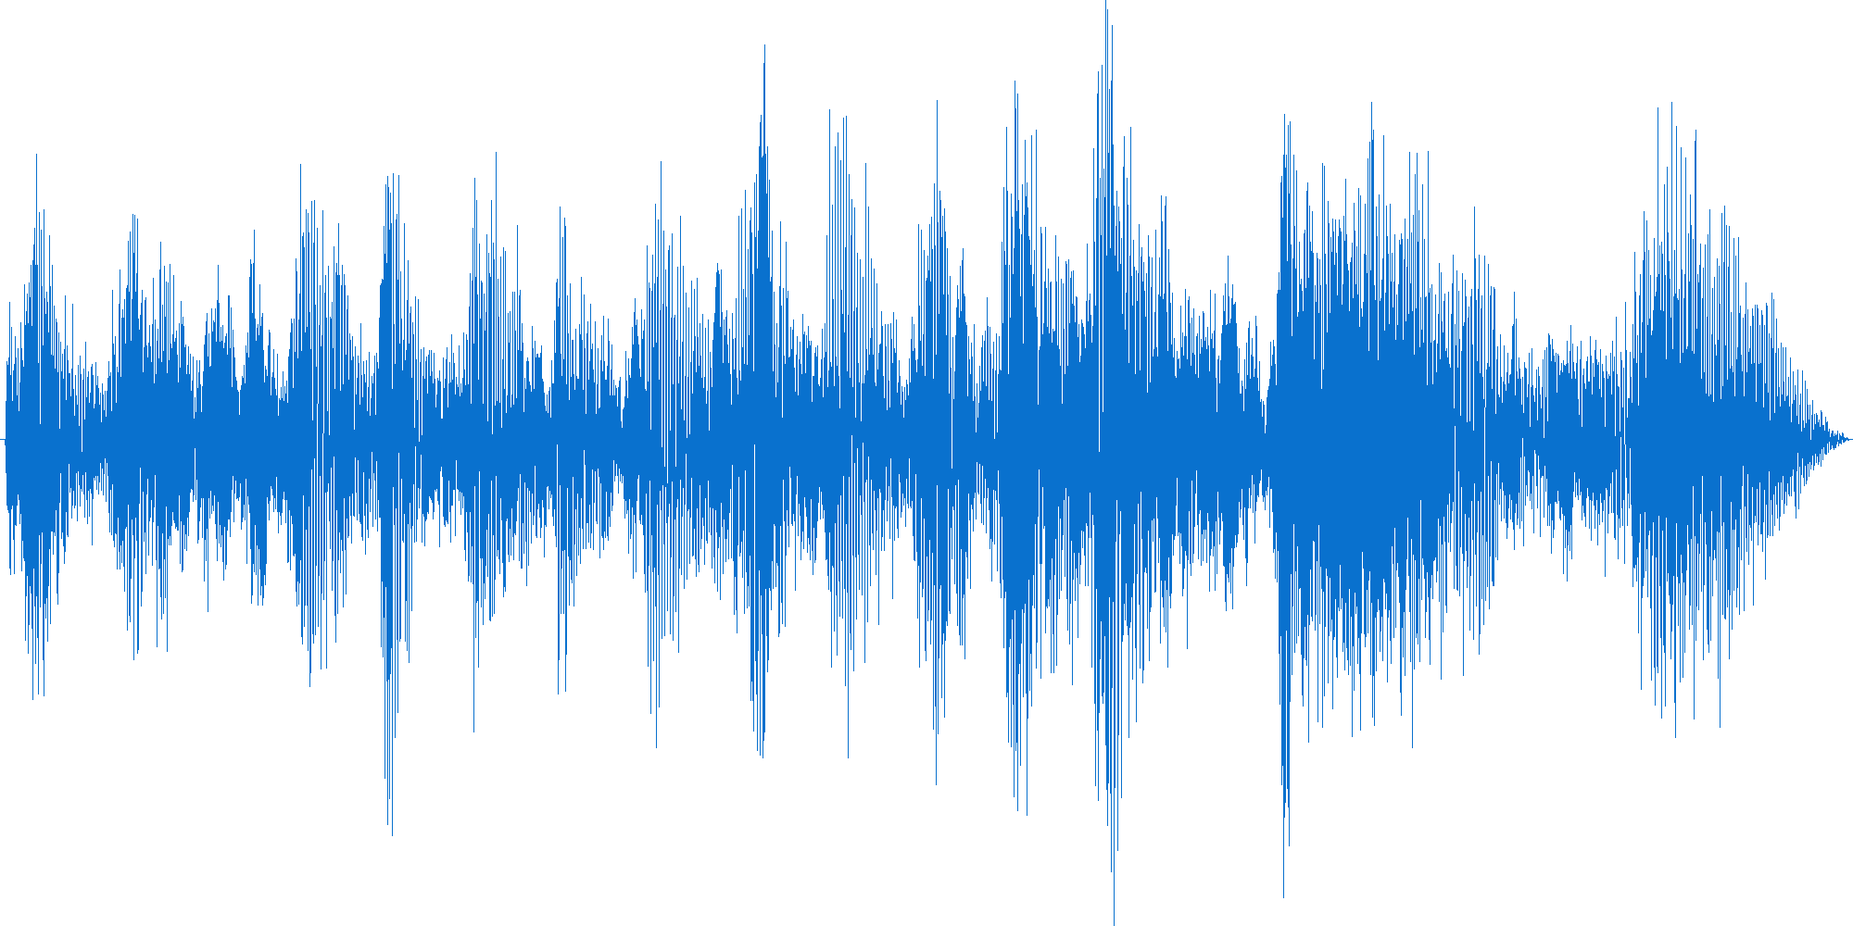
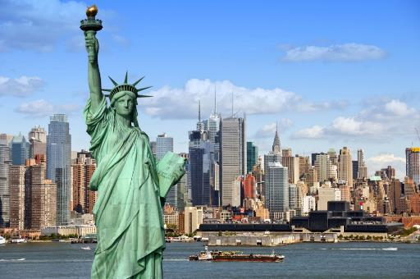


Unstructured Data
Data without an enforced pattern or type
Challenging to process using standard programming techniques
Notes:
Unstructured data are things like images, sounds, videos, emails, tweets, etc. We refer to these as unstructured because the contents of the data do not have structure; however, the delivery mechanism does have some structure. For example, a picture may come in the form of a JPEG file which does have some structure which defines how to interpret the data and render the image on the screen. An email has some structure in that it has a sender, receiver, subject and then the body of the email. This kind of structure is often referred to as the metadata for the object (attributes that define the object) but the contents of the data (like the sentences in the email) could be anything and don’t have the same kind of structure as our previous example on structured data.
In the case of machine learning and deep learning, we are often looking for patterns within the unstructured data. For example, looking for patterns in an image file can help a system recognize if the image is a picture of a cat or a dog. Or we may be looking for the signature sound wave of a gun shot to be able to predict if a violent action has taken place in a neighborhood before it is even reported to police (or if the sound was simply a fire cracker or a car backfiring). Or with emails we may want to find patterns to indicate the authors sentiment (are they upset or happy or sad) or we may be looking for specific patterns of speech to understand a question and build a reply to the email without human intervention, or even identifying spam.
These are the types of problems ML and DL are typically used for with unstructured data.

Slide 8

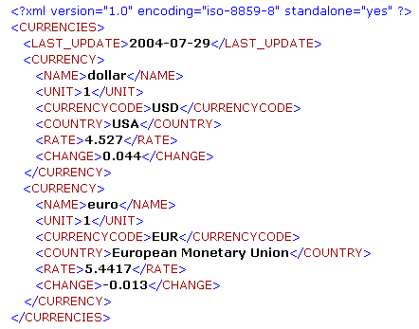
Semi-structured Data
{
"apiVersion": "v1",
"kind": "Service",
"metadata": {
"name": "powerai-vision-vision-ui",
"namespace": "gpu",
"resourceVersion": "483980",
"labels": {
"app": "powerai-vision-vision",
"chart": "ibm-powerai-vision-prod-1.1.0",
"component": "powerai-vision-vision-ui",
"release": "vision",
"run": "powerai-vision-vision-ui-svc“
}
},
"spec": {
"ports": [
{
"name": "ui-port",
"protocol": "TCP",
"port": 80,
"targetPort": 80
}
]
}
}
Notes:
The final class of data is “semi-structured”. This data has a more rigid structure around it than unstructured data. For example, a JSON document has a well formed structure that describes each element within the document; like a person’s name, address, phone number, etc. much like a relational structured table has column headings. But the difference is that a structured relational table has fixed number of columns based on how it was defined (and changing that definition can be a lot of work), whereas a JSON document can have any number of data fields and a developer is free to add new fields whenever they see fit without worrying about the data structure.
Similarly, a tweet has a formed structure in that it has a fixed length and within the tweet certain symbols have specific meanings (like a hashtag or a persons @ handle). This gives the tweet some structure but again like unstructured data, the “payload” or the contents don’t have a defined structure.

Slide 9
Training Types
Notes:
Now let’s move onto machine learning and deep learning training. By training we mean that we are “teaching” the computer how to find patterns from. Not by telling it what patterns exist, but instead we feed in the data and let the algorithms find the patterns on their own. That is what training means … the computer is training a model to be able to detect patterns based on what it “sees” within the training runs.

Slide 10
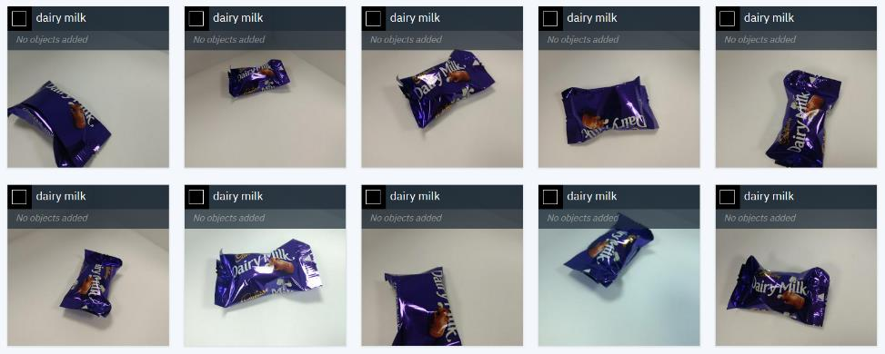
Supervised learning
Provide labelled data to the system
This is considered the ground truth
The system will find the patterns that determine your labels
4.849315 | 5.669982 | TRUE
5.548189 | 5.023918 | TRUE
5.449399 | 6.107647 | TRUE
4.138449 | 4.424792 | FALSE
4.407822 | 4.530602 | TRUE
3.212067 | 6.99535 | FALSE
4.036322 | 5.150239 | FALSE
4.17845 | 4.262555 | FALSE
3.949967 | 6.322179 | FALSE
4.68341 | 6.821367 | TRUE
3.569664 | 5.524142 | FALSE
2.366305 | 1.552303 | FALSE
3.430706 | 2.388652 | FALSE
2.438954 | 1.884384 | FALSE
4.526269 | 1.500568 | TRUE
2.826602 | 1.95353 | FALSE
4.184532 | 2.259855 | FALSE
Notes:
The first type of training is called “Supervised Learning”. Think of this as how we teach our children to identify objects. We sit with them and open a book of animal pictures and we point to a picture of a dog and we say “dog” then we point to a picture of a cat and say “cat”. The child learns by doing this over and over until they can point to a dog and say the word dog. And if you are a parent, you will know that the first time they see a picture of a horse, they may point to it and say “dog”. Why? Because it has four legs, a tail and no big whiskers so it looks more like a dog than a cat and the child has not yet heard the word for horse. In our supervised learning model, we say “no Sophia that is a horse … can you say horse?”
That’s what supervised machine learning is. We pass in data to an algorithm and tell it what the expected outcome is. For example, with structured data we pass in the table of values and include the expected outcome (in the home sales example we pass in all the attributes of the home AND we pass in the sold price column that the home sold for). For images, we pass in images of chocolate bars AND we pass in the name of those chocolate bars. The learning model then has the facts it needs to discover patterns so it carry out predictions: like what chocolate bars are in an image.

Slide 11

Unsupervised learning
Provide unlabelled data to the system
You do not have a clear understanding of what you are looking for
Interested in patterns within the data
Can identify correlations between data
BILL_AMT1 | BILL_AMT2 | BILL_AMT3 | PAY_AMT1 | PAY_AMT2 | PAY_AMT3
£3,913.00 | £3,102.00 | £689.00 | £0.00 | £689.00 | £0.00
£2,682.00 | £1,725.00 | £2,682.00 | £0.00 | £1,000.00 | £1,000.00
£29,239.00 | £14,027.00 | £13,559.00 | £1,518.00 | £1,500.00 | £1,000.00
£46,990.00 | £48,233.00 | £49,291.00 | £2,000.00 | £2,019.00 | £1,200.00
£8,617.00 | £5,670.00 | £35,835.00 | £2,000.00 | £36,681.00 | £10,000.00
£64,400.00 | £57,069.00 | £57,608.00 | £2,500.00 | £1,815.00 | £657.00
£367,965.00 | £412,023.00 | £445,007.00 | £55,000.00 | £40,000.00 | £38,000.00
£11,876.00 | £380.00 | £601.00 | £380.00 | £601.00 | £0.00
£11,285.00 | £14,096.00 | £12,108.00 | £3,329.00 | £0.00 | £432.00
Notes:
“Unsupervised learning” is really more like putting a child in a room full of toys without any parent in the room and then they learn on their own. For example, if you put a child in front of a set of Lego blocks they may have no idea what they are for. And the first thing they will likely do is try to eat them ☺ but they will quickly find that they don’t taste good and they will likely notice that two Lego blocks actually connect together (they find the pattern of bumps on a block that fit into the holes on another block). This may actually happen by accident, but once discovered the child will notice that other blocks have the same pattern and they then start to connect many blocks together (without supervision).
Quite simply, with unsupervised learning, a set of data is provided and ML or DL algorithms look for patterns within the data. This is often used for clustering like objects together. That is, looking for things in the data that are like other things in the data and grouping them together (more on clustering and classification later).
In the examples above, you might be looking for patterns in a table of structured data (without a target column to “supervise” the result). Or you might, for example, look at flickr images and group them together into similar images as in the graphic on the right.

Slide 12
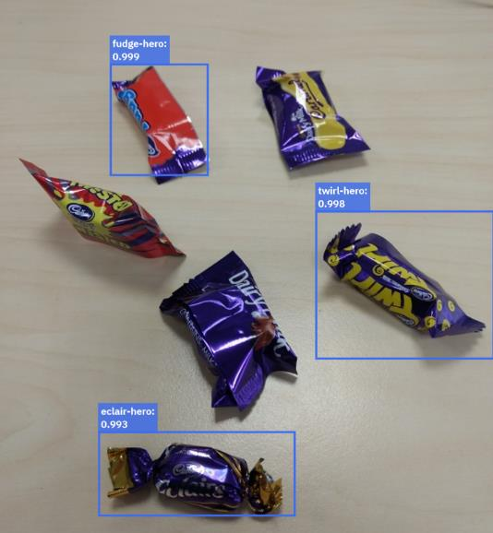


Reinforcement Learning
Provide feedback to a system using rewards for correct results
Often implemented for gaming tasks
Aim of the model is to maximise the reward it gets
User provides feedback rather than labels
+3
-3
=0
Notes:
Reinforcement learning is much like a reward system you might have with a pet (or a child). For example, one way to train a dog is to teach them how to perform a task, and when the task is performed correctly, the dog is given a treat. This tells the dog that their behaviour was correct so they should do it again to get another treat.
With machine learning, reinforcement is providing by way of a goal or score. When a task finds a pattern correctly, it is rewarded with a higher score and the goal is to find something that improves the score. As noted on this slide, this is often used with gaming tasks.
As an example, think of the old computer game of pong where you have two “paddles” (one on each side of the screen) that simply move up and down and a “ball” that bounces around the screen from side to side. If the ball hits the paddle it bounces back towards the other side of the screen. If the ball does not hit the paddle it will fall off the screen and that player loses a point. If I start with the computer not knowing how to play pong at all, but given them a “penalty” when they miss the ball, the computer will eventually just hit the ball at random and realize there is a reward for performing that task. Subsequently, the computer will start moving the paddle and eventually understand how to track the ball and hit the paddle repeatedly in order to receive the reward (and eventually learn how to hit the ball to make it harder for the opponent to hit it back). In the above example, the “goal” is to increase the score as much as possible and the score is calculated as the number of correctly identified objects gives you a plus 1 and the number of objects missed subtracts 1 from your overall score. The goal is to get the highest score. That is reinforcement learning in a nut shell.

Slide 13
Data splitting
Notes:
Another important concept to understand is not only “how” a learning model can take a set of data and find patterns but we also need to make sure that the patterns it is finding are “correct” or not. To do that we need a set of data to “train” the model and another set of data to “test” the model against to see how well the predictions match to reality.
This takes us to the topic of data splitting.

Slide 14
Data preparation
Data is split into smaller sets before training
  Training data is used to train the model
  Validation data is used to test the performance of the model and make refinements
  Test data is used to measure the accuracy of the final model
Validate
Train
Test
Notes:
Of course to train a model to find patterns in data, you need a large set of data for it to learn from. However, the training of the model is only one step in the process. In order to know if the model is good, you need to take some additional data and test the model for accuracy.
Often you only have one data set to work with and so a data scientist will split the data (randomly) into 3 sets. The first set is the training data set and is typically made up of 70% - 80% of the data you have to work with. This is the data that will be used to train the model.
The second set of data is called the validation set and is used to look at how the model is performing while the data scientist is training the model. That is, after a model is created a data scientist will run the model against the validation set of data and may then go back to retrain the model using a different set of hyperparameters (more on hyperparameters later in this deck). By doing this they are refining the model over many iterations. However, by doing this they are also tuning the model to “fit” both the training data and the validation set of data (although not directly training the data on the validation set, it does influence the final model indirectly because it was used to make the model better based on the results of the predictions in the validation set).
The third set of data is the test data set. This is data that the model has never seen before in any of the training runs and is used to measure the accuracy of the final model. The model will be used against the Test data set and you will see how well (or how accurate) the predictions are to the real outcomes (which are in the test data set). For example, in a Kaggle competition (https://www.kaggle.com/) you are given a data set to train on and then a data set to test on which you will use for your final submissions to the contest (you don’t know the correct predictions in the test data set but Kaggle will take your test results and score them and let you know how well your model performs).

Slide 15
Dimensionality / Complexity
Notes:
In this next section we will discuss the concept of dimensionality and how it relates to the complexity of building a machine learning or deep learning model.

Slide 16
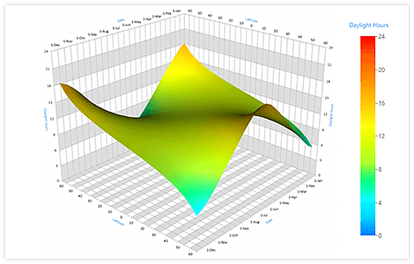
Adding dimensions to data
Data sets have a number of dimensions
Humans can visualise data in low numbers of dimensions
Patterns in larger dimension data sets are hard to see
2D
3D
Notes:
Most people can easily conceptualize dimensions when it comes to 2D and 3D objects. For example, a drawing on a piece of paper is a two dimensional object (it has length and width dimensions). Similarly a graph is typically drawn with x and y axis (or horizontal and vertical axis) which then renders in two dimensions on your screen.
A three dimensional object now also has depth in addition to length and width. For example, a cube or a sphere has 3 dimensions on this slide you can see examples of 3D graphs (in the example in the lower right of the slide, the 3rd dimension is represented by the size of the circle).
Humans are good at visualizing objects in 2 and even 3 dimensions but that is close to the limit of what we can easily comprehend.

Slide 17
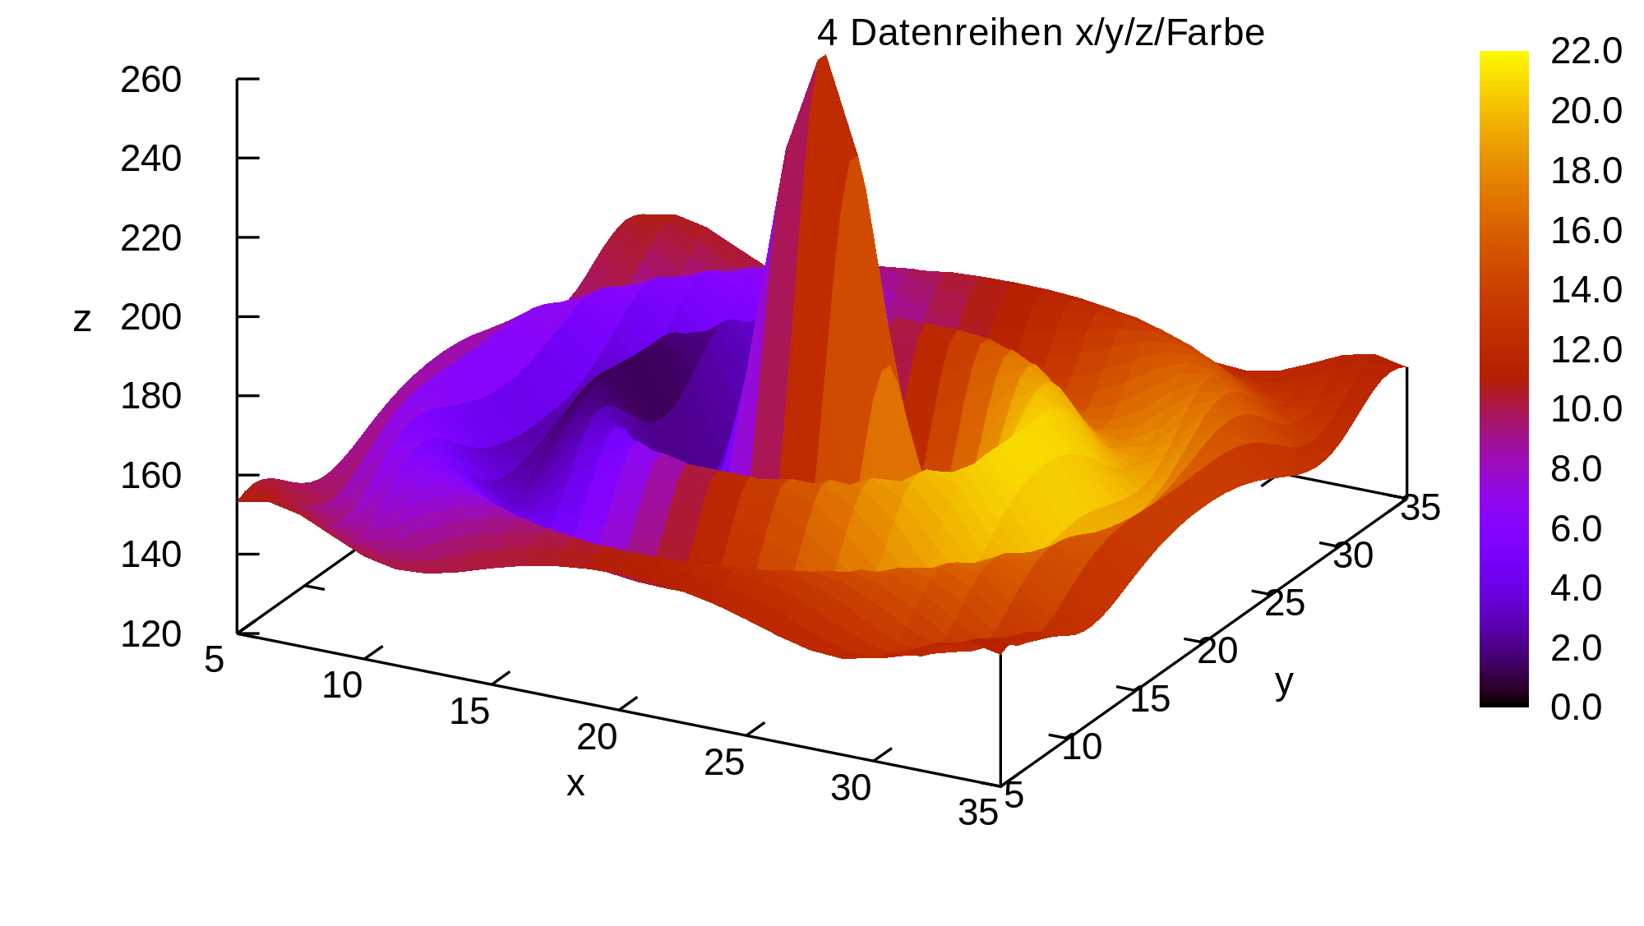
Adding dimensions adds complexity
4D – X, Y, Z and Color
4D
Notes:
This slide shows an example of a graph drawn in 4 dimensions (to humans in the real world the 4th dimension is often referred to as the time dimension – i.e. a ball travelling through the air has 4 dimensions).
In this example we have a 3 dimensional graph (in the x, y, and z plane) and then it is colored with a heat map that can represent a 4th dimension.
But how then would you graphically represent a 5th dimension or a 6th?

Slide 18
Adding dimensions adds complexity
LIMIT_BAL | AGE | PAY_0 | BILL_AMT1 | BILL_AMT2 | BILL_AMT3 | PAY_AMT1 | PAY_AMT2 | PAY_AMT3
£20,000.00 | 24 | 2 | £3,913.00 | £3,102.00 | £689.00 | £0.00 | £689.00 | £0.00
£120,000.00 | 26 | -1 | £2,682.00 | £1,725.00 | £2,682.00 | £0.00 | £1,000.00 | £1,000.00
£90,000.00 | 34 | 0 | £29,239.00 | £14,027.00 | £13,559.00 | £1,518.00 | £1,500.00 | £1,000.00
£50,000.00 | 37 | 0 | £46,990.00 | £48,233.00 | £49,291.00 | £2,000.00 | £2,019.00 | £1,200.00
£50,000.00 | 57 | -1 | £8,617.00 | £5,670.00 | £35,835.00 | £2,000.00 | £36,681.00 | £10,000.00
£50,000.00 | 37 | 0 | £64,400.00 | £57,069.00 | £57,608.00 | £2,500.00 | £1,815.00 | £657.00
£500,000.00 | 29 | 0 | £367,965.00 | £412,023.00 | £445,007.00 | £55,000.00 | £40,000.00 | £38,000.00
£100,000.00 | 23 | 0 | £11,876.00 | £380.00 | £601.00 | £380.00 | £601.00 | £0.00
£140,000.00 | 28 | 0 | £11,285.00 | £14,096.00 | £12,108.00 | £3,329.00 | £0.00 | £432.00
£20,000.00 | 35 | -2 | £0.00 | £0.00 | £0.00 | £0.00 | £0.00 | £0.00
£200,000.00 | 34 | 0 | £11,073.00 | £9,787.00 | £5,535.00 | £2,306.00 | £12.00 | £50.00
£260,000.00 | 51 | -1 | £12,261.00 | £21,670.00 | £9,966.00 | £21,818.00 | £9,966.00 | £8,583.00
£630,000.00 | 41 | -1 | £12,137.00 | £6,500.00 | £6,500.00 | £1,000.00 | £6,500.00 | £6,500.00
£70,000.00 | 30 | 1 | £65,802.00 | £67,369.00 | £65,701.00 | £3,200.00 | £0.00 | £3,000.00
£250,000.00 | 29 | 0 | £70,887.00 | £67,060.00 | £63,561.00 | £3,000.00 | £3,000.00 | £3,000.00
£50,000.00 | 23 | 1 | £50,614.00 | £29,173.00 | £28,116.00 | £0.00 | £1,500.00 | £1,100.00
£20,000.00 | 24 | 0 | £15,376.00 | £18,010.00 | £17,428.00 | £3,200.00 | £0.00 | £1,500.00
£320,000.00 | 49 | 0 | £253,286.00 | £246,536.00 | £194,663.00 | £10,358.00 | £10,000.00 | £75,940.00
£360,000.00 | 49 | 1 | £0.00 | £0.00 | £0.00 | £0.00 | £0.00 | £0.00
£180,000.00 | 29 | 1 | £0.00 | £0.00 | £0.00 | £0.00 | £0.00 | £0.00
£130,000.00 | 39 | 0 | £38,358.00 | £27,688.00 | £24,489.00 | £3,000.00 | £1,537.00 | £1,000.00
£120,000.00 | 39 | -1 | £316.00 | £316.00 | £316.00 | £316.00 | £316.00 | £0.00
£70,000.00 | 26 | 2 | £41,087.00 | £42,445.00 | £45,020.00 | £2,007.00 | £3,582.00 | £0.00
£450,000.00 | 40 | -2 | £5,512.00 | £19,420.00 | £1,473.00 | £19,428.00 | £1,473.00 | £560.00
£90,000.00 | 23 | 0 | £4,744.00 | £7,070.00 | £0.00 | £5,757.00 | £0.00 | £5,398.00
£50,000.00 | 23 | 0 | £47,620.00 | £41,810.00 | £36,023.00 | £1,973.00 | £1,426.00 | £1,001.00
£60,000.00 | 27 | 1 | -£109.00 | -£425.00 | £259.00 | £0.00 | £1,000.00 | £0.00
£50,000.00 | 30 | 0 | £22,541.00 | £16,138.00 | £17,163.00 | £1,300.00 | £1,300.00 | £1,000.00
£50,000.00 | 47 | -1 | £650.00 | £3,415.00 | £3,416.00 | £3,415.00 | £3,421.00 | £2,044.00
£50,000.00 | 26 | 0 | £15,329.00 | £16,575.00 | £17,496.00 | £1,500.00 | £1,500.00 | £1,000.00
£230,000.00 | 27 | -1 | £16,646.00 | £17,265.00 | £13,266.00 | £17,270.00 | £13,281.00 | £15,339.00
£50,000.00 | 33 | 2 | £30,518.00 | £29,618.00 | £22,102.00 | £1,718.00 | £1,500.00 | £1,000.00
£100,000.00 | 32 | 0 | £93,036.00 | £84,071.00 | £82,880.00 | £3,023.00 | £3,511.00 | £3,302.00
£500,000.00 | 54 | -2 | £10,929.00 | £4,152.00 | £22,722.00 | £4,152.00 | £22,827.00 | £7,521.00
£500,000.00 | 58 | -2 | £13,709.00 | £5,006.00 | £31,130.00 | £5,006.00 | £31,178.00 | £3,180.00
£160,000.00 | 30 | -1 | £30,265.00 | -£131.00 | -£527.00 | £131.00 | £396.00 | £396.00
9D
Notes:
What happens if you have a data table with 9 dimensions? How would you represent this spreadsheet graphically? This becomes very complicated for humans to understand. However, in a table format, the data is easy to understand. The table has 9 columns (or attributes) that represent the 9 dimensions of the data.
The complexity comes when you’re looking for patterns and/or correlations within the data: adding more dimensions makes the problem exponentially more difficult to solve. The more dimensions you have, the more data you need to feed into training the model in order to find patterns amongst all of the possible combinations of the various columns (or dimensions) in the data.

Slide 19
Some mathematics
There are different terms and representations for different dimensions of data
Scalar
Vector
Matrix
Tensor
17
12
24
36
42
12 27 78
24 14 11
36 78 16
42 33 59
12 27 78
24 14 11
78 16
33 59
14 52 16
18 02 83
17 62 55
36 75 40
11 94
17 47
62 99 03
12 05 87
Notes:
Another term you will come across in data science is a Tensor. So what is a Tensor? Before we get there let’s look at more primitive dimensions of data.
The first is a scalar. The definition of which is a quantity that has only a magnitude but no direction. That’s a complicated way of just saying it’s a number ☺ If I ask you how is the car moving and you say 17 that doesn’t tell me much (because you only gave me a scalar).
If instead you say 17 miles per hour due east then I know how fast you are going and in what direction. That description is actually a vector which is defined as a quantity having both magnitude and direction. In mathematics, this may be represented as an X and a Y coordinate (and then the line drawn from 0,0 to x,y represents the vector of a car’s motion where the length of the line is the magnitude and the angle of the line represents the direction. As discussed on the previous slide, it gets more complicated when you go beyond 2 or 3 dimensions. In the example shown on the slide, we have a vector in 4 dimensions, which is represented by 4 numbers inside of a set of parenthesis, like (12,24,36,42). This is known as a vector.
A matrix is a two dimensional vector (which in itself is a multidimensional type…confused yet?). It is often referred to as a rectangular array of scalar elements. There may be M rows and N columns in the M x N (pronounced m by n) matrix. Just like there are mathematical rules for multiplying, dividing, adding and subtracting scalars, there are also mathematical rules that define how you multiply, divide, add and subtract two matrices (which is the plural of matrix) together. The interesting thing about matrices is that a graphics processing unit (GPU) is very good at doing matrix mathematics (they were specially designed for doing math on graphical data which themselves are represented by a set of matrices). This is why GPUs are so useful when doing deep learning as they are very good at matrix math.
Finally this brings us to a tensor. A tensor can be defined as a multi-dimensional array of matrices as shown above. These are simple for a computational system to store and manipulate (and input and output). And as mentioned above, GPUs make it very easy to accelerate the manipulation of matrices (and therefore tensors). Note that a tensor is not limited to the dimensions that we have shown on the slide above. It can be a nested set of matrices to any depth.

Slide 20
Machine Learning
Notes:
Now let’s jump into what machine learning algorithms mean and what they are trying to do for us in terms of pattern detection or pattern recognition.

Slide 21


Machine Learning tasks
We are looking for patterns within high dimension data
Primary method to find patterns is regression
Various types to suit different purposes
Linear regression
Notes:
Remember that machine learning (and deep learning) is a technique used to find patterns in data. Typically we are looking to find correlations between different dimensions in the data. A very simple (but powerful) statistical method to represent these patterns is called regression. A regression is defined as a statistical technique that represents the relationship among a set of variables.
For example, let’s look at the relationship between the amount of money a person earns and the amount of taxes they must pay. In a very simple tax system, the more you make the more you pay. In the simplest cases, if you earn twice as much money, you would expect to pay twice as much in taxes. This is known as linear regression, whereby when you double one variable in the equation the other variable that is related also doubles. We all know taxation is much more complex than that in most countries but you can see the idea of regression in practice here.
On the left you can see a linear regression model fits the data pretty well and it seems that there is a correlation between the X variable and the Y variable that would follow a linear equation.
However, on the right, you can see that there is still a strong correlation between the X values and the Y values but it does not fit a linear regression (or linear equation) nicely at all…it looks more curved (see the next slide for this one).

Slide 22
Machine Learning tasks – overfitting and underfitting
Machine learning tries to predict the general case
Overfitting looks good on the test data but scores poorly in general
Underfitting means I need to train on a larger sample of data to find the patters
Overfitting
Underfitting
Notes:
The goal of a machine learning model is to be able to predict an outcome based on prior experience to derive or predict a value. The higher the accuracy the better. However, there are cases where too high of an accuracy while training a model is bad. If for example the algorithm tries to predict every data point, you may end up with a graph that looks like something on the left. If however I ask the model to predict a data point that it has previously not seen, it will likely not make an accurate prediction. The model has been “overfitted” to the data it was given to model. When this happens we typically need to increase the amount of data we are training on and adjust other hyperparameters to avoid overfitting the model to the training data.
Likewise, if I don’t train the model for long enough (not enough iterations for example) then the predictions may not accurately reflect the patterns that exist in the data. Like the example on the right, the predictions are underfitting the data provided. Typically, to solve this problem we train with more iterations or adjust other hyperparameters or select a different machine learning algorithm to model the data.

Slide 23
Machine Learning tasks
Alternative regression options are available
Including logistic regression and polynomial regression
More complex models may offer better fit, but require more computation
Notes:
There are other forms of regressions that are non linear. In the case of this graph, the correlation between the x values and the y values does not fit a straight line (linear) regression. Rather it appears more curved which is referred to as a polynomial regression.

Slide 24
Machine Learning tasks
Alternative regression options are available
Including logistic regression and polynomial regression
More complex models may offer better fit, but require more computation
Notes:
If you fit a polynomial function to this set of data you can see that the predictions are much closer to the actual values than a straight line (or linear regression) would be.
Another form of regression that is often used for machine learning is called “logistic regression”. What is different here from linear or polynomial regressions is that the output of logistic regression is a 0 or a 1. So for example, will this person applying for a loan default on their loan payments Yes (1) or No (0). If I show this person a web advertisement are they likely to click on it (Yes or No). Based on this persons habits and history are they likely to develop diabetes (Yes or No). These types of questions can be modeled using logistic regression algorithms which are very popular in machine learning today.

Slide 25
Machine Learning tasks
Another approach is clustering
Most commonly seen as K-means clustering
A type of unsupervised learning, which segregates data
Notes:
Another approach in machine learning is not to try to find a single answer (predicted value or yes/no answer) but rather we want to try to classify or categorize observations into groups of like objects. This is referred to as clustering.
If you look at the data plotted on this slide, you can see a set of groupings of the dots. Note that humans are pretty good at finding patterns in data and if I asked you to draw ovals around the groups of similar dots you probably would come up with something like what is described on the next slide (fairly easily). Of course with more dimensions that becomes not only difficult for humans but near impossible as the dimensionality increases.

Slide 26
Machine Learning tasks
Another approach is clustering
Most commonly seen as K-means clustering
A type of unsupervised learning, which segregates data
A
B
D
C
Notes:
As described on the previously slide, a clustering algorithm (or a human doing the same thing) might be able to easily find similarities between various points on this graph and cluster them into 4 different categories. For example, this might be a measure of make and model of cars people drive correlated to their personal income. You may find clusters of people that drive a Honda Civic or Ford Focus within one income bracket that is different from a cluster of people that drive an Acura RDX or BMW x3 who may be in a different income bracket. Clustering algorithms look for correlations between distinct variables (like car driven and income) to find patterns.
Note that clustering itself is not a single algorithm but rather a class of machine learning algorithms. A very common one is known as k-means clustering.

Slide 27
Machine Learning tasks
Another approach is clustering
Most commonly seen as K-means clustering
A type of unsupervised learning, which segregates data
A
B
D
C
Notes:
K-means clustering will take a set of N observations (the blue dots in this graph) and cluster them into K clusters (the 4 clusters: A,B,C and D) and it will calculate the mean of each cluster (as represented by the purple dot).
What would be a practical use of K-mean clustering? Let’s assume I want to build a drone delivery system and I need to know where my drone home bases should be located. I could cluster my clients into k-means and put the launch base at the mean of those clusters so that I can avoid travelling too far from any one base. I could add in my most profitable clients as a variable and have the launch base for my drones at the mean location of profit so my profitable customers get better service.
Another example might be insurance fraud clustering. If I were to create k-mean clusters of insurance claims and segment them into clusters representing fraudulent claims versus not fraudulent claims, I could then map a new claim into this model and detect how far from the mean fraudulent cluster versus how close to the normal claim cluster this new claim is to try to extrapolate if the claim should be investigated further.

Slide 28
Deep Learning
Notes:
Now that we have covered machine learning lets dive into deep learning to understand what it means and what is the difference to machine learning.

Slide 29
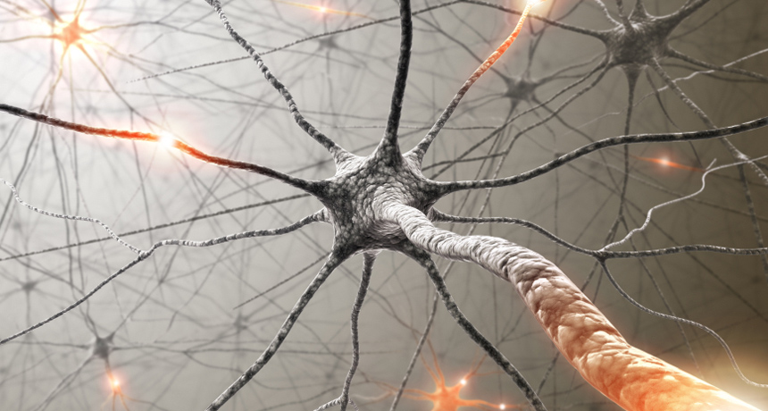
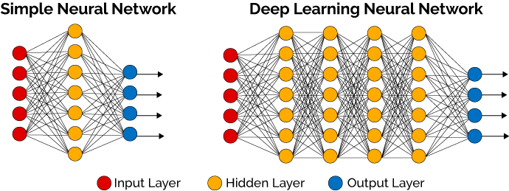
Neural Networks
Neural networks are systems designed to “loosely” mimic the human brain
They involve a lot of processing to identify patterns in data
Calculations are encapsulated in layers
Multiple layers are connected together in a network
7 | 6
8 | 2
0.18
0.04
0.79
0.00
4 | 4
3 | 8
Notes:
Before we jump into what is deep learning we first have to mention neural networks (and you will see shortly the often cited relation between deep learning and neural networks). The idea behind a neural network is to have a computer system that “mimics” the way a human brain works. And in fact, mimic the way neurons communicate inside the brain. A neuron contains 3 parts; the dendrite which receives messages from other neurons, the cell body which processes the input “message” and the axon which distributes the output of the cell to other neurons. The other important property of the brain is that the use of certain neurons strengthens those neuron connections (so the more you think about something the stronger that memory encoded in those neurons).
A simple neural network takes a set of inputs (think dimensions of data or matrices of pixel values in an image), then pass that information on to what is called a hidden layer. In a computational neural network that is analysing images for example that hidden layer may take pixel values and find things like lines, curves, etc in a picture and pass that on to the next layer. In a simple Neural network there is one input layer, one hidden layer and one output layer that gives a result.
Deep learning neural networks are those neural networks that have several hidden layers. In our example on image recognition to distinguish between dogs and cats, the first hidden layer my detect lines, shapes, arcs, circles, etc which then get passed on to the next hidden layer which might be using those shapes to identify features like nose, tail, whiskers, etc which are then passed on to the next layer, etc. etc.
In the end the output layer may determine if the image is a dog or a cat. In training of a deep learning model if the model output was “dog” and the image was actually a cat, then those branches within the neural network that favoured the output of dog would be weakened (weights of those connections would be reduced) and connections and nodes which favoured the image being a cat would be strengthened (weights of those predictions would be increased). This is much like the case of the brain where neural networks are strengthened by their repeated use.
There are many public architectures for various neural networks that have been developed in recent years (like Imagenet, googleNet, Inception (v3, v4 etc), YOLO). If you want to get a deeper understanding of these, they are described further here: https://medium.com/@sidereal/cnns-architectures-lenet-alexnet-vgg-googlenet-resnet-and-more-666091488df5
There are also some good examples at Quora.com (where many of these network images have been taken from) here https://www.quora.com/What-is-the-difference-between-Neural-Networks-and-Deep-Learning

Slide 30
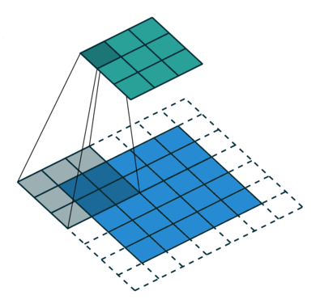
Neural Networks
Different types depending on the use case
Convolutional Neural Networks (CNNs)
  Performs the same processing over multiple subsets of the data
  Heavily used in Image Classification use cases
Recurrent Neural Networks (RNNs)
  Pass output of some layers back into the input of same layer
  Often used in Text to Speech as the model has ‘memory’
Notes:
As mentioned on the previous slide, there are a number of different types of neural networks. If you really want to spend more time on the details of neural networks, you can find a very detailed list of network types and what they are useful for here: https://towardsdatascience.com/the-mostly-complete-chart-of-neural-networks-explained-3fb6f2367464
Two very common neural networks are shown on this slide. The first is known as a convolutional neural network (CNN) which is used frequently in image processing. A CNN is looking at sections of an image at a time and essentially is looking for patterns across the sets of data (lines, edges, curves, etc.). This is why CNNs excels at classifying images and detecting objects within an image (as it is looking for similar patterns across sets of data). The second common network is known as a recurrent neural network (RNN) which takes the output of some layers and uses them as input for the same layer. This is often used for text recognition because it learns from what it found in the past. For example, an RNN is a good method to know that a “dog” is different when you put the word “hot” in front of it. RNNs are also frequently used for speech recognition as it is often needed for understanding the context of a sentence (looking at the entire sentence and not just each individual word is important to understand the context).
As well, if you want to dive deeper into convolutional neural networks, there is a good guide by Vincent Dumoulin and Francesco Visin here (https://arxiv.org/abs/1603.07285).

Slide 31
Building a model – and what’s a hyperparameter
Each layer has a series of weights and biases
These are modified as the model is trained to produce higher accuracy
These weights and biases are held in matrices
The amount of change each iteration is called the learning rate
Notes:
As previously mentioned, a neural network in your brain is “strengthened” when a given neural path is used frequently. Similarly, in a computational neural network, there are aspects called weights and biases that perform similar functions. As a model is trained, the network is “learning” how to predict and model the correct outcome. The way this happens is that any path within the neural network that predicts the correct answer will have its weights increased such that similar patterns found in the future will be biased towards the correct outcome.
As shown on this slide, weights are associated with each edge that connect one neuron to every other neuron. Each line has its own weight (in the above diagram labeled as W x,y … where y is the input neuron and x is the output neuron). The function of the neuron takes the input values of the previous layer and the weights of those lines to determine the value of the output of that cell. Bias is added at each cell before the output is sent on to the next layer. At the end of the network, when we notice that the model accurately or inaccurately made a prediction, we go back through the network and adjust the weights and the biases in order to strengthen the connections that were making correct predictions and weaken the connections (lower the values) that were leading us to the incorrect prediction (more on this in a bit … but this process is known as back propagation). By adjusting these weights during the training the model evolves into being able to make accurate predictions.
As you may be able to imagine, if you only change the weights by very small amounts in each pass, it may take a very long time to converge on an optimal prediction. Likewise, if you change these values by a large amount, you may easily overshoot the optimal values and never converge on the best solution for a given model. The amount of change of these values is called the learning rate and is one kind of “hyperparameter”.
A hyperparameter is a configuration parameter, when building a neural network, that describes how the learning will happen within the network. There are many other hyperparameters and data scientists spend a significant amount of time building models, changing hyperparameters and iterating over and over again tweaking these parameters and re-training models to find the optimal model.

Slide 32


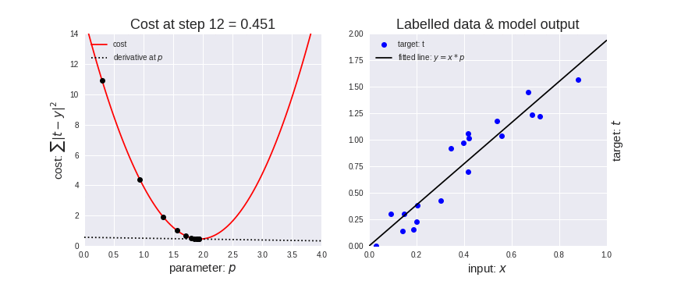
Building a model – and what’s a hyperparameter
Deep Learning training requires the system to learn from the data
This requires multiple iterations or epochs
Over each iteration or epoch the system looks at all of the training data
The model is refined based on the loss from previous run
Iteration 1
Refine model
Iteration 2
Refine model
Iteration 3
Refine model
. . .
Iteration 2000
Final
model
Notes:
When training a deep learning model, you need to iterate many times over the data to find the optimal result. The way this works is that the model is generated and the error rate is found. For example, in the lower right graph, a linear regression finds some line to fit the data and you can measure how far away from the line each dot on the graph is. This would be considered a loss function (how far away the prediction is from the truth). The algorithm will then go through another iteration in an attempt to minimise the errors (i.e. minimise the loss function).
The number of iterations (also known in deep learning as epochs) that a training run will go through is also a typical hyperparameter that a data scientist will tweak as they iterate over building their model.

Slide 33
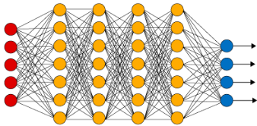
Building a model
The model is refined based on loss which is a measure of error
This is based on a loss function and the difference between predicted and actual results
This step is called feed forward as we pass through the model forwards
This loss can be calculated per layer moving backwards through the network
This is called back propagation and is key to Deep Learning training
Training Data
Refine Model
Calculate Loss
Loss
Notes:
How do these iterations and loss functions interact with weights? Here we will combine the 3 previous concepts. During the forward portion of an iteration, the algorithm will produce some output. That output will have a measurable loss. That loss is used to adjust the weights between the layers before the next iteration. This application of loss information to the weights is known as “back propagation”.
The model will continue to be refined in this manner for N iterations or epochs (defined as a hyperparameter).
If you want to dive a lot deeper into how weights and biases are leveraged and modified during a training run, there is a detailed explanation here: https://medium.com/@neuralnets/back-propagation-algorithm-and-bias-neural-networks-fcf68b5153

Slide 34
Building a model
A trained model includes:
  A network definition file that describes the layers
  Weights and biases for each layer within that network
7 | 6
8 | 2
4 | 4
3 | 8
7 | 6
8 | 2
4 | 4
3 | 8
Trained model
weights
7
2
4
0
7
2
4
0
7
2
4
0
network definition
biases
Notes:
To summarize, deep learning is a method in which a network (with many hidden layers) is used to create a trained model which can take some input, apply weights and biases throughout the layers, and produce an output (prediction).
This trained model is often simply referred to as a deep learning algorithm … or simply a deep learning model.

Slide 35
Deep Learning frameworks
Notes:
To make it easier for data scientists and developers to build these deep learning models, frameworks have evolved to simplify the creation and programming of deep learning models. In this section we will discuss some of the more common frameworks.

Slide 36




Frameworks
Frameworks are also known as libraries
They contain common functions to simplify model building
Most of the common frameworks are Open Source
Notes:
Like many application development environments, a framework is a set of libraries that simplify the common functions that are needed by data scientists to build models. Most of these frameworks are open source and as such they have evolved rapidly.
Four of the most common are:
TensorFlow - developed by the Google Brain team for internal Google use. It was released under the Apache 2.0 open-source license on November 9, 2015. TensorFlow provides libraries for Python, C, C++, Go, Java, JavaScript and Swift. In TensorFlow, multi-dimensional matrices of data are known as tensors and are manipulated by built-in functions. Developers can create graphs (networks) to process tensors.
PyTorch - pronounced “pie torch” – is an open source machine learning library for Python, used for applications such as natural language processing. It is primarily developed by Facebook's artificial-intelligence research group but is open source so there are many other contributors including IBM.
Caffe - From the Berkeley Vision Learning Center (BVLC) and alternative versions have been produced by NVIDIA and IBM with optimizations for their hardware. With Caffe you create models using networks of layers and build training iterations. Pre-trained models are often shared in a what is known as a Model Zoo (which makes it easier for various developers to collaborate and extend each others works). Rather than working on tensors like with TensorFlow, data is passed between layers in Blobs (binary large objects) within Caffe.
Keras - An open source neural network library written in Python. It runs on top of TensorFlow, and has been designed to enable fast experimentation with deep neural networks, it focuses on being user-friendly, modular, and extensible. In fact, it is part of TensorFlow today, but people will still refer to it on its own so we put it here.

Slide 37
Making use of trained models
Notes:
Now that you have a model created, how is it used?

Slide 38
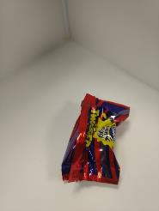
Deployment
Trained models can be used to predict outcomes based on new data
Models can be deployed for inference – also known as scoring
This generally uses a cut down version of the framework
A common method is to create an Application Programming Interface (API)
API
{
result: "success",
imageUrl: "http:/ibm/test.jpg",
classified:
{
creme-egg: "0.94855"
}
}
Model
Notes:
Once you have a model, you then take some input (which would be the same kind of data you used in the training) and passing it into the model to have it produce a prediction. The prediction is often referred to as an inference (we are inferring a result based on the model and the input) or sometimes it is called scoring (we are producing a score as output that someone can make a decision on).
To use the model there is usually an application programming interface (API) that is called with the input data (the input data could be a structured row of data or it could be an image or whatever was used as input data when the model was trained). The API will use the model to run the data through and produce an output that can be used within an application to make some decision on. Most often this is a REST API which makes it easily invokable from a web application.
Note that we have said that we will generally use a cut down version of the framework and by this we mean that the input is the same as what was done during the training and the output will be the same but there is no learning going on during the inferencing. As such, there are no iterations or back propagation or weight/bias changes. We simply execute the model to come up with a prediction or a score. This may mean that GPUs are less critical for inferencing (but in some high volume cases like video stream object detection, GPUs may be a critical success factor). There is also inferencing possible on other servers that are not where the model was trained. In fact inferencing can often benefit by being closer to the actual source of the input (like next to the cameras or attached directly to the sensors used to collect input).

Slide 39
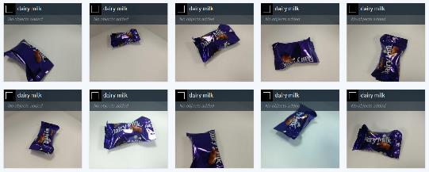
Quality of results
Each inference event will provide a confidence value
  This value relates to that prediction only
The accuracy of a model is determined through:
  Correct predictions of data within the Test data set or the validation data set described previously
Accuracy relates to the model, confidence relates to the prediction
{
result: "success",
imageUrl: "http:/ibm/test.jpg",
classified:
{
creme-egg: "0.94855"
}
}
80% Accurate
95% Confident
Notes:
Along with the prediction that the model produces for a given single input, the model will also produce a confidence value. That is, how sure is the model that its prediction is accurate. In the above example on the right, we have a model that can identify types of chocolates. The output on the right is saying that the model predicts this image is of type “cream-egg” chocolate and it is 95% sure (confident) that its prediction is correct. Confidence is related to a given prediction.
Another quality measure is a measure of the model itself. That is, how often does the model make the correct prediction. If the model is given 100 chocolates and it correctly categorizes 80 of those 100 then it is said to have an accuracy of 80%. The key metric that data scientists look for is how accurate the model is and so accuracy is a very important quality metric (they often refer to it as performance, as in “performance of the model”).
In fact, the most common goal is to increase Accuracy of a model which is often achieved by providing more labelled data to train, run training over a larger number of iterations, or provide higher quality data.

Slide 40
Working with images
Notes:
One final area of terminology we want to discuss is some of the language used when working with images.

Slide 41
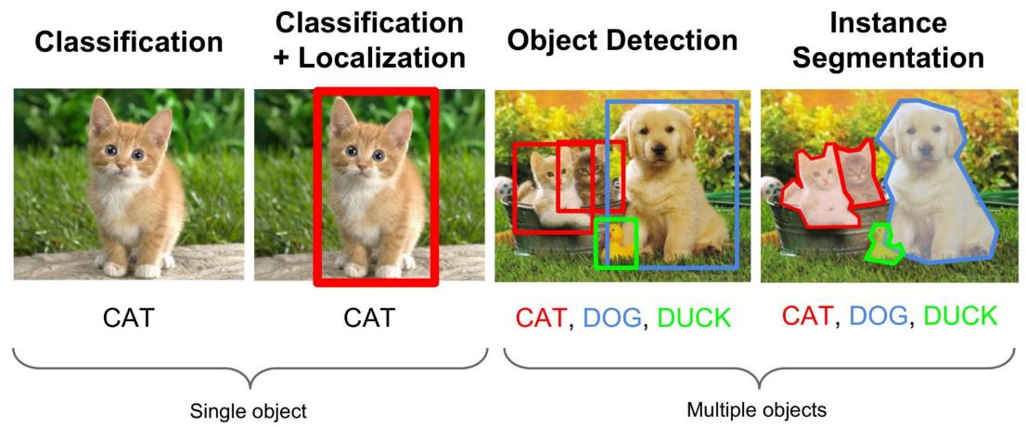
Image recognition and Deep Learning
Image classification (whole image)
Object detection (boxes)
Segmentation (boundaries)
From Arthur Ouaknine: https://medium.com/comet-app/review-of-deep-learning-algorithms-for-object-detection-c1f3d437b852
Notes:
We had previously talked about working with images using deep learning algorithms. But there are many ways to identify objects within an image. The first is known as classification (far left image on the slide) in which we take a single image file and put it into one of many defined classifications. In the example above we have a single file and the output of classification on that single file is to call it a CAT. Note that we are defining the entire file as a CAT.
The second option for processing data is to have classification (which would identify the image as a cat) but then add “localization” which creates a bounding box within the image which specifies “where” in the image is the cat (what are the edges of the cat).
The next type of image processing is known as Object Detection. Using this method we are taking an image and trying to find one or more objects within the image. In the example above, our model found a dog a cat and a duck within the image and we drew bounding boxes around the objects.
Finally Instance segmentation is part of object detection but in this case the model draws lines around the edge pixels of the objects it finds (thus segmenting the image into parts that belong to the given object). Note with instance segmentation a pixel is part of one object but not multiple objects. Where as with object detection, the bounding boxes will often overlap.

Slide 42
Summary
Feel confident with the vocabulary of Deep Learning
Notes:
After going through this session, you have hopefully learned something about the various terms used in deep learning and machine learning and feel more comfortable having a conversation with someone on this subject.

