Slide 1



IBM Watson Studio Local (WSL) on Power
Simplified and Accelerated Data Science Development and Deployment
Client Deck
Watson Studio Local
Kelly Schlamb (kschlamb@ca.ibm.com)
Keshav Ranganathan (keshav@us.ibm.com)
Notes:
NOTE: This product was previously called Data Science Experience (DSX) Local. It was rebranded to Watson Studio Local (WSL) on October 2nd, 2018. Also, the Model Management and Deployment (MMD) part/capability was renamed to Watson Machine Learning (WML). The old names may still be found in diagrams, URLs, content pointed to from this presentation, and so on. This will change over time, but in the meantime you can still expect to see those older names in use as you’re reading up on this product elsewhere.
This is the IBM Watson Studio Local (WSL) on Power client presentation. This slide deck is intended to be used by Power sellers (both direct and business partners) with clients to introduce data science and the IBM WSL offering.
The flow of the presentation is as follows:
Introduction to data science and typical use cases
Challenges faced by data science professionals
How WSL addresses those challenges
High level overview of some of the main WSL capabilities
Value proposition of Power (including infrastructure and PowerAI software) with WSL
There are a number of key messages that need to be reinforced in your discussions with clients. Primarily, data science is not simple. It requires expertise – in fact, it’s often described as a team sport with various disciplines and roles involved – and it also requires the right tools for the team to be productive. WSL is an environment that brings together everything that a data scientist and the supporting team needs. It includes the most popular Open Source tools and IBM unique value-add functionalities with community and social features, integrated as first class citizens to make data science teams more successful.

Slide 2




Why is Data Science Essential?
Complexity
Data Volume
A single truck visiting
5 different locations:
120 different routes
1995: 130 billion GB
2020: 40 trillion GB
A single truck visiting
10 different locations:
Over 3 million
different routes
We cannot plan for every eventuality
or write code for every scenario
Real world problems contain
100s of trucks and 1000s of locations
Data science is made up of algorithms and approaches that will find the
right solution – even if they haven’t encountered that exact situation before
There are more possibilities
than grains of sand in the world
Notes:
A search of “What is data science” in Google will result in millions of hits. It’s a very frequently used term these days and it’s difficult to find a concise, agreed upon definition. To put it simply, it’s about extracting knowledge and insights from data and deriving value from it.
There are two main reasons why the discipline of data science is essential… one is complexity and the other is data volume.
Let’s look at complexity first.
Let’s say that you have a single truck that needs to visit 5 different locations and we are trying to determine in what order to visit these locations in order to minimize the distance traveled (this is often referred to as the travelling sales person problem). The number of different ways in which we can visit these 5 locations is 120 [5 factorial (5!) is 5 x 4 x 3 x 2 x 1 = 120]. So we can easily enumerate them, sort them and pick the best. If we double the number of locations that we need to visit to 10 then the number of possibilities goes from 120 to over 3 million [10 factorial (10!)]. So by increasing the inputs by a factor of 2 we increase the possibilities that we need to consider by a factor of 20,000!
Now consider that real world problems contain 100s of trucks and 1000s of locations. The number of possibilities that we have to consider is literally larger than the number of grains of sand in the entire world! It would be impossible to look for this proverbial needle or grain in a hay stack even if we had a lifetime to do it. Yet companies like UPS and FedEx are faced with attempting to solve this problem repeatedly on a daily basis.
This problem is known as the combinatorial explosion, in which the number of combinations that we need to consider grows much faster than what we can keep up with.
Now let’s look at data volume.
It is not only the number of combinations that grows much faster than anything we can keep up with. It is also the amount of data available. In 1995 the data universe was approximately 130 billion gigabytes but by 2020 it is expected to reach 40 trillion gigabytes. These numbers are definitely hard to visualize. In 1995, that amounted to about 23 gigabytes of data per person on the planet – which is the amount that could fit on 32 compact discs (CDs) at the time. By 2020 (with a world population that will be about 30% higher than in 1995), it will be about 5,300 gigabytes of data per person, or about 7,600 CDs per person (or about 200 Blu Ray discs, to use a more modern medium).
It is impossible to plan in advance for every eventuality and write code for every scenario. We cannot code “if this then do that” 40 trillion times.
Luckily, data scientists have developed algorithms and approaches that can often find the right solution every time even if they haven’t been explicitly programmed to do so. So data science applications can provide good solutions even if they haven’t encountered that exact same situation before.
Examples from: ‘Getting Started with Data Science’ Publisher: IBM Press; 1 edition (Dec 13 2015) Print.
Author: Murtaza Haider

Slide 3
Enterprises generate TONS OF DATA
Which must be cleaned and shaped for training
Data
…then models must be designed
Data that requires governance
SPSS
… which generates even more data
…that must be hosted and monitored
…and trained on
high performance compute
To select an optimal model...
Notes:
This slide shows the high level steps involved in the building and deployment of a machine learning model as part of a data science initiative.
As part of their daily operations, businesses generate and collect data. This can include business transactions, customer interactions, sensor/monitor/IoT output, application logs and so on. This might be done for specific purposes (like reporting) but often they’re collecting more data than they’re actually using or looking at. They know the data is important and likely contains insight to help them improve or augment their business activities, but they’re not actually sure how at this point. And as time goes on, more and more of this data is being generated at a faster rate – for example, from the growth of their customer base, new touch points with their customers, the collection of social media data as it pertains to their business and the increased use of Internet of Things (IoT) devices being used within their business. Of course, when dealing with all of this data it’s important to understand its provenance – its lineage and how trustworthy it is – and ensure that only the right people are working with the data. This data governance is extremely important and is something IBM has been a leader at for a long time.
This is typically the start of a company’s data science journey. They have all of this data… and now what? How can they use the unmined gems of information in that data to improve their business and differentiate themselves from their competitors? Where to even start? It’s one thing to use data to answer a specific question, but most times you’re not even sure what questions to ask of the data. This is where data science and machine learning comes in.
<CLICK>
Of course, data is rarely in a form that is immediately usable for analysis. Think of it like an oil refinery that takes crude oil and converts it into more useful products like gasoline and heating oil. In the case of data, it’s cleaned, transformed and potentially augmented with other data to get it into a form that can be readily analyzed or such that machine learning algorithms can more effectively use it.
<CLICK>
From there, AI frameworks and tooling (such as those shown on the slide) come into play. Data is used with machine learning algorithms to build a model – for example, to predict whether somebody applying for a mortgage is likely to default on it, or whether a piece of machinery is likely to break down soon.
<CLICK>
The model is built and accuracy is improved through the process of training and tuning, which is a very iterative process.
Running on high performance hardware that is optimized for this kind of workload means that all of this can be done faster. Why is that important? It means being able to build and deploy models faster (so quicker time to action) or being able to do more training and tuning to come up with more accurate models.
<CLICK>
Once a model is ready, it is put into production. That means that it gets embedded in an application to be used as part of a business process (often times, this means that the model is hosted somewhere with a corresponding REST API that the application can call over the web). Using an online mortgage application as an example, the information provided by a prospective customer can be scored using the model and this might be used to either automatically approve/reject that customer or it might be a piece of information passed along to the mortgage specialist who will use it in conjunction with other information to make a decision.
<CLICK>
Models are typically not static. A model gets built initially with the data at hand. Over time, the model needs to be constantly evaluated for accuracy using the new historical data being generated (new mortgage applications in our example – as well as with more recent information now on who has defaulted on their mortgage). Also, other factors might change – maybe there are new government regulations around mortgage lending that is influencing who is being given mortgages and impacting the pattern of who’s defaulting on their mortgages.
<CLICK>
All of this means that the model might need to be retrained, taking into consideration the new data that is available – multiple times even. Therefore, it’s important to measure the performance and results of your models over time, and manage the versioning of it. This is a piece of the puzzle that is often times overlooked.
A data science platform needs to encompass all aspects of this data and model lifecycle and as you’ll see later, that’s what you get with IBM Watson Studio Local. And partnered with IBM Power – including the AC922 server and PowerAI software – you have a co-optimized hardware/software system for AI, ML and DL workloads that “just works”.

Slide 4
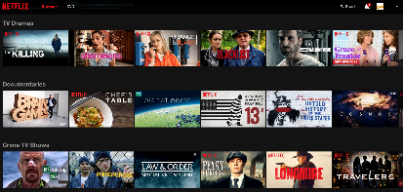
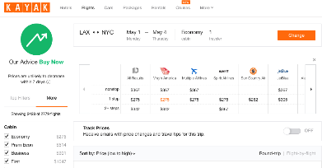




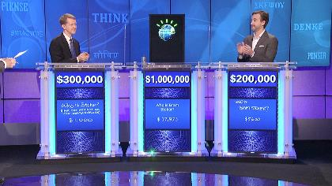
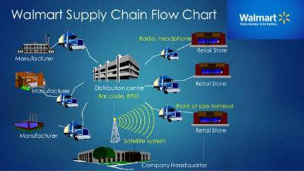



Common Use Cases
Hyper or Radical Personalization
Price and Product Optimization
Predictions and Classifications
Resource Allocation and
Strategic Planning
Discover Patterns,
Anomalies and Trends
Natural Language Processing
Notes:
There are many different ways that data science is used. Some of the more common use cases are shown on the slide. And it’s not limited to any one industry – all industries can take advantage of data science and machine learning. Take a minute and bring up your web browser. Do a Google search on “data science retail” or “data science finance” (no quotes) and you’ll see more results than you’ll ever be able to read. Keep this in mind the next time you’re meeting with a client – it’s a great way to prepare.
More details on the use cases shown on the slide can be found below.
Hyper or Radical Personalization
One of the most visible applications of data science is its use in personalizing the online shopping or online content delivery experience. The level of personalization goes further than anything else done before and that is why it is now called hyper or radical personalization.
The underlying algorithms capture each consumer’s content preferences and shopping patterns, compare them with those of other consumers and determine the content or shopping items that each individual would be most likely interested in. This is easily observed on websites like Netflix, Amazon or Facebook where the page served to each individual is unique.
Price and Product Optimization
This is another area where data science is heavily applied with significant impact. Consider a traveler going from Los Angeles to New York City next month. Each of the major US carriers probably has tens of different flight itineraries to carry passengers. Each itinerary might contain one or more flights, and on each flight the customer might request a different class of service like business, economy plus, or economy. The airline has to price all these itineraries and classes of service given how many days in advance the customer is willing to book their flight. As the flight date approaches, competitors change their fares and seats either get filled up or remain empty. The airline needs to keep updating their fares to remain attractive and ensure that each seat will be filled by the highest paying customer. The same is true for hotels and rental cars. The volume of different classes of services and the complexity of setting the fares has led these industries in adopting data science approaches to setting and updating the fares on a daily basis (for example, executing Price Optimization).
Similarly, retailers have discovered that different products are more likely to sell in different quantities across stores that are visited by different demographics. In order to take advantage of this and respect the inventory holding capacity at each store, a different set of products or quantities (more on this in a bit) are taken to each store, one that ensures higher profits given the likely shoppers at that location. This is commonly known as Product Assortment Optimization.
Predictions and Classifications
More accurate predictions of any kind is another application area for data science. We are already used to seeing weather forecasts but their impact to operations, transportation, product demand, consumption of goods and services can be further quantified through data science.
Another big area for data science is the classification of images or sensory input. This is particular useful for autonomous anything; for example, an autonomous vehicle that needs to classify the feedback it gets from sensors, such as a car in the next lane, a pedestrian crossing the street ahead, a red traffic light and so on.
Similar techniques are also becoming more prevalent in medical fields where X-ray images or MRI scans can be reviewed by data science applications which can detect several symptoms and provide initial diagnosis with increasing confidence.
Resource Allocation and Strategic Planning
Another common area of data science applications has to do with the allocation and flow of product throughout the supply chain. How much should be transported, and on which carrier, from a manufacturer to a warehouse and then when should we resupply a retail location from that warehouse? If a lot of product is stored at the warehouse, too much liquidity is tied in inventory, if too little is stored then we won’t be able to respond to a surge in demand from a certain region or particular store. This needs to happen on a daily basis across 10s of manufacturers and suppliers, 100s of warehouses, 1000s of stores and 10s of 1000s of different products.
Similarly, figuring out which pilot and crew need to work which flight, where to connect, and which connecting flight to take while respecting all union and Federal Aviation Administration (FAA) regulations is truly mind boggling. Airlines are currently using advanced data science applications to help them match crews with flights so that their operations run smoothly.
The same is true for plant managers that have to determine which work order a manufacturing crew should work on at any given time. It is no easy task and cannot really be done manually since each task in the plant is really interconnected with previous work and is blocking future work. If something is moved to a future time it will likely create various conflicts that will have to be resolved with even more changes and so on.
Resource allocation and strategic planning applications are able to take into consideration all of these interdependent factors, operational constraints and determine the best course of action to achieve the required business goals.
Discover Patterns, Anomalies and Trends
Data science is also great at detecting patterns and trends and alerting us when these are broken. It is widely used in tax and insurance or healthcare fraud detection for specifically this reason. It is also the reason search engines are able to provide reasonable recommendations before you can finish typing in your search and how retailers know what you typically shop for.
Natural Language Processing (NLP)
Finally, specific approaches in data science are able to consume, understand and process natural language leading to applications such as the various Natural Language APIs of Watson.

Slide 5
Data Scientists combine skills across various areas of expertise
Mathematical Background
Computational Science
Unicorn
Statistician
Business/Industry
Expertise
Domain Knowledge
  Supply Chain
  CRM
  Financials
  Networking
Scripting, SQL,
Python, R Scala
Data Pipelines
Big Data,
Apache Spark
Computer
Science
Domain
Expert
Notes:
There is no denying that data science is a very hot topic these days. With the growing interest, development and use of artificial intelligence (AI) technologies over the last few years, the possibilities for how this technology can significantly change business – and even our day to day lives – now seem limitless.
While new hardware, software and algorithms are leading us down the path of commoditized AI, there is still a need for somebody that can take the ever-growing mountains of data and apply this technology to gain insight from it. This is where the data scientist comes in.
Data science is such a hot field that data scientist is one of the most in-demand jobs (and therefore, one that is also very well paid :-) According to a LinkedIn survey, data scientist roles have grown over 650% since 2012. However, a Mckinsey Global Institute report projects a shortage of approximately 250,000 data scientists in the US alone by 2024. (LinkedIn report: https://economicgraph.linkedin.com/research/LinkedIns-2017-US-Emerging-Jobs-Report; MGI report: https://www.mckinsey.com/business-functions/mckinsey-analytics/our-insights/the-age-of-analytics-competing-in-a-data-driven-world)
But what makes the data scientist so special? The scope of what they are expected to know is actually quite extensive. Different data scientists will have varying degrees of expertise, but they are expected to be proficient in mathematics/statistics as well as various areas of computer science (such as programming and Big Data). An often used way of describing a data scientist is that “they are a better statistician than most programmers, and a better programmer than most statisticians.” And those that have domain expertise in the area/industry in which they’re working bring an added level of proficiency to the table.
Those people having this unique combination of skills are quite rare to find – hence the often used term “unicorn” to describe a true data scientist that can even communicate with the line of business (LOB). However, in practice you will likely not come across an individual who is an expert in all of these areas. In most cases, a group of individuals with varying strengths and weaknesses are combined into a team to assemble all of the needed skills. This is the reason that data science is often referred to as a “team sport”. This is also why the right platform – one that focuses on collaboration, ease of use, and open source technologies – is extremely important to the success of a project (and this is where Watson Studio Local fits in perfectly). The data science team and the typical roles within it will be described in more detail shortly.

Slide 6
Why are there so few models in production?
Data
Dev Ops
Skills
80% of your team’s time
is spent wrangling and
cleansing data
Getting access to data
is a challenge
Putting models into production and managing them is difficult
Governance, security and compliance issues
Hiring and retaining
talent is difficult
Explosion of new tools and teams with different skill sets
Notes:
A primary goal of a data science project is to build a model and deploy it into production. But what exactly does that mean?
It is very difficult to find a simple definition of what a machine learning model is. The way I tend to think of it is that it’s a system for making predictions, identifications, or prescribing an action to take. It’s built using various mathematical and machine learning algorithms and it “learns” by analyzing training data. This “learning” or training is a potentially long and iterative process where different algorithms might be evaluated against the data and tuning parameters are adjusted to come up with a model that will do its job as accurately as possible. Once in production (added into a business process by an application developer) new data is fed to the model to be scored or come up with a prediction. If the accuracy of the model diminishes over time then it might mean going back to the training phase – or maybe even looking at other algorithms again.
For example, an online retailer wants to improve sales by making real-time personalized recommendations to customers on other items they might want to buy before they go through the checkout process. Based on what the customer is buying now (and maybe what they bought in the past as well), what else did customers with similar profiles – who previously purchased this same item – also purchase at the same time? A model can be built using past purchase data from their customer base as the training data. They may also have additional data on user likes and dislikes, which could factor in as well. Once the model is trained and tuned, an application developer can embed that logic into the source code for the website’s checkout process. Often this is done through a microservices-based approach where the model is hosted somewhere and an API is provided for it. The application developer can call the API and pass the relevant data to it.
What are some of the difficulties or challenges that you’re likely to run into along the way? One of the big ones is the data. It’s easy to say “we’ve got lots of data that we can use to build our models” but in practice there’s a lot more to it than that. What data do you need exactly? Is it one source or multiple sources? How hard is it to actually access it? Do you trust its quality? Does it have to be massaged and manipulated into a usable form?
Most people tend to think that training is what takes the most time, but in reality it’s this data preparation phase. Good and accurate outcomes are based on good data. Remember the old adage “garbage in, garbage out”? That definitely applies here. 80% is an often quoted number for the amount of time that a data scientist spends working with data and getting it ready to use. For example: https://www.forbes.com/sites/gilpress/2016/03/23/data-preparation-most-time-consuming-least-enjoyable-data-science-task-survey-says – but keep in mind that some of these stats originate from data enrichment software vendors, so take it with a grain of salt. However, it’s still safe to assume that it’s a large and disproportionate amount of time that data science teams spend getting and preparing their data versus building and training models.
Skills is another common topic of conversation when it comes to the success or failure of a data science project. Having a strong set of data science skills is important. However, as discussed on the last slide, data scientists are in high demand and hiring and retaining talent is difficult. And it’s not just a data scientist that is typically involved, it usually requires a team of people with different skills. Having them use consistent tools with effective collaboration goes a long way towards the success of the project.
And things don’t stop once the model is put into production. It’s important to monitor the performance (the accuracy) of the model, to ensure that it’s meeting the goals originally set out. If it’s not then it may require going back and retraining the model, otherwise it’s not providing the intended value (or may actually be resulting in bad decisions which are worse than not having it in place at all). This management, monitoring and versioning of the model becomes a very important part of the process.
Consider a real estate example in which a model is created to come up with an initial sale price for a home. It uses historic home prices and sales information to see how much houses with similar features (# bedrooms, # bathrooms, finished basement, location and so on) have sold for in the past. Or conversely, maybe it’s to be used by a customer or their real estate agent to determine the value of a house the customer wishes to purchase. Is it priced too high and they should come in with a lower offer? Is it priced too low, which might suggest that there is something wrong with it? As we all know, housing prices go up (and sometimes down) over time, for various reasons. Therefore, the original model created might become less effective and less accurate over time and must be retrained.
As you’ll see later on, IBM Watson Studio Local is built to tackle these issues and make the overall process easier and faster. Even more so when partnered with IBM Power servers and PowerAI software.

Slide 7

Data Scientist Challenges & Pain Points
Rigid toolsets mean…
  Have to choose one and only one approach
  Cannot easily connect all of the capabilities required
  Difficult to navigate between the various tools used
Fragmented environments mean…
  Excessive time spent on multiple disjointed environments
  Separate on-ramp/community for each tool/environment
  Does not have meta data or data lineage
Analytical silos mean…
  Difficult to maintain and version control project assets
  Limited means of collaborating with teams
  Results are difficult to share
Notes:
Data science is a field that is filled with opportunity, especially for improvements in tooling and processes. It’s an exciting time, with new open source algorithms and libraries released every week - but this fast moving innovation also brings challenges for organizations to keep up with and manage these fast moving infrastructures and tools.
Data scientists and data science teams today typically have many pain points that they must deal with on a daily basis. Many companies struggle with which programming language to use – should they standardize on just one, like R or Python? Or should they let employees use any language of their choice? What scalable implementations should they use? How will they stitch all of this together into a flowing system for getting data science to work for the organization?
Furthermore, most data science teams don’t know their data’s lineage and lack metadata or any formal way to govern their projects. It’s typical that projects are just hacked together without any real thought into the longer term consequences of their decisions.
And once a data product has been developed, data scientists must find a way to share it with others. They need an easy way to create visualizations and dashboards for business analysts and line of business (LOB) users – deploying their work as a web service or simply even sharing the analysis with other data scientists. The barriers around sharing and deployment can be major hurdles preventing organizations from deriving value from the analysis of their data assets.
Frankly, data science is not easy.

Slide 8





Data Science is a Team Sport
Data
Engineer
Data Scientist
Business Analyst
Dev
Ops
App Developer
Dev
Ops
Extract Data
Build models
Use models
Train Models
Prepare Data
Evaluate
Deploy
Monetize
$$$
Monitor
Building cognitive applications using ML and DL
requires multiple skillsets and collaboration
Notes:
Data science is a team sport. There is no one individual that has all the right skills to create a data science application on their own (and if there is, they are affectionately known as “unicorns” due to their rarity). Some of the more common roles are shown here but others may be involved depending on the project (and some organizations have different names for these roles, or more specialized roles for what is shown here, but ultimately those people involved with the steps shown here are included, regardless of what their actual title is). This does not imply that there is only one person per role – you may have multiple data scientists or multiple application developers on a team.
Data Engineer: Helps gather, organize and clean the data that the data scientist will ultimately use to build and train their models. Data typically comes from multiple, disparate systems and the process of “refining” all of this data is often a complicated process.
Data Scientist: Uses advanced analytics techniques – including (but not limited to) deep learning, machine learning, modeling, statistics and visualization – to find hidden patterns in data. They construct models to predict outcomes or discover underlying patterns, to produce actionable insights that can be used to improve future outcomes. They typically have a variety of skill sets including statistics, computer science, domain expertise (they understand the business) and more.
Business Analyst (sometimes referred to as the Citizen Analyst): Provides business-level expertise and guidance. They understand the business needs and help evaluate the results of the models being built.
Application Developer: Responsible for building the applications where the models will sit (or will be called, via an exposed API). They are effectively “baking in” the data science results into the company’s business processes.
Dev Ops (Development Operations): Working closely with an application developer, Dev Ops needs to build, deploy and manage applications that put the deep learning and machine learning algorithms to work. Part of this work is to ensure the integration with the operational data, where this new, unseen data is inferenced (scored) against the model. When model scoring is used against the operational data, its accuracy needs to be monitored to ensure it is not losing precision, or better yet, the new data is leveraged to improve the model’s accuracy. This involves working with the data scientist to retrain a model with the feedback data before redeploying it into the application again.
Some of the information above was taken from an IBM white paper on the makeup of data science teams (https://www-01.ibm.com/common/ssi/cgi-bin/ssialias?htmlfid=CDM12348USEN). See that paper for additional details on the different roles.

Slide 9














Watson Studio Local (WSL)
is a collaborative platform for
data scientists, built on open source components with IBM added value
IBM ranked as “Visionary” in 2018 Gartner
Magic Quadrant for Data Science Platforms
Notes:
IBM Watson Studio Local (WSL) is an environment that brings together everything that a data scientist needs. It includes the most popular Open Source tools and unique IBM value-add capabilities, with community and social features, all integrated as first class citizens to make data scientists more successful. The goal is to have all of the tools that a data scientist needs in one place, thereby making it easier for data science teams to learn, create, and collaborate.
Additionally, WSL helps operationalize machine learning. In the enterprise world, it's not enough to just build a model. IBM WSL helps you bring those models into your production environment and lets you manage the quality of those models over time.
Gartner Magic Quadrant source: https://www.gartner.com/doc/3860063/magic-quadrant-data-science-machinelearning. While it is an accomplishment in itself to be considered as part of the Visionary category, IBM was included in the Leadership category in 2017. At the time, Gartner noted that “DSX is likely to be one of the most attractive platforms in the future – modern, open, flexible, and suitable for a range of users, from expert data scientists to business users” (Watson Studio Local was previously called Data Science Experience (DSX)). To IBM’s dismay, Watson Studio Local was not fully evaluated as part of the 2018 assessment and we feel that we are in fact a Leader in this space. More details on this, including IBM’s internal response can be found here: https://ibm.ent.box.com/s/2259an361xlp4hqkxmcuekqihku5lbs8.

Slide 10
IBM Gives Data Scientists Their Choice of Tools
Combined with a Secure Enterprise Platform
Freedom:
Choose the right tool
for your team and business, including open source
Productivity:
Make both experienced and novice data scientists more productive
Trust:
Confidently deploy insights generated
from the most current data and trends
Notes:
With Watson Studio Local (WSL), IBM brings collaboration across the enterprise for teams to quickly get competitive insights from their data.
What kinds of things are important to an enterprise and to the data science team?
1. Freedom – For the enterprise, and for the data scientist, you don’t want to be locked into a particular framework or platform. You need to have the freedom to choose a language, framework and platform of your choice. Often this means open source.
2. Productivity – Data scientists are a highly valuable asset in your organization. They are in high demand. According to a McKinsey Global Institute report there will be shortage of roughly 250,000 data scientists in the US alone by 2024 (https://www.mckinsey.com/business-functions/mckinsey-analytics/our-insights/the-age-of-analytics-competing-in-a-data-driven-world). So, you want to get the most productivity out of your data science team and also equip non-data scientists with basic data science skills and tooling.
3. Trust – As a business and technology leader, you need to know that the insights being produced are usable and based on current trends (and your analytics models are only as good as the data fed into it). You can confidently deploy these insights in a variety of different situations knowing that your insights are accurate.

Slide 11
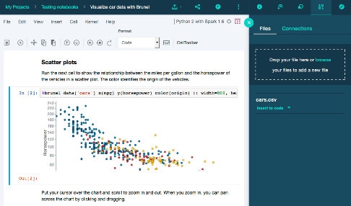
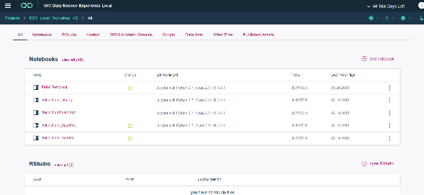
IBM Watson Studio Local
Go from experimentation to production faster
Data Preparation
Implementation
Exploration
Production
Model Development
Data Exploration
Model Management
Deployment
Explore & Learn
Use Jupyter notebooks (Python, R, and Scala). Code or use drag & drop visualization tools.
Model & Evaluate
Build and optimize
models using the top
Open Source tools.
Deploy & Predict
Develop and deploy where you want, whether you need to develop behind the firewall or in the cloud.
Monitor & Measure
Measure the performance and results of your models with built in performance monitoring.
Notes:
Watson Studio Local (WSL) was designed to address the challenges faced by organizations as they embark on their data science journey and to help transform their business by deriving maximum value out of their investments in new data science and advanced analytics capabilities.
The key take-away is that WSL is an enterprise data science platform that allows you to easily collaborate across teams, use the top open source tools, get your models into production faster and integrate these models into enterprise applications.
Let’s take a bit more detailed look at the WSL capabilities. WSL is a self-contained and extendable platform. It’s self-contained because it includes everything that’s needed to develop and deploy analytics applications. It’s extendible because it works with a number of existing compute and data sources like remote Spark clusters, multiple databases and Hadoop. WSL integrates with LDAP and supports adding additional libraries to development environments.
The development tools that analysts can use in WSL include Jupyter notebooks and RStudio, among other things. The runtime engine is Spark. Customers have an option of using Spark that’s bundled with WSL or they can use remote Spark using the Livy API.
“Projects” in WSL are a great way to work with a team… share a set of assets and then build new models and analyze them together. Projects are a core component of WSL. Projects make collaboration easier – they are a collaborative entity with data services, connections, object storage, notebooks and more. A framework like this can play a huge role in bringing down siloes across the various data personas and promote collaboration.
We often get questions about WSL integration with Hadoop. The first type of integration is when Hadoop is used as a data source. WSL supports both secure and unsecure connection to HDFS and Hive. You can configure a connection via the UI or programmatically. If you configure a connection via the UI, you can browse for files, preview them, and share data sources with project collaborators. The second type of integration is using a Spark environment in the Hadoop cluster for running WSL notebooks and batch jobs. The main advantage of this approach is cutting down the performance impact of moving data from Hadoop to the Spark cluster in WSL.
With our Deployment Manager, you can easily deploy a trained model without any coding.
WSL supports the deployment of different types of analytic assets. In WSL, an analytic asset is a notebook, a model, an SPSS stream, an R-based Shiny application or a script. In general, there are two deployment options, batch and online. Most analytic assets support both deployment options.
Online deployment makes the analytical asset accessible via a REST API. It is supported for SparkML, scikit-learn, Keras, XGBoost, TensorFlow, and PMML models. Online deployment scores one row of data at a time, and that data is passed in with the scoring request (via the API). Scoring results are returned with the REST response. The model that has been deployed can be tested with WSL’s Test UI or REST API in notebooks. After the data scientist has tested the model, it can be integrated with a line of business application.
Batch deployment is usually defined as the scoring of a static data set. During scoring, data is read in from a static data source and output results are written to the same or different data source. In WSL, batch scoring is supported for SparkML, scikit-learn, Keras, XGBoost, TensorFlow, and notebooks.
WSL’s model management dashboard shows the predictive accuracy of your models. Data scientists and IT can review, and even schedule evaluation of deployed models, so you spend less of your time managing what’s in production, and more time on driving business results.
And finally WSL includes Platform Administration dashboards which help clients monitor the status of their systems, view log files, and restart services when needed.

Slide 12
IBM is The Leading Platform Across the Data Science Lifecycle
Data Preparation & Exploration
Model Development & Implementation
Deployment & Model Management
DS Lifecycle
  Visual exploration of unstructured data (text, img)
  Access any data sources:
  on-premises, private,
  public cloud
  Ability to use extensive data connectors (pre-built/yours)
  Flexibility and choice of tooling in the workflow
  Enhanced visualization to explore & prepare data
  Combined predictive & prescriptive capabilities
  Combined open source & visual model building
  Support GPU based deep learning models
  Model version
  control & security
  Ease of deployment in
  multi-cloud environment
  Model management, evaluation & auto-retrain
  Deep learning deployment
  & model management
  Multi-deployment platform integration (private cloud, Docker, Hadoop, IIAS)
IBM
Collaboration
Open Source
Deployment
Other Vendors
Notes:
A data science application follows a simple process flow / lifecycle:
Data collection, preparation and exploration
Model development and implementation
Model deployment and management
Watson Studio Local (WSL) offers all of the tools necessary to drive the full data science life cycle.
For data preparation and exploration, WSL provides the ability to connect to a number of data sources to access data needed for effective exploration and analysis. Data can come from a number of diverse sources. This can be data from external sources like Internet-of-Things (IoT) sensors, on-line services like weather data providers, as well as internal sources like historical transactional systems that provide a rich history of past consumer behavior. A broad set of tools (Jupiter notebooks, RStudio, Spark and so on) are include for data exploration, visualization and transformation.
For model development and implementation, WSL provides the ability for data scientists to collaborate in teams, explore the data sets made available from the previous steps in the process and develop and experiment with data science models, algorithms and approaches from different fields to produce, results, insights and recommendations.
WSL facilitates creation of machine learning models and also the deployment of those models as RESTful API end-points. Capabilities like git integration and being able to publish content in multiple formats (PDF, HTML, R-Shiny apps and so on) enhance collaboration across data science and business teams. Add-ons like Decision Optimization and SPSS provides the capabilities to use visual model building and for delivering prescriptive analytics.
For model deployment and management, WSL supports the deployment of models in production systems so that they can be called upon to process new data that will be made available by new customers or returning customers, or by line of business users reacting to the business needs and environment.
Deployed models can be monitored through a dashboard and this supports model versioning and evaluation. Model evaluation is scoring the model against the new set of historical data to evaluate its performance. We have to monitor performance because models were built on a snapshot of data, and as data or the business environment changes, it’s possible that the model no longer contains the best predictors. WSL provides two views for model evaluation. You can use the model details view which shows model accuracy of the selected model version as well as model accuracy over time. It also shows results of evaluation batch jobs. The Model Management dashboard shows an evaluation summary for all models and model refresh can also be automated as desired.
WSL supports the Dev -> Test -> Staging -> Production paradigm for continuous development / continuous integration (CD/CI). It enables a clear path to the promotion of assets to production, while enabling development to continue.
In summary, WSL provides an end-to-end collaboration and deployment platform for data science – from development to deployment and integration with line of business applications.

Slide 13
IBM Watson Studio Local Can
Increase the ROI of Your Data Science Team
50%
Reduction in
Dev Ops Time
10%
Reduction in Data Cleansing Time
10%
Reduction in Data Collection Time
5%
Increased value per model
*Assumptions Based On a 30 Person Data Science Team
Notes:
WSL provides opportunities to save time and money across various aspects of the analytics lifecycle.
For example, savings are incurred through collaboration – where team members have access to the same shared data sets, analytics assets and best practices. Consolidation is another example, where the users have access to the same tools (without having to search for and install each one separately) so there’s no need to jump between disjointed environments and they have access to all of the same data regardless of the tool selected.
The numbers shown on the slide are based on an IBM business case assessment of a real customer and their potential (conservative) savings – specifically in regards to their data scientists. Results shown may not be typical and in no way does IBM commit to similar savings in other scenarios. The intention here isn’t to show your client the specific savings they can expect, but the ways in which WSL can help increase their return on investment (ROI) for their data science team.
Here are the numbers and assumptions that made up the business case (based on this specific customer):
Loaded labor cost for data scientist: $150K
User base of 30 users initially - total cost for data scientists $4.5M
Users base spread across the enterprise
IT cost to install, upgrade and interwork tools for users: $100K
Collaboration - potential increased performance of concepts
2 Collaborators: 16% improvement
3-5 Collaborators: 32% improvement
6+ Collaborators: 58% improvement
Consolidation – Data preparation and integration in one place
60% data cleansing
19% collecting data sets
3% building training sets
9% mining for patterns
4% refining algorithms
5% other
Deployment - Average Business Value of a data scientist’s model: $250K
(assumes output is worth ~3/2 their cost to business)
Here are the projected cost savings:
Collaboration - Opportunity Value ($360k/year):
WSL Projects and Community allow increased collaboration resulting in 5% better business value for models
$12k opportunity value per data scientist = $360k
Consolidation - Cost Savings through WSL usage ($365k):
WSL brings data cleansing libraries, automated data preparation capabilities and the ability for the entire team to share cleansed data sets
10% reduction in data cleansing time (6% overall for Data Scientists time = $270k)
WSL community provides the entire team equal access to popular and useful data sets
10% reduction in collecting data set time (1% overall for Data Scientists time = $45k)
IT Team no longer needs to install, upgrade and interconnect Data Science Tools, instead needs only to maintain single WSL cluster:
50% reduction in IT cost = $50K
Deployment - Opportunity Value of early Deployment ($300k/year):
WSL deployment allows each data scientist’s work to be deployed 2 weeks per year earlier on average realizing the business benefit for that time:
$10k per data scientist = $300k
Total Value: $1.025M / yr.

Slide 14
Only
IBM Watson Studio Local Provides…
Hybrid Environment
Access all of your data (on-premises, GPU, private/public cloud)
Securely train models behind your firewall and deploy where you want – on-premises/private cloud/public cloud
Extensive Data Science Tools
Secure access to Open Source tools & visual modeling
Visual exploration of unstructured data (text, image)
Decision Optimization with machine learning
Ease of Production
Flexible and fast
deployment
Security, compliance & governance
Advanced model management capabilities
Notes:
Data science and IT leaders struggle with securely accessing data, using open source on approved platforms, and getting their models into production fast. To accelerate your data science practice, IBM has developed a platform called Watson Studio Local (WSL) that provides a differentiated approach to solving your team’s challenges:
Hybrid
First we provide a hybrid environment, because the reality is, your data is everywhere, you need the ability to access all of your data, whether it’s on a mainframe, on a Hortonworks Hadoop cluster, in a private cloud, or on a public cloud. There is so much data behind the firewall that it doesn’t make sense to move it, and sometimes regulations won’t allow you to move your data. So, IBM is one of the few vendors that allows you to train your models behind your own firewall, and then easily deploy where you want – on-premises/private cloud or public cloud. For example, you could build a model on-premises using WSL (using private/sensitive data that might need to remain behind the firewall for security reasons) but then deploy the model on the IBM Cloud using Watson Machine Learning.
Tools
WSL also provides a wide array of data science tools, so you can utilize the skill sets of your entire team, whether they’re a coder or non-coder. Your data scientists or data analysts can use the top open source tools in an approved environment, or they can use drag and drop tools with WSL’s visual model builder. You can also use advanced data science tools to do visual exploration of unstructured data (e.g. text, images), as well as do Decision Optimization to get more out of your machine learning models.
Production
WSL accelerates your models into production – which is where many enterprises struggle. With WSL’s advanced deployment and model management capabilities, you can easily deploy your trained models without coding and reduce your Dev Ops time. All done in a secure environment.

Slide 15
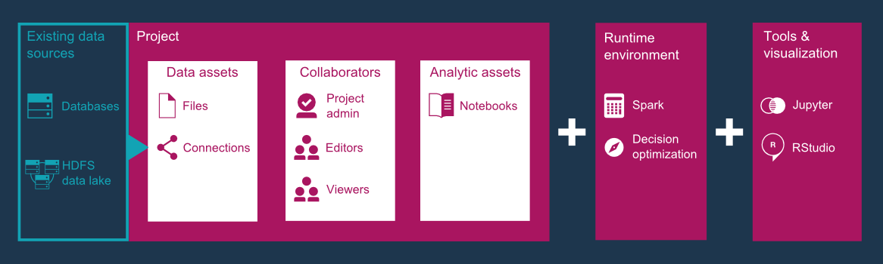
WSL is a self-contained and extendable platform for developing and deploying analytics applications
WSL includes…
Notes:
IBM Watson Studio Local (WSL) is a self-contained and extendable platform for developing and deploying analytics applications. It offers a suite of data science tools, such as RStudio, Spark, Jupyter notebooks and so on, that are integrated with proprietary IBM technologies.
The intuitive WSL user interface provides a collaborative projects space for teams and individuals to reduce the time to value. Projects are your home base for collaboration. You can use projects to collect assets, such as notebooks, models, data sources, and remote and local data sets, in one place. Projects are a great way to work with a team: share a set of assets and then build new models and analysis together. You can collaborate either in WSL or an external Git repository.
You can create notebooks in R, Python, or Scala. Start from scratch, import an existing notebook, or use one of the samples provided within the Community space of WSL.

Slide 16
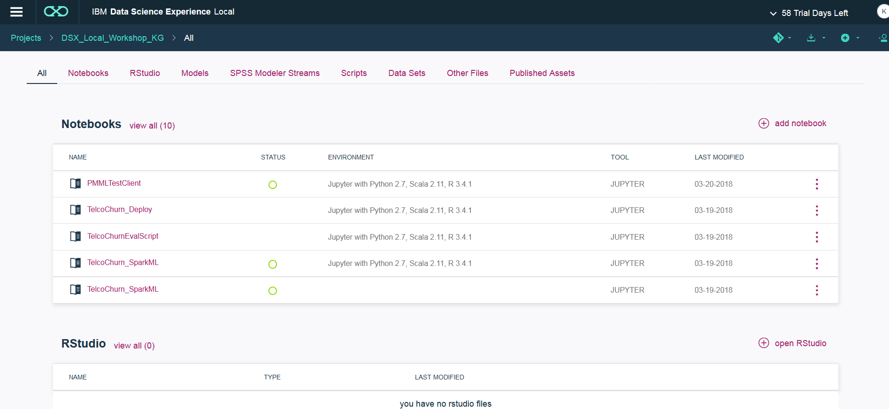
Collaborate Using Projects
Notes:
Projects are a core component of Watson Studio Local (WSL). Projects make collaboration easier – they are a collaborative entity with data services, connections, object storage, notebooks and more. Simply put, a project is a logical grouping of assets that users collaborate on.
Once you create a new project within WSL, you are presented with an interface like the one shown in the slide. It is a project management framework where you can view/create/add/modify/remove various assets. A framework like this can play a huge role in bringing down siloes across the various data personas in an organization and promote collaboration.

Slide 17
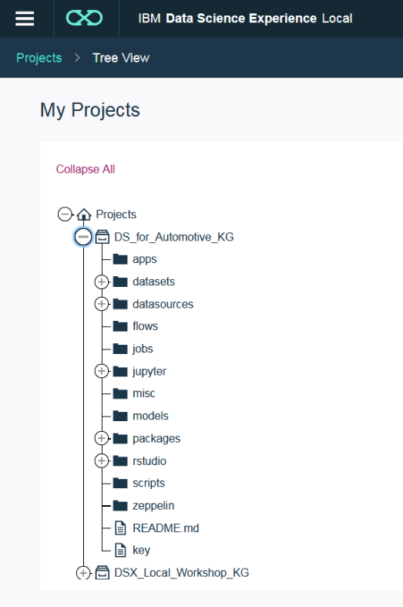
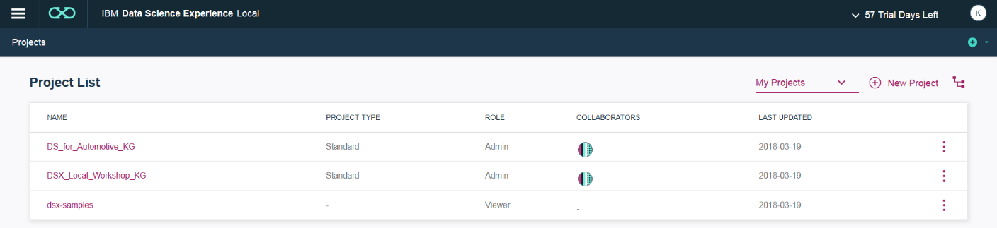
Create Projects
A project is how you organize your assets
to achieve a particular data analysis goal.
Your project assets can include:
  Notebooks
  RStudio files
  Models
  SPSS Modeler Streams (add-on)
  Data sets (local files and remote data sets)
  Scripts
  Published assets
Notes:
Projects are the primary way of collaborating and organizing the various assets that are used as part of achieving a particular data analysis goal. The slide contains a list of the types of assets that can be included in a project. WSL even provides a sample project named dsx-samples, available to all users, with sample notebooks to help users get started.

Slide 18
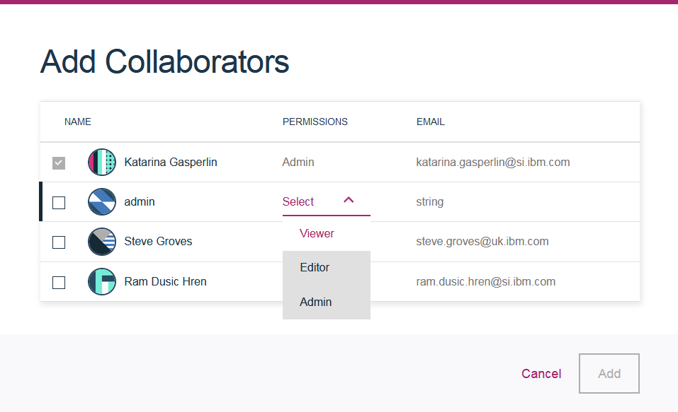
Share, fork and reuse Project assets to increase your data science team’s productivity
Notes:
Projects allow different users and personas to share sets of assets while building their data products. For example, you can create a Project, add in your assets such as a notebook and files into an object storage-based repository, and then add collaborators such as your co-workers. Your collaborators can have different permission rights too. Maybe you’ll make some of your collaborators Editors of the Project, others Viewers, and maybe a couple of people will have Admin rights.
You can also easily share notebooks with others by posting its permalink in view-only mode on Twitter, GitHub, Slack, and so on.

Slide 19
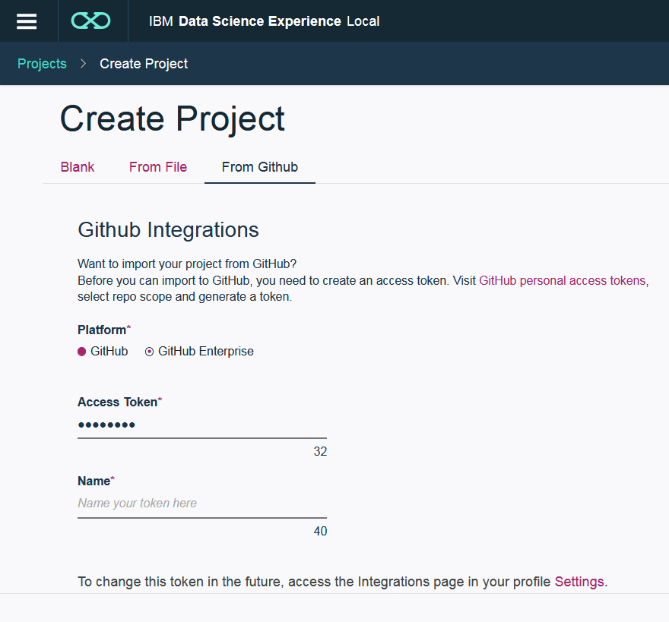
GitHub Integration
When starting a project you can:
  Create new project
  Import a project
  Connect to a project
  on GitHub
Notes:
IBM Watson Studio Local (WSL) includes integration with GitHub to enhance the collaboration between data scientists and teams. You can combine code, data and visualizations in real-time with your colleagues.
The various ways you can use GitHub with WSL are listed below:
Connect your GitHub account with WSL
Connect a GitHub repo to a WSL Project
Publish your notebook to GitHub
Import notebooks from GitHub
What is git and GitHub? git is an open source distributed version control system, used to track changes in files and coordinate work on those files among multiple people, and GitHub is a web-based hosting service for git repositories. GitHub does add some extra functionality on top of what git itself provides. For more information on git and GitHub see here: http://try.github.io/.
For a step by step approach (with screenshots) to connect WSL and GitHub, please look here: https://medium.com/ibm-data-science-experience/github-integration-available-3ffcdda4a76b.
For those who want version control but don’t feel too comfortable with GitHub, WSL has its own simplified version control available too, that is based on Jupyter checkpoints and is limited to 10 versions of each notebook.

Slide 20
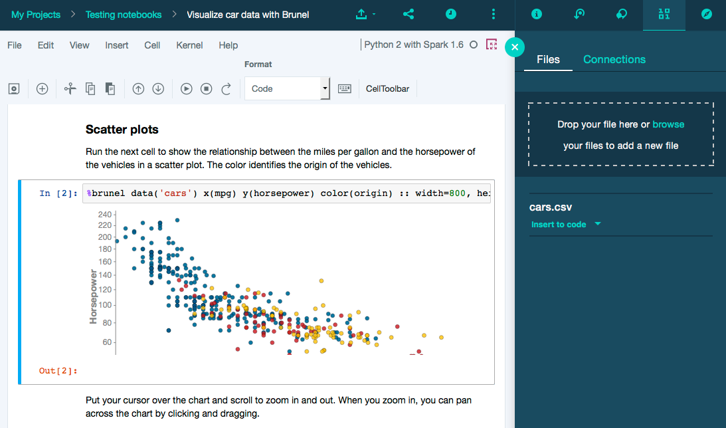
Integrated notebooks for interactive and collaborative environment – seamless Spark execution
Notes:
Included with Watson Studio Local (WSL) are Jupyter and Zeppelin notebooks; these are web-based applications for interactive computing that are very popular tools for data scientists and other data professionals. Rather than get into specific details here, we’ll explain more about notebooks on the next slide. At the time of writing (3Q18), the cloud-based Watson Studio offering does not include Zeppelin notebooks, only Jupyter notebooks. Over time the capabilities will become common across both Watson Studio and WSL.
Also included with WSL is Apache Spark (Spark). Spark is an open source, fast, flexible, developer-friendly, in-memory data processing engine. High-level APIs allow for programming in Java, Scala, Python and R. Spark is frequently used for large-scale SQL, batch processing, stream processing and machine learning. Within WSL, Spark jobs can be submitted and subsequently monitored by calling APIs. IBM is a key contributor to Spark.
A key takeaway here is that these are popular, open source technologies that are seamlessly integrated into WSL. These are tools that data professionals are familiar with and so WSL gives them an environment that they already know and love and can be immediately productive with.

Slide 21


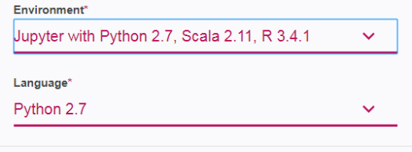
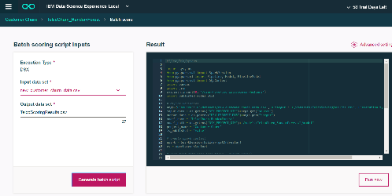
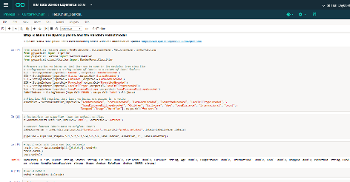
What is a notebook?
A notebook is an open-source web application that
allows you to create and share documents that contain live code, equations, visualizations and explanatory text
Jupyter
Notebooks
Zeppelin
Notebooks
Evaluate
Create Jupyter Notebook & Select Environment & Language
Analyze Data and Create Model within Notebook
Batch Deploy
Example WSL Machine Learning Workflow
Deploy using RESTful API for Real-Time Scoing
Notes:
A notebook is an open-source web application that allows you to create and share documents that contain live code, equations, visualizations and explanatory (narrative) text. Uses for notebooks include data cleansing and transformation, numerical simulation, statistical modeling, data visualization, machine learning annotation, and much more.
Within a notebook, you can run small pieces of code that process your data and immediately view the results of your computation. Notebooks include all of the building blocks you need to work with data:
The data
The code computations that process the data
Visualizations of the results
Text and rich media to enhance understanding
Two commonly used notebooks are Jupyter Notebook and Apache Zeppelin. Both are open source. Jupyter Notebook (formerly IPython Notebook) came first and is more widely used. In a 2017 Kaggle survey (https://www.kaggle.com/surveys/2017), data scientists were asked what tools they use and 40% of respondents said that they use Jupyter notebooks. Zeppelin was not on the list. However, Zeppelin is a newer player, with some differentiating capabilities and more modern features, and it’s use is growing. WSL includes both types. However, at the time of writing (3Q18), the cloud-based Watson Studio offering does not include Zeppelin notebooks, only Jupyter notebooks. Over time the capabilities will become common across both Watson Studio and WSL.
In any case, both notebook types are available within WSL and so data scientists have their choice. Open source… choice… familiarity… all common, recurring themes within WSL.
Shown here is a sample workflow showing how to create new Jupyter Notebook and then use it to create a model. Once done it can be used for batch scoring or for real-time scoring using an API. The specific details in the small screenshots aren’t important, but you can see the interactive and graphical nature of the process.

Slide 22
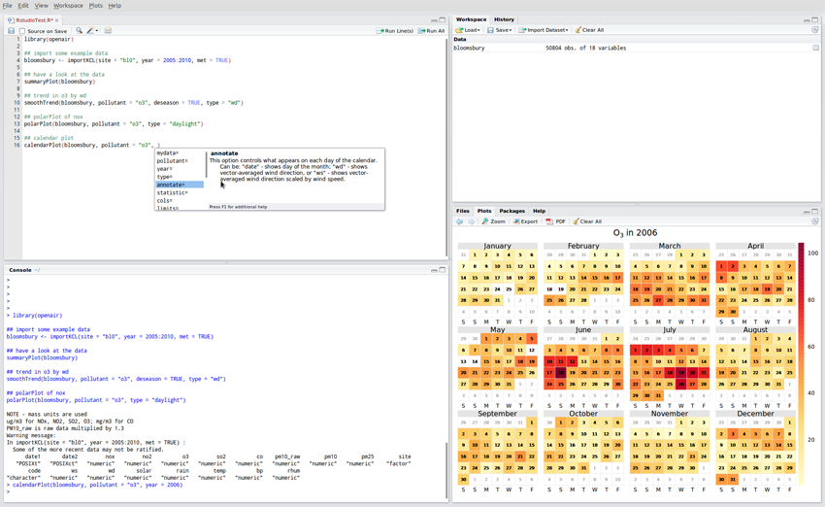
IBM Watson Studio Local has R built into the experience thanks to our strategic partnership with RStudio
Notes:
R is a popular statistical analysis and machine-learning package that enables data management and includes tests, models, analyses, and graphics. RStudio, included in IBM Watson Studio Local (WSL), provides an Integrated Development Environment (IDE) for working with R.
In June of 2016, IBM announced a strategic partnership with RStudio to further demonstrate IBM’s commitment to the R language and to build a superior experience for data scientists.
RStudio is a provider of open-source and enterprise-ready commercial tools for the R community. Founded in 2008, it is headquartered in Boston, MA. Inspired by the innovations of R users in science, education, and industry, RStudio develops free and open tools for R and enterprise-ready professional products for teams to scale and share work.
A partnership with RStudio brings together IBM’s Big Data & Analytics technology depth and services breadth with RStudio’s platform and expertise on R. We are mutually aligned on the goal to make R a first-class citizen for data science.
IBM integrates RStudio’s open source offerings (RStudio Server and Shiny Server) into WSL. RStudio Server is an IDE for R. It includes a console, syntax-highlighting editor that supports direct code execution, as well as tools for plotting, history, debugging and workspace management. Shiny Server is an open source web application server that combines the power of R with the interactivity of the modern web, providing the deployment needed for Shiny applications.
You can easily install the more than 5000 R packages on CRAN (Comprehensive R Archive Network) in WSL RStudio.
In a 2017 Kaggle survey (https://www.kaggle.com/surveys/2017), data scientists were asked what tools they use and almost 60% of the respondents said that they use R (only behind Python – which can also be used as part of notebooks in WSL).

Slide 23
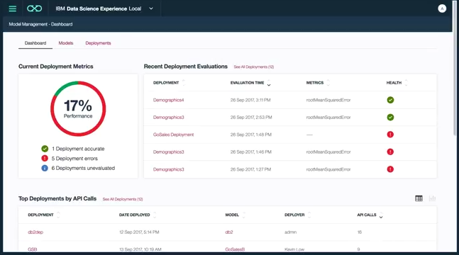
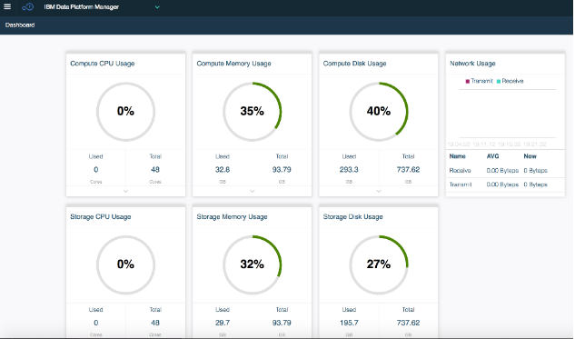
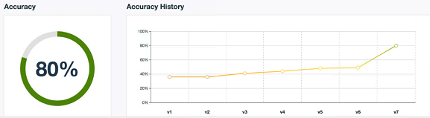
Deploy, monitor and manage
Monitor models through a dashboard
Model versioning, evaluation history
Publish versions of models, supporting dev/stage/production paradigm
Monitor scalability through
cluster dashboard
Adapt scalability by redistributing compute/memory/disk resources
Watch it in action
  http://ibm.biz/WSL-Models
Notes:
With Watson Studio Local (WSL), you can build your own models using WSL’s powerful and easy-to-use model builder (you also have the option of importing models).
When building a model, the first thing you need is data to analyze and that can be pulled in directly from a data repository like database or Hadoop, among others, or from an uploaded asset file (e.g. a CSV file). A meaningful model requires data that is thorough and well formatted. WSL can prepare the data for you and automatically choose the best transformers based on the given data. Or, you can manually choose the transformers yourself – and WSL provides a wide variety of them (example: check for missing values, automatic indexing of strings).
The data scientist then needs to do feature engineering, evaluate various algorithms, and train the model. WSL provides a lot of options in terms of the techniques (algorithms) it can use. Based on the data being used and the desired outcome (example: a column value to predict), WSL will actually make recommendations on what techniques might be most appropriate to use. You can add estimators to train on the data and produce a model for each one. As part of model evaluation, you can select which trained model you want to keep and save it. Each time you save the model, its version is incremented and past versions are maintained – so you have version control of the model. You can use this to compare the accuracies of each version you ran. WSL also provides a way to test the model by providing input data and displaying the results using WSL’s easy to understand visualizations (such as with a pie chart or bar graph).
At this point, the data scientist has a model that they’re happy with and they’re ready to put it into production. This is the point where enterprises struggle – how do you take this model and make it consumable? With WSL, the data scientist “commits” the model and provides a version tag for it. Dev Ops (Development Operations) can then use this to create a product release and deploy the model – and with that WSL provides a REST-based scoring API endpoint (a URL) for you to use in your machine learning applications. You can also run batch prediction jobs that read in a data set, score the data, and output the predictions to a CSV file.
WSL can use automated scripts to do evaluations of the models over time and show how they're performing... that way you can know when time to retrain or rebuild any unhealthy models.
As you can see, there are a lot of steps involved in building a model and making it available for production use (and it’s typically an iterative process where you’re going through these steps multiple times over the life of a model). And the more models you build, the more difficult they are to keep track of. Using WSL’s model management dashboard, you can manage all of your user’s models and deployments in one place. You can also view statistics about your models and monitor their health. You can use WSL to test and deploy the models as APIs, retrain the models as needed, and share the models with colleagues. You can also monitor and manage the resources of the WSL cluster itself through the console.
Just remember that it’s not all about a data scientist building a model – WSL helps operationalize machine learning by helping you put your models into production and manage their quality over time.
This video shows a good overview of the process: http://ibm.biz/WSL-Models

Slide 24



Faster time to action is what will differentiate you from your competitors
but ...
Limited time and resources means fewer (or less accurate) models get built and deployed
Setting up and using open source AI frameworks is complicated
True Cognitive Systems are about co-optimized
software
+
hardware
which just work for machine learning, deep learning and artificial intelligence
Notes:
A promise of data science is to be able to gain insights from data and use this to make critical decisions and bring new capabilities to market. Competitive advantage comes from being able to do this quickly and accurately. This is what is meant here by faster time to action.
<CLICK>
But it has probably become evident to you by this point that data science – and the disciplines of machine learning and deep learning – aren’t easy. It takes people with the right skills using the right tools for the job. But even then there are difficulties and challenges along the way. The good news is that many of these challenges are solved or simplified by IBM Watson Studio Local (WSL).
However, even with the best people and tools, it takes time. It takes time to build an environment and setup open source-based deep learning frameworks (although this is helped by WSL as well). It takes time to train and tune models. Inferencing (scoring data using a model) takes time. And as they say, “time is money”. In fact, the act of training a model is a highly iterative process where training data is passed through the model over and over again – possibly thousands and thousands of times. Generally speaking, the more times this is done, the more accurate the result. Another factor is the amount of data you’re dealing with. The more data you have, the longer these training runs will typically take. In some situations, training a model can take hours or days… even weeks.
<CLICK>
Because of this, infrastructure matters a great deal. What if your infrastructure can speed up training times by 2x … or 10x … or more? What value does this provide to you? For one, it means building and deploying your models faster, which leads to faster time to action. It also means being able to move on to other business challenges and building more models, which will ultimately bring more value to your organization. Or maybe you take the time savings and use it to do further refinement on the original model by executing more training iterations on it, giving you a more accurate model. Or perhaps it’s some combination of both approaches.
Servers are getting faster all of the time, but incremental processor improvements aren’t enough to keep up with the ever-growing mountains of data that organizations want to analyze. What’s needed are systems that are built for the Cognitive Era. Co-optimized hardware and software that work together.
And with that, let’s talk about how IBM Power Systems and PowerAI software provide the best foundation on which to run Enterprise AI…

Slide 25

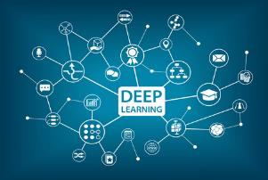



Deploy WSL directly
on Power servers
(VMs, bare metal) or on top of IBM Cloud Private
Utilize PowerAI Deep Learning libraries and frameworks optimized
for Power hardware
Watson Studio Local
on IBM Power Systems
Why Power servers?
Superior performance and value for
data intensive and AI workloads
Delivered secure
#1 in reliability
Enterprise-cloud ready
WSL leverages the unique capabilities
of Power hardware and optimized
PowerAI software
Get blazing fast results for your AI and ML/DL workloads using breakthrough POWER9
servers with GPU acceleration
CPU Optimized
GPU Accelerated
Notes:
Power Systems offer an optimized platform for deploying Watson Studio Local (WSL) because they are designed from the ground up to support data intensive and AI workloads.
Up to this point, you’ve seen the value of WSL as a data science platform … greatly simplifying and speeding up the work that needs to be done by data scientists and their extended teams (through the phases of data preparation, model building, training, evaluation, deployment and monitoring).
However, enterprise data scientists are often constrained by a lack of compute resources. Deep learning (DL) neural networks and machine learning (ML) techniques require a lot of processing power and a lot of memory – particularly during training on larger datasets. CPUs are great for general purpose work, but not so much for these types of workloads that are doing a lot of statistical analysis and matrix mathematics. It turns out that GPUs (Graphical Processing Units – they had their origins in personal computers for graphics and gaming) are really good at doing this kind of work. So, the trend over the last few years has been to include GPUs inside of servers, to offload this difficult work from the CPUs and to accelerate AI workloads as a result. But not all architectures are created equal. As you’ll see in the upcoming slides, the IBM Power AC922 server with NVidia GPUs and NVLink 2.0 is built to be the best server for Enterprise AI. The key value is the time-to-insight… accelerating time-to-results and driving greater productivity. It should be noted, however, that WSL does not require that the servers have GPUs. For example, the LC922 server is a great option for workloads when GPUs aren’t needed, nor desired, for whatever reason.
Infrastructure matters. Not just for performance, as we’ve talked about above, but for things like security and reliability. For mission critical applications (data intensive workloads tend to be the most critical in any enterprise), reliability is always an important consideration when choosing the underlying hardware. In December of 2017, Information Technology Intelligence Consulting (ITIC), completed a study called the “ITIC 2017 - 2018 Global Server Hardware, Server OS Reliability Report”. This Report compared the reliability of 14 major server platforms, 18 server operating system distributions and 11 server hardware virtualization layers. In it they showed that both IBM AIX on Power Systems as well as several Linux distributions running on Power Systems had the lowest unplanned downtime of any non-mainframe vendor/OS combination they looked at; only 0.11 hours of unplanned downtime per year. That is in stark contrast to solutions offered by Dell, HP and Oracle whose unplanned downtime ranged from 0.25 to 0.46 hours per year per server. Enterprise clients in the survey considered 0.2 hours to be the cut-off for acceptable mission critical reliability. The benefit to an organization of having the reliability of Power Systems behind them means more productivity and less stress for those managing the infrastructure. The full ITIC report can be found here: https://cloud.kapostcontent.net/pub/3dee045e-4b09-48e3-9077-8b126a9f2093/itic-2017-2018-global-server-hardware-server-os-reliability-report.pdf.
Security is (or should be) at the forefront of most clients’ minds as well. Security incidents and data breaches often make big news because of the potential impact they have to the business and their customers. While some companies are making a move to the public cloud, others (including some who are reversing their decision after realizing that the public cloud isn’t everything they thought it would be) want to keep their data local and secure behind their firewall. With an IBM Power Systems server, you know that the system is secure. Power servers have security built in at all layers, from the processor cores to the OS, and IBM tests all permutations of entire stack to deliver end to end security.
Performance, security, reliability, hardware-optimized software, simplicity … all advantages that clients will get with the winning combination of WSL and Power Systems.
WSL is available to install as a standalone product, but it’s also available in other ways. For example, it can be deployed within in the IBM Cloud Private (ICP) environment. ICP is a full stack private cloud software offering, built using industry standard open source technologies (such as Docker, Kubernetes and Terraform). Included is a self-service catalog of application runtimes, data services, analytics tooling (including WSL), and much more. WSL is also a standard component of the IBM Integrated Analytics System (IIAS) – an optimized hardware and software appliance with a massively parallel processing (MPP) architecture. Each node uses IBM Power processors and FlashSystem storage for advanced query performance. It also provides high-performance Db2 processing and BLU Acceleration for dynamic in-memory computing capabilities. WSL is integrated into the system and allows you to quickly connect to the data in IIAS (as well as other data outside the system) to begin modeling immediately.

Slide 26


Top Reasons Why Clients Choose PowerAI
Simplicity: Integrated
Platform that Just Works
Ease of Use,
Unique Capabilities
Faster Model Training Time
Open AI Platform with Ecosystem Partners
Power9
CPU
IBM SW
ISV SW
Solution SIs
PowerAI
GPU
AI Platform
Built for the Enterprise
Co-optimized hardware/software
Distributed
Deep Learning
Large
Model Support
Auto Tuning
Scalability to
10s of Servers & 100s of GPUs
Platform Partners Can Build On:
Software Partners, System Integrators, Silicon Vendors
Notes:
Clients are choosing our PowerAI offering for four key reasons:
Simplicity
Unique capabilities
Faster AI model training
The open platform we provide that enables startups and IBM software to reach our clients
Simplicity is key. We’re providing an AI platform that just works. It can take weeks and even up to months to deploy infrastructure, open source frameworks, optimize them, and so on. IBM PowerAI lets you deploy your preferred open sourced deep learning (DL) framework during the time it takes to go for a quick lunch break or brew and drink a cup of tea. This is because IBM PowerAI is provided in easy-to-deploy and set up packages for some of the most popular DL frameworks (Caffe, TensorFlow, among others) and their dependencies, along with the required libraries. But these frameworks are also supported on platforms made for the enterprise. Many of these frameworks run on Ubuntu Linux, but PowerAI extends them to RedHat, where not otherwise available, which is quite important for many enterprise clients. PowerAI is supported on both Ubuntu and RedHat Enterprise Linux (see documentation for specific versions).
But PowerAI isn’t just about simplified packaging. PowerAI is optimized for Power hardware (which has its own AI accelerators, such as the unique NVLink 2.0 connectivity between GPU/GPU and GPU/CPU) and IBM has included many unique software capabilities and features as part of PowerAI. These capabilities lead to faster model development and training times.
And another important aspect is that we are trying to become the AI platform for our partners to build on. Whether they are software companies who offer AI software on top of PowerAI, or they’re system integrators like our own business services team, GBS, or Accenture or TCS, who we work with, they can offer their services on top of our platform.
For more details on PowerAI, consider taking one or both of the following courses:
PowerAI – Level 1 (IBMers): https://smarter-sellers.mybluemix.net/#/systems/course/651/details
PowerAI – Level 1 (BPs): http://www.ibm.com/services/weblectures/dlv/partnerworld/captbpai
PowerAI: How Infrastructure Matters on the Journey to AI (IBMers): https://smarter-sellers.mybluemix.net/#/systems/course/1827/details
PowerAI: How Infrastructure Matters on the Journey to AI (BPs): https://www.ibm.com/services/weblectures/dlv/partnerworld/capt_237

Slide 27

Watson Studio Local and PowerAI
Data Scientist - Browser
Jupyter Notebook Service
Spark Service
PowerAI Deep
Learning Libraries
Watson Machine Learning
Model Management
RStudio/Zeppelin Service
Cluster of Power Servers – GPU / Non-GPU
Power-specific capability
Notes:
PowerAI makes deep learning (DL), machine learning (ML), and artificial intelligence (AI) more accessible and more performant. By combining this software platform for DL with IBM Power Systems, enterprises can rapidly deploy a fully optimized and supported platform for ML with blazing performance. The PowerAI platform includes the most popular ML/DL frameworks and their dependencies, and it is built for easy and rapid deployment. PowerAI runs on IBM’s highest performing server in its OpenPOWER LC line (the Power AC922), and utilizes ML/DL frameworks and building block software to make it easier for enterprises to dive into AI and ML/DL.
PowerAI is meant to enable the rapid development and deployment of DL models. It provides a suite of capabilities from the open source community, and combines them into a single enterprise distribution of software that incorporates complete lifecycle management of installation and configuration, data ingestion and preparation, building, optimizing, and training the model, inference, testing, and moving the model into production. IBM PowerAI takes advantage of a distributed architecture to help enable your teams to quickly iterate through the training cycle with more data to help continuously improve the model over time. Included with PowerAI are ready-to-use DLL frameworks (examples include TensorFlow and Caffe, among others).
When WSL is installed on Power servers with GPUs (such as the S822LC HPC or AC922 servers), the PowerAI deep learning libraries are automatically included (including GPU-enabled libraries for TensorFlow and Caffe). Users of WSL can create notebooks and build models that that use these frameworks and the Power/GPU-optimized libraries.
These PowerAI libraries that are included with WSL come without support – similar to how the PowerAI base product is available for free, without support for anybody that wishes to use it. Clients who want support can purchase support, or they can also purchase PowerAI Enterprise, which in addition to being fully supported, also comes with capabilities such as Deep Learning Impact (DLI) and Spectrum Conductor. DLI provides tuning for deep learning model training tasks and Spectrum Conductor has multitenant Spark cluster capabilities. WSL can be integrated with PowerAI Enterprise using the Apache Livy interface. In this scenario, WSL is the development and collaboration platform and the PowerAI Enterprise cluster is used to run model training.
In general terms, PowerAI integrated with WSL provides optimized deep learning frameworks and libraries to leverage IBM Power Servers with GPUs (AC922). As mentioned earlier, WSL would be the platform where notebooks are created, data sources are identified/accessed, and collaboration between team members is enabled. PowerAI Enterprise, if available, can be used for Spark-based ETL and deep learning model tuning and training. WSL is where the user creates the notebook (where the model training "program" is created). Without PowerAI Enterprise, the training job is run on the compute cluster that is part of WSL. With PowerAI Enterprise, the training job gets scheduled on the PowerAI Enterprise cluster.

Slide 28



IBM POWER SYSTEMS for AI
AC922
IBM POWER SYSTEMS for AI
An Acceleration Superhighway
Unleash state of the art IO and accelerated computing potential in
the post “CPU-only” era
Designed for the AI Era
Architected for the modern analytics and AI workloads that fuel insights
Delivering Enterprise-Class AI
Flatten the time to AI value curve
by accelerating the journey to build,
train, and infer deep neural networks
Notes:
This IBM Power Accelerated Computing (AC) platform is loaded with POWER9 on 2 socket systems within a 2U standard rack footprint, that’s why it’s called the AC922.
There are 3 key points that make the AC922 the best server for Enterprise AI.
It’s designed from the ground up for AI workloads, this starts with its acceleration superhighway. The AC922 introduces second generation NVLink between the CPU and GPU; this is 5.6x faster than PCIe Gen 3 architectures which x86 remains committed in their current offerings (2018). Other GPU offerings (Intel-based servers as of 3Q18) in the marketplace only accelerate communications between GPUs but the NVLink technology in the AC922 accelerates GPU communications as well as GPU to CPU communications which is critical for AI workloads.
IBM didn’t just focus on the NVLink communications for the CPU ←→ GPU pipeline … the AC922 was designed as a balanced system; specifically for the AI era with industry leading memory bandwidth, PCIe Gen 4 busses (for the best network connectivity), and high performance storage adapters.
When designing the AC922 infrastructure, IBM took the world’s most prevalent open source machine learning (ML) and deep learning (DL) frameworks and optimized them around the AC922’s advanced infrastructure design with added enhancements such as Spectrum Conductor for Distributed Deep Learning (DDL) and large model support (LMS). This results in the best server and solution for Enterprise AI, because optimizations come from leading edge hardware co-optimized with performance-related software innovations. Quite simply, AC922 lets you flatten the time to AI value curve by accelerating the journey to build, train, and infer deep neural networks.
Additionally, the AC922 design can be used in applications such as high performance computing (HPC) and accelerated databases (like Kinetica)… so don’t think (or let your customers think) this is a solution only for AI, machine learning, or deep learning.

Slide 29

IBM Power Systems LC922 & LC921
For the Analytics that feed Enterprise AI
The IBM Power Systems LC922 enhances the LC product line’s open heritage while delivering superior performance in a cost optimized design needed in today’s AI Era.
2x
Price performance advantage for data intensive applications such as MongoDB
59%
Improved Spark price-performance for efficiency across the AI data leveraging the P9 thread density for large amounts of concurrent Spark queries
2X
more data scientists on a single server at FASTER RESPONSE TIMES with Watson Studio Local (WSL)
Notes:
The LC922 and LC921 systems (released in May 2018) are the newest additions to the Power Linux scale out family and are cost optimized and uniquely designed with capabilities for the analytics that feed Enterprise AI. The LC922 is an ideal system for data lakes and data stores with up to 120TB of storage capacity in a 2U form factor and up to 44 cores and 2TB of RAM.
For data lakes, the ideal platform needs to have great cost economics and be storage rich with the ability to scale – and the LC922 perfectly delivers on these requirements. The LC921 is ideal for dense computing – with a 1U form factor and up to 40 cores with 2TB RAM – allowing your business to drive the most compute in the smallest rack space.
The LC922 and LC921 systems are the ideal platform to eliminate Big Data bottlenecks. How would you like to get results and insights faster by improving Spark performance by 59%? What better competitive advantage can you achieve if you can double the number of data scientist users at faster response times? What would it mean for your business if you can achieve 2x the price performance on key open source data intensive applications such as MongoDB? The Power LC systems enable you to achieve these goals with superior price performance.
Watson Studio Local (WSL) does not require GPUs in the servers. It will work on systems without GPUs as well – albeit with slower model training. If you do have a requirement for GPUs (for example, there’s a need to speed up model training times) then LC922 servers can be used for the data lake (or for the other nodes in the WSL cluster that aren’t involved in model training) and AC922 servers can be used to do the model training (which uses data pulled from the data lake). Or, if there isn’t a requirement for GPUs then model training can be performed on the LC922 server as well (albeit with less performance than can be expected with an AC922 server). You will see an example of this coming up on the next slide.

Slide 30
Accelerate Data Scientist productivity and drive faster insights with Watson Studio Local on Power
LC922
AC922
2x users with better response time
Lower is better
Lower is better
Power LC922 vs. Intel Xeon SP Gold 6140:
2x the number of users with faster response time
Over 41% faster insights for the same number of users (4-8 users)
22% lower price
Power AC922 delivers 2x faster insights for
GPU accelerated K-means clustering workload than Intel Xeon SP Gold 6150 based servers
Notes:
This slide includes the results of two benchmark tests that were done internally by IBM to compare the performance of a data science workload on IBM Power servers versus Intel x86 servers. Benchmark details can be found further below. Also, more details on these tests as well as additional ones can be found in the Backup section of the presentation.
Hands down, the AC922 is the best server for Enterprise AI. It was designed specifically for the AI era with GPUs, NVLink 2.0 for GPU ←→ GPU and GPU ←→ CPU communications, industry leading memory bandwidth, PCIe Gen 4 busses and high performance storage adapters. It’s compared here against an Intel server that also contains GPUs, but it does not have the same design elements that exist in Power – such as the NVLink 2.0 CPU ←→ GPU connectivity. In this test, the Power AC922 server is twice as fast at running the workload compared to the Intel server… even as additional users are added. Lower is better in this graph.
As previously described, the LC922 server is designed for the Analytics that feed Enterprise AI. However, it can also run AI workloads itself. But not having GPUs, it will not have the same kind of performance for these types of workloads that you get with the AC922 server. Both the LC922 and the Intel server tested against it here use CPU only. In this test, for a given number of users the Power server outperformed the Intel server by 41% or more (and at a 22% lower price). Even looking at the 4 user result for the Intel server, the Power server at *double* the users (8) performed the work faster. Again, lower is better in the graph.
With two graphs shown here, it’s tempting to directly compare one to the other – to see LC922 vs. AC922 results. However, it’s not that simple and requires an understanding of the differences between the tests and the graphs. For one, the Y-axis (response time in seconds) and the X-axis (concurrent users) are using different scales across the two graphs. Also, these tests were done with different amounts of data (1 GB with the LC922 and 15 GB with the AC922). That said, what you can take away from this after looking closely is that the AC922 is much better at handling these types of workloads. Just looking at 4 concurrent users, the AC922 was able to handle the workload on 15 GB of data in ~650 seconds while the LC922 took about 1/3rd of the time but with only 1/15th of the data. Of course, the specs of the servers are not exactly the same and so you can’t directly compare the results, but they do help tell the story of the suitability of the AC922 server for AI workloads.
AC922 benchmark details:
Based on IBM internal testing of the core computational step to form 5 clusters using a 5270410 x 301 float64 data set (15 GB) running the K-means algorithm using Apache Python ® and Tensorflow. Results valid as of 6/13/2018 and conducted under laboratory condition with speculative execution controls to mitigate user-to-kernel and user-to-user side-channel attacks on both systems, individual results can vary based on workload size, use of storage subsystems & other conditions.
IBM Power AC922 (2x20-core/3.78 GHz and 4 NVIDIA® Tesla® V100 GPUs with NVLink) using 2x 960 GB SSD, 10 GbE two-port, RHEL 7.5 LE for Power9. Total 1 TB memory, each user assigned 180 GB in WSL.
Competitive stack: 2-socket Intel Xeon SP (Skylake and 4 NVIDIA® Tesla® V100 GPUs) Gold 6150 (2x18-core/2.7 GHz) using 2x 960 GB SSD, 10 GbE two-port and RHEL 7.5. Total 768 GB memory, each user assigned 180 GB in WSL.
Apache®, Apache Python®, and associated logos are either registered trademarks or trademarks of the Apache Software Foundation in the United States and/or other countries. No endorsement by The Apache Software Foundation is implied by the use of these marks.
LC922 benchmark details:
Based on IBM internal testing of the core computational step to form 5 clusters using a 350694 x 301 float64 data set (1 GB) running the K-means algorithm using Apache Python ® and Tensorflow. Results valid as of 4/21/18 and conducted under laboratory condition with speculative execution controls to mitigate user-to-kernel and user-to-user side-channel attacks on both systems, individual results can vary based on workload size, use of storage subsystems & other conditions.
IBM Power LC922 (2x22-core/2.6 GHz/512 GB memory) using 10 x 4TB HDD, 10 GbE two-port, RHEL 7.5 LE for Power9
Competitive stack: 2-socket Intel Xeon SP (Skylake) Gold 6140 (2x18-core/2.4 GHz/512 GB memory) using 10 x 4TB HDD, 10 GbE two-port and RHEL 7.5
Apache®, Apache Python®, and associated logos are either registered trademarks or trademarks of the Apache Software Foundation in the United States and/or other countries. No endorsement by The Apache Software Foundation is implied by the use of these marks.

Slide 31

Try IBM Watson Studio Local today!
WSL includes 60 day free trial license
https://www.ibm.com/products/data-science-experience
Notes:
What have we learned today? For one, data science and its practice in the enterprise is complicated. Teams can struggle trying to deliver value to the enterprise, particularly when they do things in a one-off fashion. Watson Studio Local (WSL) standardizes and simplifies the lifecycle, allowing for data science teams that can scale and focus on building and deploying models to drive business impact. This platform puts their data science practice into production much faster. And also accelerating the process is Power9 servers – the AC922 in particular – as well as the optimized software frameworks and tooling that come with PowerAI. WSL, PowerAI and AC922 are a winning combination and together form a Cognitive System like no other.
What’s next? Try IBM Watson Studio Local (WSL) today – risk free!
WSL includes a built-in trial license that expires after 60 days. WSL Trial licensing is explained here: https://www.ibm.com/support/knowledgecenter/SS7JXE/local/licensing.html. To subsequently unlock the enterprise version of your WSL cluster, you can purchase and apply an enterprise license.
When taking that next step of trying it out, here are a couple of sites that will help you:
WSL Tutorial: https://www.ibm.com/cloud/garage/tutorials/data-science-experience
WSL Content Hub: https://content-dsxlocal.mybluemix.net/

Slide 33
BACKUP SLIDES
Notes:
Depending on how much deeper you want to get into some of the concepts with your client, you might want to consider adding some of these slides into the main deck when you present.

Slide 34


Data Science: Two Main Interests
Exploration: There is no specific attribute we want to predict. Instead, we want to understand the structure present in the data. Are there clusters? Non-obvious relationships?
Often referred to as “unsupervised learning”
Example: K-means clustering
Use Cases: Understanding categories of customers,
cross-selling opportunities, …
Prediction: The data contains a particular attribute (called the target attribute) and we want to learn how the target attribute depends on the other attributes.
Also referred to as “supervised learning”
Example: Support vector machines
Use Cases: Building a model to predict customer
churn, fraud, …
Notes:
In the process of extracting knowledge from data, the data scientist’s main tasks generally fall into one of two categories: Exploration and Prediction.
When exploring data you are inherently trying to understand the structure present in the data. It is assumed that the structure is a result of some underlying process. The data scientist wants to look for areas of similarity in the dataset – are there obvious clusters? Are their non-obvious relationships? Exploration often uses types of unsupervised learning for use cases such as customer segmentation and anomaly detection. An example of this would be looking at phone call records and determining optimal pricing plans and bundles. For unsupervised learning, the input data does not need to be labelled.
Prediction on the other hand is when the data contains some target attribute of interest. We want to learn (or have a machine learning algorithm learn) how the target attribute depends on the other attributes in the dataset. This is referred to as supervised learning, where a machine learning algorithm builds a model for prediction. These predictive models are for use cases such as predicting customer churn or identifying fraudulent activities.

Slide 35

Power and Watson Studio Local – A Synergistic Relationship
Drive data scientist productivity and faster insights with Watson Studio Local (WSL) on a versatile, highly scalable LC922 server paired with an industry leading GPU accelerated AC922 server
NGINX
WSL UI Service
Control Servers
Compute Servers
Storage Servers
Admin Dashboards
Redis
Kubernetes Cluster
Metering Monitoring
Gluster
Jupyter Notebook Service
Spark Service
RStudio Service
Project Service
Object Store
Canvas & Models
Kubernetes Master Components
Analytic Libraries
Cloudant
LC922/LC921
AC922
Delivers a superior SPARK platform for development/deployment of data science applications
ML Models not leveraging acceleration are ideally suited for LC922 with 41% faster ⁽⁵⁾ speed of insights with more users supported
Storage capacity needed in the data lakes
that sit external to WSL
Leverages 2nd Gen NVLink between CPU
to GPU only available with P9 for industry leading data throughput
Train DL models up to 4X faster with superior scaling efficiency ⁽¹⁾
CPU Optimized
LC922
GPU Accelerated
AC922
Notes:
IBM Power Systems offers the best of breed infrastructure solution for deploying Watson Studio Local (WSL). The LC922/LC921 class of Power Servers provides the ideal base for the control, storage and compute (non-GPU) components of WSL while the AC922 offers an optimized GPU-attached environment for the compute components of WSL. LC922's superior Spark performance and storage capacities paired with AC922 leadership performance for GPU-accelerated algorithms delivers the perfect mix of performance, scalability and price-point for a WSL deployment.
We will get into more details on each of AC922 and LC922/LC921 on the upcoming slides.

Slide 36
IBM Power Systems provide unique capabilities for the analytics that feed Enterprise AI
Striking the right balance of compute capabilities delivered with the P9 processor and up to 120TB of storage capacity
Most advanced IO with PCIe 4.0/CAPI 2.0
Up to 44 cores (176 threads) and 2TB RAM
Superior performance while having a list price which is ~30% less
Density focused with 2 POWER9 sockets
in a 1U form factor
Most advanced IO with PCIe 4.0/CAPI 2.0
Up to 40 cores (160 threads) and
2TB RAM – ideal for environments
requiring dense computing
LC922
LC921
Announce 5/8 GA 5/25
Announce 5/8 GA 5/25
Notes:
The LC922 and LC921 systems (released in May 2018) are the newest additions to the Power Linux scale out family and are cost optimized and uniquely designed with capabilities for the analytics that feed Enterprise AI. The LC922 is an ideal system for data lakes and data stores with up to 120TB of storage capacity in a 2U form factor and up to 44 cores and 2TB of RAM.
For data lakes, the ideal platform needs to have great cost economics and be storage rich with the ability to scale – and the LC922 perfectly delivers on these requirements. The LC921 is ideal for dense computing – with a 1U form factor and up to 40 cores with 2TB RAM – allowing your business to drive the most compute in the smallest rack space.
The LC922 and LC921 systems are the ideal platform to eliminate Big Data bottlenecks. How would you like to get results and insights faster by improving Spark performance by 59%? What better competitive advantage can you achieve if you can double the number of data scientist users at faster response times? What would it mean for your business if you can achieve 2x the price performance on key open source data intensive applications such as MongoDB? The Power LC systems enable you to achieve these goals with superior price performance.
Watson Studio Local (WSL) does not require GPUs in the servers. It will work on systems without GPUs as well – albeit with slower model training. If you do have a requirement for GPUs (for example, there’s a need to speed up model training times) then LC922 servers can be used for the data lake (or for the other nodes in the WSL cluster that aren’t involved in model training) and AC922 servers can be used to do the model training (which uses data pulled from the data lake). Or, if there isn’t a requirement for GPUs then model training can be performed on the LC922 server as well (albeit with less performance than can be expected with an AC922 server). You will see an example of this coming up on the next slide.

Slide 37
Accelerate data scientist productivity and drive faster insights with Watson Studio Local on Power LC922
Power LC922 running k-means clustering supports 2x the number of users with FASTER RESPONSE TIME than Intel Xeon SP Gold 6140-based servers
Power LC922 delivers over 41% FASTER INSIGHTS for the same number of users (4-8 users)
2x users with better response time
Lower is better
Notes:
We have some fantastic proof-points showcasing WSL performance, scalability and price-performance advantage when deployed on Power Systems vs. commodity infrastructure.
Before we review those proof points I want to talk about a couple of key infrastructure characteristics to derive the most out of your WSL Deployment. These characteristics are:
(1) Ability to support and scale number of data scientists that can be on-boarded
(2) Ability to train and build models faster
Power Systems shines in both these aspects. We can support a higher number of users on a smaller infrastructure footprint and thereby reduce infrastructure cost and sprawl. The ability to train and build models faster drives up data scientist productivity and improves time to insight.
This is a performance benchmark based on internal testing on an IBM Power System LC 922 and a 2-socket Intel Xeon SP (Skylake) system.
The workload used is a common k-means clustering machine learning algorithm using Python and Tensorflow. The goal is to execute the core computational steps to form 5 clusters using a k-means clustering algorithm with a 1 GB data set (350694 (rows) X 301 (columns) float64 data set). k-means clustering is a popular algorithm for cluster analysis, with the goal of finding groups in the data. The "k" in the name refers to the number of groups or clusters that you want to define (in this case 5). This is particularly useful for things like customer analysis, where you want to group together customers that are similar to each other.
The configurations used were:
IBM Power LC922 (2x22-core/2.6 GHz/512 GB memory) using 10 x 4TB HDD, 10 GbE two-port, RHEL 7.5 LE for Power9
Competitive stack: 2-socket Intel Xeon SP (Skylake) Gold 6140 (2x18-core/2.4 GHz/512 GB memory) using 10 x 4TB HDD, 10 GbE two-port and RHEL 7.5
The Power System servers were capable of supporting 2X the number of users with a faster response time than the competitive Intel servers based on the latest version of Intel processors (Skylake). Also, for the same number of users we saw a 41% faster time-to-result. This faster response time was valid as we scaled the number of simultaneous users from 4 to 8. Intel servers were not able to scale beyond 8 users.
Benchmark Details:
Based on IBM internal testing of the core computational step to form 5 clusters using a 350694 x 301 float64 data set (1 GB) running the K-means algorithm using Apache Python ® and Tensorflow. Results valid as of 4/21/18 and conducted under laboratory condition with speculative execution controls to mitigate user-to-kernel and user-to-user side-channel attacks on both systems, individual results can vary based on workload size, use of storage subsystems & other conditions.
IBM Power LC922 (2x22-core/2.6 GHz/512 GB memory) using 10 x 4TB HDD, 10 GbE two-port, RHEL 7.5 LE for Power9
Competitive stack: 2-socket Intel Xeon SP (Skylake) Gold 6140 (2x18-core/2.4 GHz/512 GB memory) using 10 x 4TB HDD, 10 GbE two-port and RHEL 7.5
Apache®, Apache Python®, and associated logos are either registered trademarks or trademarks of the Apache Software Foundation in the United States and/or other countries. No endorsement by The Apache Software Foundation is implied by the use of these marks.

Slide 38
Accelerate data scientist productivity and drive faster insights with Watson Studio Local on Power AC922
Power AC922 delivers
2x FASTER insights for
GPU accelerated k-means
clustering workload than
Intel Xeon SP Gold
6150-based servers
Response Time (sec)
Lower is better
Notes:
Now, when we switched to GPU-accelerated servers, we saw very similar results. Deep learning workloads are very compute-intensive and are perfect for acceleration with GPUs.
We used the same workload: k-means cluster machine learning algorithm using Python and TensorFlow. In this scenario, the algorithm is GPU-accelerated. Similar to the previous test, we wanted to form 5 clusters, but in this case with a larger dataset – 15 GB (5270410 x 301 float64 data set). k-means clustering is a popular algorithm for cluster analysis, with the goal of finding groups in the data. The "k" in the name refers to the number of groups or clusters that you want to define (in this case 5). This is particularly useful for things like customer analysis, where you want to group together customers that are similar to each other.
The configurations used were:
IBM Power AC922 (2x20-core/3.78 GHz and 4 NVIDIA® Tesla® V100 GPUs with NVLink) using 2x 960 GB SSD, 10 GbE two-port, RHEL 7.5 LE for Power9. Total 1 TB memory, each user assigned 180 GB in WSL.
Competitive stack: 2-socket Intel Xeon SP (Skylake and 4 NVIDIA® Tesla® V100 GPUs) Gold 6150 (2x18-core/2.7 GHz) using 2x 960 GB SSD, 10 GbE two-port and RHEL 7.5. Total 768 GB memory, each user assigned 180 GB in WSL.
Again, we saw 2X faster time-to-results on IBM Power Systems (AC922) vs. Intel x86 servers with GPUs. The AC922 Power server is the blue line which shows delivering the results in half the time vs. Intel Skylake – with both servers configured with four Nvidia Tesla V100 GPUs. The results were consistent as we scaled the number of users from 1 to 4.
The unique software performance features in PowerAI and NVLINK 2.0 capability in Power allow the GPU to efficiently access the CPU memory and avoid IO bottlenecks.
Benchmark details:
Based on IBM internal testing of the core computational step to form 5 clusters using a 5270410 x 301 float64 data set (15 GB) running the K-means algorithm using Apache Python ® and Tensorflow. Results valid as of 6/13/2018 and conducted under laboratory condition with speculative execution controls to mitigate user-to-kernel and user-to-user side-channel attacks on both systems, individual results can vary based on workload size, use of storage subsystems & other conditions.
IBM Power AC922 (2x20-core/3.78 GHz and 4 NVIDIA® Tesla® V100 GPUs with NVLink) using 2x 960 GB SSD, 10 GbE two-port, RHEL 7.5 LE for Power9. Total 1 TB memory, each user assigned 180 GB in WSL.
Competitive stack: 2-socket Intel Xeon SP (Skylake and 4 NVIDIA® Tesla® V100 GPUs) Gold 6150 (2x18-core/2.7 GHz) using 2x 960 GB SSD, 10 GbE two-port and RHEL 7.5. Total 768 GB memory, each user assigned 180 GB in WSL.
Apache®, Apache Python®, and associated logos are either registered trademarks or trademarks of the Apache Software Foundation in the United States and/or other countries. No endorsement by The Apache Software Foundation is implied by the use of these marks.

Slide 39

Watson Studio Local on Power LC922 Server:
Improved Price-Performance for Clients
Increased model completion and lower cost running K-means Clustering than tested
Intel Xeon SP servers
Power LC922
340 seconds
Intel Xeon SP Gold 6140 server:
$45,390
41% FASTER
Insights¹
Includes 3 years server and OS support
Execution time (Seconds)
22% LOWER
Price^{2,3,4}
Power LC922
Versus
Intel Xeon SP Gold 6140 server
K-Means Clustering
Intel Xeon SP Gold
6140 server:
578 seconds
Power LC922
$35,618
Notes:
Here is another view of the performance results from the earlier LC922 performance slide (where we compared the k-means clustering performance on LC922 (CPU only servers) vs x86 Intel Skylake servers). We saw a 41% faster time-to-result on LC922 at a 22% lower price point compared to the competitive server.
Benchmark Details:
Based on IBM internal testing of the core computational step for 8 users to form 5 clusters using a 350694 x 301 float64 data set (1 GB) running the K-means algorithm using Apache Python ® and Tensorflow. Results valid as of 4/21/18 and conducted under laboratory condition with speculative execution controls to mitigate user-to-kernel and user-to-user side-channel attacks on both systems, individual results can vary based on workload size, use of storage subsystems & other conditions.
IBM Power LC922 2x22-core/2.6 GHz/512 GB memory) using 10 x 4TB HDD, 10 GbE two-port, RHEL 7.5 LE for Power9
Competitive stack: 2-socket Intel Xeon SP (Skylake) Gold 6140 (2x18-core/2.4 GHz/512 GB memory) using 10 x 4TB HDD, 10 GbE two-port and RHEL 7.5
Pricing is based on Power LC922 http://www-03.ibm.com/systems/power/hardware/linux-lc.html and publicly available x86 pricing.
Apache®, Apache Python®, and associated logos are either registered trademarks or trademarks of the Apache Software Foundation in the United States and/or other countries. No endorsement by The Apache Software Foundation is implied by the use of these marks.

